Slide 1
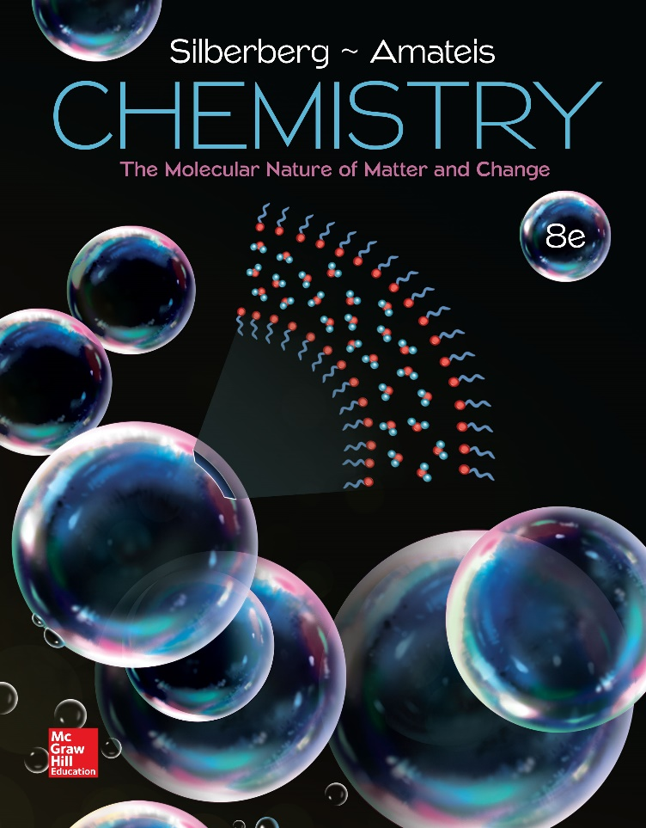
Chemistry
The Molecular Nature of Matter and Change Seventh Edition
Martin S. Silberberg and Patricia G. Amateis

Slide 2
Chapter 1: Keys to the Study of Chemistry
1.1 Some Fundamental Definitions
1.2 Chemical Arts and the Origins of Modern Chemistry
1.3 The Scientific Approach: Developing a Model
1.4 Measurement and Chemical Problem Solving
1.5 Uncertainty in Measurement: Significant Figures

Slide 3
Chemistry
Chemistry is the study of matter, its properties, the changes that matter undergoes, and the energy associated with these changes.

Slide 4
Definitions
Matter: anything that has both mass and volume – the “stuff” of the universe: books, planets, trees, professors, students
Composition: the types and amounts of simpler substances that make up a sample of matter
Properties: the characteristics that give each substance a unique identity

Slide 5
The States of Matter
A solid has a fixed shape and volume. Solids may be hard or soft, rigid or flexible.
A liquid has a varying shape that conforms to the shape of the container, but a fixed volume. A liquid has an upper surface.
A gas has no fixed shape or volume and therefore does not have a surface.

Slide 6
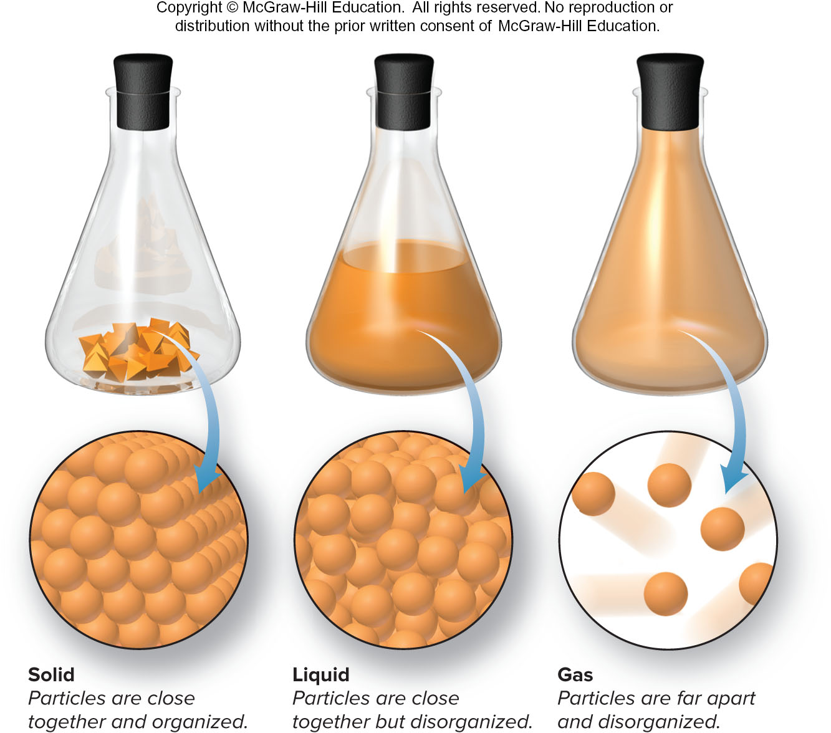
The Physical States of Matter
Fig 1.1

Slide 7
Physical and Chemical Properties
Physical Properties
  properties a substance shows by itself without interacting with another substance
  color, melting point, boiling point, density
Chemical Properties
  properties a substance shows as it interacts with, or transforms into, other substances
  flammability, corrosiveness

Slide 8
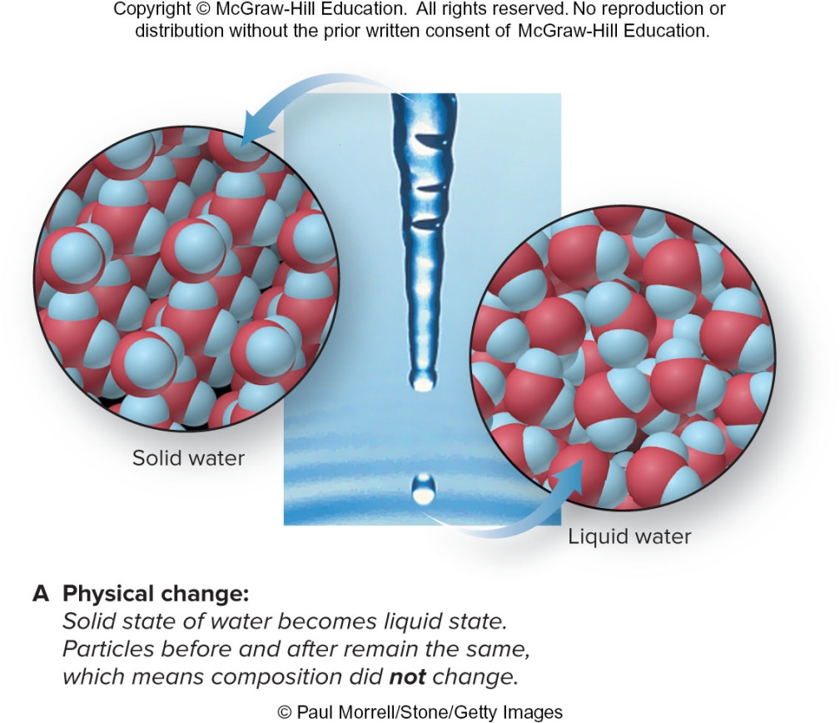
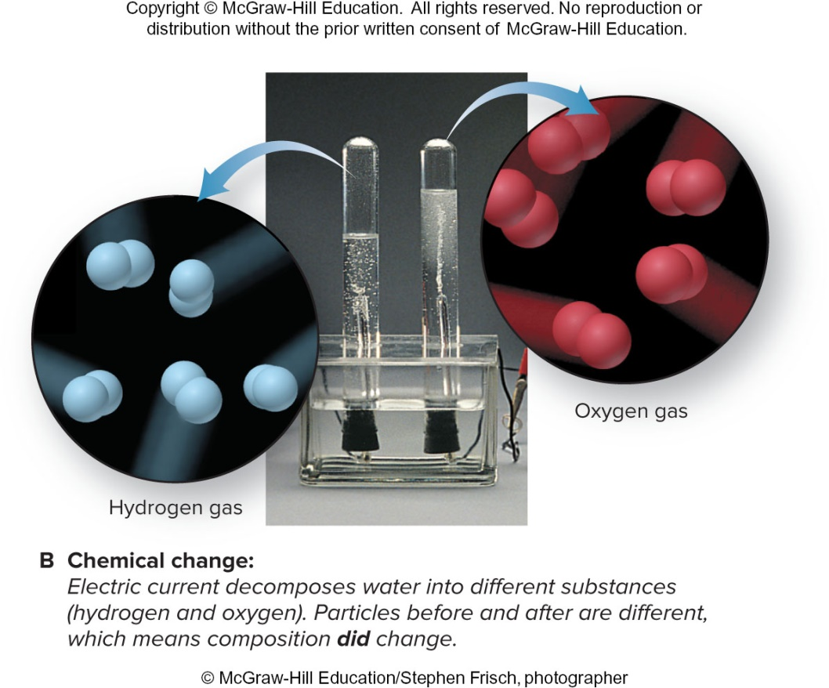
The Distinction Between Physical and Chemical Change
Fig 1.2
(A) © Paul Morrell/Stone/Getty Images; (B) © McGraw-Hill Education/Stephen Frisch, photographer

Slide 9
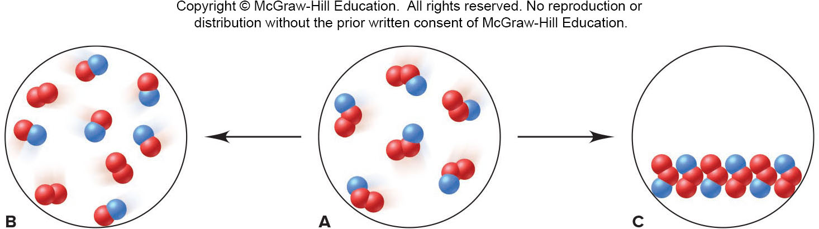
Sample Problem 1.1 – Problem and Plan
Visualizing Change on the Atomic Scale
PROBLEM: The scenes below represent an atomic-scale view of substance A undergoing two different changes. Decide whether each scene shows a physical or a chemical change.
PLAN: We need to determine what change is taking place. The numbers and colors of the little spheres that represent each particle tell its “composition”. If the composition does not change, the change is physical, whereas a chemical change results in a change of composition.

Slide 10
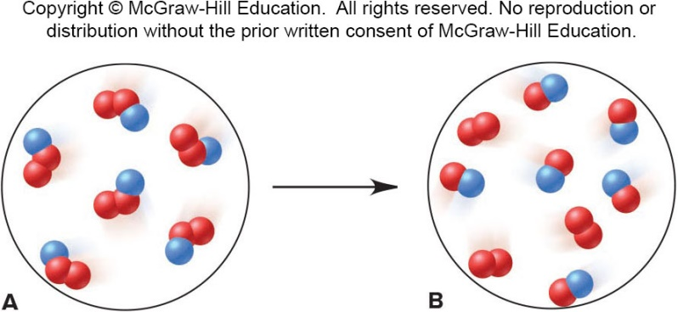
Sample Problem 1.1 – Solution
SOLUTION: Each particle of substance A is composed of one blue and two red spheres. Sample B is composed of two different types of particles – some have two red spheres while some have one red and one blue. As A changes to B, the chemical composition has changed. A → B is a chemical change.

Slide 11
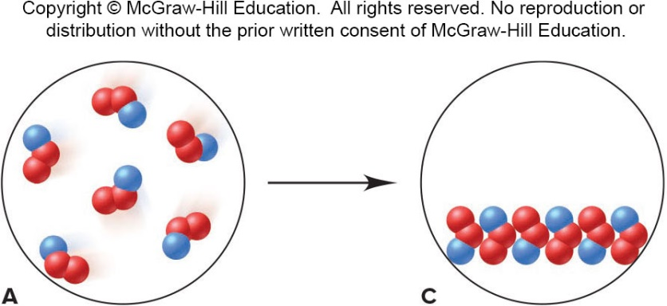
Sample Problem 1.1 – Solution, Cont’d
SOLUTION: Each particle of C is still composed of one blue and two red spheres, but the particles are closer together and are more organized. The composition remains unchanged, but the physical form is different. A → C is a physical change.

Slide 12
Temperature and Change of State
A change of state is a physical change.
  – Physical form changes, composition does not.
Changes in physical state are reversible
  – by changing the temperature.
A chemical change cannot simply be reversed by a change in temperature.

Slide 13
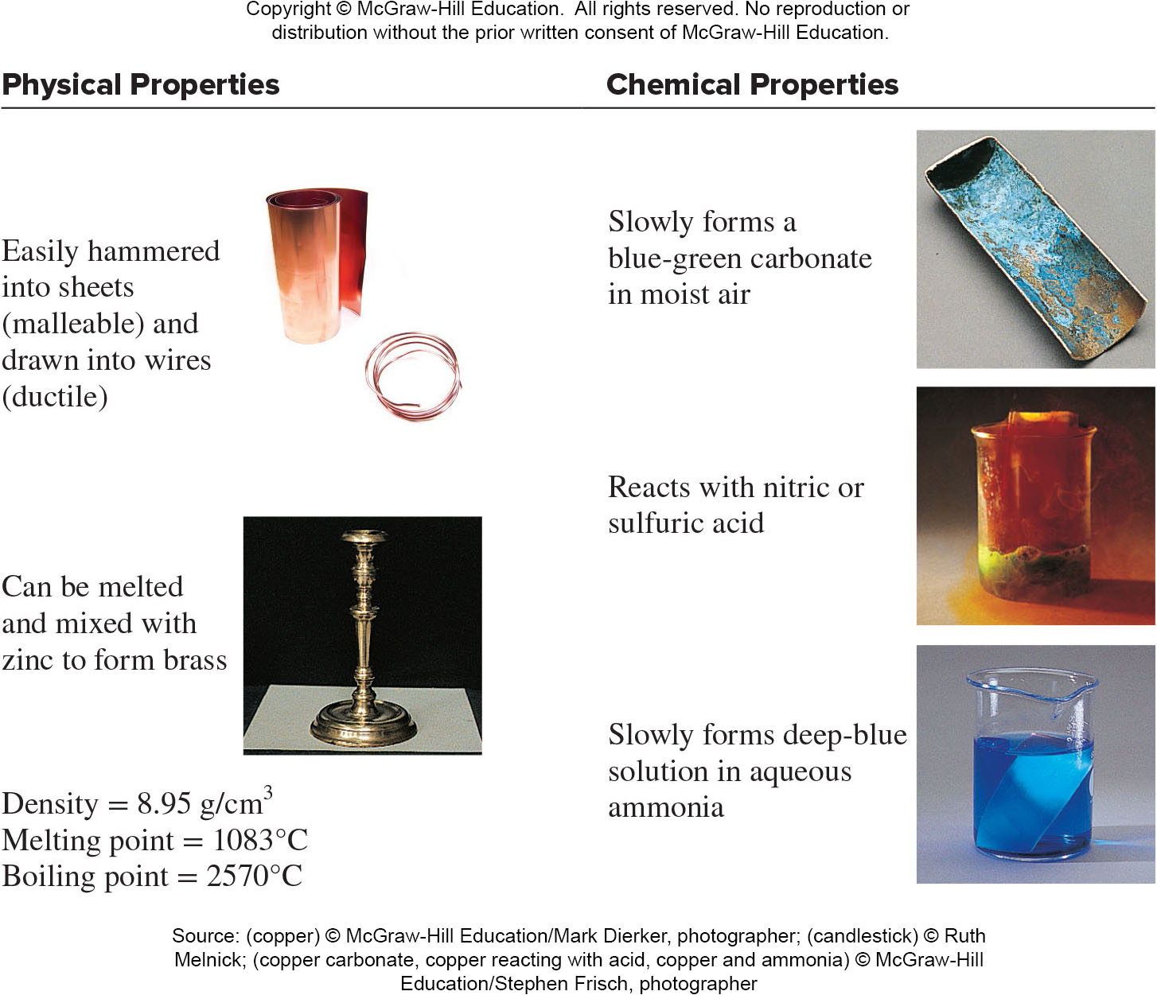
Some Characteristic Properties of Copper
Table 1.1
(copper) © McGraw-Hill Education/Mark Dierker, photographer; (candlestick) © Ruth Melnick; (copper carbonate, copper reacting with acid, copper and ammonia)
© McGraw-Hill Education/Stephen Frisch, photographer

Slide 14
Sample Problem 1.2 – Problem and Plan
Distinguishing Between Physical and Chemical Change
PROBLEM: Decide whether each of the following processes is primarily a physical or a chemical change, and explain briefly:
(a) Frost forms as the temperature drops on a humid winter night.
(b) A cornstalk grows from a seed that is watered and fertilized.
(c) A match ignites to form ash and a mixture of gases.
(d) Perspiration evaporates when you relax after jogging.
(e) A silver fork tarnishes slowly in air.
PLAN: “Does the substance change composition or just change form?”

Slide 15
Sample Problem 1.2 – Solution
(a) Frost forms as the temperature drops on a humid winter night – physical change
(b) A cornstalk grows from a seed that is watered and fertilized – chemical change
(c) A match ignites to form ash and a mixture of gases – chemical change
(d) Perspiration evaporates when you relax after jogging – physical change
(e) A silver fork tarnishes slowly in air – chemical change

Slide 16
Energy in Chemistry
Energy is the ability to do work.
Potential Energy is energy due to the position of an object.
Kinetic Energy is energy due to the movement of an object.
Total Energy = Potential Energy + Kinetic Energy

Slide 17
Energy Changes
Lower energy states are more stable and are favored over higher energy states.
Energy is neither created nor destroyed
  it is conserved
  and can be converted from one form to another

Slide 18
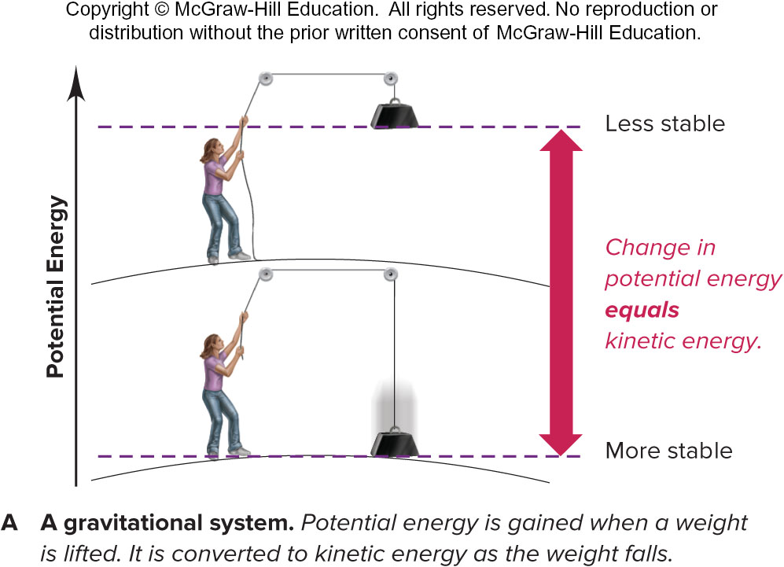
Potential Energy is Converted to Kinetic Energy
A gravitational system. The potential energy gained when a weight is lifted is converted to kinetic energy as the weight falls.
A lower energy state is more stable.
Fig 1.3

Slide 19
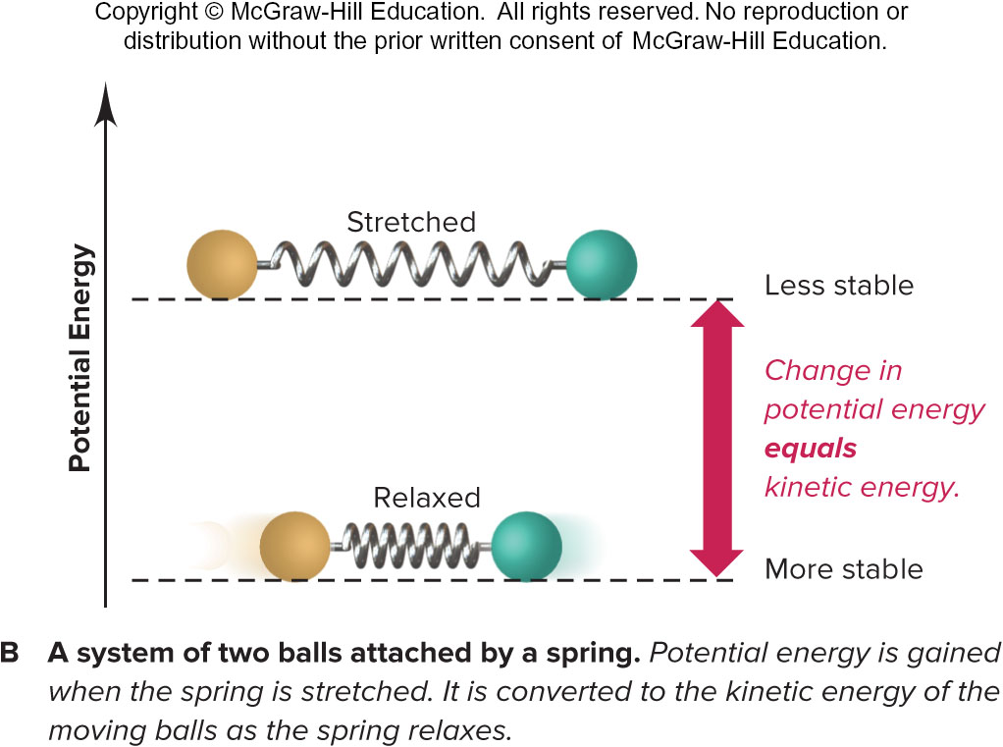
Potential Energy is Converted to Kinetic Energy (2)
A system of two balls attached by a spring. The potential energy gained by a stretched spring is converted to kinetic energy when the moving balls are released.
Energy is conserved when it is transformed.
Fig 1.3

Slide 20
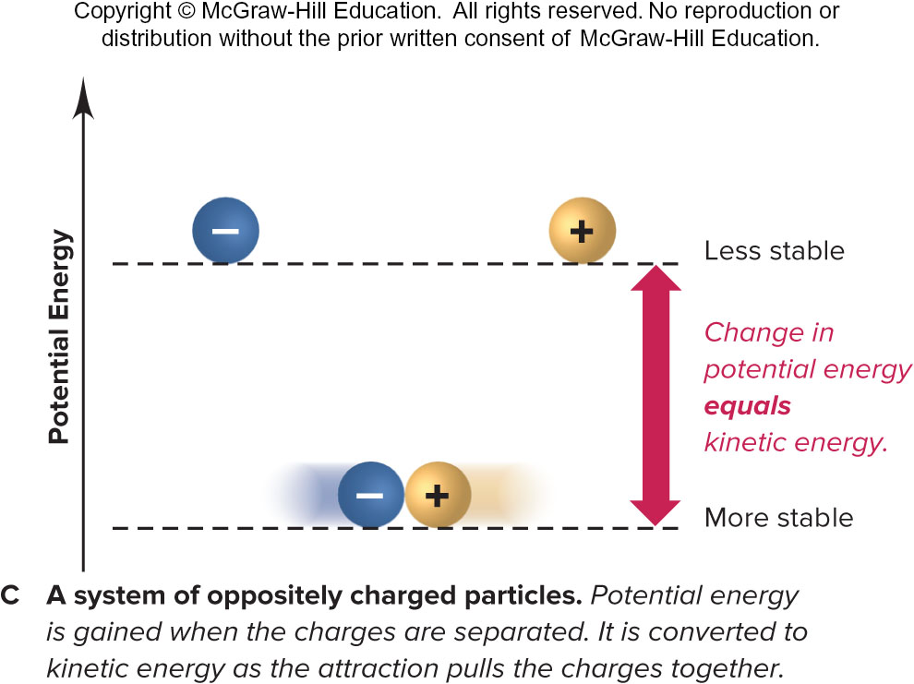
Potential Energy is Converted to Kinetic Energy, Cont’d
A system of oppositely charged particles. The potential energy gained when the charges are separated is converted to kinetic energy as the attraction pulls these charges together.
Fig 1.3

Slide 21
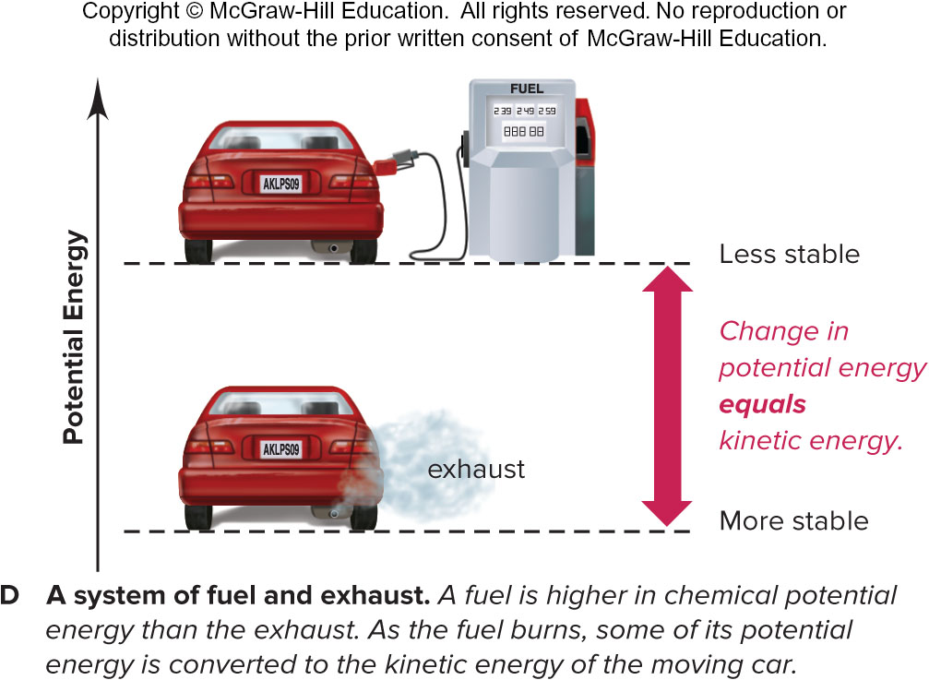
Potential Energy is Converted to Kinetic Energy, Further Cont’d
A system of fuel and exhaust. A fuel is higher in chemical potential energy than the exhaust. As the fuel burns, some of its potential energy is converted to the kinetic energy of the moving car.
Fig 1.3

Slide 22
Chemical Arts and the Origins of Modern Chemistry
Alchemy, medicine, and technology placed little emphasis on objective experimentation, focusing instead on mystical explanations or practical experience, but these traditions contributed some apparatus and methods that are still important.
Lavoisier overthrew the phlogiston theory by showing, through quantitative, reproducible measurements, that oxygen, a component of air, is required for combustion and combines with a burning substance.

Slide 23
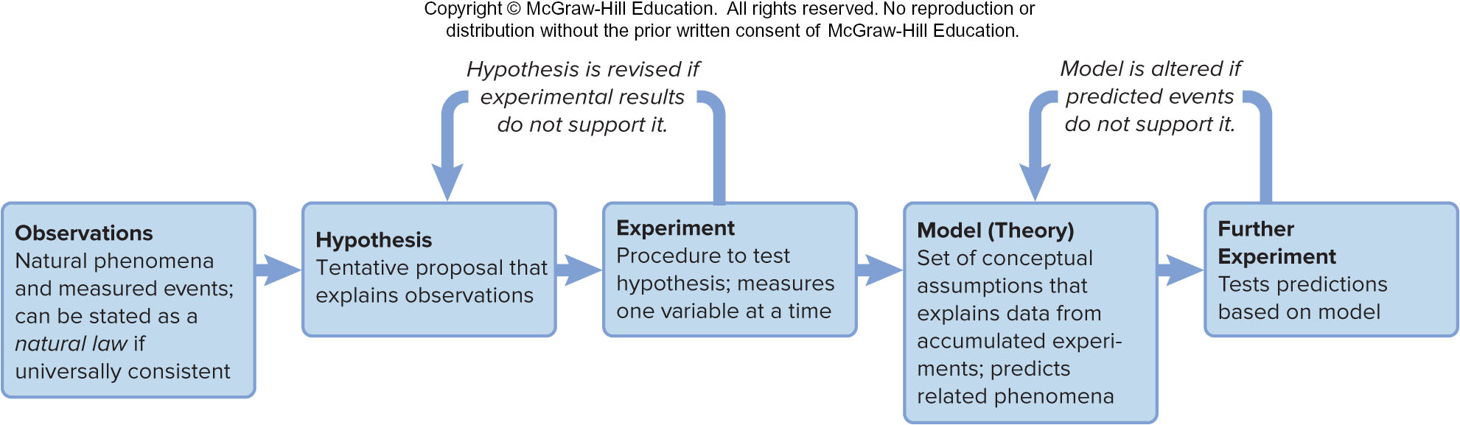
The Scientific Approach to Understanding Nature
Fig 1.6

Slide 24
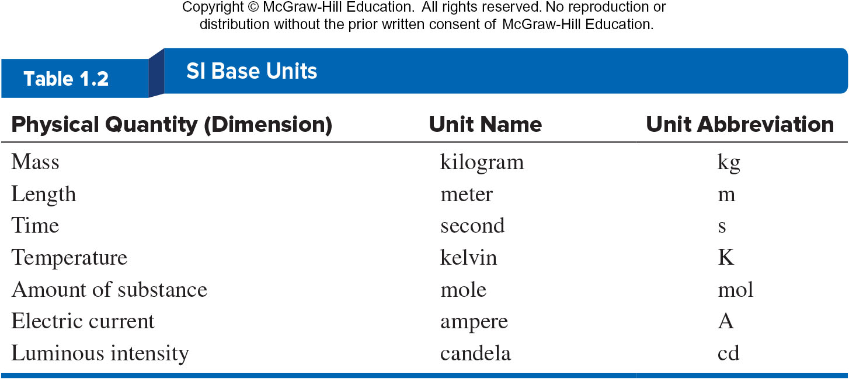
SI Base Units
Table 1.2

Slide 25
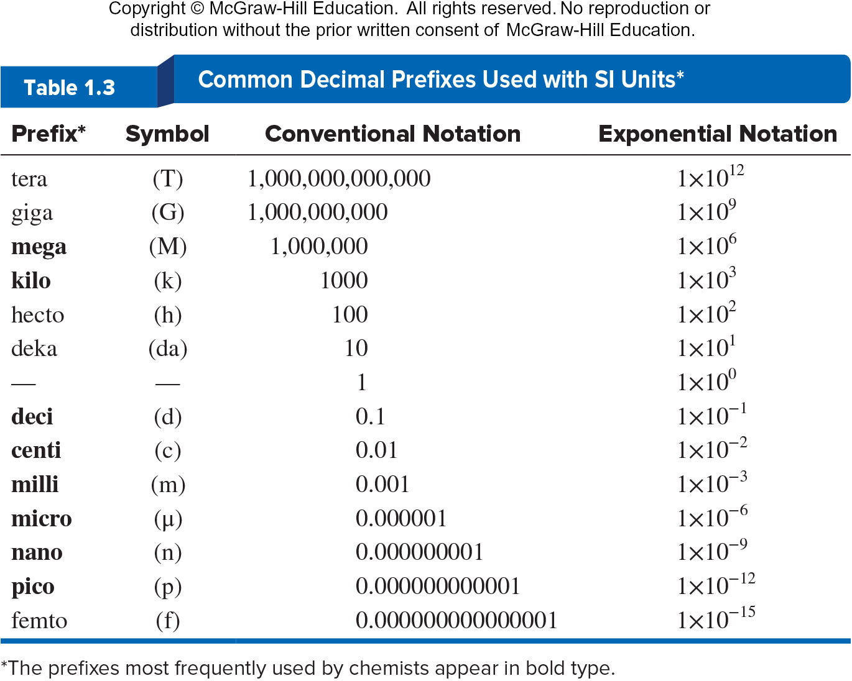
Common Decimal Prefixes Used With SI Units
Table 1.3

Slide 26
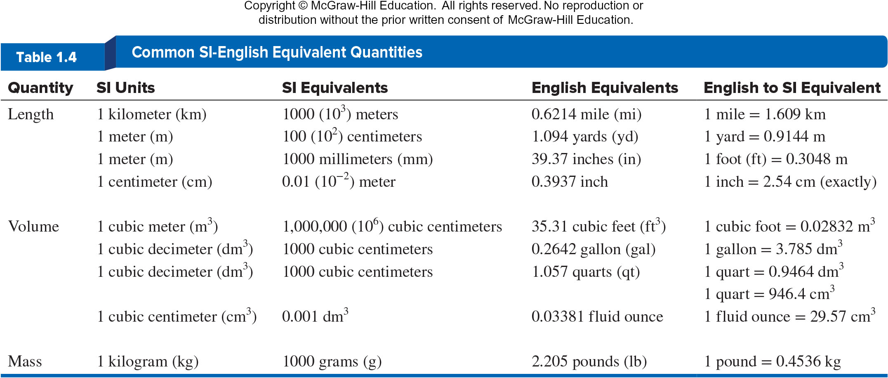
Common SI-English Equivalent Quantities
Table 1.4

Slide 27
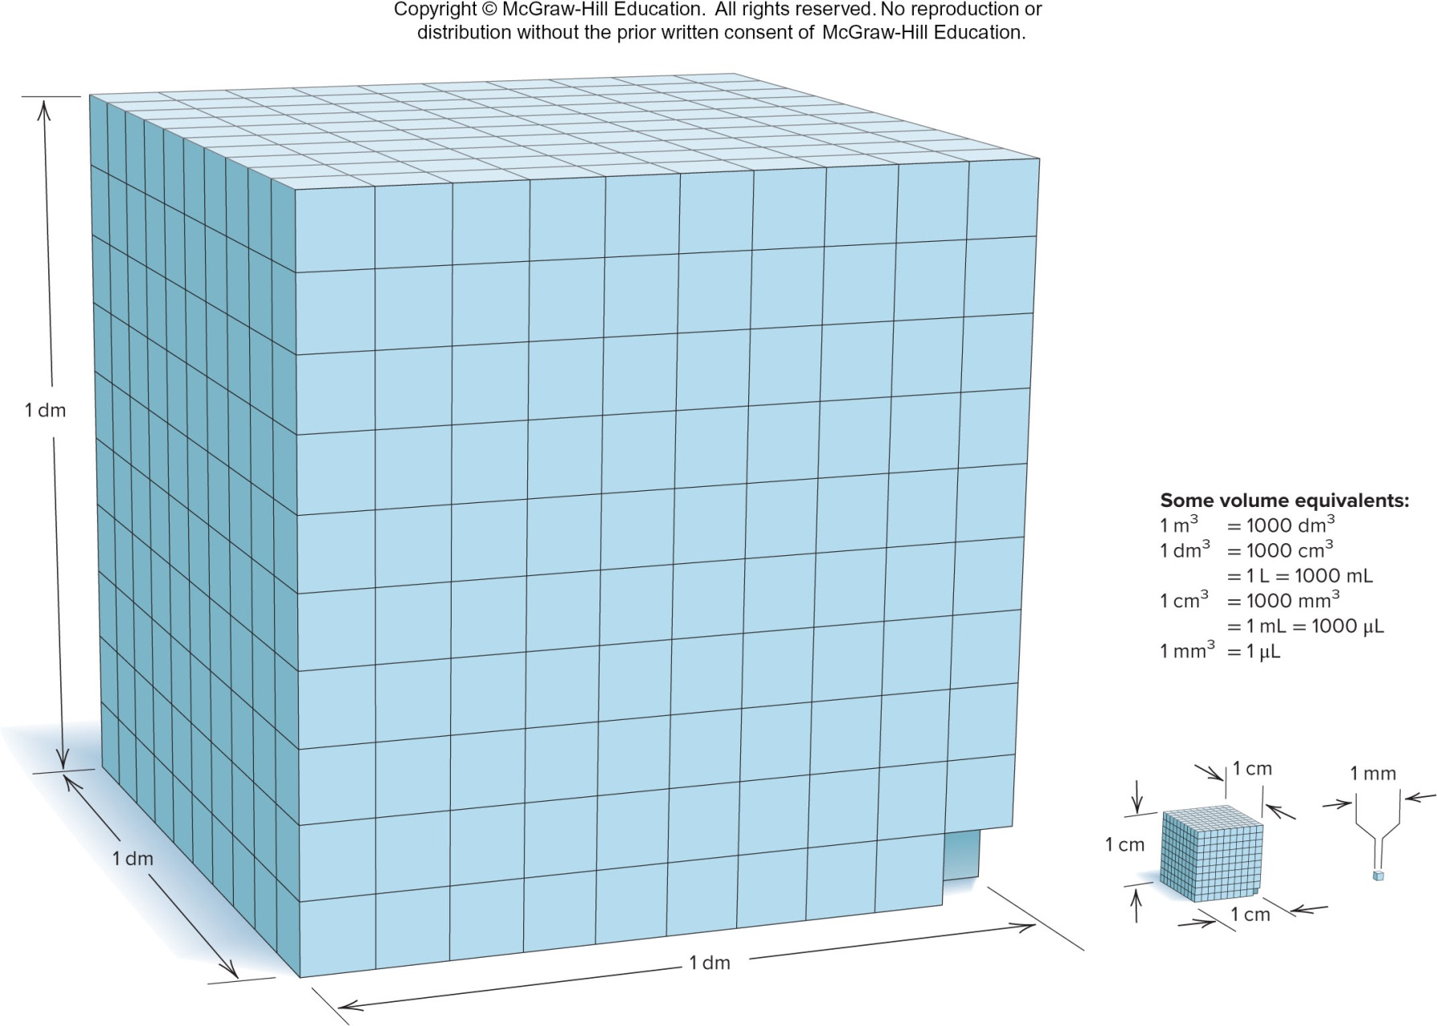
Some Volume Relationships in SI
Fig 1.7

Slide 28
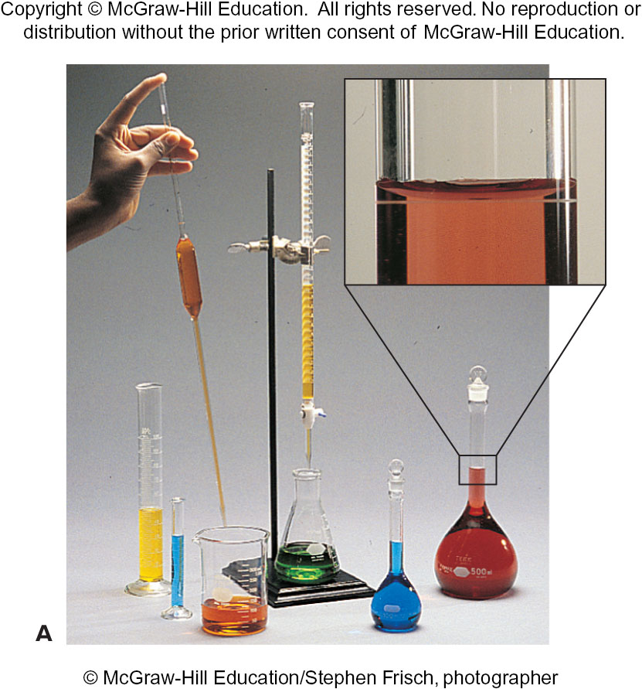
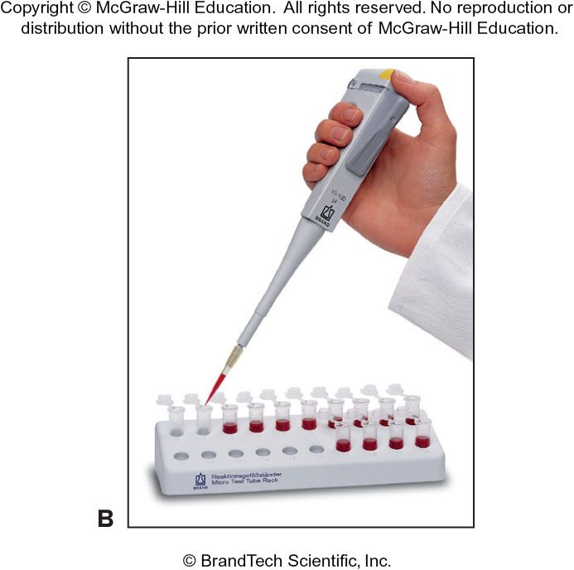
Common Laboratory Volumetric Glassware
Fig 1.8

Slide 29
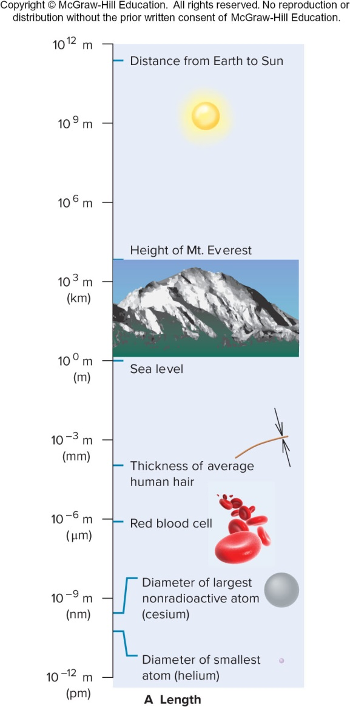
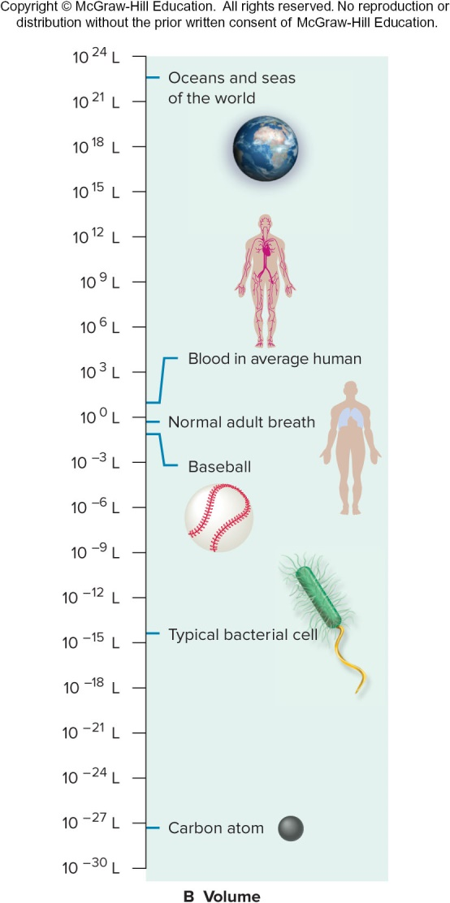
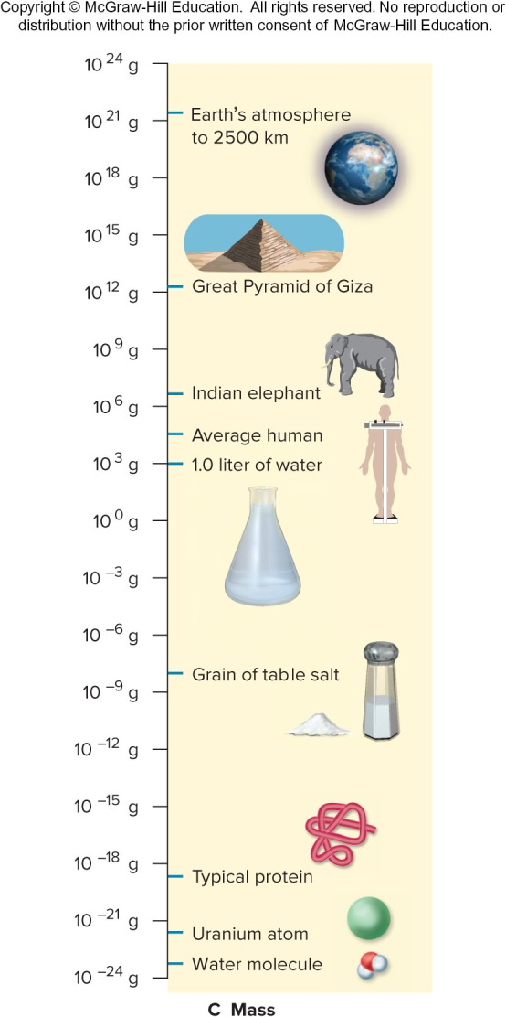
Quantities of Length (A), Volume (B), and Mass (C)
Fig 1.9

Slide 30

Chemical Problem Solving
All measured quantities consist of
  a number and a unit.
Units are manipulated like numbers:
  $$3ft×4ft={12ft}^{2}$$
  $$\frac{350 mi}{7 h}=\frac{50 mi}{1 h} or 50 mi{∙h}^{−1}$$

Slide 31

Conversion Factors
A conversion factor is a ratio of equivalent quantities used to express a quantity in different units.
The relationship 1 mi = 5280 ft gives us the conversion factor:
$$\frac{1 mi}{5280 ft}=\frac{5280 ft}{5280 ft}=1$$

Slide 32
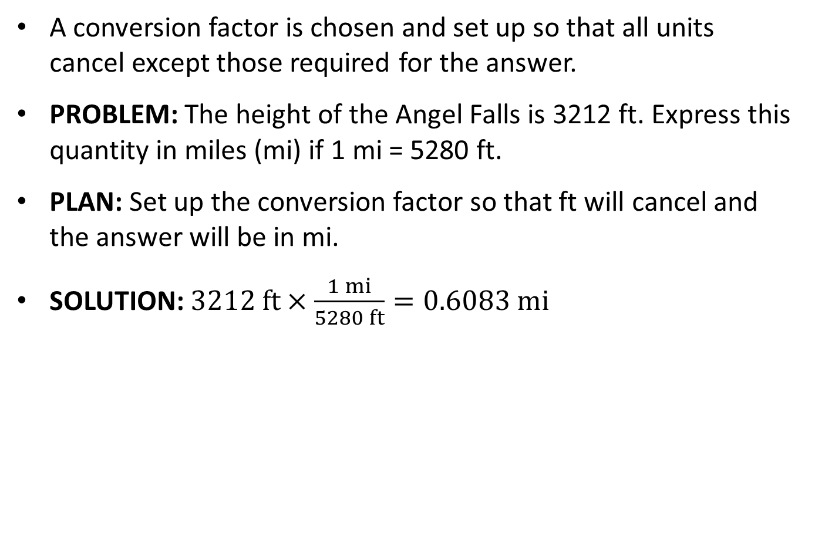
Conversion Factor Problem
A conversion factor is chosen and set up so that all units cancel except those required for the answer.
PROBLEM: The height of the Angel Falls is 3212 ft. Express this quantity in miles (mi) if 1 mi = 5280 ft.
PLAN: Set up the conversion factor so that ft will cancel and the answer will be in mi.
SOLUTION: $3212 ft×\frac{1 mi}{5280 ft}=0.6083 mi$

Slide 33
Systematic Approach to Solving Chemistry Problems
State Problem
Plan
  Clarify the known and unknown.
  Suggest steps from known to unknown.
  Prepare a visual summary of steps that includes conversion factors, equations, known variables.
Solution
Check
Comment
Follow-up Problem

Slide 34
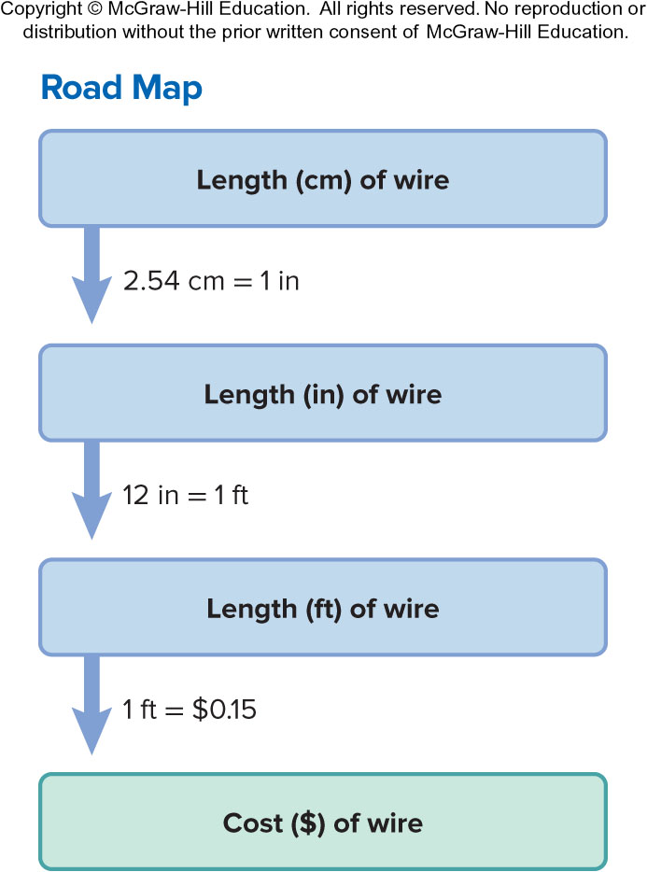
Sample Problem 1.3 – Problem and Plan
Converting Units of Length
PROBLEM: To wire your stereo equipment, you need 325 centimeters (cm) of speaker wire that sells for $0.15/ft. What is the price of the wire?
PLAN: We know the length (in cm) of wire and cost per length ($/ft). We have to convert cm to inches and inches to feet. Then we can find the cost for the length in feet.

Slide 35
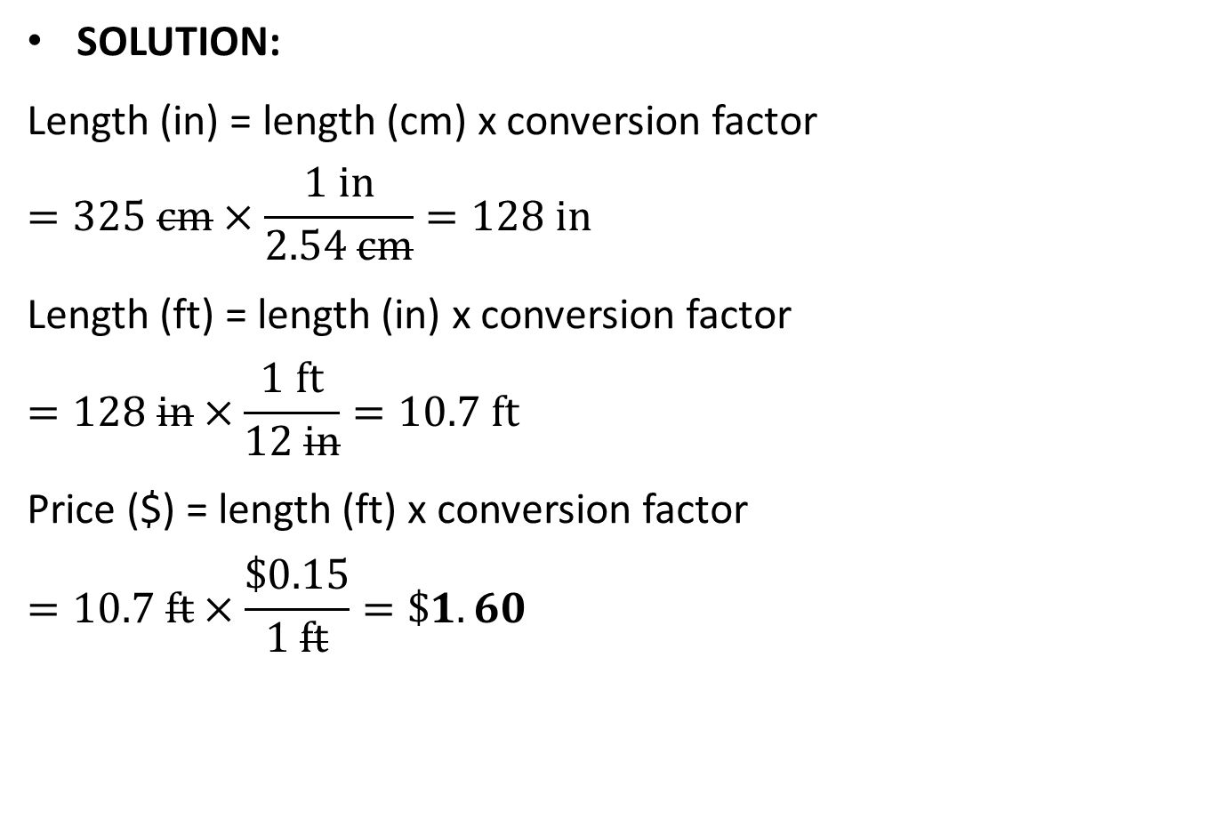
Sample Problem 1.3 - Solution
SOLUTION:
Length (in) = length (cm) x conversion factor
$$=325 cm×\frac{1 in}{2.54 cm}=128 in$$
Length (ft) = length (in) x conversion factor
$$=128 in×\frac{1 ft}{12 in}=10.7 ft$$
Price ($) = length (ft) x conversion factor
$$=10.7 ft×\frac{\$0.15}{1 ft}=\$1.60$$

Slide 36
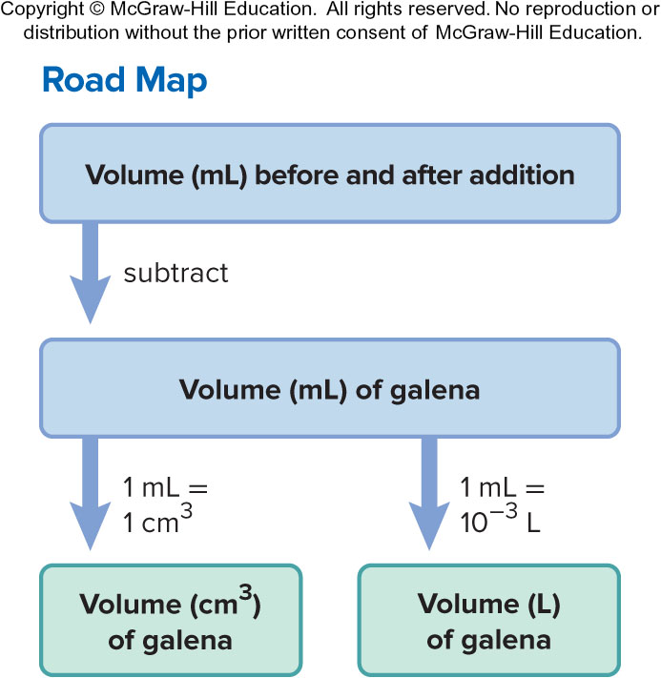
Sample Problem 1.4 – Problem and Plan
Converting Units of Volume
PROBLEM: A graduated cylinder contains 19.9 mL of water. When a small piece of galena, an ore of lead, is added, it sinks and the volume increases to 24.5 mL. What is the volume of the piece of galena in cm³ and in L?
PLAN: The volume of the galena is equal to the difference in the volume of the water before and after the addition.

Slide 37

Sample Problem 1.4 - Solution
SOLUTION
$$\left(24.5−19.9\right)mL=volume of galena=4.6 mL$$
$$4.6 mL×\frac{1 {cm}^{3}}{1 mL}=4.6 {cm}^{3}$$
$$4.6 mL×\frac{{10}^{−3}L}{1 mL}=4.6×{10}^{−3} L$$

Slide 38
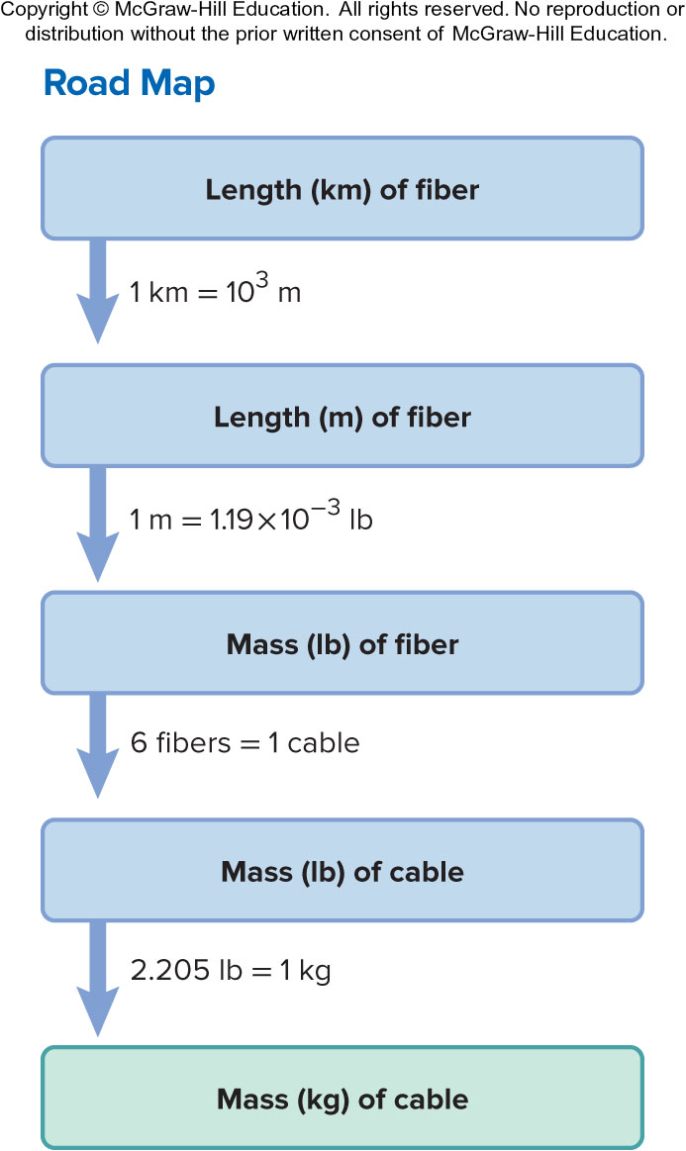
Sample Problem 1.5 – Problem and Plan
Converting Units of Mass
PROBLEM: Many international computer communications are carried out by optical fibers in cables laid along the ocean floor. If one strand of optical fiber weighs 1.19 x 10⁻³ lb/m, what is the mass (in kg) of a cable made of six strands of optical fiber, each long enough to link New York and Paris (a distance of 8.94 x 10³ km)?
PLAN: The sequence of steps may vary but essentially we need to find the length of the entire cable and convert it to mass.

Slide 39
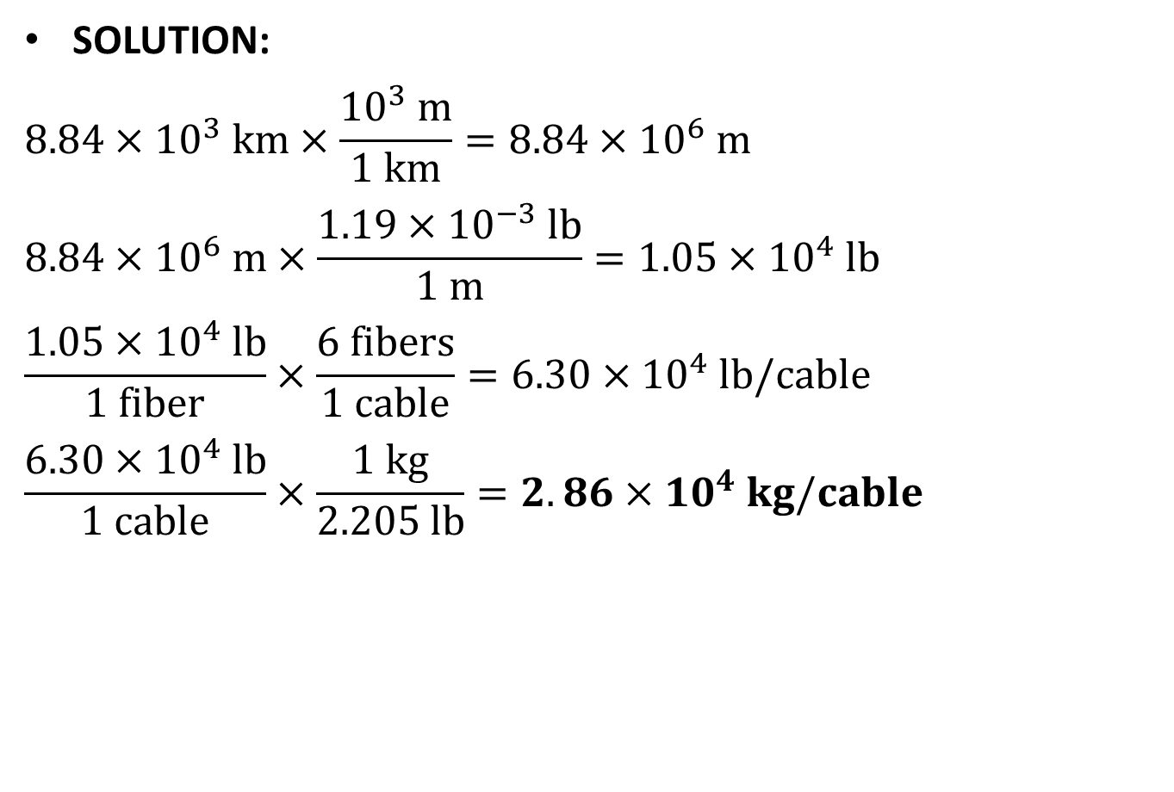
Sample Problem 1.5 - Solution
SOLUTION:
$$8.84×{10}^{3} km×\frac{{10}^{3} m}{1 km}=8.84×{10}^{6} m$$
$$8.84×{10}^{6} m×\frac{1.19×{10}^{−3} lb}{1 m}=1.05×{10}^{4} lb$$
$$\frac{1.05×{10}^{4} lb}{1 fiber}×\frac{6 fibers}{1 cable}=6.30×{10}^{4} lb/cable$$
$$\frac{6.30×{10}^{4} lb}{1 cable}×\frac{1 kg}{2.205 lb}=2.86×{10}^{4} kg/cable$$

Slide 40
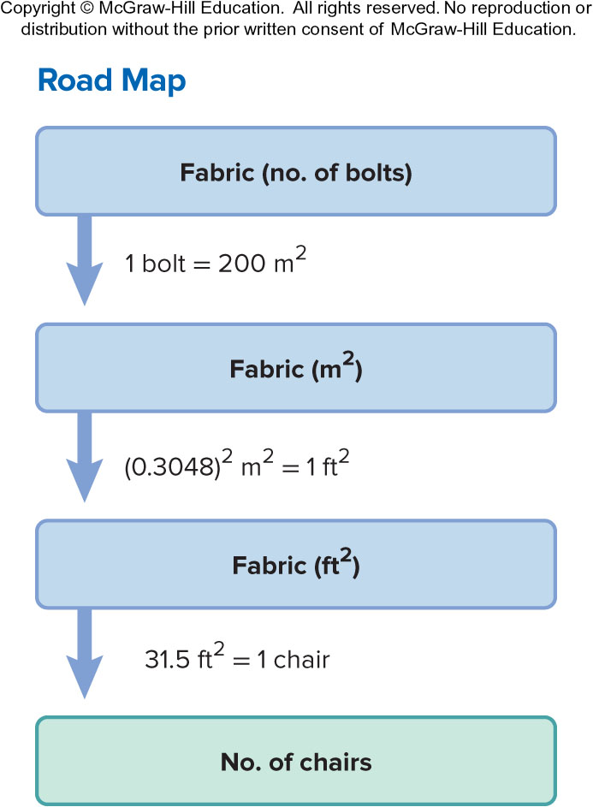
Sample Problem 1.6 – Problem and Plan
Converting Units Raised to a Power
PROBLEM: A furniture factory needs 31.5 ft² of fabric to upholster one chair. Its Dutch supplier sends the fabric in bolts that hold exactly 200 m². How many chairs can be upholstered with three bolts of fabric?
PLAN: We know the amount of fabric in one bolt in m²; multiplying the m² of fabric by the number of bolts gives the total amount of fabric available in m². We convert the amount of fabric from m² to ft² and use the conversion factor 31.5 ft² of fabric = 1 chair to find the number of chairs (see the road map).

Slide 41
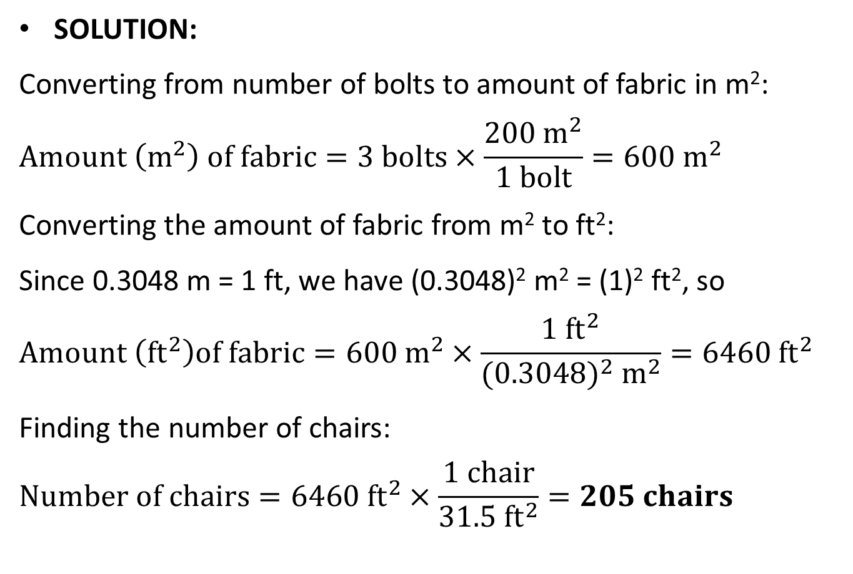
Sample Problem 1.6 - Solution
SOLUTION:
Converting from number of bolts to amount of fabric in m²:
$$Amount \left(m^{2}\right) of fabric=3 bolts×\frac{200 m^{2}}{1 bolt}=600 m^{2}$$
Converting the amount of fabric from m² to ft²:
Since 0.3048 m = 1 ft, we have (0.3048)² m² = (1)² ft², so
$$Amount \left({ft}^{2}\right)of fabric=600 m^{2}×\frac{1 {ft}^{2}}{(0.3048)^{2} m^{2}}=6460 {ft}^{2}$$
Finding the number of chairs:
$$Number of chairs=6460 {ft}^{2}×\frac{1 chair}{31.5 {ft}^{2}}=205 chairs$$

Slide 42

Density
$$density=\frac{mass}{volume}$$
At a given temperature and pressure, the density of a substance is a characteristic physical property and has a specific value.

Slide 43
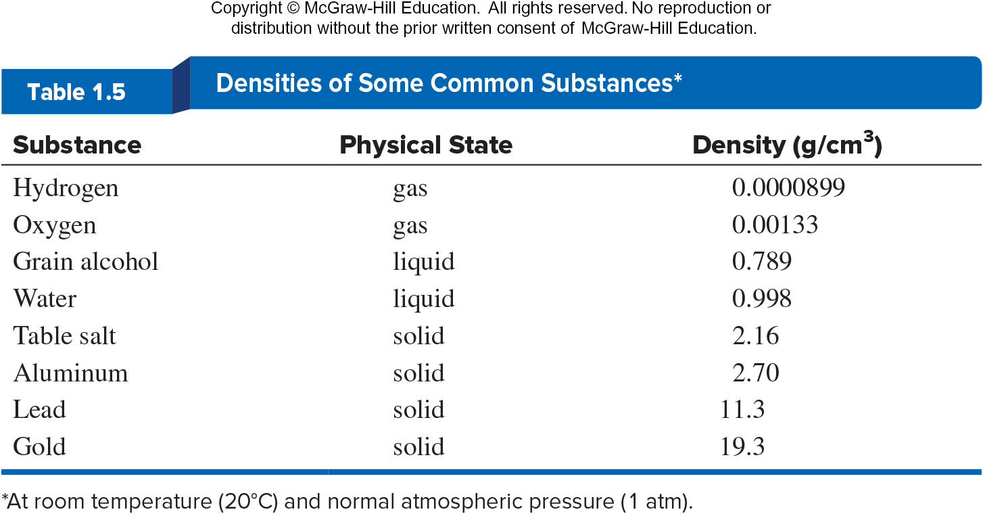
Densities of Some Common Substances

Slide 44
Sample Problem 1.7 – Problem and Plan
Calculating Density from Mass and Volume
PROBLEM: Lithium, a soft, gray solid with the lowest density of any metal, is a key component of advanced batteries. A slab of lithium weighs 1.49 x 10³ mg and has sides that are 20.9 mm by 11.1 mm by 11.9 mm. Find the density of lithium in g/cm³.
PLAN: Density is expressed in g/cm³ so we need the mass in g and the volume in cm³.

Slide 45
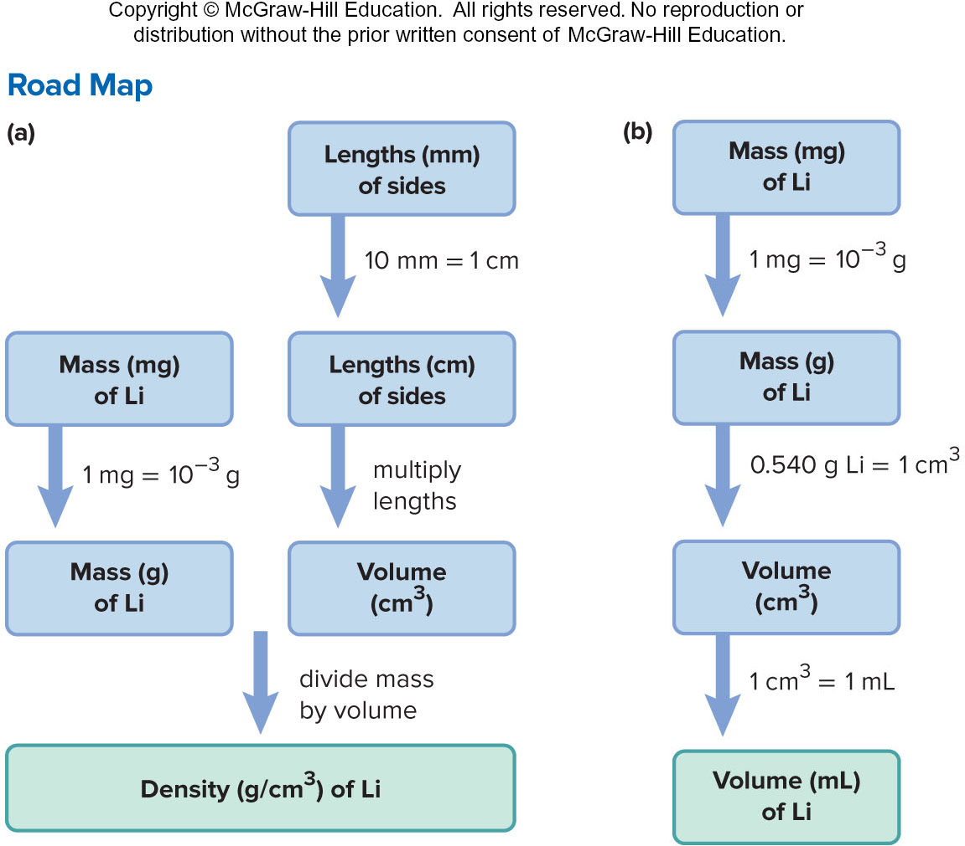
Sample Problem 1.7 –Plan, Cont’d

Slide 46
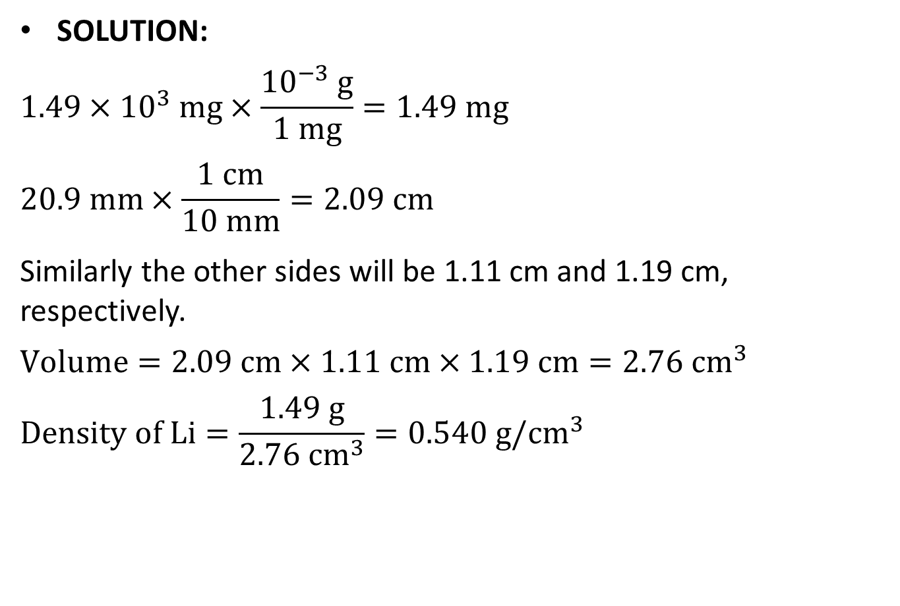
Sample Problem 1.7 - Solution
SOLUTION:
$$1.49×{10}^{3} mg×\frac{{10}^{−3} g}{1 mg}=1.49 mg$$
$$20.9 mm×\frac{1 cm}{10 mm}=2.09 cm$$
Similarly the other sides will be 1.11 cm and 1.19 cm, respectively.
$$Volume=2.09 cm×1.11 cm×1.19 cm=2.76 {cm}^{3}$$
$$Density of Li=\frac{1.49 g}{2.76 {cm}^{3}}=0.540 g/{cm}^{3}$$

Slide 47
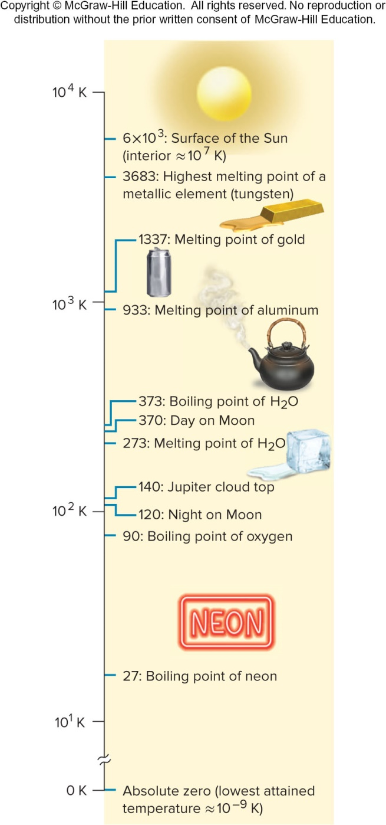
Some Interesting Temperatures
Fig 1.10

Slide 48
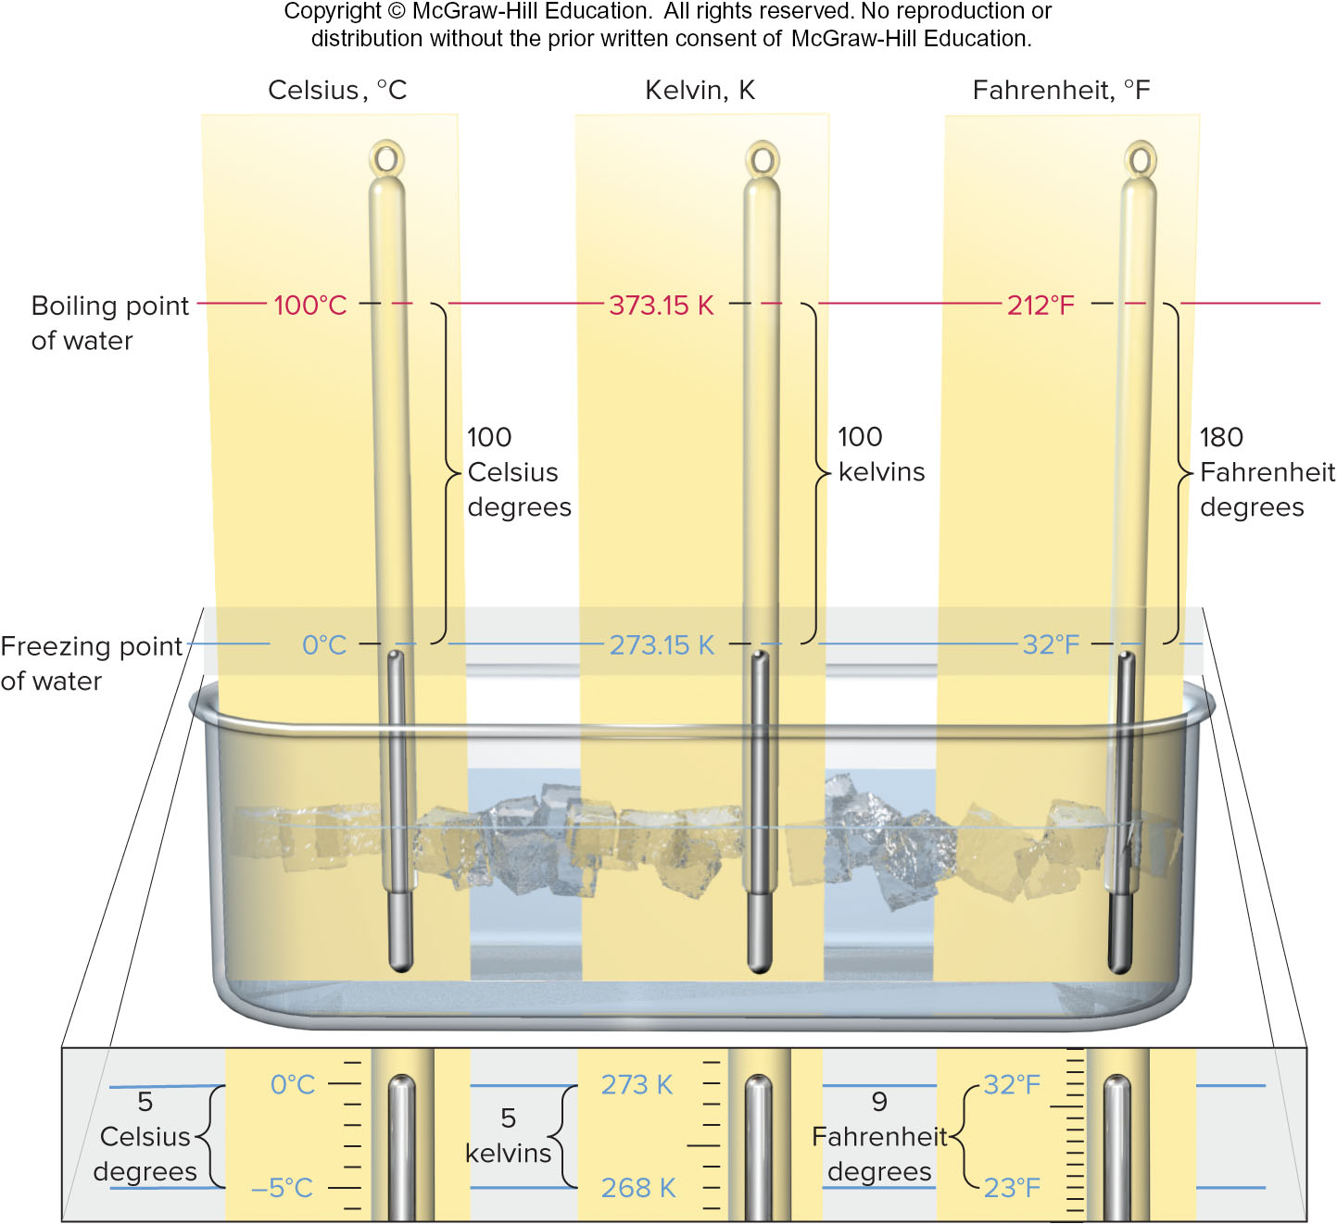
Freezing and Boiling Points of Water
Fig 1.11

Slide 49
Temperature Scales
Kelvin (K) – The “absolute temperature scale” begins at absolute zero and has only positive values. Note that the kelvin is not used with the degree sign (º).
Celsius (ºC) – The Celsius scale is based on the freezing and boiling points of water. This is the temperature scale used most commonly around the world. The Celsius and Kelvin scales use the same size degree although their starting points differ.
Fahrenheit (ºF) – The Fahrenheit scale is commonly used in the U.S. The Fahrenheit scale has a different degree size and different zero points than both the Celsius and Kelvin scales.

Slide 50

Temperature Conversions
$$T\left(in K\right)=T\left(in°C\right)+273.15$$
$$T\left(in°C\right)=T\left(in K\right)−273.15$$
$$T\left(in°F\right)=\frac{9}{5}T\left(in°C\right)+32$$
$$T\left(in°C\right)=[T\left(in℉\right)−32]\frac{5}{9}$$

Slide 51
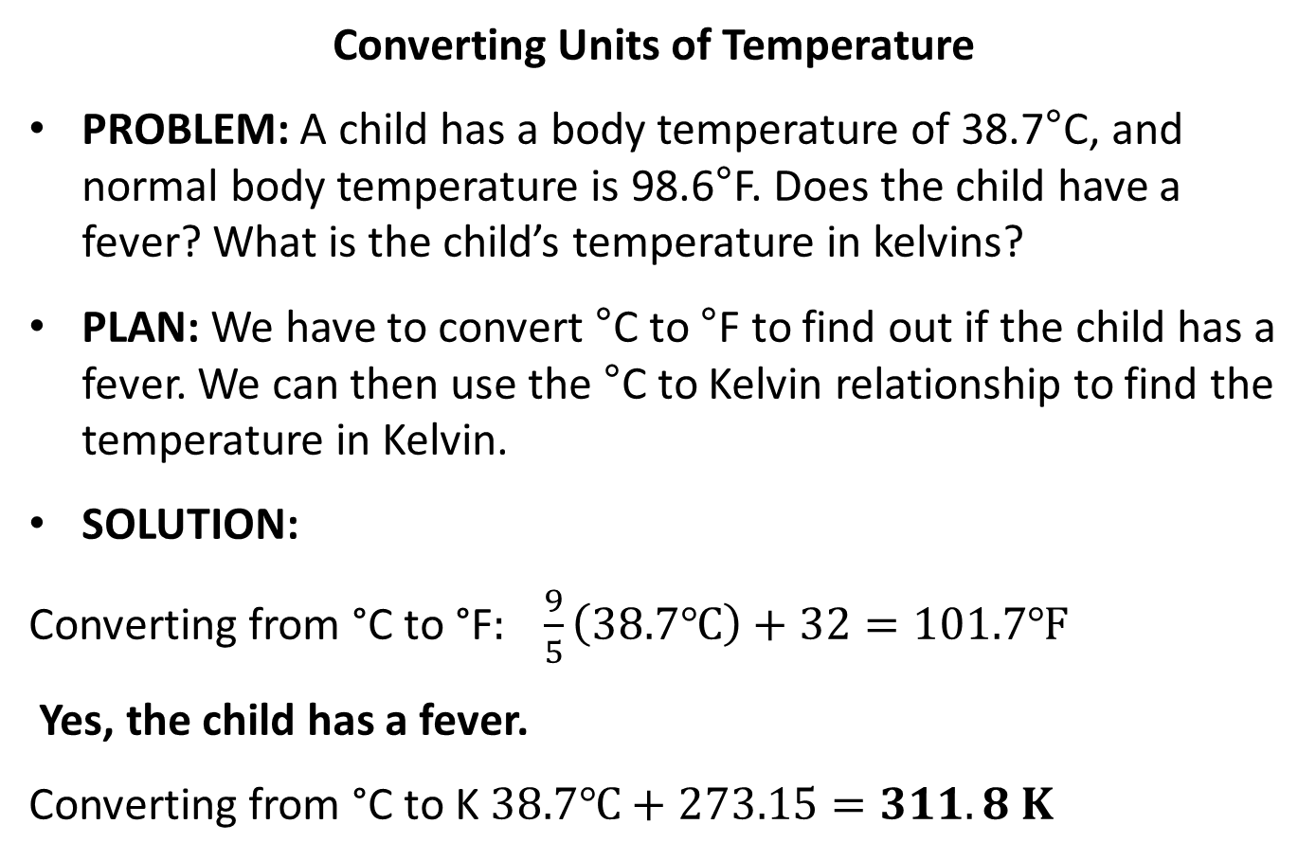
Sample Problem 1.8 – Problem, Plan and Solution
Converting Units of Temperature
PROBLEM: A child has a body temperature of 38.7°C, and normal body temperature is 98.6°F. Does the child have a fever? What is the child’s temperature in kelvins?
PLAN: We have to convert °C to °F to find out if the child has a fever. We can then use the °C to Kelvin relationship to find the temperature in Kelvin.
SOLUTION:
Converting from °C to °F$: \frac{9}{5}\left(38.7℃\right)+32=101.7℉$
Yes, the child has a fever.
Converting from °C to K $38.7℃+273.15=311.8 K$

Slide 52
Extensive and Intensive Properties
Extensive properties are dependent on the amount of substance present; mass and volume, for example, are extensive properties.
Intensive properties are independent of the amount of substance; density is an intensive property.

Slide 53
Significant Figures
Every measurement includes some uncertainty. The rightmost digit of any quantity is always estimated.
The recorded digits, both certain and uncertain, are called significant figures.
The greater the number of significant figures in a quantity, the greater its certainty.

Slide 54
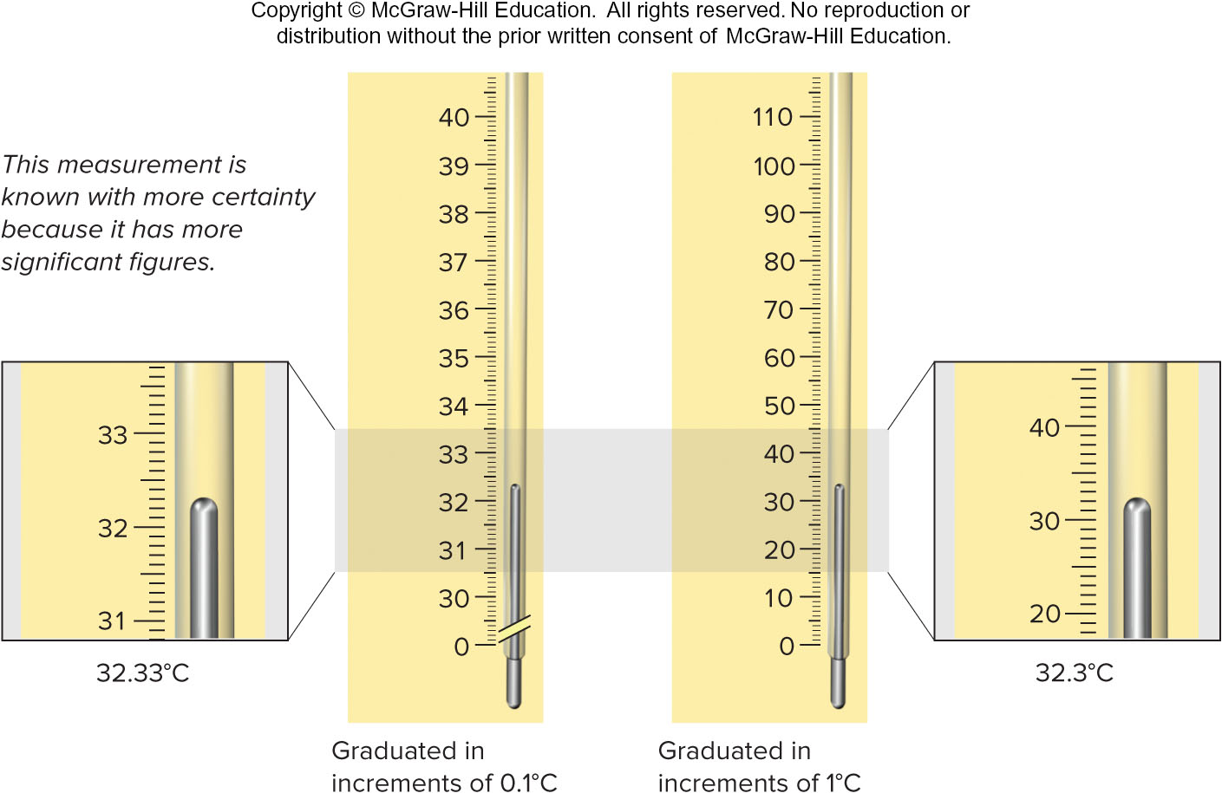
The Number of Significant Figures in a Measurement
Fig 1.13

Slide 55
Determining Which Digits Are Significant
All digits are significant
  except zeros that are used only to position the decimal point.
Zeros that end a number are significant
  whether they occur before or after the decimal point
  as long as a decimal point is present.
    1.030 mL has 4 significant figures.
    5300. L has 4 significant figures.
If no decimal point is present
  zeros at the end of the number are not significant.
    5300 L has only 2 significant figures.

Slide 56
Sample Problem 1.9 – Problem and Plan
Determining the Number of Significant Figures
PROBLEM: For each of the following quantities, underline the zeros that are significant figures (sf), and determine the number of significant figures in each quantity. For (d) to (f), express each in exponential notation first.
0.0030L (b) 0.1044g (c) 53.069L
(d) 0.00004715m (e) 57,600.s (f) 0.0000007160cm³
PLAN: We determine the number of significant figures by counting digits, paying particular attention to the position of zeros in relation to the decimal point, and underline zeros that are significant.

Slide 57
Sample Problem 1.9 - Solution
SOLUTION:
0.0030 L has 2 sf
(b) 0.1044 g has 4 sf
(c) 53,069 mL has 5 sf
0.00004715 m = 4.715 x 10⁻⁵ m has 4 sf
(e) 57,600. s = 5.7600 x 10⁴ s has 5 sf
(f) 0.0000007160 cm³ = 7.160 x 10⁻⁷ cm³ has 4 sf

Slide 58

Rules for Significant Figures in Calculations
1. For multiplication and division. The answer contains the same number of significant figures as there are in the measurement with the fewest significant figures.
Multiply the following numbers:
$$9.2 cm ×6.8 cm ×0.3744 cm=23.4225 {cm}^{3}=23{cm}^{3}$$

Slide 59
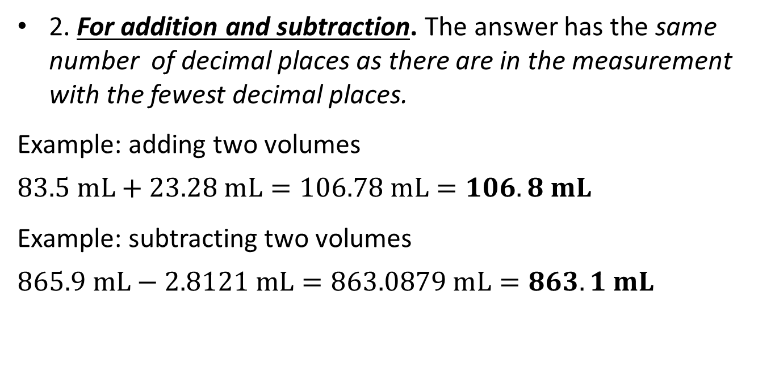
Rules for Significant Figures in Calculations, Cont’d
2. For addition and subtraction. The answer has the same number of decimal places as there are in the measurement with the fewest decimal places.
Example: adding two volumes
$$83.5 mL+23.28 mL=106.78 mL=106.8 mL$$
Example: subtracting two volumes
$$865.9 mL−2.8121 mL=863.0879 mL=863.1 mL$$

Slide 60
Rules for Rounding Off Numbers
1. If the digit removed is more than 5, the preceding number increases by 1.
  5.379 rounds to 5.38 if 3 significant figures are retained.
2. If the digit removed is less than 5, the preceding number is unchanged.
  0.2413 rounds to 0.241 if 3 significant figures are retained.
3. If the digit removed is 5 followed by zeros or with no following digits, the preceding number increases by 1 if it is odd and remains unchanged if it is even.
  17.75 rounds to 17.8, but 17.65 rounds to 17.6.
If the 5 is followed by other nonzero digits, rule 1 is followed:
  17.6500 rounds to 17.6, but 17.6513 rounds to 17.7

Slide 61
Rules for Rounding Off Numbers, Cont’d
4. Be sure to carry two or more additional significant figures through a multistep calculation and round off the final answer only.

Slide 62
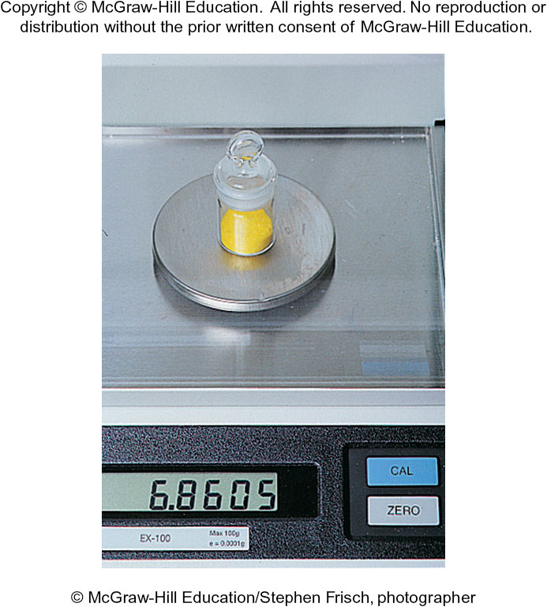
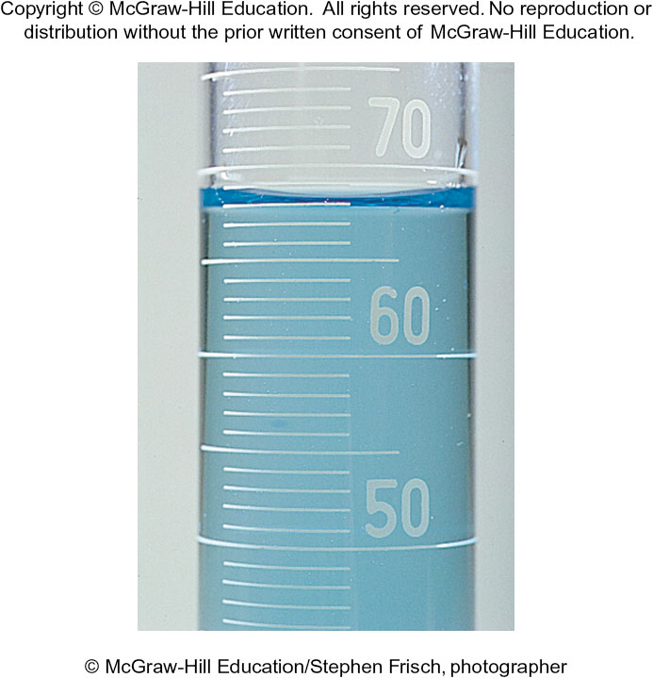
Significant Figures in the Lab
The measuring device used determines the number of significant digits possible.
Fig 1.14

Slide 63
Exact Numbers
Exact numbers have no uncertainty associated with them.
Numbers may be exact by definition:
  1000 mg = 1 g
  60 min = 1 hr
  2.54 cm = 1 in
Numbers may be exact by count:
  exactly 26 letters in the alphabet
Exact numbers do not limit the number of significant digits in a calculation.

Slide 64
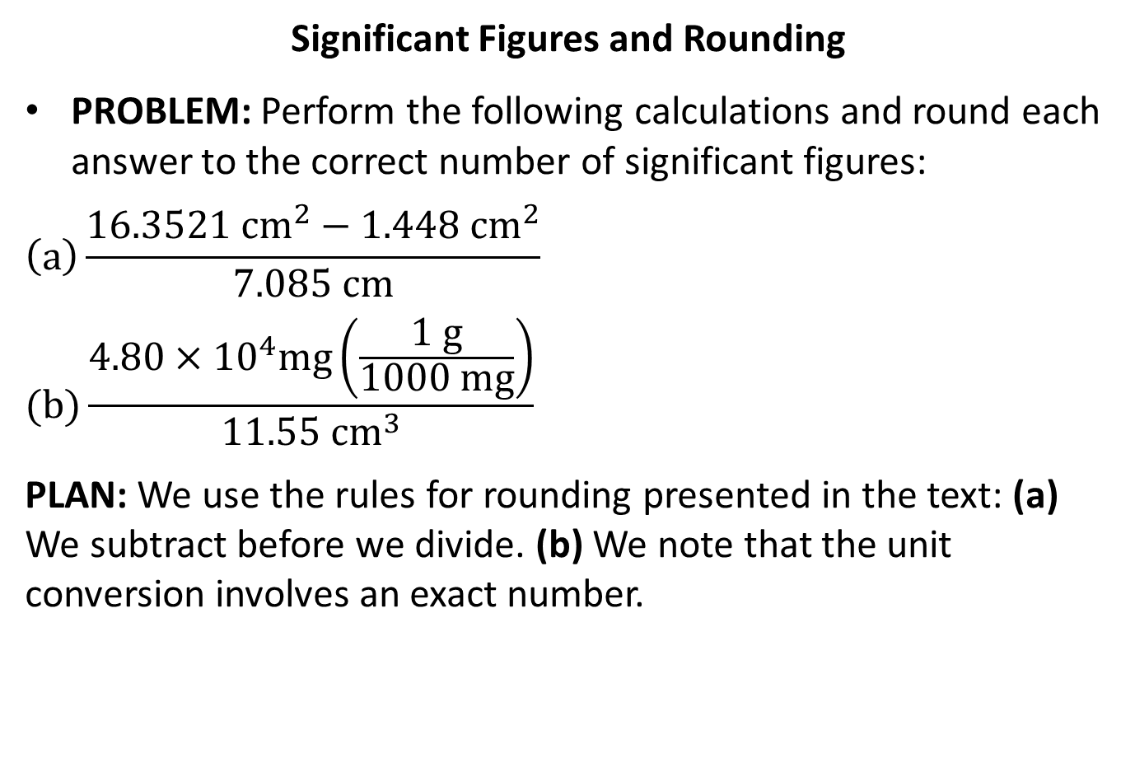
Sample Problem 1.10 – Problem and Plan
Significant Figures and Rounding
PROBLEM: Perform the following calculations and round each answer to the correct number of significant figures:
$$\left(a\right)\frac{16.3521 {cm}^{2}−1.448 {cm}^{2}}{7.085 cm}$$
$$(b)\frac{4.80×{10}^{4}mg\left(\frac{1 g}{1000 mg}\right)}{11.55 {cm}^{3}}$$
PLAN: We use the rules for rounding presented in the text: (a) We subtract before we divide. (b) We note that the unit conversion involves an exact number.

Slide 65
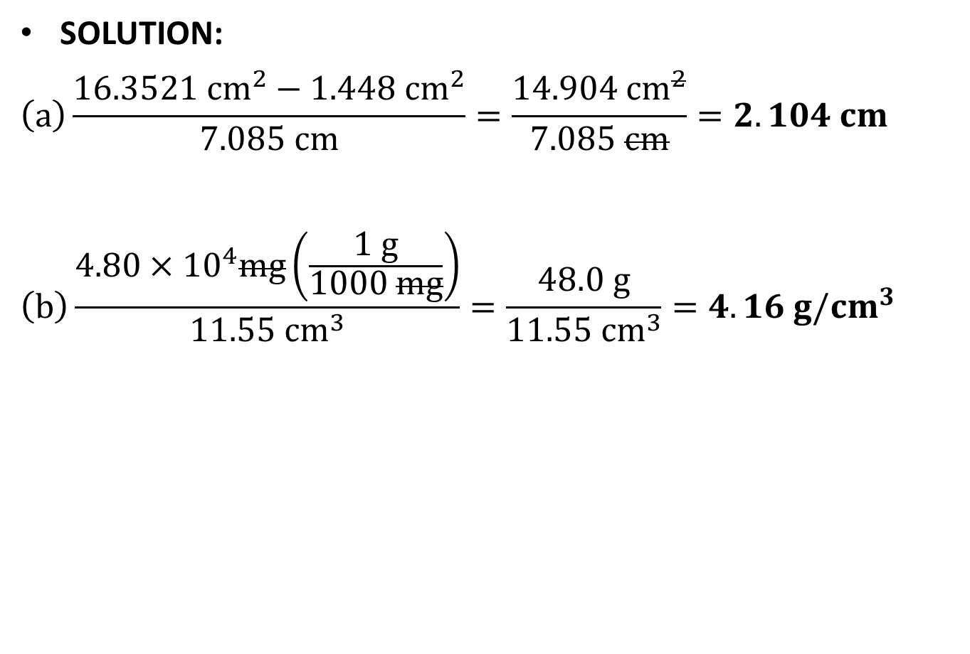
Sample Problem 1.10 - Solution
SOLUTION:
$$\left(a\right)\frac{16.3521 {cm}^{2}−1.448 {cm}^{2}}{7.085 cm}=\frac{14.904 {cm}^{2}}{7.085 cm}=2.104 cm$$
$$\left(b\right)\frac{4.80×{10}^{4}mg\left(\frac{1 g}{1000 mg}\right)}{11.55 {cm}^{3}}=\frac{48.0 g}{11.55 {cm}^{3}}=4.16 g/{cm}^{3}$$

Slide 66
Precision, Accuracy, and Error
Precision refers to how close the measurements in a series are to each other.
Accuracy refers to how close each measurement is to the actual value.
Systematic error produces values that are either all higher or all lower than the actual value.
  This error is part of the experimental system.
Random error produces values that are both higher and lower than the actual value.

