Slide 1
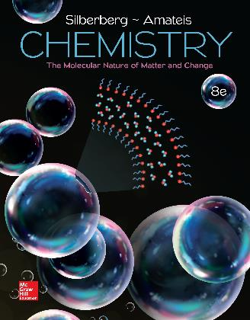
Chemistry
The Molecular Nature of Matter and Change Eighth Edition
Martin S. Silberberg and Patricia G. Amateis

Slide 2
Chapter 2: The Components of Matter
2.1 Elements, Compounds, and Mixtures:
An Atomic Overview
2.2 The Observations That Led to an Atomic View of Matter
2.3 Dalton’s Atomic Theory
2.4 The Observations That Led to the Nuclear Atom Model
2.5 The Atomic Theory Today

Slide 3
Chapter 2: The Components of Matter (2)
2.6 Elements: A First Look at the Periodic Table
2.7 Compounds: Introduction to Bonding
2.8 Formulas, Names, and Masses of Compounds
2.9 Mixtures: Classification and Separation
Notes:
3

Slide 4
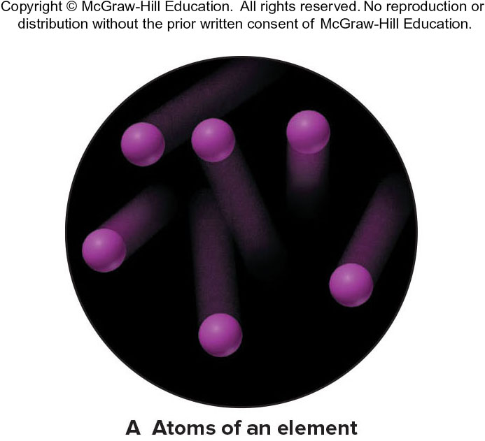
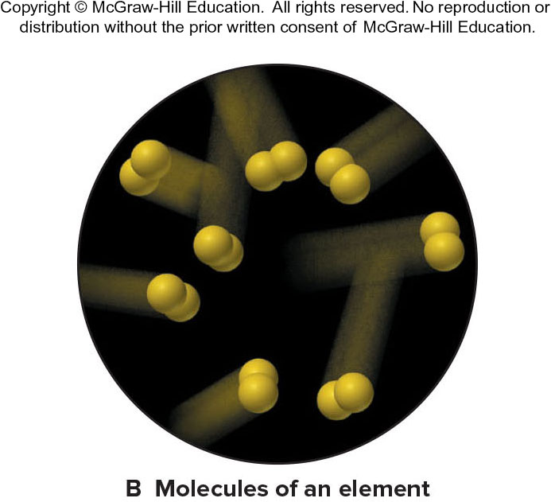
Definitions for Components of Matter
Element - the simplest type of substance with unique physical and chemical properties. An element consists of only one type of atom. It cannot be broken down into any simpler substances by physical or chemical means.
Molecule - a structure that consists of two or more atoms that are chemically bound together and thus behaves as an independent unit.

Slide 5
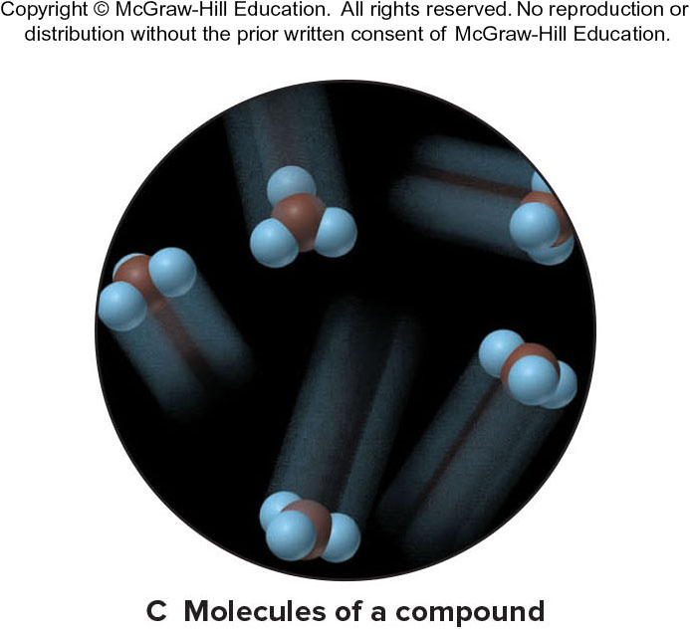
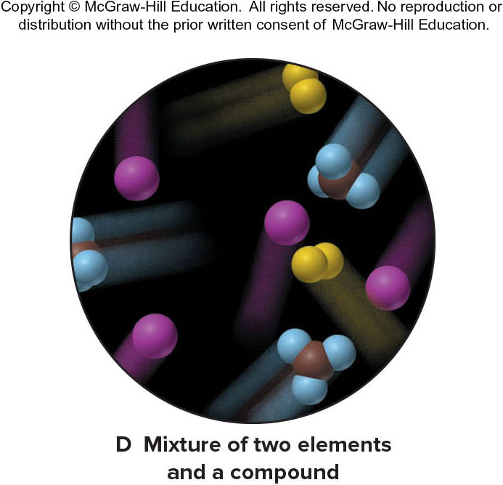
Definitions for Components of Matter (2)
Compound – a substance composed of two or more elements that are chemically combined.
Mixture – a group of two or more elements and/or compounds that are physically intermingled.

Slide 6
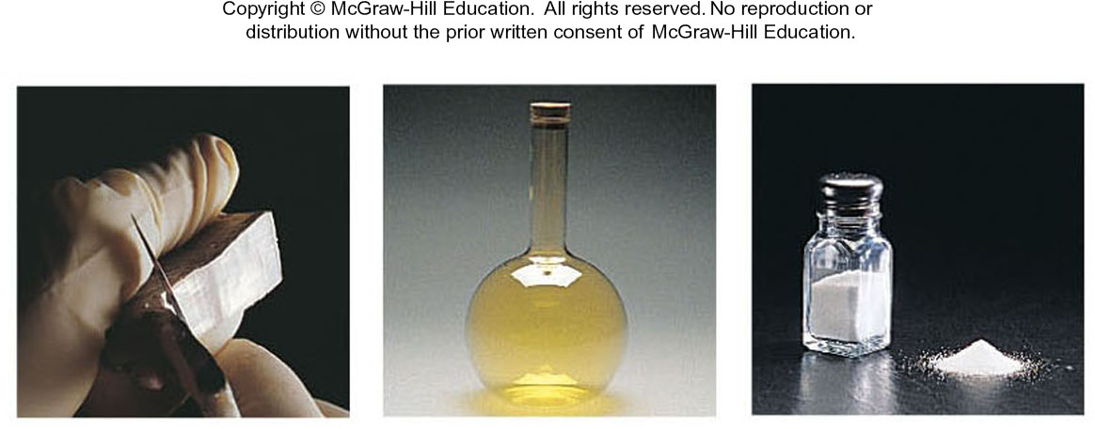
Table 2.1 Some Properties of Sodium, Chlorine, and Sodium Chloride
Property | Sodium + | Chlorine | Sodium Chloride
Melting point | 97.8°C | -101°C | 801°C
Boiling point | 881.4°C | -34°C | 1413°C
Color | Silvery | Yellow-green | Colorless (white)
Density | 0.97 g/cm³ | 0.0032 g/cm³ | 2.16 g/cm³
Behavior in water | Reacts | Dissolves slightly | Dissolves freely
Source:(Sodium, Chlorine, Sodium chloride) © McGraw-Hill Education/Stephen Frisch, photographer

Slide 7
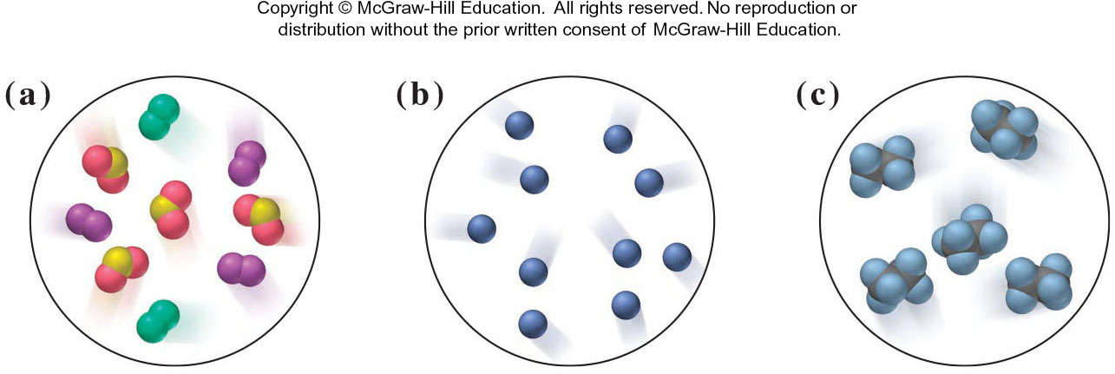
Sample Problem 2.1: Problem and Plan
PROBLEM: The following scenes represent an atomic-scale view of three samples of matter. Describe each sample as an element, compound, or mixture.
PLAN: A sample that contains only one type of particle is either an element or a compound. The particles of an element consist of only one type of atom, whereas the particles of a compound have two or more types of atom bonded together.
Copyright © McGraw-Hill Education. All rights reserved. No reproduction or distribution without the prior written consent of McGraw-Hill Education.

Slide 8
Sample Problem 2.1: Solution
SOLUTION:
Sample (a) contains three different types of particles and is therefore a mixture.
Sample (b) contains only one type of particle and each particle has only one atom. This is an element.
Sample (c) contains only one type of particle, each of which contains two different types of atoms. This is a compound.
Copyright © McGraw-Hill Education. All rights reserved. No reproduction or distribution without the prior written consent of McGraw-Hill Education.

Slide 9
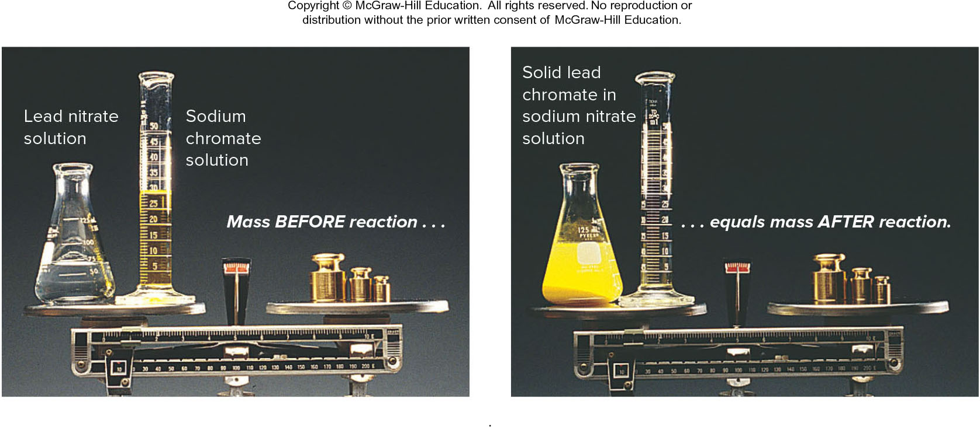
Figure 2.2: The law of mass conservation.
The total mass of substances does not change during a chemical reaction.
Source: © McGraw-Hill Education/Stephen Frisch, photographer

Slide 10
Law of Mass Conservation
The total mass of substances present does not change during a chemical reaction.
reactant 1 + reactant 2
product
total mass
=
total mass
calcium oxide + carbon dioxide
calcium carbonate
CaO + CO₂
CaCO₃
56.08 g + 44.00 g
100.08 g

Slide 11
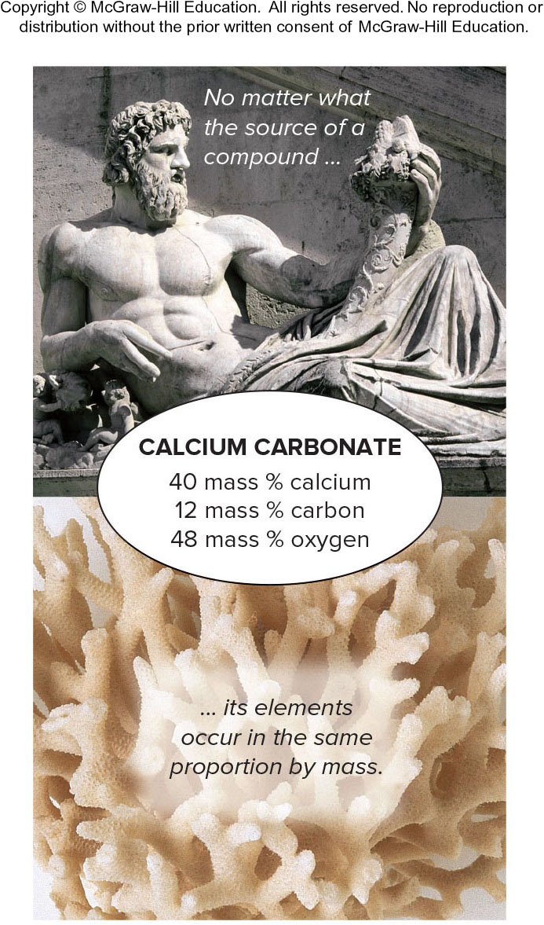
Figure 2.3 Law of Definite (or Constant) Composition
Source: (top): © Punchstock RF; (bottom): © Alexander Cherednichenko/Shutterstock.com
Notes:
11

Slide 12
Calcium carbonate
Analysis by Mass (grams/20.0 g) | Mass Fraction (parts/1.00 part) | Percent by Mass (parts/100 parts)
8.0 g calcium | 0.40 calcium | 40% calcium
2.4 g carbon | 0.12 carbon | 12% carbon
9.6 g oxygen | 0.48 oxygen | 48% oxygen
20.0 g | 1.00 part by mass | 100% by mass

Slide 13
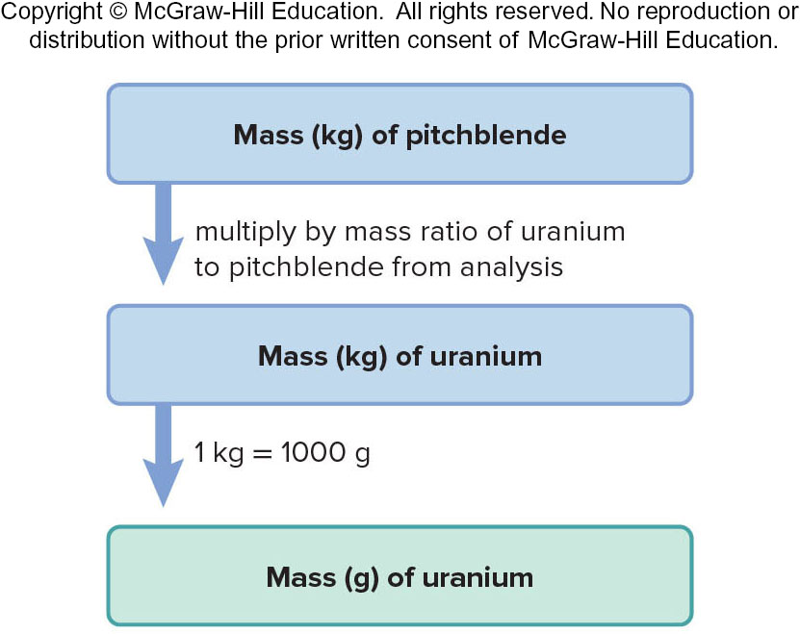
Sample Problem 2.2: Problem and Plan
PROBLEM: Analysis of 84.2 g of the uranium containing compound pitchblende shows it is composed of 71.4 g of uranium, with oxygen as the only other element. How many grams of uranium can be obtained from 102 kg of pitchblende?
PLAN: The mass ratio of uranium/pitchblende is the same no matter the source. We can use the ratio to find the answer.

Slide 14
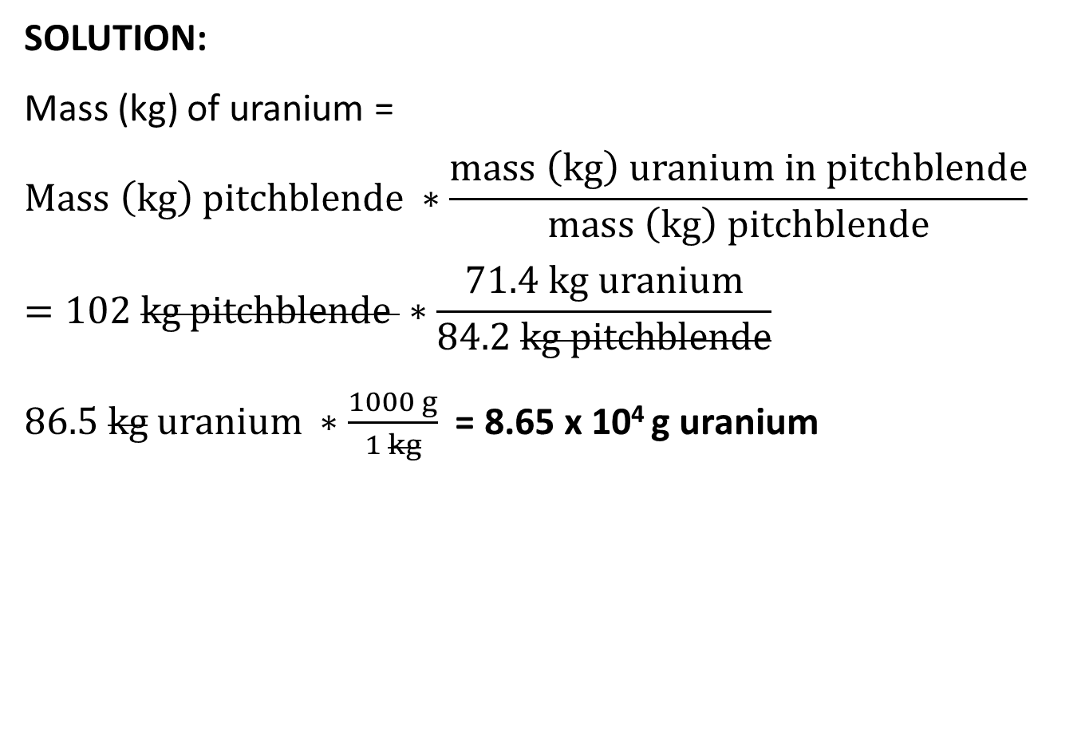
Sample Problem 2.2: Solution
SOLUTION:
Mass (kg) of uranium =
$$Mass \left(kg\right) pitchblende ∗\frac{mass \left(kg\right) uranium in pitchblende}{mass \left(kg\right) pitchblende}$$
$$=102 kg pitchblende ∗\frac{71.4 kg uranium}{84.2 kg pitchblende}$$
$86.5 kg uranium ∗\frac{1000 g}{1 kg}$ = 8.65 x 10⁴ g uranium
Notes:
14

Slide 15
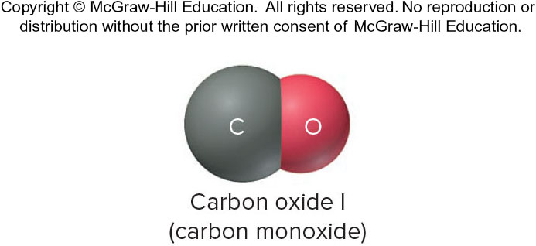
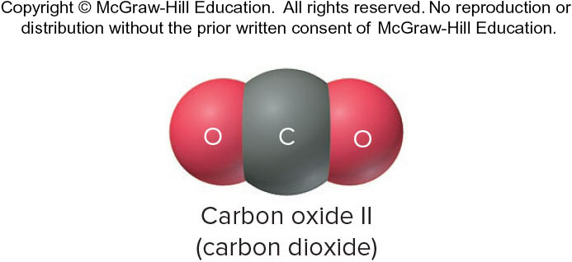
Law of Multiple Proportions
If elements A and B react to form two compounds, the different masses of B that combine with a fixed mass of A can be expressed as a ratio of small whole numbers.
Example: Carbon Oxides A & B
Carbon Oxide I : 57.1% oxygen and 42.9% carbon
Carbon Oxide II : 72.7% oxygen and 27.3% carbon

Slide 16

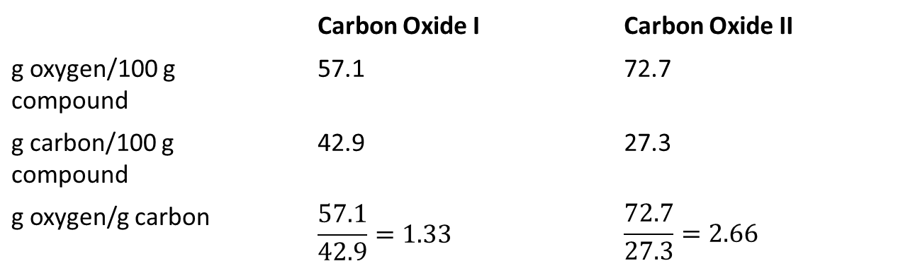
Multiple Proportions Demonstration
Assume that you have 100 g of each compound.
$$\frac{2.66 g O / g C in II}{1.33 g O / g C in I}=\frac{2}{1}$$
 | Carbon Oxide I | Carbon Oxide II
g oxygen/100 g compound | 57.1 | 72.7
g carbon/100 g compound | 42.9 | 27.3
g oxygen/g carbon | $$\frac{57.1}{42.9}=1.33$$ | $$\frac{72.7}{27.3}=2.66$$
Notes:
16

Slide 17
Dalton’s Atomic Theory
Dalton postulated that:
All matter consists of atoms; tiny indivisible particles of an element that cannot be created or destroyed.
Atoms of one element cannot be converted into atoms of another element.
Atoms of an element are identical in mass and other properties and are different from the atoms of any other element.
Compounds result from the chemical combination of a specific ratio of atoms of different elements.
Notes:
17

Slide 18
Dalton’s Atomic Theory and Mass Conservation
Mass conservation
postulate 1: Atoms cannot be created or destroyed
postulate 2: or converted into other types of atoms.
postulate 3: Since every atom has a fixed mass,
during a chemical reaction the same atoms are present but in different combinations; therefore there is no mass change overall.
Notes:
18

Slide 19
Dalton’s Atomic Theory and Definite Composition
Definite composition
postulate 4: Atoms are combined in compounds in specific ratios
postulate 3: and each atom has a specific mass.
Each element constitutes a fixed fraction of the total mass in a compound.

Slide 20
Dalton’s Atomic Theory and Multiple Proportions
Multiple proportions
postulate 3: Atoms of an element have the same mass
postulate 1: and atoms are indivisible.
When different numbers of atoms of elements combine, they must do so in ratios of small, whole numbers.

Slide 21
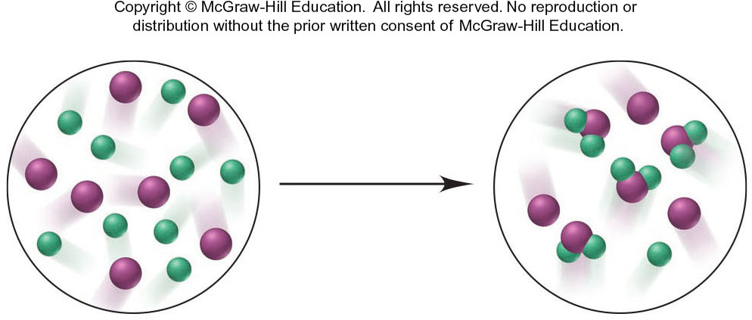
Sample Problem 2.3: Problem and Plan
Visualizing the Mass Laws
PROBLEM:
  The following scene represents an atomic-scale view of a chemical reaction. Which of the mass laws (mass conservation, definite composition, or multiple proportions) is (are) illustrated?
PLAN:
  Note the numbers, types, and combination of atoms before and after the reaction.

Slide 22
Sample Problem 2.3: Solution
SOLUTION:
There are 7 purple and 9 green atoms both before and after the reaction. Mass is therefore conserved.
After the reaction some purple atoms remain unreacted, but some have combined with green atoms to form a compound. Each particle of this compound contains 1 purple and 2 green atoms – the composition is constant, illustrating the law of definite composition.
Only one compound forms, so the law of multiple proportions does not pertain.

Slide 23
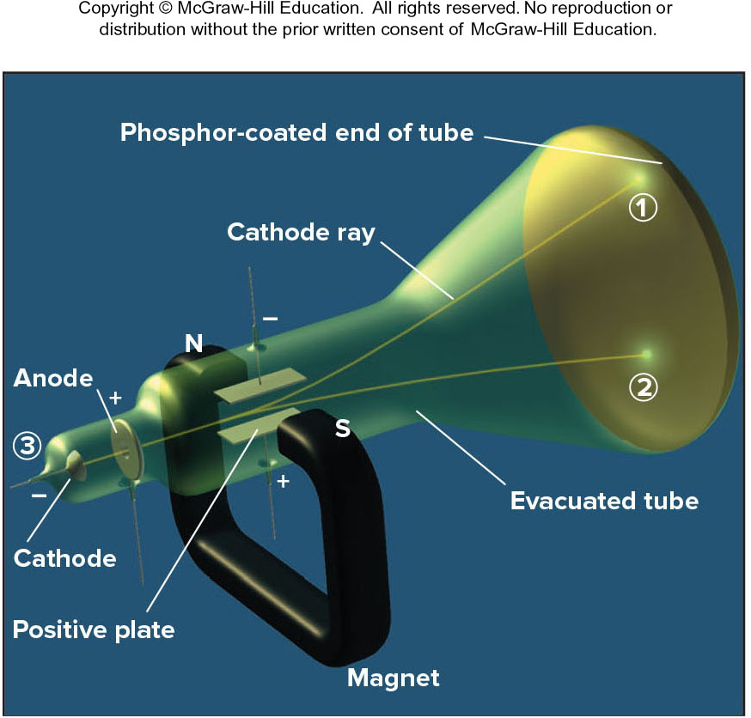
Observations that established the properties of cathode rays
Observation → Conclusion
Ray bends in magnetic field → Consists of charged particles
Ray bends toward (+) plate → Consists of negative particles
Ray is identical for any cathode → Particles found in all matter
Figure 2.4

Slide 24
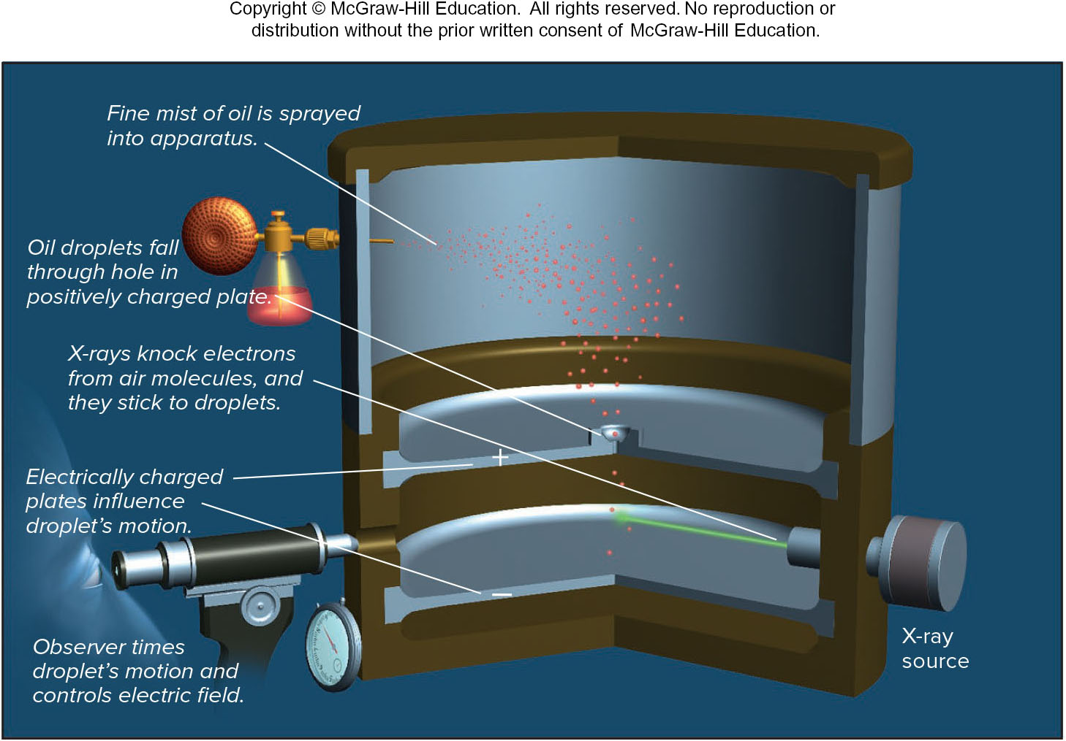
Millikan’s oil-drop experiment for measuring an electron’s charge
Figure 2.5

Slide 25

Millikan’s findings were used to calculate the mass of an electron
$$mass of electron=\frac{mass (as determined by J.J. Thompson) }{charge}∗charge$$
$=\left(−5.686∗{10}^{−12} \frac{kg}{C}\right)∗\left(−1.602∗{10}^{−19}C\right)$
$=9.109∗{10}^{−31} kg=9.09 ∗{10}^{−28} g$

Slide 26
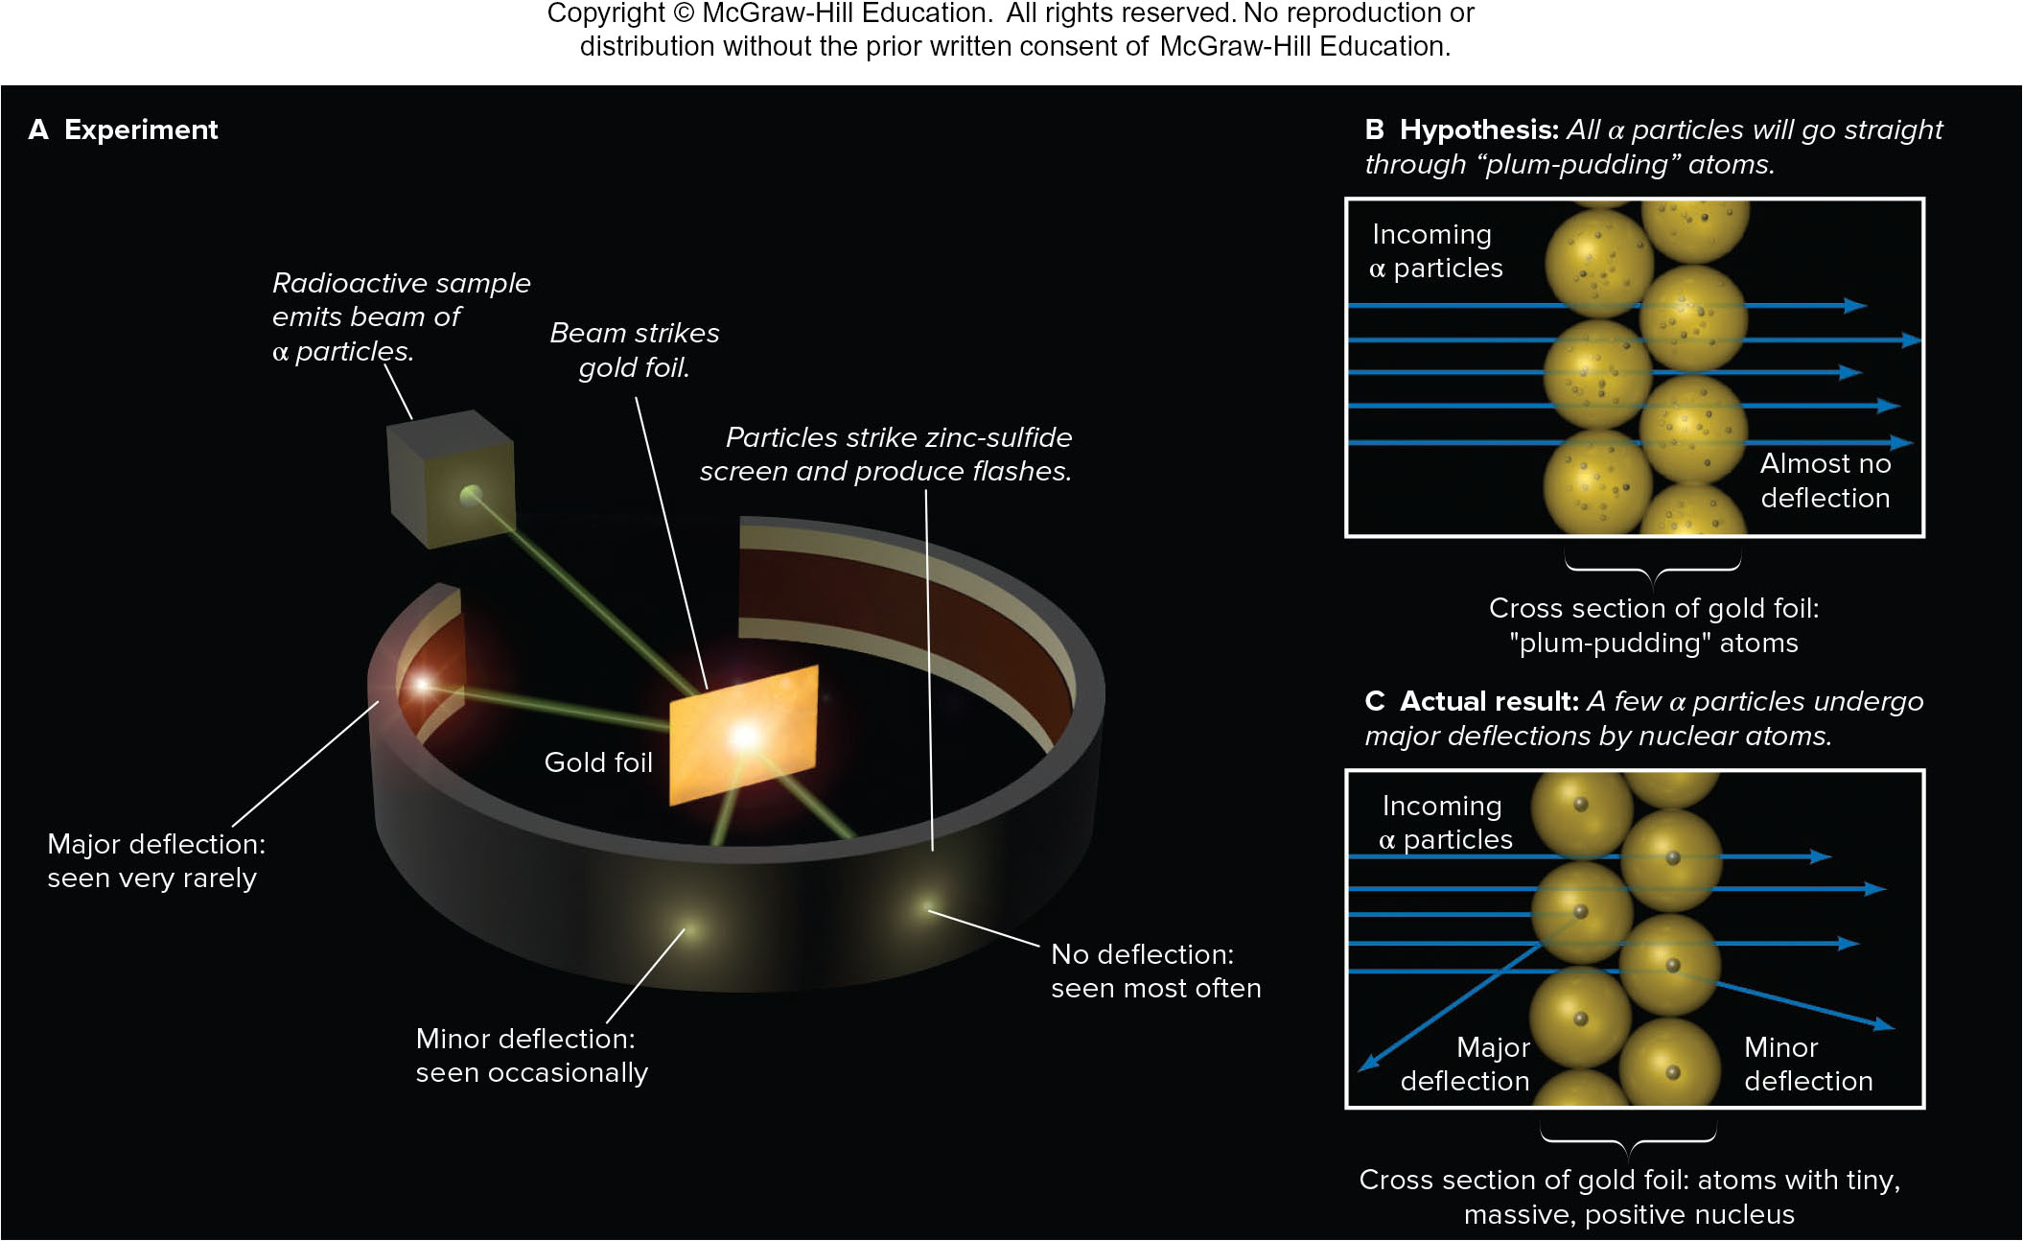
Rutherford’s α-scattering experiment and discovery of the atomic nucleus
Figure 2.6

Slide 27
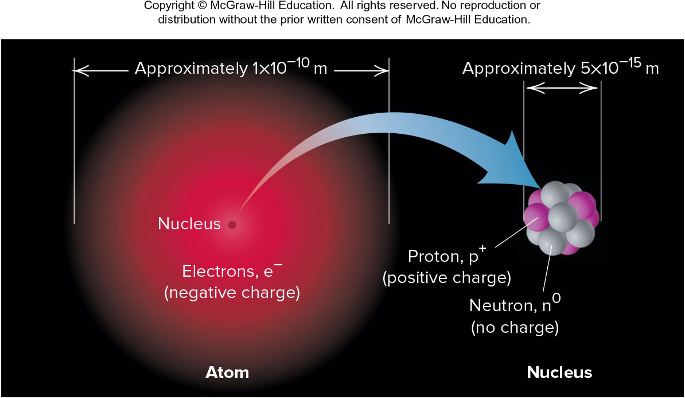
General features of the atom.
The atom is an electrically neutral, spherical entity composed of a positively charged central nucleus surrounded by one or more negatively charged electrons. The atomic nucleus consists of protons and neutrons.
Figure 2.7

Slide 28
Properties of the Three Key Subatomic Particles
Table 2.2
* The coulomb (C) is the SI unit of charge.
† The atomic mass unit (amu) equals 1.66054x10⁻²⁴ g.
 | Charge |  | Mass
Name (Symbol) | Relative | Absolute (C)* | Relative (amu)† | Absolute (g) | Location in Atom
Proton (p⁺) | 1+ | +1.60218x10⁻¹⁹ | 1.00727 | 1.67262x10⁻²⁴ | Nucleus
Neutron (n⁰) | 0 | 0 | 1.00866 | 1.67493x10⁻²⁴ | Nucleus
Electron (e⁻) | 1- | -1.60218x10⁻¹⁹ | 0.00054858 | 9.10939x10⁻²⁸ | Outside nucleus

Slide 29
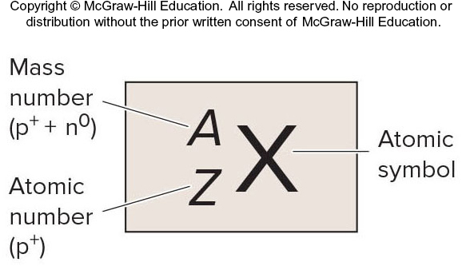
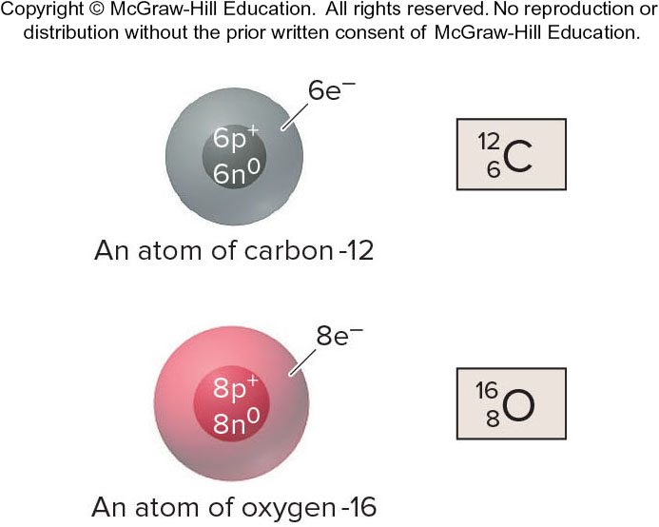
Atomic Symbol, Number and Mass
X = Atomic symbol of the element
A = mass number; A = Z + N
Z = atomic number (the number of protons in the nucleus)
N = number of neutrons in the nucleus
Figure 2.8

Slide 30
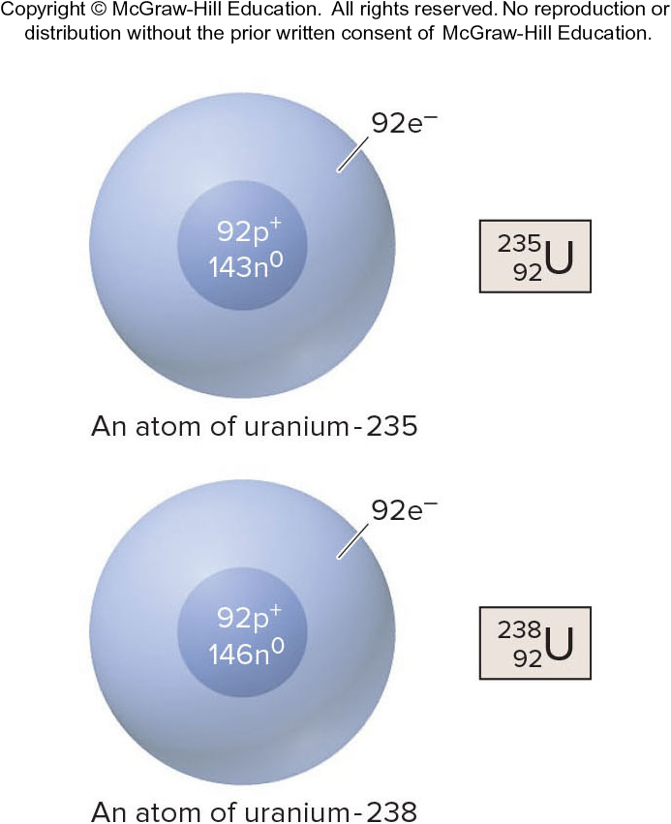
Isotopes
Isotopes are atoms of an element with the same number of protons, but a different number of neutrons.
Isotopes have the same atomic number, but a different mass number.
Figure 2.8
Notes:
30

Slide 31
Sample Problem 2.4: Problem and Plan
Determining the Number of Subatomic Particles in the Isotopes of an Element
PROBLEM:
  Silicon (Si) has three naturally occurring isotopes: ²⁸Si, ²⁹Si, and ³⁰Si. Determine the number of protons, neutrons, and electrons in each silicon isotope.
PLAN:
  The mass number (A; left superscript) of each of the three isotopes is given, which is the sum of protons and neutrons. From the List of Elements, we find the atomic number (Z, number of protons), which equals the number of electrons. We obtain the number of neutrons by subtracting Z from A.

Slide 32
Sample Problem 2.4: Solution
SOLUTION:
  The atomic number of silicon is 14; therefore
  ²⁸Si has 14p⁺, 14e–, and 14n⁰ (28 – 14 = 14)
  ²⁹Si has 14p⁺, 14e–, and 15n⁰ (29 – 14 = 15)
  ³⁰Si has 14p⁺, 14e–, and 16n⁰ (30 – 14) = 16

Slide 33
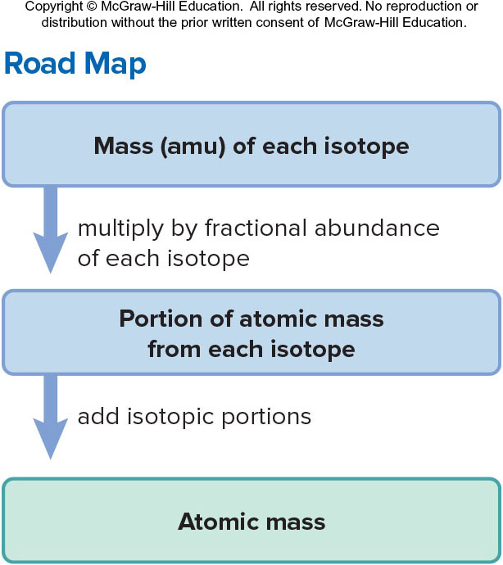
Sample Problem 2.5: Problem and Plan
Calculating the Atomic Mass of an Element
PROBLEM: Silver (Ag, Z = 47) has two naturally occurring isotopes, ¹⁰⁷Ag and ¹⁰⁹Ag. From the mass spectrometric data provided, calculate the atomic mass of Ag.
PLAN:
  Find the weighted average
  of the isotopic masses.
Isotope | Mass (amu) | Abundance (%)
¹⁰⁷Ag ¹⁰⁹Ag | 106.90509 108.90476 | 51.84 48.16

Slide 34
Sample Problem 2.5: Solution
mass portion from ¹⁰⁷Ag =
106.90509 amu x 0.5184 = 55.42 amu
mass portion from ¹⁰⁹Ag =
108.90476 amu x 0.4816 = 52.45 amu
atomic mass of Ag = 55.42 amu + 52.45 amu
= 107.87amu
Notes:
34

Slide 35
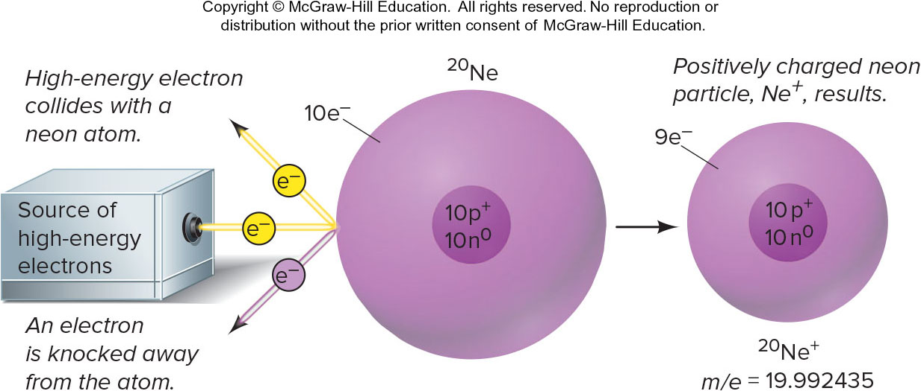
Tools of the Laboratory
Formation of a positively charged neon particle (Ne⁺).
Figure B2.1
Notes:
35

Slide 36
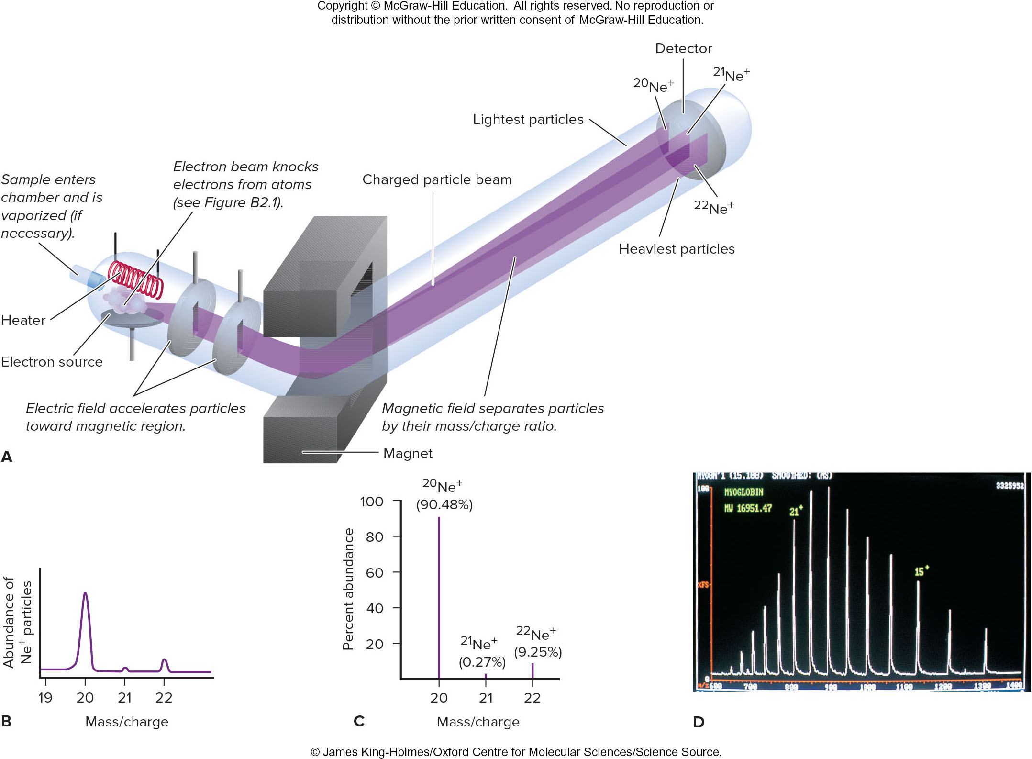
The mass spectrometer and its data.
Figure B2.2
Source: © James King Holmes/Oxford Centre for Molecular Sciences/Science Source.
Notes:
36

Slide 37
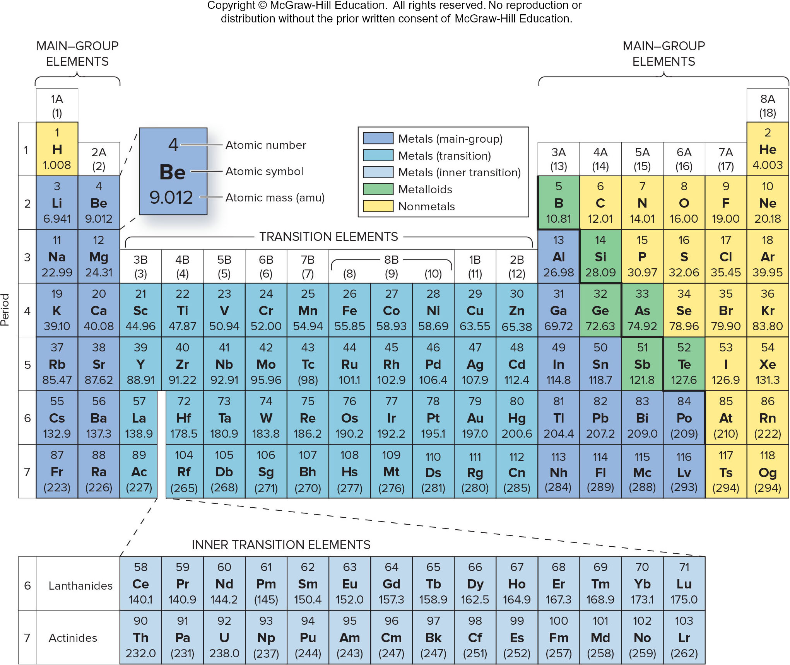
The modern periodic table.
Figure 2.9

Slide 38
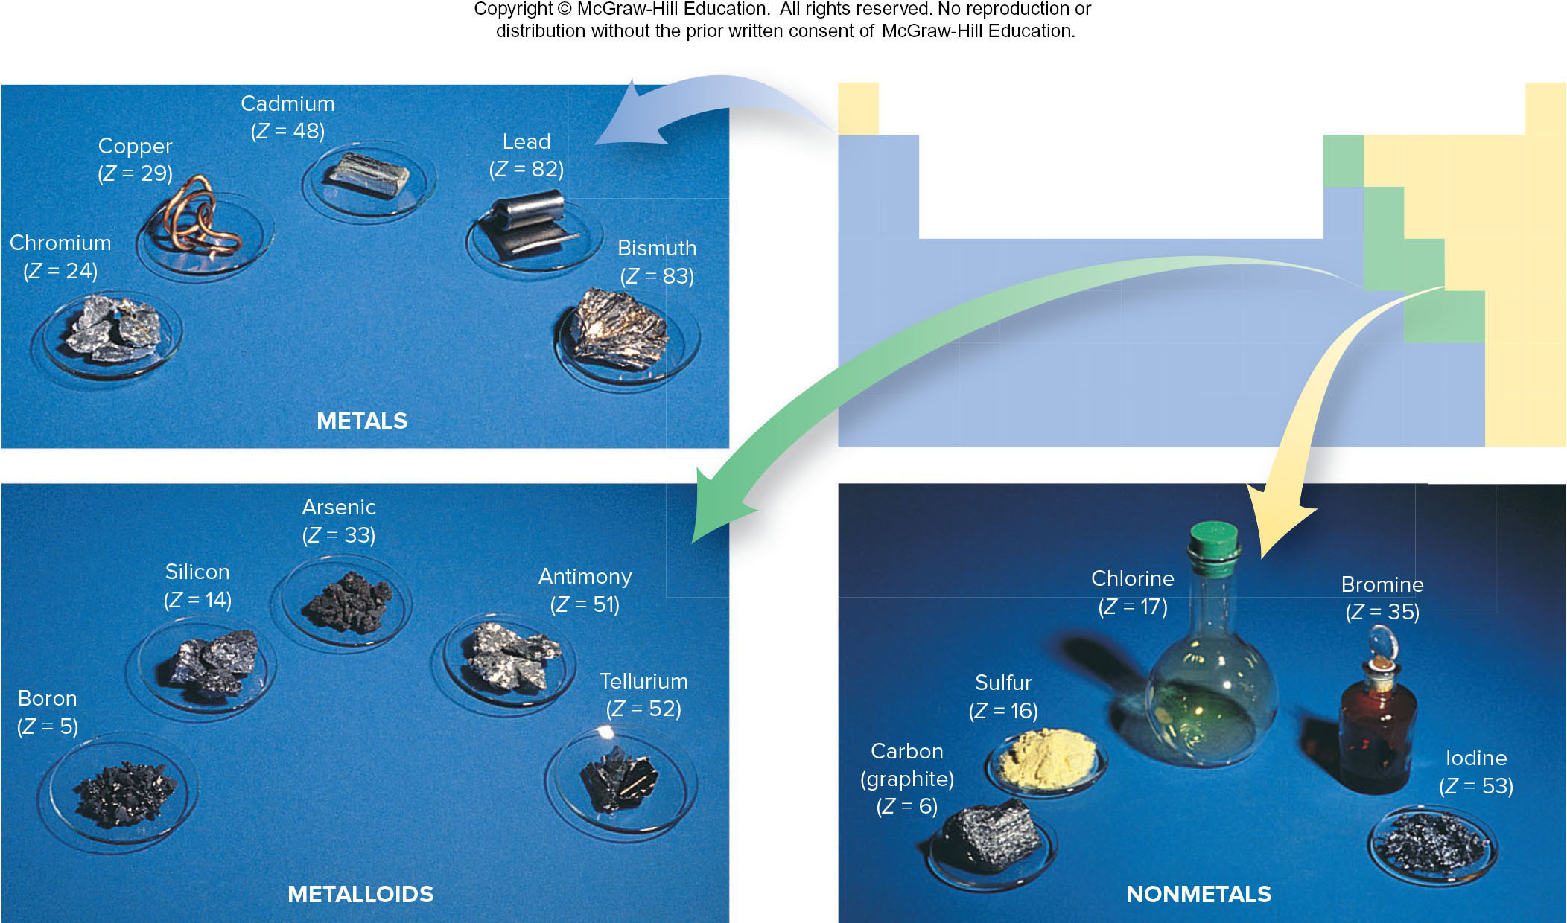
Some metals, metalloids, and nonmetals.
Figure 2.10
Source: &#169; McGraw-Hill Education/Stephen Frisch, photographer

Slide 39
Sample Problem 2.6: Problem and Plan
Identifying an Element from its Z value
PROBLEM:
  For each of the following Z values, give the name, symbol, and group and period numbers of the element and classify it as a main group metal, transition metal, inner-transition metal, nonmetal, or metalloid: (a) Z = 38; (b) Z = 17; (c) Z = 27.
PLAN:
  The Z value is the atomic number of an element. The list of elements inside the front cover is alphabetical, so we look up the name and symbol of the element. Then we use the periodic table to find the group number (top of the column) and the period number (left end of the row) in which the element is located. We classify the element from the color coding in the periodic table.

Slide 40
Sample Problem 2.6: Solution
SOLUTION:
(a) Strontium, Sr, is in Group 2A(2) and Period 5, and it is a main group metal.
(b) Chlorine, Cl, is in Group 7A(17) and Period 3, and it is a nonmetal.
(c) Cobalt, Co, is in Group 8B(9) and Period 4, and it is a transition metal.
Notes:
40

Slide 41
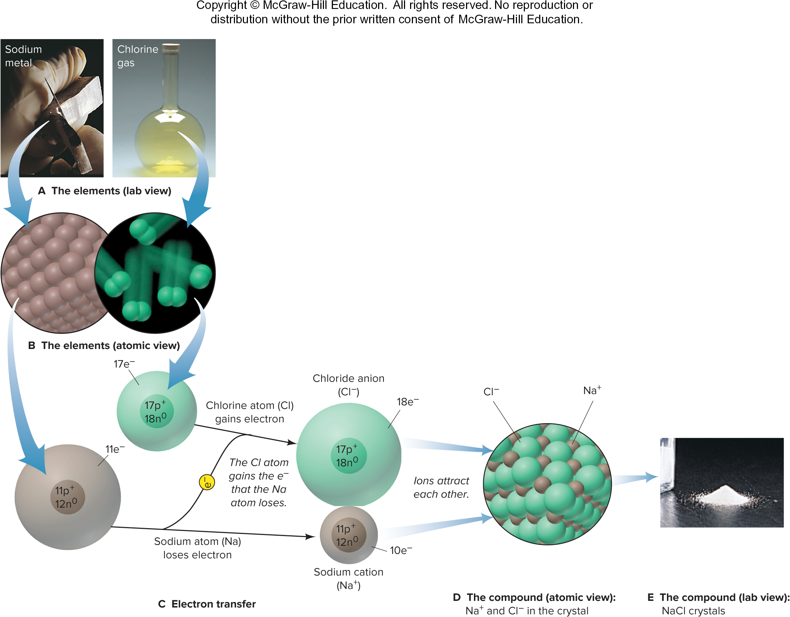
The formation of an ionic compound.
Transferring electrons from the atoms of one element to those of another results in an ionic compound.
Figure 2.11
Source: A(1−2), E: © McGraw-Hill Education/Stephen Frisch, photographer

Slide 42
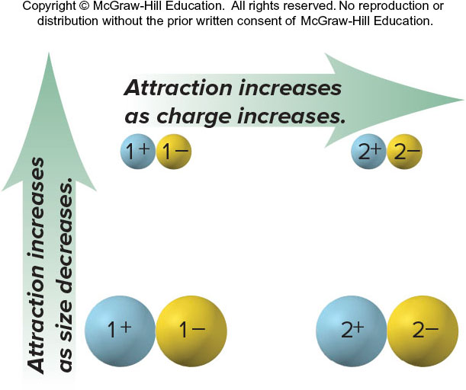
Factors that influence the strength of ionic bonding
Figure 2.12

Slide 43
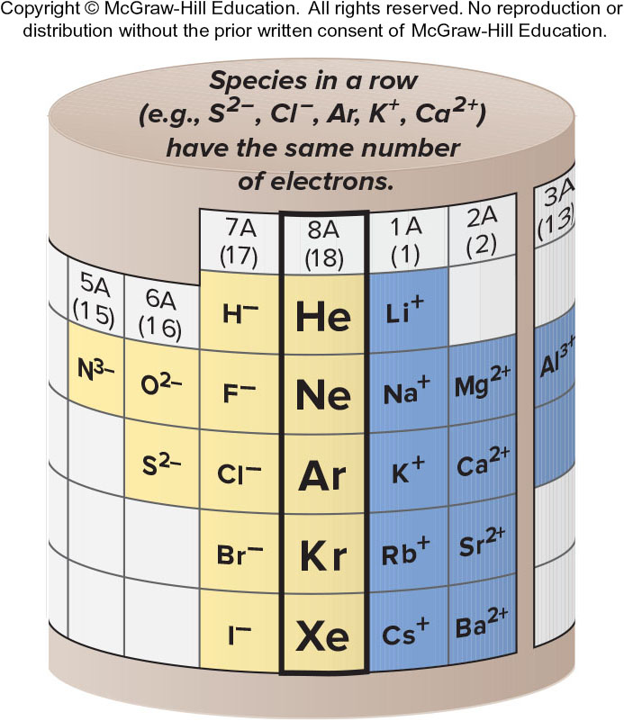
The relationship between ions formed and the nearest noble gas.
Figure 2.13

Slide 44
Sample Problem 2.7: Problem and Plan
PROBLEM: What monatomic ions would you expect the following elements to form?
  Iodine (Z = 53)
  Calcium (Z = 20)
  Aluminum (Z = 13)
PLAN:
  We use the given Z value to find the element in the periodic table and see where its group lies relative to the noble gases. Elements in Groups 1A, 2A, and 3A lose electrons to attain the same number as the nearest noble gas and become positive ions; those in Groups 5A, 6A, and 7A gain electrons and become negative ions.

Slide 45
Sample Problem 2.7: Solution
SOLUTION:
Iodine is in Group 7A, the halogens. Like any member of this group, it gains 1 electron to attain the same number as the nearest Group 8A member, in this case, Xe.
Calcium is in Group 2A, the alkaline earth metals. Like any Group 2A member, it loses 2 electrons to attain the same number as the nearest noble gas, Ar.
Aluminum is a metal in the boron family [Group 3A] and thus loses 3 electrons to attain the same number as its nearest noble gas, Ne.

Slide 46
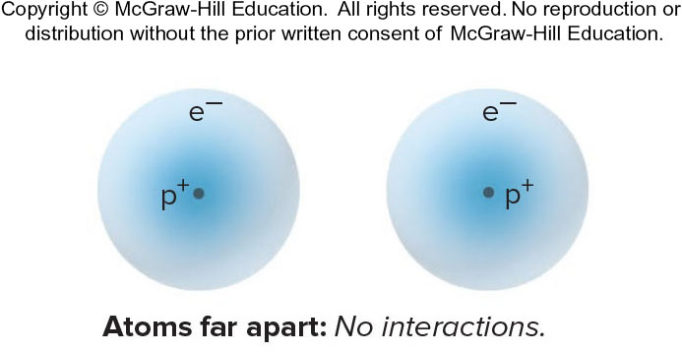
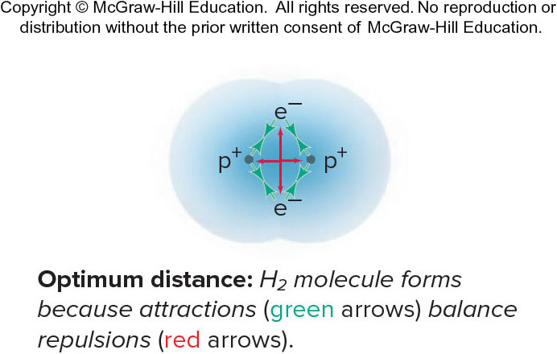
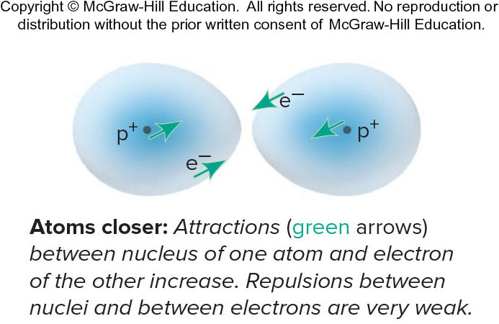
Formation of a covalent bond between two H atoms
Covalent bonds form when elements share electrons, which usually occurs between nonmetals.
Figure 2.14

Slide 47
Molecules and Ions
Molecule – the basic unit of a molecular element or covalent compound, consisting of two or more atoms bonded by the sharing of electrons. Most covalent substances consist of molecules.
Ion – a single atom or covalently bonded group of atoms that has an overall electrical charge. There are no molecules in an ionic compound.

Slide 48
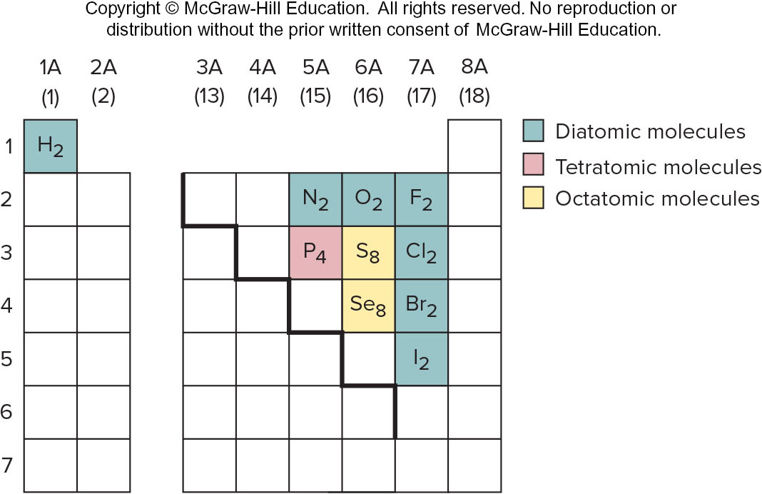
Elements that occur as molecules.
Figure 2.15
Notes:
48

Slide 49
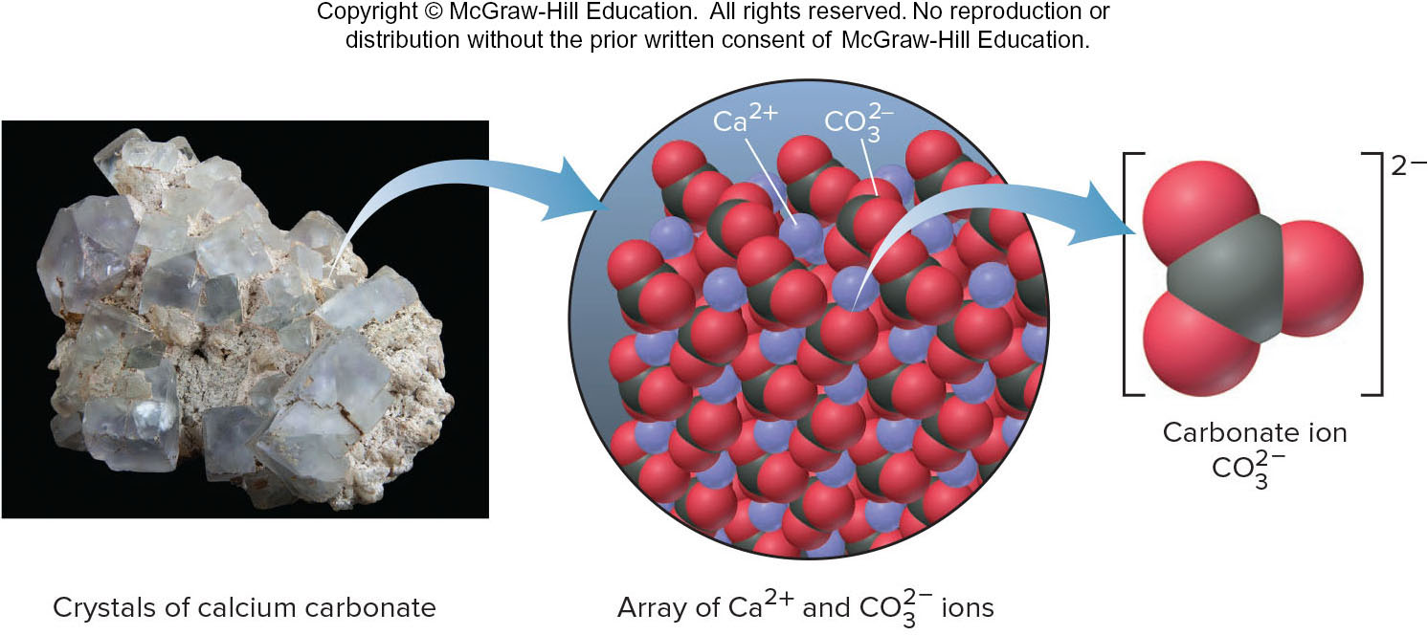
The carbonate ion in calcium carbonate
A polyatomic ion consists of two of more atoms covalently bonded together and has an overall charge. In many reactions the polyatomic ion will remain together as a unit.
Figure 2.16
Source: (calcium carbonate crystals) © papa1266/Shutterstock.com

Slide 50
Chemical Formulas
A chemical formula consists of element symbols with numerical subscripts.
The chemical formula indicates the type and number of each atom present in the smallest unit of a substance.
Notes:
50

Slide 51
Naming Binary Ionic Compounds
For all ionic compounds, the name and formula lists the cation first and the anion second.
In a binary ionic compound, both the cation and the anion are monatomic.
The name of the cation is the same as the name of the metal. Many metal names end in -ium.
The anion is named by adding the suffix -ide to the root of the nonmetal name.
Calcium and bromine form calcium bromide.

Slide 52
Common Monatomic Ions*
Charge | Cations Formula | Name |  | Charge | Anions Formula | Name
+1 | H⁺ Li⁺ Na⁺ K⁺ Cs⁺ Ag⁺ | hydrogen lithium sodium potassium cesium silver |  | –1 | H– F– Cl– Br– I– | hydride fluoride chloride bromide iodide
+2 | Mg²⁺ Ca²⁺ Sr²⁺ Ba²⁺ Zn²⁺ Cd²⁺ | magnesium calcium strontium barium zinc cadmium |  | –2 | O^{2–} S^{2–} | oxide sulfide
+3 | Al³⁺ | aluminum |  | –3 | N^{3–} | nitride
*Listed by charge; those in boldface are most common.

Slide 53
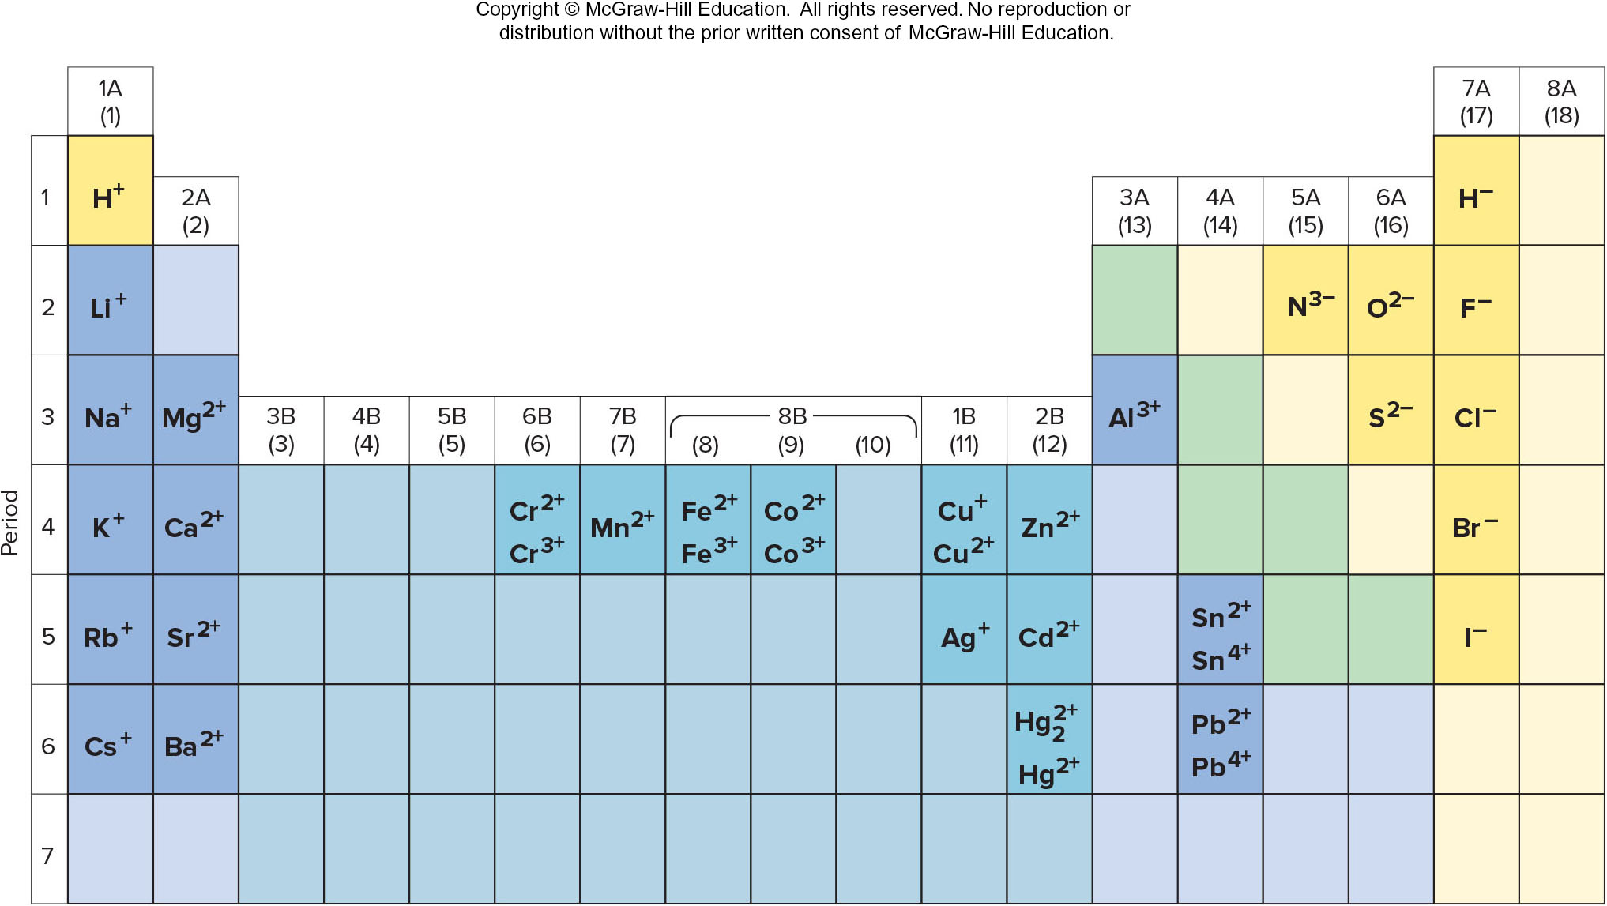
Some common monatomic ions of the elements
Figure 2.17
Most main-group elements form one monatomic ion.
Most transition elements form two monatomic ions.

Slide 54
Sample Problem 2.8: Problem and Plan
Naming Binary Ionic Compounds
PROBLEM: Name the ionic compound formed from each of the following pairs of elements:
  magnesium and nitrogen
  iodine and cadmium
  strontium and fluorine
  sulfur and cesium
PLAN: Use the periodic table to decide which element is the metal and which the nonmetal. The metal (cation) is named first and the suffix –ide is added to the root of the non-metal name.

Slide 55
Sample Problem 2.8: Solution
SOLUTION:
  magnesium nitride
  cadmium iodide
  strontium fluoride
  cesium sulfide

Slide 56
Sample Problem 2.9: Problem and Plan
Determining Formulas of Binary Ionic Compounds
PROBLEM: Write empirical formulas for each of the compounds named in Sample Problem 2.8:
  magnesium nitride
  cadmium iodide
  strontium fluoride
  cesium sulfide
PLAN: We find the smallest number of each ion that will produce a neutral compound. These numbers appear as right subscripts to the relevant element symbol.

Slide 57
Sample Problem 2.9: Solution
SOLUTION:
  Mg²⁺ and N^{3–}; three Mg²⁺(6+) and two N^{3–} (6-); Mg₃N₂
  Cd²⁺ and I–; one Cd²⁺(2+) and two I– (2-); CdI₂ strontium fluoride
  Sr²⁺ and F–; one Sr²⁺(2+) and two F– (2-); SrF₂
  Cs⁺ and S^{2–}; two Cs⁺(2+) and one S^{2–} (2-); Cs₂S

Slide 58
Some Metals That Form More Than One Monatomic Ion*
*Listed alphabetically by metal name; the ions in boldface are most common.
Element | Ion Formula | Systematic Name | Common Name
Chromium Cobalt Copper Iron Lead Mercury Tin | Cr²⁺ Cr³⁺ Co²⁺ Co³⁺ Cu⁺ Cu²⁺ Fe²⁺ Fe³⁺ Pb²⁺ Pb⁴⁺ Hg₂²⁺ Hg²⁺ Sn²⁺ Sn⁴⁺ | chromium(II) chromium(III) cobalt(II) cobalt(III) copper(I) copper(II) iron(II) iron(III) lead(II) lead(IV) mercury (I) mercury (II) tin(II) tin(IV) | chromous chromic cuprous cupric ferrous ferric mercurous mercuric stannous stannic
Notes:
58

Slide 59
Sample Problem 2.10: Problem and Plan
Determining Formulas of Binary Ionic Compounds
PROBLEM: Give the systematic name for each formula or the formula for each name for the following compounds:
  tin(II) fluoride
  CrI₃
  ferric oxide
  CoS
PLAN: Find the smallest number of each ion that will produce a neutral formula.

Slide 60
Sample Problem 2.10: Solution
SOLUTION:
  Tin(II) is Sn²⁺; fluoride is F–; so the formula is SnF₂.
  The anion I– is iodide; 3I– means that Cr (chromium) is +3. CrI₃ is chromium(III) iodide.
  Ferric is a common name for Fe³⁺; oxide is O^{2–}; therefore the formula is Fe₂O₃.
  Co is cobalt; the anion S^{2–} is sulfide, which requires the cation to be Co²⁺, and the compound is cobalt(II) sulfide.

Slide 61
Some Common Polyatomic Ions*
* Bold face ions are most common.
Formula | Name |  |  | Formula |  |  | Name
Cations
NH₄⁺ |  | ammonium |  | H₃O⁺ |  | hydronium
Common Anions
CH₃COO⁻ CN⁻ OH⁻ ClO⁻ ClO₂⁻ ClO₃⁻ NO₂⁻ NO₃⁻ MnO₄⁻ |  | acetate cyanide hydroxide hypochlorite chlorite chlorate nitrite nitrate permanganate |  |  | CO₃²⁻ HCO₃⁻ CrO₄²⁻ Cr₂O₇²⁻ O₂²⁻ PO₄³⁻ HPO₄²⁻ SO₃²⁻ SO₄²⁻ | carbonate bicarbonate chromate dichromate peroxide phosphate hydrogen phosphate sulfite sulfate
Notes:
61

Slide 62
Naming oxoanions
# oxygens | Prefix | Root |  | Suffix
higher lower | per hypo | root root root root |  |  | ate ate ite ite
Figure 2.18

Slide 63
Numerical Prefixes for Hydrates and Binary Covalent Compounds
Table 2.6
Number | Prefix
1 | mono-
2 | di-
3 | tri-
4 | tetra-
5 | penta-
6 | hexa-
7 | hepta-
8 | octa-
9 | nona-
10 | deca-
Notes:
63

Slide 64
Sample Problem 2.11: Problem and Plan
Determining Names and Formulas of Ionic Compounds Containing Polyatomic Ions
PROBLEM: Give the systematic name for each formula or the formula for each name for the following compounds :
  Fe(ClO₄)₂
  sodium sulfite
  Ba(OH)₂·8H₂O
PLAN: Remember to use parentheses when more than one unit of a particular polyatomic ion is present in the compound.

Slide 65
Sample Problem 2.11: Solution
SOLUTION:
  ClO₄– is perchlorate; Fe must have a 2+ charge since there are 2 ClO₄– ions. This is iron(II) perchlorate.
  The anion sulfite is SO₃^{2–}; therefore 2 Na⁺ ions are needed for each sulfite. The formula is Na₂SO₃.
  The ionic compound is barium hydroxide. When water is included in the formula, we use the term “hydrate” and a prefix that indicates the number of molecules of H₂O. This compound is barium hydroxide octahydrate.

Slide 66
Sample Problem 2.12: Problem
Recognizing Incorrect Names and Formulas of Ionic Compounds
PROBLEM: Explain what is wrong with the name or formula at the end of each statement, and correct it:
  Ba(C₂H₃O₂)₂ is called barium diacetate.
  Sodium sulfide has the formula (Na)₂SO₃.
  Iron(II) sulfate has the formula Fe₂(SO₄)₃.
  Cesium carbonate has the formula Cs₂(CO₃).

Slide 67
Sample Problem 2.12: Solution
SOLUTION:
  The charge of Ba²⁺ must be balanced by two C₂H₃O₂– ions. The prefix “di” is not required and is not used in this way when naming ionic compounds. The correct name is simply barium acetate.
  An ion of a single element does not need parentheses, and sulfide is S^{2–}, not SO₃^{2–}. The correct formula is Na₂S.
  Sulfate or SO₄^{2–} has a 2- charge, and only one Fe²⁺ is needed to form a neutral compound. The formula should be FeSO₄.
  The parentheses are unnecessary, since only one CO₃^{2–} ion is present. The correct formula is Cs₂CO₃.

Slide 68
Naming Acids
Binary acid solutions form when certain gaseous compounds dissolve in water.
  For example, when gaseous hydrogen chloride (HCl) dissolves in water, it forms a solution called hydrochloric acid.
  Prefix hydro- + anion nonmetal root + suffix -ic + the word acid -
hydro + chlor + ic + acid
hydrochloric acid
Oxoacid names are similar to those of the oxoanions, except for two suffix changes:
  -ate in the anion becomes –ic in the acid
  -ite in the anion becomes –ous in the acid
  The oxoanion prefixes hypo- and per- are retained. Thus, BrO₄– is perbromate, and HBrO₄ is perbromic acid; IO₂– is iodite, and HIO₂ is iodous acid.

Slide 69
Sample Problem 2.13: Problem
Determining Names and Formulas of Anions and Acids
PROBLEM: Name the following anions and give the name and formula of the acid derived from each:
  Br –
  IO₃–
  CN–
  HSO₄–

Slide 70
Sample Problem 2.13: Solution
SOLUTION:
  The anion is bromide; the acid is hydrobromic acid, HBr.
  The anion is iodate; the acid is iodic acid, HIO₃.
  The anion is cyanide; the acid is hydrocyanic acid, HCN.
  The anion is hydrogen sulfate; the acid is sulfuric acid, H₂SO₄. (In this case, the suffix is added to the element name sulfur, not to the root, sulf-.)

Slide 71
Naming Binary Covalent Compounds
A binary covalent compound is typically formed by the combination of two non-metals.
Some of these compounds are very common and have trivial names, e.g., H2O is water.
For a binary covalent compound, the element with the lower group number in the periodic table is first in the name and formula. Its name remains unchanged.
The element that is second is named using the root with the suffix –ide. Numerical prefixes indicate the number of atoms of each element present.

Slide 72
Sample Problem 2.14: Problem
Determining Names and Formulas of Binary Covalent Compounds
PROBLEM:
  What is the formula of carbon disulfide?
  What is the name of PCl₅?
  Give the name and formula of the compound whose molecules each consist of two N atoms and four O atoms.

Slide 73
Sample Problem 2.14: Solution
SOLUTION:
  The prefix di- means “two.” The formula is CS₂.
  P is the symbol for phosphorus; there are five chlorine atoms, which is indicated by the prefix penta-. The name is phosphorus pentachloride.
  Nitrogen (N) comes first in the name (lower group number). The compound is dinitrogen tetroxide, N₂O₄.

Slide 74
Sample Problem 2.15: Problem
Recognizing Incorrect Names and Formulas of Binary Covalent Compounds
PROBLEM: Explain what is wrong with the name or formula at the end of each statement, and correct it:
  SF₄ is monosulfur pentafluoride.
  Dichlorine heptoxide is Cl₂O₆.
  N₂O₃ is dinitrotrioxide.

Slide 75
Sample Problem 2.15: Solution
SOLUTION:
  There are two mistakes. Mono- is not needed if there is only one atom of the first element, and the prefix for four is tetra-, not penta-. The correct name is sulfur tetrafluoride.
  The prefix hepta- indicates seven, not six. The correct formula is Cl₂O₇.
  The full name of the first element is needed, and a space separates the two element names. The correct name is dinitrogen trioxide.

Slide 76
Naming Straight-Chain Alkanes
Hydrocarbons are compounds that contain only carbon and hydrogen atoms.
Alkanes are the simplest type of hydrocarbon.
Alkanes are named using a root name followed by the suffix –ane.

Slide 77
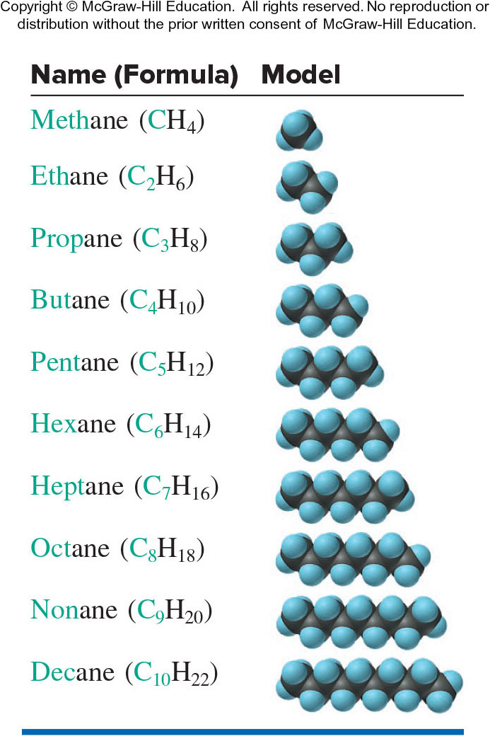
The First 10 Straight-Chain Alkanes
Table 2.7

Slide 78
Molecular Masses from Chemical Formulas
Molecular mass = sum of atomic masses
For the H₂O molecule:
molecular mass = (2 x atomic mass of H) + (1 x atomic mass of O)
= (2 x 1.008 amu) + (1 x 16.00 amu)
= 18.02 amu
  By convention, we read masses off the periodic table to 4 significant figures.
For ionic compounds we refer to a formula mass since ionic compounds do not consist of molecules.

Slide 79
Sample Problem 2.16: Problem and Plan
Calculating the Molecular Mass of a Compound
PROBLEM: Using the periodic table, calculate the molecular (or formula) mass of:
  tetraphosphorous trisulfide
  ammonium nitrate
PLAN: Write the formula and then multiply the number of atoms by the respective atomic masses. Add the masses for each compound.

Slide 80
Sample Problem 2.16: Solution
SOLUTION:
  P₄S₃:
  Molecular mass = (4 x atomic mass of P) + (3 x atomic mass of S)
  = (4 x 30.97 amu) + (3 x 32.07 amu) = 220.09 amu
  NH₄NO₃:
Formula mass = (2 x atomic mass of N) + (4 x atomic mass of H) +
(3 x atomic mass of O)
= (2 x 14.01 amu) + (4 x 1.008 amu) + (3 x 16.00 amu)
= 80.05 amu

Slide 81
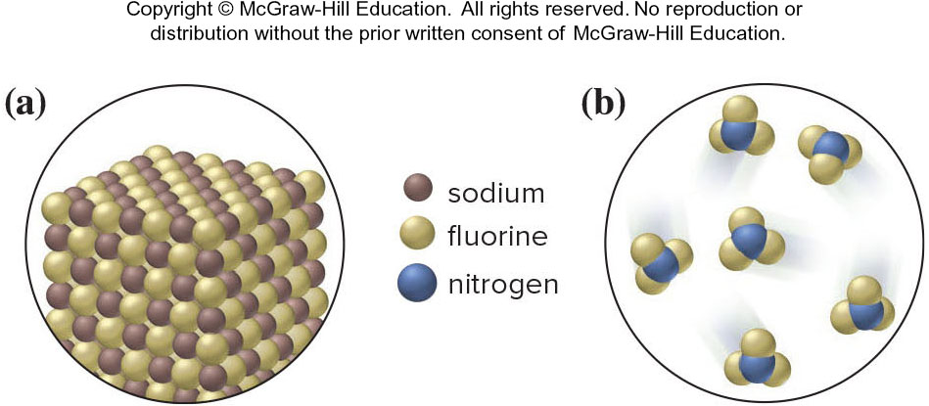
Sample Problem 2.17: Problem and Plan
Using Molecular Depictions to determine Formula, Name, and Mass for a compound
PROBLEM: Each scene represents a binary compound. Determine its formula, name, and molecular (or formula) mass.
PLAN: Each compound contains only two elements. Find the simplest whole number ratio of atoms in each compound and use this formula to determine the name and the molecular (or formula) mass.

Slide 82
Sample Problem 2.17: Solution
SOLUTION:
  There is 1 brown Na⁺ for every green F⁻, so the formula is NaF, an ionic compound, which is named sodium fluoride.
Formula mass = (1 x atomic mass of Na) + (1 x atomic mass of F)
  = 22.99 amu + 19.00 amu = 41.99 amu
  There are 3 green F for every blue N, so the formula is NF₃, a covalent compound, which is named nitrogen trifluoride.
Molecular mass = (1 x atomic mass of N) + (3 x atomic mass of F)
= 14.01 amu + (3 x 19.00) = 71.01 amu

Slide 83
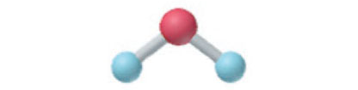
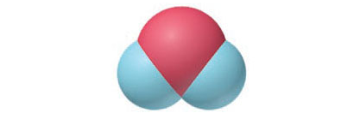
Representing Molecules with Formulas and Models
H₂O | Molecular formula for water.
H-O-H H:O:H | Structural formulas for water.
 | Ball-and-stick model for water.
 | Space-filling model for water.

Slide 84
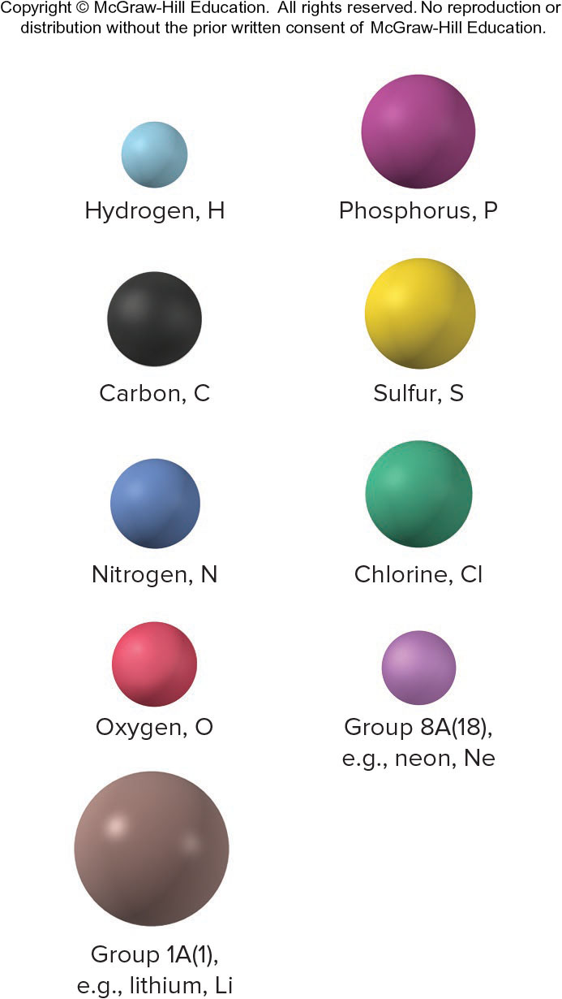
Representing Molecules with Formulas and Models
Figure 2.14

Slide 85
Mixtures
A heterogeneous mixture has one or more visible boundaries between the components.
A homogeneous mixture has no visible boundaries because the components are mixed as individual atoms, ions, and/or molecules.
A homogeneous mixture is also called a solution. Solutions in which water is the solvent are called aqueous solutions.

Slide 86
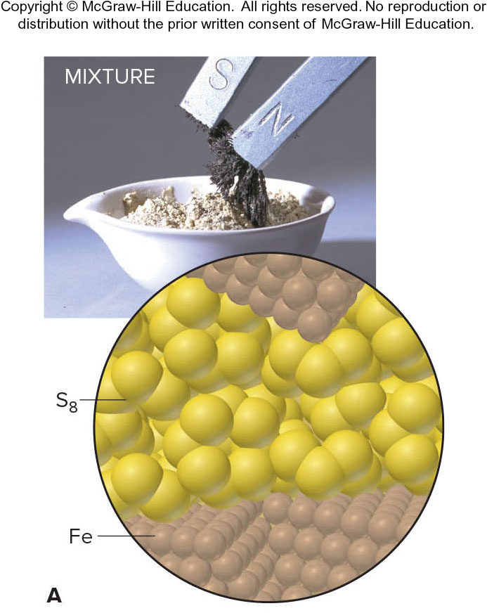
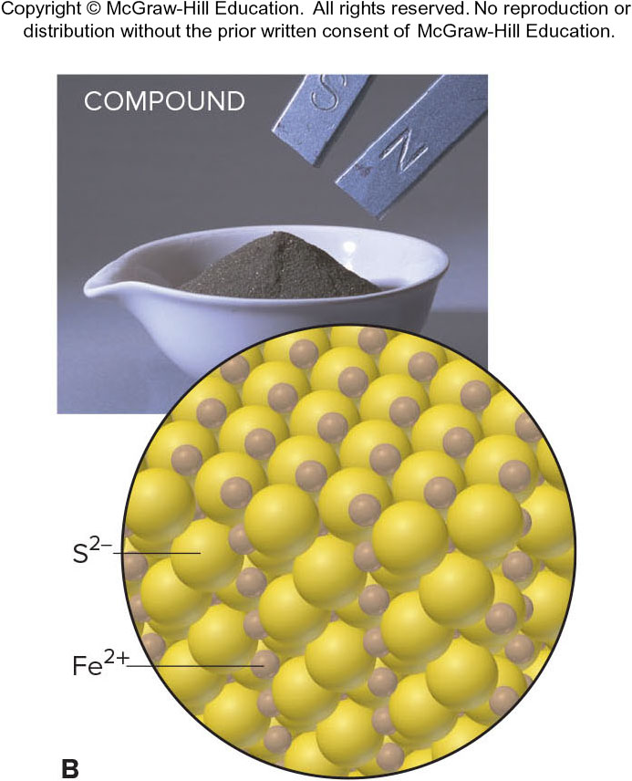
The distinction between mixtures and compounds.
A physical mixture of the elements Fe and S₈ can be separated using a magnet.
Fe and S have reacted chemically to form the compound FeS. The elements cannot be separated by physical means.
Figure 2.19
Source: © McGraw-Hill Education/Stephen Frisch, photographer

Slide 87
Tools of the Laboratory: Basic Separation Techniques
Filtration: Separates components of a mixture based upon differences in particle size. Filtration usually involves separating a precipitate from solution.
Crystallization: Separation is based upon differences in solubility of the components in a mixture.
Distillation: Separation is based upon differences in volatility.
Extraction: Separation is based upon differences in solubility in different solvents (major material).
Chromatography: Separation is based upon differences in solubility in a solvent versus a stationary phase.

Slide 88
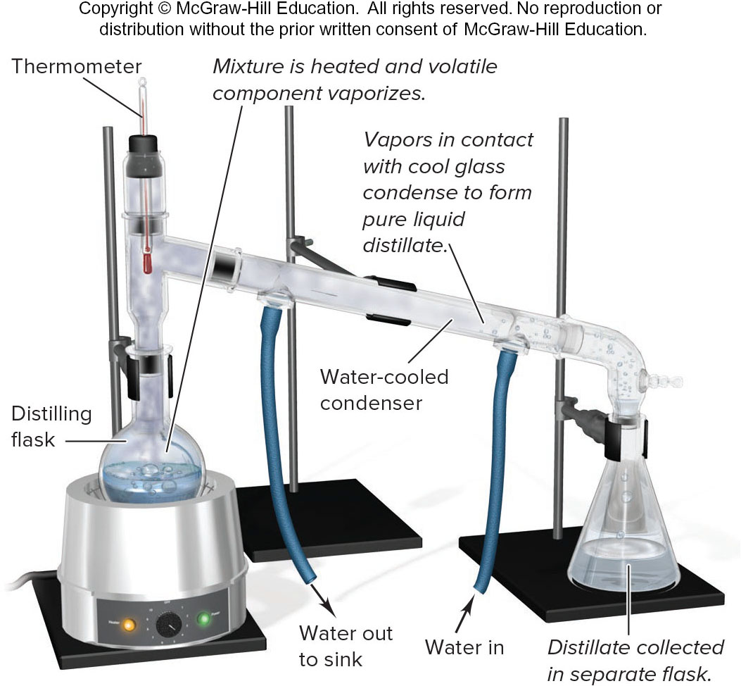
Distillation
Figure B2.3

Slide 89
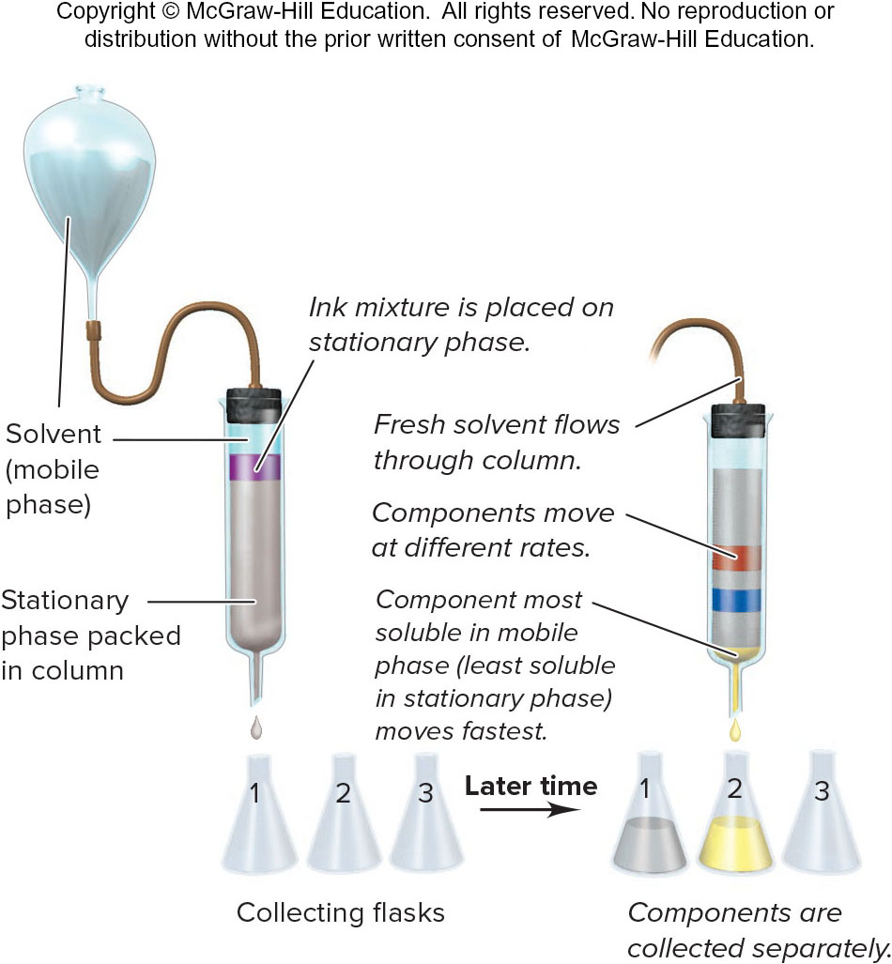
Procedure for column chromatography
Figure B2.4

Slide 90
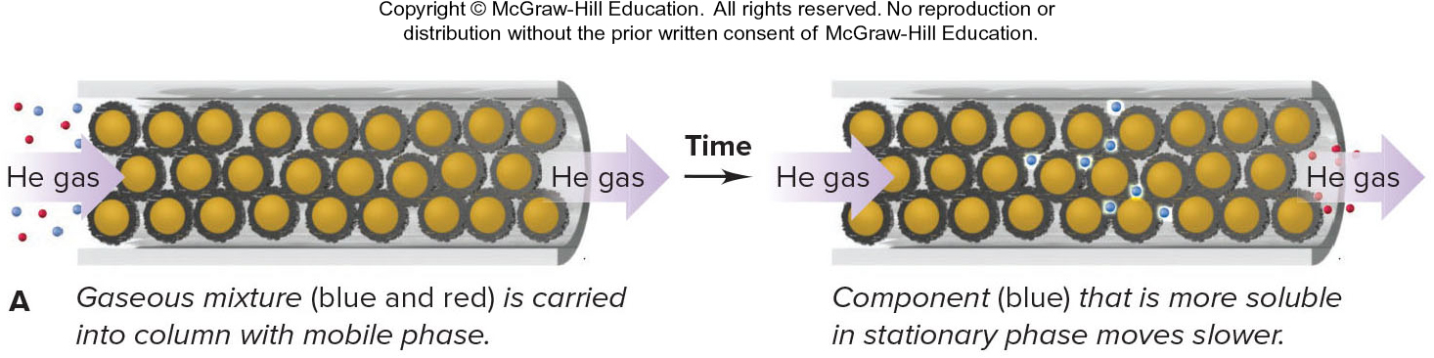
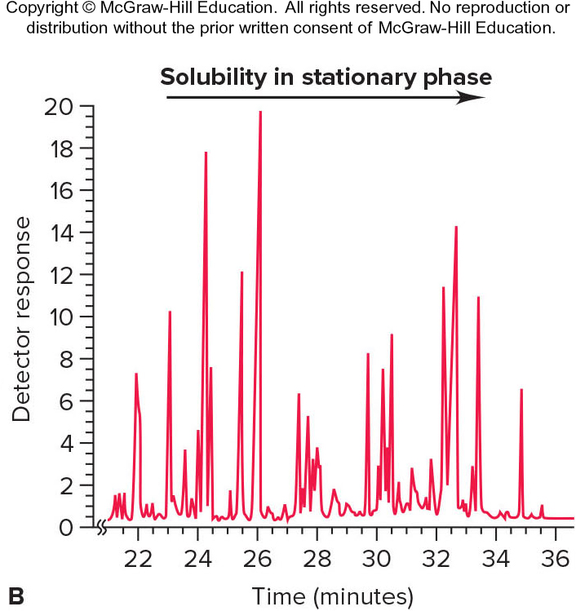
Principle of gas-liquid chromatography (GLC)
Figure B2.5

