Slide 1
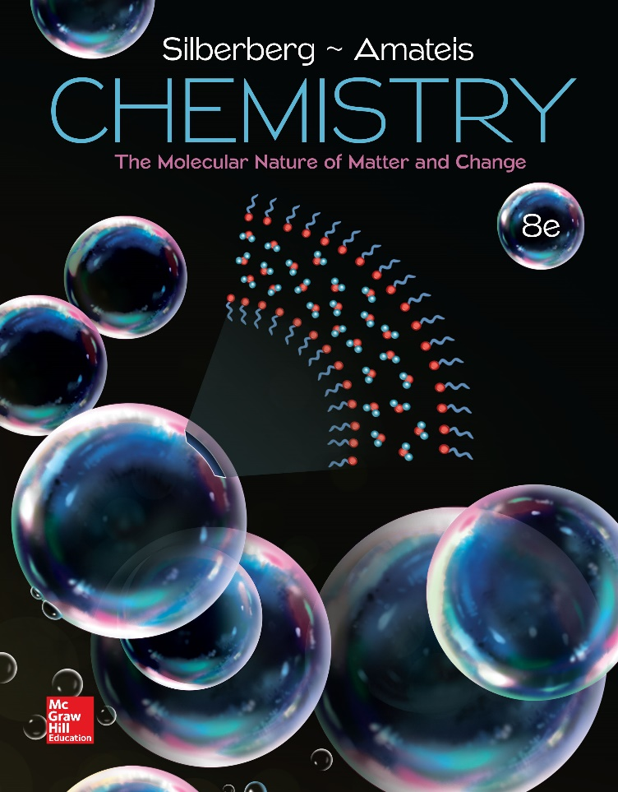
Chemistry
The Molecular Nature of Matter and Change Eighth Edition
Martin S. Silberberg and Patricia G. Amateis

Slide 2
Chapter 3: Stoichiometry of Formulas and Equations
3.1 The Mole
3.2 Determining the Formula of an Unknown Compound
3.3 Writing and Balancing Chemical Equations
3.4 Calculating Quantities of Reactant and Product

Slide 3
The Mole
The mole (mol) is the amount of a substance that contains the same number of entities as there are atoms in exactly 12 g of carbon-12.
  The term “entities” refers to atoms, ions, molecules, formula units, or electrons – in fact, any type of particle.
One mole (1 mol) contains 6.022x10²³ entities (to four significant figures).
  This number is called Avogadro’s number and is abbreviated as N.

Slide 4
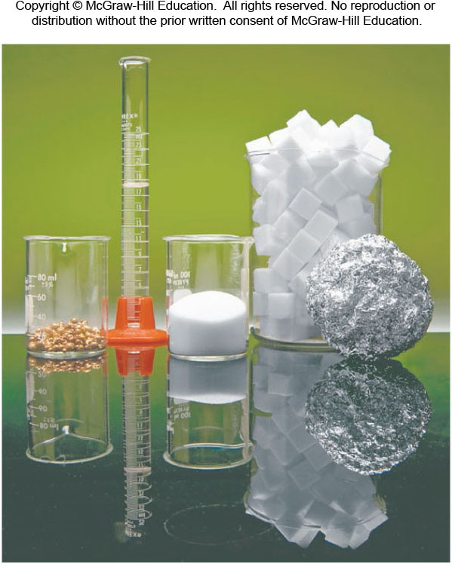
One Mole of Some Familiar Substances
Fig 3.1
© McGraw-Hill Education/Charles Winters/Timeframe Photography, Inc.

Slide 5
Molar Mass
The molar mass (M) of a substance is the mass per mole of its entities (atoms, molecules, or formula units).
For monatomic elements, the molar mass is the same as the atomic mass in grams per mole. The atomic mass is simply read from the Periodic Table.
  The molar mass of Ne = 20.18 g/mol.
Notes:
5

Slide 6
Molar Mass, Cont’d
For molecular elements and for compounds, the formula is needed to determine the molar mass.
The molar mass of O₂ = 2 x M of O
= 2 x 16.00 g/mol
= 32.00 g/mol
The molar mass of SO₂ = 1 x M of S + 2 x M of O
= [32.00 + 2(16.00)] g/mol
= 64.00 g/mol

Slide 7
Chemical Formula of Glucose C₆H₁₂O₆
 | Carbon (C) | Hydrogen (H) | Oxygen (O)
Atoms/molecule of compound | 6 atoms | 12 atoms | 6 atoms
Moles of atoms/mole of compound | 6 mol of atoms | 12 mol of atoms | 6 mol of atoms
Atoms/mole of compound | 6(6.022x10²³) atoms | 12(6.022x10²³) atoms | 6(6.022x10²³) atoms
Mass/molecule of compound | 6(12.01 amu) = 72.06 amu | 12(1.008 amu) = 12.10 amu | 6(16.00 amu) = 96.00 amu
Mass/mole of compound | 72.06 g | 12.10 g | 96.00 g
Table 3.1

Slide 8
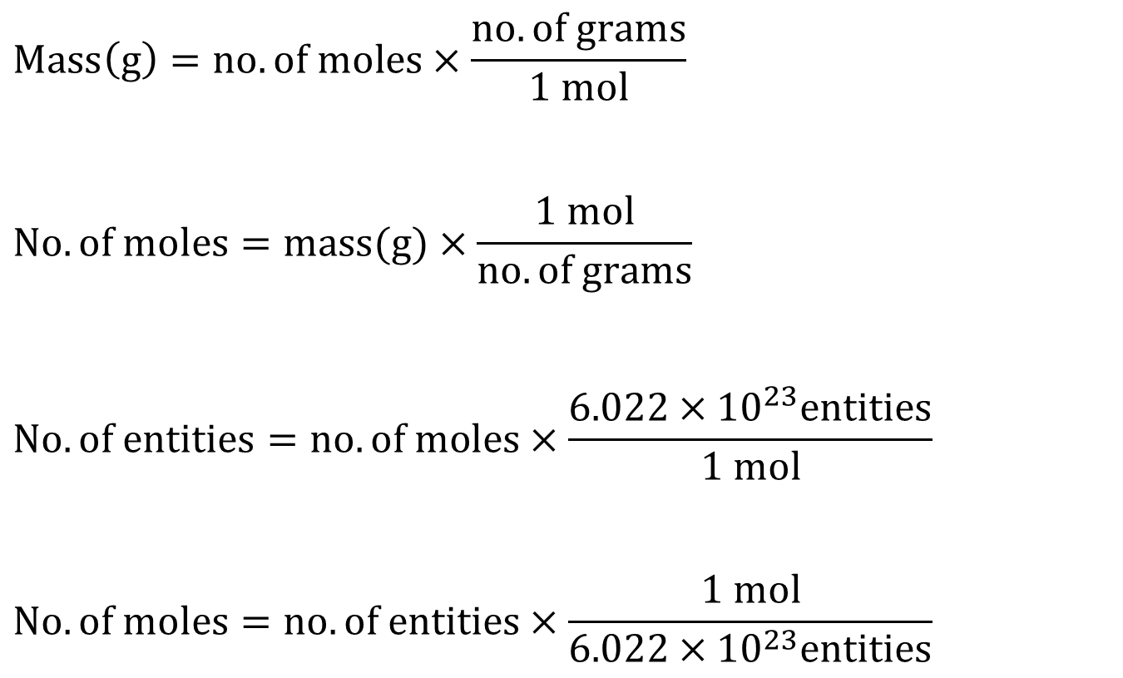
Interconverting Moles, Mass, and Number of Chemical Entities
$$Mass\left(g\right)=no. of moles×\frac{no. of grams}{1 mol}$$
$$No. of moles=mass(g)×\frac{1 mol}{no. of grams}$$
$$No. of entities=no. of moles×\frac{6.022×{10}^{23}entities}{1 mol}$$
$$No. of moles=no. of entities×\frac{1 mol}{6.022×{10}^{23}entities}$$

Slide 9
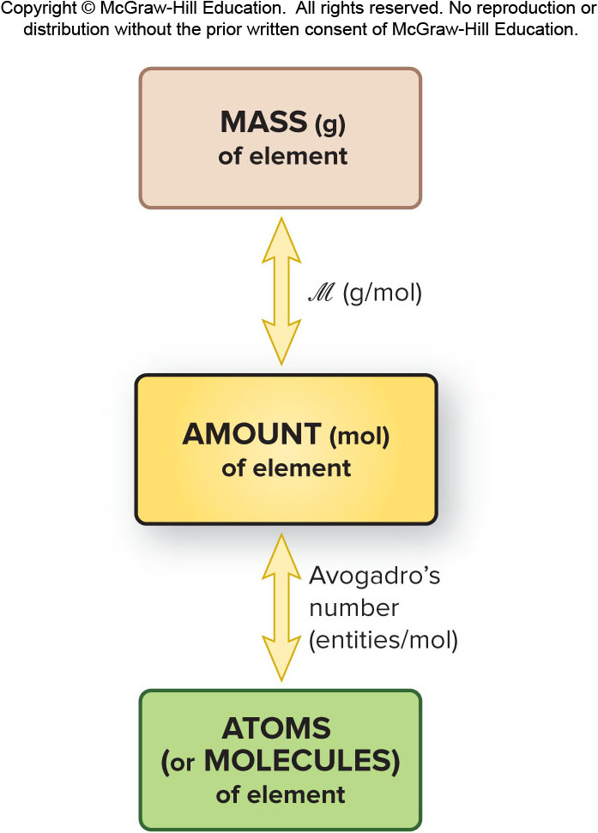
Mass-mole-number Relationships for Elements
Fig 3.2

Slide 10
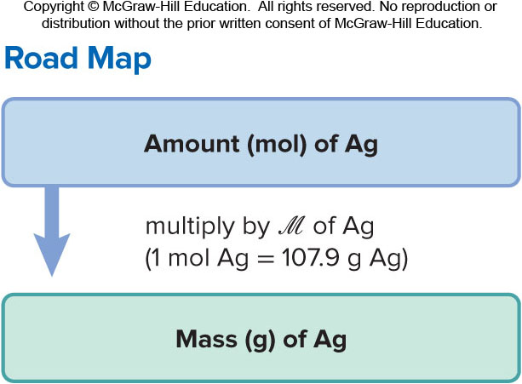
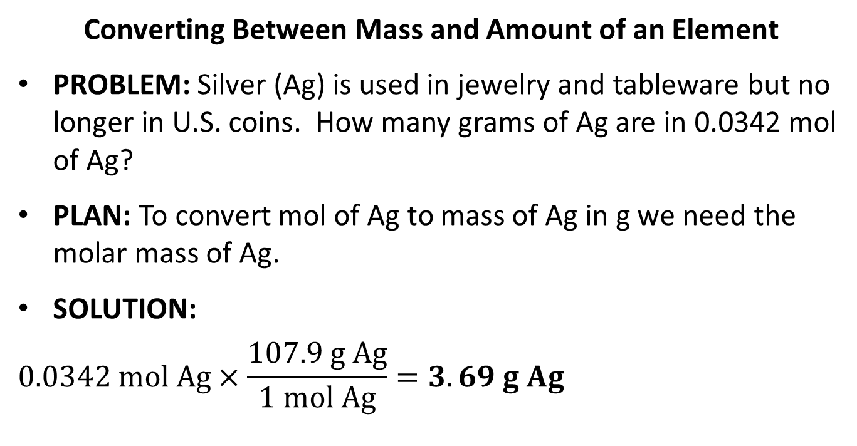
Sample Problem 3.1 – Problem, Plan and Solution
Converting Between Mass and Amount of an Element
PROBLEM: Silver (Ag) is used in jewelry and tableware but no longer in U.S. coins. How many grams of Ag are in 0.0342 mol of Ag?
PLAN: To convert mol of Ag to mass of Ag in g we need the molar mass of Ag.
SOLUTION:
$$0.0342 mol Ag×\frac{107.9 g Ag}{1 mol Ag}=3.69 g Ag$$

Slide 11
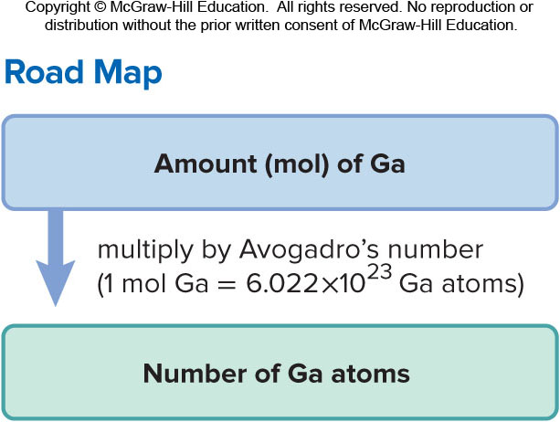
Sample Problem 3.2 - Problem and Plan
Converting Between Number of Entities and Amount of an Element
PROBLEM: Gallium (Ga) is a key element in solar panels, calculators and other light-sensitive electronic devices. How many Ga atoms are in 2.85 x 10⁻³ mol of gallium?
PLAN: To convert mol of Ga to number of Ga atoms we need to use Avogadro’s number.

Slide 12

Sample Problem 3.2 - Solution
SOLUTION:
$$2.85×{10}^{−3} mol Ga atoms×\frac{6.022×{10}^{23} Ga atoms}{1 mol Ga atoms}=1.72×{10}^{21} Ga atoms$$

Slide 13
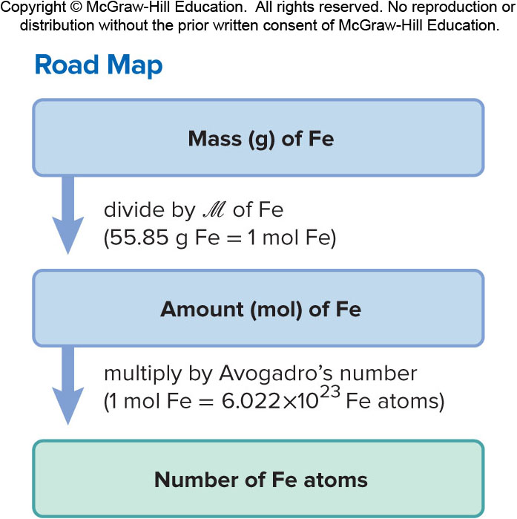
Sample Problem 3.3 – Problem and Plan
Converting Between Number of Entities and Mass of an Element
PROBLEM: Iron (Fe) is the main component of steel and is therefore the most important metal in society; it is also essential in the body. How many Fe atoms are in 95.8 g of Fe?
PLAN: The number of atoms cannot be calculated directly from the mass. We must first determine the number of moles of Fe atoms in the sample and then use Avogadro’s number.

Slide 14

Sample Problem 3.3 - Solution
SOLUTION:
$$95.8 g Fe×\frac{1 mol Fe}{55.85 g Fe}=1.72 mol Fe$$
$$1.72 mol Fe×\frac{6.022×{10}^{23} atoms Fe}{1 mol Fe}=1.04×{10}^{24} atoms Fe$$

Slide 15
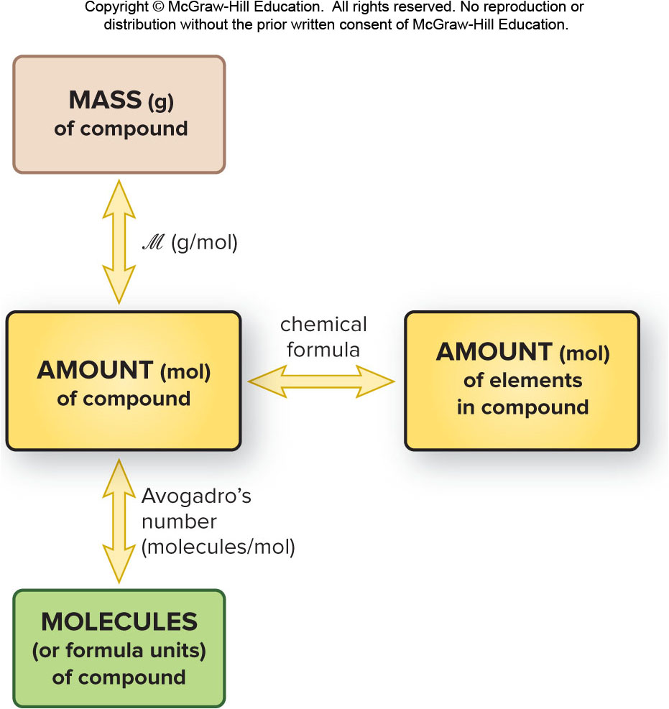
Amount-Mass-Number Relationship
Fig 3.3

Slide 16
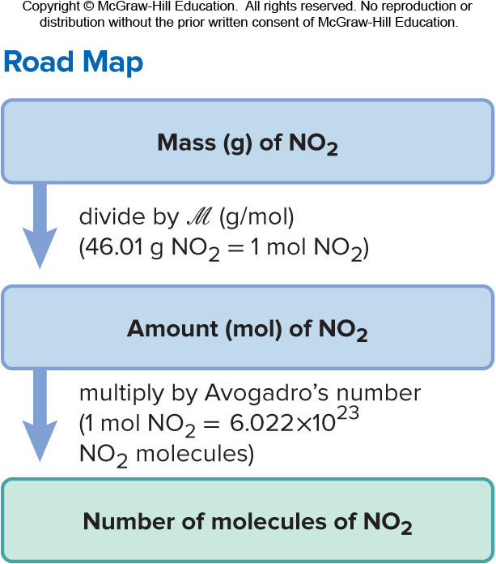
Sample Problem 3.4 – Problem and Plan
Converting Between Number of Entities and Mass of Compound I
PROBLEM: Nitrogen dioxide is a component of urban smog that forms from the gases in car exhausts. How many molecules are in 8.92 g of nitrogen dioxide?
PLAN: Write the formula for the compound and calculate its molar mass. Use the given mass to calculate first the number of moles and then the number of molecules.

Slide 17
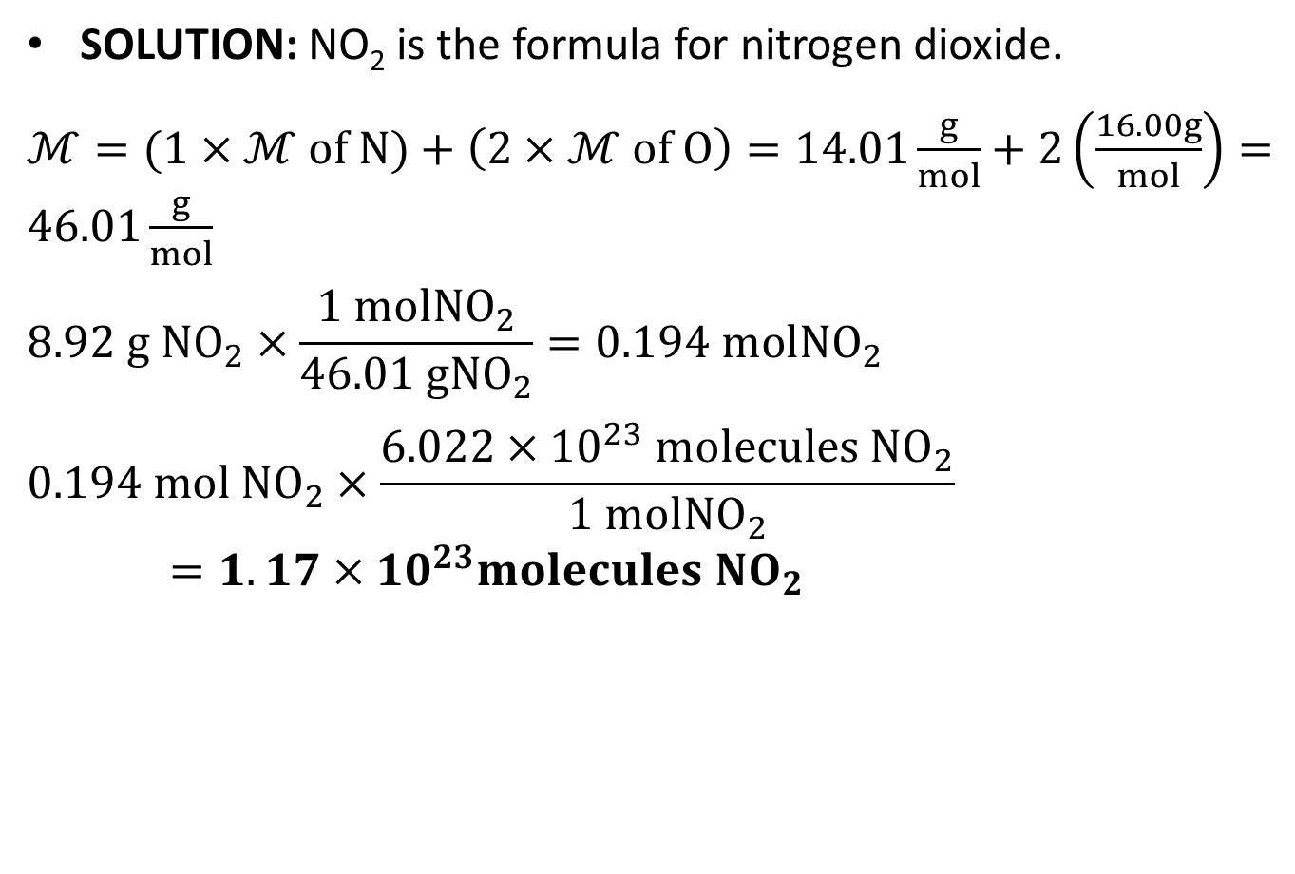
Sample Problem 3.4 - Solution
SOLUTION: NO₂ is the formula for nitrogen dioxide.
$ℳ=(1×$ $ℳ of N)+\left(2×ℳ of O\right)=14.01\frac{g}{mol}+2\left(\frac{16.00g}{mol}\right)=46.01\frac{g}{mol}$
$$8.92 g {NO}_{2}×\frac{1 mol{NO}_{2}}{46.01 g{NO}_{2}}=0.194 mol{NO}_{2}$$
$$0.194 mol {NO}_{2}×\frac{6.022×{10}^{23} molecules {NO}_{2}}{1 mol{NO}_{2}}=1.17×{10}^{23}{molecules NO}_{2}$$
Notes:
17

Slide 18
Sample Problem 3.5 – Problem and Plan
Converting Between Number of Entities and Mass of Compound II
PROBLEM: Ammonium carbonate, a white solid that decomposes on warming, is an component of baking powder.
How many formula units are in 41.6 g of ammonium carbonate?
b) How many O atoms are in this sample?
PLAN: Write the formula for the compound and calculate its molar mass. Use the given mass to calculate first the number of moles and then the number of formula units. The number of O atoms can be determined using the formula and the number of formula units.
Notes:
18

Slide 19
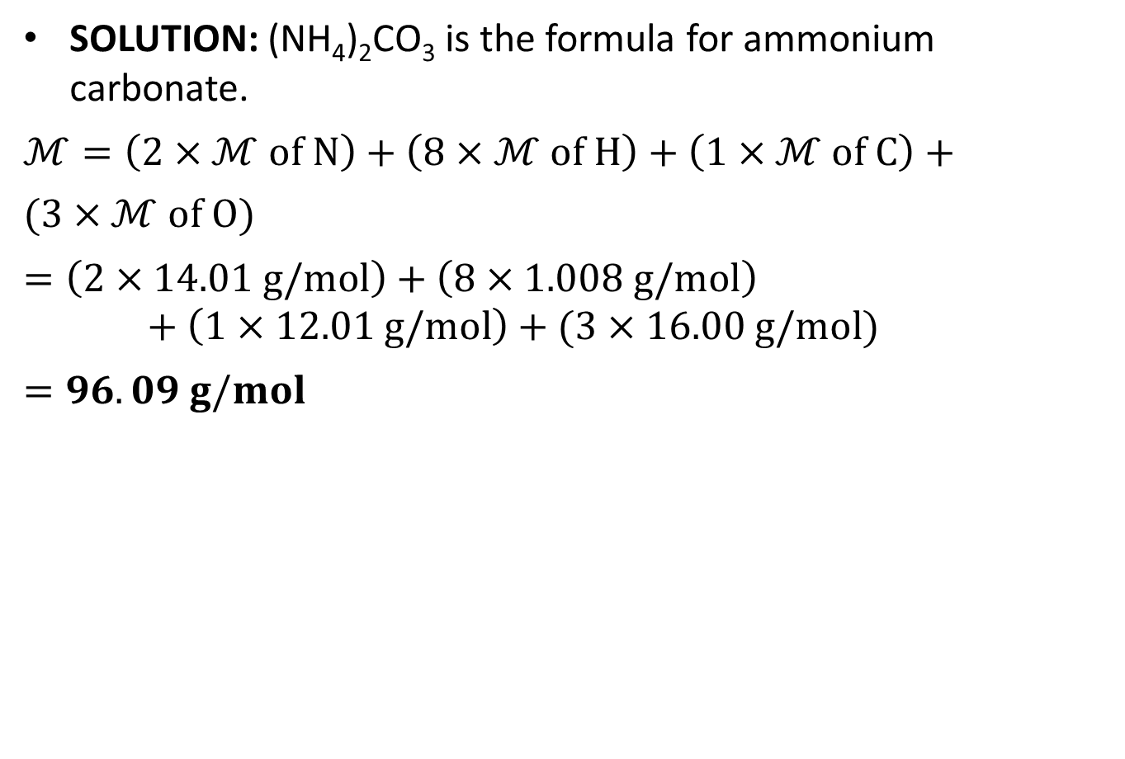
Sample Problem 3.5 - Solution
SOLUTION: (NH₄)₂CO₃ is the formula for ammonium carbonate.
$$ℳ=\left(2×ℳ of N\right)+\left(8×ℳ of H\right)+\left(1×ℳ of C\right)+$$
$$(3×ℳ of O)$$
$$=\left(2×14.01 g/mol\right)+\left(8×1.008 g/mol\right)+\left(1×12.01 g/mol\right)+(3×16.00 g/mol)$$
$$=96.09 g/mol$$
Notes:
19

Slide 20
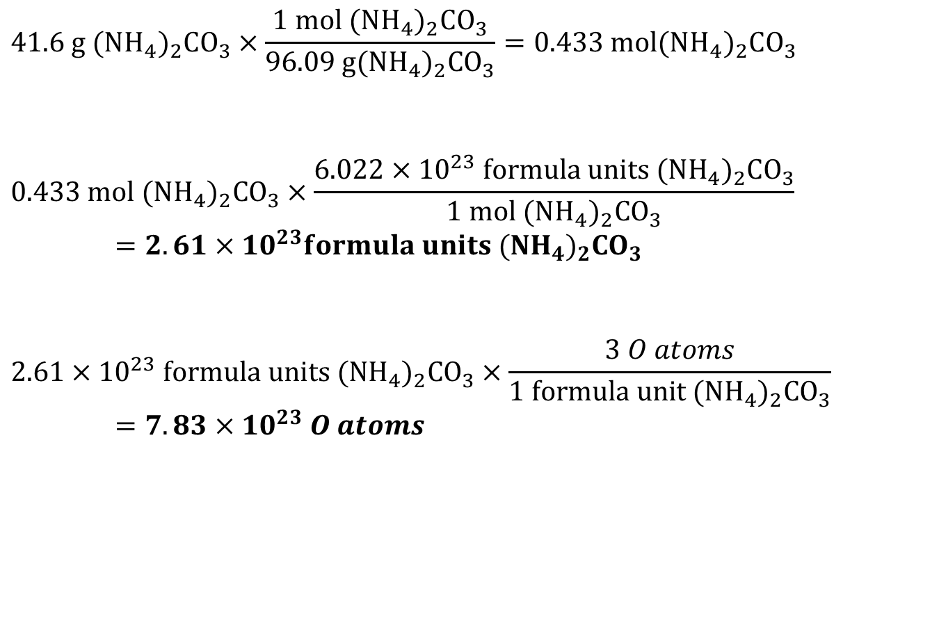
Sample Problem 3.5 – Solution, Cont’d
$$41.6 g ({NH}_{4})_{2}CO_{3}×\frac{1 mol ({NH}_{4})_{2}CO_{3}}{96.09 g({NH}_{4})_{2}CO_{3}}=0.433 mol({NH}_{4})_{2}CO_{3}$$
$$0.433 mol ({NH}_{4})_{2}CO_{3}×\frac{6.022×{10}^{23} formula units ({NH}_{4})_{2}CO_{3}}{1 mol ({NH}_{4})_{2}CO_{3}}=2.61×{10}^{23}formula units ({NH}_{4})_{2}CO_{3}$$
$$2.61×{10}^{23} formula units ({NH}_{4})_{2}CO_{3}×\frac{3 O atoms}{1 formula unit ({NH}_{4})_{2}CO_{3}}=7.83×{10}^{23} O atoms$$
Notes:
20

Slide 21
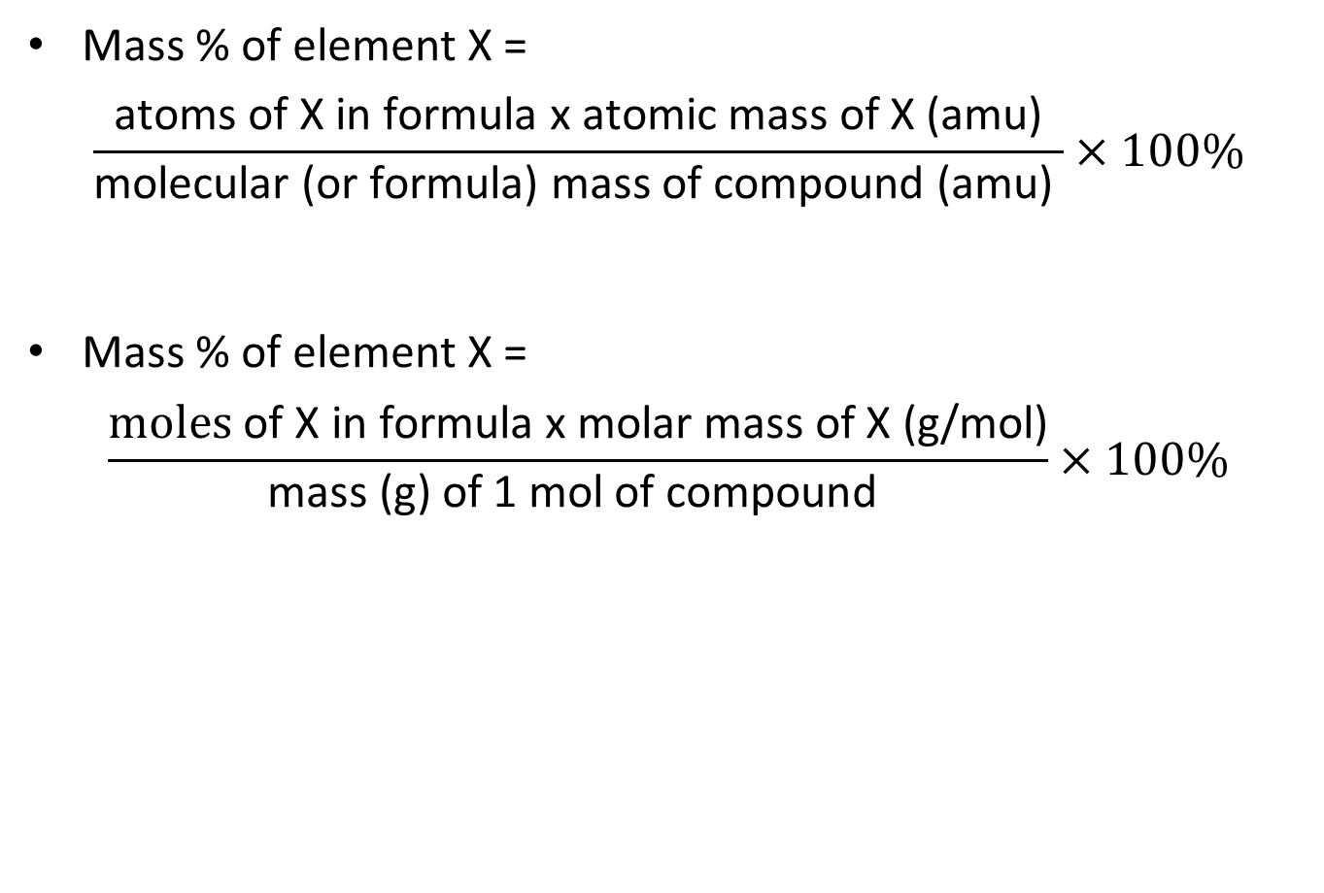
Mass Percent from the Chemical Formula
Mass % of element X =
$$\frac{\text{atoms} \text{of} \text{X} \text{in} \text{formula} \text{x} \text{atomic} \text{mass} \text{of} \text{X}\text{ (}\text{amu}\text{)}}{\text{molecular}\text{ (}\text{or} \text{formula}\text{) }\text{mass} \text{of} \text{compound}\text{ (}\text{amu}\text{) }}×100\%$$
Mass % of element X =
$$\frac{\text{moles} \text{of} \text{X} \text{in} \text{formula} \text{x} \text{molar} \text{mass} \text{of} \text{X}\text{ (}\text{g}\text{/}\text{mol}\text{)}}{\text{m}\text{ass}\text{ (}\text{g}\text{) }\text{of}\text{ 1 }\text{mol} \text{of} \text{compound} }×100\%$$

Slide 22
Sample Problem 3.6 – Problem and Plan
Calculating the Mass Percent of Each Element in a Compound from the Formula
PROBLEM: The effectiveness of fertilizers depends upon their nitrogen content. Ammonium nitrate is a common fertilizer. What is the mass percent of each element in ammonium nitrate?
PLAN: We know the relative amounts (mol) of the elements from the formula and we have to find the mass % of each element. We multiply the amount of each by its molar mass to find its mass. Dividing each mass by the mass of 1 mol of ammonium nitrate gives the mass fraction of each element, and multiplying by 100 gives each mass %. The calculation steps for any element (X) are shown in the road map.

Slide 23
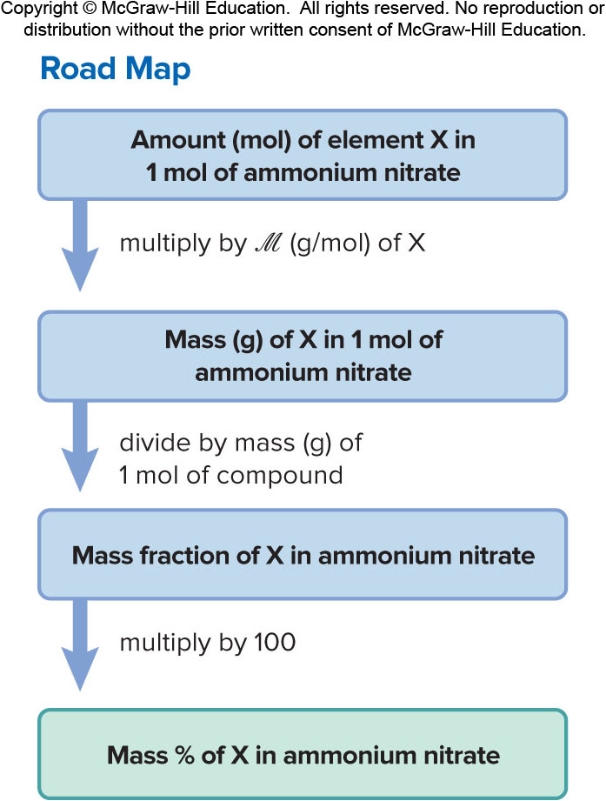
Sample Problem 3.6 – Plan, Cont’d
Notes:
23

Slide 24
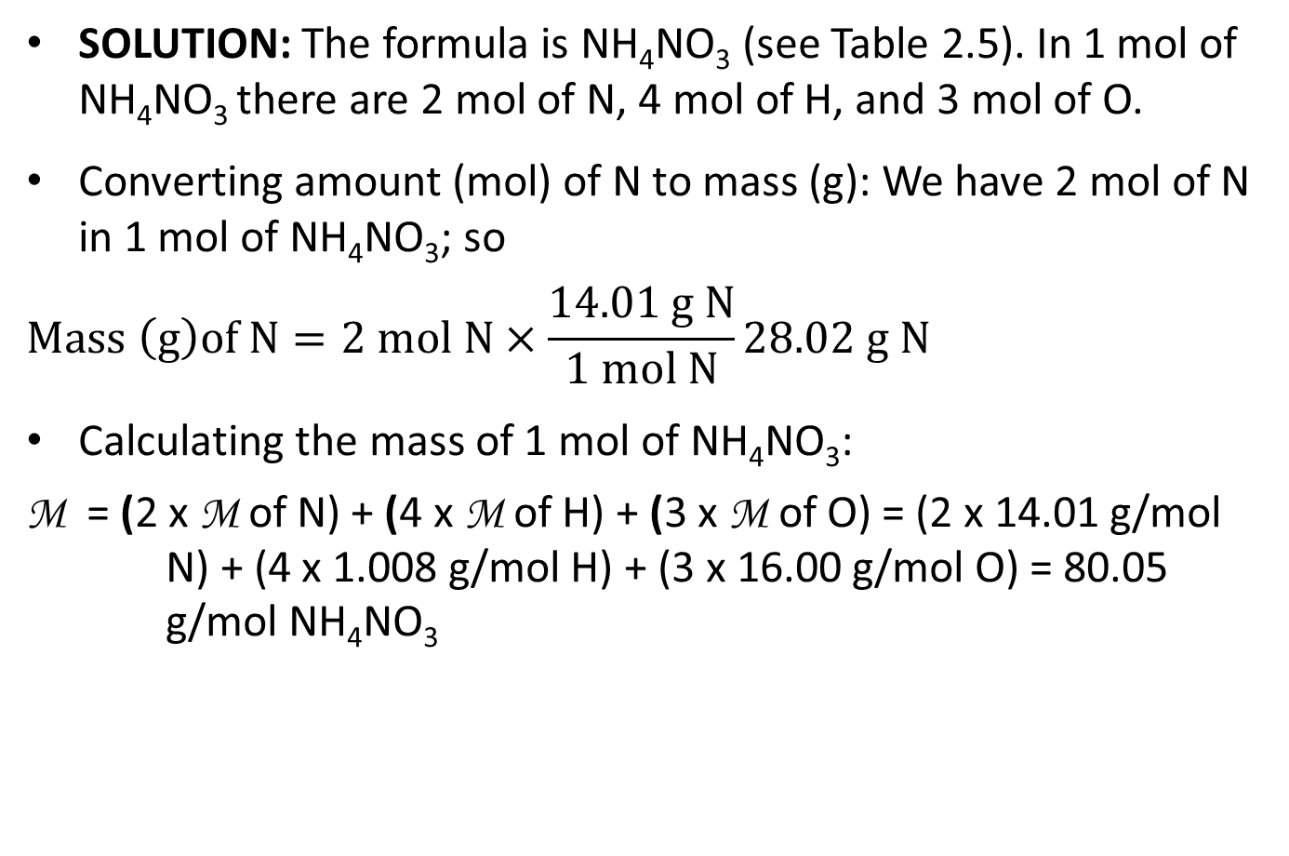
Sample Problem 3.6 - Solution
SOLUTION: The formula is NH₄NO₃ (see Table 2.5). In 1 mol of NH₄NO₃ there are 2 mol of N, 4 mol of H, and 3 mol of O.
Converting amount (mol) of N to mass (g): We have 2 mol of N in 1 mol of NH₄NO₃; so
$$Mass \left(g\right)of N=2 mol N×\frac{14.01 g N}{1 mol N}28.02 g N$$
Calculating the mass of 1 mol of NH₄NO₃:
$$\text{M} \text{=}\text{ (}\text{2 }\text{x} \text{M} \text{of} \text{N}\text{) + }\text{(}\text{4 }\text{x} \text{M} \text{of} \text{H}\text{) + }\text{(}\text{3 }\text{x} \text{M} \text{of} \text{O}\text{) = (2 }\text{x}\text{ 14.01 }\text{g}\text{/}\text{mol} \text{N}\text{) + (4 }\text{x}\text{ 1.008 }\text{g}\text{/}\text{mol} \text{H}\text{) + (3 }\text{x}\text{ 16.00 }\text{g}\text{/}\text{mol} \text{O}\text{) = 80.05 }\text{g}\text{/}\text{mol} \text{NH}\text{4}\text{NO}\text{3}$$
Notes:
24

Slide 25
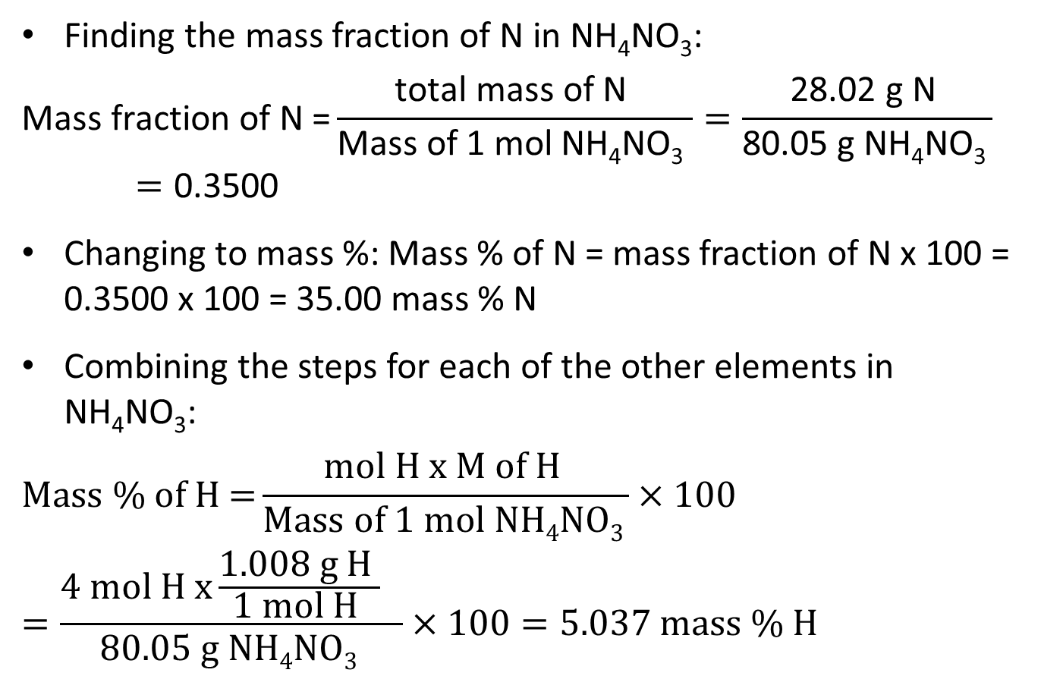
Sample Problem 3.6 – Solution, Cont’d
Finding the mass fraction of N in NH₄NO₃:
$$\text{Mass} \text{fraction} \text{of} \text{N}\text{ =}\frac{\text{total} \text{mass} \text{of} \text{N} }{\text{Mass} \text{of}\text{ 1 }\text{mol} \text{NH}\text{4}\text{NO}\text{3} }=\frac{\text{28.02 }\text{g} \text{N} }{\text{80.05 }\text{g} \text{NH}\text{4}\text{NO}\text{3 }}=\text{0.3500}$$
Changing to mass %: Mass % of N = mass fraction of N x 100 = 0.3500 x 100 = 35.00 mass % N
Combining the steps for each of the other elements in NH₄NO₃:
$$\text{Mass}\text{ \% }\text{of} \text{H}\text{ =}\frac{\text{mol} \text{H} \text{x} \text{M} \text{of} \text{H} }{\text{Mass} \text{of}\text{ 1 }\text{mol} \text{NH}\text{4}\text{NO}\text{3 }}×100$$
$$=\frac{\text{4 }\text{mol} \text{H} \text{x}\frac{\text{1.008 }\text{g} \text{H} }{\text{1 }\text{mol} \text{H} } }{\text{80.05 }\text{g} \text{NH}\text{4}\text{NO}\text{3 }}×100=5.037 mass \% H$$
Notes:
25

Slide 26
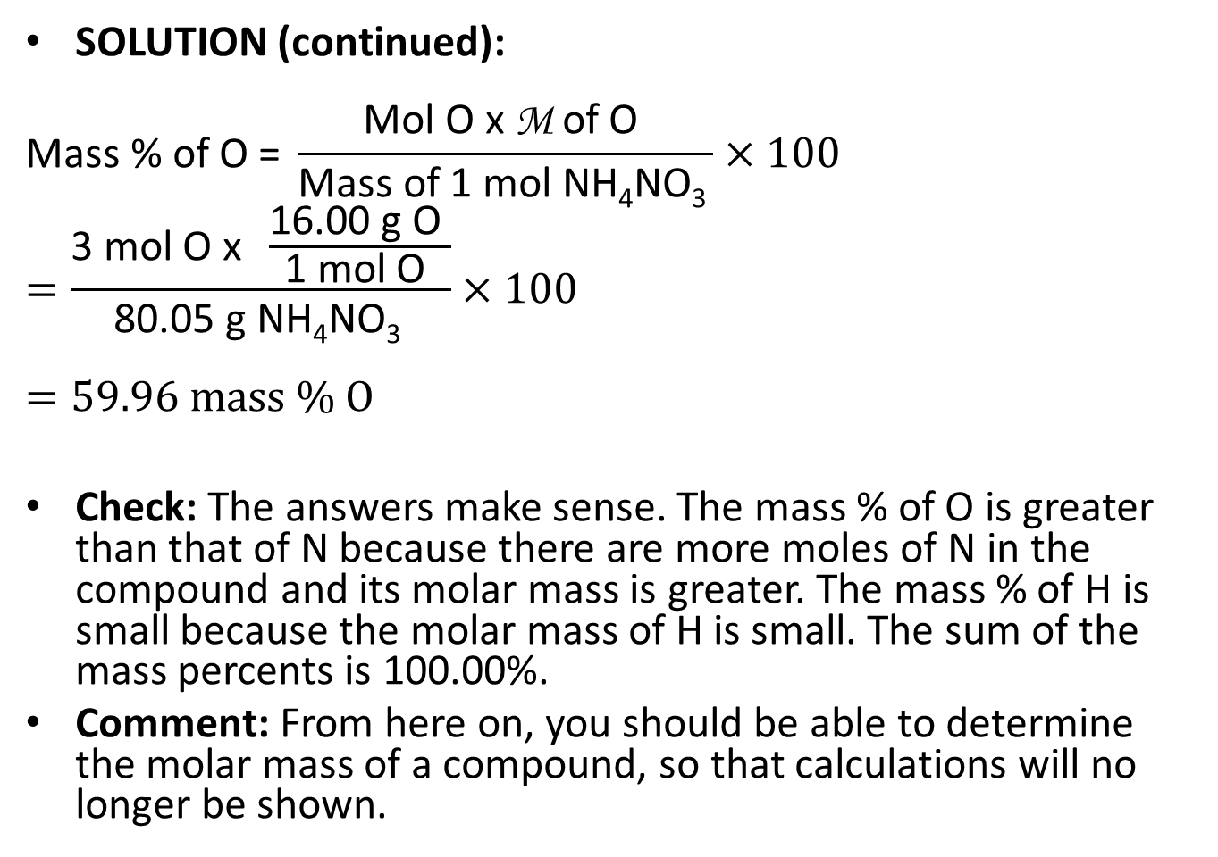
Sample Problem 3.6 - Check
SOLUTION (continued):
$$\text{Mass}\text{ \% }\text{of} \text{O}\text{ = }\frac{\text{Mol} \text{O} \text{x} \text{M} \text{of} \text{O} }{\text{Mass} \text{of}\text{ 1 }\text{mol} \text{NH}\text{4}\text{NO}\text{3 }}×100$$
$$=\frac{\text{3 }\text{mol} \text{O} \text{x} \frac{\text{16.00 }\text{g} \text{O} }{\text{1 }\text{mol} \text{O} }}{\text{80.05 }\text{g} \text{NH}\text{4}\text{NO}\text{3 }}×100$$
$$=59.96 mass \% O$$
Check: The answers make sense. The mass % of O is greater than that of N because there are more moles of N in the compound and its molar mass is greater. The mass % of H is small because the molar mass of H is small. The sum of the mass percents is 100.00%.
Comment: From here on, you should be able to determine the molar mass of a compound, so that calculations will no longer be shown.
Notes:
26

Slide 27

Mass Fraction and the Mass of an Element
Mass fraction can also be used to calculate the mass of a particular element in any mass of a compound.
Mass of any element in sample =
$$\text{mass} \text{of} \text{compound} \text{x}\frac{\text{mass} \text{of} \text{element} \text{in}\text{ 1 }\text{mol} \text{of} \text{compound} }{\text{mass} \text{of}\text{ 1 }\text{mol} \text{of} \text{compound} }$$
Notes:
27

Slide 28
Sample Problem 3.7 – Problem and Plan
Calculating the Mass of an Element in a Compound
PROBLEM: Use the information from Sample Problem 3.6 to determine the mass (g) of nitrogen in 650. g of ammonium nitrate.
PLAN: The mass fraction of nitrogen in ammonium nitrate gives us the relative mass of nitrogen in 1 mole of ammonium nitrate. We can use this information to find the mass of nitrogen in any sample of ammonium nitrate.
Notes:
28

Slide 29
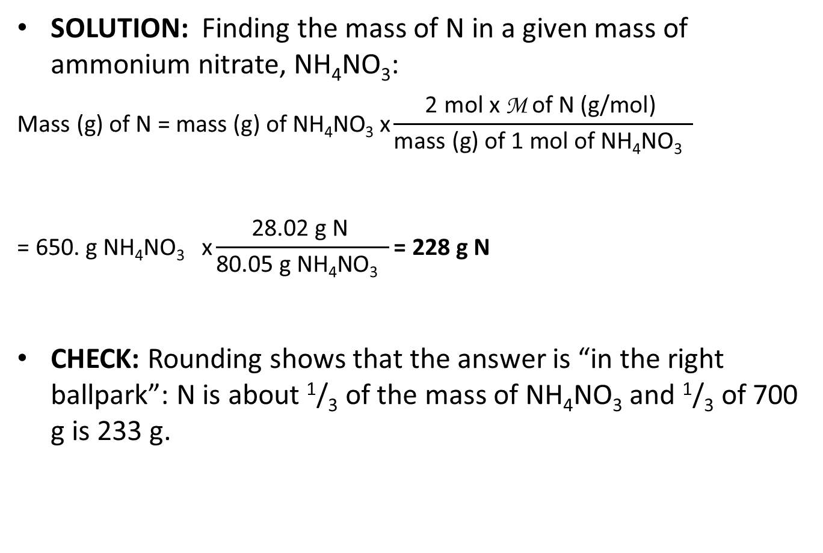
Sample Problem 3.7 - Solution
SOLUTION: Finding the mass of N in a given mass of ammonium nitrate, NH₄NO₃:
$$\text{Mass}\text{ (}\text{g}\text{) }\text{of} \text{N}\text{ = }\text{mass}\text{ (}\text{g}\text{) }\text{of} \text{NH}\text{4}\text{NO}\text{3} \text{x}\frac{\text{2 }\text{mol} \text{x} \text{M} \text{of} \text{N}\text{ (}\text{g}\text{/}\text{mol}\text{)} }{\text{mass}\text{ (}\text{g}\text{) }\text{of}\text{ 1 }\text{mol} \text{of} \text{NH}\text{4}\text{NO}\text{3} }$$
$$\text{= 650. }\text{g} \text{NH}\text{4}\text{NO}\text{3} \text{x}\frac{\text{28.02 }\text{g} \text{N} }{\text{80.05 }\text{g} \text{NH}\text{4}\text{NO}\text{3} }\text{= 228 }\text{g} \text{N}$$
CHECK: Rounding shows that the answer is “in the right ballpark”: N is about ¹/₃ of the mass of NH₄NO₃ and ¹/₃ of 700 g is 233 g.

Slide 30
Empirical and Molecular Formulas
The empirical formula is the simplest formula for a compound that agrees with the elemental analysis. It shows the lowest whole number of moles and gives the relative number of atoms of each element present.
  The empirical formula for hydrogen peroxide is HO.
The molecular formula shows the actual number of atoms of each element in a molecule of the compound.
  The molecular formula for hydrogen peroxide is H₂O₂.

Slide 31
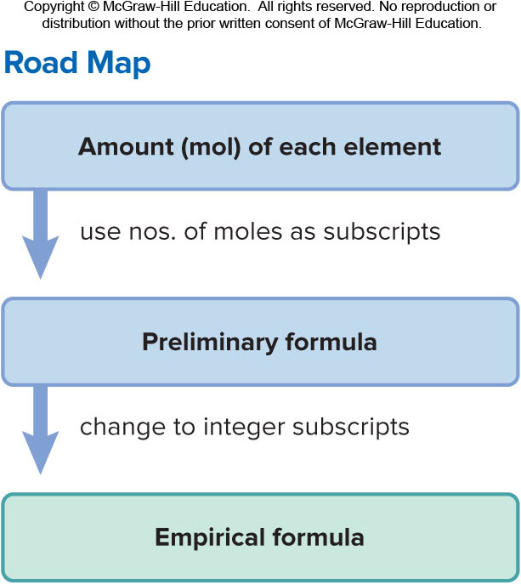
Sample Problem 3.8 – Problem and Plan
Determining an Empirical Formula from Amounts of Elements
PROBLEM: A sample of an unknown compound contains 0.21 mol of zinc, 0.14 mol of phosphorus, and 0.56 mol of oxygen. What is its empirical formula?
PLAN: Find the relative number of moles of each element. Divide by the lowest mol amount to find the relative mol ratios (empirical formula).

Slide 32
Sample Problem 3.8 - Solution
SOLUTION: Using the numbers of moles of each element given, we write the preliminary formula Zn_{0.21}P_{0.14}O_{0.56.}
Next we divide each fraction by the smallest one; in this case 0.14:
0.21/0.14 = 1.5 0.14/0.14 = 1.0 0.56/0.14 = 4.0
This gives Zn_{1.5}P_{1.0}O_{4.0}
We convert to whole numbers by multiplying by the smallest integer that gives whole numbers; in this case 2:
1.5 x 2 = 3 1.0 x 2 = 2 4.0 x 2 = 8
This gives us the empirical formula Zn₃P₂O₈

Slide 33
Sample Problem 3.9 – Problem and Plan
Determining an Empirical Formula from Masses of Elements
PROBLEM: Analysis of a sample of an ionic compound yields 2.82 g of Na, 4.35 g of Cl, and 7.83 g of O. What is the empirical formula and the name of the compound?
PLAN: Find the relative number of moles of each element. Divide by the lowest mol amount to find the relative mol ratios (empirical formula).
Notes:
33

Slide 34
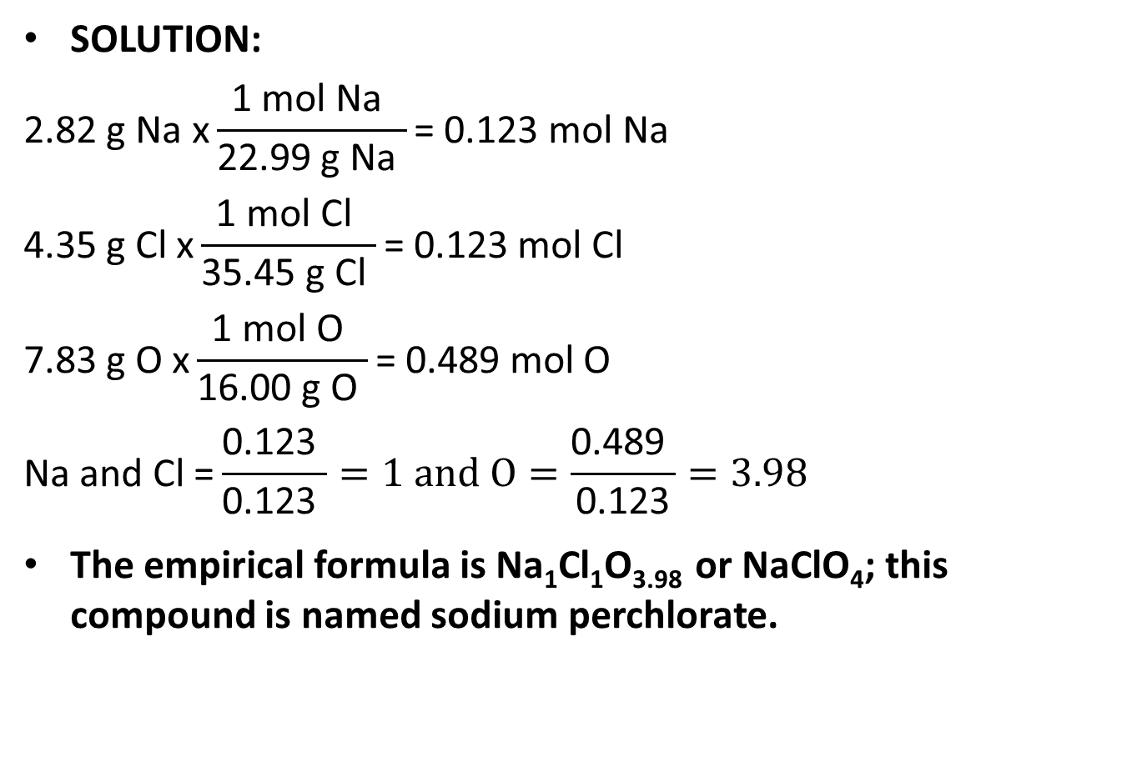
Sample Problem 3.9 - Solution
SOLUTION:
$$\text{2.82 }\text{g} \text{Na} \text{x}\frac{\text{1 }\text{mol} \text{Na} }{\text{22.99 }\text{g} \text{Na} }\text{= 0.123 }\text{mol} \text{Na}$$
$$\text{4.35 }\text{g} \text{Cl} \text{x}\frac{\text{1 }\text{mol} \text{Cl} }{\text{35.45 }\text{g} \text{Cl} }\text{= 0.123 }\text{mol} \text{Cl}$$
$$\text{7.83 }\text{g} \text{O} \text{x}\frac{\text{1 }\text{mol} \text{O} }{\text{16.00 }\text{g} \text{O} }\text{= 0.489 }\text{mol} \text{O}$$
$$\text{Na} \text{and} \text{Cl}\text{ =}\frac{\text{0.123} }{\text{0.123} }=1 and O=\frac{\text{0.489} }{\text{0.123}}=3.98$$
The empirical formula is Na₁Cl₁O_{3.98} or NaClO₄; this compound is named sodium perchlorate.
Notes:
34

Slide 35

Determining the Molecular Formula
The molecular formula gives the actual numbers of moles of each element present in 1 mol of compound.
The molecular formula is a whole-number multiple of the empirical formula.
$$\frac{\text{molar} \text{mass}\text{ (}\text{g}\text{/}\text{mol}\text{) }}{\text{empirical} \text{formula} \text{mass}\text{ (}\text{g}\text{/}\text{mol}\text{) }}\text{= }\text{whole}\text{−}\text{number} \text{multiple}$$
Notes:
35

Slide 36
Sample Problem 3.10 – Problem and Plan
Determining a Molecular Formula from Elemental Analysis and Molar Mass
PROBLEM: During excessive physical activity, lactic acid ( M = 90.08 g/mol) forms in muscle tissue and is responsible for muscle soreness. Elemental analysis shows that this compound has 40.0 mass % C, 6.71 mass % H, and 53.3 mass % O.
a) Determine the empirical formula of lactic acid.
b) Determine the molecular formula.
c) Determine the empirical formula
PLAN: Assume 100g of sample

Slide 37
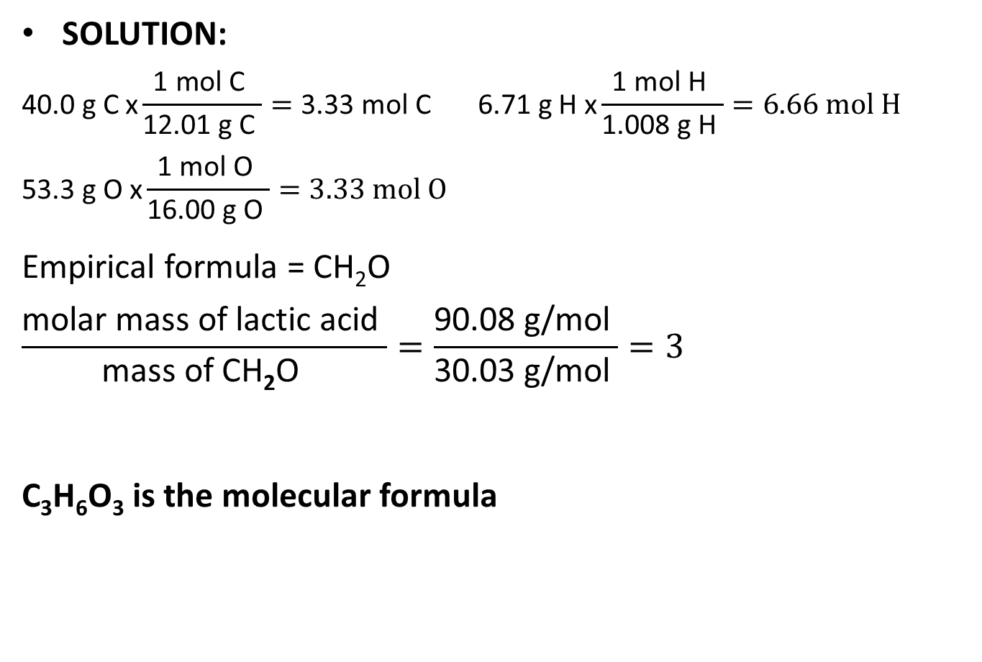
Sample Problem 3.10 - Solution
SOLUTION:
$$\text{40.0 }\text{g} \text{C} \text{x}\frac{\text{1 }\text{mol} \text{C} }{\text{12.01 }\text{g} \text{C} }=\text{3.33 }\text{mol} \text{C} \text{6.71 }\text{g} \text{H} \text{x}\frac{\text{1 }\text{mol} \text{H} }{\text{1.008 }\text{g} \text{H} }=6.66 mol H$$
$$\text{53.3 }\text{g} \text{O} \text{x}\frac{\text{1 }\text{mol} \text{O} }{\text{16.00 }\text{g} \text{O} }=3.33 mol O$$
Empirical formula = CH₂O
$$\frac{\text{molar} \text{mass} \text{of} \text{lactic} \text{acid} }{\text{mass} \text{of} \text{CH}\text{2}\text{O} }=\frac{\text{90.08 }\text{g}\text{/}\text{mol} }{\text{30.03 }\text{g}\text{/}\text{mol} }=3$$
C₃H₆O₃ is the molecular formula

Slide 38
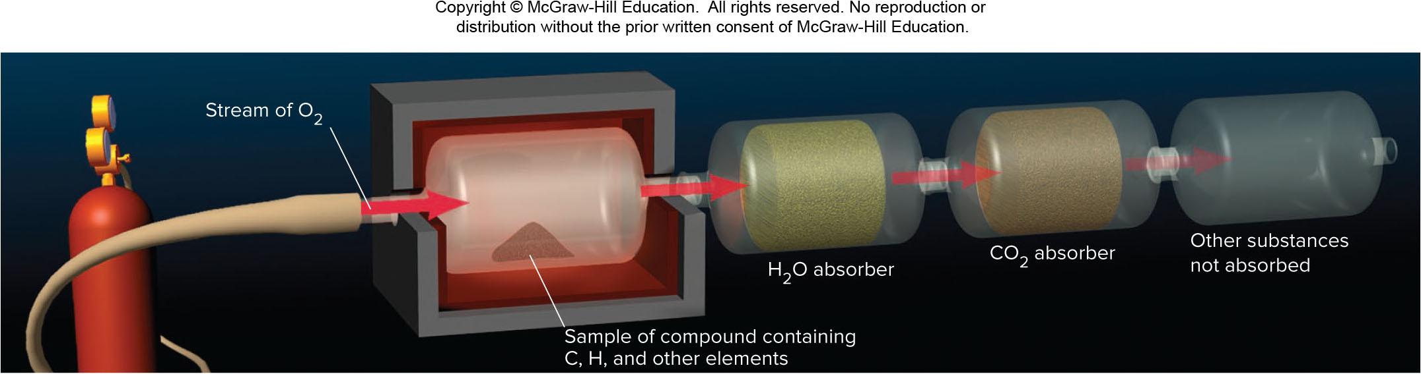
Combustion Apparatus
Figure 3.4

Slide 39
Sample Problem 3.11 – Problem and Plan
Determining a Molecular Formula from Combustion Analysis
PROBLEM: When a 1.000 g sample of vitamin C (M = 176.12 g/mol) is placed in a combustion chamber and burned, the following data are obtained:
mass of CO₂ absorber after combustion = 85.35 g
mass of CO₂ absorber before combustion = 83.85 g
mass of H₂O absorber after combustion = 37.96 g
mass of H₂O absorber before combustion = 37.55 g
PLAN: The masses of CO₂ and H₂O produced will give us the masses of C and H present in the original sample. From this we can determine the mass of O.

Slide 40
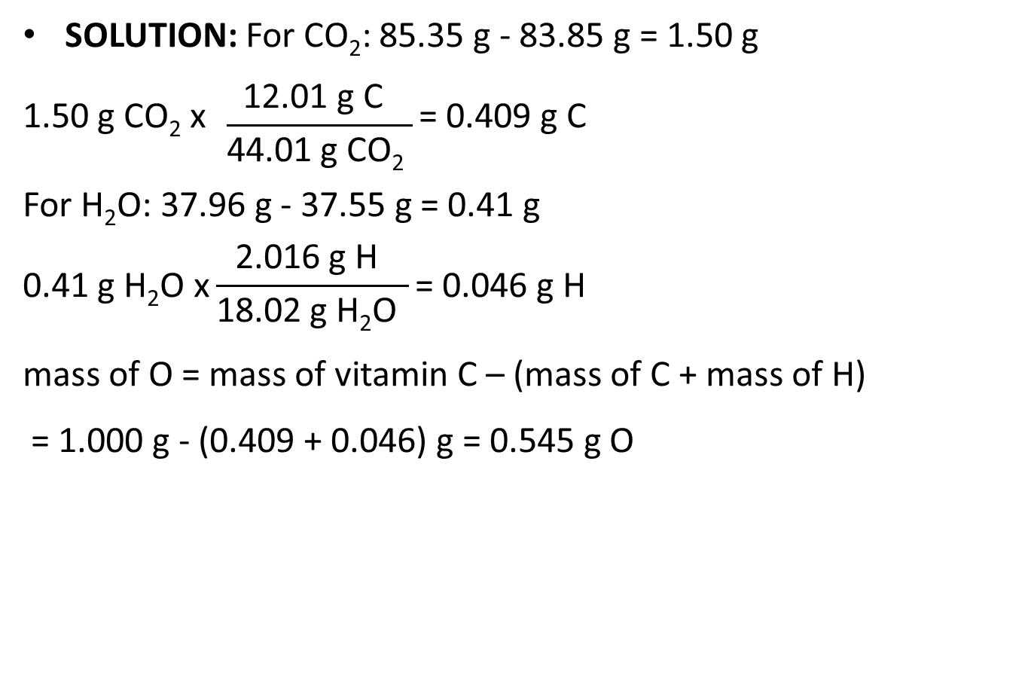
Sample Problem 3.11 - Solution
SOLUTION: For CO₂: 85.35 g - 83.85 g = 1.50 g
$$\text{1.50 }\text{g} \text{CO}\text{2} \text{x} \frac{\text{12.01 }\text{g} \text{C} }{\text{44.01 }\text{g} \text{CO}\text{2} }\text{= 0.409 }\text{g} \text{C}$$
For H₂O: 37.96 g - 37.55 g = 0.41 g
$$\text{0.41 }\text{g} \text{H}\text{2}\text{O} \text{x}\frac{\text{2.016 }\text{g} \text{H} }{\text{18.02 }\text{g} \text{H}\text{2}\text{O} }\text{= 0.046 }\text{g} \text{H}$$
mass of O = mass of vitamin C – (mass of C + mass of H)
= 1.000 g - (0.409 + 0.046) g = 0.545 g O

Slide 41
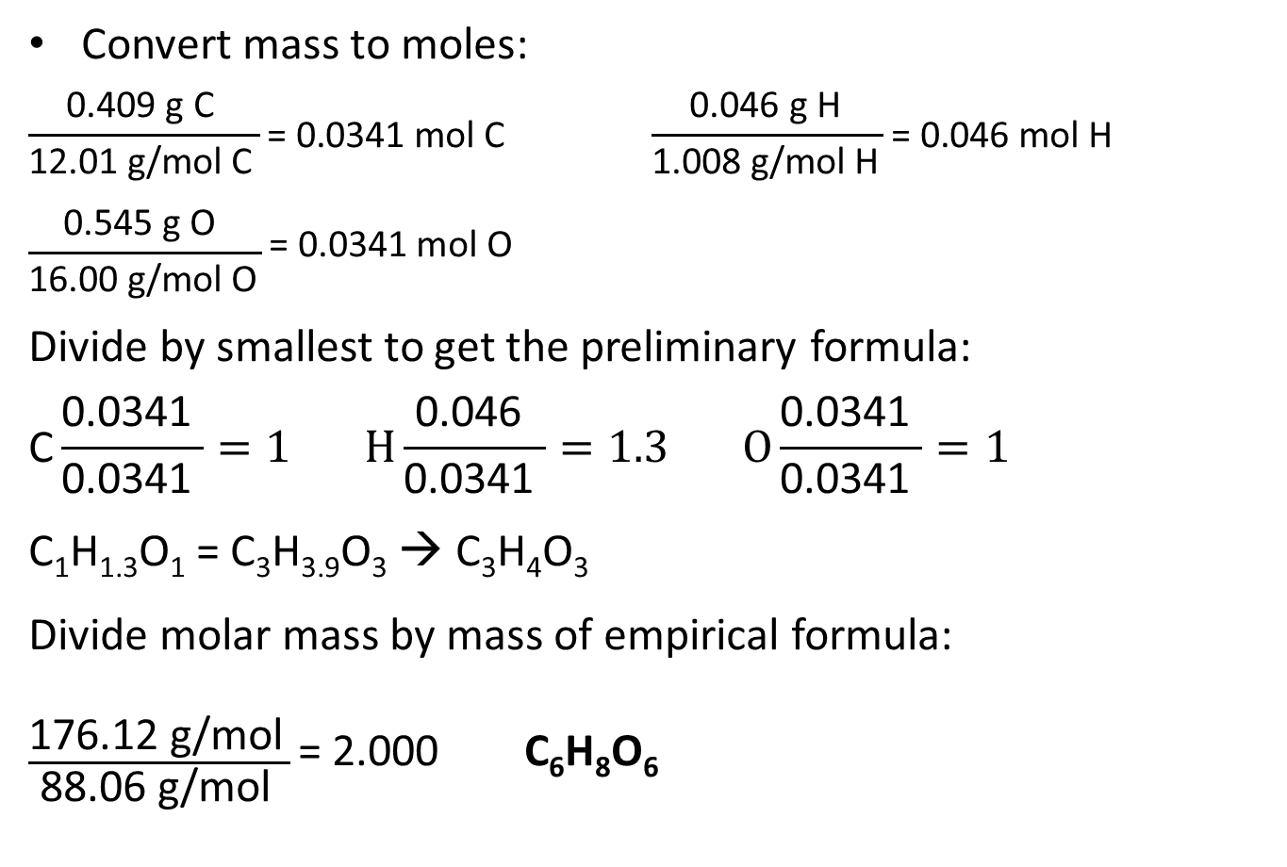
Sample Problem 3.11 – Solution, Cont’d
Convert mass to moles:
$$\frac{\text{0.409 }\text{g} \text{C} }{\text{12.01 }\text{g}\text{/}\text{mol} \text{C} }\text{= 0.0341 }\text{mol} \text{C} \frac{\text{0.046 }\text{g} \text{H} }{\text{1.008 }\text{g}\text{/}\text{mol} \text{H} }\text{= 0.046 }\text{mol} \text{H}$$
$$\frac{\text{0.545 }\text{g} \text{O} }{\text{16.00 }\text{g}\text{/}\text{mol} \text{O} }\text{= 0.0341 }\text{mol} \text{O}$$
Divide by smallest to get the preliminary formula:
$$\text{C}\frac{\text{0.0341} }{\text{0.0341} }=1 H\frac{\text{0.046} }{\text{0.0341} }=1.3 O\frac{\text{0.0341} }{\text{0.0341} }=1$$
C₁H_{1.3}O₁ = C₃H_{3.9}O₃ → C₃H₄O₃
Divide molar mass by mass of empirical formula:
$\frac{\text{176.12 }\text{g}\text{/}\text{mol} }{\text{88.06 }\text{g}\text{/}\text{mol} }\text{= 2.000}$ C₆H₈O₆
Notes:
41

Slide 42
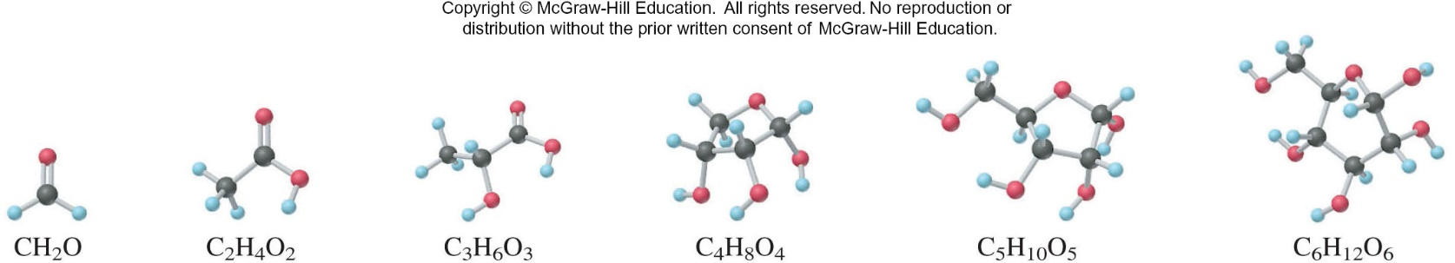
Table 3.2 Compounds with Empirical Formula CH₂O
Name | Molecular Formula | Whole-Number Multiple | M (g/mol) | Use or Function
Formaldehyde | CH₂O | 1 | 30.03 | Disinfectant; biological preservative
Acetic acid | C₂H₄O₂ | 2 | 60.05 | Acetate polymers; vinegar (5% solution)
Lactic acid | C₃H₆O₃ | 3 | 90.08 | Causes milk to sour; forms in muscles during exercise
Erythrose | C₄H₈O₄ | 4 | 120.10 | Forms during sugar metabolism
Ribose | C₅H₁₀O₅ | 5 | 150.13 | Component of many nucleic acids and vitamin B₂
Glucose | C₆H₁₂O₆ | 6 | 180.16 | Major nutrient for energy in cells

Slide 43
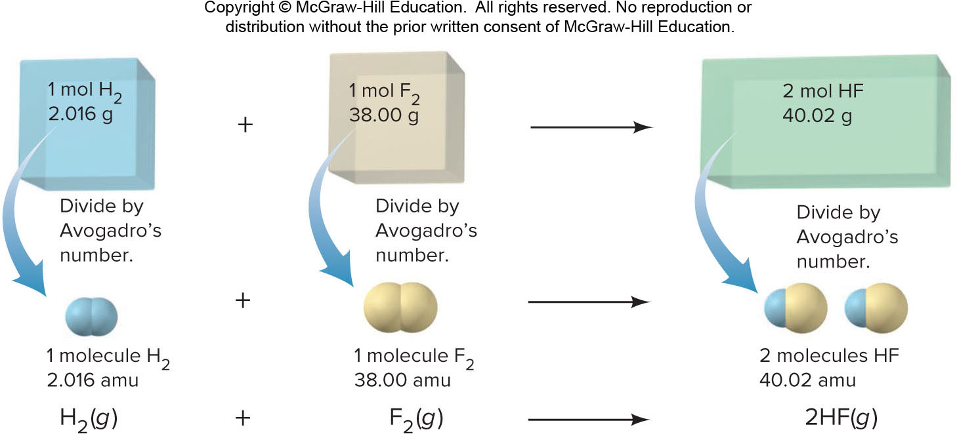
Chemical Equations
A chemical equation uses formulas to express the identities and quantities of substances involved in a physical or chemical change.
Figure 3.6
Notes:
43

Slide 44
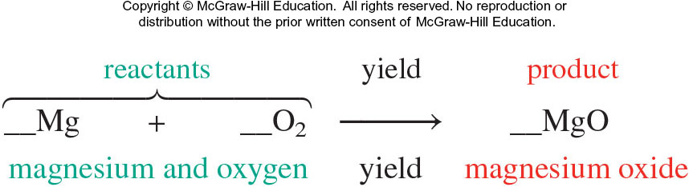
Features of Chemical Equations
The equation must be balanced; the same number and type of each atom must appear on both sides.

Slide 45
Balancing a Chemical Equation
1) Translating the statement: we first translate the chemical statement into a “skeleton” equation.
2) Balancing the atoms: we match the numbers of each type of atom on the left and the right of the yield arrow
3) Adjusting the coefficients: in most cases, the smallest whole-number coefficients are preferred
4) Checking: after balancing and adjusting the coefficients, we always check that the equation is balanced:
5) Specifying the states of matter: the final equation also indicates the physical state of each substance or whether it is dissolved in water.

Slide 46
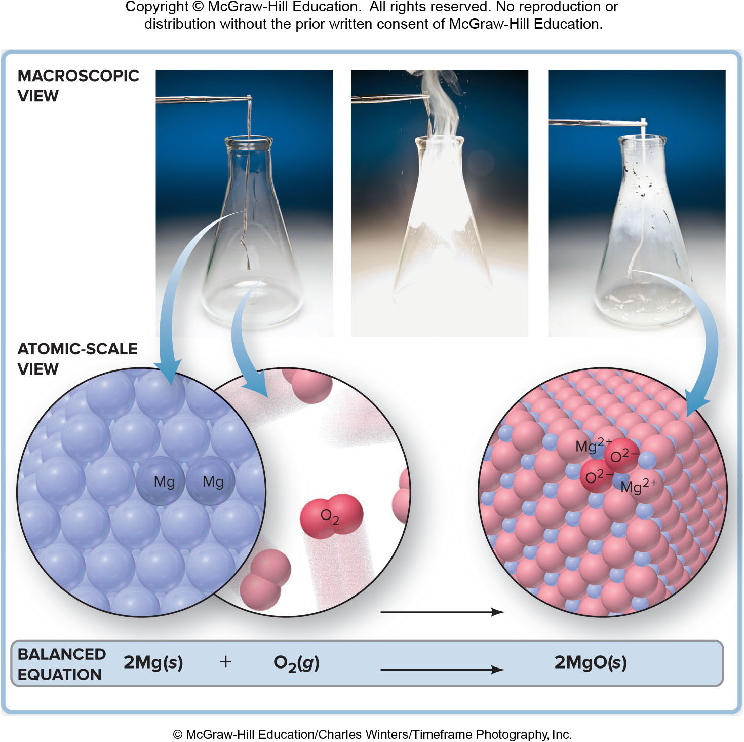
A Three-level View of a Reaction
Figure 3.7
© McGraw-Hill Education/Charles Winters/Timeframe Photography, Inc.

Slide 47
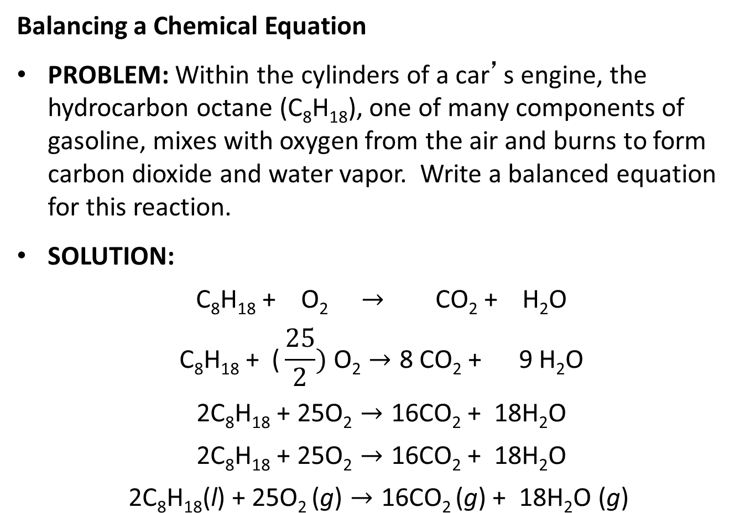
Sample Problem 3.12 – Problem and Solution
Balancing a Chemical Equation
PROBLEM: Within the cylinders of a car’s engine, the hydrocarbon octane (C₈H₁₈), one of many components of gasoline, mixes with oxygen from the air and burns to form carbon dioxide and water vapor. Write a balanced equation for this reaction.
SOLUTION:
$$\text{C}\text{8}\text{H}\text{18}\text{ + }\text{O}\text{2} → \text{CO}\text{2}\text{ + }\text{H}\text{2}\text{O}$$
$$\text{C}\text{8}\text{H}\text{18}\text{ + }\text{(}\frac{25}{2}) \text{O}\text{2}→\text{8 }\text{CO}\text{2}\text{ + 9 }\text{H}\text{2}\text{O}$$
$$\text{2}\text{C}\text{8}\text{H}\text{18}\text{ + 25}\text{O}\text{2}→\text{16}\text{CO}\text{2}\text{ + 18}\text{H}\text{2}\text{O}$$
$$\text{2}\text{C}\text{8}\text{H}\text{18}\text{ + 25}\text{O}\text{2}→\text{16}\text{CO}\text{2}\text{ + 18}\text{H}\text{2}\text{O}$$
$$\text{2}\text{C}\text{8}\text{H}\text{18}\text{(}\text{l}\text{) + 25}\text{O}\text{2 }\text{(}\text{g}\text{)}→\text{16}\text{CO}\text{2 }\text{(}\text{g}\text{) + 18}\text{H}\text{2}\text{O}\text{ (}\text{g}\text{) }$$

Slide 48
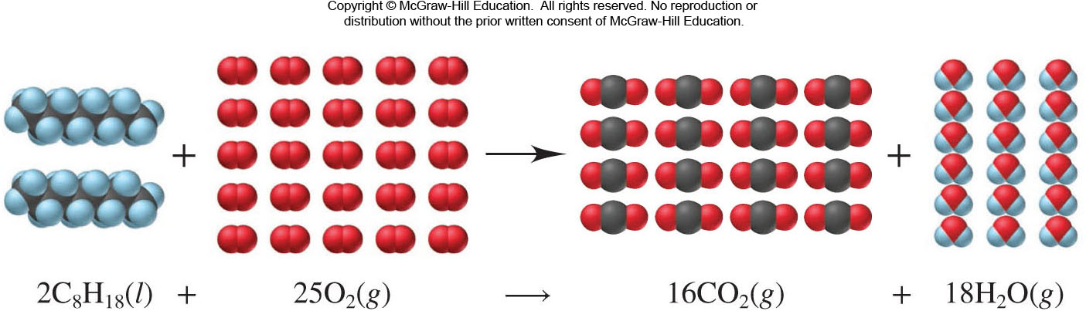
Visualizing a Reaction with a Molecular Scene
Combustion of Octane

Slide 49
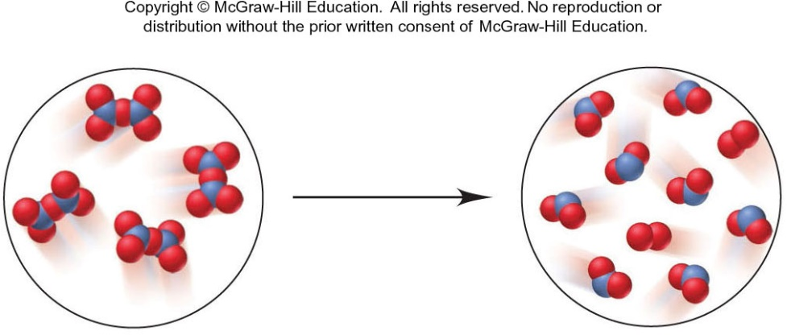
Sample Problem 3.13 – Problem and Plan
Balancing an Equation from a Molecular Scene
PROBLEM: The following molecular scenes depict an important reaction in nitrogen chemistry. The blue spheres represent nitrogen while the red spheres represent oxygen. Write a balanced equation for this reaction.
PLAN: Determine the formulas of the reactants and products from their composition. Arrange this information in the correct equation format and balance correctly, including the states of matter.

Slide 50
Sample Problem 3.13 - Solution
SOLUTION: The reactant circle shows only one type of molecule, composed of 2 N and 5 O atoms. The formula is thus N₂O₅. There are 4 N₂O₅ molecules depicted.
The product circle shows two types of molecule; one has 1 N and 2 O atoms while the other has 2 O atoms. The products are NO₂ and O₂. There are 8 NO₂ molecules and 2 O₂ molecules shown.
The reaction depicted is 4N₂O₅ → 8NO₂ + 2O₂.
Writing the equation with the smallest whole-number coefficients and states of matter included;
2N₂O₅ (g) → 4NO₂ (g) + O₂ (g)

Slide 51
Stoichiometric Calculations
In a balanced equation, the amounts (mol) of substances are stoichiometrically equivalent to each other, which means that a specific amount of one substance is formed from, produces, or reacts with a specific amount of the other. The quantitative relationships are expressed as stoichiometrically equivalent molar ratios that we use as conversion factors to calculate the amounts.

Slide 52
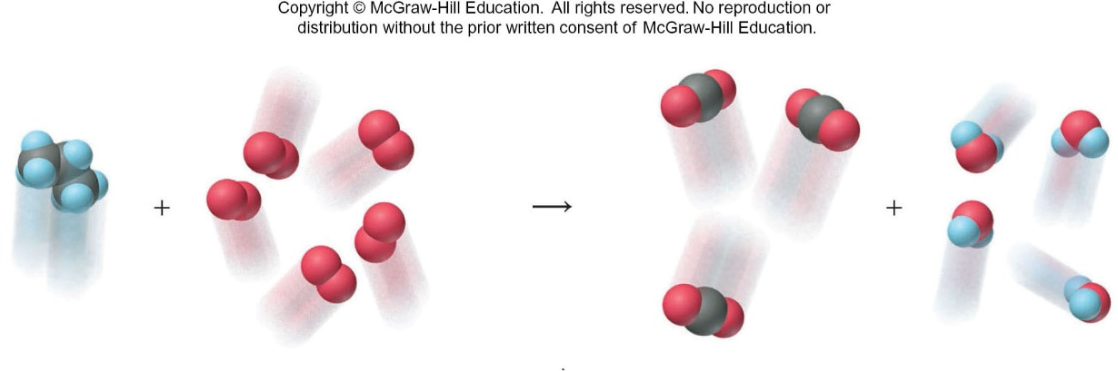
Table 3.4 Information Contained in a Balanced Equation
Viewed in Terms of | Reactants C₃H₈(g) + 5O₂(g) | → | Products 3CO₂(g) + 4H₂O(g)
Molecules | 1 molecule C₃H₈ + 5 molecules O₂ | → | 3 molecules CO₂ + 4 molecules H₂O
Amount (mol) | 1 mol C₃H₈ + 5 mol O₂ | → | 3 mol CO₂ + 4 mol H₂O
Mass (amu) | 44.09 amu C₃H₈ + 160.00 amu O₂ | → | 132.03 amu CO₂ + 72.06 amu H₂O
Mass (g) | 44.09 g C₃H₈ + 160.00 g O₂ | → | 132.03 g CO₂ + 72.06 g H₂O
Total mass (g) | 204.09 g | → | 204.09 g

Slide 53
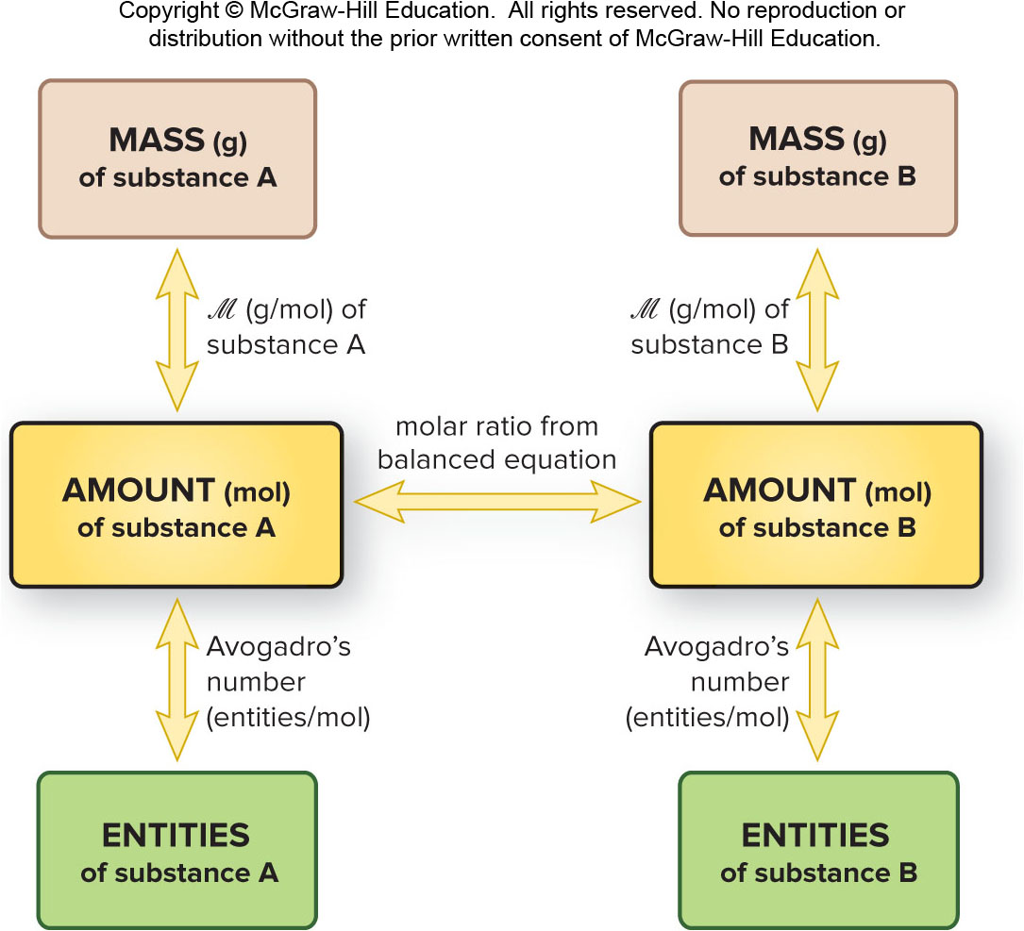
Amount-mass-number Relationships
Figure 3.8

Slide 54
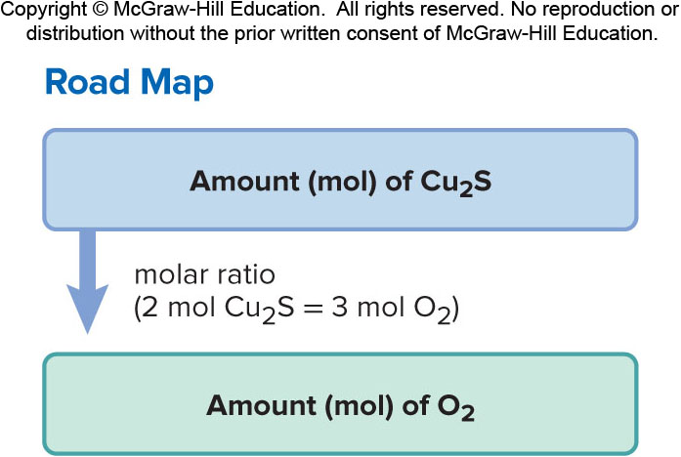
Sample Problem 3.14 – Problem and Plan
Calculating Quantities of Reactants and Products: Amount (mol) to Amount (mol)
PROBLEM: Copper is obtained from copper(I) sulfide by roasting it in the presence of oxygen gas to form powdered copper(I) oxide and gaseous sulfur dioxide. How many moles of oxygen are required to roast 10.0 mol of copper(I) sulfide?
PLAN:

Slide 55

Sample Problem 3.14 –Solution
SOLUTION:
2Cu₂S (s) + 3O₂ (g) → 2Cu₂O (s) + 2SO₂ (g)
$$\text{10.0 }\text{mol} \text{Cu}\text{2}\text{S} \text{x}\frac{\text{3 }\text{mol} \text{O}\text{2} }{\text{2 }\text{mol} \text{Cu}\text{2}\text{S} }=15.0 mol O2$$

Slide 56
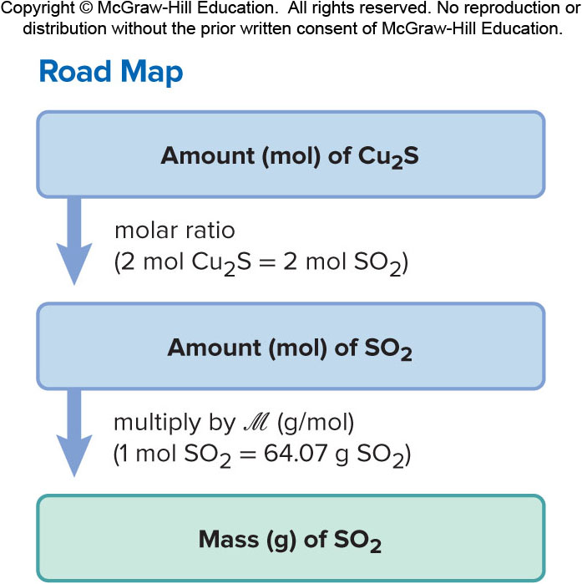
Sample Problem 3.15 – Problem and Plan
Calculating Quantities of Reactants and Products: Amount (mol) to Mass (g)
PROBLEM: During the process of roasting copper(I) sulfide, how many grams of sulfur dioxide form when 10.0 mol of copper(I) sulfide reacts?
PLAN: Using the balanced equation from the previous problem, we again use the mole ratio as a conversion factor.

Slide 57

Sample Problem 3.15 - Solution
SOLUTION: 2Cu₂S (s) + 3O₂ (g) → 2Cu₂O (s) + 2SO₂ (g)
$$\text{10.0 }\text{mol} \text{Cu}\text{2}\text{S} \text{x}\frac{\text{2 }\text{mol} \text{SO}\text{2} }{\text{2 }\text{mol} \text{Cu}\text{2}\text{S} }×\frac{\text{64.07 }\text{g} \text{SO}\text{2} }{\text{1 }\text{mol} \text{SO}\text{2} }=641 g SO2$$

Slide 58
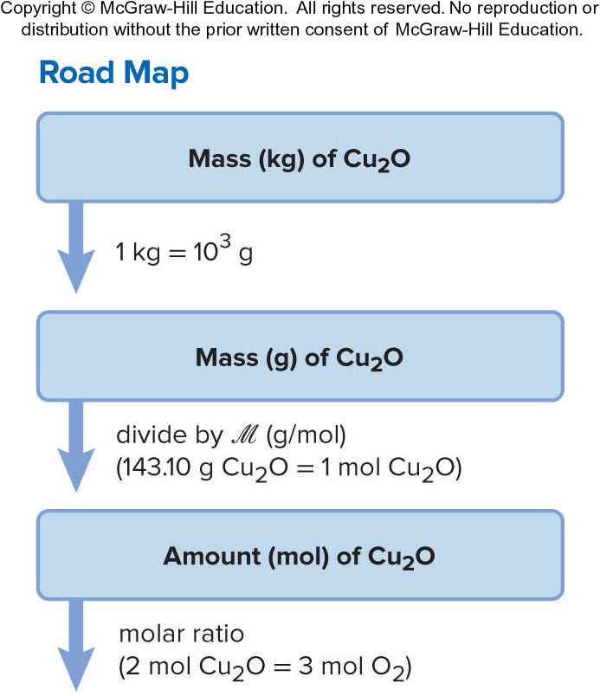
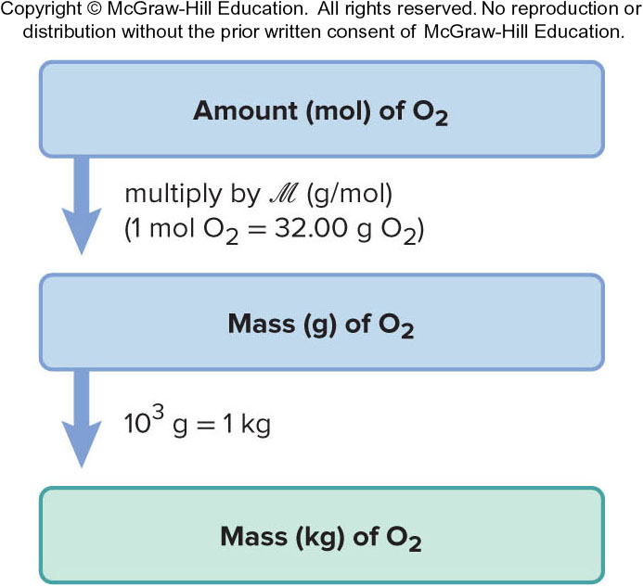
Sample Problem 3.16 – Problem and Plan
Calculating Quantities of Reactants and Products: Mass to Mass
PROBLEM: During the roasting of copper(I) sulfide, how many kilograms of oxygen are required to form 2.86 kg of copper(I) oxide?
PLAN: We convert the mass of Cu₂O from kg to g and then to amount (mol). Then, we use the molar ratio (3 mol O₂/2 mol Cu₂O) to find the amount (mol) of O₂ required. Finally, we convert the amount of O₂ to g and then kg.

Slide 59
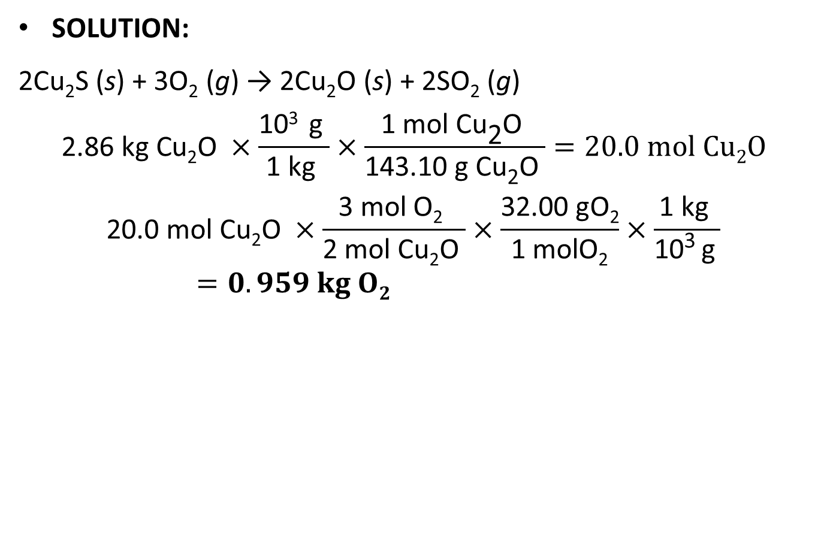
Sample Problem 3.16 - Solution
SOLUTION:
2Cu₂S (s) + 3O₂ (g) → 2Cu₂O (s) + 2SO₂ (g)
$$\text{2.86 }\text{kg} \text{Cu}\text{2}\text{O} ×\frac{\text{10}\text{3} \text{g} }{\text{1 }\text{kg} }×\frac{\text{1 }\text{mol} \text{Cu}\text{2}\text{O} }{\text{143.10 }\text{g} \text{Cu}\text{2}\text{O} }=20.0 mol Cu2O$$
$$\text{20.0 }\text{mol} \text{Cu}\text{2}\text{O} ×\frac{\text{3 }\text{mol} \text{O}\text{2} }{\text{2 }\text{mol} \text{Cu}\text{2}\text{O} }×\frac{\text{32.00 }\text{gO}\text{2}}{\text{1 }\text{molO}\text{2}}×\frac{\text{1 }\text{kg} }{\text{10}\text{3 }\text{g} }=0.959 kg O2$$

Slide 60
Reactions in Sequence
For stoichiometric purposes, when the same substance forms in one reaction and reacts in the next (it is common to both reactions), we eliminate that substance in an overall (net) equation. The steps in writing the overall equation are:
1) Write the sequence of balanced equations.
2) Adjust the equations arithmetically to cancel the common substance(s).
3) Add the adjusted equations together to obtain the overall balanced equation.

Slide 61
Sample Problem 3.17 - Problem and Plan
Writing an Overall Equation for a Reaction Sequence
PROBLEM: Roasting is the first step in extracting copper from chalcocite, the ore used in the previous problem. In the next step, copper(I) oxide reacts with powdered carbon to yield copper metal and carbon monoxide gas. Write a balanced overall equation for the two-step process.
PLAN: Write individual balanced equations for each step. Adjust the coefficients so that any common substances can be canceled. Add the adjusted equations together to obtain the overall equation.

Slide 62
Sample Problem 3.17 - Solution
SOLUTION: Write individual balanced equations for each step:
2Cu₂S (s) + 3O₂ (g) → 2Cu₂O (s) + 2SO₂ (g)
Cu₂O (s) + C (s) → 2Cu (s) + CO (g)
Adjust the coefficients so that the 2 moles of Cu₂O formed in reaction 1 are used up in reaction 2:
2Cu₂S (s) + 3O₂ (g) → 2Cu₂O (s) + 2SO₂ (g)
2Cu₂O (s) + 2C (s) → 4Cu (s) + 2CO (g)
Add the equations together:
2Cu₂S (s) + 3O₂ (g) + 2C (s) → 2SO₂ (g) + 4Cu (s) + 2CO (g)
Notes:
62

Slide 63
Limiting Reactants
So far we have assumed that reactants are present in the correct amounts to react completely.
In reality, one reactant may limit the amount of product that can form.
The limiting reactant will be completely used up in the reaction.
The reactant that is not limiting is in excess – some of this reactant will be left over.

Slide 64
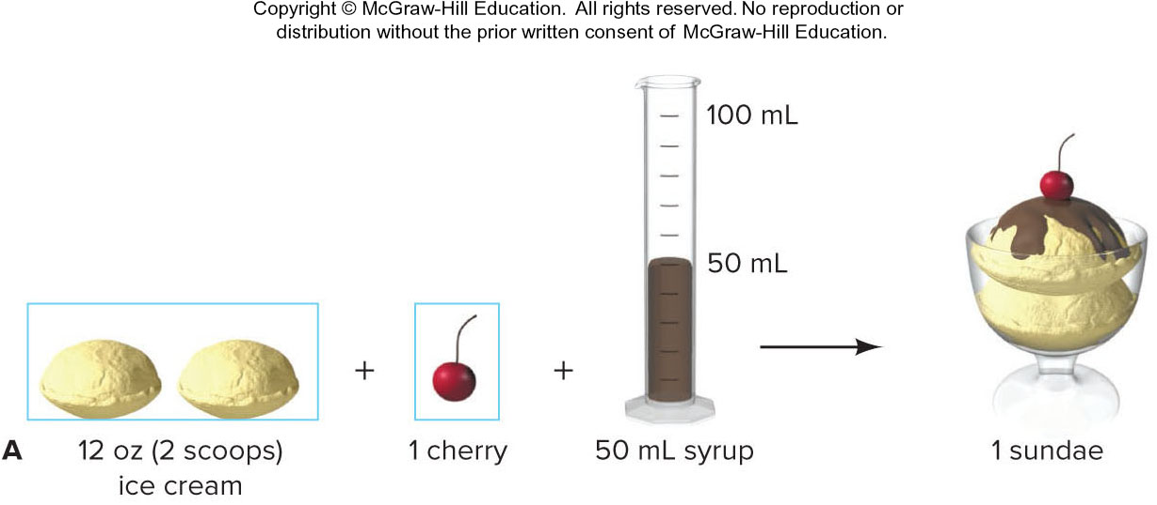
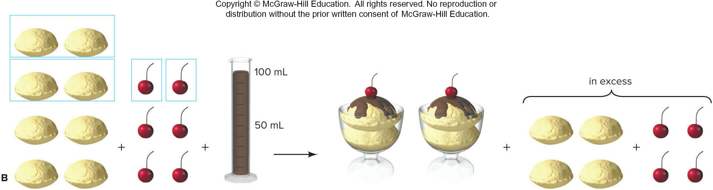
Analogy for Limiting Reactions
Figure 3.10

Slide 65
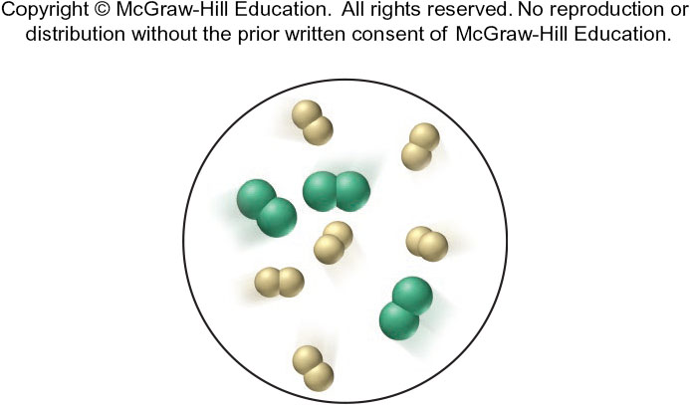
Sample Problem 3.18 - Problem
Using Molecular Depictions in a Limiting-Reactant Problem
PROBLEM: Chlorine trifluoride, an extremely reactive substance, is formed as a gas by the reaction of elemental chlorine and fluorine. The molecular scene shows a representative portion of the reaction mixture before the reaction starts. (Chlorine is green, and fluorine is yellow.)
Find the limiting reactant.
Write a reaction table for the process.
Draw a representative portion of the mixture after the reaction is complete. (Hint: The ClF₃ molecule has 1 Cl atom bonded to 3 individual F atoms).

Slide 66
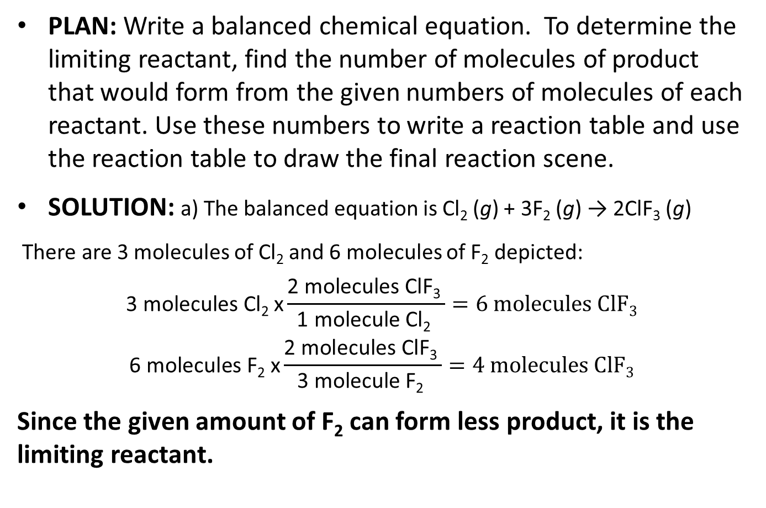
Sample Problem 3.18 – Plan and Solution (a)
PLAN: Write a balanced chemical equation. To determine the limiting reactant, find the number of molecules of product that would form from the given numbers of molecules of each reactant. Use these numbers to write a reaction table and use the reaction table to draw the final reaction scene.
SOLUTION: a) The balanced equation is Cl₂ (g) + 3F₂ (g) → 2ClF₃ (g)
There are 3 molecules of Cl₂ and 6 molecules of F₂ depicted:
$$\text{3 }\text{molecules} \text{Cl}\text{2} \text{x}\frac{\text{2 }\text{molecules} \text{ClF}\text{3} }{\text{1 }\text{molecule} \text{Cl}\text{2} }=6 molecules ClF3$$
$$\text{6 }\text{molecules} \text{F}\text{2} \text{x}\frac{\text{2 }\text{molecules} \text{ClF}\text{3} }{\text{3 }\text{molecule} \text{F}\text{2} }=4 molecules ClF3$$
Since the given amount of F₂ can form less product, it is the limiting reactant.
Notes:
66

Slide 67
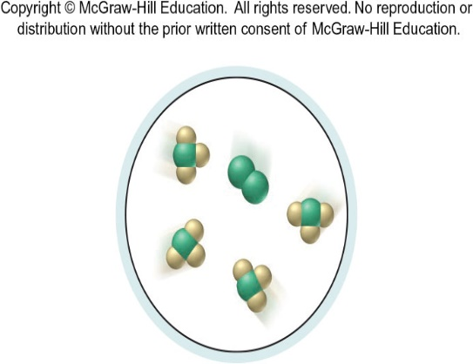
Sample Problem 3.18 – Solution (b) and (c)
(b) We use the amount of F₂ to determine the “change” in the reaction table, since F₂ is the limiting reactant:
(c) The final reaction scene shows that all the F₂ has reacted and that there is Cl₂ left over. 4 molecules of ClF₃ have formed:
Molecules | Cl₂ (g) + | 3F₂ (g) → | 2ClF₃ (g)
Initial Change | 3 -2 | 6 -6 | 0 +4
Final | 1 | 0 | 4

Slide 68
Sample Problem 3.19 – Problem and Plan
Calculating Quantities in a Limiting-Reactant Problem: Amount to Amount
PROBLEM: In another preparation of ClF₃, 0.750 mol of Cl₂ reacts with 3.00 mol of F₂.
  Find the limiting reactant.
  Write a reaction table.
PLAN: Find the limiting reactant by calculating the amount (mol) of ClF₃ that can be formed from each given amount of reactant. Use this information to construct a reaction table.

Slide 69

Sample Problem 3.19 –Solution (a) and (b)
SOLUTION: (a) The balanced equation is Cl₂ (g) + 3F₂ (g) → 2ClF₃ (g)
$$\text{0.750 }\text{mol} \text{Cl}\text{2} \text{x}\frac{\text{2 }\text{mol} \text{ClF}\text{3} }{\text{1 }\text{mol} \text{Cl}\text{2} }=1.50 mol ClF3$$
$$\text{3.00 }\text{mol} \text{F}\text{2} \text{x}\frac{\text{2 }\text{mol} \text{ClF}\text{3} }{\text{3 }\text{mol} \text{F}\text{2} }=2.00 mol ClF3$$
Cl₂ is limiting, because the given amount yields less ClF₃.
(b) All the Cl₂ reacts since this is the limiting reactant. For every 1 Cl₂ that reacts, 3 F₂ will react, so 3(0.750) or 2.25 moles of F₂ reacts.
Amount (mol) | Cl₂(g) | + | 3F₂(g) | → | 2ClF₃(g)
Initial | 0.750 |  | 3.00 |  | 0
Change | −0.750 |  | −2.25 |  | +1.50
Final | 0 |  | 0.75 |  | 1.50

Slide 70
Sample Problem 3.20 – Problem and Plan
Calculating Quantities in a Limiting-Reactant Problem: Mass to Mass
PROBLEM: A fuel mixture used in the early days of rocketry consisted of two liquids, hydrazine (N₂H₄) and dinitrogen tetroxide (N₂O₄), which ignite on contact to form nitrogen gas and water vapor.
  How many grams of nitrogen gas form when 1.00 x 10² g of N₂H₄ and 2.00 x 10² g of N₂O₄ are mixed?
  Write a reaction table for this process.
PLAN: Find the limiting reactant by calculating the amount (mol) of product that can be formed from each given mass of reactant. Make sure you calculate the mass of the SAME product for each given amount of reactant. Use this information to construct a reaction table.
Notes:
70

Slide 71

Sample Problem 3.20 – Plan, Cont’d

Slide 72

Sample Problem 3.20 – Solution (a)
SOLUTION: (a) 2N₂H₄ (l) + N₂O₄ (l) → 3N₂ (g) + 4H₂O (g)
For N₂H₄: $\text{1.00}\text{x}\text{ 102 }\text{g} \text{N}\text{2}\text{H}\text{4} \text{x}\frac{\text{1 }\text{mol} \text{N}\text{2}\text{H}\text{4} }{\text{32.05 }\text{g} \text{N}\text{2}\text{H}\text{4} }\text{= 3.12 }\text{mol} \text{N}\text{2}\text{H}\text{4}$
$$\text{3.12 }\text{mol} \text{N}\text{2}\text{H}\text{4} \text{x}\frac{\text{3 }\text{mol} \text{N}\text{2} }{\text{2 }\text{mol} \text{N}\text{2}\text{H}\text{4} }=4.68 mol N2$$
For N₂O₄: $\text{2.00}\text{x}\text{ 102 }\text{g} \text{N}\text{2}\text{O}\text{4} \text{x}\frac{\text{1 }\text{mol} \text{N}\text{2}\text{O}\text{4} }{\text{92.02 }\text{g} \text{N}\text{2}\text{O}\text{4} }=2.17 mol N2O4$
$$\text{2.17 }\text{mol} \text{N}\text{2}\text{O}\text{4} \text{x}\frac{\text{3 }\text{mol} \text{N}\text{2} }{\text{1 }\text{mol} \text{N}\text{2}\text{O}\text{4} }=\text{6.51 }\text{mol} \text{N}\text{2}$$
N₂H₄ is limiting and only 4.68 mol of N₂ can be produced:
$$\text{4.68 }\text{mol} \text{N}\text{2} \text{x}\frac{\text{28.02 }\text{g} \text{N}\text{2} }{\text{1 }\text{mol} \text{N}\text{2} }\text{= 131 }\text{g} \text{N}\text{2}$$
Notes:
72

Slide 73

Sample Problem 3.20 – Solution (b)
(b) All the N₂H₄ reacts since it is the limiting reactant. For every 2 moles of N₂H₄ that react 1 mol of N₂O₄ reacts and 3 mol of N₂ form:
$$\text{3.12 }\text{mol} \text{N}\text{2}\text{H}\text{4} \text{x}\frac{\text{1 }\text{mol} \text{N}\text{2}\text{O}\text{4} }{\text{2 }\text{mol} \text{N}\text{2}\text{H}\text{4} }\text{= 1.56 }\text{mol} \text{N}\text{2}\text{O}\text{4} \text{reacts}$$
Amount (mol) | 2N₂H₄(l) + | N₂O₄(l) → | 3N₂(g) + | 4H₂O(g)
Initial | 3.12 | 2.17 | 0 | 0
Change | −3.12 | −1.56 | +4.68 | +6.24
Final | 0 | 0.61 | 4.68 | 6.24
Notes:
73

Slide 74

Stoichiometric Relationships
Figure 3.11

Slide 75

Reaction Yields
The theoretical yield is the amount of product calculated using the molar ratios from the balanced equation.
The actual yield is the amount of product actually obtained. The actual yield is usually less than the theoretical yield.
$$\text{\% }\text{yield}\text{ =}\frac{\text{actual} \text{yield} }{\text{theoretical} \text{yield} }×100$$

Slide 76

Effect of Side Reactions on Yield of Main Product.
Figure 3.12

Slide 77


Sample Problem 3.21 – Problem and Plan
Calculating Percent Yield
PROBLEM: Silicon carbide (SiC) is made by reacting sand (silicon dioxide, SiO₂) with powdered carbon at high temperature. Carbon monoxide is also formed. What is the percent yield if 51.4 kg of SiC is recovered from processing 100.0 kg of sand?
PLAN: After writing the balanced equation, we convert the given mass of SiO₂ (100.0 kg) to amount (mol). We use the molar ratio to find the amount of SiC formed and convert it to mass (kg) to obtain the theoretical yield.

Slide 78

Sample Problem 3.21 - Solution
SOLUTION: SiO₂(s) + 3C(s) → SiC(s) + 2CO(g)
$$\text{100.0 }\text{kg} \text{SiO}\text{2} \text{x}\frac{\text{10}\text{3 }\text{g} }{\text{1 }\text{kg} }\text{x}\frac{\text{1 }\text{mol} \text{SiO}\text{2} }{\text{60.09 }\text{g} \text{SiO}\text{2} }\text{= 1664 }\text{mol} \text{SiO}\text{2}$$
mol SiO₂ = mol SiC = 1664 mol SiC
$$\text{1664 }\text{mol} \text{SiC} \text{x}\frac{\text{40.10 }\text{g} \text{SiC} }{\text{1 }\text{mol} \text{SiC} }\text{x}\frac{\text{1 }\text{kg} }{\text{10}\text{3}\text{g} }\text{= 66.73 }\text{kg}$$
$$\frac{\text{51.4 }\text{kg} }{\text{66.73 }\text{kg} }×100=77.0\%$$

