Slide 1
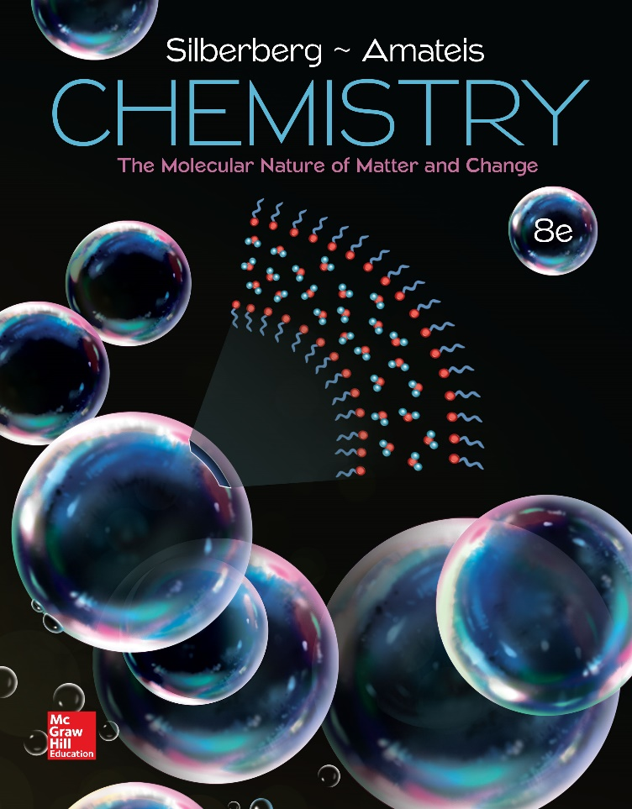
Chemistry
The Molecular Nature of Matter and Change Eighth Edition
Martin S. Silberberg and Patricia G. Amateis

Slide 2
Gases and the Kinetic Molecular Theory
5.1 An Overview of the Physical States of Matter
5.2 Gas Pressure and Its Measurement
5.3 The Gas Laws and Their Experimental Foundations
5.4 Rearrangements of the Ideal Gas Law
5.5 The Kinetic-Molecular Theory: A Model for Gas Behavior
5.6 Real Gases: Deviations from Ideal Behavior

Slide 3
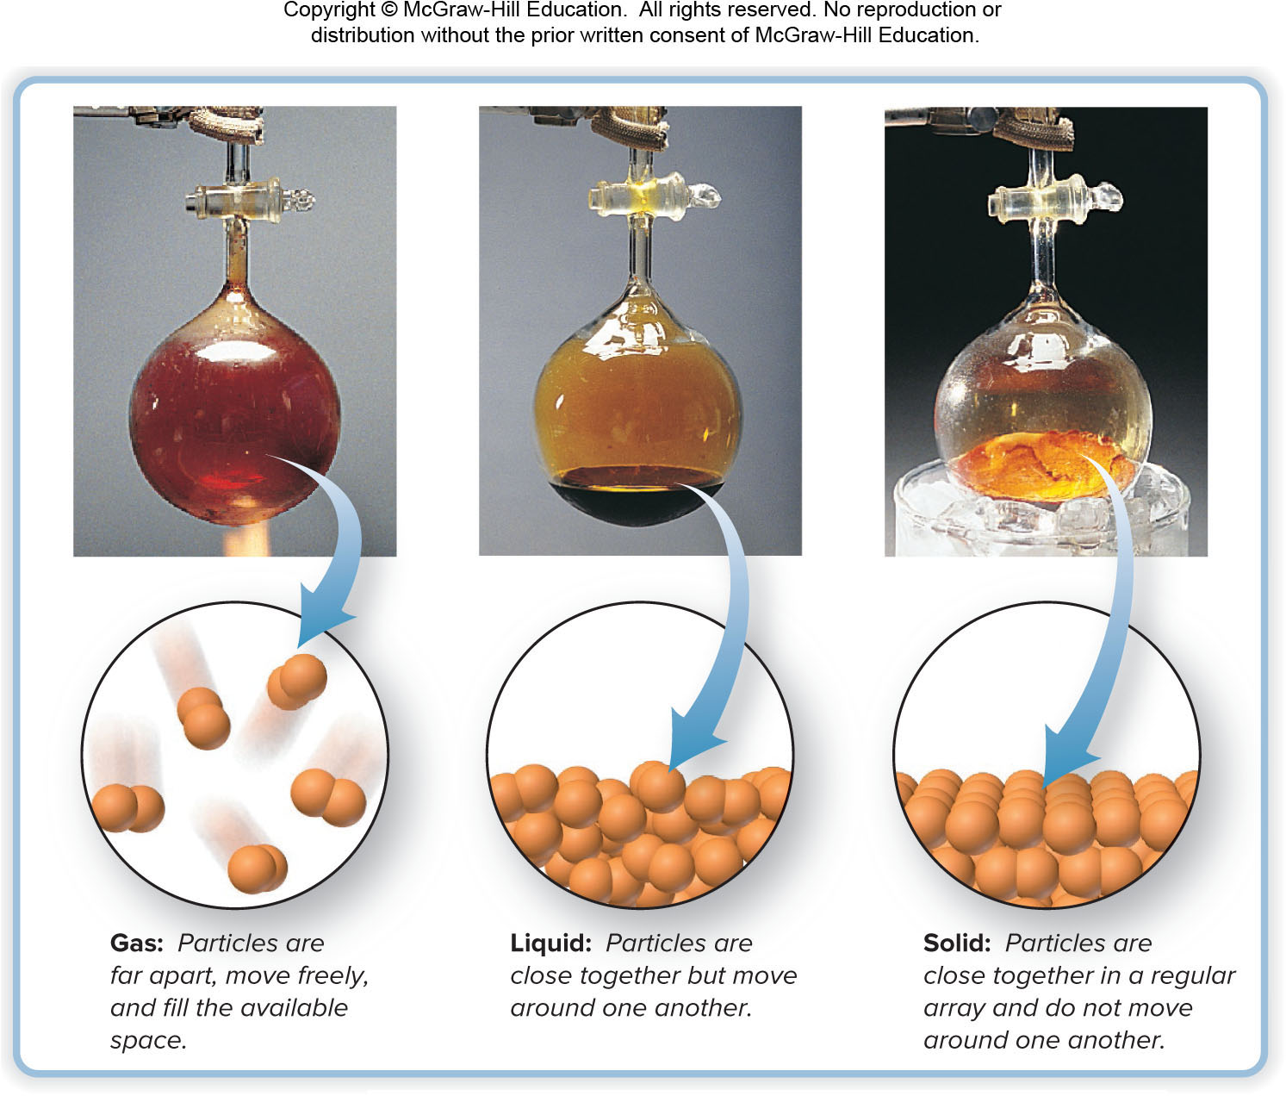
The Three States of Matter
Figure 5.1
© McGraw-Hill Education/Stephen Frisch, photographer

Slide 4
An Overview of the Physical States of Matter
Distinguishing gases from liquids and solids.
Gas volume changes significantly with pressure.
  Solid and liquid volumes are not greatly affected by pressure.
Gas volume changes significantly with temperature.
  Gases expand when heated and shrink when cooled.
  The volume change is 50 to 100 times greater for gases than for liquids and solids.
Gases flow very freely.
Gases have relatively low densities.
Gases form a solution in any proportions.
  Gases are freely miscible with each other.

Slide 5

Gas Pressure and its Measurement
$$\text{Pressure}\text{ = }\frac{\text{force}}{\text{area}}$$
Atmospheric pressure arises from the force exerted by atmospheric gases on the earth’s surface.
Atmospheric pressure decreases with altitude.

Slide 6
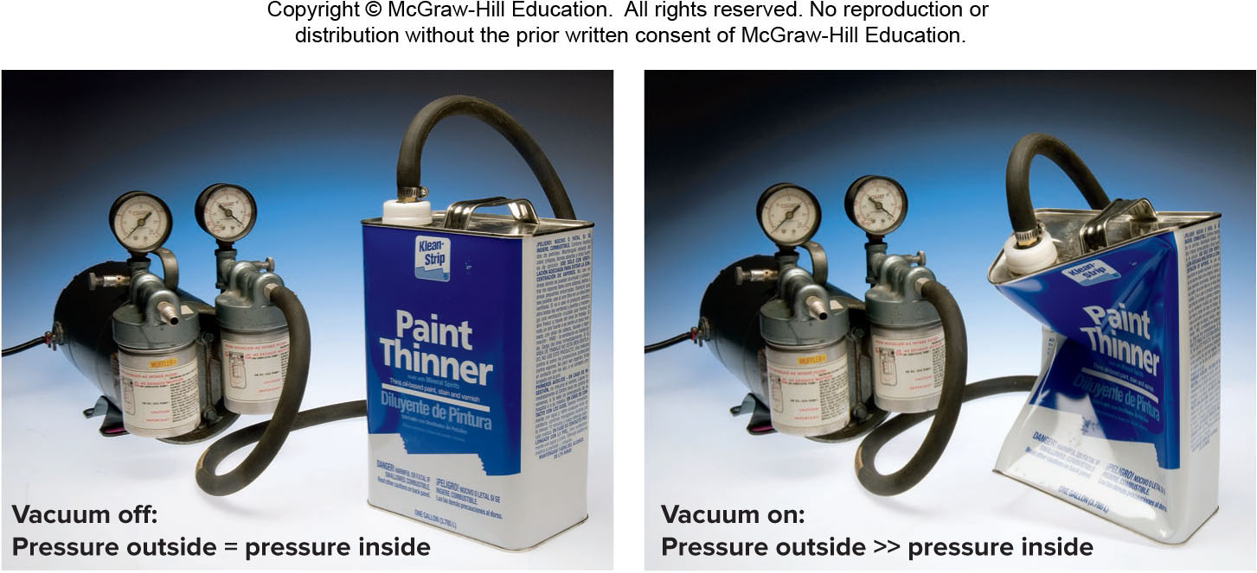
Effect of Atmospheric Pressure on a Familiar Object
Figure 5.2
© McGraw-Hill Education/Charles Winters/Timeframe Photography, Inc.

Slide 7
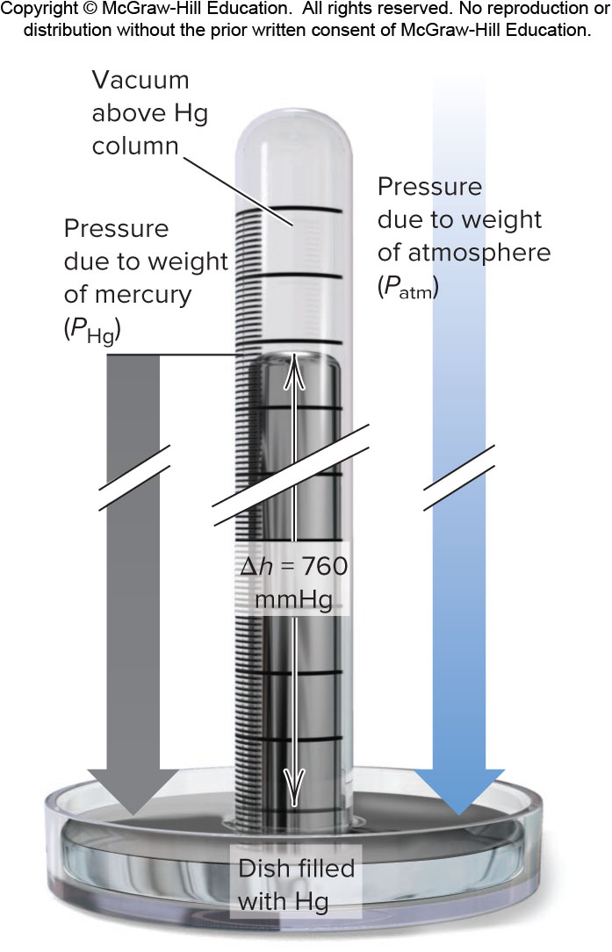
A Mercury Barometer
Figure 5.3

Slide 8
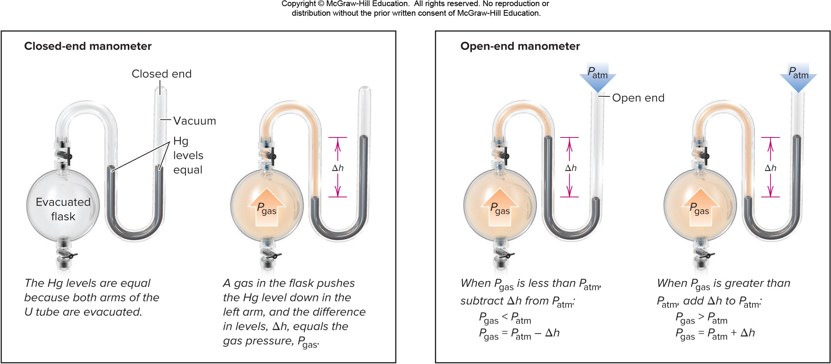
Two Types of Manometer
Figure 5.4

Slide 9
Common Units of Pressure
Unit | Normal Atmospheric Pressure at Sea Level and 0°C
pascal (Pa); kilopascal (kPa) | 1.01325×10⁵ Pa; 101.325 kPa
atmosphere (atm) | 1 atm*
millimeters of mercury (mmHg) | 760 mmHg*
torr | 760 torr*
pounds per square inch (lb/in² or psi) | 14.7 lb/in²
bar | 1.01325 bar
*These are exact quantities; in calculations, we use as many significant figures as necessary.

Slide 10
Sample Problem 5.1 – Problem and Plan
Converting Units of Pressure
PROBLEM: A geochemist heats a limestone (CaCO₃) sample and collects the CO₂ released in an evacuated flask attached to a closed-end manometer. After the system comes to room temperature, Δh = 291.4 mm Hg. Calculate the CO₂ pressure in torrs, atmospheres, and kilopascals.
PLAN: Construct conversion factors to find the other units of pressure.

Slide 11

Sample Problem 5.1 –Solution
SOLUTION:
$$\text{291.4 }\text{mmHg} \text{x}\frac{\text{1}\text{torr}}{\text{1 }\text{mmHg} }\text{= 291.4 }\text{torr}$$
$$\text{291.4 }\text{torr} \text{x}\frac{\text{1 }\text{atm} }{\text{760 }\text{torr} }\text{= 0.3834 }\text{atm}$$
$$\text{0.3834 }\text{atm} \text{x}\frac{\text{101.325 }\text{kPa} }{\text{1 }\text{atm} }\text{= 38.85 }\text{kPa}$$

Slide 12
The Gas Laws
The gas laws describe the physical behavior of gases in terms of 4 variables:
  pressure (P)
  temperature (T)
  volume (V)
  amount (number of moles, n)
An ideal gas is a gas that exhibits linear relationships among these variables.
No ideal gas actually exists, but most simple gases behave nearly ideally at ordinary temperatures and pressures.

Slide 13
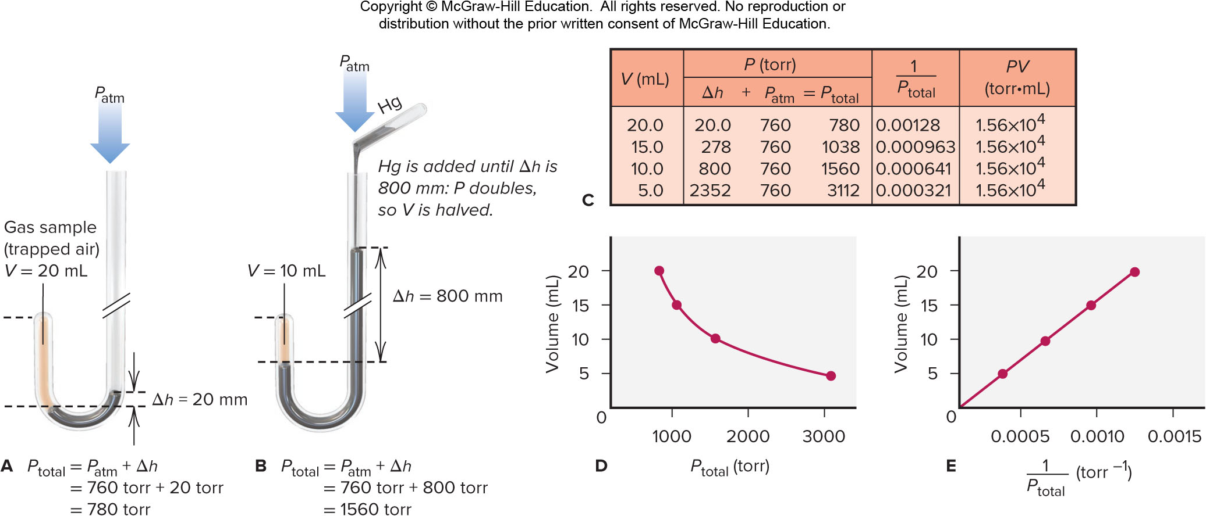
Boyle’s Law in Images
Figure 5.5

Slide 14
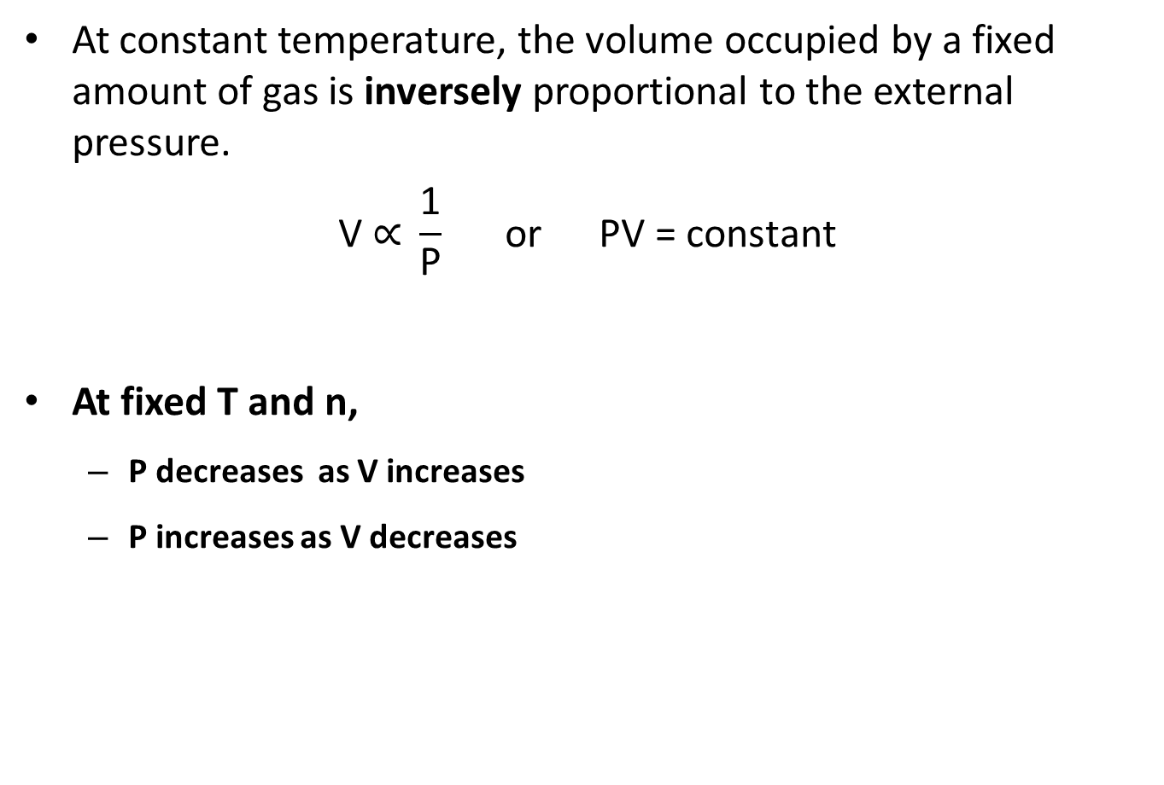
Boyle’s Law
At constant temperature, the volume occupied by a fixed amount of gas is inversely proportional to the external pressure.
$$\text{V}\text{ ∝ }\frac{\text{1}}{\text{P}} \text{or} \text{PV}\text{ = }\text{constant}$$
At fixed T and n,
  P decreases as V increases
  P increases as V decreases

Slide 15
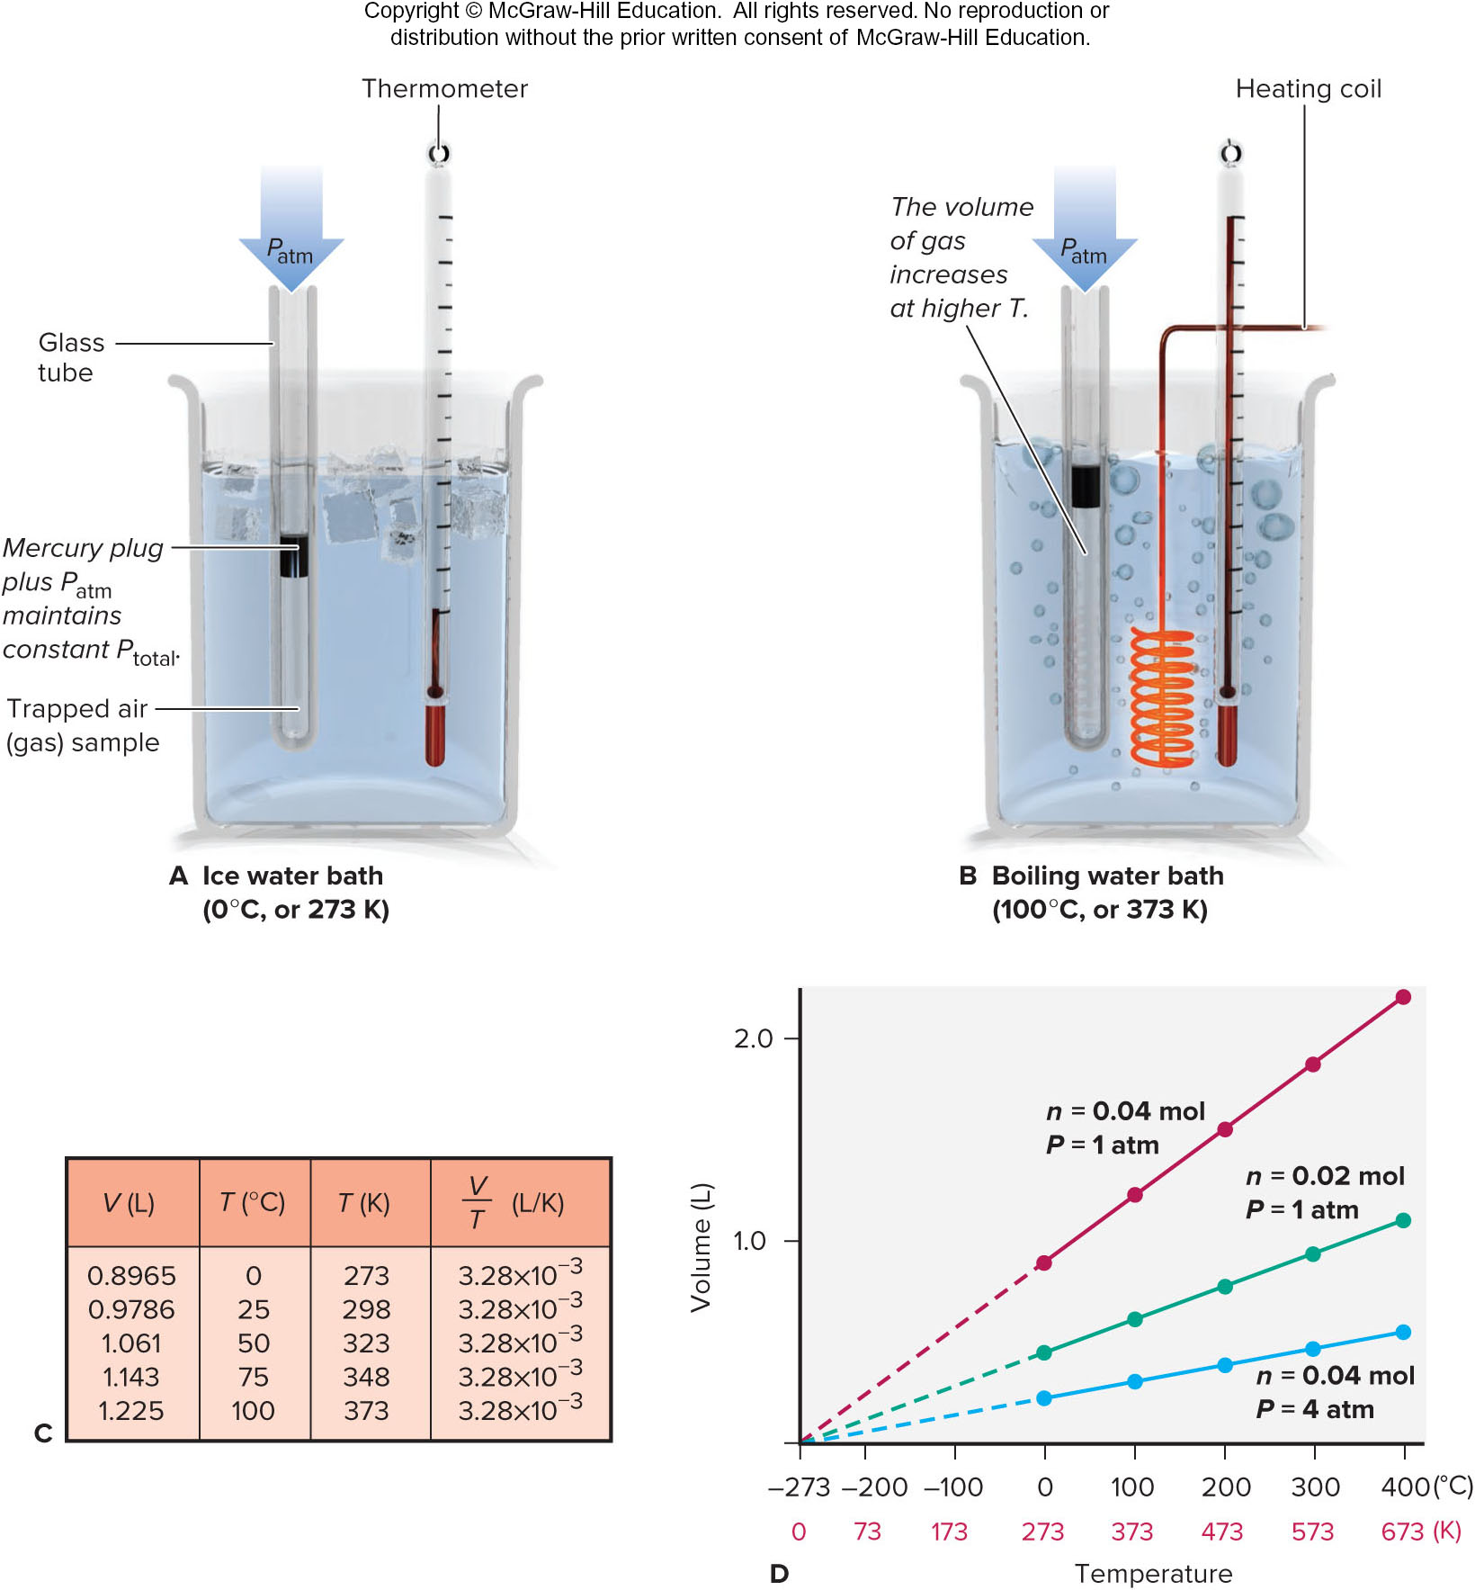
Charles’s Law in Images
Figure 5.6

Slide 16
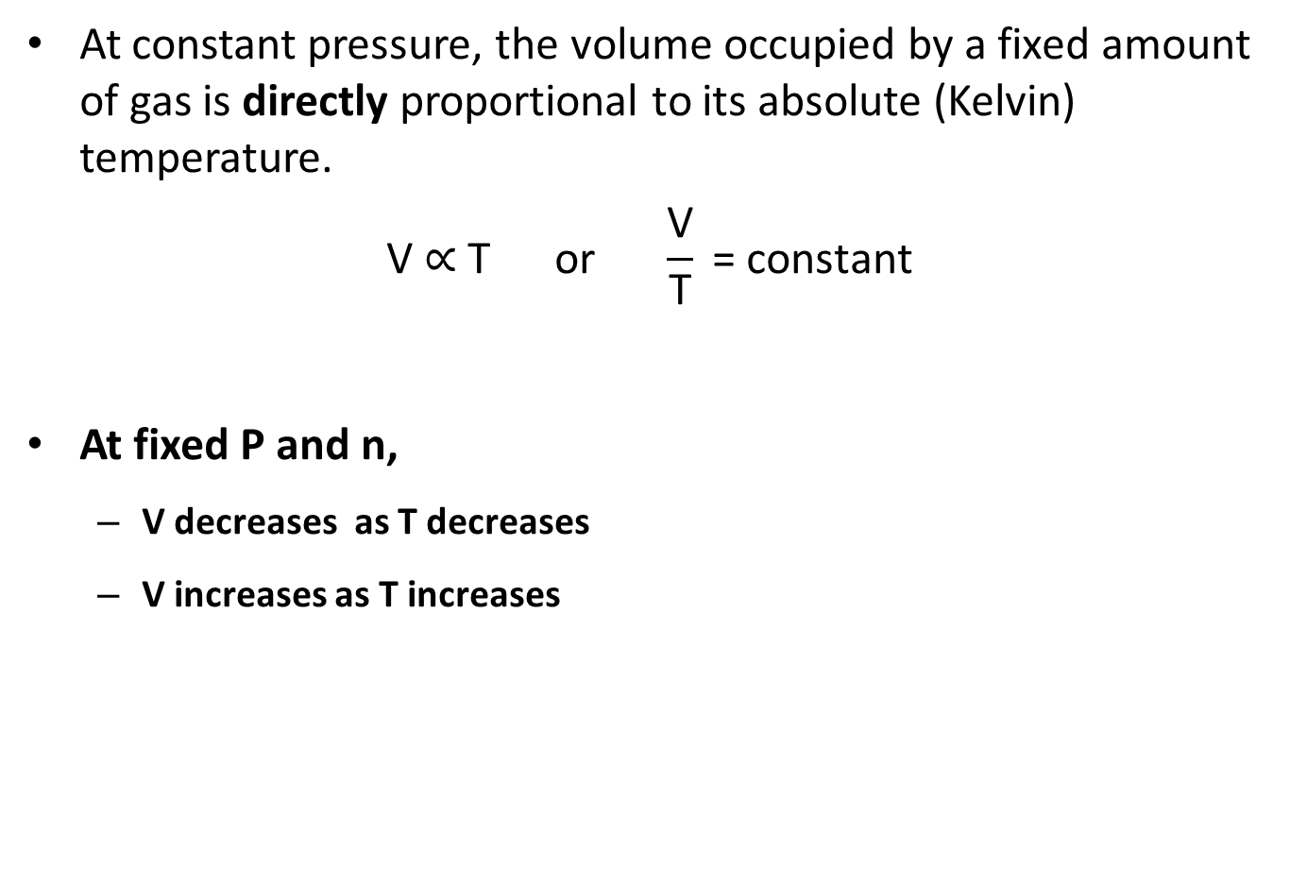
Charles’s Law
At constant pressure, the volume occupied by a fixed amount of gas is directly proportional to its absolute (Kelvin) temperature.
$$\text{V}\text{ ∝ }\text{T} \text{or} \frac{\text{V}}{\text{T}}\text{ = }\text{constant}$$
At fixed P and n,
  V decreases as T decreases
  V increases as T increases

Slide 17
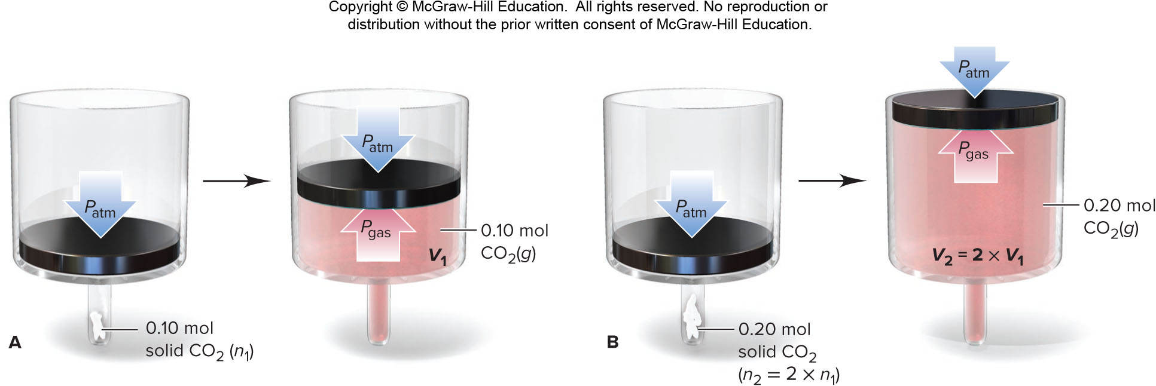
Avogadro’s Law
At fixed temperature and pressure, the volume occupied by a gas is directly proportional to the amount of gas.
Avogadro’s Law: at fixed temperature and pressure, equal volumes of any ideal gas contain equal numbers of particles (or moles).
Figure 5.7

Slide 18
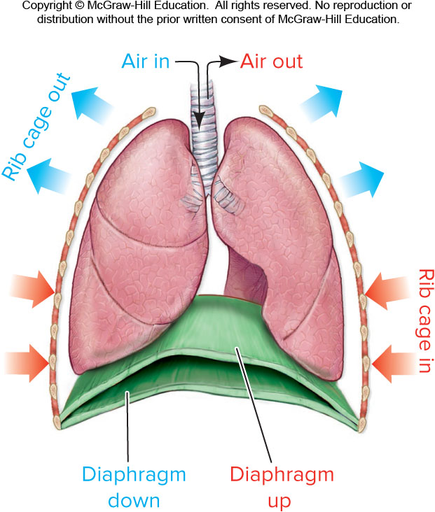
Familiar Application of the Gas Laws
Figure 5.8

Slide 19
Gas Behavior at Standard Conditions
STP or standard temperature and pressure specifies a pressure of 1 atm (760 torr) and a temperature of 0°C ( 273.15 K).
The standard molar volume is the volume of 1 mol of an ideal gas at STP.
Standard molar volume = 22.4141 L or 22.4 L

Slide 20
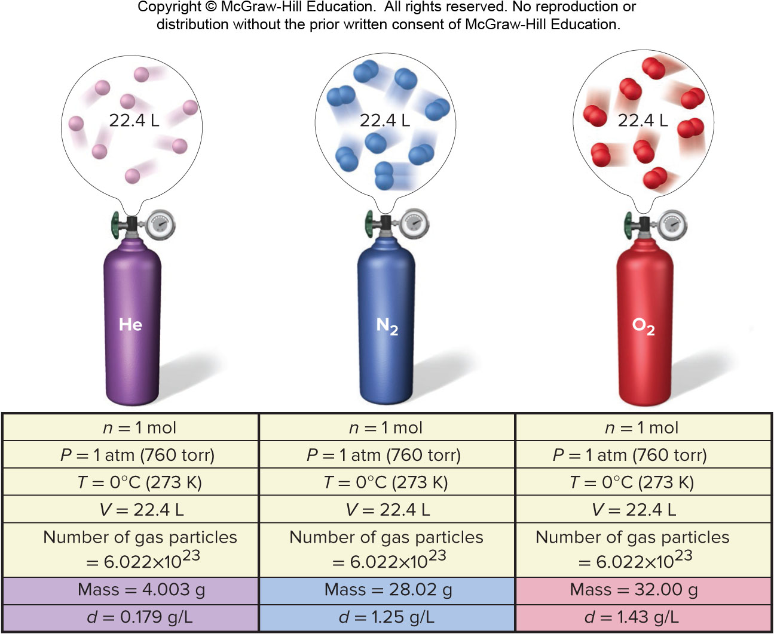
Standard Molar Volume
Figure 5.9

Slide 21
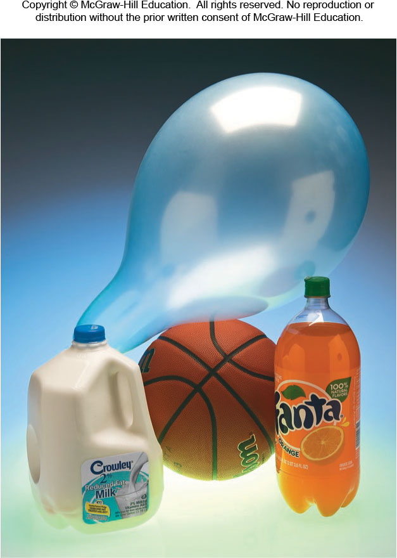
Volume of 1 mol of Some Familiar Objects
Figure 5.10
© McGraw-Hill Education/Charles Winters/Timeframe Photography, Inc.

Slide 22
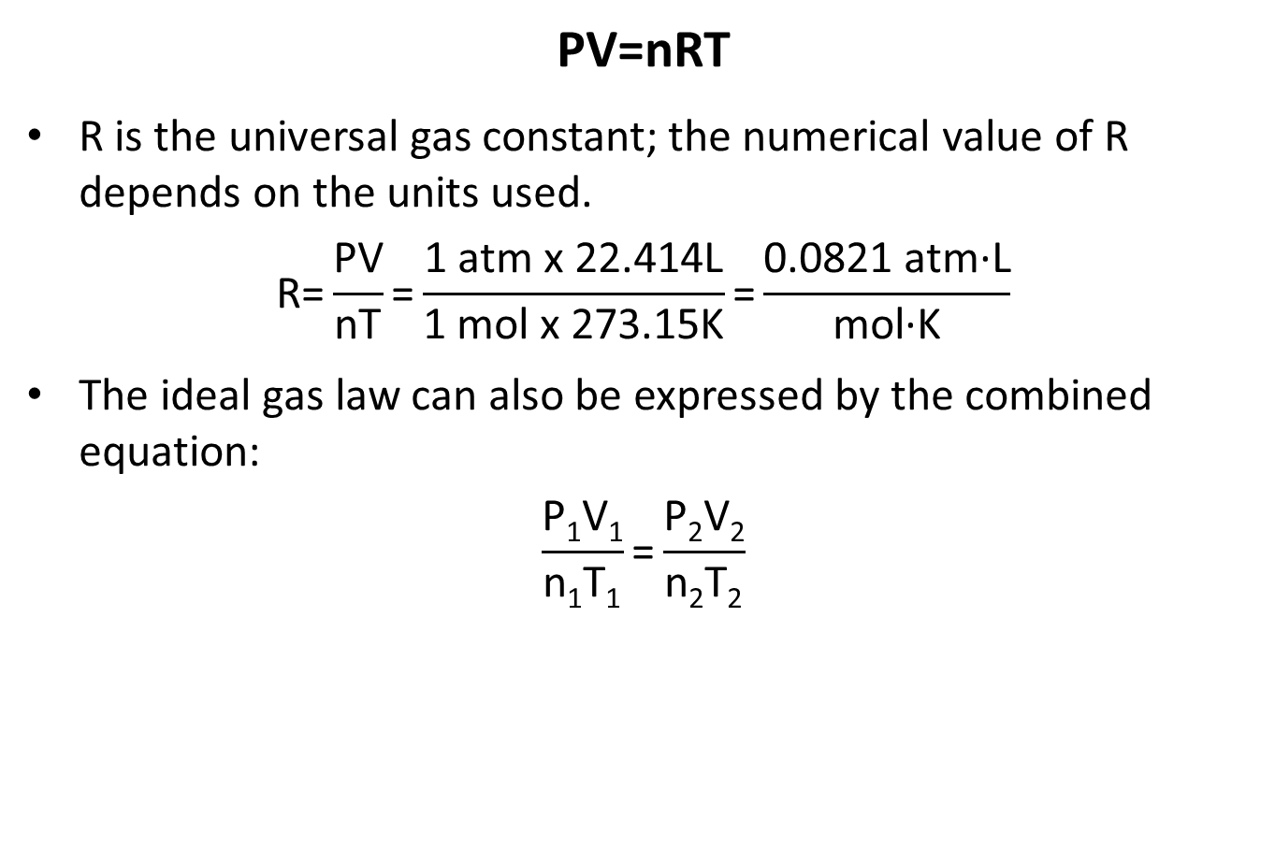
The Ideal Gas Law
PV=nRT
R is the universal gas constant; the numerical value of R depends on the units used.
$$\text{R}\text{=}\frac{\text{PV}}{\text{nT}}\text{=}\frac{\text{1 }\text{atm} \text{x}\text{ 22.414}\text{L}}{\text{1 }\text{mol} \text{x}\text{ 273.15}\text{K}}\text{=}\frac{\text{0.0821 }\text{atm}\text{∙}\text{L}}{\text{mol}\text{∙}\text{K}}$$
The ideal gas law can also be expressed by the combined equation:
$$\frac{\text{P}\text{1}\text{V}\text{1}}{\text{n}\text{1}\text{T}\text{1}}\text{=}\frac{\text{P}\text{2}\text{V}\text{2}}{\text{n}\text{2}\text{T}\text{2}}$$

Slide 23
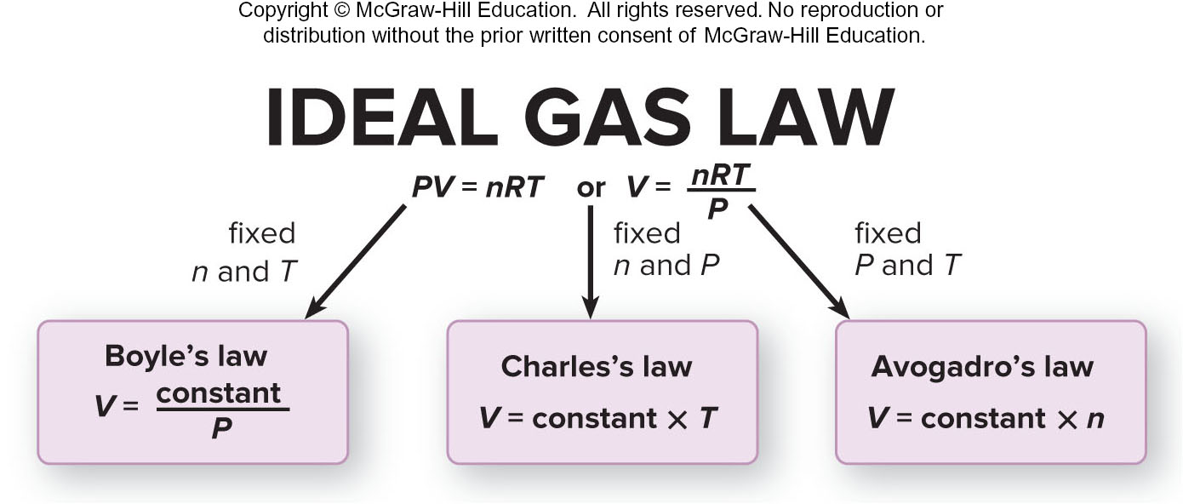
Individual Gas Laws as Special Cases
Figure 5.11

Slide 24
Sample Problem 5.2 – Problem and Plan
Applying the Volume-Pressure Relationship
PROBLEM: Boyle’s apprentice finds that the air trapped in a J tube occupies 24.8 cm³ at 851 torr. By adding mercury to the tube, he increases the pressure on the trapped air to 2.64 atm. Assuming constant temperature, what is the new volume of air (in L)?
PLAN: We must find the final volume (V₂) in liters, given the initial volume (V₁), initial pressure(P₁), and final pressure (P₂). The temperature and amount of gas are fixed. We must use consistent units of pressure, so we convert the unit of P₁ from torr to atm. We then convert the unit of V₁ from cm³ to mL and then to L, rearrange the ideal gas law to the appropriate form, and solve for V₂.

Slide 25
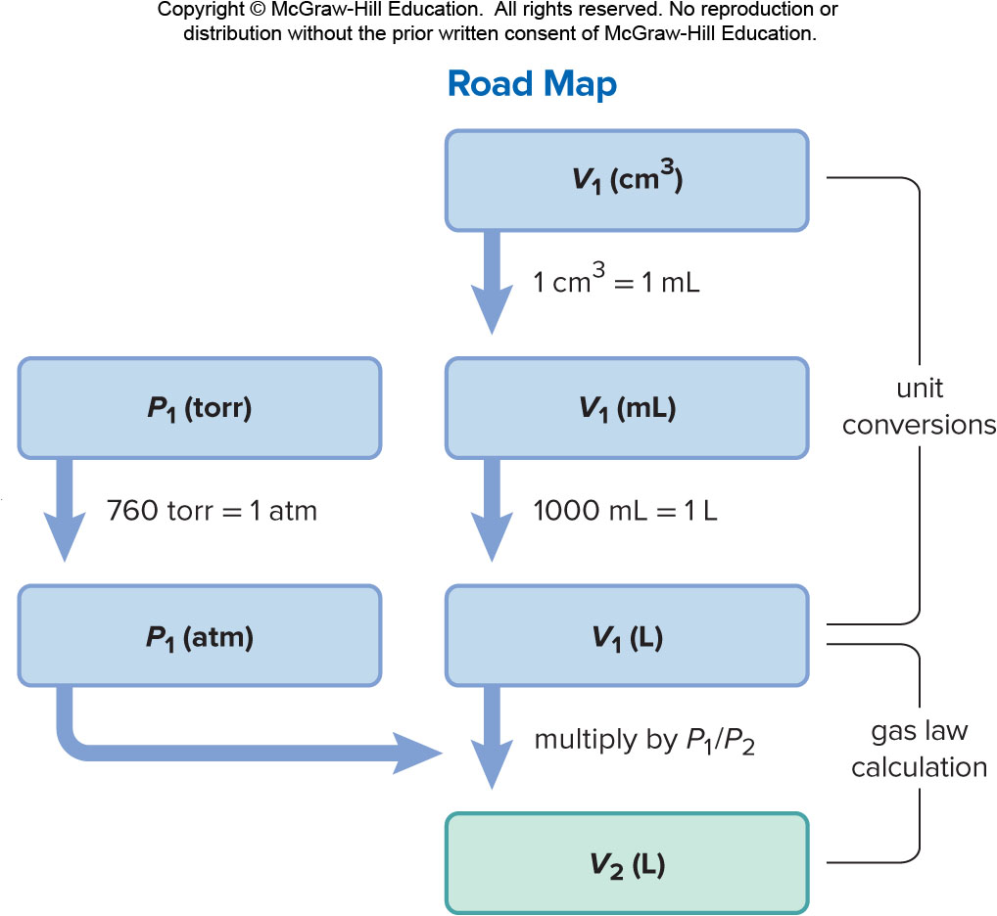
Sample Problem 5.2 –Plan

Slide 26
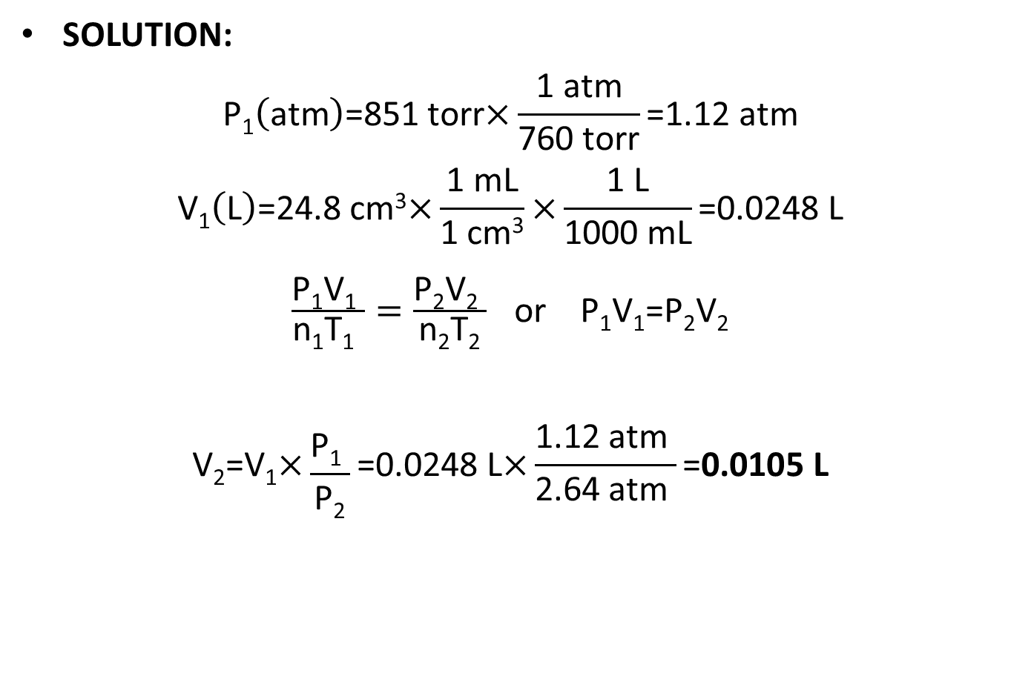
Sample Problem 5.2 - Solution
SOLUTION:
$$\text{P}\text{1}\left(\text{atm}\right)\text{=851 }\text{torr}\text{×}\frac{\text{1 }\text{atm}}{\text{760 }\text{torr}}\text{=1.12 }\text{atm}$$
$$\text{V}\text{1}\left(\text{L}\right)\text{=24.8 }\text{cm}\text{3}\text{×}\frac{\text{1 }\text{mL}}{\text{1 }\text{cm}\text{3}}\text{×}\frac{\text{1 }\text{L}}{\text{1000 }\text{mL}}\text{=0.0248 }\text{L}$$
$\frac{\text{P}\text{1}\text{V}\text{1} }{\text{n}\text{1}\text{T}\text{1} }=\frac{\text{P}\text{2}\text{V}\text{2} }{\text{n}\text{2}\text{T}\text{2}}$ or $\text{P}\text{1}\text{V}\text{1}\text{=}\text{P}\text{2}\text{V}\text{2}$
$$\text{V}\text{2}\text{=}\text{V}\text{1}\text{×}\frac{\text{P}\text{1} }{\text{P}\text{2}}\text{=0.0248 }\text{L}\text{×}\frac{\text{1.12 }\text{atm} }{\text{2.64 }\text{atm} }\text{=}\text{0.0105 }\text{L}$$

Slide 27
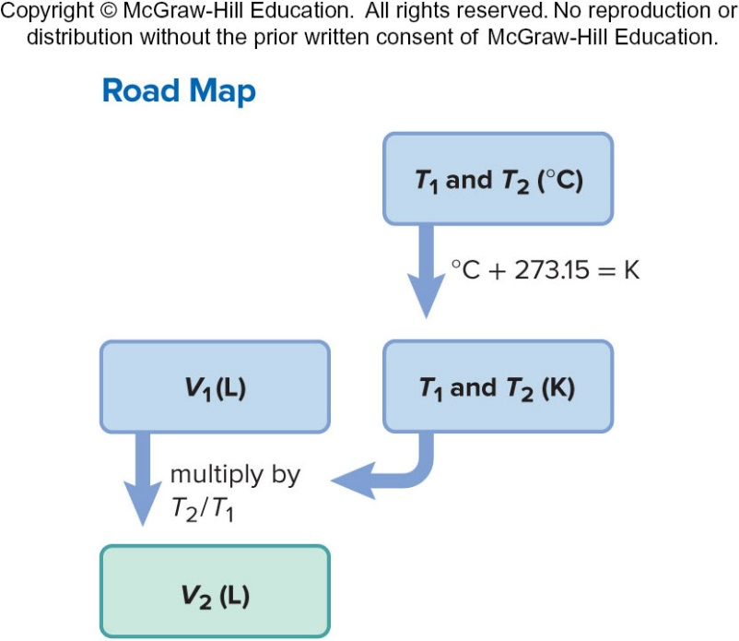
Sample Problem 5.3 – Problem and Plan
Applying the Volume-Temperature and Pressure-Temperature Relationships
PROBLEM: A balloon is filled with 1.95 L of air at 25°C and then placed in a car in the sun. What is the volume of the balloon when the temperature in the car reaches 90°C?
PLAN: We know the initial volume (V₁) and the initial (T₁) and final temperatures (T₂) of the gas; we must find the final volume (V₂). The pressure of the gas is fixed since the balloon is subjected to atmospheric pressure and n is fixed since air cannot escape or enter the balloon. We convert both T values to degrees Kelvin, rearrange the ideal gas law, and solve for V₂.

Slide 28
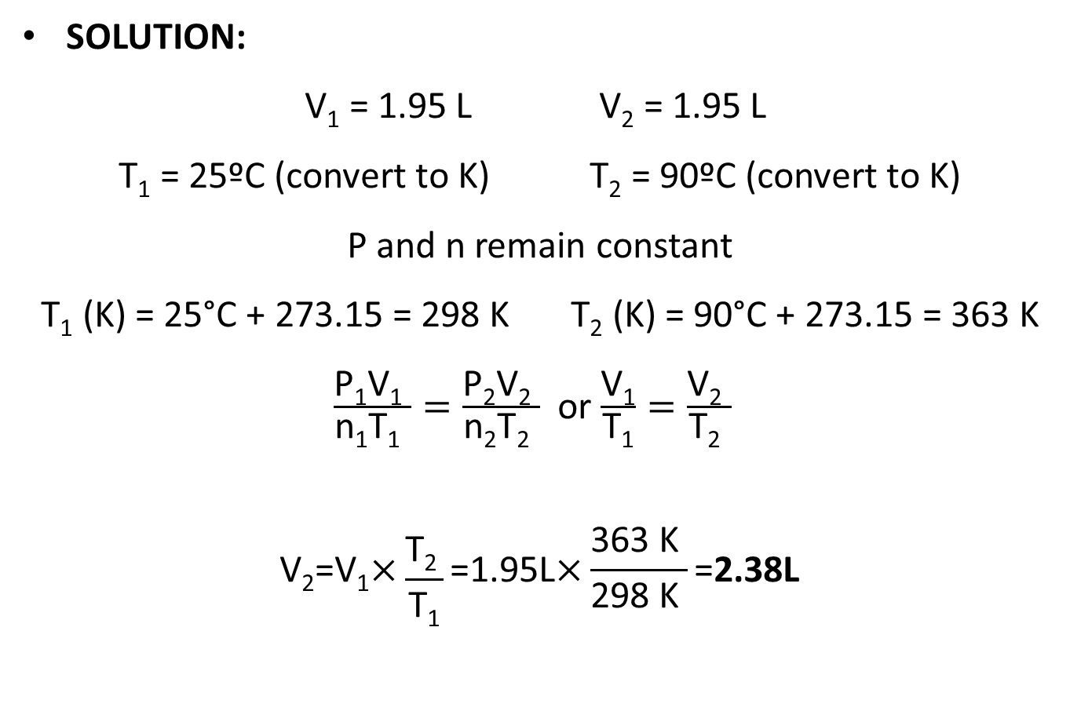
Sample Problem 5.3 - Solution
SOLUTION:
V₁ = 1.95 L V₂ = 1.95 L
T₁ = 25ºC (convert to K) T₂ = 90ºC (convert to K)
P and n remain constant
T₁ (K) = 25°C + 273.15 = 298 K T₂ (K) = 90°C + 273.15 = 363 K
$\frac{\text{P}\text{1}\text{V}\text{1} }{\text{n}\text{1}\text{T}\text{1} }=\frac{\text{P}\text{2}\text{V}\text{2} }{\text{n}\text{2}\text{T}\text{2} }$ or $\frac{\text{V}\text{1}}{\text{T}\text{1}}=\frac{\text{V}\text{2} }{\text{T}\text{2} }$
$$\text{V}\text{2}\text{=}\text{V}\text{1}\text{×}\frac{\text{T}\text{2 }}{\text{T}\text{1}}\text{=1.95}\text{L}\text{×}\frac{\text{363 }\text{K} }{\text{298 }\text{K} }\text{=}\text{2.38}\text{L}$$

Slide 29
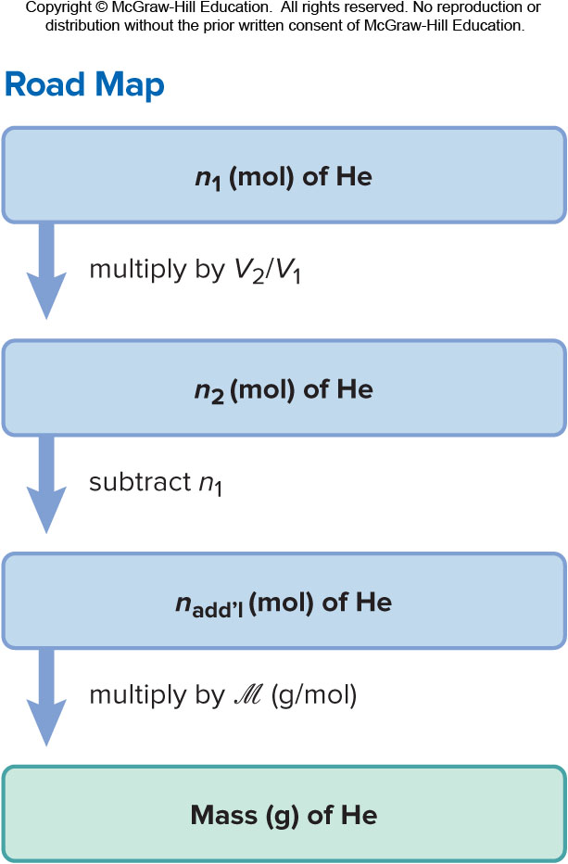
Sample Problem 5.4 – Problem and Plan
Applying the Volume-Amount Relationship
PROBLEM: A scale model of a blimp rises when it is filled with helium to a volume of 55.0 dm³. When 1.10 mol of He is added to the blimp, the volume is 26.2 dm³. How many more grams of He must be added to make it rise? Assume constant T and P.
PLAN: The initial amount of helium (n₁) is given, as well as the initial volume (V₁) and the volume needed to make it rise (V₂). We need to calculate n₂, and hence the mass of He to be added.
Notes:
29

Slide 30
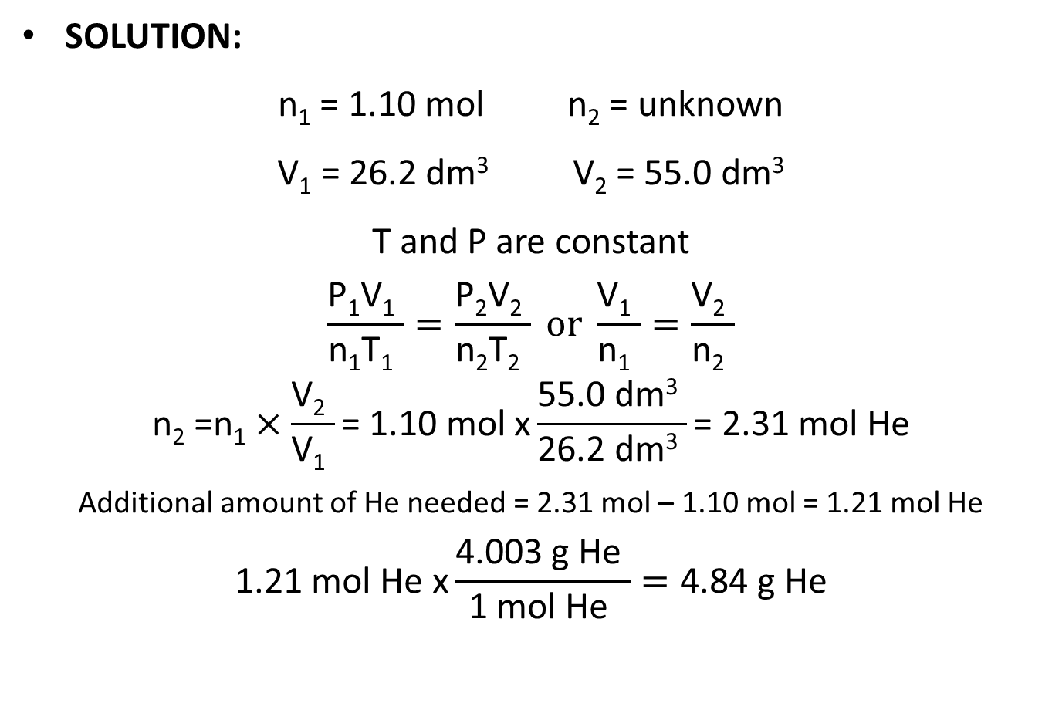
Sample Problem 5.4 - Solution
SOLUTION:
n₁ = 1.10 mol n₂ = unknown
V₁ = 26.2 dm³ V₂ = 55.0 dm³
T and P are constant
$$\frac{\text{P}\text{1}\text{V}\text{1} }{\text{n}\text{1}\text{T}\text{1} }=\frac{\text{P}\text{2}\text{V}\text{2} }{\text{n}\text{2}\text{T}\text{2} } or \frac{\text{V}\text{1} }{\text{n}\text{1} }=\frac{\text{V}\text{2} }{\text{n}\text{2} }$$
$$\text{n}\text{2}\text{ =}\text{n}\text{1}×\frac{\text{V}\text{2} }{\text{V}\text{1} }\text{= 1.10 }\text{mol} \text{x}\frac{\text{55.0 }\text{dm}\text{3} }{\text{26.2 }\text{dm}\text{3} }\text{= 2.31 }\text{mol} \text{He}$$
Additional amount of He needed = 2.31 mol – 1.10 mol = 1.21 mol He
$$\text{1.21 }\text{mol} \text{He} \text{x}\frac{\text{4.003 }\text{g} \text{He} }{\text{1 }\text{mol} \text{He} }=\text{4.84 }\text{g} \text{He}$$

Slide 31
Sample Problem 5.5 – Problem and Plan
Applying the Volume-Pressure-Temperature Relationship
PROBLEM: A helium-filled balloon has a volume of 15.8 L at a pressure of 0.980 atm and 22°C. What is its volume at the summit of Mt. Hood, Oregon’s highest mountain, where the atmospheric pressure is 532 mmHg and the temperature is 0°C?
PLAN: We know the initial volume (V₁), pressure (P₁), and temperature (T₁) of the gas; we also know the final pressure (P₂) and temperature (T₂) and we must find the final volume (V₂). Since the amount of helium in the balloon does not change, n is fixed. We convert both T values to degrees Kelvin, the final pressure to atm, rearrange the generalized ideal gas equation, and solve for V₂.
Notes:
31

Slide 32
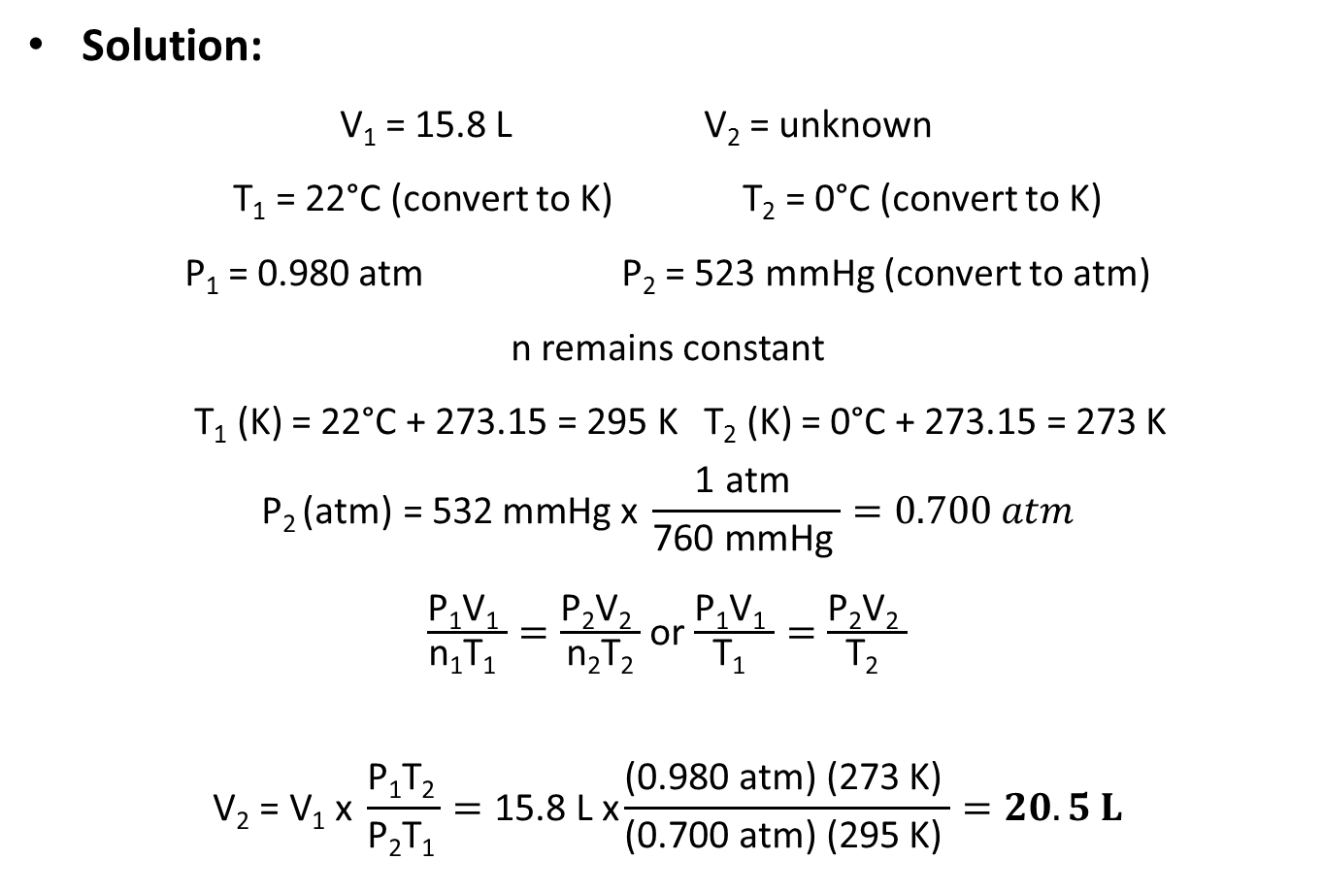
Sample Problem 5.5 - Solution
Solution:
V₁ = 15.8 L V₂ = unknown
T₁ = 22°C (convert to K) T₂ = 0°C (convert to K)
P₁ = 0.980 atm P₂ = 523 mmHg (convert to atm)
n remains constant
T₁ (K) = 22°C + 273.15 = 295 K T₂ (K) = 0°C + 273.15 = 273 K
$$\text{P}\text{2 }\text{(}\text{atm}\text{) = 532 }\text{mmHg} \text{x} \frac{\text{1 }\text{atm} }{\text{760 }\text{mmHg} }=0.700 atm$$
$\frac{\text{P}\text{1}\text{V}\text{1} }{\text{n}\text{1}\text{T}\text{1} }=\frac{\text{P}\text{2}\text{V}\text{2} }{\text{n}\text{2}\text{T}\text{2}}$ or $\frac{\text{P}\text{1}\text{V}\text{1} }{\text{T}\text{1} }=\frac{\text{P}\text{2}\text{V}\text{2} }{\text{T}\text{2} }$
$$\text{V}\text{2}\text{ = }\text{V}\text{1} \text{x} \frac{\text{P}\text{1}\text{T}\text{2 }}{\text{P}\text{2}\text{T}\text{1 }}=\text{15.8 }\text{L} \text{x}\frac{\text{(0.980 }\text{atm}\text{) (273 }\text{K}\text{) }}{\text{(0.700 }\text{atm}\text{) (295 }\text{K}\text{) }}=20.5 L$$

Slide 33
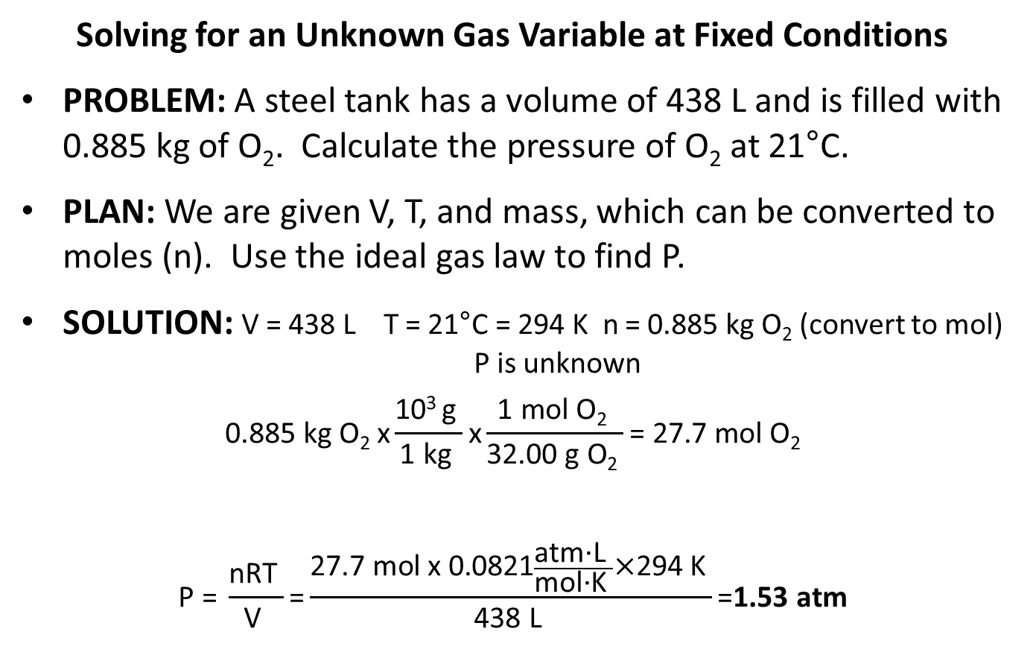
Sample Problem 5.6 – Problem, Plan and Solution
Solving for an Unknown Gas Variable at Fixed Conditions
PROBLEM: A steel tank has a volume of 438 L and is filled with 0.885 kg of O₂. Calculate the pressure of O₂ at 21°C.
PLAN: We are given V, T, and mass, which can be converted to moles (n). Use the ideal gas law to find P.
SOLUTION: V = 438 L T = 21°C = 294 K n = 0.885 kg O₂ (convert to mol) P is unknown
$$\text{0.885 }\text{kg} \text{O}\text{2} \text{x}\frac{\text{10}\text{3 }\text{g} }{\text{1 }\text{kg} }\text{x}\frac{\text{1 }\text{mol} \text{O}\text{2} }{\text{32.00 }\text{g} \text{O}\text{2} }\text{= 27.7 }\text{mol} \text{O}\text{2}$$
$$\text{P}\text{ = }\frac{\text{nRT} }{\text{V} }\text{=}\frac{\text{27.7 }\text{mol} \text{x} \text{0}\text{.}\text{0821}\frac{\text{atm}\text{·}\text{L} }{\text{mol}\text{·}\text{K} }\text{×}\text{294 }\text{K} }{\text{438 }\text{L} }\text{=}\text{1.53 }\text{atm}$$

Slide 34
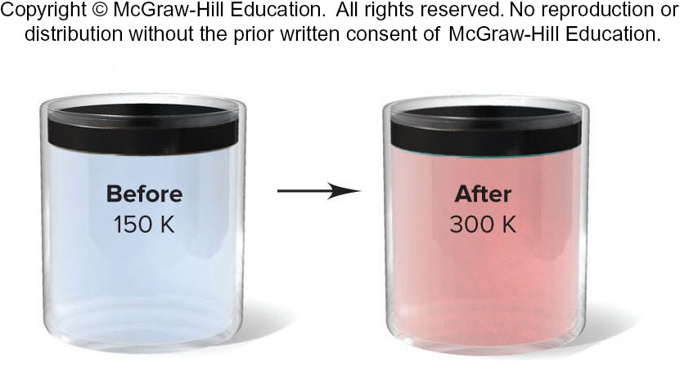
Sample Problem 5.7 - Problem
Using Gas Laws to Determine a Balanced Equation
PROBLEM: The piston-cylinder is depicted before and after a gaseous reaction that is carried out at constant pressure. The temperature is 150 K before the reaction and 300 K after the reaction. (Assume the cylinder is insulated.)
Which of the following balanced equations describes the reaction?
(1) A₂ (g) + B₂ (g) → 2AB (g) (2) 2AB (g) + B₂ (g) → 2AB₂ (g)
(3) A (g) + B₂ (g) → AB₂ (g) (4) 2AB₂ (g) → A₂ (g) + 2B₂ (g)

Slide 35
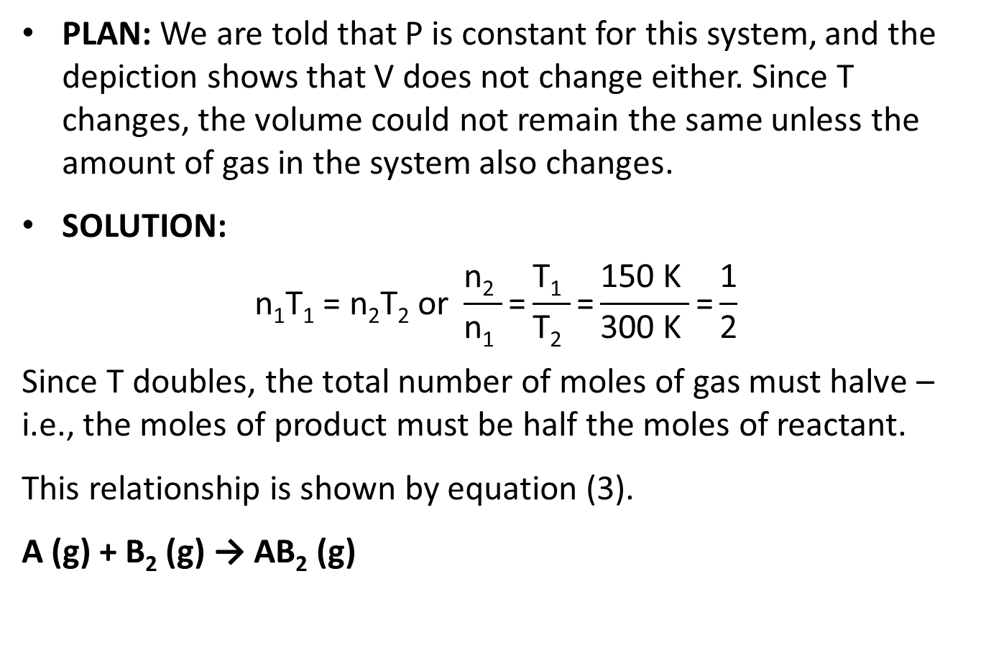
Sample Problem 5.7 – Plan and Solution
PLAN: We are told that P is constant for this system, and the depiction shows that V does not change either. Since T changes, the volume could not remain the same unless the amount of gas in the system also changes.
SOLUTION:
$$\text{n}\text{1}\text{T}\text{1} \text{=} \text{n}\text{2}\text{T}\text{2} \text{or} \frac{\text{n}\text{2} }{\text{n}\text{1} }\text{=}\frac{\text{T}\text{1} }{\text{T}\text{2} }\text{=}\frac{\text{150 }\text{K} }{\text{300 }\text{K} }\text{=}\frac{\text{1}}{\text{2}}$$
Since T doubles, the total number of moles of gas must halve – i.e., the moles of product must be half the moles of reactant.
This relationship is shown by equation (3).
A (g) + B₂ (g) → AB₂ (g)
Notes:
35

Slide 36

The Ideal Gas Law and Gas Density
The density of a gas is
  directly proportional to its molar mass and
  inversely proportional to its temperature.
$\text{density}\text{ =}\frac{\text{m} }{\text{V}}$ and $\text{moles}\text{ = }\frac{\text{m}}{\text{M} }$
$$\text{PV}\text{ = }\frac{\text{m}}{\text{M}}\text{RT}$$
$$\frac{\text{m}}{\text{V}} \text{= }\text{d}\text{ = }\frac{\text{MP}}{\text{RT}}$$

Slide 37
Sample Problem 5.8 – Problem and Plan
Calculating Gas Density
PROBLEM: To apply a green chemistry approach, a chemical engineer uses waste CO₂ from a manufacturing process, instead of chlorofluorocarbons, as a “blowing agent” in the production of polystyrene. Find the density (in g/L) of CO₂ and the number of molecules per liter (a) at STP (0°C and 1 atm) and (b) at room conditions (20.°C and 1.00 atm).
PLAN: We must find the density (d) and the number of molecules of CO₂, given two sets of P and T data. We find ​​, convert T to kelvins, and calculate d. Then we convert the mass per liter to molecules per liter with Avogadro’s number.
Notes:
37

Slide 38
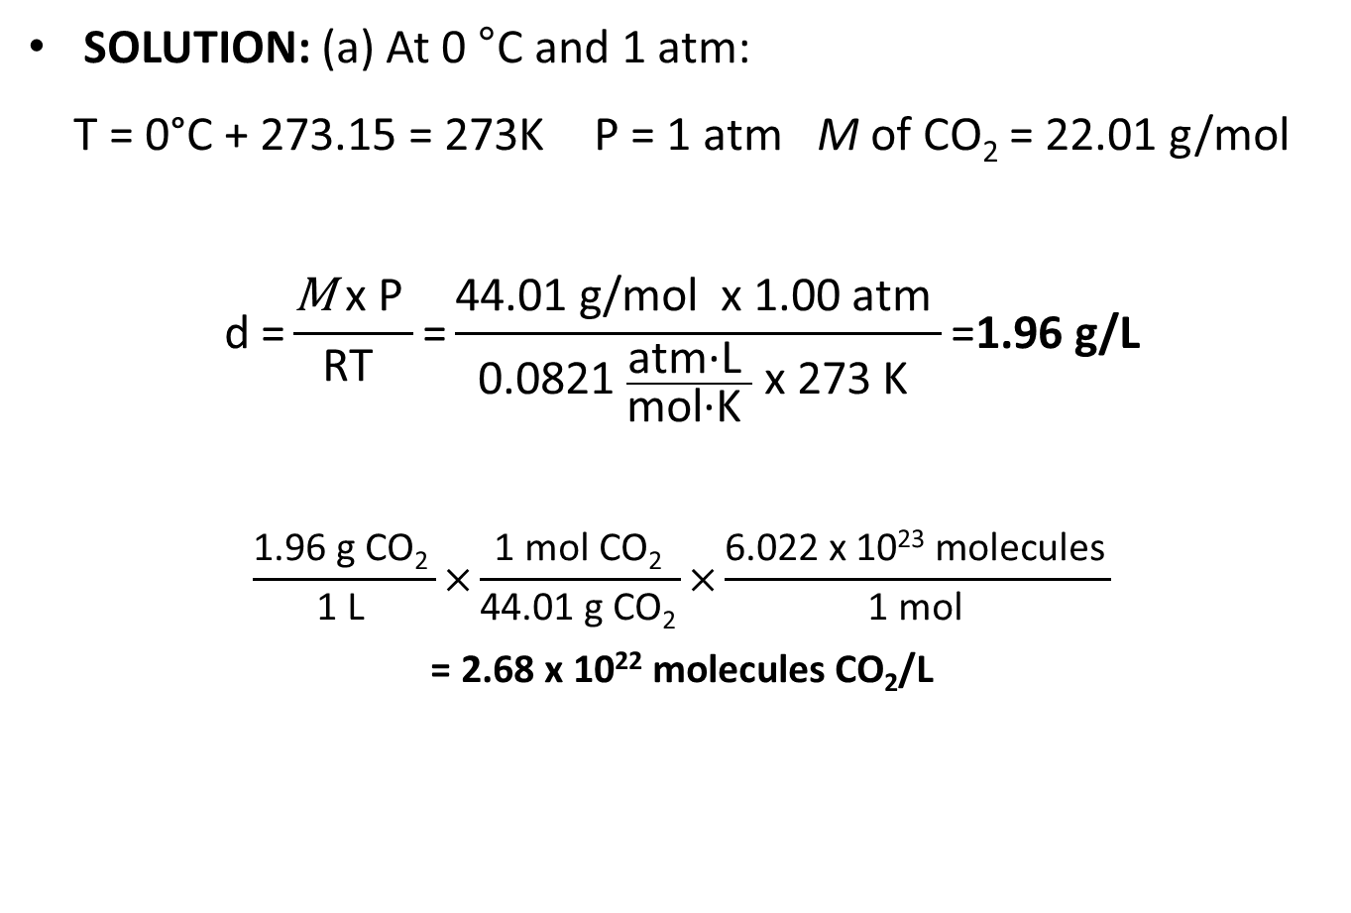
Sample Problem 5.8 – Solution
SOLUTION: (a) At 0 °C and 1 atm:
T = 0°C + 273.15 = 273K P = 1 atm M of CO₂ = 22.01 g/mol
$$\text{d}\text{ =}\frac{\text{M} \text{x} \text{P} }{\text{RT} }\text{=}\frac{\text{44.01 }\text{g}\text{/}\text{mol} \text{x}\text{ 1.00 }\text{atm} }{\text{0.0821 }\frac{\text{atm}\text{·}\text{L} }{\text{mol}\text{·}\text{K} } \text{x}\text{ 273 }\text{K} }\text{=}\text{1.96 }\text{g}\text{/}\text{L}$$
$$\frac{\text{1.96 }\text{g} \text{CO}\text{2} }{\text{1 }\text{L} }\text{×}\frac{\text{1 }\text{mol} \text{CO}\text{2} }{\text{44.01 }\text{g} \text{CO}\text{2} }\text{×}\frac{\text{6.022 }\text{x}\text{ 1023 }\text{molecules} }{\text{1 }\text{mol} }$$
$$\text{= 2.68 }\text{x}\text{ 1022 }\text{molecules} \text{CO}\text{2}\text{/}\text{L}$$
Notes:
38

Slide 39
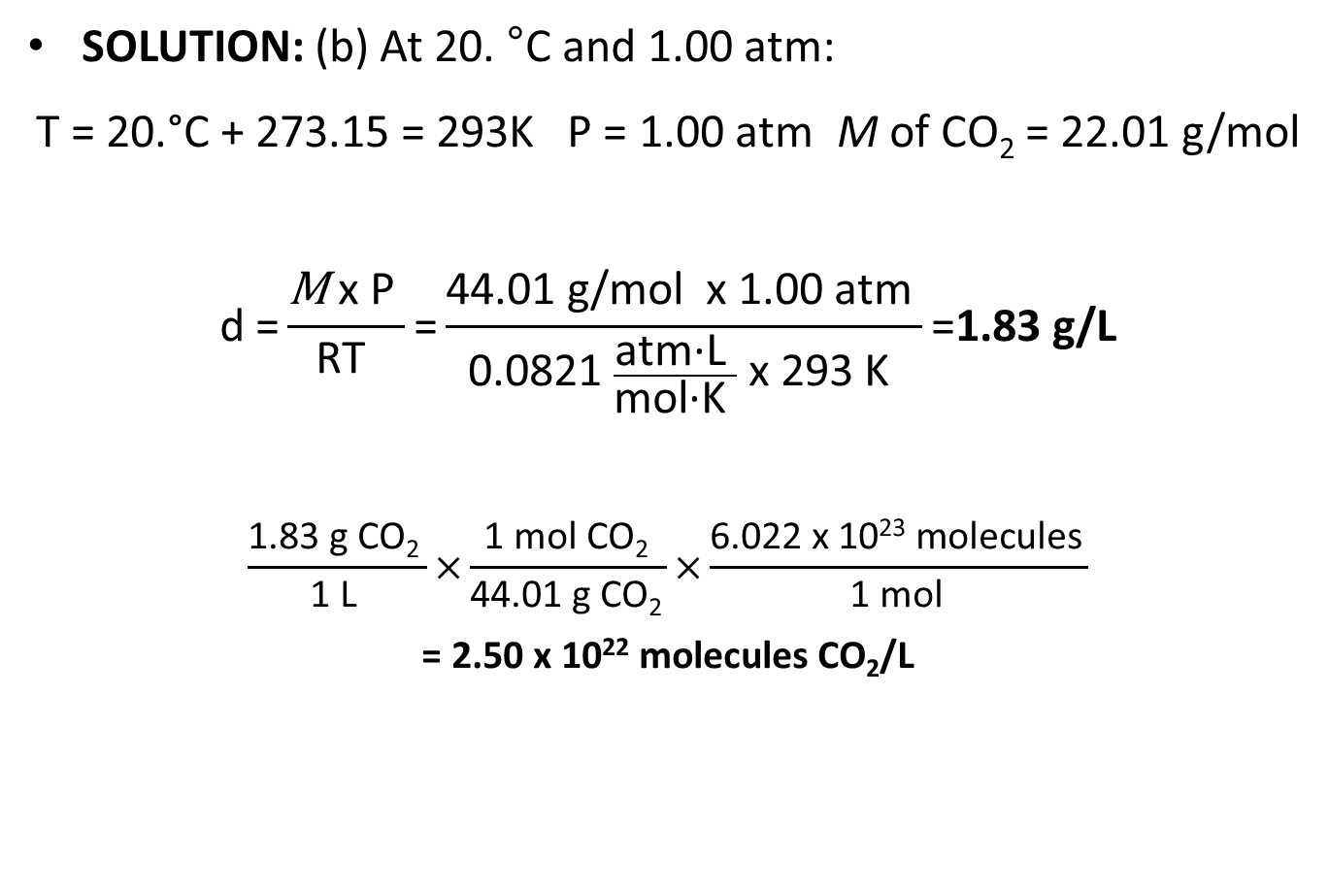
Sample Problem 5.8 – Solution, Cont’d
SOLUTION: (b) At 20. °C and 1.00 atm:
T = 20.°C + 273.15 = 293K P = 1.00 atm M of CO₂ = 22.01 g/mol
$$\text{d}\text{ =}\frac{\text{M} \text{x} \text{P} }{\text{RT} }\text{=}\frac{\text{44.01 }\text{g}\text{/}\text{mol} \text{x}\text{ 1.00 }\text{atm} }{\text{0.0821 }\frac{\text{atm}\text{·}\text{L} }{\text{mol}\text{·}\text{K} } \text{x}\text{ 293 }\text{K} }\text{=}\text{1.83 }\text{g}\text{/}\text{L}$$
$$\frac{\text{1.}\text{83} \text{g} \text{CO}\text{2} }{\text{1 }\text{L} }\text{×}\frac{\text{1 }\text{mol} \text{CO}\text{2} }{\text{44.01 }\text{g} \text{CO}\text{2} }\text{×}\frac{\text{6.022 }\text{x}\text{ 1023 }\text{molecules} }{\text{1 }\text{mol} }$$
$$\text{= 2.50 }\text{x}\text{ 1022 }\text{molecules} \text{CO}\text{2}\text{/}\text{L}$$
Notes:
39

Slide 40

Molar Mass from the Ideal Gas Law
$$\text{n}\text{=}\frac{\text{m}}{\text{M}}\text{=}\frac{\text{PV}}{\text{RT}}$$
$$\text{M}\text{=}\frac{\text{mRT}}{\text{PV}}$$

Slide 41
Sample Problem 5.9 – Problem and Plan
Finding the Molar Mass of a Volatile Liquid
PROBLEM: An organic chemist isolates a colorless liquid from a petroleum sample. She places the liquid in a preweighed flask and puts the flask in boiling water, causing the liquid to vaporize and fill the flask with gas. She closes the flask and reweighs it. She obtains the following data:
Volume (V) of flask = 213 mL T = 100.0°C P = 754 torr
mass of flask + gas = 78.416 g mass of flask = 77.834 g
Calculate the molar mass of the liquid.
PLAN: The variables V, T and P are given. We find the mass of the gas by subtracting the mass of the flask from the mass of the flask with the gas in it, and use this information to calculate M.

Slide 42
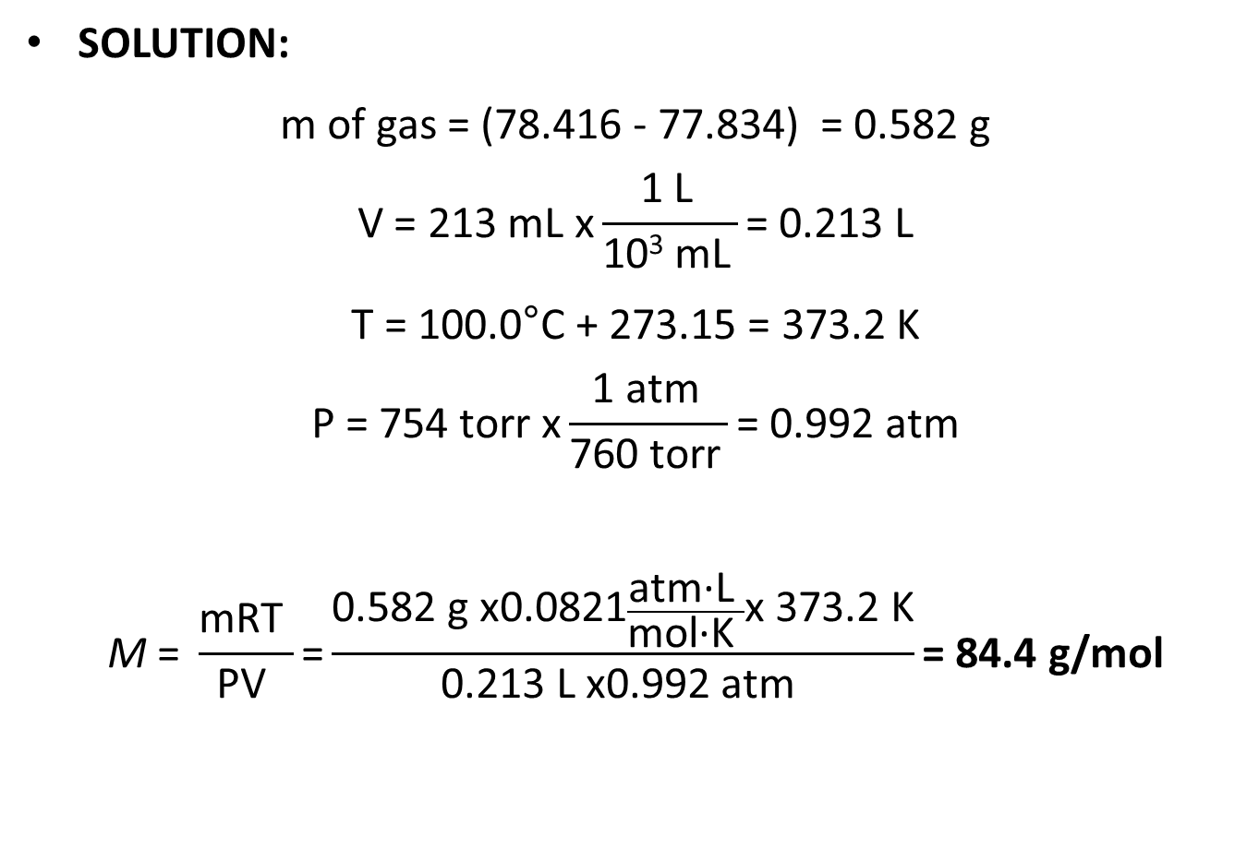
Sample Problem 5.9 - Solution
SOLUTION:
m of gas = (78.416 - 77.834) = 0.582 g
$$\text{V}\text{ = 213 }\text{mL} \text{x}\frac{\text{1 }\text{L} }{\text{10}\text{3} \text{mL} }\text{= 0.213 }\text{L}$$
T = 100.0°C + 273.15 = 373.2 K
$$\text{P}\text{ = 754 }\text{torr} \text{x}\frac{\text{1 }\text{atm} }{\text{760 }\text{torr} }\text{= 0.992 }\text{atm}$$
$$\text{M} \text{= }\frac{\text{mRT} }{\text{PV} }\text{=}\frac{\text{0.582 }\text{g} \text{x}\text{0.0821}\frac{\text{atm}\text{·}\text{L} }{\text{mol}\text{·}\text{K} }\text{x}\text{ 373.2 }\text{K}}{\text{0.213 }\text{L} \text{x}\text{0.992 }\text{atm} }\text{= 84.4 }\text{g}\text{/}\text{mol}$$
Notes:
42

Slide 43
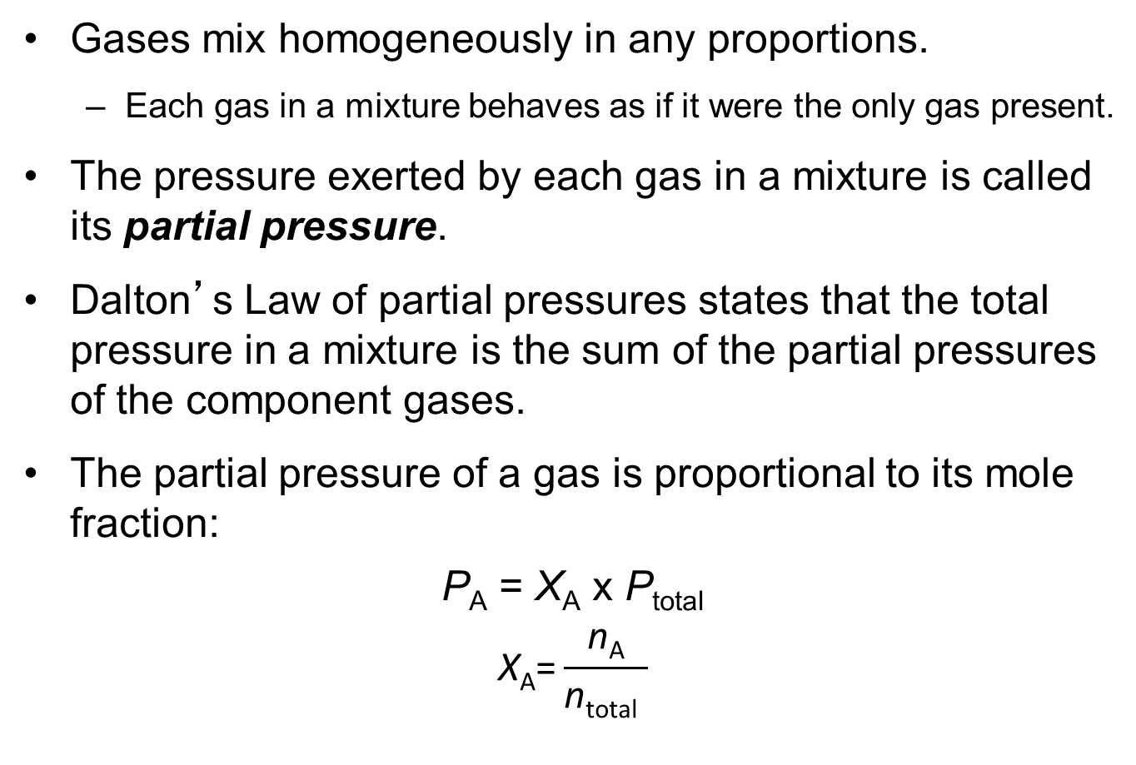
Mixtures of Gases
Gases mix homogeneously in any proportions.
  Each gas in a mixture behaves as if it were the only gas present.
The pressure exerted by each gas in a mixture is called its partial pressure.
Dalton’s Law of partial pressures states that the total pressure in a mixture is the sum of the partial pressures of the component gases.
The partial pressure of a gas is proportional to its mole fraction:
$$\text{P}\text{A}\text{ = }\text{Χ}\text{A} \text{x} \text{P}\text{total}$$
$$\text{X}\text{A}\text{=}\frac{\text{n}\text{A}}{\text{n}\text{total} }$$

Slide 44
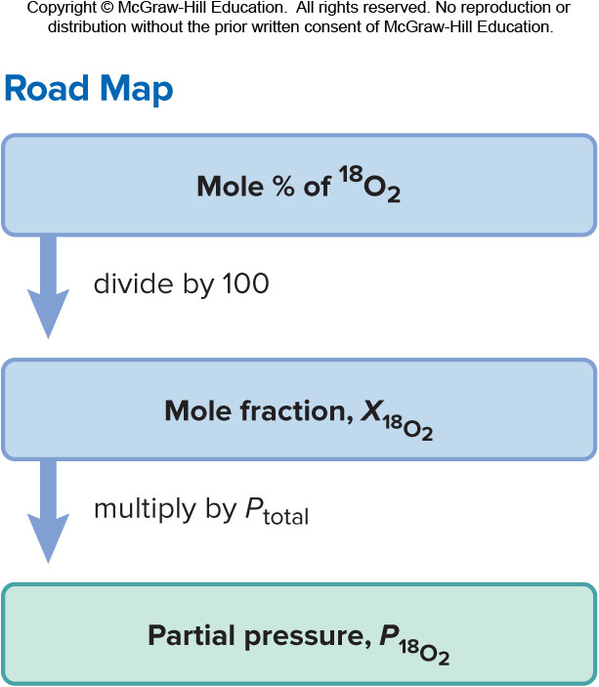
Sample Problem 5.10 – Problem and Plan
Applying Dalton’s Law of Partial Pressures
PROBLEM: In a study of O₂ uptake by muscle at high altitude, a physiologist prepares an atmosphere consisting of 79 mole % N₂, 17 mole % ¹⁶O_{2,} and 4.0 mole % ¹⁸O₂. (The isotope ¹⁸O will be measured to determine the O₂ uptake.) The total pressure of the mixture is 0.75 atm to simulate high altitude. Calculate the mole fraction and partial pressure of ¹⁸O₂ in the mixture.
PLAN: Find X¹⁸O₂ and P¹⁸O₂ from P_{total} and mol % ¹⁸O₂. Dividing the mole % by 100 gives the mole fraction, X¹⁸O₂. Then we multiply X¹⁸O₂ by P_{total} to find P¹⁸O₂.

Slide 45

Sample Problem 5.10 - Solution
SOLUTION:
$$\text{X}\text{18}\text{O}\text{2 }\text{=}\frac{\text{4.0 }\text{mol}\text{ \%18}\text{O}\text{2}}{\text{100}}\text{ = 0.040}$$
$$\text{P}\text{18}\text{O}\text{2} \text{= }\text{X}\text{18}\text{O}\text{2} \text{×} \text{Ptotal}\text{ = 0.040 }\text{×}\text{ 0.75}\text{atm}\text{ =}\text{ 0.030 }\text{atm}$$
Notes:
45

Slide 46
Vapor Pressure of Water at Different Temperatures
T (°C) | P_{H2O} (torr) | T (°C) | P_{H2O} (torr) | T (°C) | P_{H2O} (torr) | T (°C) | P_{H2O} (torr)
0 | 4.6 | 20 | 17.5 | 40 | 55.3 | 75 | 289.1
5 | 6.5 | 22 | 19.8 | 45 | 71.9 | 80 | 355.1
10 | 9.2 | 24 | 22.4 | 50 | 92.5 | 85 | 433.6
12 | 10.5 | 26 | 25.2 | 55 | 118.0 | 90 | 525.8
14 | 12.0 | 28 | 28.3 | 60 | 149.4 | 95 | 633.9
16 | 13.6 | 30 | 31.8 | 65 | 187.5 | 100 | 760.0
18 | 15.5 | 35 | 42.2 | 70 | 233.7

Slide 47
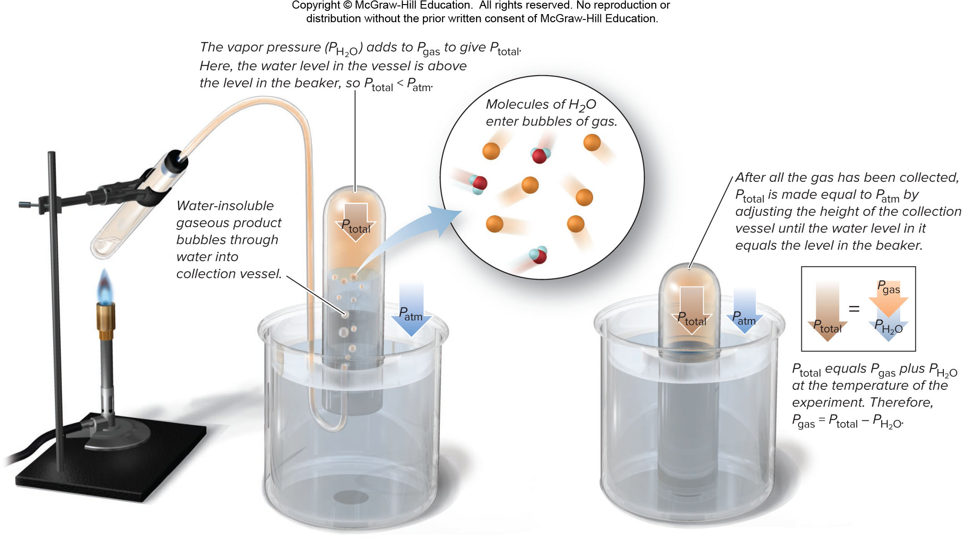
Determining Pressure of a Water-insoluble Gaseous Product
Figure 5.12

Slide 48
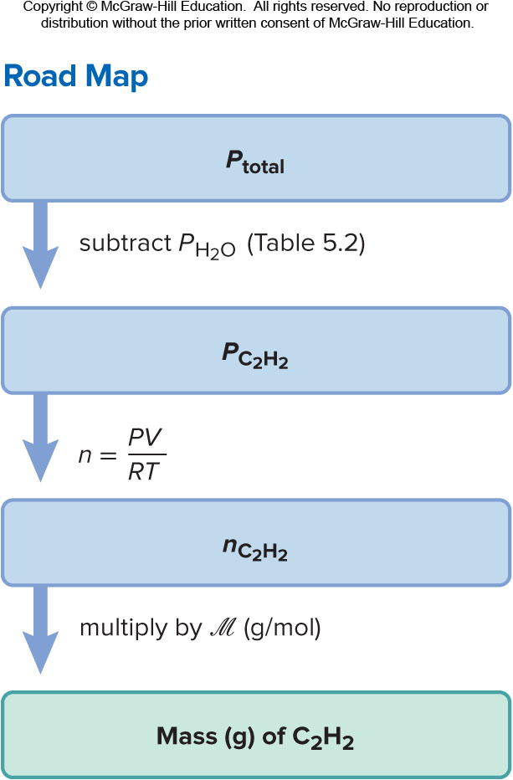
Sample Problem 5.11 – Problem and Plan
Calculating the Amount of Gas Collected over Water
PROBLEM: Acetylene (C₂H₂) is produced in the laboratory when calcium carbide (CaC₂) reacts with water:
CaC₂ (s) + 2H₂O (l) → C₂H₂ (g) + Ca(OH)₂ (aq)
A collected sample of acetylene has a total gas pressure of 738 torr and a volume of 523 mL. At the temperature of the gas (23°C), the vapor pressure of water is 21 torr. How many grams of acetylene are collected?
PLAN: The difference in pressures will give P for the C₂H₂. The number of moles (n) is calculated from the ideal gas law and converted to mass using the molar mass.

Slide 49
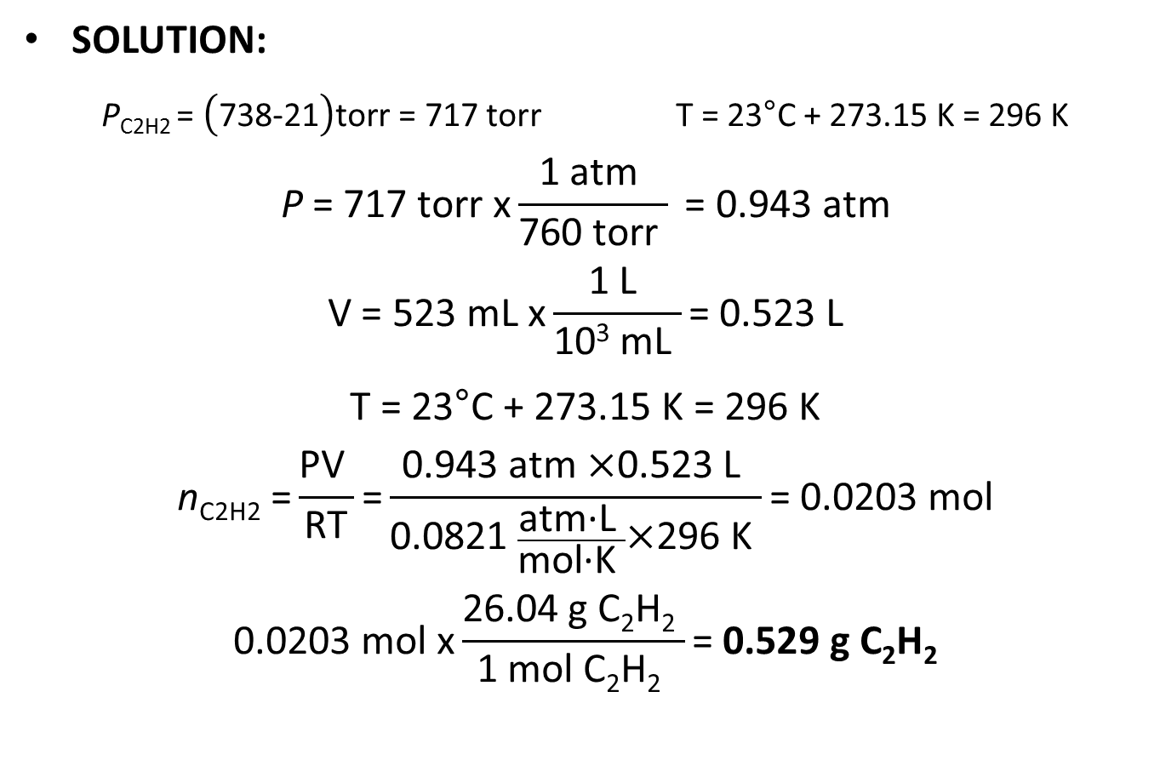
Sample Problem 5.11 - Solution
SOLUTION:
$\text{P}\text{C}\text{2}\text{H}\text{2 = }\left(\text{738−21}\right)\text{torr}\text{ = 717 }\text{torr}$ T = 23°C + 273.15 K = 296 K
$$\text{P}\text{ = 717 }\text{torr} \text{x}\frac{\text{1 }\text{atm} }{\text{760 }\text{torr} }\text{ = 0.943 }\text{atm}$$
$$\text{V}\text{ = 523 }\text{mL} \text{x}\frac{\text{1 }\text{L} }{\text{10}\text{3} \text{mL} }\text{= 0.523 }\text{L}$$
T = 23°C + 273.15 K = 296 K
$$\text{n}\text{C}\text{2}\text{H}\text{2 =}\frac{\text{PV} }{\text{RT}}\text{=}\frac{\text{0.943 }\text{atm} \text{×}\text{0.523 }\text{L} }{\text{0.0821 }\frac{\text{atm}\text{·}\text{L} }{\text{mol}\text{·}\text{K} }\text{×}\text{296 }\text{K} }\text{= 0.0203 }\text{mol}$$
$$\text{0.0203 }\text{mol} \text{x}\frac{\text{26.04 }\text{g} \text{C}\text{2}\text{H}\text{2} }{\text{1 }\text{mol} \text{C}\text{2}\text{H}\text{2} }\text{=} \text{0.529 }\text{g} \text{C}\text{2}\text{H}\text{2}$$

Slide 50
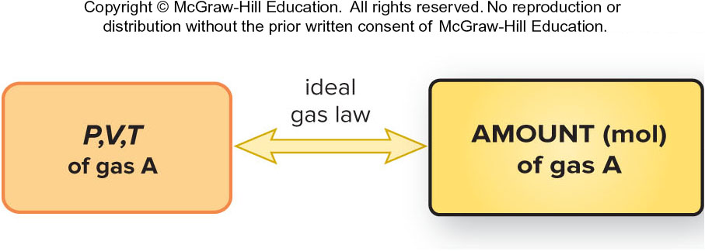
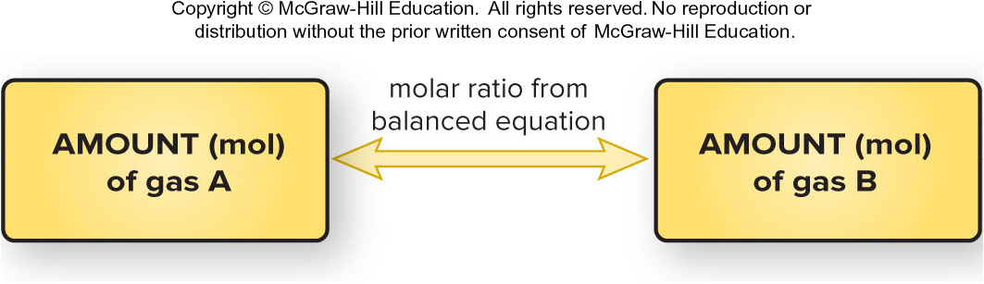
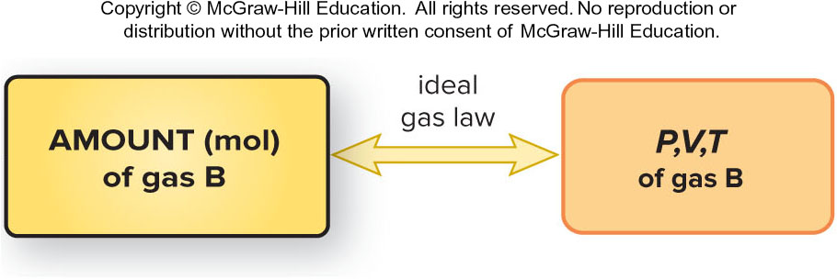
The Ideal Gas Law and Stoichiometry
Figure 15.13

Slide 51
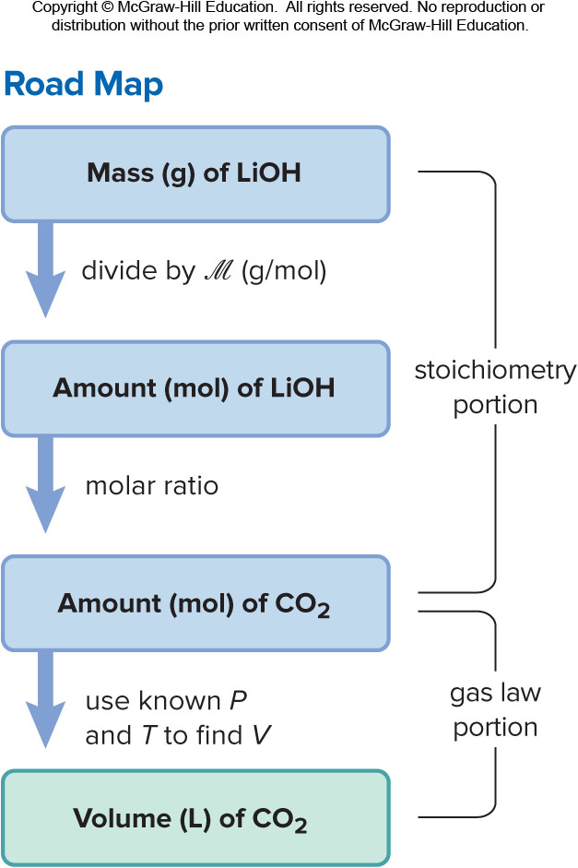
Sample Problem 5.12 – Problem and Plan
Using Gas Variables to Find Amounts of Reactants and Products I
PROBLEM: Solid lithium hydroxide is used to "scrub" CO₂ from the air in spacecraft and submarines; it reacts with the CO₂ to produce lithium carbonate and water. What volume of CO₂ at 23°C and 716 torr can be removed by reaction with 395 g of lithium hydroxide?
PLAN: Write a balanced equation. Next, we convert the given mass (395 g) of lithium hydroxide, LiOH, to amount (mol) and use the molar ratio to find amount (mol) of CO₂ that reacts (stoichiometry portion). Then, we use the ideal gas law to convert moles of CO₂ to liters (gas law portion).

Slide 52
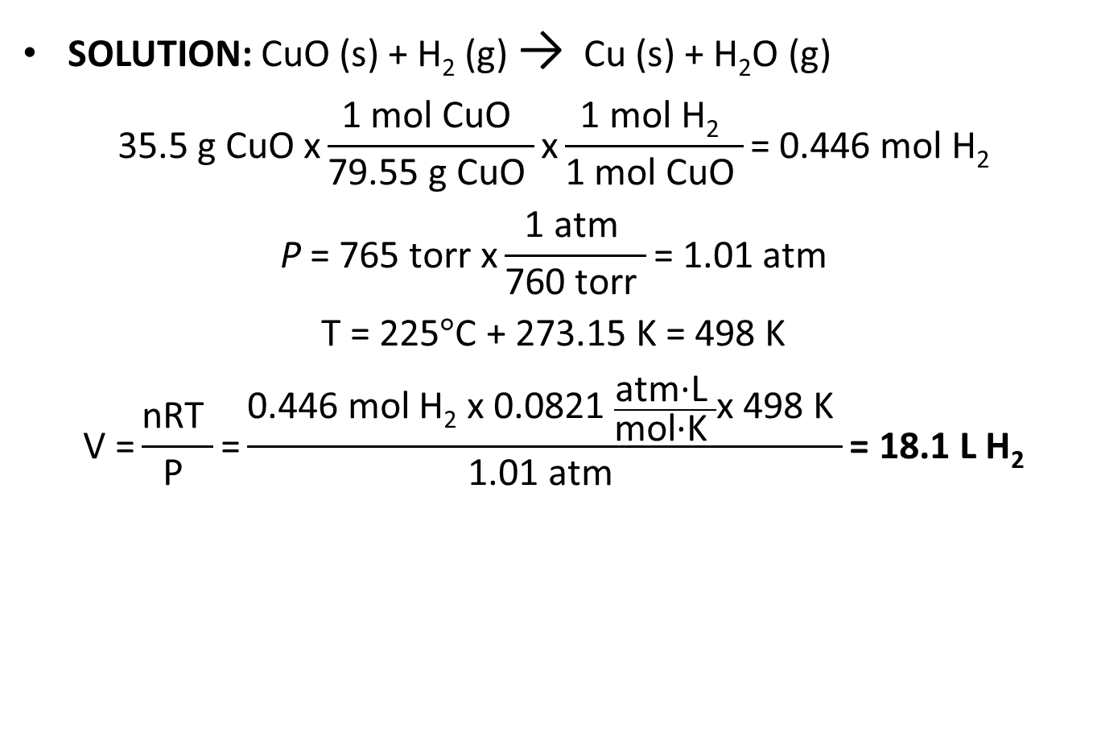
Sample Problem 5.12 - Solution
SOLUTION: CuO (s) + H₂ (g) → Cu (s) + H₂O (g)
$$\text{35.5 }\text{g} \text{CuO} \text{x}\frac{\text{1 }\text{mol} \text{CuO} }{\text{79.55 }\text{g} \text{CuO} }\text{x}\frac{\text{1 }\text{mol} \text{H}\text{2} }{\text{1 }\text{mol} \text{CuO} }\text{= 0.446 }\text{mol} \text{H}\text{2}$$
$$\text{P}\text{ = 765 }\text{torr} \text{x}\frac{\text{1 }\text{atm} }{\text{760 }\text{torr} }\text{= 1.01 }\text{atm}$$
$$\text{T}\text{ = 225}°\text{C}\text{ + 273.15 }\text{K}\text{ = 498 }\text{K}$$
$$\text{V}\text{ =}\frac{\text{nRT} }{\text{P} }\text{=}\frac{\text{0.446 }\text{mol} \text{H}\text{2} \text{x} \text{0.0821 }\frac{\text{atm}\text{·}\text{L} }{\text{mol}\text{·}\text{K} }\text{x}\text{ 498 }\text{K} }{\text{1.01 }\text{atm} }\text{= 18.1 }\text{L} \text{H}\text{2}$$
Notes:
52

Slide 53
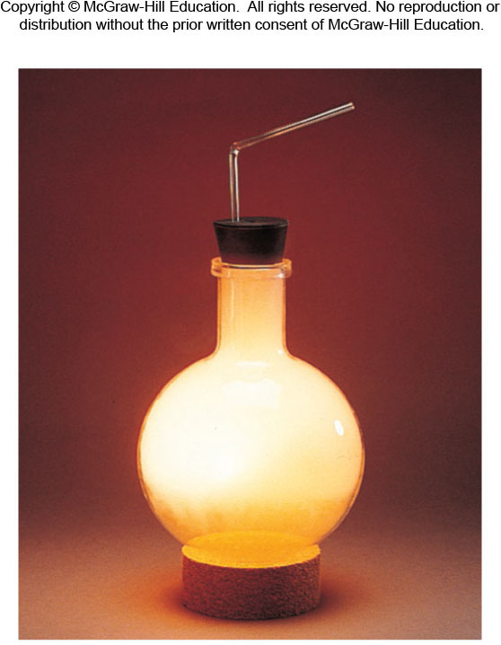
Sample Problem 5.13 – Problem
Using Gas Variables to Find Amounts of Reactants and Products II
PROBLEM: The alkali metals [Group 1A(1)]react with the halogens [Group 7A(17)] to form
ionic metal halides. What mass of
potassium chloride forms when
5.25 L of chlorine gas at 0.950 atm
and 293 K reacts with 17.0 g of
potassium?
© McGraw-Hill Education/Stephen Frisch, photographer

Slide 54
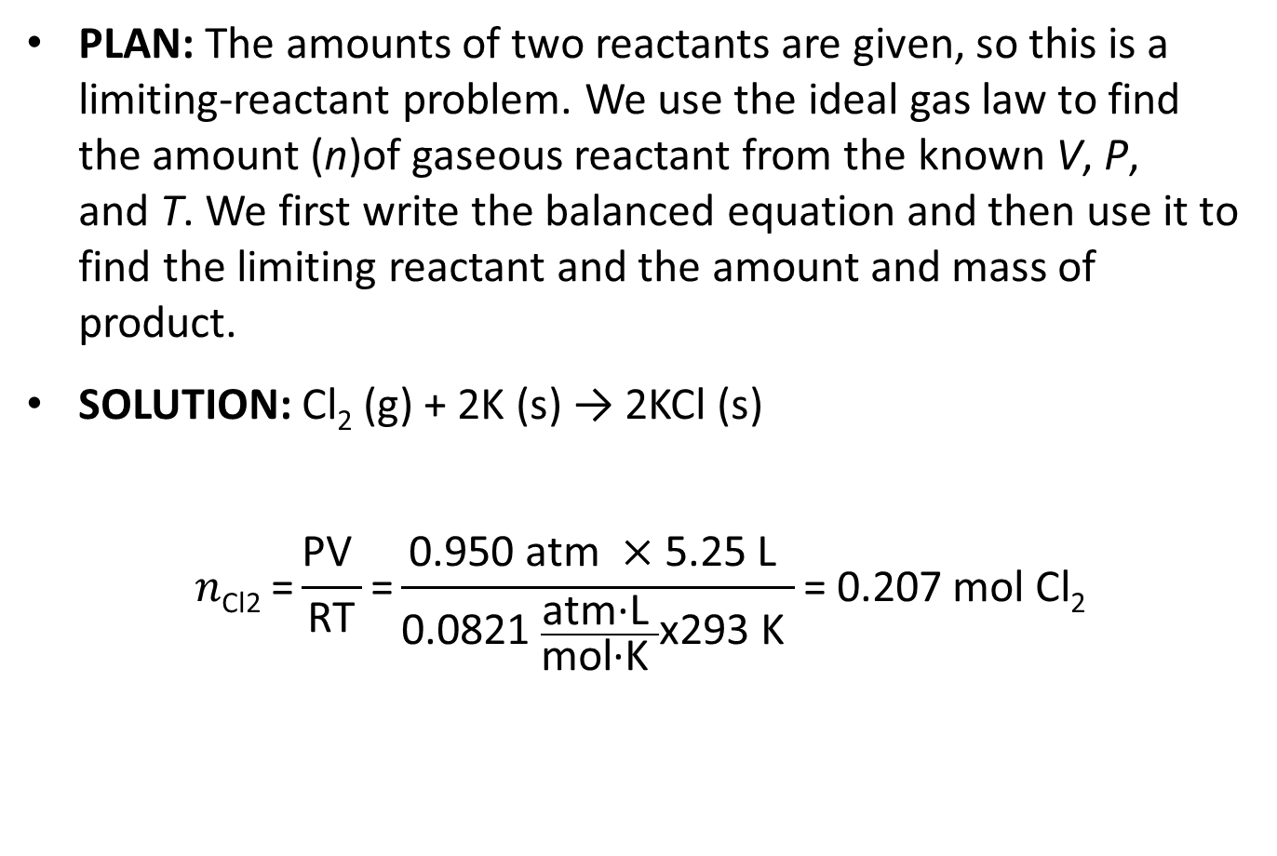
Sample Problem 5.13 – Plan and Solution
PLAN: The amounts of two reactants are given, so this is a limiting-reactant problem. We use the ideal gas law to find the amount (n)of gaseous reactant from the known V, P, and T. We first write the balanced equation and then use it to find the limiting reactant and the amount and mass of product.
SOLUTION: Cl₂ (g) + 2K (s) → 2KCl (s)
$$n\text{Cl}\text{2 =}\frac{\text{PV} }{\text{RT}}\text{=}\frac{\text{0.950 }\text{atm} ×\text{5.25 }\text{L} }{\text{0.0821 }\frac{\text{atm}\text{·}\text{L} }{\text{mol}\text{·}\text{K} }\text{x}\text{293 }\text{K} }\text{= 0.207 }\text{mol} \text{Cl}\text{2}$$

Slide 55
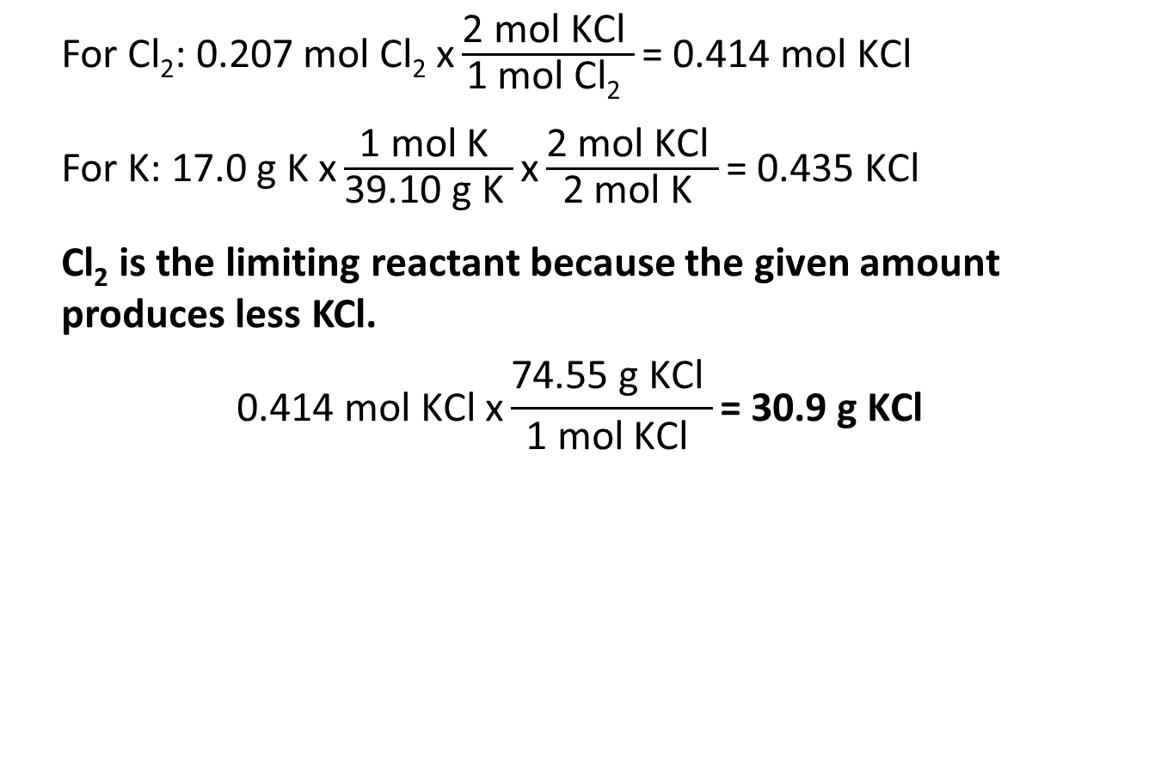
Sample Problem 5.13 – Solution
For Cl₂: $\text{0.207 }\text{mol} \text{Cl}\text{2} \text{x}\frac{\text{2 }\text{mol} \text{KCl} }{\text{1 }\text{mol} \text{Cl}\text{2} }\text{= 0.414 }\text{mol} \text{KCl}$
For K: $\text{17.0 }\text{g} \text{K} \text{x}\frac{\text{1 }\text{mol} \text{K} }{\text{39.10 }\text{g} \text{K} }\text{x}\frac{\text{2 }\text{mol} \text{KCl} }{\text{2 }\text{mol} \text{K} }\text{= 0.435 }\text{KCl}$
Cl₂ is the limiting reactant because the given amount produces less KCl.
$$\text{0.414 }\text{mol} \text{KCl} \text{x}\frac{\text{74.55 }\text{g} \text{KCl} }{\text{1 }\text{mol} \text{KCl} }\text{= 30.9 }\text{g} \text{KCl}$$
Notes:
55

Slide 56
Kinetic-Molecular Theory
Postulate 1: Gas particles are tiny with large spaces between them. The volume of each particle is so small compared to the total volume of the gas that it is assumed to be zero.
Postulate 2: Gas particles are in constant, random, straight-line motion except when they collide with each other or with the container walls.
Postulate 3: Collisions are elastic, meaning that colliding particles exchange energy but do not lose any energy due to friction. Their total kinetic energy is constant. Between collisions the particles do not influence each other by attractive or repulsive forces.

Slide 57
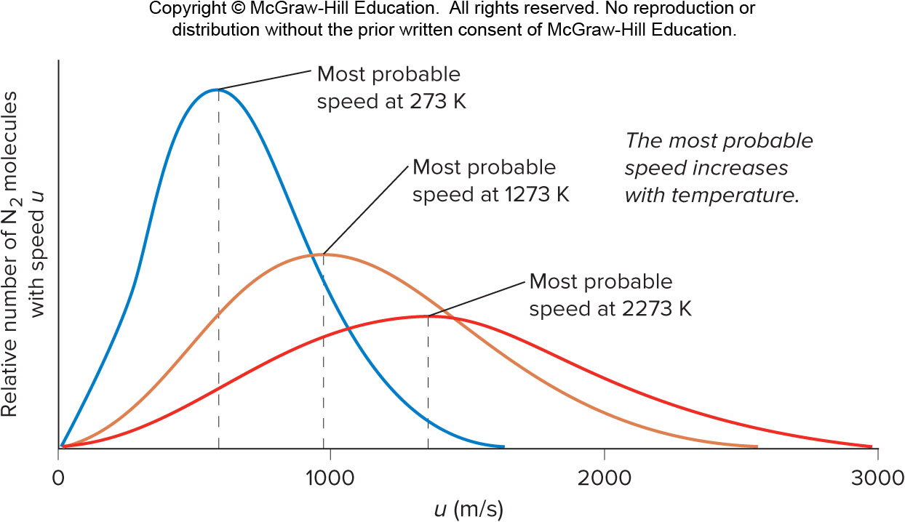
Molecular Speeds at Three Temperatures
Figure 5.14

Slide 58
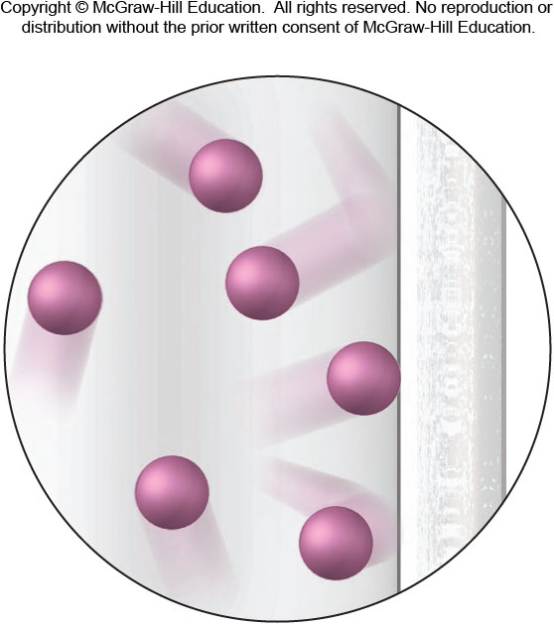
The Origin of Pressure
Figure 5.15

Slide 59
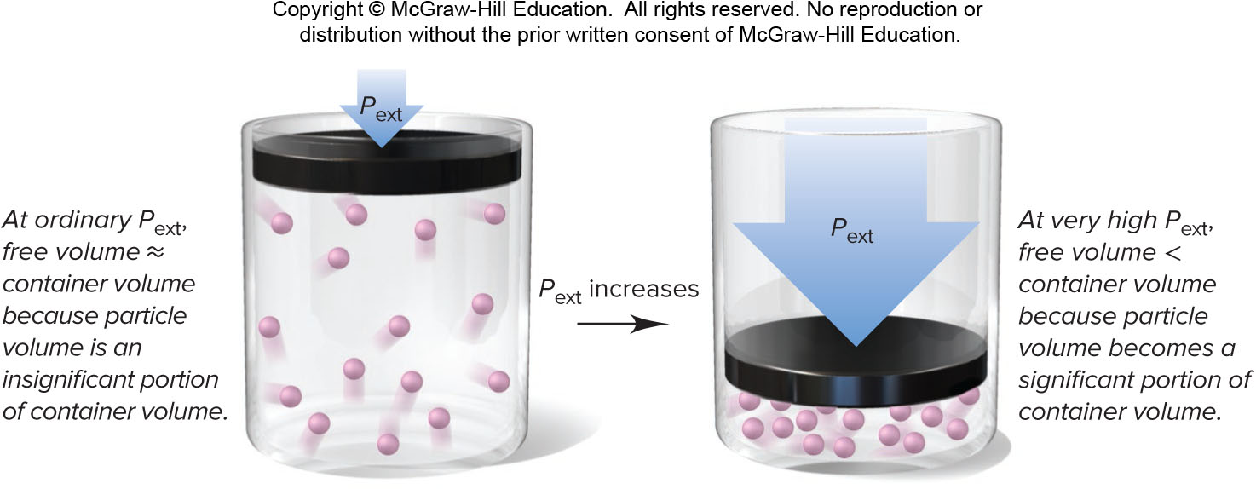
Molecular View of Boyle’s Law
Figure 5.16

Slide 60
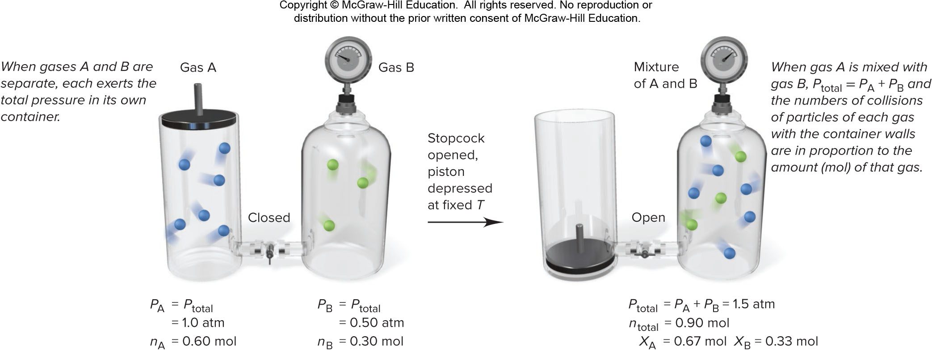
Molecular View of Dalton’s Law
Figure 5.17

Slide 61

Molecular View of Charles’s Law
Figure 5.18

Slide 62

Molecular View of Avogadro’s Law
Figure 5.19

Slide 63

Kinetic Energy and Gas Behavior
At a given T, all gases in a sample have the same average kinetic energy.
$$\text{E}\text{k}\text{=} \frac{\text{1}}{\text{2 }}\text{mass} \text{×} \text{speed}$$
Kinetic energy depends on both the mass and the speed of a particle.
At the same T, a heavier gas particle moves more slowly than a lighter one.

Slide 64

Molar Mass and Molecular Speed
Figure 5.20

Slide 65

Graham’s Law of Effusion
Effusion is the process by which a gas escapes through a small hole in its container into an evacuated space.
Graham’s law of effusion states that the rate of effusion of a gas is inversely proportional to the square root of its molar mass.
  A lighter gas moves more quickly and therefore has a higher rate of effusion than a heavier gas at the same T.
$$\text{Rate} \text{of} \text{effusion}\text{ ∝}\frac{1}{\sqrt{ℳ}}$$

Slide 66

Process of Effusion
Figure 5.21

Slide 67
Sample Problem 5.14 – Problem and Plan
Applying Graham’s Law of Effusion
PROBLEM: A mixture of helium (He) and methane (CH₄) is placed in an effusion apparatus. (a) Calculate the ratio of the effusion rates of the two gases. (b) If it takes 7.55 min for a given volume of CH₄ to effuse from the apparatus, how long will it take for the same volume of He to effuse?
PLAN: (a) The effusion rate is inversely proportional to ​​ , so we find the molar mass of each substance from the formula and take its square root. The inverse of the ratio of the square roots is the ratio of the effusion rates. (b) Once we know the ratio of effusion rates, we can apply that ratio to the time.

Slide 68

Sample Problem 5.14 – Solution
SOLUTION:
(a) M of CH₄ = 16.04 g/mol M of He = 4.003 g/mol
$$\frac{\text{rate}\text{He}}{\text{rate}\text{CH}\text{4}}\text{=}\sqrt{\frac{\text{16.04}}{\text{4.001}}}=2.002$$
(b) $\frac{\text{7.55 }\text{min}}{\text{2.002}}\text{ =} \text{3.77 }\text{min}$

Slide 69

Diffusion of Gases
Figure 5.22

Slide 70

Variations in P and T with altitude on Earth
Figure B5.1

Slide 71
Composition of Air at Sea Level
Component | Mole Fraction
Nitrogen (N₂) Oxygen (O₂) Argon (Ar) Carbon dioxide (CO₂) Neon (Ne) Helium (He) Methane (CH₄) Krypton (Kr) Hydrogen (H₂) Dinitrogen monoxide (N₂O) Carbon monoxide (CO) Xenon (Xe) Ozone (O₃) Ammonia (NH₃) Nitrogen dioxide (NO₂) Nitrogen monoxide (NO) Sulfur dioxide (SO₂) Hydrogen sulfide (H₂S) | 0.78084 0.20946 0.00934 0.00040 1.818×10⁻⁵ 5.24×10⁻⁶ 2×10⁻⁶ 1.14×10⁻⁶ 5×10⁻⁷ 5×10⁻⁷ 1×10⁻⁷ 8×10⁻⁸ 2×10⁻⁸ 6×10⁻⁹ 6×10⁻⁹ 6×10⁻¹⁰ 2×10⁻¹⁰ 2×10⁻¹⁰

Slide 72
Real Gases: Deviations from Ideal Behavior
The kinetic-molecular model describes the behavior of ideal gases. Real gases deviate from this behavior.
Real gases have real volume.
  Gas particles are not points of mass, but have volumes determined by the sizes of their atoms and the bonds between them.
Real gases do experience attractive and repulsive forces between their particles.
Real gases deviate most from ideal behavior at low temperature and high pressure.

Slide 73
Molar Volume of Some Common Gases at STP
Gas | Molar Volume (L/mol) | Boiling Point (°C)
He | 22.435 | −268.9
H₂ | 22.432 | −252.8
Ne | 22.422 | −246.1
Ideal gas | 22.414 | —
Ar | 22.397 | −185.9
N₂ | 22.396 | −195.8
O₂ | 22.390 | −183.0
CO | 22.388 | −191.5
Cl₂ | 22.184 | −34.0
NH₃ | 22.079 | −33.4

Slide 74

Deviations From Ideal Behavior With Increasing External Pressure
Figure 5.23

Slide 75

Effect of Interparticle Attractions on Measured Gas Pressure
Figure 5.24

Slide 76
Effect of Particle Volume on Measured Gas Volume
Figure 5.25

Slide 77

Van der Waals Equation
The van der Waals equation adjusts the ideal gas law to take into account
  the real volume of the gas particles and
  the effect of interparticle attractions.
Van der Waals equation for n moles of a real gas
$$\left(P+\frac{n2a}{V2}\right)\left(V−nb\right)=nRT$$
The constant a relates to factors that influence the attraction between particles.
The constant b relates to particle volume.

Slide 78
Van der Waals Constants for Some Common Gases
Gas | a​​ (atm ⋅ L²/mol²) | ​​b (L/mol)
He | 0.034 | 0.0237
Ne | 0.211 | 0.0171
Ar | 1.35 | 0.0322
Kr | 2.32 | 0.0398
Xe | 4.19 | 0.0511
H₂ | 0.244 | 0.0266
N₂ | 1.39 | 0.0391
O₂ | 1.36 | 0.0318
Cl₂ | 6.49 | 0.0562
CH₄ | 2.25 | 0.0428
CO | 1.45 | 0.0395
CO₂ | 3.59 | 0.0427
NH₃ | 4.17 | 0.0371
H₂O | 5.46 | 0.0305

