Slide 1
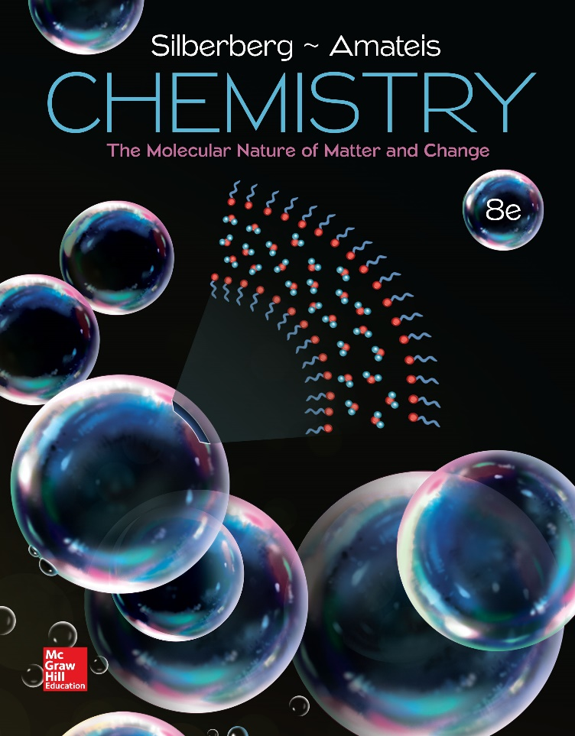
Chemistry
The Molecular Nature of Matter and Change Eighth Edition
Martin S. Silberberg and Patricia G. Amateis

Slide 2
Intermolecular Forces:
Liquids, Solids, and Phase Changes
12.1 An Overview of Physical States and Phase Changes
12.2 Quantitative Aspects of Phase Changes
12.3 Types of Intermolecular Forces
12.4 Properties of the Liquid State
12.5 The Uniqueness of Water
12.6 The Solid State: Structure, Properties, and Bonding
12.7 Advanced Materials

Slide 3
Phases of Matter
Each physical state of matter is a phase, a physically distinct, homogeneous part of a system.
The properties of each phase are determined by the balance between the potential and kinetic energy of the particles.
The potential energy, in the form of attractive forces, tends to draw particles together.
The kinetic energy associated with movement tends to disperse particles.

Slide 4
Attractive Forces
Intramolecular or bonding forces are found within a molecule. The chemical behavior of each phase of matter is the same because the same constituent particle is present in each case.
  H₂O molecules are present whether the substance is in the solid, liquid, or gas phase.
Intermolecular or nonbonding forces are found between molecules. The physical behavior of each phase of matter is different because the strength of these forces differs from state to state.

Slide 5
Kinetic Molecular View of the Three States
State | Attractive Forces vs. Kinetic Energy | Properties
Gas | Attractive forces are weak relative to kinetic energy. | Particles are far apart. A gas has no fixed shape or volume.
Liquid | Attractive forces are stronger because particles have less kinetic energy. | A liquid can flow and change shape, but has a fixed volume.
Solid | Attractions dominate motion. Particles are fixed in place relative to each other. | A solid has a fixed shape and volume.

Slide 6
A Macroscopic Comparison of Gases, Liquids, and Solids
State | Shape and Volume | Compressibility | Ability to Flow
Gas | Conforms to shape and volume of container | High | High
Liquid | Conforms to shape of container; volume limited by surface | Very low | Moderate
Solid | Maintains its own shape and volume | Almost none | Almost none

Slide 7
Types of Phase Changes and Their Enthalpies
Gas to liquid, and vice versa
  As the temperature drops (and/or the pressure rises), the molecules in the gas phase come together and form a liquid in the process of condensation; the opposite process, changing from a liquid to a gas, is vaporization.
Liquid to solid, and vice versa
  As the temperature drops further, the particles move more slowly and become fixed in position in the process of freezing; the opposite change is called melting, or fusion.
Gas to solid, and vice versa
  At ordinary conditions, solid CO₂ changes directly to a gas, a process called sublimation. Freeze-dried foods are prepared by freezing the food and subliming the water. The opposite process, changing from a gas directly into a solid, is called deposition.

Slide 8
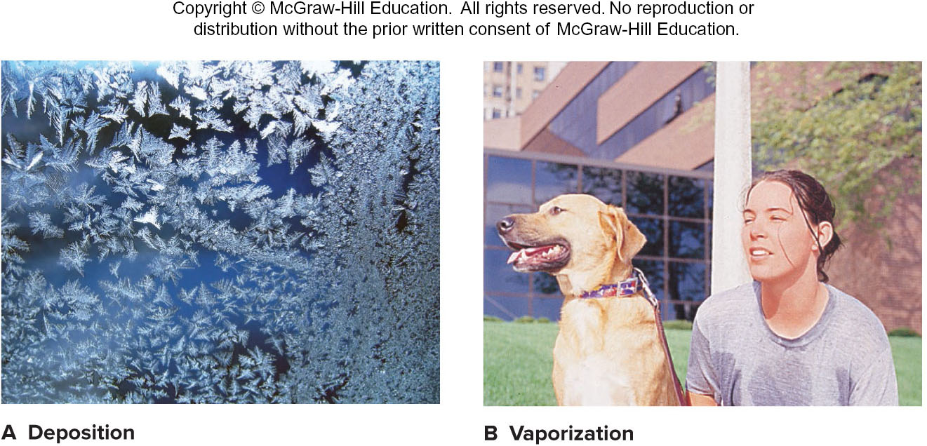
Two Familiar Phase Changes.
Figure 12.1
Source: (A) © dinadesign/Shutterstock.com; (B) © Jill Birschbach Photo Services

Slide 9
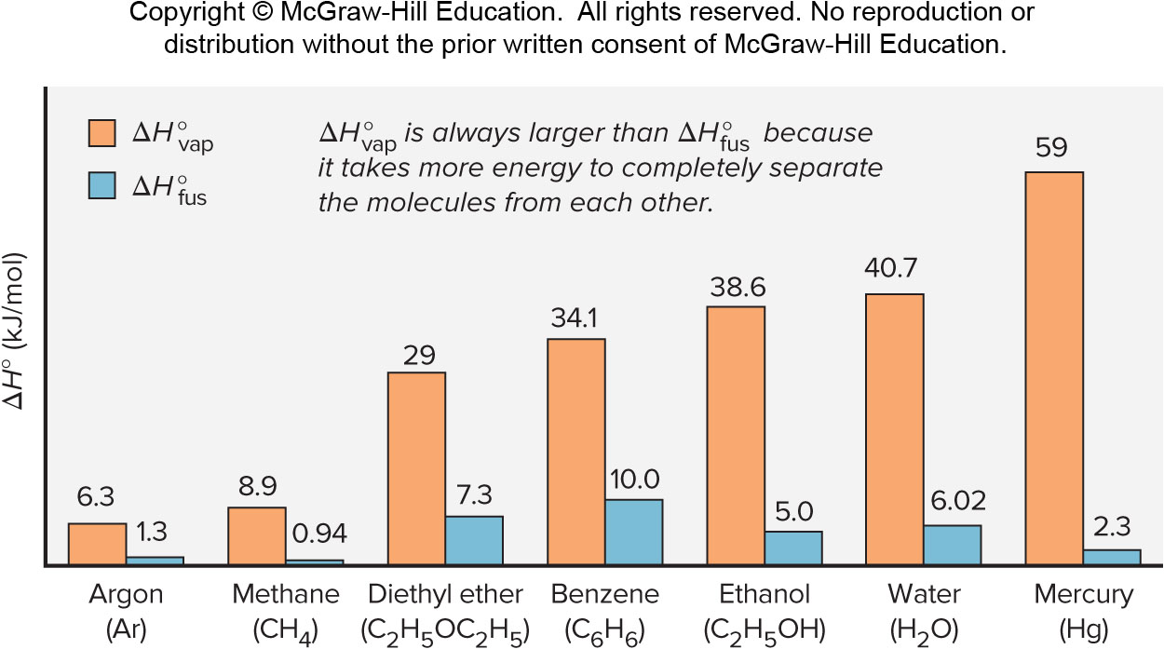
Heats Of Vaporization And Fusion For Several Common Substances
Neutral

Slide 10
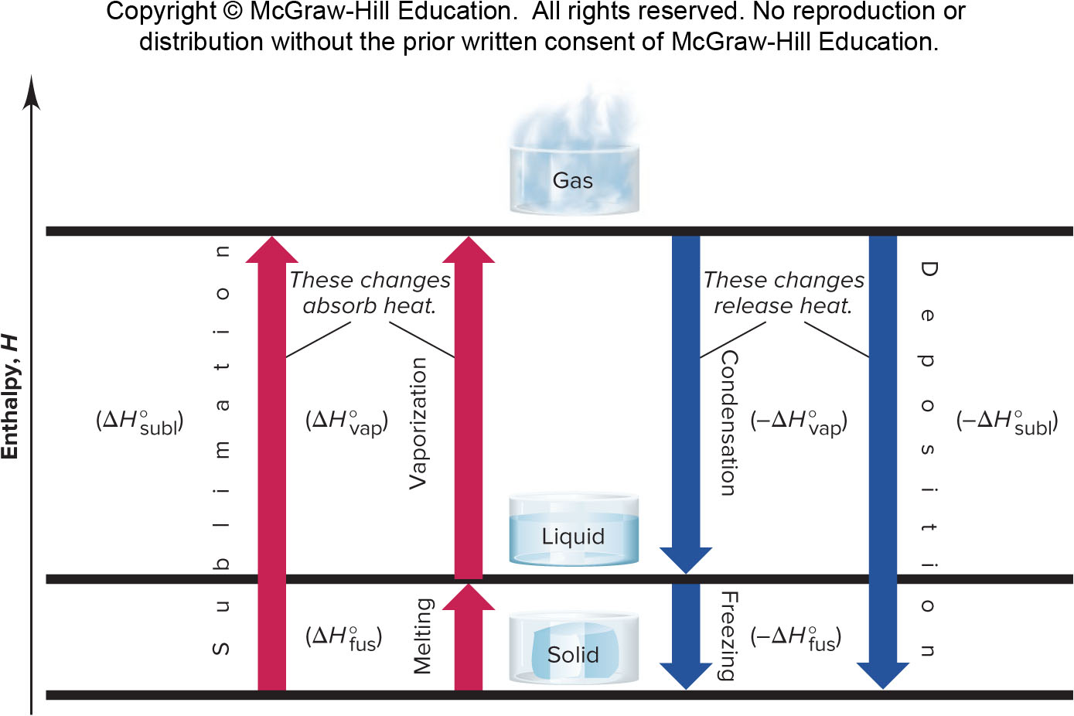
Phase Changes And Their Enthalpy Changes
Figure 12.3

Slide 11
Quantitative Aspects of Phase Changes
Within a phase, heat flow is accompanied by a change in temperature, since the average E_{k} of the particles changes.
  q = (amount) x (heat capacity) x ΔT
During a phase change, heat flow occurs at constant temperature, as the average distance between particles changes.
  q = (amount)(ΔH of phase change)

Slide 12
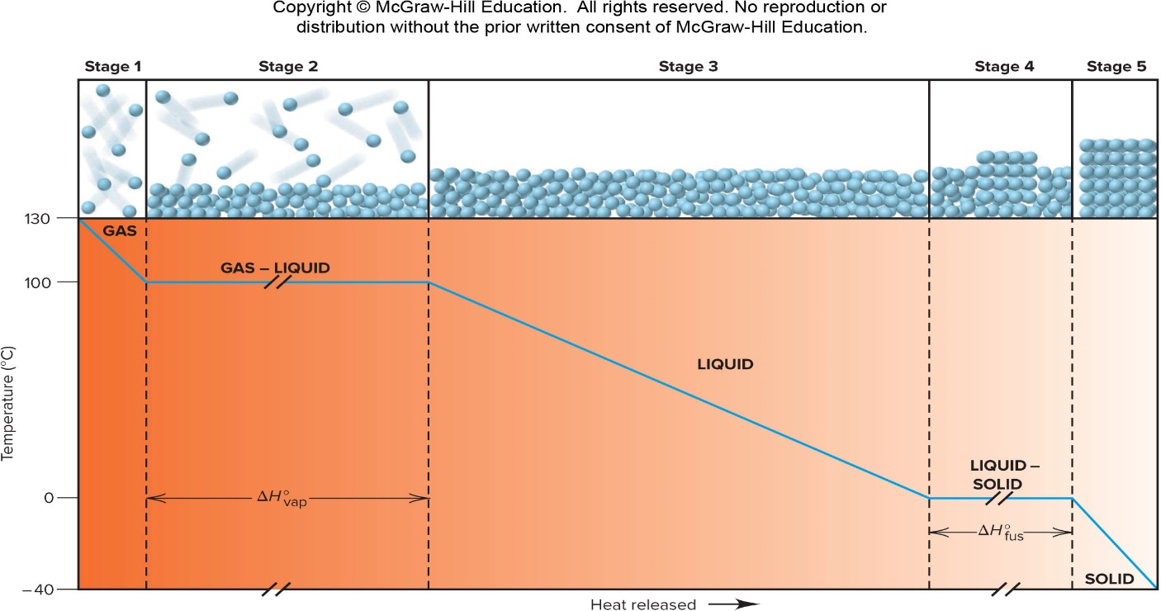
A Heating-cooling Curve For The Conversion Of Gaseous Water To Ice
Neutral

Slide 13
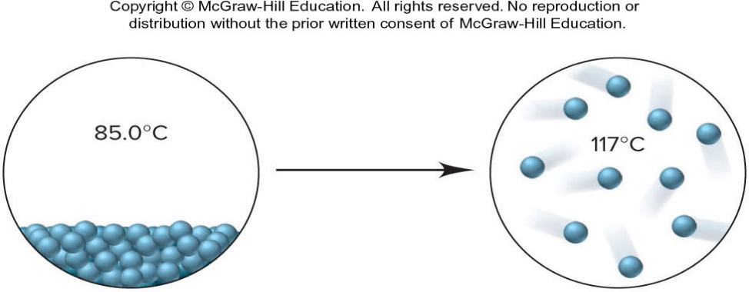
Sample Problem 12.1 – Problem
Finding the Heat of a Phase Change Depicted by Molecular Scenes
PROBLEM: The scenes below represent a phase change of water. Use values for molar heat capacities and heats of phase changes from the text discussion to find the heat (in kJ) released or absorbed when 24.3 g of H₂O undergoes this change.

Slide 14
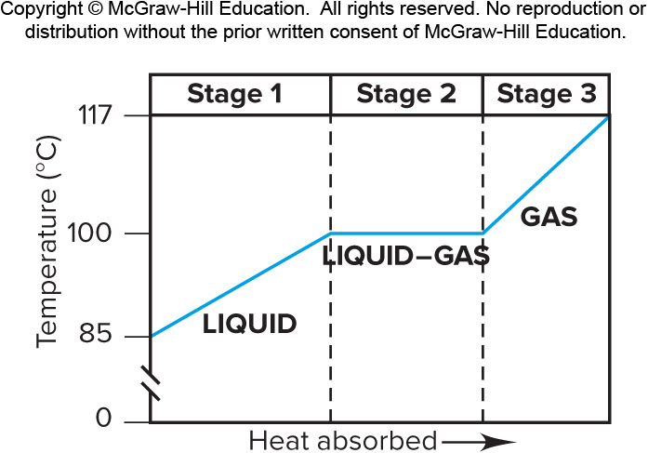
Sample Problem 12.1 – Plan
PLAN: From the molecular scenes, values given in the text discussion, and the given mass (24.3 g) of water, we have to find the heat that accompanies this change. The scenes show a disorderly, condensed phase at 85.0°C changing to separate molecules at 117°C. Thus, the phase change they depict is vaporization, an endothermic process. The values for molar heat capacities and heats of phase changes are per mole, so we first convert the mass (g) of water to amount (mol). There are three stages: (1) heating the liquid from 85.0°C to 100.°C; (2) converting liquid water at 100.°C to gaseous water at 100.°C; and (3) heating the gas from 100.°C to 117°C. We add the values of q for these stages to obtain the total heat.

Slide 15
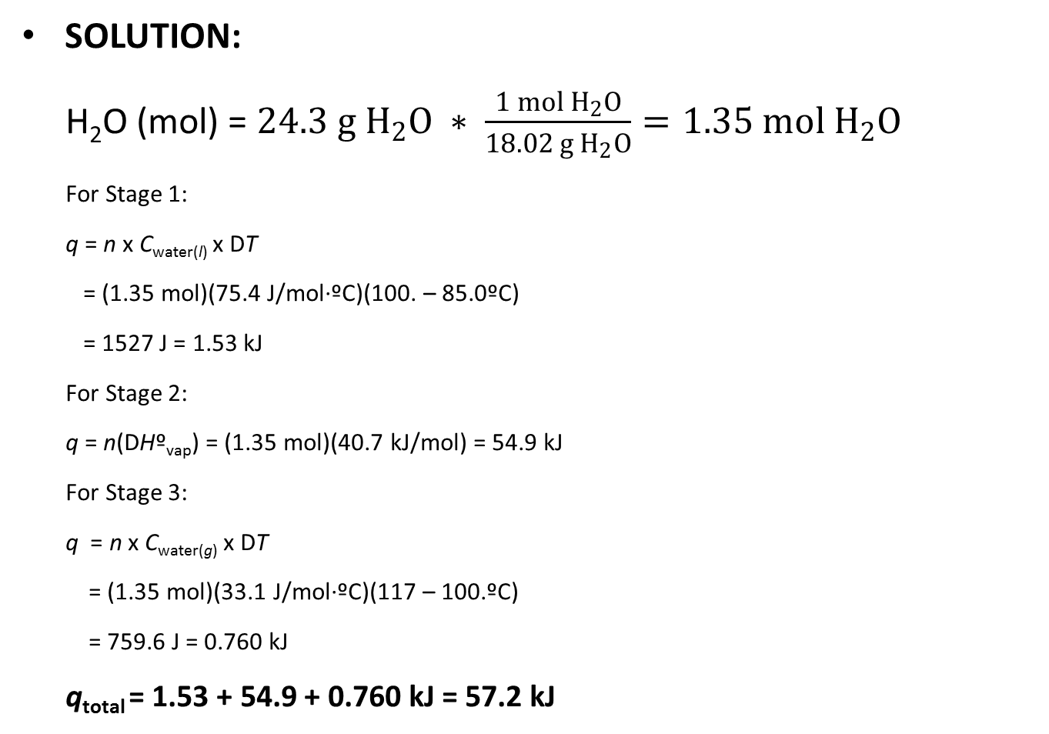
Sample Problem 12.1 - Solution
SOLUTION:
H₂O (mol) = $24.3 g H_{2}O ∗ \frac{1 mol{ H}_{2}O}{18.02 g{ H}_{2}O}=1.35 mol{ H}_{2}O$
For Stage 1:
  q = n x C_{water(l)} x DT
  = (1.35 mol)(75.4 J/mol∙ºC)(100. – 85.0ºC)
  = 1527 J = 1.53 kJ
For Stage 2:
  q = n(DHº_{vap}) = (1.35 mol)(40.7 kJ/mol) = 54.9 kJ
For Stage 3:
  q = n x C_{water(g)} x DT
  = (1.35 mol)(33.1 J/mol∙ºC)(117 – 100.ºC)
  = 759.6 J = 0.760 kJ
q_{total} = 1.53 + 54.9 + 0.760 kJ = 57.2 kJ

Slide 16
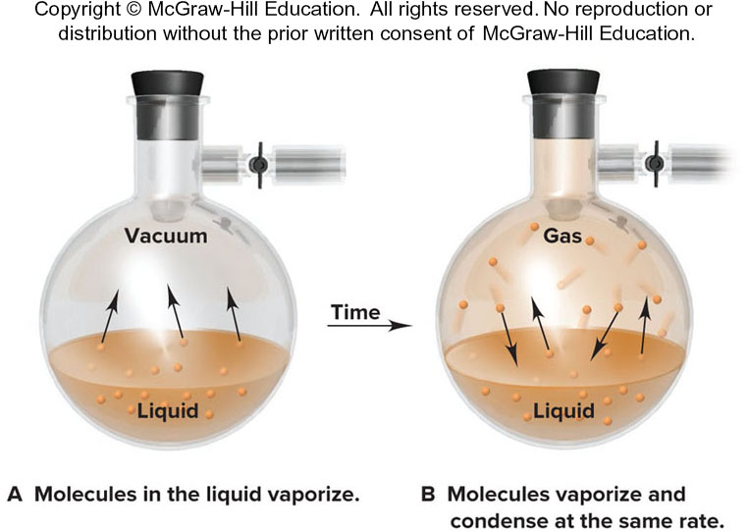
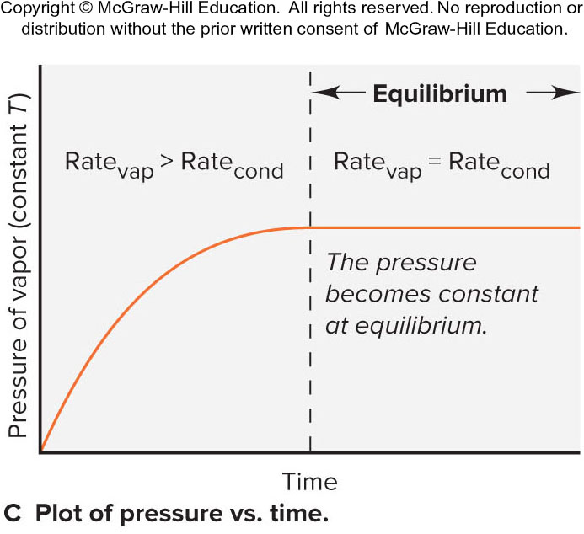
Liquid-gas Equilibrium
In a closed flask, the system reaches a state of dynamic equilibrium, where molecules are leaving and entering the liquid at the same rate.
The vapor pressure is the pressure exerted by the vapor on the liquid. The pressure increases until equilibrium is reached; at equilibrium the vapor pressure is constant.
Figure 12.5

Slide 17
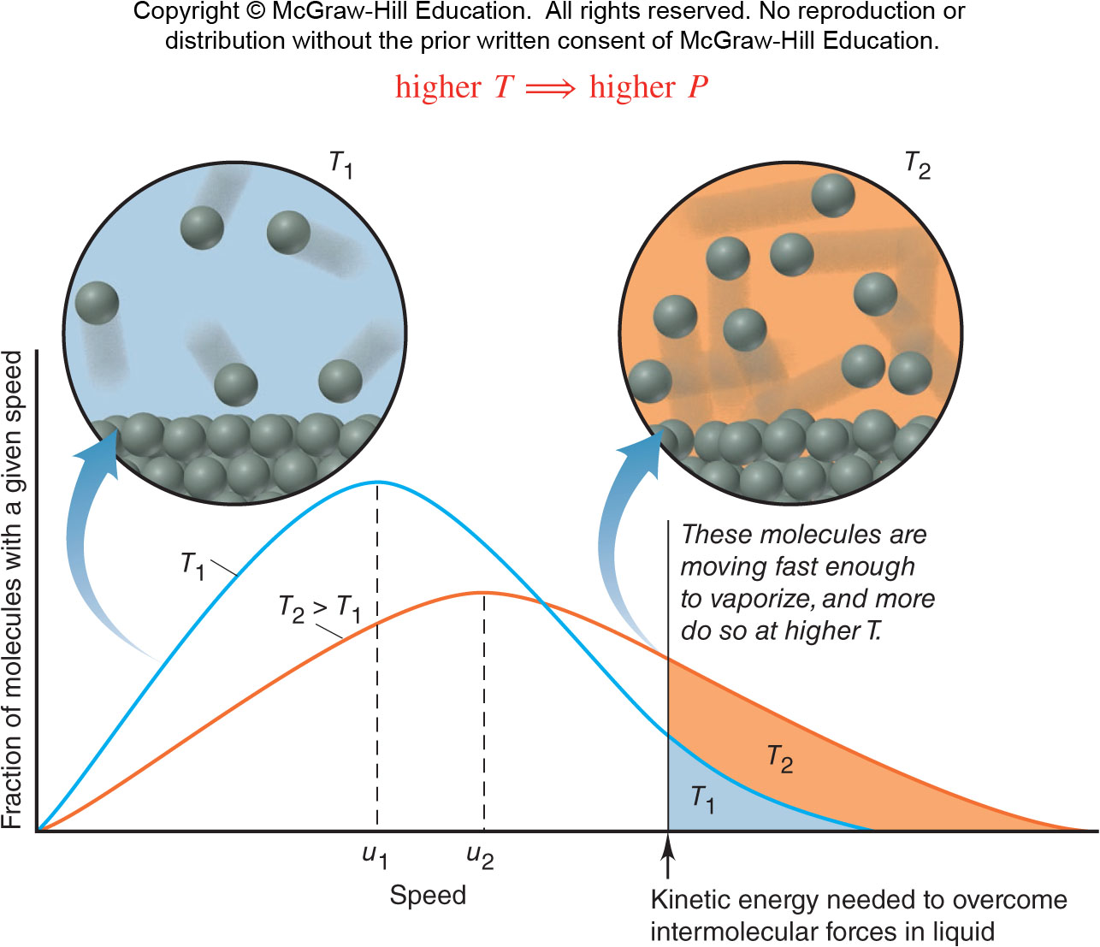
The Effect Of Temperature On The Distribution Of Molecular Speeds
Figure 12.6

Slide 18
Factors Affecting Vapor Pressure
As temperature increases, the fraction of molecules with enough energy to enter the vapor phase increases, and the vapor pressure increases.
higher T → higher P
The weaker the intermolecular forces, the more easily particles enter the vapor phase, and the higher the vapor pressure.
weaker forces → higher P

Slide 19
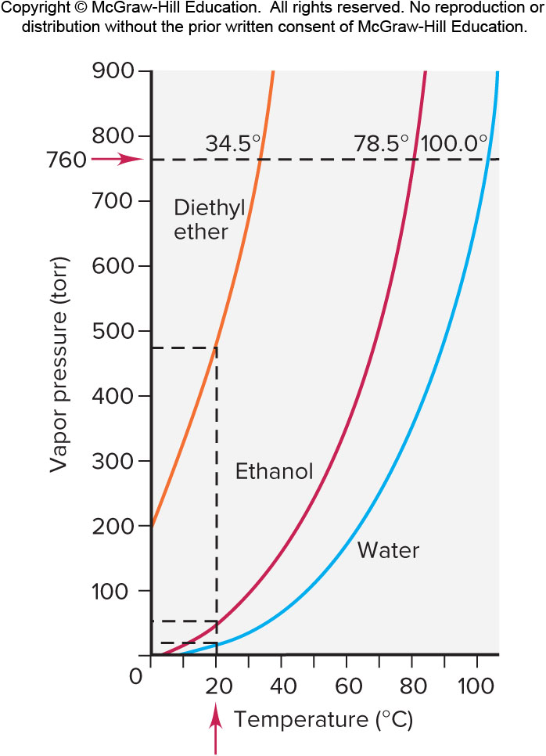
Vapor Pressure As A Function Of Temperature And Intermolecular Forces
Vapor pressure increases as temperature increases.
Vapor pressure decreases as the strength of the intermolecular forces increases.
Figure 12.7

Slide 20
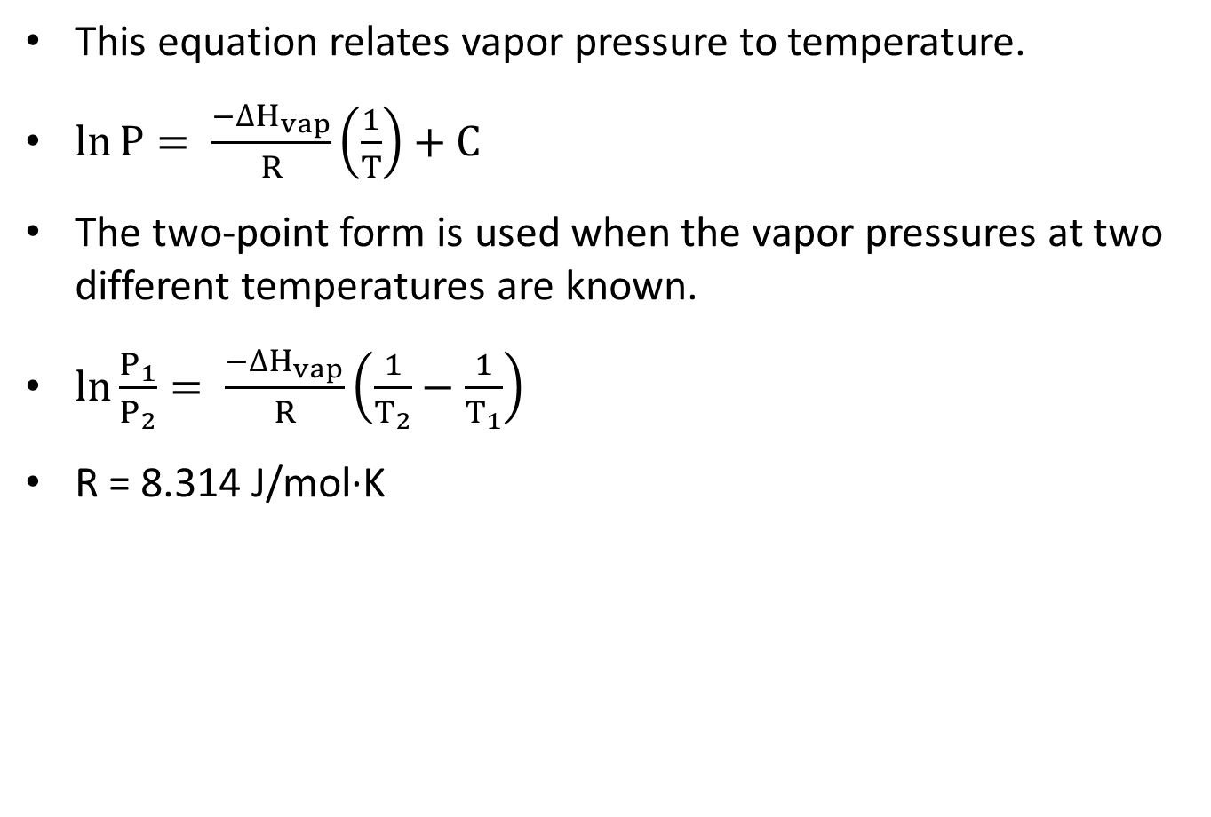
The Clausius-Clapeyron Equation
This equation relates vapor pressure to temperature.
$\ln{P}= \frac{{−∆H}_{vap}}{R}\left(\frac{1}{T}\right)+C$
The two-point form is used when the vapor pressures at two different temperatures are known.
$\ln{\frac{P_{1}}{P_{2}}}= \frac{{−∆H}_{vap}}{R}\left(\frac{1}{T_{2}}−\frac{1}{T_{1}}\right)$
R = 8.314 J/mol·K

Slide 21
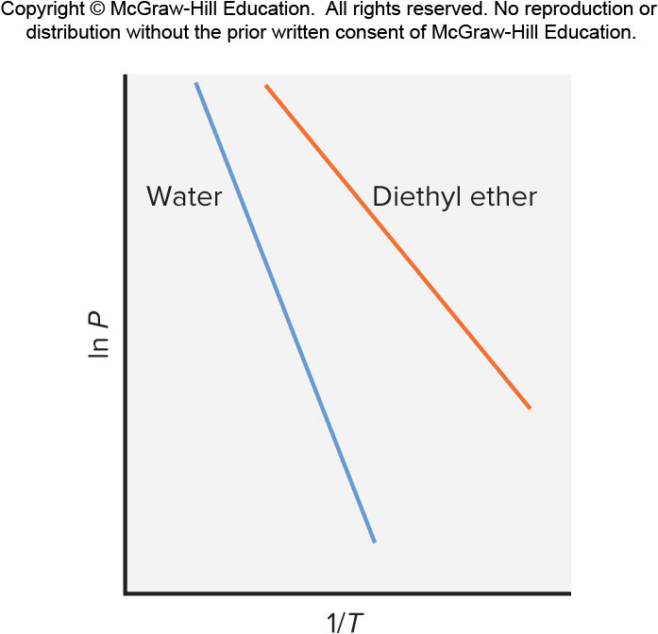
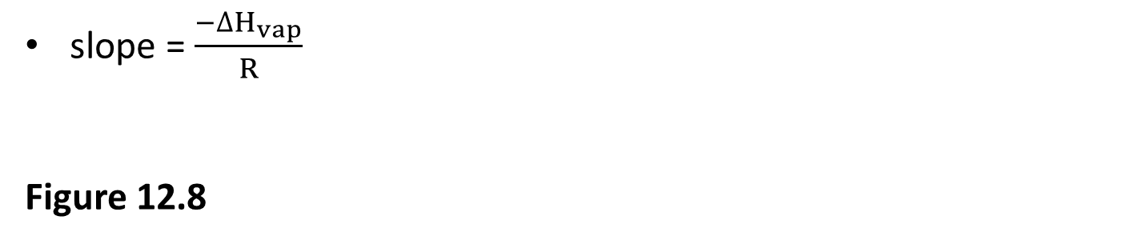
Linear Plots Of The Relationship Between Vapor Pressure And Temperature
slope = $\frac{{−∆H}_{vap}}{R}$
Figure 12.8

Slide 22
Sample Problem 12.2 – Problem and Plan
Applying the Clausius-Clapeyron Equation
PROBLEM: The vapor pressure of ethanol is 115 torr at 34.9°C. If ΔH_{vap} of ethanol is 38.6 kJ/mol, calculate the temperature (in °C) when the vapor pressure is 760 torr.
PLAN: We are given ΔH_{vap}, P₁, P₂, and T₁ and substitute them into the Clausius-Clapeyron equation to solve for T₂. The value of R here is 8.314 J/mol⋅K, so we must convert T₁ to K to obtain T₂, and then convert T₂ back to °C.

Slide 23
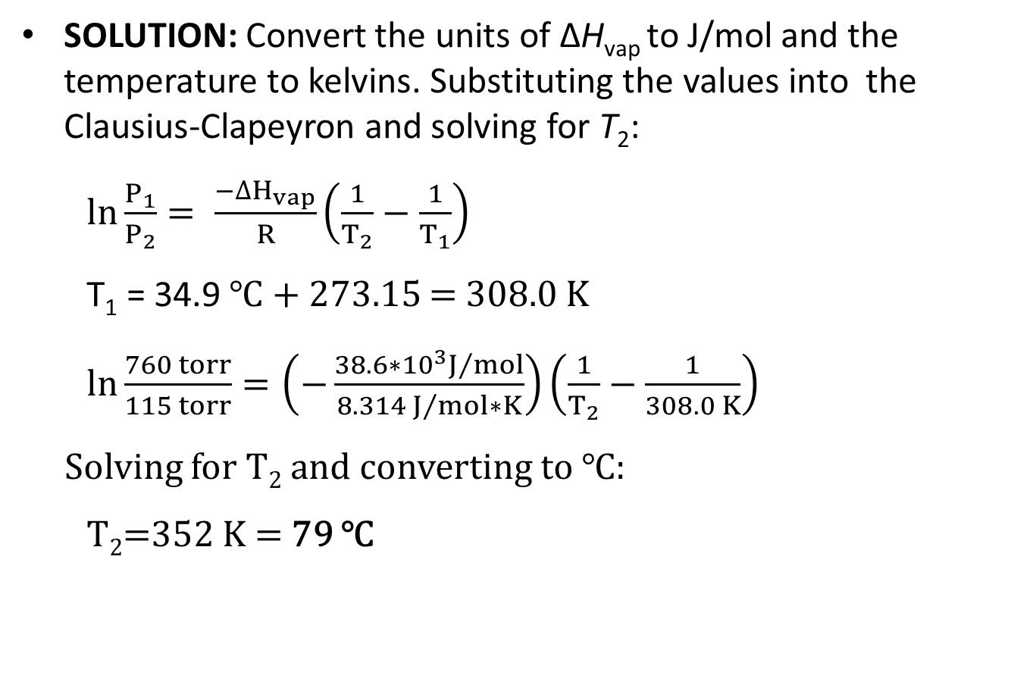
Sample Problem 12.2 - Solution
SOLUTION: Convert the units of ΔH_{vap} to J/mol and the temperature to kelvins. Substituting the values into the Clausius-Clapeyron and solving for T₂:
$\ln{\frac{P_{1}}{P_{2}}}= \frac{{−∆H}_{vap}}{R}\left(\frac{1}{T_{2}}−\frac{1}{T_{1}}\right)$
T₁ = 34.9 ℃ + 273.15 = 308.0 K
$ln\frac{760 torr}{115 torr}=\left(−\frac{38.6∗{10}^{3}J/{mol}}{8.314{ J}/{mol}∗K}\right)\left(\frac{1}{T_{2}}−\frac{1}{308.0 K}\right)$
Solving for T₂ and converting to ℃:
T₂=352 K = 79 ℃

Slide 24
Vapor Pressure and Boiling Point
The boiling point of a liquid is the temperature at which the vapor pressure equals the external pressure.
The normal boiling point of a substance is observed at standard atmospheric pressure or 760 torr.
As the external pressure on a liquid increases, the boiling point increases.

Slide 25
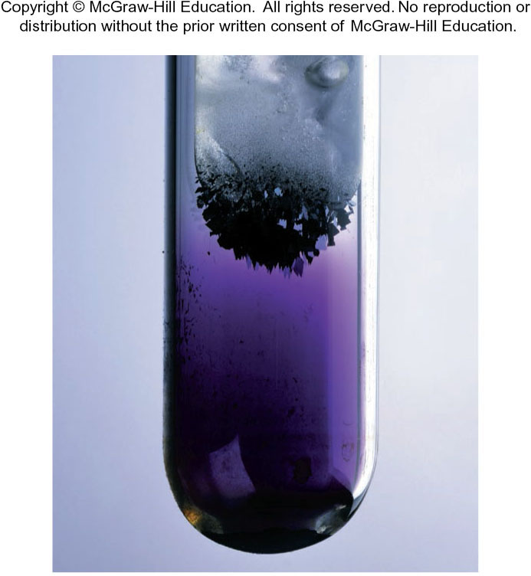
Iodine Subliming
Neutral
Source: © McGraw-Hill Education/ Richard Megna, photographer

Slide 26
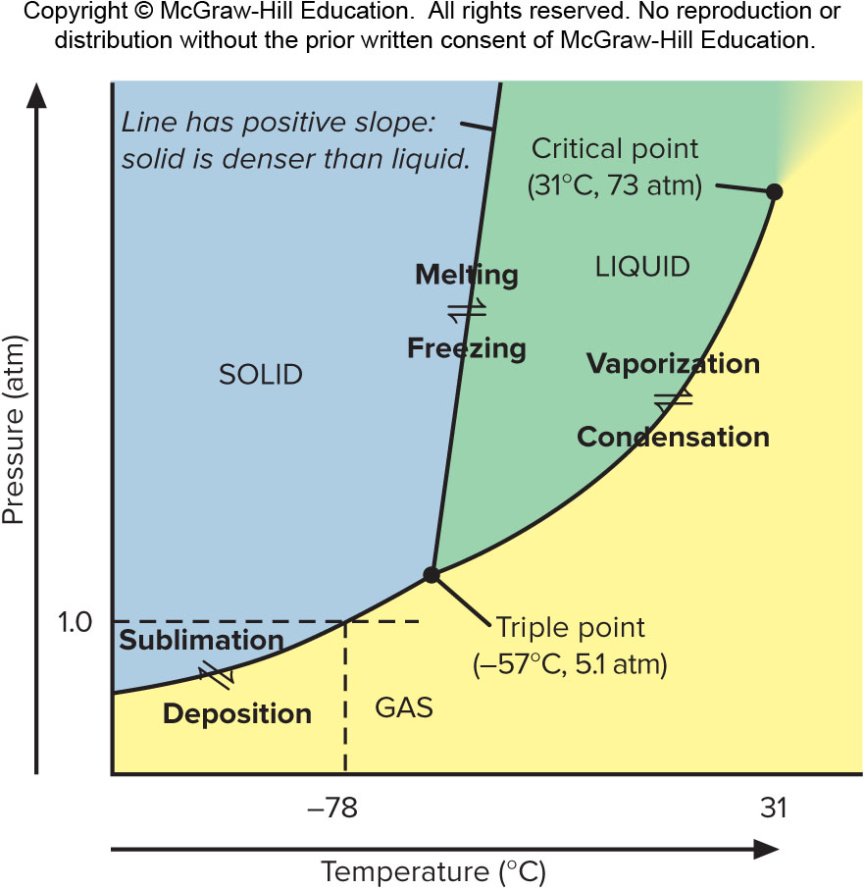
Phase Diagram For CO₂
Figure 12.10

Slide 27
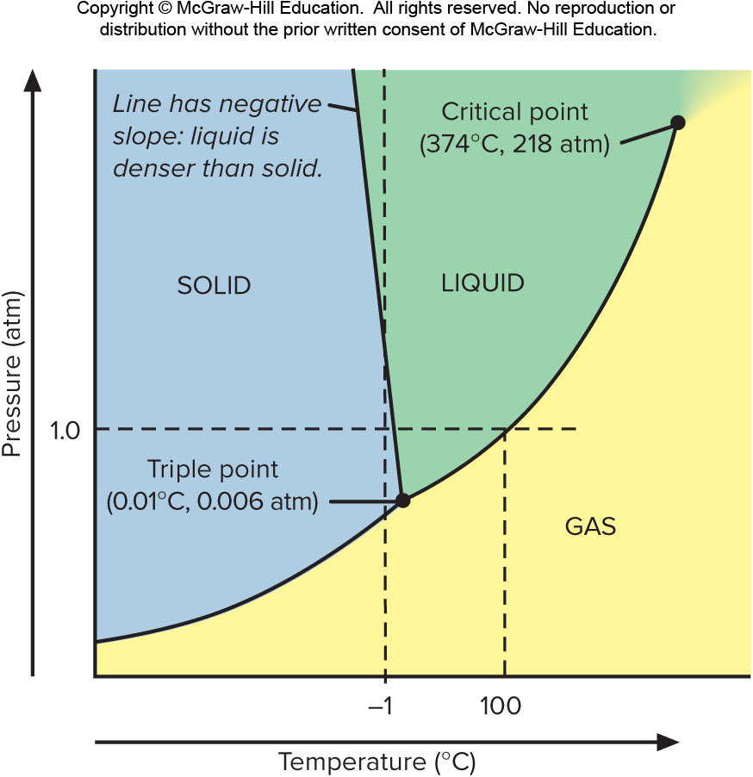
Phase Diagram For H₂O
Neutral

Slide 28
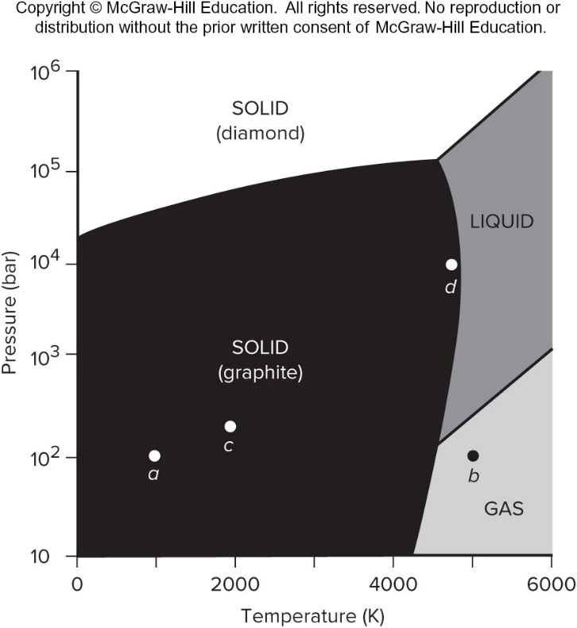
Sample Problem 12.3 – Problem
Using a Phase Diagram to Predict Phase Changes
PROBLEM: Use the phase diagram for carbon (shown below) to describe the phase changes that a sample of carbon undergoes during the following: (a) The sample is heated at 10² bar (99 atm) from 1000 K to 5000 K. (b) The sample is then compressed at 5000 K to 10⁶ bar (990,000 atm).

Slide 29
Sample Problem 12.3 – Plan
PLAN: We have to describe the phase changes due to heating at constant pressure (10² bar) and then compressing at constant temperature (5000 K).
(a) Using the phase diagram, we find the starting conditions (10² bar and 1000 K), the point labeled a, and draw a horizontal line from there to point b, at the ending conditions (10² bar and 5000 K). We note any phase-transition curves that the line crosses.
(b) Then, from the new starting conditions at point b (10² bar and 5000 K), we draw a vertical line to the ending pressure (10⁶ bar) and note any phase-transition curves that this line crosses.

Slide 30
Sample Problem 12.3 - Solution
SOLUTION:
(a) At 10² bar and 1000 K, the sample is in the form of solid graphite. As it is heated, the graphite sublimes and becomes carbon gas (at around 4400 K).
(b) As it is compressed at 5000 K, the gas first condenses to liquid carbon (at around
300 bar), which then solidifies to diamond (at around 3×10⁵ bar).

Slide 31
The Nature of Intermolecular Forces
Intermolecular forces arise from the attraction between molecules with partial charges, or between ions and molecules.
Intermolecular forces are relatively weak compared to bonding forces because they involve smaller charges that are farther apart.

Slide 32
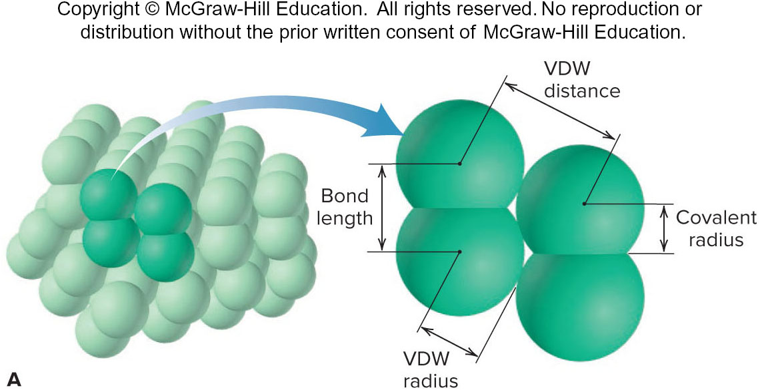
Covalent and Van Der Waals Radii
The van der Waals distance is the distance between two nonbonded atoms in adjacent molecules.
The van der Waals radius is one-half the closest distance between the nuclei of two nonbonded atoms. The VDW radius is always larger than the covalent radius.
Neutral

Slide 33
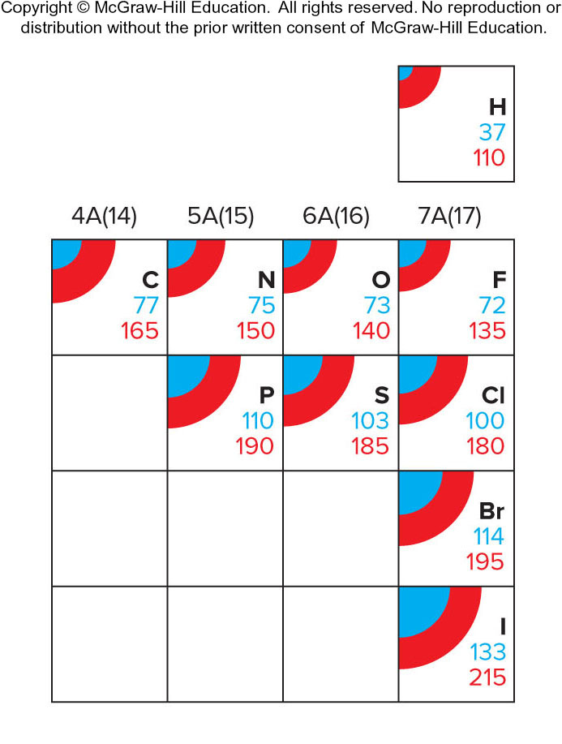
Periodic Trends In Covalent And Van Der Waals Radii
Neutral

Slide 34



Comparison of Bonding Forces
Force | Model | Basis of Attraction | Energy (kJ/mol) | Example
Ionic |  | Cation–anion | 400–4000 | NaCl
Covalent |  | Nuclei–shared e⁻pair | 150–1100 | H─H
Metallic |  | Cations–delocalized electrons | 75–1000 | Fe

Slide 35








Comparison of Non-Bonding Forces
Force | Model | Basis of Attraction | Energy (kJ/mol) | Example
Ion–dipole |  | Ion charge–dipole charge | 40–600
H bond |  | Polar bond to H-dipole charge (high EN of N, O, F) | 10–40
Dipole–dipole |  | Dipole charges | 5–25 | l─Cl⋯l─Cl
Ion–induced dipole |  | Ion charge–polarizable e⁻cloud | 3–15 | Fe²⁺⋯O₂
Dipole–induced dipole |  | Dipole charge–polarizable e⁻cloud | 2–10 | H─Cl⋯Cl─Cl
Dispersion (London) |  | Polarizable e⁻clouds | 0.05–40 | F─F⋯F─F

Slide 36
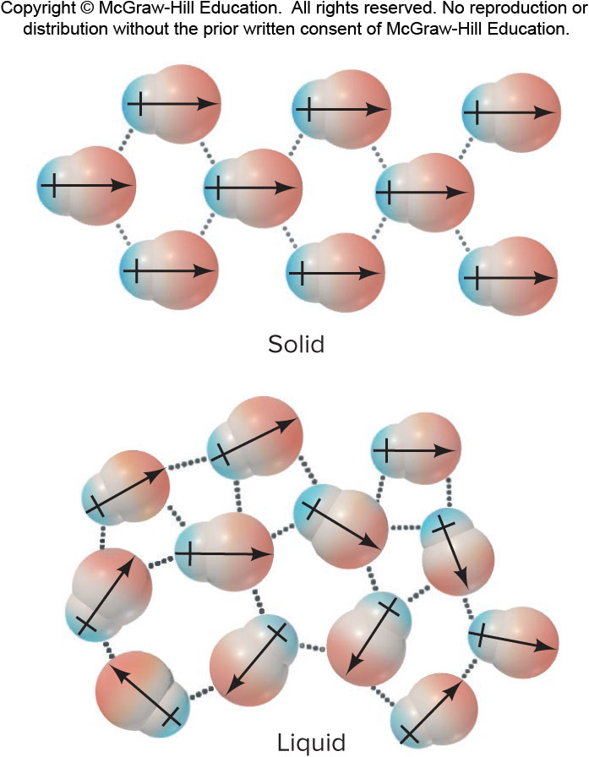
Polar Molecules and Dipole-Dipole Forces
Figure 12.13

Slide 37
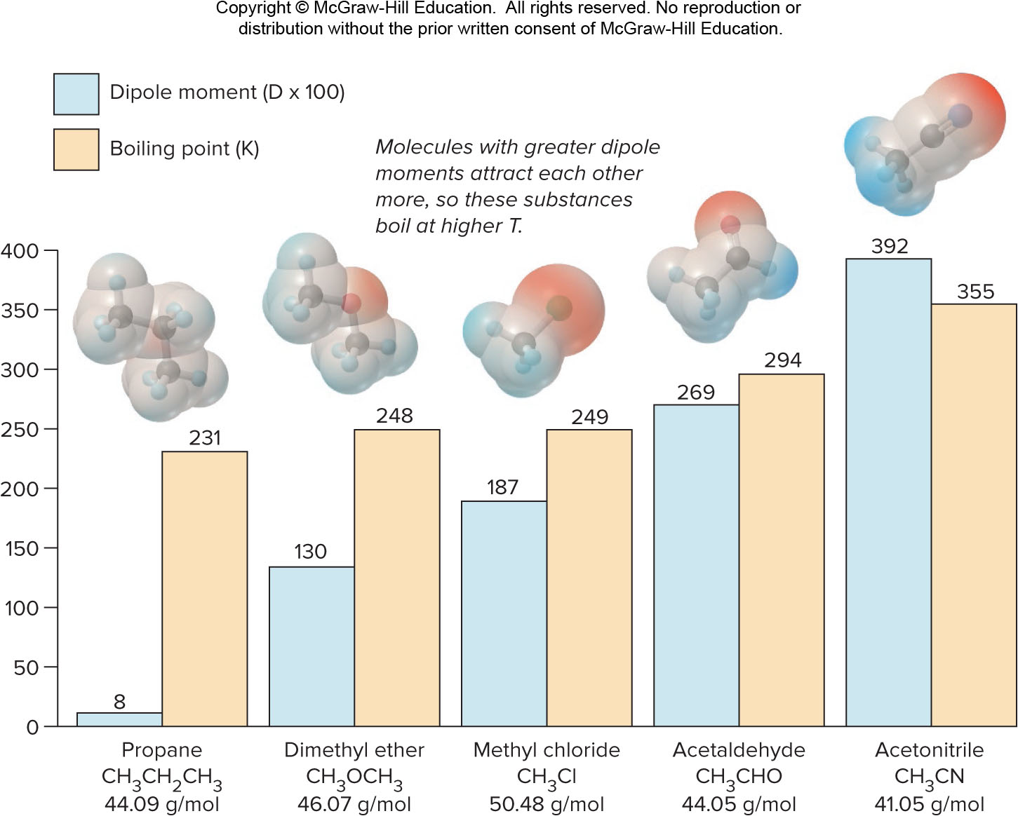
Dipole Moment and Boiling Point
Figure 12.14

Slide 38
The Hydrogen Bond
Hydrogen bonding is possible for molecules that have a hydrogen atom covalently bonded to a small, highly electronegative atom with lone electron pairs, specifically N, O, or F.
An intermolecular hydrogen bond is the attraction between the H atom of one molecule and a lone pair of the N, O, or F atom of another molecule.

Slide 39
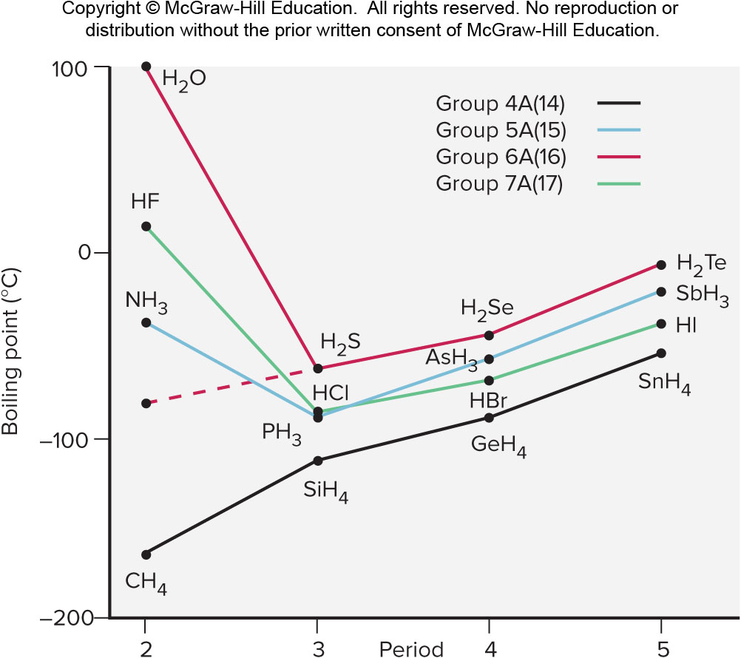
Hydrogen Bonding and Boiling Point
Figure 12.15

Slide 40

Sample Problem 12.4 – Problem and Plan
Drawing Hydrogen Bonds Between Molecules of a Substance
PROBLEM: Which of these substances exhibits H bonding? Draw examples of the H bonds between two molecules of each substance that does. (a) C₂H₆ (b) CH₃OH (c)
PLAN: If the molecule does not contain N, O, or F, it cannot form H bonds. If it contains any of these atoms covalently bonded to H, we draw two molecules in the -B:⋯H-A- pattern.

Slide 41
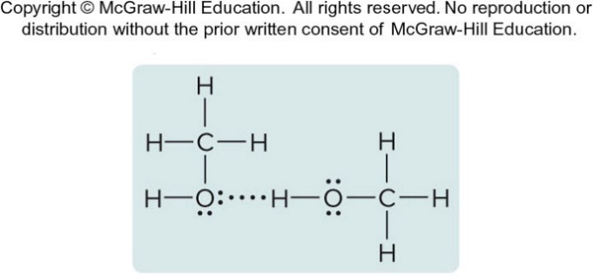
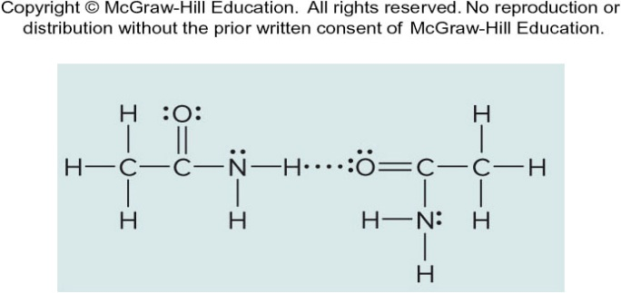
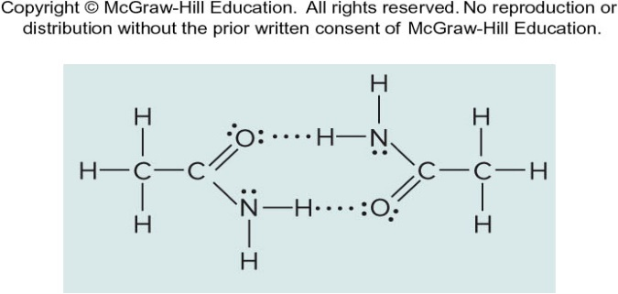
Sample Problem 12. - Solution
SOLUTION:
(a) No N, O, or F, so no H bonds can form.
(b) The H covalently bonded to the O in one molecule forms an H bond to the lone pair on the O of an adjacent molecule:
(c) Two of these molecules can form one H bond between an H bonded to N and the O, or they can form two such H bonds:

Slide 42
Polarizability and Induced Dipoles
A nearby electric field can induce a distortion in the electron cloud of an atom, ion, or molecule.
  For a nonpolar molecule, this induces a temporary dipole moment.
  For a polar molecule, the field enhances the existing dipole moment.
The polarizability of a particle is the ease with which its electron cloud is distorted.

Slide 43
Trends in Polarizability
Smaller particles are less polarizable than larger ones because their electrons are held more tightly.
Polarizability increases down a group because atomic size increases and larger electron clouds distort more easily.
Polarizability decreases across a period because of increasing Z_{eff}.
Cations are smaller than their parent atoms and less polarizable; anions show the opposite trend.

Slide 44
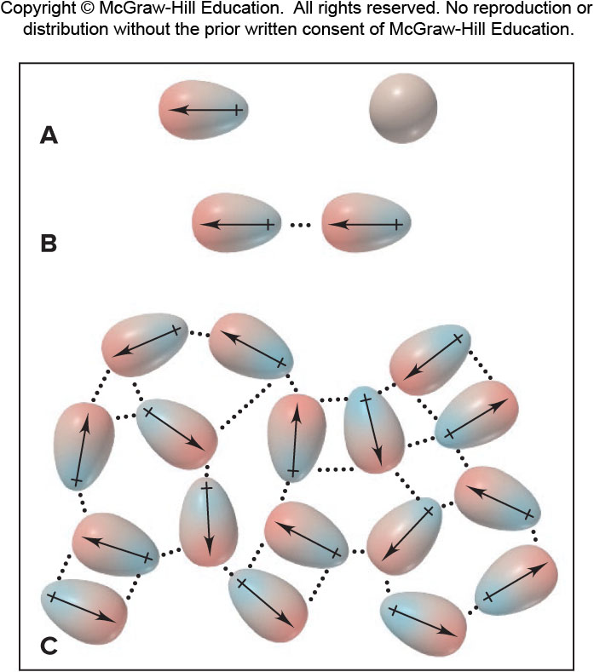
Dispersion Forces Among Nonpolar Particles
When atoms are far apart they do not influence one other.
When atoms are close together, the instantaneous dipole in one atom induces a dipole in the other.
The process occurs throughout the sample.
Figure 12.16

Slide 45
Dispersion (London) Forces
Dispersion forces or London forces arise when an instantaneous dipole in one particle induces a dipole in another, resulting in an attraction between them.
Dispersion forces exist between all particles, increasing the energy of attraction in all matter.
Dispersion forces are stronger for more polarizable particles.
  In general, larger particles experience stronger dispersion forces than smaller ones.

Slide 46
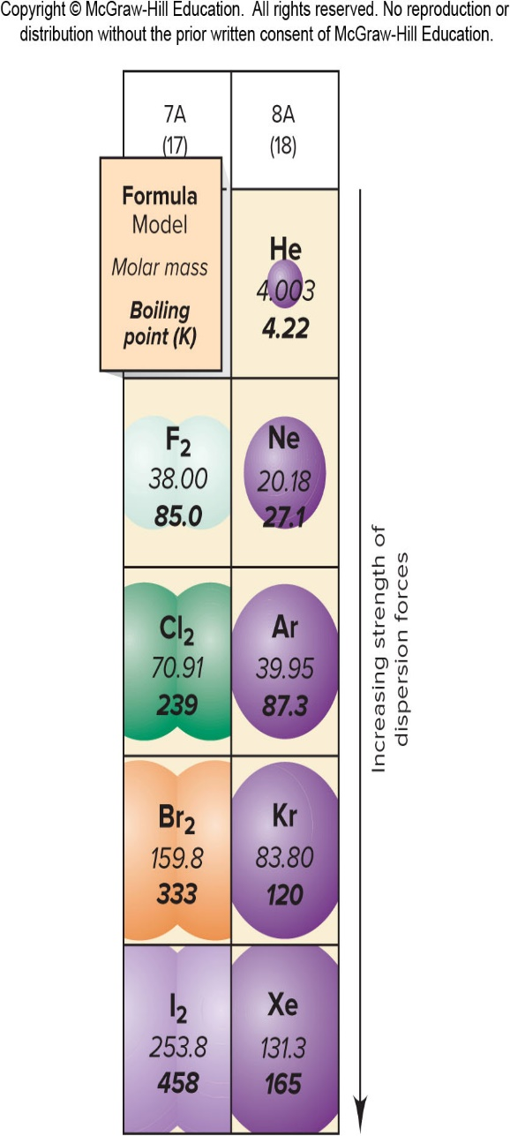
Molar Mass and Trends In Boiling Point
Dispersion forces are stronger for larger, more polarizable particles.
Polarizability correlates closely with molar mass for similar particles.
Figure 12.17

Slide 47
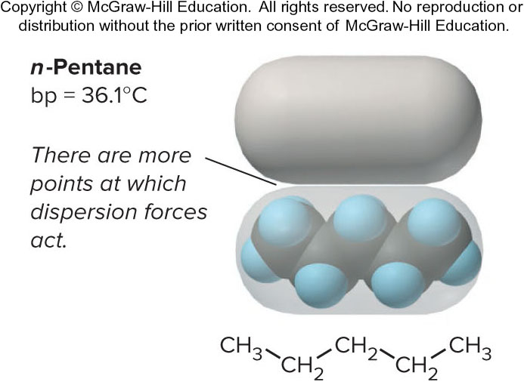
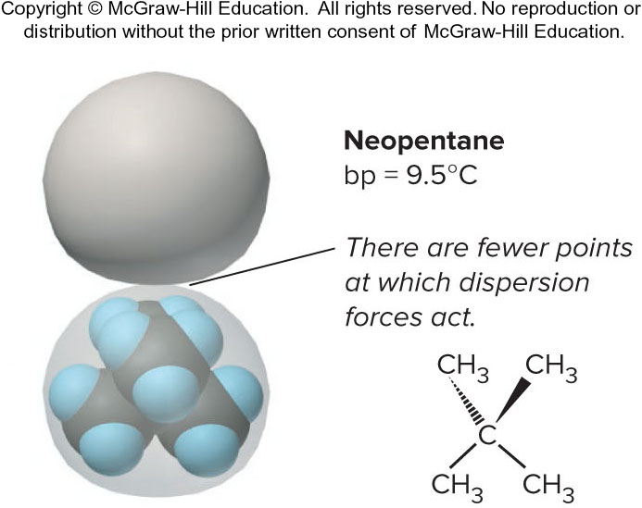
Molecular Shape, Intermolecular Contact, and Boiling Point
Figure 12.18

Slide 48
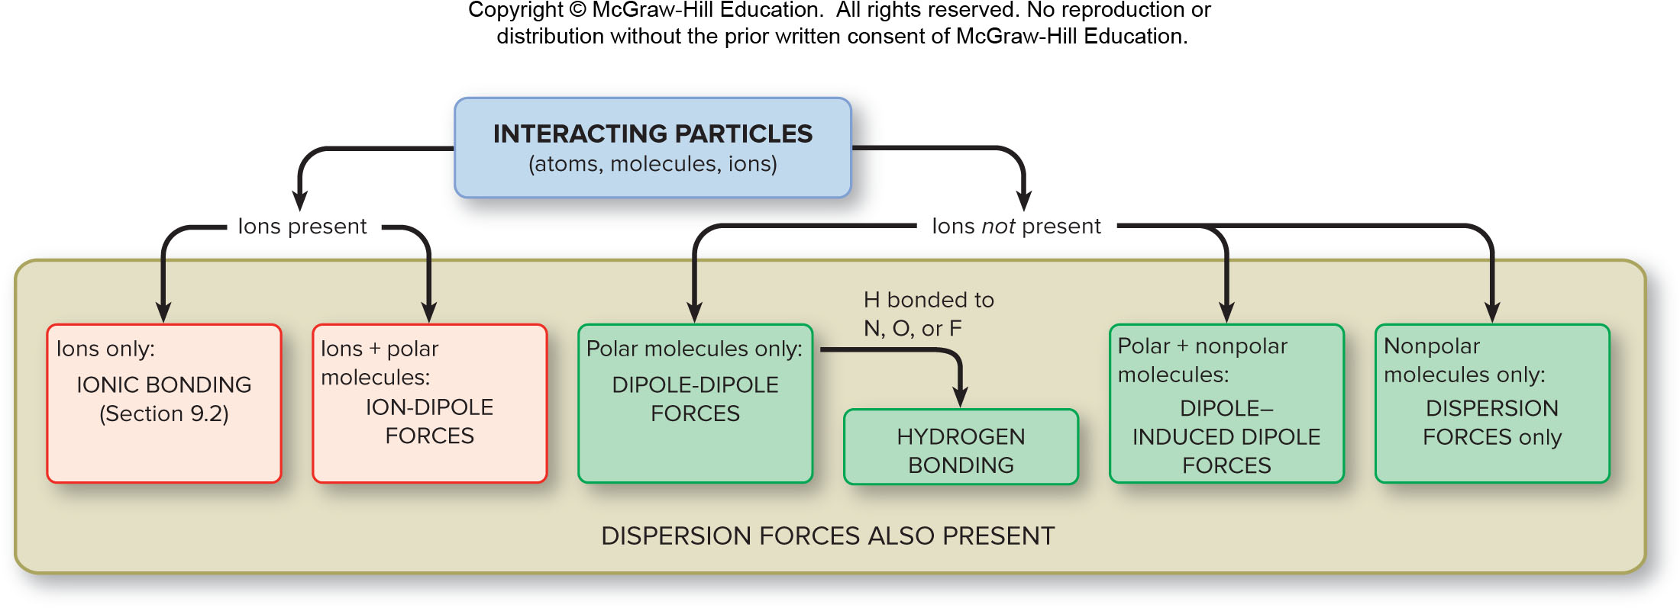
Determining the Intermolecular Forces In a Sample
Figure 12.19

Slide 49
Sample Problem 12.5 – Problem and Plan
Identifying the Types of Intermolecular Forces
PROBLEM: For each substance, identify the key bonding and/or intermolecular force(s), and predict which substance of the pair has the higher boiling point: (a) MgCl₂ or PCl₃ (b) CH₃NH₂ or CH₃F (c) CH₃OH or CH₃CH₂OH (d) Hexane (CH₃CH₂CH₂CH₂CH₂CH₃) or 2,2-dimethylbutane
PLAN: We examine the formulas and structures for key differences between members of the pair: Are ions present? Are molecules polar or nonpolar? Is N, O, or F bonded to H? Do the molecules have different masses or shapes?

Slide 50

Sample Problem 12.5 – Solution (a) and (b)
SOLUTION:
(a) MgCl₂ consists of Mg²⁺ and Cl⁻ ions held together by ionic bonding forces; PCl₃ ,with a trigonal pyramidal geometry, consists of polar molecules, so intermolecular dipole-dipole forces are present. The forces in MgCl₂ are stronger, so it should have a higher boiling point.
(b) CH₃NH₂ and CH₃F both consist of polar molecules of about the same molar mass. CH₃NH₂ has N─H bonds, so it can form H bonds. CH₃F contains a C─F bond but no H─F bond, so dipole-dipole forces occur but not H bonds. Therefore, CH₃NH₂ should have the higher boiling point.

Slide 51
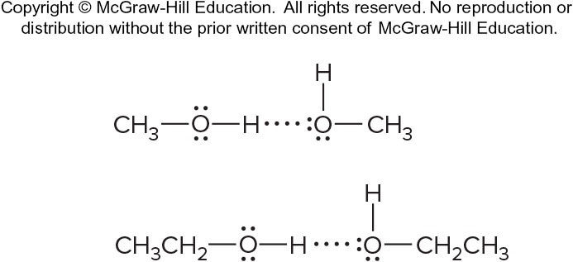
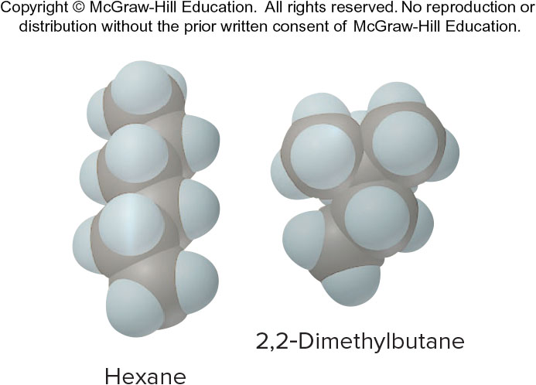
Sample Problem 12.5 – Solution (c) and (d)
SOLUTION:
(c) CH₃OH and CH₃CH₂OH molecules both contain an O─H bond, so they can form H bonds.CH₃CH₂OH has an additional ─CH₂─ group and thus a larger molar mass, which correlates with stronger dispersion forces; therefore, it should have a higher boiling point.
(d) Hexane and 2,2-dimethylbutane are nonpolar molecules of the same molar mass but different molecular shapes. Cylindrical hexane molecules make more intermolecular contact than more compact 2,2-dimethylbutane molecules do, so hexane should have stronger dispersion forces and a higher boiling point.

Slide 52
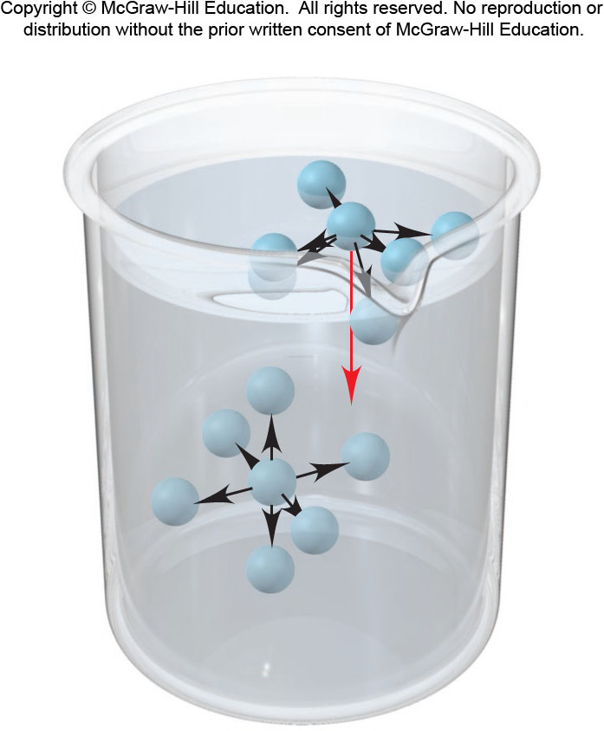
The Molecular Basis Of Surface Tension
A surface molecule experiences a net attraction downward. This causes a liquid surface to have the smallest area possible.
An interior molecule is attracted by others on all sides.
Surface tension is the energy required to increase the surface area of a liquid. The stronger the forces between the particles the higher the surface tension.
Figure 12.20

Slide 53
Surface Tension, Viscosity, and Forces Between Particles
Substance | Formula | Surface Tension (J/m²) at 20°C | Viscosity (N·s/m²) at 20°C | Major Force(s)
Diethyl ether | CH₃CH₂OCH₂CH₃ | 1.7×10⁻² | 0.240×10⁻³ | Dipole-dipole; dispersion
Ethanol | CH₃CH₂OH | 2.3×10⁻² | 1.20×10⁻³ | H bonding
Butanol | CH₃CH₂CH₂CH₂OH | 2.5×10⁻² | 2.95×10⁻³ | H bonding; dispersion
Water | H₂O | 7.3×10⁻² | 1.00×10⁻³ | H bonding
Mercury | Hg | 48×10⁻² | 1.55×10⁻³ | Metallic bonding

Slide 54
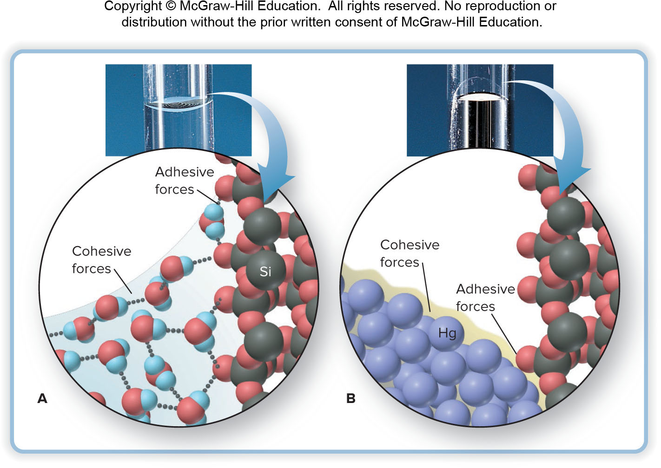
Capillary Action and the Shape Of The Water or Mercury Meniscus In Glass
A. Water displays a concave meniscus.
B. Mercury displays a convex meniscus.
Figure 12.21

Slide 55
Viscosity of Water at Several Temperatures
Temperature (°C) | Viscosity (N·s/m²)
20 | 1.00×10⁻³
40 | 0.65×10⁻³
60 | 0.47×10⁻³
80 | 0.35×10⁻³

Slide 56
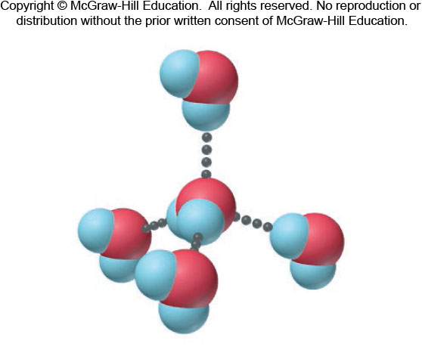
H-bonding Ability of water
Each H₂O molecule can form four H bonds to other molecules, resulting in a tetrahedral arrangement.
Figure 12.22

Slide 57
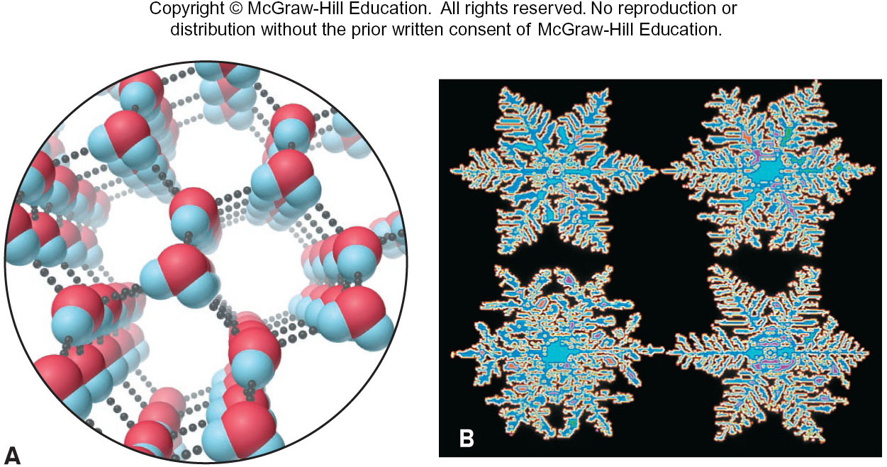
The Hexagonal Structure Of Ice
Ice has an open structure due to H-bonding. Ice is therefore less dense than liquid water.
Figure 12.23
Source: (B) © Scott Camazine/Science Source

Slide 58
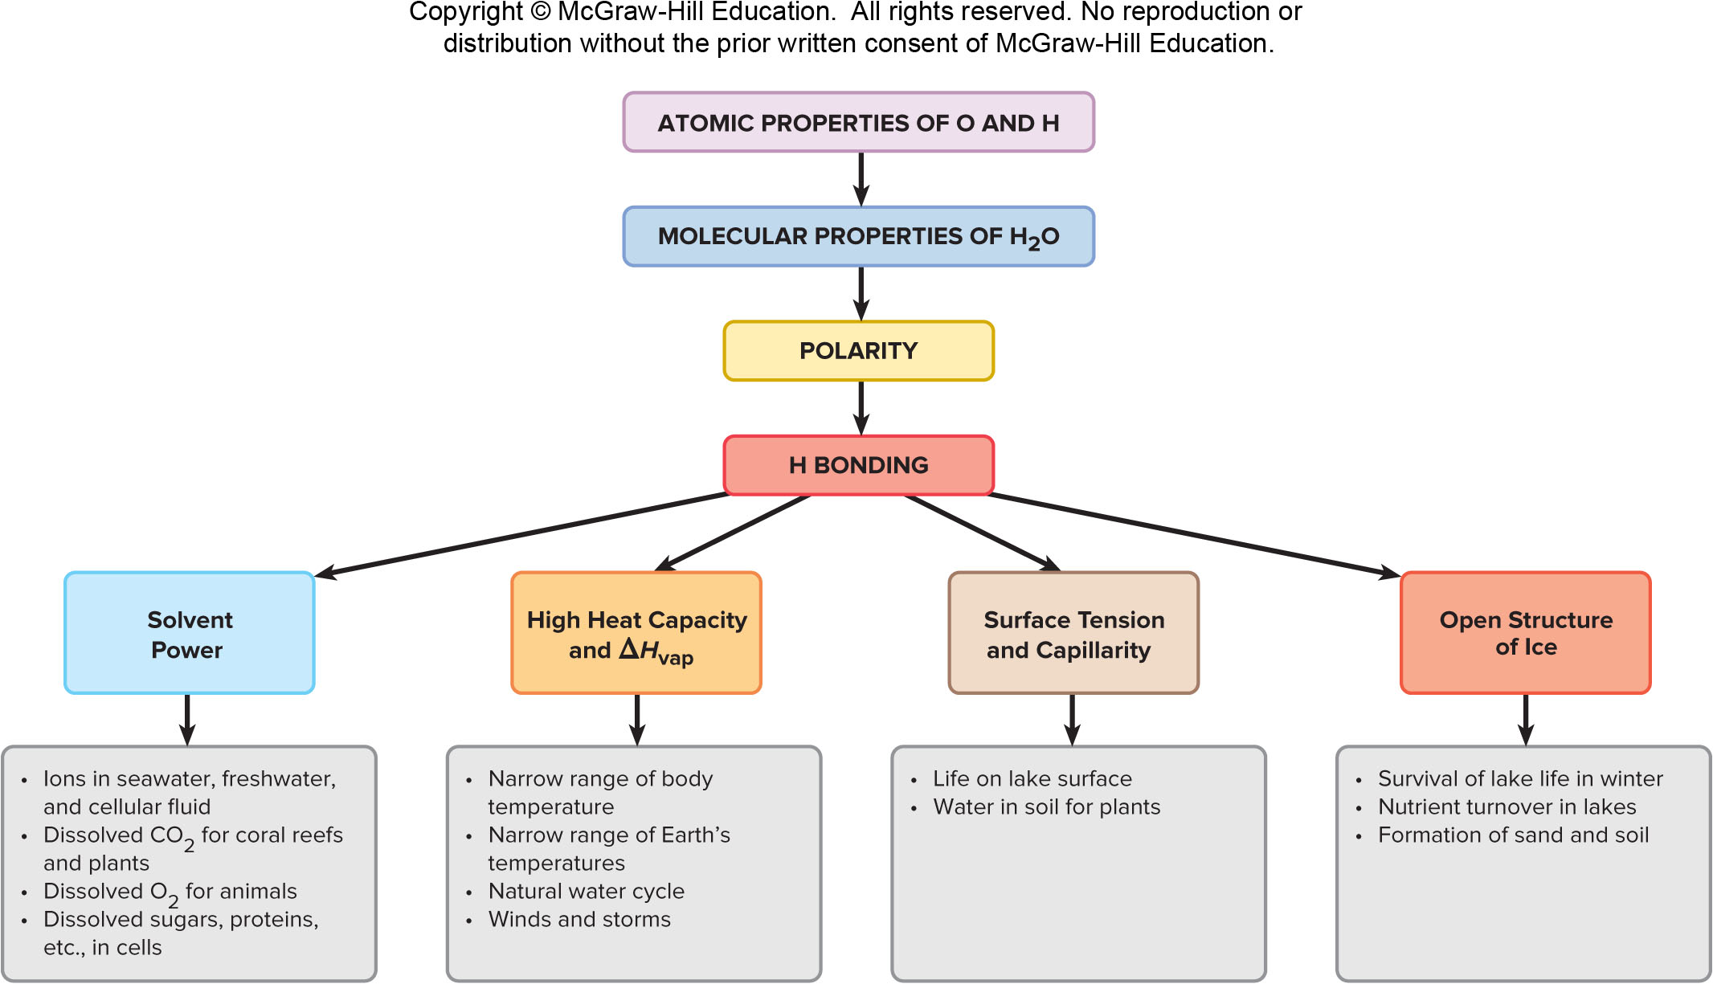
The Unique Macroscopic Behavior of Water that Emerges from its Atomic and Molecular Properties
Figure 12.24

Slide 59
The Solid State
Solids are divided into two categories:
  Crystalline solids have well defined shapes due to the orderly arrangement of their particles.
  Amorphous solids lack orderly arrangement and have poorly defined shapes.
A crystal is composed of particles packed in an orderly three-dimensional array called the crystal lattice.

Slide 60
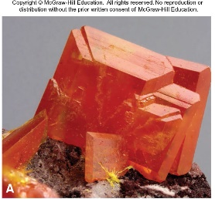
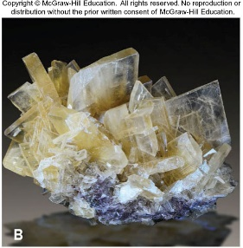
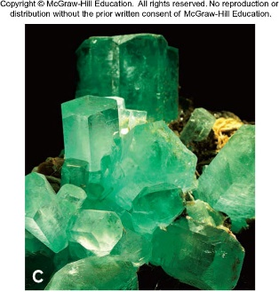
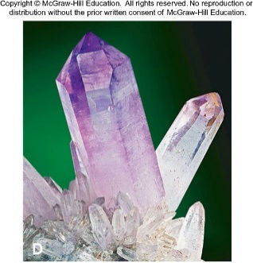
The Beauty Of Crystalline Solids
Wulfenite
Barite
Beryl (emerald)
Quartz (amethyst)
Figure 12.25
Source: (A) © Matteo Chinellato/Shutterstock.com (B) © Albert Russ/Shutterstock.com (C) © Gabbro/Alamy (D) © Walter Geiersperger/Corbis

Slide 61
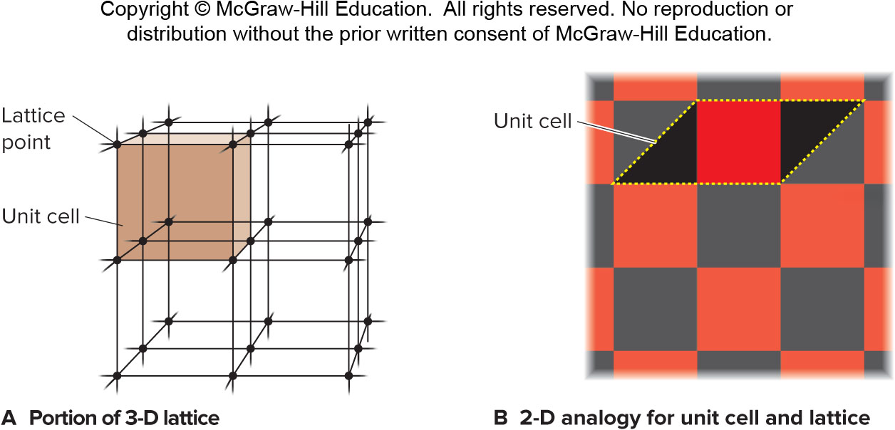
The Crystal Lattice and the Unit Cell
Figure 12.26

Slide 62
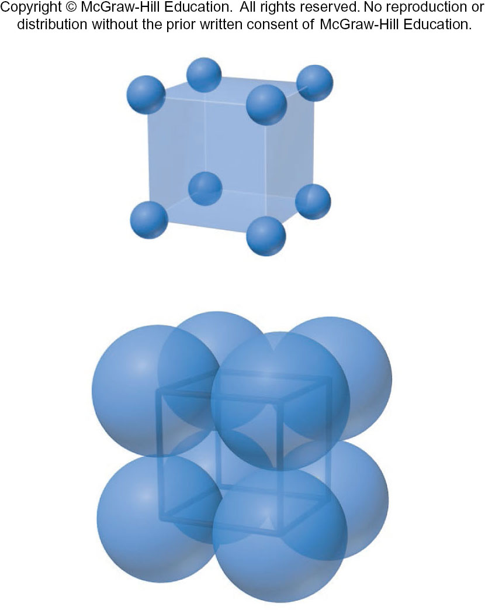
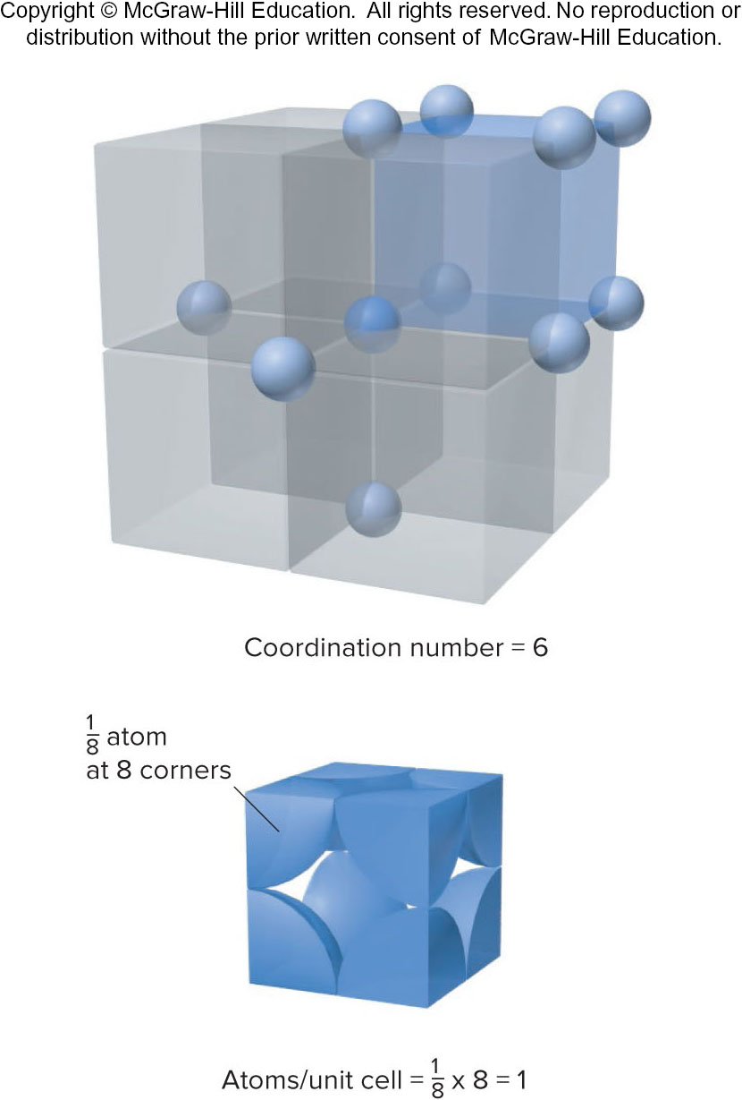
Simple Cubic Unit Cell
Figure 12.27

Slide 63
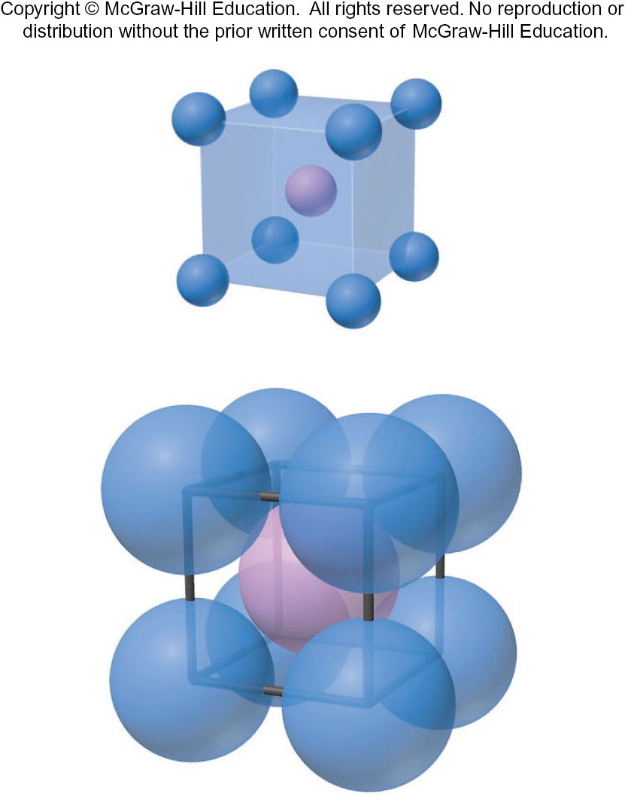
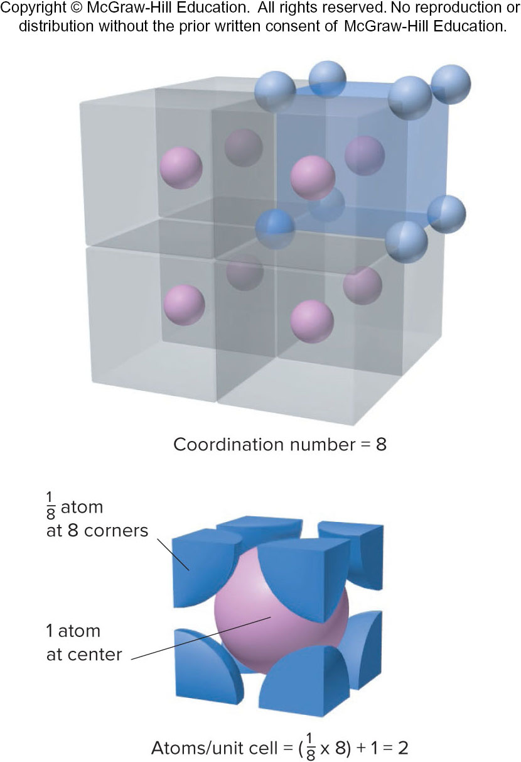
Body-centered Cubic Unit Cell
Figure 12.27

Slide 64
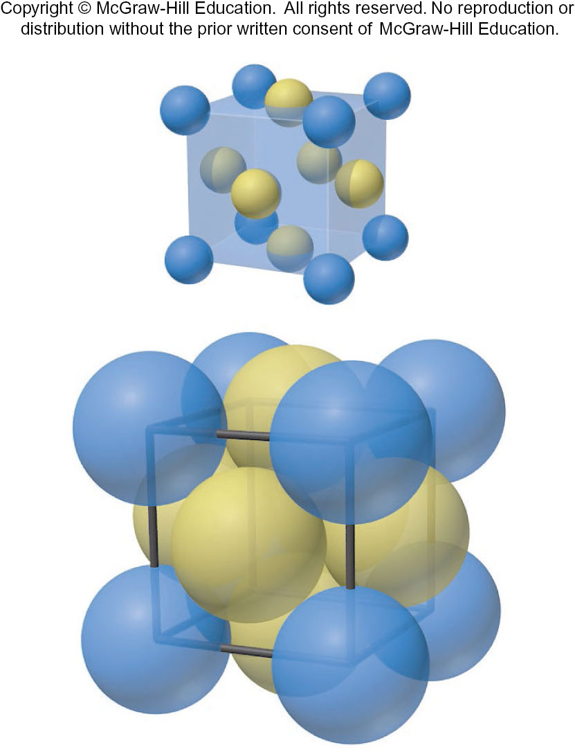

Face-centered Cubic Unit Cell
Figure 12.27

Slide 65



Sample Problem 12.6 – Problem
Determining the Number of Particles per Unit Cell and the Coordination Number
PROBLEM: For each of the crystalline solids shown, determine the number of atoms (or ions) per unit cell and the coordination number.
(a) Pd (b) CuI (c) Mo

Slide 66
Sample Problem 12.6 – Plan
PLAN: To determine the number of particles (atoms or ions) in a unit cell, we count the number of particles at the corners, in the faces, and within the body of the cell. The eight corners are shared by eight other cells for a total of 8 corners × ​​1/8 particle per corner, or 1 particle; particles in the body of a cell are in that cell only; particles in the faces are shared by two cells, 6 faces × 1/2​​ particle per face, or 3 particles. We count the number of nearest neighboring particles to obtain the coordination number.

Slide 67

Sample Problem 12.6 - Solution
SOLUTION:
(a) Palladium metal adopts a face-centered cubic unit cell:
  Atoms/unit cell = (8 × $\frac{1}{8}$ ​​) + (6 × $\frac{1}{2}$​​) = 4 atoms
  The coordination number is 12.
(b) Copper(I) iodide has a unit cell that can be viewed as a face-centered cubic array of Cu⁺ ions interpenetrating a face-centered cubic array of I⁻ ions:
  Cu⁺ ions within the body of the unit cell = 4
  I⁻ ions/unit cell = (8 × $\frac{1}{8}$​​) + (6 × ​​ $\frac{1}{2}$) = 4 Cu⁺ and 4 I⁻ ions
  Each ion is surrounded by four of the oppositely charged ions: coordination number is 4.
(c) Molybdenum metal adopts a body-centered cubic cell:
  Atoms/unit cell = (8 × ​​ $\frac{1}{8}$) + (1 × 1) = 2 atoms
  The coordination number is 8.

Slide 68

Packing Spheres To Obtain Three Cubic And Hexagonal Unit Cells – Simple Solutions
Figure 12.28

Slide 69

Packing Spheres To Obtain Three Cubic And Hexagonal Unit Cells
Figure 12.28

Slide 70

Sample Problem 12.7 – Problem
Determining Atomic Radius
PROBLEM: Barium is the largest nonradioactive alkaline earth metal. It has a body-centered cubic unit cell and a density of 3.62 g/cm³. What is the atomic radius of barium? (Volume of a sphere: $V=\frac{4}{3}πr^{3}$)

Slide 71

Sample Problem 12.7 – Plan
PLAN: An atom is spherical, so we can find its radius from its volume. If we multiply the reciprocal of density (volume/mass) by the molar mass (mass/mole), we find the volume/mole of Ba metal. The metal crystallizes in the body-centered cubic structure, so 68% of this volume is occupied by 1 mol of the Ba atoms themselves. Dividing by Avogadro’s number gives the volume of one Ba atom, from which we find the radius.

Slide 72

Sample Problem 12.7 - Solution
SOLUTION:
  $$\frac{volume}{mol} of Ba metal=\frac{1}{density}∗M=\frac{1cm^{3}}{3.62g Ba}∗\frac{137.3g Ba}{1 mol Ba}=37.9\frac{cm^{3}}{mol}Ba$$
  volume/mol of Ba atoms = 37.9 cm³ / mol Ba * 0.68 = 26 cm³/mol Ba atoms
  volume of Ba atoms = 26 cm³/mol / (6.022x10²³ atoms/mol) = 4.3x10⁻²³ cm³/Ba atom
  V of Ba atom = $\frac{4}{3}π$r³ , so r³ = $\frac{3V}{4π}$
  r = $\sqrt[3]{\frac{3V}{4π}}= \sqrt[3]{\frac{3(4.3∗{10}^{−23}{cm}^{3})}{4∗3.14}}$ = 2.2x10⁻⁸ cm

Slide 73

Edge Length and Atomic (Ionic) Radius In the Three Cubic Unit Cells
Figure 12.29

Slide 74

Sample Problem 12.8 – Problem and Plan
Determining Atomic Radius from the Unit Cell
PROBLEM: Copper adopts cubic closest packing, and the edge length of the unit cell is 361.5 pm. What is the atomic radius of copper?
PLAN: Cubic closest packing gives a face-centered cubic unit cell, and we know the edge length. From Figure 12.29, with A = 361.5 pm, we solve for r.

Slide 75

Sample Problem 12.8 - Solution
SOLUTION:
Using the Pythagorean theorem to find C, the diagonal of the cell’s face: $C=\sqrt{A^{2}+B^{2}}$. The unit cell is a cube, so A = B. Therefore, $C=\sqrt{2A^{2}}= \sqrt{2(361.5 pm)^{2}}=511.2 pm$
Finding r: C = 4r. Therefore:
r = 511.2 pm/4 = 127.8 pm

Slide 76

Diffraction Of X-rays By Crystal Planes
Figure B12.1

Slide 77

Formation Of An X-ray Diffraction Pattern Of The Protein Hemoglobin
Figure B12.2

Slide 78

A Scanning Tunneling Micrograph Of Cesium Atoms (Red) On Gallium Arsenide
Figure B12.3
Source: Courtesy National Institute of Standards and Technology

Slide 79
Types of Crystalline Solids
Atomic solids consist of individual atoms held together only by dispersion forces.
Molecular solids consist of individual molecules held together by various combinations of intermolecular forces.
Ionic solids consist of a regular array of cations and anions.
Metallic solids exhibit an organized crystal structure.
Network Covalent solids consist of atoms covalently bonded together in a three-dimensional network.

Slide 80
Characteristics of the Major Types of Crystalline Solids
Type | Particle(s) | Interparticle Forces | Physical Properties | Examples [mp, °C]
Atomic | Atoms | Dispersion | Soft, very low mp, poor thermal and electrical conductors | Elements in Group 8A(18) (Ne [−249] to Rn [−71])
Molecular | Molecules | Dispersion, dipole-dipole, H bonds | Fairly soft, low to moderate mp, poor thermal and electrical conductors | Nonpolar O₂ [−219], C₄H₁₀ [−138] Cl₂ [−101], C₆H₁₄ [−95], P₄ [44.1] Polar SO₂ [−73], CHCl₃ [−64], HNO₃ [−42],H₂O [0.0], CH₃COOH [17]
Ionic | Positive and negative ions | Ion-ion attraction | Hard and brittle, high mp, good thermal and electrical conductors when molten | NaCl [801] CaF₂ [1423] MgO [2852]
Metallic | Atoms | Metallic bond | Soft to hard, low to very high mp, excellent thermal and electrical conductors, malleable and ductile | Na [97.8] Zn [420] Fe [1535]
Network covalent | Atoms | Covalent bond | Very hard, very high mp, usually poor thermal and electrical conductors | SiO₂ (quartz) [1610] C (diamond) [∼4000]

Slide 81


Cubic Closest Packing Of Argon And CH₄
Cubic closest packing of frozen argon (face-centered cubic cell).
Cubic closest packing (face-centered unit cell) of frozen CH4.
Figures 12.30 and 12.31

Slide 82


The Sodium Chloride Structure
Expanded View
Space-filling depiction of the NaCl unit cell
Figure 12.32

Slide 83


The Zinc Blende Structure
Expanded view (with bonds shown for clarity)
The unit cell, expanded to show interior ions.
Figure 12.33

Slide 84


The Fluorite Structure
Expanded view (with bonds shown for clarity)
The unit cell, expanded to show interior ions.
Figure 12.34

Slide 85


Crystal Structures Of Metals
Copper adopts cubic closest packing.
Magnesium adopts hexagonal closest packing.
Figure 12.35

Slide 86


Comparison of the Properties of Diamond and Graphite
Property | Graphite | Graphite Diagram | Diamond | Diamond Diagram
Density (g/cm³) | 2.27 |  | 3.51
Hardness | <1 (very soft) |  | 10 (hardest)
Melting point (K) | 4100 |  | 4100
Color | Shiny black |  | Colorless transparent
Electrical conductivity | High (along sheet) |  | None
​​ for combustion (kJ/mol) | −393.5 |  | −395.4
​​ (kJ/mol) | 0 (standard state) |  | 1.90

Slide 87


Crystalline and Amorphous Silicon Dioxide
Cristobalite, a crystalline form of silica (SiO₂), shows cubic closest packing.
Quartz glass is amorphous with a generally disordered structure.
Figure 12.36

Slide 88

The Band Of Molecular Orbitals In Lithium Metal
Figure 12.37

Slide 89

Electrical Conductivity In A Conductor, Semiconductor, And Insulator
The conducting properties of a substance are determined by the energy gap between the valence and conduction bands of MOs.
Figure 12.38

Slide 90



Crystal Structures And Band Representations Of Doped Semiconductors
Pure silicon has an energy gap between its valence and conduction bands. Its conductivity is low at room temperature.
Doping silicon with phosphorus adds additional valence e⁻. These enter the conductance band, bridging the energy gap and increasing conductivity.
Doping silicon with gallium removes electrons from the valence band and introduces positive ions. Si electrons can migrate to the empty orbitals, increasing conductivity.
Figure 12.39

Slide 91

The p-n Junction
Placing a p-type semiconductor adjacent to an n-type creates a p-n junction. Electrons flow freely in the n-to-p direction.
Figure 12.40

Slide 92

Structures Of Two Typical Molecules That Form Liquid Crystal Phases
Figure 12.41

Slide 93

The Three Common Types of Ordering in Liquid Crystal Phases
Figure 12.42

Slide 94


Liquid Crystal-type Phases In Biological Systems
Nematic arrays of tobacco mosaic virus particles within the fluid of a tobacco leaf.
The smectic-like arrangement of actin and myosin protein filaments in voluntary muscle cells.
Figure 12.43
Source: (A) © J. R. Factor/Science Source (B) © C. F. Armstrong/Science Source

Slide 95

A Liquid Crystal Display (LCD)
Figure 12.44

Slide 96
Some Uses of Modern Ceramics and Ceramic Mixtures
Ceramic | Applications
SiC, Si₃N₄, TiB₂, Al₂O₃ | Whiskers (fibers) to strengthen Al and other ceramics
Si₃N₄ | Car engine parts; turbine rotors for “turbo” cars; electronic sensor units
Si₃N₄, BN, Al₂O₃ | Support or layering materials (as insulators) in electronic microchips
SiC, Si₃N₄, TiB₂, ZrO₂, Al₂O₃, BN | Cutting tools, edge sharpeners (as coatings and whole devices), scissors, surgical tools, industrial “diamond”
BN, SiC | Armor-plating reinforcement fibers (as in Kevlar composites)
ZrO₂, Al₂O₃ | Surgical implants (hip and knee joints)

Slide 97

Expanded View Of The Atom Arrangements In Some Ceramic Materials
Figure 12.45

Slide 98
Molar Masses of Some Common Polymers
Name | ​​ (g/mol) | n | Uses
Acrylates | 2×10⁵ | 2×10³ | Rugs, carpets
Polyamide (nylons) | 1.5×10⁴ | 1.2×10² | Tires, fishing line
Polycarbonate | 1×10⁵ | 4×10² | Compact discs
Polyethylene | 3×10⁵ | 1×10⁴ | Grocery bags
Polyethylene (ultrahigh molecular weight) | 5×10⁶ | 2×10⁵ | Hip joints
Poly(ethylene terephthalate) | 2×10⁴ | 1×10² | Soda bottles
Polystyrene | 3×10⁵ | 3×10³ | Packing, coffee cups
Poly(vinyl chloride) | 1×10⁵ | 1.5×10³ | Plumbing

Slide 99

The Random-coil Shape Of A Polymer Chain
Figure 12.46

Slide 100

The Semicrystallinity Of A Polymer Chain
Figure 12.47

Slide 101

The Viscosity Of A Polymer In Aqueous Solution
Figure 12.48

Slide 102
Some Common Elastomers
Name | T_{g} (°C) | Uses
Poly(dimethyl siloxane) | −123 | Breast implants
Polybutadiene | −106 | Rubber bands
Polyisoprene | −65 | Surgical gloves
Polychloroprene (neoprene) | −43 | Footwear; medical tubing

Slide 103

The Colors Of Quantum Dots
Quantum dots are nanoparticles of semiconducting materials (e.g., GaAs or GaSe) that are smaller than 10 nm. The smaller the dots, the shorter the emitted wavelength.
Figure 12.49
Source: Courtesy of Benoit Dubertret

Slide 104

The Magnetic Behavior Of A Ferrofluid
Nanoparticles of magnetite (Fe₃O₄) dispersed in a viscous fluid are suspended between the poles of a magnet.
Figure 12.50
Source: © & by permission from Ferrotec (USA) Corporation. May not be reproduced without written permission.

Slide 105

Driving a Nanocar
The nanocar, with buckyball wheels, is only 4 nm wide and is “driven” on a gold surface under the direction of an atomic force microscope.
Figure 12.51
Source: T. Sasaki/Rice University (Image courtesy of Rice University Office of Media Relations and Information)

