Slide 1
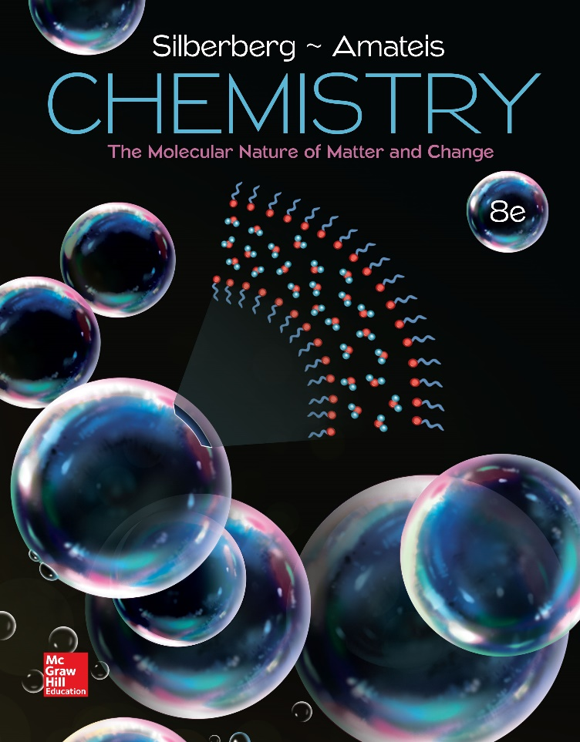
Chemistry
The Molecular Nature of Matter and Change Eighth Edition
Martin S. Silberberg and Patricia G. Amateis

Slide 2
Kinetics: Rates and Mechanisms of Chemical Reactions
16.1 Focusing on Reaction Rate
16.2 Expressing the Reaction Rate
16.3 The Rate Law and Its Components
16.4 Integrated Rate Laws: Concentration Changes Over Time
16.5 Theories of Chemical Kinetics
16.6 Reaction Mechanisms: The Steps from Reactant to Product
16.7 Catalysis: Speeding Up a Reaction

Slide 3
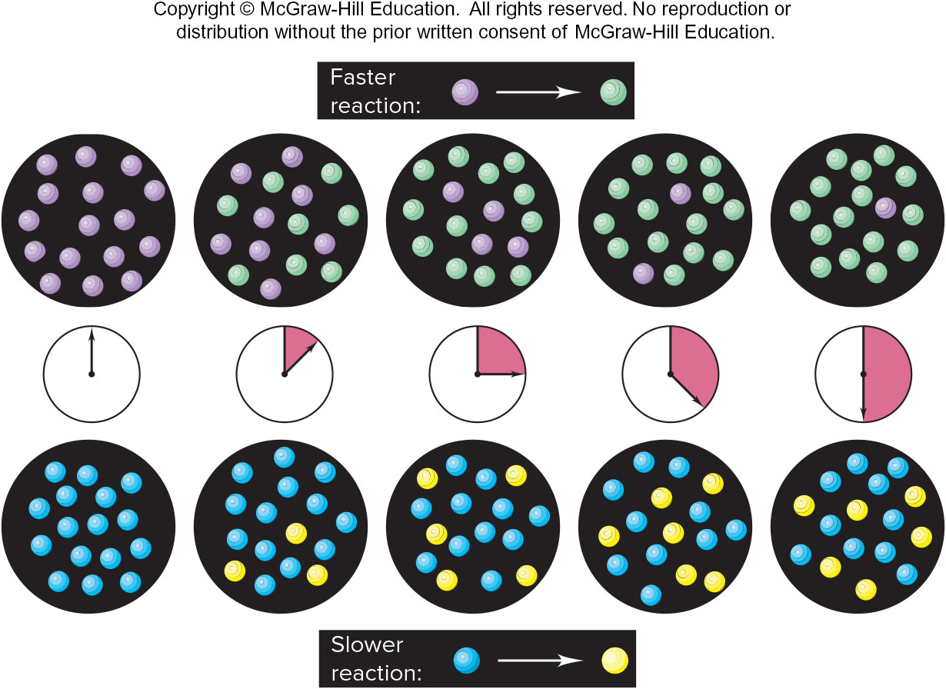
A Faster Reaction and a Slower Reaction
Figure 16.1

Slide 4
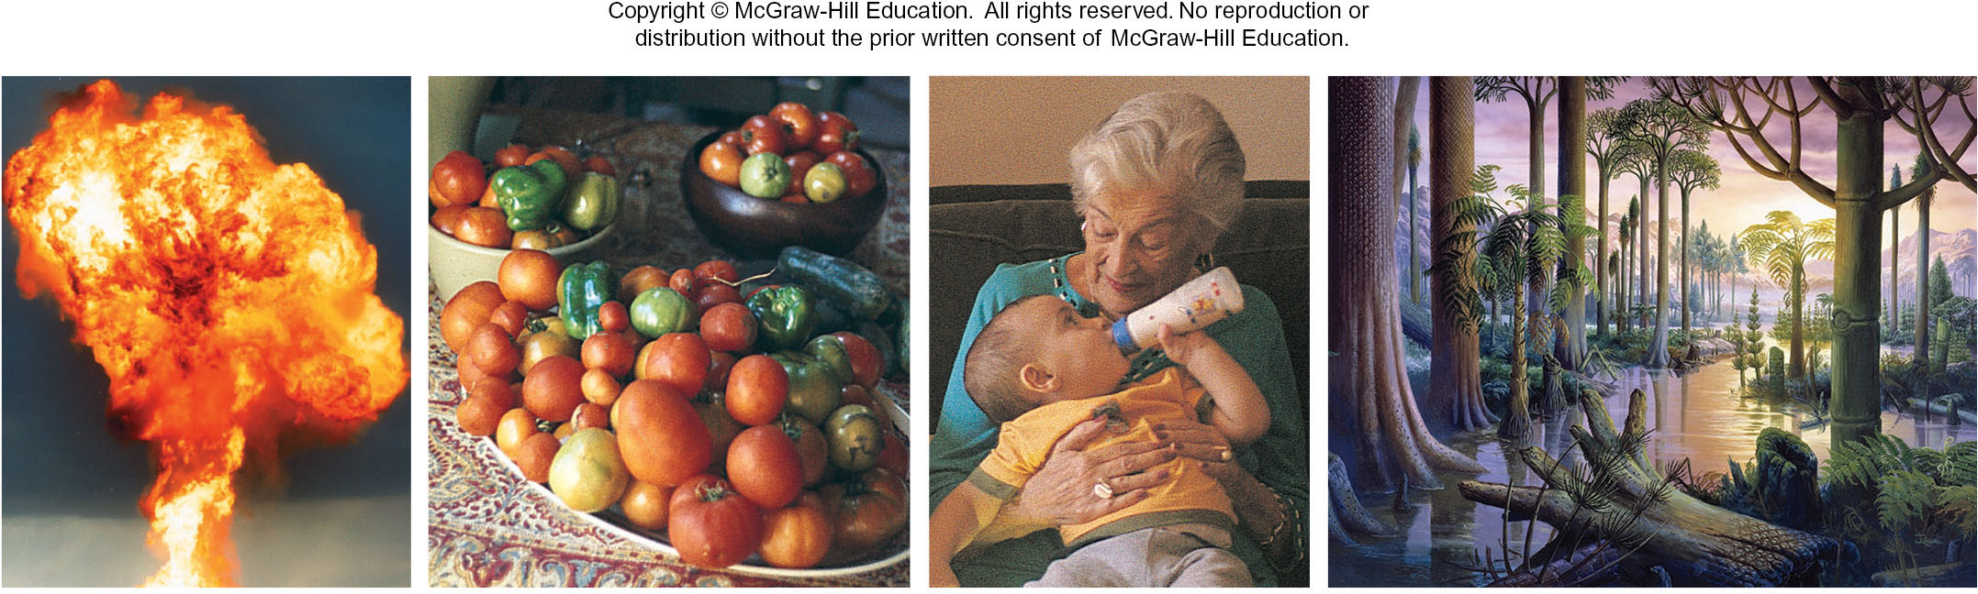
The Wide Range of Reaction Rates
Figure 16.2
Source: (explosion): © Crown Copyright/Health & Safety Lab./Science Source; (fruit and baby): © Ruth Melnick; (landscape): © Publiphoto/Science Source

Slide 5
Factors That Influence Reaction Rate
Particles must collide in order to react.
The higher the concentration of reactants, the greater the reaction rate.
  A higher concentration of reactant particles allows a greater number of collisions.
The physical state of the reactants influences reaction rate.
  Substances must mix in order for particles to collide.
The higher the temperature, the greater the reaction rate.
  At higher temperatures particles have more energy and therefore collide more often and more effectively.

Slide 6
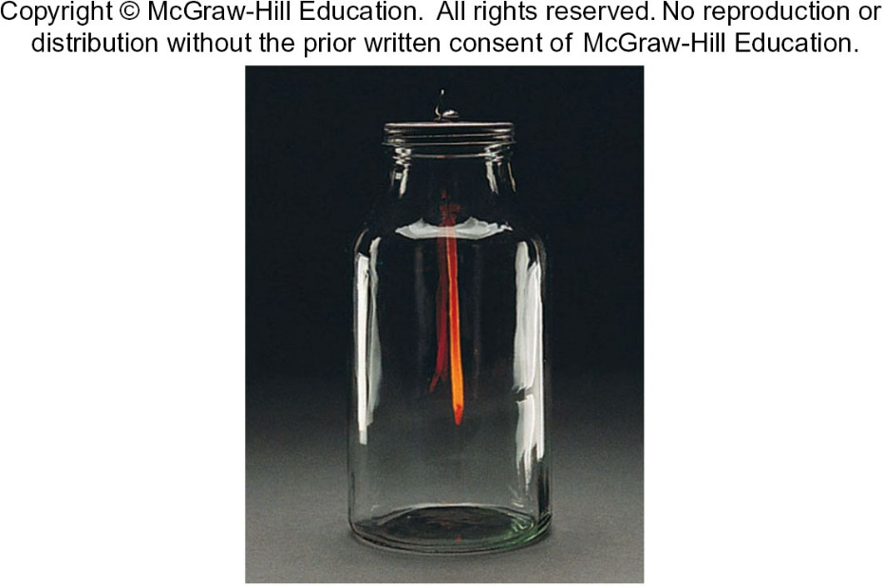
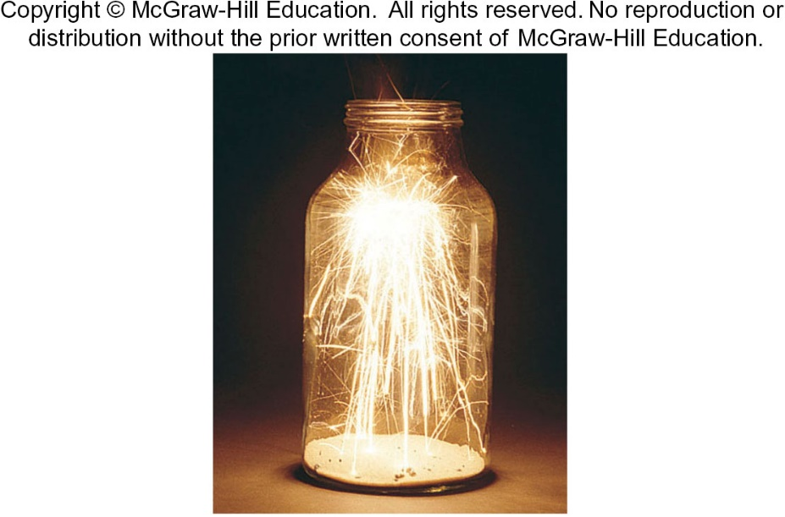
The Effect of Surface Area on Reaction Rate
A hot steel nail glows feebly when placed in O₂.
The same mass of steel wool bursts into flame.
Figure 16.3
Source: © McGraw-Hill Education/Stephen Frisch, photographer

Slide 7
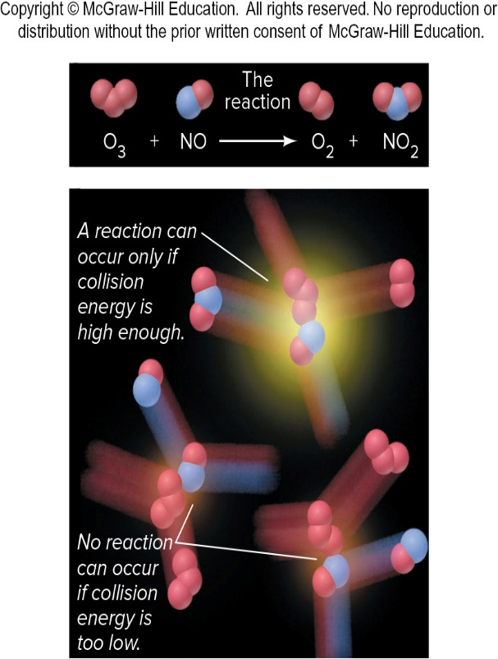
Sufficient Collision Energy Is Required for a Reaction to Occur
Figure 16.4

Slide 8
Expressing the Reaction Rate
Reaction rate is measured in terms of the changes in concentrations of reactants or products per unit time.
For the general reaction A → B, we measure the concentration of A at t₁ and at t₂:
Square brackets indicate a concentration in moles per liter.
The negative sign is used because the concentration of A is decreasing. This gives the rate a positive value.

Slide 9
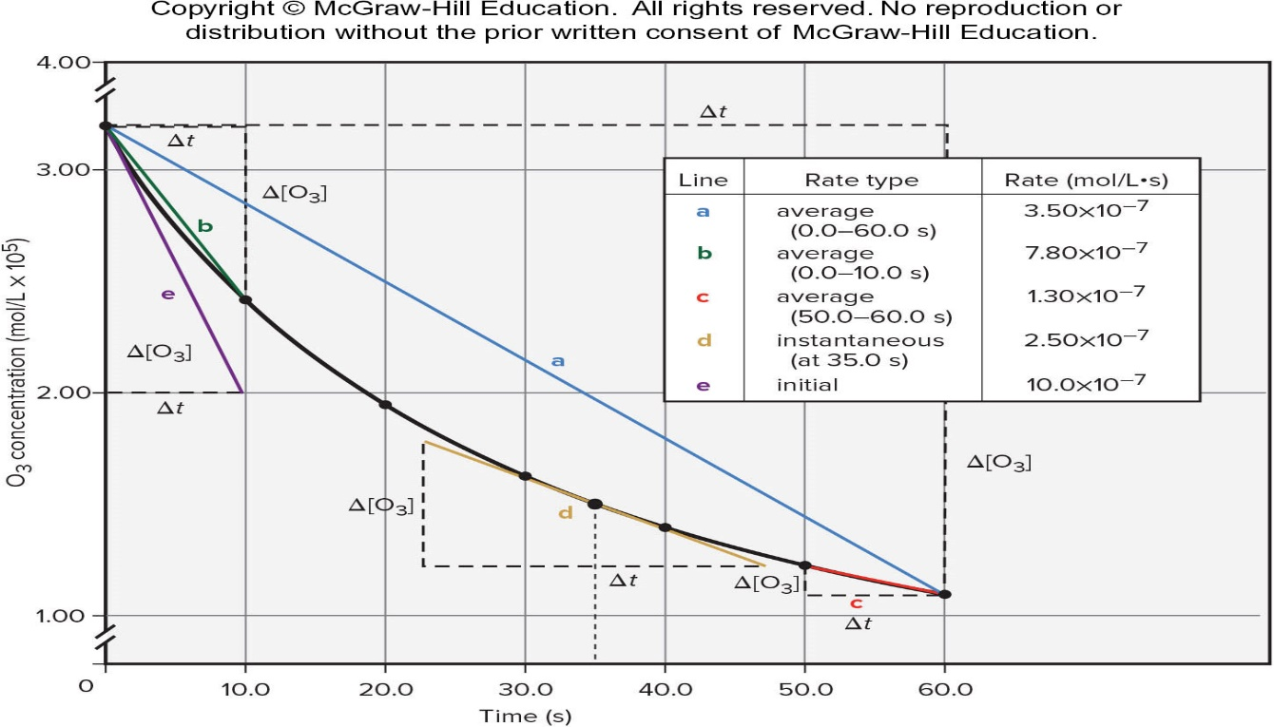
Three Types of Reaction Rates for the Reaction of O₃ and C₂H₄
Time (s) | Concentration of O₃ (mol/L)
0.0 | 3.20x10⁻⁵
10.0 | 2.42x10⁻⁵
20.0 | 1.95x10⁻⁵
30.0 | 1.63x10⁻⁵
40.0 | 1.40x10⁻⁵
50.0 | 1.23x10⁻⁵
60.0 | 1.10x10⁻⁵
Figure 16.5

Slide 10
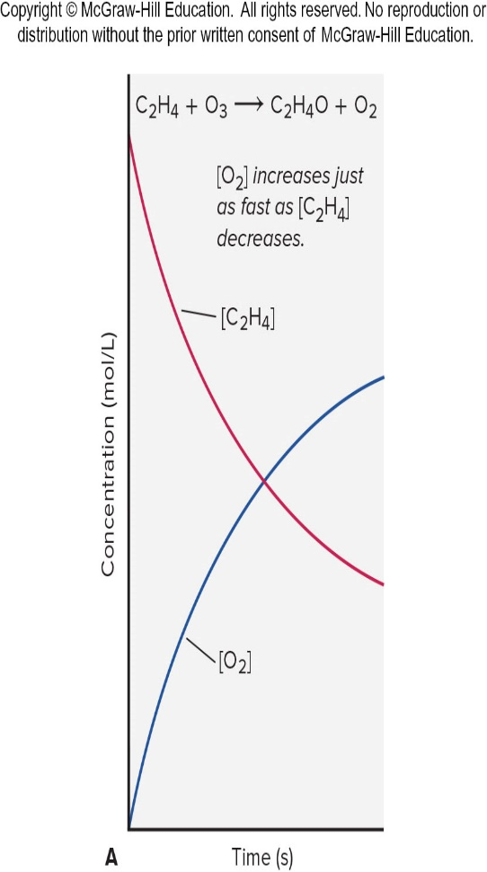
Plots of [Reactant] and [Product] vs. Time
[O₂] increases just as fast as [C₂H₄] decreases.
Figure 16.6A

Slide 11
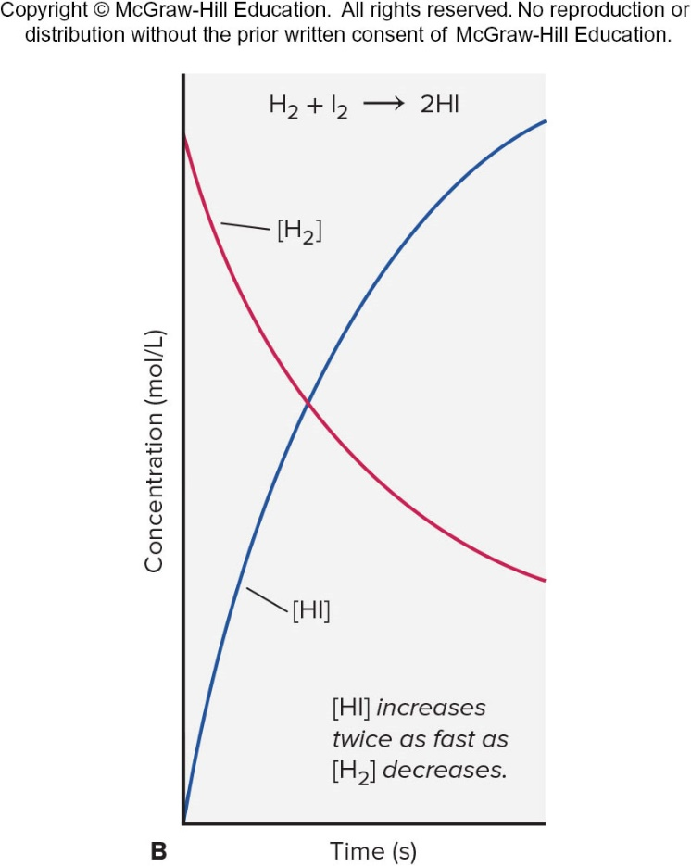
Plots of [Reactant] and [Product] vs. Time:
H₂ + I₂
[HI] increases twice as fast as [H₂] decreases.
Figure 16.6B

Slide 12
General Form of Reaction Rates
In general, for the reaction
where a, b, c, and d are the coefficients for the balanced equation, the rate is expressed as:

Slide 13
Sample Problem 16.1 – Problem
Expressing Rate in Terms of Changes in Concentration with Time
PROBLEM: Hydrogen gas has a nonpolluting combustion product (water vapor). This gas is used as a fuel aboard the space shuttle and in earthbound cars with prototype engines:
(a) Express the rate in terms of changes in [H₂], [O₂], and [H₂O] with time.
(b) When [O₂] is decreasing at 0.23 mol/L⋅s, at what rate is [H₂O] increasing?

Slide 14
Sample Problem 16.1 – Plan
PLAN: (a) Of the three substances in the equation, let’s choose O₂ as the reference because its coefficient is 1. For every molecule of O₂ that disappears, two molecules of H₂ disappear. Thus, the rate of [O₂] decrease is one-half the rate of [H₂] decrease. By similar reasoning, the rate of [O₂] decrease is one-half the rate of [H₂O] increase.
(b) Because [O₂] is decreasing, the change in its concentration must be negative. We substitute the given rate as a negative value (−0.23 mol/L⋅s) into the expression and solve for Δ[H₂O]/Δt.

Slide 15
Sample Problem 16.1 - Solution
SOLUTION: (a) Expressing the rate in terms of each component:
(b) Calculating the rate of change of [H₂O]:

Slide 16
The Rate Law
For any general reaction occurring at a fixed temperature:
The term k is the rate constant, which is specific for a given reaction at a given temperature.
The exponents m and n are reaction orders and are determined by experiment.
  The values of m and n are not necessarily related in any way to the coefficients a and b.

Slide 17
Reaction Orders
A reaction has an individual order “with respect to” or “in” each reactant.
For the simple reaction A → products:
If the rate doubles when [A] doubles, the rate depends on [A]¹ and the reaction is first order with respect to A.
If the rate quadruples when [A] doubles, the rate depends on [A]² and the reaction is second order with respect to [A].
If the rate does not change when [A] doubles, the rate does not depend on [A], and the reaction is zero order with respect to A.

Slide 18
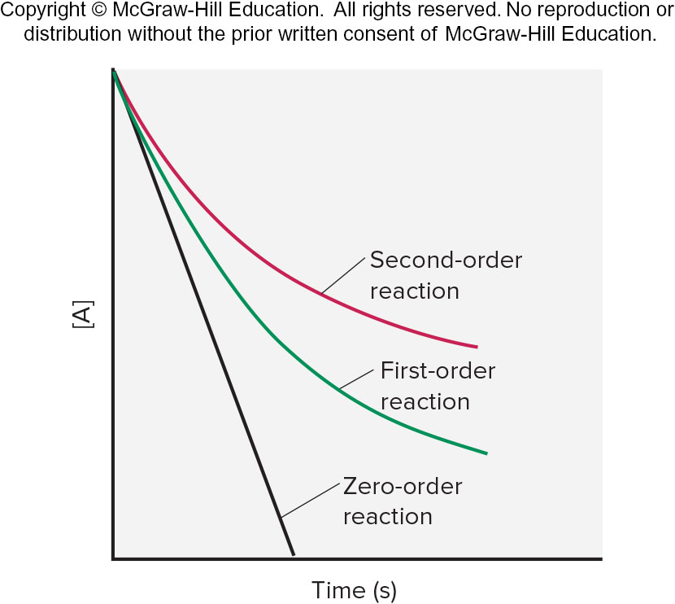
Plots of Reactant Concentration, [A], vs. Time for First-, Second-, and Zero-Order Reactions
Figure 16.7

Slide 19
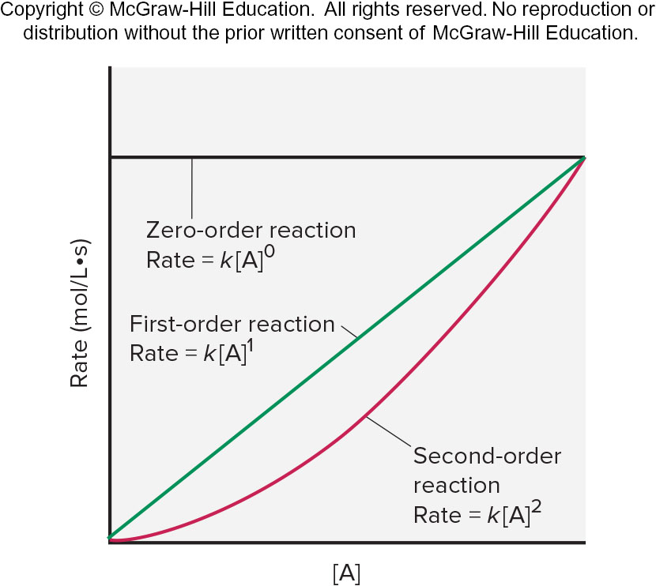
Plots of Rate vs. Reactant Concentration, [A], for First-, Second-, and Zero-Order Reactions
Figure 16.8

Slide 20
Individual and Overall Reaction Orders
For the reaction
The rate law is
The reaction is second order with respect to NO, first order with respect to H₂ and third order overall.
Note that the reaction is first order with respect to H₂ even though the coefficient for H₂ in the balanced equation is 2.
Reaction orders must be determined from experimental data and cannot be deduced from the balanced equation.

Slide 21
Sample Problem 16.2 – Problem
Determining Reaction Orders from Rate Laws
PROBLEM: For each of the following reactions, use the given rate law to determine the reaction order with respect to each reactant and the overall order; for the reaction in (a), determine the factor by which the rate changes if [NO] is tripled and [O₂] is doubled.

Slide 22
Sample Problem 16.2 – Plan
PLAN: We inspect the exponents in the rate law, not the coefficients of the balanced equation, to find the individual orders, and then take their sum to find the overall reaction order. To find the change in rate for the reaction in (a), we substitute 3 for [NO] in the rate law (since that concentration changes by a factor of 3) and 2 for [O₂] (since that concentration changes by a factor of 2), and solve for the rate.

Slide 23
Sample Problem 16.2 - Solution
SOLUTION: (a) The exponent of [NO] is 2, so the reaction is second order with respect to NO, first order with respect to O₂, and third order overall. Finding the change in rate:
The rate increases by a factor of 18.
(b) The reaction is 3 2 order in CH₃CHO and 3 2 order overall.
(c) The reaction is first order in H₂O₂, first order in I⁻, and second order overall.
The reactant H⁺ does not appear in the rate law, so the reaction is zero order in H⁺.

Slide 24
Determining Reaction Orders
For the general reaction A + 2B → C + D, the rate law will have the form:
To determine the values of m and n, we run a series of experiments in which one reactant concentration changes while the other is kept constant, and we measure the effect on the initial rate in each case.

Slide 25
Initial Rates for the Reaction between A and B
Experiment | Initial Rate (mol/L·s) | Initial [A] (mol/L) | Initial [B] (mol/L)
1 | 1.75×10⁻³ | 2.50×10⁻² | 3.00×10⁻²
2 | 3.50×10⁻³ | 5.00×10⁻² | 3.00×10⁻²
3 | 3.50×10⁻³ | 2.50×10⁻² | 6.00×10⁻²
4 | 7.00×10⁻³ | 5.00×10⁻² | 6.00×10⁻²
[B] is kept constant for experiments 1 and 2, while [A] is doubled. Then [A] is kept constant while [B] is doubled.

Slide 26
Calculating the Order of A
Finding m, the order with respect to A:
We compare experiments 1 and 2, where [B] is kept constant but [A] doubles:
Dividing, we get 2.00 = (2.00)^{m} so m = 1

Slide 27
Calculating the Order of B
Finding n, the order with respect to B:
We compare experiments 3 and 1, where [A] is kept constant but [B] doubles:
Dividing, we get 2.00 = (2.00)^{n} so n = 1

Slide 28
Initial Rates for the Reaction Between O₂ and NO
Experiment | Initial Rate (mol/L·s) | Initial [A] (mol/L) | Initial [B] (mol/L)
1 | 1.75×10⁻³ | 2.50×10⁻² | 3.00×10⁻²
2 | 3.50×10⁻³ | 5.00×10⁻² | 3.00×10⁻²
3 | 3.50×10⁻³ | 2.50×10⁻² | 6.00×10⁻²
4 | 7.00×10⁻³ | 5.00×10⁻² | 6.00×10⁻²

Slide 29
Calculating the Order with Respect to O₂
Finding m, the order with respect to O₂:
We compare experiments 1 and 2, where [NO] is kept constant but [O₂] doubles:
Dividing, we get 1.99 = (2.00)^{m} or 2 = 2^{m}, so m = 1
The reaction is first order with respect to O₂.

Slide 30
Using Logarithms to Solve for Reaction Order
Sometimes the exponent is not easy to find by inspection. In those cases, we solve for m with an equation of the form a = b^{m}:
This confirms that the reaction is first order with respect to O₂.
Reaction orders may be positive integers, zero, negative integers, or fractions.

Slide 31
Using Logarithms for the Order of NO
Finding n, the order with respect to NO:
We compare experiments 1 and 3, where [O₂] is kept constant but [NO] doubles:
Dividing, we get 3.99 = (2.00)^{n} or 4 = 2^{n}, so n = 2.
Alternatively:
The reaction is second order with respect to NO.
The rate law is given by:

Slide 32
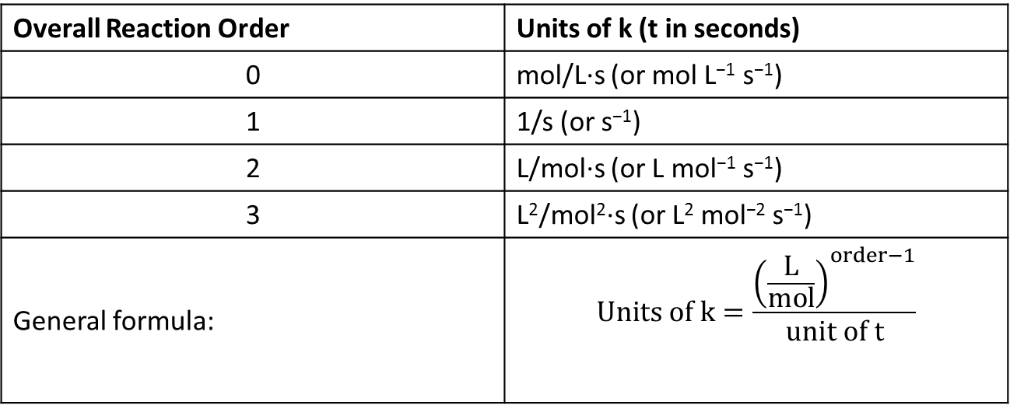
Units of the Rate Constant k for Several Overall Reaction Orders
Overall Reaction Order | Units of k (t in seconds)
0 | mol/L·s (or mol L⁻¹ s⁻¹)
1 | 1/s (or s⁻¹)
2 | L/mol·s (or L mol⁻¹ s⁻¹)
3 | L²/mol²·s (or L² mol⁻² s⁻¹)
General formula:
The value of k is easily determined from experimental rate data. The units of k depend on the overall reaction order.

Slide 33
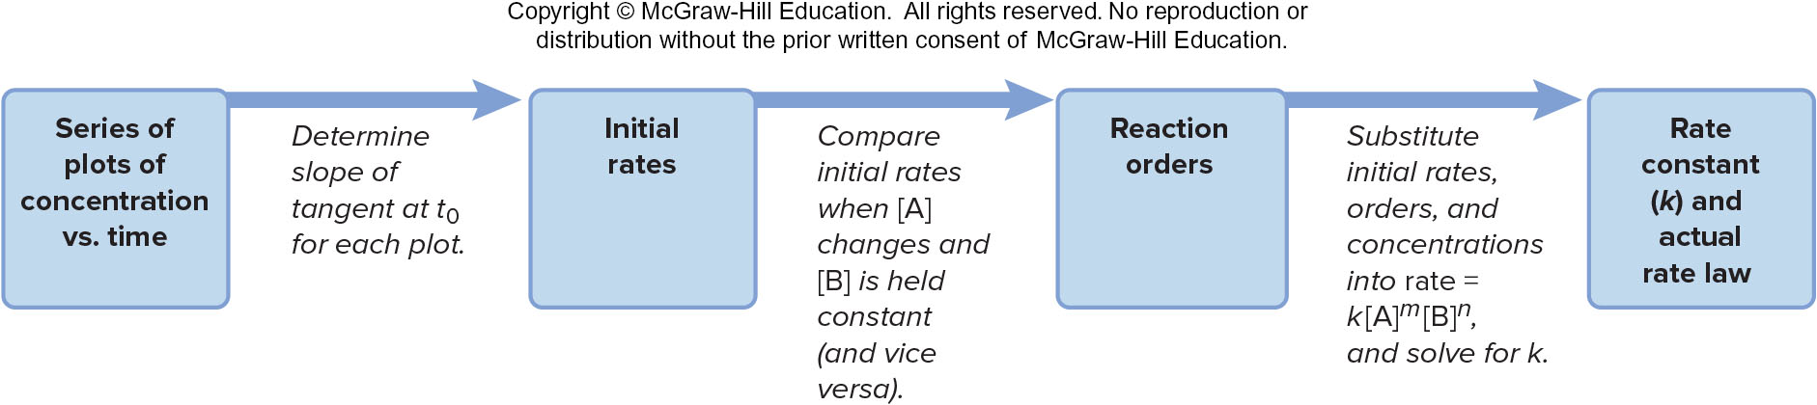
Information Sequence to Determine the Kinetic Parameters of a Reaction
Figure 16.9

Slide 34
Sample Problem 16.3 – Problem
Determining Reaction Orders and Rate Constants from Rate Data
PROBLEM: Many gaseous reactions occur in car engines and exhaust systems. One of these is
(a) Use the following data to determine the individual and overall reaction orders.
(b) Calculate k using the data from experiment 1
Experiment | Initial Rate (mol/L·s) | Initial [NO₂] (mol/L) | Initial [CO] (mol/L)
1 | 0.0050 | 0.10 | 0.10
2 | 0.080 | 0.40 | 0.10
3 | 0.0050 | 0.10 | 0.20

Slide 35
Sample Problem 16.3 – Plan
PLAN: (a) We need to solve the general rate law for m and for n and then add those orders to get the overall order. To solve for each exponent, we proceed as in the text, taking the ratio of the rate laws for two experiments in which only the reactant in question changes. (b) We substitute the values for the rate and the reactant concentrations from experiment 1 into the rate law and solve for k.

Slide 36
Sample Problem 16.3 – Solution (a), Part 1
SOLUTION: (a) Calculating m in [NO₂]^{m}: We take the ratio of the rate laws for experiments 1 and 2, in which [NO₂] varies but [CO] is constant:
This gives 16 = (4.0)^{m}, so we have m = log 16/log 4.0 = 2.0.
The reaction is second order in NO₂.

Slide 37
Sample Problem 16.3 – Solution (a), Part 2
SOLUTION: (a) Calculating n in [CO]^{n}: We take the ratio of the rate laws for experiments 1 and 3, in which [CO] varies but [NO₂] is constant:
We have 1.0 = (2.0)^{n}, so n = 0. The rate does not change when [CO] varies, so the reaction is zero order in CO.
Therefore, the rate law is:
The reaction is second order overall.

Slide 38
Sample Problem 16.3 – Solution (b)
SOLUTION: (b) From experiment 1, rate = 0.0050 mol/L·s and [NO₂] = 0.10 mol/L. Calculating k:

Slide 39
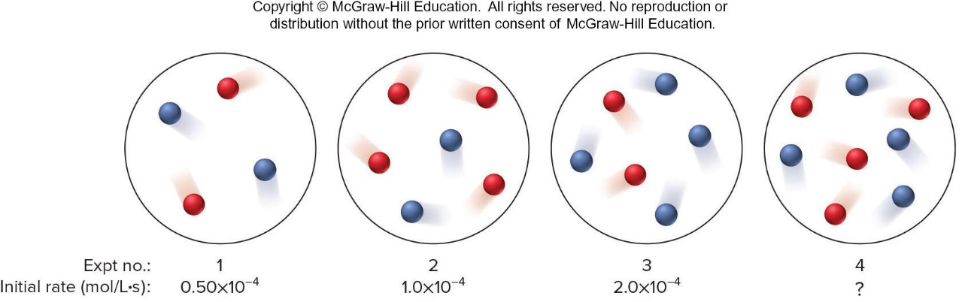
Sample Problem 16.4 – Problem
Determining Reaction Orders from Molecular Scenes
PROBLEM: At a particular temperature and volume, two gases, A (red) and B (blue), react. The following molecular scenes represent starting mixtures for four experiments:
(a) What is the reaction order with respect to A? With respect to B? The overall order?
(b) Write the rate law for the reaction.
(c) Predict the initial rate of Expt 4.

Slide 40
Sample Problem 16.4 – Plan
PLAN: (a) As before, we find the individual reaction orders by seeing how a change in each reactant changes the rate. In this case, however, instead of using concentration data, we count numbers of particles. The sum of the individual orders is the overall order. (b) To write the rate law, we use the orders from part (a) as exponents in the general rate law. (c) Using the results from Expts 1 through 3 and the rate law from part (b), we find the unknown initial rate of Expt 4.

Slide 41
Sample Problem 16.4 – Solution (a)
SOLUTION: (a) The rate law is rate = k[A]^{m}[B]^{n}. For reactant A (red) in Expts 1 and 2 (k and number of B particles are constant):
Thus, 2 = (2)^{m} so the order with respect to A is 1. For reactant B in Expts 1 and 3 (k and number of A particles are constant):
Thus, 4 = (2)^{n} so the order with respect to B is 2. The overall order is 1 + 2 = 3.

Slide 42
Sample Problem 16.4 – Solution (b) and (c)
SOLUTION: (b) Writing the rate law: The general rate law is rate = k[A]^{m}[B]^{n}, so we have:
(c) Finding the initial rate of Expt 4: There are several possibilities, but let’s compare Expts 3 and 4, in which the number of particles of A doubles (from 2 to 4) and the number of particles of B doesn’t change. Since the rate law shows that the reaction is first order in A, the initial rate in Expt 4 should be double the initial rate in Expt 3, or 4.0×10⁻⁴ mol/L·s.

Slide 43
Integrated Rate Laws
An integrated rate law includes time as a variable.
First-order rate equation:
Second-order rate equation:
Zero-order rate equation:

Slide 44
Sample Problem 16.5 – Problem
Determining the Reactant Concentration After a Given Time
PROBLEM: At 1000°C, cyclobutane (C₄H₈) decomposes in a first-order reaction, with the very high rate constant of 87 s⁻¹, to two molecules of ethylene (C₂H₄).
(a) The initial C₄H₈ concentration is 2.00 M. What is the concentration after 0.010 s?
(b) How long will it take for 70.0% of the C₄H₈ to decompose?

Slide 45
Sample Problem 16.5 – Plan
PLAN: (a) We must find the concentration of cyclobutane at time t, [C₄H₈]_{t}. We are told that this is a first-order reaction, so we use the integrated first-order rate law:
We know k (87 s⁻¹), t (0.010 s), and [C₄H₈]₀ (2.00 M), so we can solve for [C₄H₈]_{t}.
(b) If 70.0% of the C₄H₈ has decomposed, 30.0% of it remains ([C₄H₈]_{t}). We know k (87 s⁻¹), [C₄H₈]₀ (2.00 M), and [C₄H₈]_{t} (0.300 × 2.00 M = 0.600 M), so we can solve for t.

Slide 46
Sample Problem 16.5 - Solution
SOLUTION: (a) Substituting the data into the integrated rate law:
Taking the antilog of both sides and solving for [C₄H₈]_{t}:
(b) Substituting the data into the integrated rate law:

Slide 47
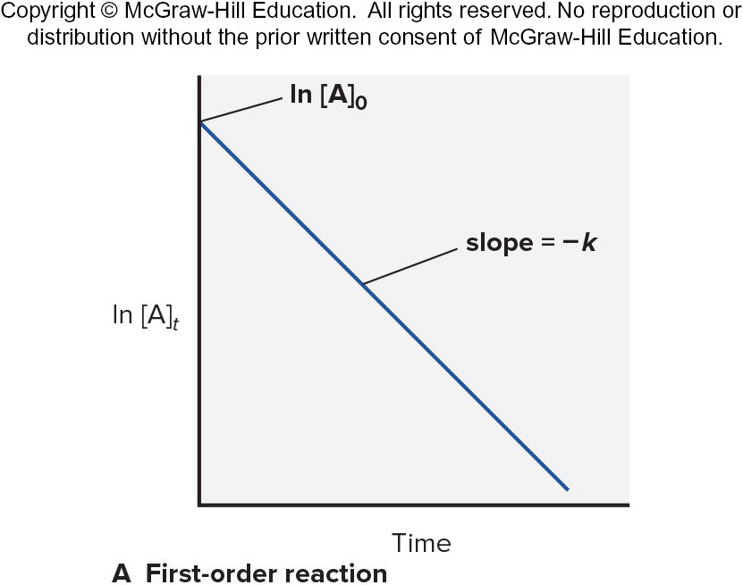
Graphical Method for Finding the Reaction Order from the Integrated Rate Law: First Order Reactions
Integrated rate law:
Straight-line form:
A plot of ln[A] vs. time gives a straight line for a first-order reaction.

Slide 48
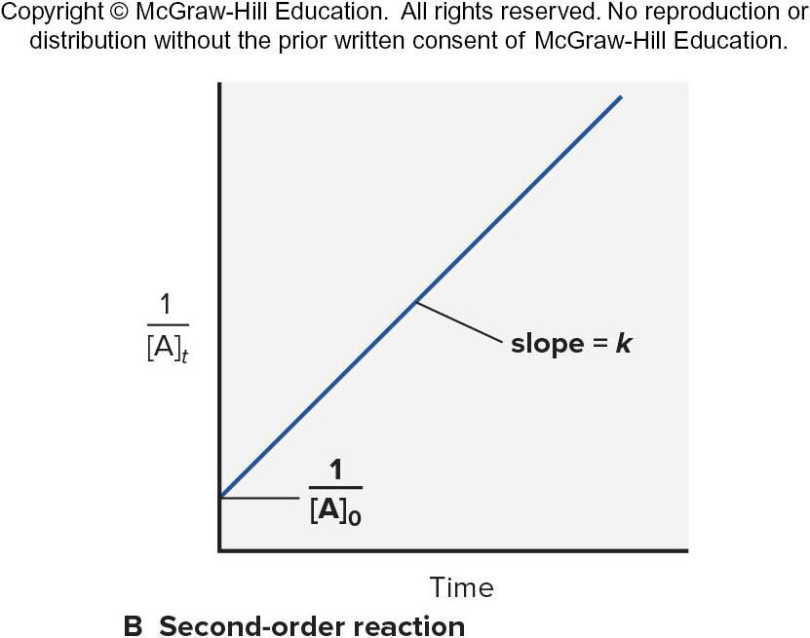
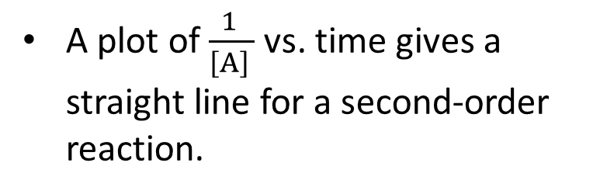
Graphical Method for Finding the Reaction Order from the Integrated Rate Law: Second Order Reactions
Integrated rate law:
Straight-line form:
A plot of $\frac{1 }{{\left[A\right]}_{ }}$ vs. time gives a straight line for a second-order reaction.

Slide 49
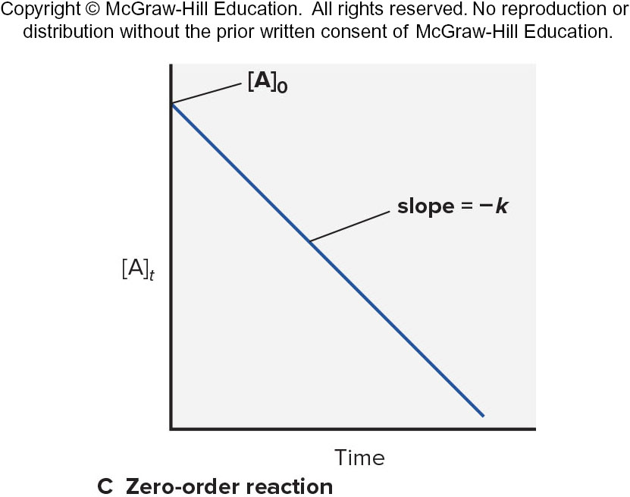
Graphical Method for Finding the Reaction Order from the Integrated Rate Law: Zero Order Reactions
Integrated rate law:
Straight-line form:
A plot of [A] vs. time gives a straight line for a zero-order reaction.

Slide 50
Graphical Determination of the Reaction Order for the Decomposition of N₂O₅: Data Table
Time (min) | [N₂O₅] | ln[N₂O₅] | 1/[N₂O₅]
0 | 0.0165 | -4.104 | 60.6
10 | 0.0124 | -4.390 | 80.6
20 | 0.0093 | -4.68 | 110
30 | 0.0071 | -4.95 | 140
40 | 0.0053 | -5.24 | 190
50 | 0.0039 | -5.55 | 260
60 | 0.0029 | -5.84 | 340

Slide 51
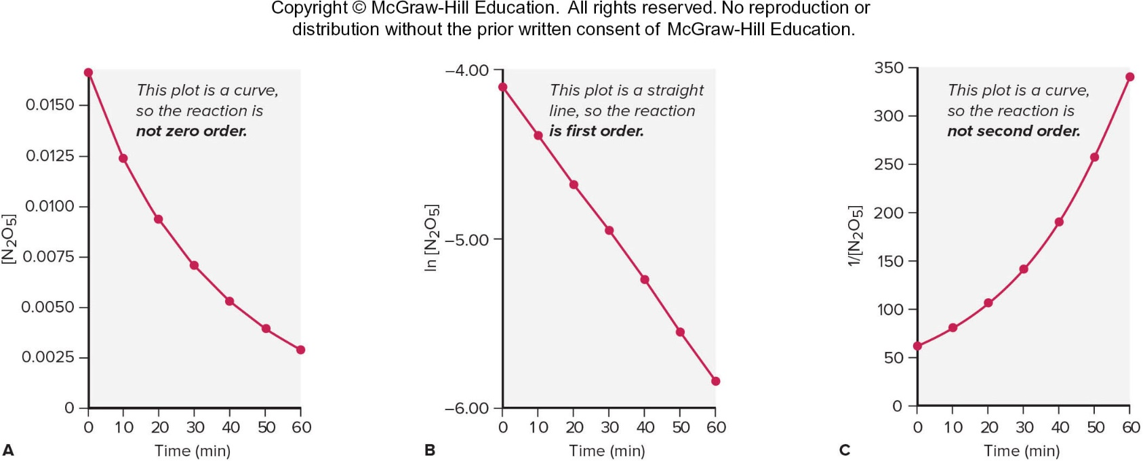
Graphical Determination of the Reaction Order for the Decomposition of N₂O₅
The concentration data is used to construct three different plots.
Since the plot of ln [N₂O₅] vs. time gives a straight line, the reaction is first order.
Figure 16.11

Slide 52
Reaction Half-Life
The half-life (t_{½} ) for a reaction is the time taken for the concentration of a reactant to drop to half its initial value.
For a first-order reaction, t_{1/2} does not depend on the starting concentration.
The half-life for a first-order reaction is a constant.
  Radioactive decay is a first-order process. The half-life for a radioactive nucleus is a useful indicator of its stability.

Slide 53
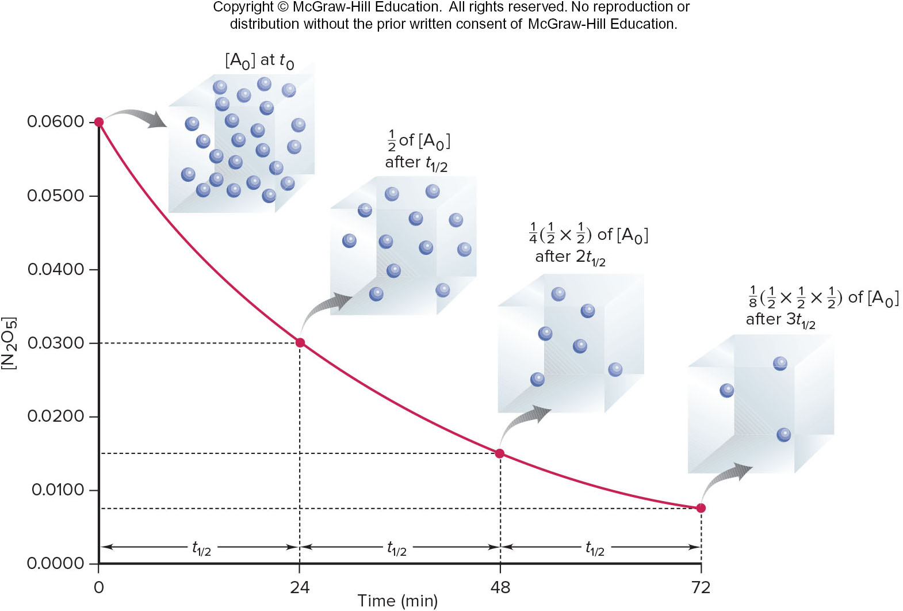
A Plot of [N₂O₅] vs. Time for Three Reaction Half-Lives
Figure 16.12

Slide 54
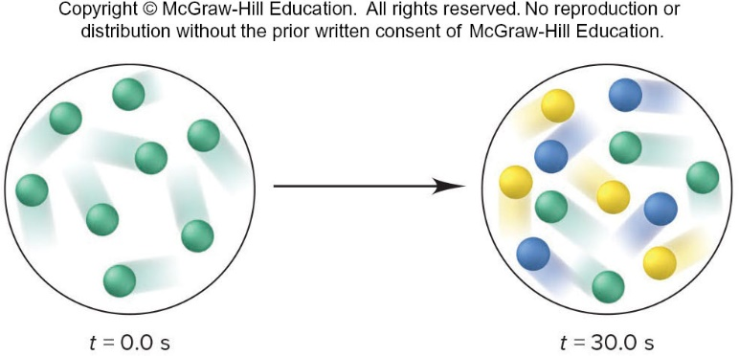
Sample Problem 16.6 – Problem
Using Molecular Scenes to Find Quantities at Various Times
PROBLEM: Substance A (green) decomposes to two other substances, B (blue) and C (yellow), in a first-order gaseous reaction. The molecular scenes below show a portion of the reaction mixture at two different times:
(a) Draw a similar molecular scene of the reaction mixture at t = 60.0 s.
(b) Find the rate constant for the reaction.
(c) If the total pressure (P_{total}) of the mixture is 5.00 atm at 90.0 s, what is the partial pressure of substance B (PB)?

Slide 55
Sample Problem 16.6 – Plan
PLAN: We are shown molecular scenes of a reaction at two times, with various numbers of reactant and product particles, and have to predict quantities at two later times.
(a) We count the number of A particles and see that A has decreased by half after 30.0 s; thus, the half-life is 30.0 s. The time t = 60.0 s represents two half-lives, so the number of A will decrease by half again, and each A forms one B and one C.
(b) We substitute the value of the half-life to find k.
(c) First, we find the numbers of particles at t = 90.0 s, which represents three half-lives. To find P_{B}, we multiply the mole fraction of B, X_{B}, by P_{total} (5.00 atm) . To find X_{B}, we know that the number of particles is equivalent to the number of moles, so we divide the number of B particles by the total number of particles.

Slide 56
Sample Problem 16.6 - Solution
SOLUTION: (a) The number of A particles decreased from 8 to 4 in one half-life (30.0 s), so after two half-lives (60.0 s), the number of A particles will be 2 (1/2 of 4). Each A decomposes to 1 B and 1 C, so 6 (8−2) particles of A form 6 of B and 6 of C.
(b) Finding the rate constant, k:
(c) Finding the number of particles after 90.0 s: After a third half-life, there will be 1 A, 7 B, and 7 C particles.
Finding the mole fraction of B, X_{B}:
Finding the partial pressure of B, P_{B}:

Slide 57

Sample Problem 16.7 – Problem
Determining the Half-Life of a First-Order Reaction
PROBLEM: Cyclopropane is the smallest cyclic hydrocarbon. Because its 60° bond angles reduce orbital overlap, its bonds are weak. As a result, it is thermally unstable and rearranges to propene at 1000°C via the following first-order reaction:
The rate constant is 9.2 s⁻¹.
(a) What is the half-life of the reaction?
(b) How long does it take for the concentration of cyclopropane to reach one-quarter of the initial value?

Slide 58
Sample Problem 16.7 – Plan
PLAN: (a) The cyclopropane rearrangement is first order, so to find t_{1/2} we use Equation 16.7 and substitute for k (9.2 s⁻¹).
(b) Each half-life decreases the concentration to one-half of its initial value, so two half-lives decrease it to one-quarter of its initial value.

Slide 59
Sample Problem 16.7 - Solution
SOLUTION: (a) Solving for t_{1/2}:
It takes 0.075 s for half the cyclopropane to form propene at this temperature.
(b) Finding the time to reach one-quarter of the initial concentration:

Slide 60
Half-Life Equations
For a first-order reaction, t_{1/2} does not depend on the initial concentration.
For a second-order reaction, t_{1/2} is inversely proportional to the initial concentration:
For a zero-order reaction, t_{1/2} is directly proportional to the initial concentration:

Slide 61
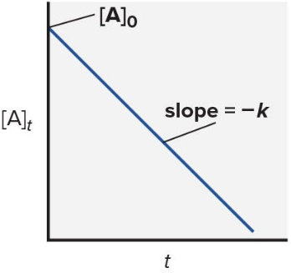
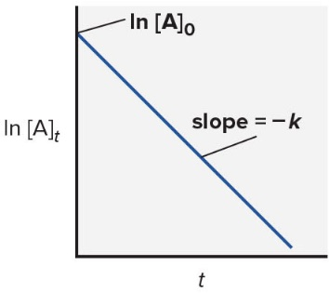
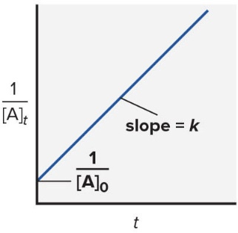
An Overview of Zero-Order, First-Order, and Simple Second-Order Reactions
 | Zero Order | First Order | Second Order
Rate law | rate = k | rate = k[A] | rate = k[A]²
Units for k | mol/L·s | 1/s | L/mol·s
Half-life | [ A ] 0 2 k | ln 2 k | 1 k [ A ] 0
Integrated rate law in straight-line form | [A]_{t} = ‒kt + [A]₀ | ln [A]_{t} = ‒kt + ln [A]₀ | 1/[A]_{t} = kt +1/[A]₀
Plot for straight line | [A]_{t} vs. t | ln [A]_{t} vs. t | 1/[A]_{t} vs. t
Slope, y-intercept | ‒k, [A]₀ | ‒k, ln [A]₀ | k, 1/[A]₀
Graph

Slide 62
Collision Theory and Concentration
The basic principle of collision theory is that particles must collide in order to react.
An increase in the concentration of a reactant leads to a larger number of collisions, hence increasing reaction rate.
The number of collisions depends on the product of the numbers of reactant particles, not their sum.
  Concentrations are multiplied in the rate law, not added.

Slide 63
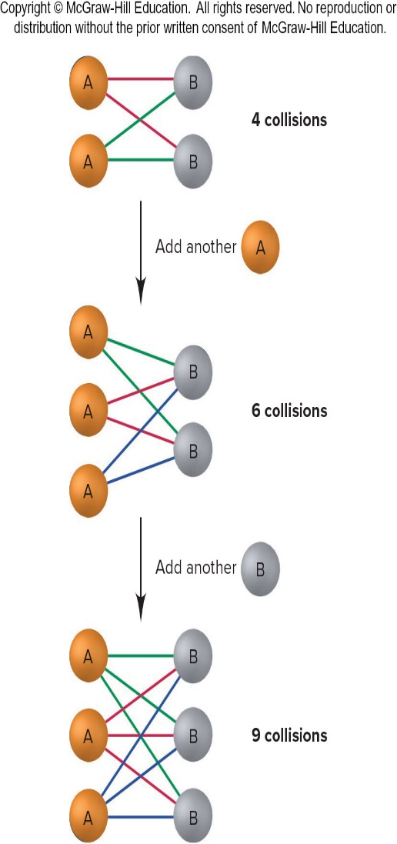
The Number of Possible Collisions is the Product, Not the Sum, of Reactant Concentrations
Figure 16.3

Slide 64
Temperature and the Rate Constant
Temperature has a dramatic effect on reaction rate.
  For many reactions, an increase of 10°C will double or triple the rate.
Experimental data shows that k increases exponentially as T increases. This is expressed in the Arrhenius equation:
  k = rate constant
  A = frequency factor
  E_{a} = activation energy

Slide 65
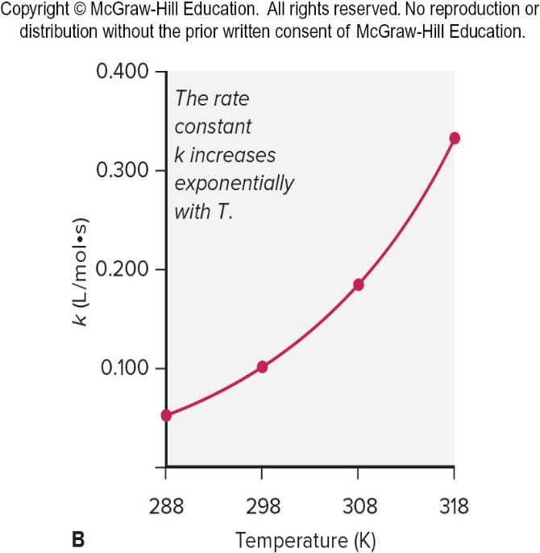
Increase of the Rate Constant with Temperature for the Hydrolysis of an Ester
Expt | [Ester] | [H₂O] | T (K) | Rate (mol/L·s) | k (L/mol·s)
1 | 0.100 | 0.200 | 288 | 1.04x10⁻³ | 0.0521
2 | 0.100 | 0.200 | 298 | 2.20x10⁻³ | 0.101
3 | 0.100 | 0.200 | 308 | 3.68x10⁻³ | 0.184
4 | 0.100 | 0.200 | 318 | 6.64x10⁻³ | 0.332
Reaction rate and k increase exponentially as T increases.
Figure 16.14

Slide 66
Activation Energy
In order to be effective, collisions between particles must exceed a certain energy threshold.
When particles collide effectively, they reach an activated state. The energy difference between the reactants and the activated state is the activation energy (E_{a}) for the reaction.
The lower the activation energy, the faster the reaction.

Slide 67
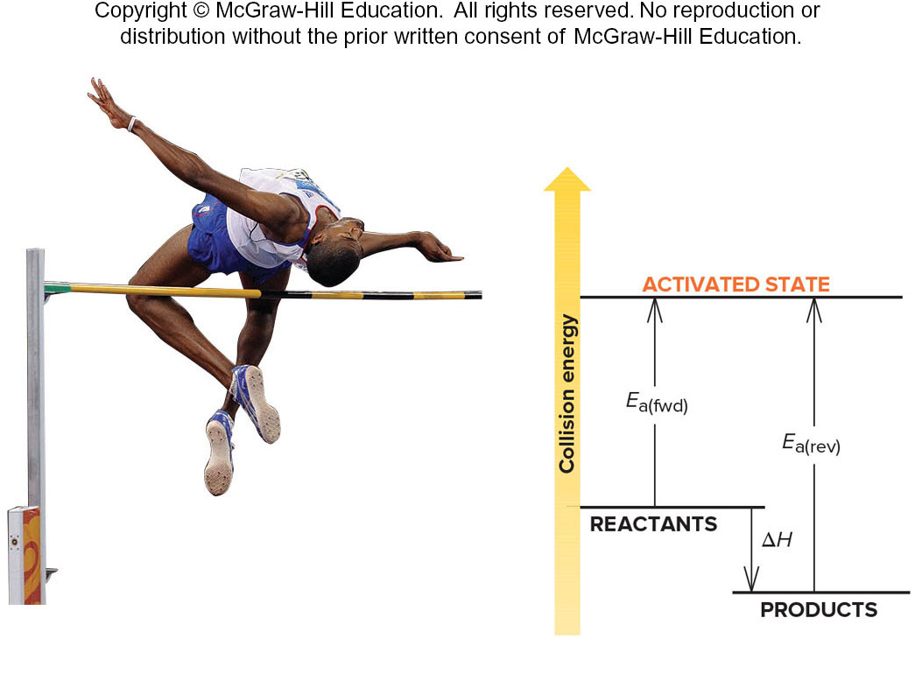
Energy-level Diagram for a Reaction
Collisions must occur with sufficient energy to reach an activated state.
This particular reaction is reversible and is exothermic in the forward direction.
Figure 16.15
Source: © Sipa via AP Images

Slide 68
Temperature and Collision Energy
An increase in temperature causes an increase in the kinetic energy of the particles. This leads to more frequent collisions and reaction rate increases.
At a higher temperature, the fraction of collisions with sufficient energy equal to or greater than E_{a} increases. Reaction rate therefore increases.

Slide 69
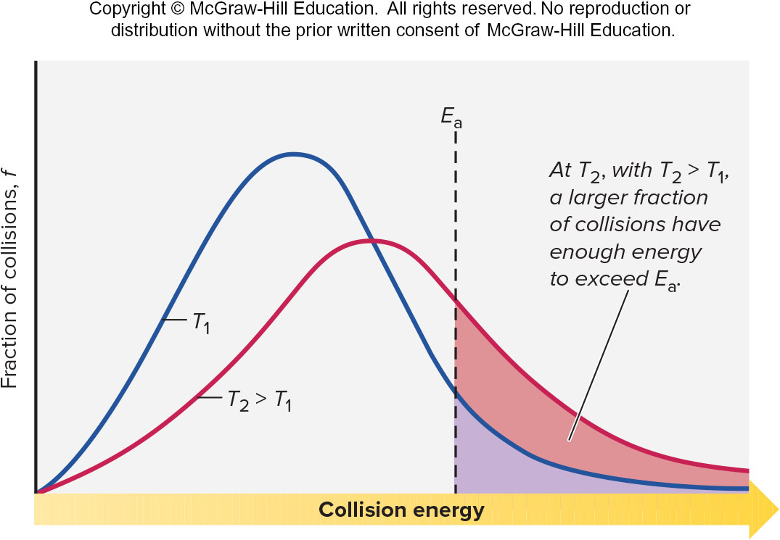
The Effect of Temperature on the Distribution of Collision Energies
Figure 16.16

Slide 70
The Effect of E_{a} and T on the Fraction (f) of Collisions with Sufficient Energy to Allow Reaction
E_{a} (kJ/mol) | f (at T = 298 K)
50 | 1.70 × 10 ⁻ ⁹
75 | 7.03 × 10 ⁻ ¹⁴
100 | 2.90 × 10 ⁻ ¹⁸
T | f (at E_{a} = 50 kJ/mol)
25°C (298 K) | 1.70 × 10 ⁻ ⁹
35°C (308 K) | 3.29 × 10 ⁻ ⁹
45°C (318 K) | 6.12 × 10 ⁻ ⁹

Slide 71
Calculating Activation Energy
E_{a} can be calculated from the Arrhenius equation:
If data is available at two different temperatures:

Slide 72
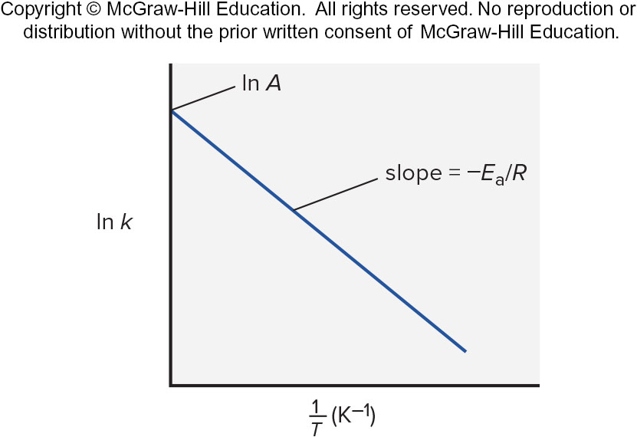
Graphical Determination of the Activation Energy
Figure 16.17

Slide 73
Sample Problem 16.8 – Problem and Plan
Determining the Energy of Activation
PROBLEM: The decomposition of hydrogen iodide, 2HI(g) ⟶ H₂(g) + I₂(g), has rate constants of 9.51×10⁻⁹ L/mol·s at 500. K and 1.10×10⁻⁵ L/mol·s at 600. K. Find E_{a}.
PLAN: We are given the rate constants, k₁ and k₂, at two temperatures, T₁ and T₂ . We solve for E_{a}.

Slide 74
Sample Problem 16.8 - Solution
SOLUTION:

Slide 75
Molecular Structure and Reaction Rate
For a collision between particles to be effective, it must have both sufficient energy and the appropriate relative orientation between the reacting particles.
The term A in the Arrhenius equation is the frequency factor for the reaction.
  p = orientation probability factor
  Z = collision frequency
The term p is specific for each reaction and is related to the structural complexity of the reactants.

Slide 76
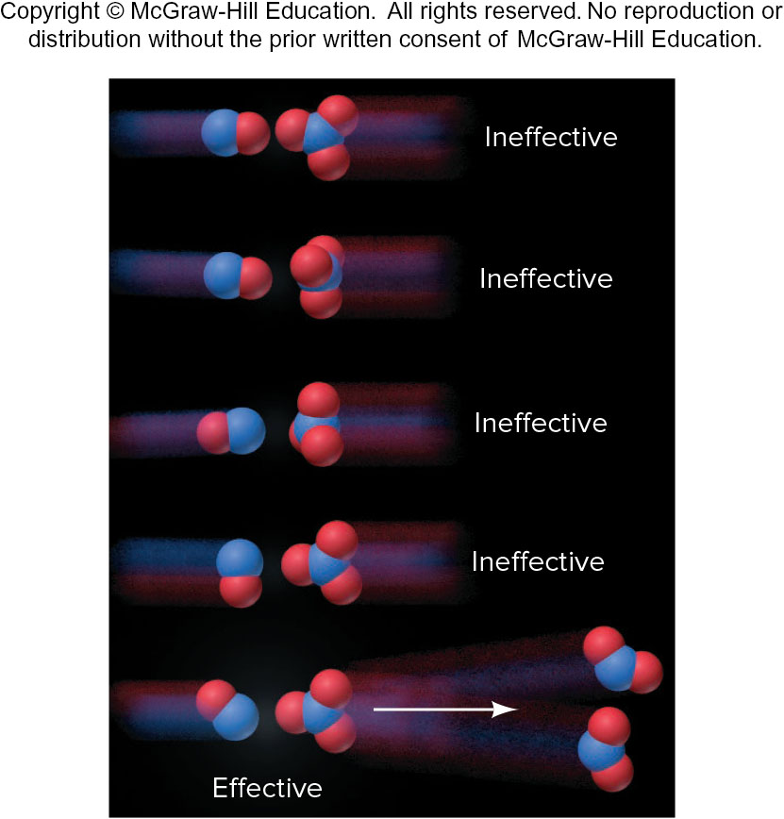
The Importance of Molecular Orientation to An Effective Collision
There is only one relative orientation of these two molecules that leads to an effective collision.
Figure 16.18

Slide 77
Transition State Theory
An effective collision between particles leads to the formation of a transition state or activated complex.
The transition state is an unstable species that contains partial bonds. It is a transitional species partway between reactants and products.
  Transition states cannot be isolated.
The transition state exists at the point of maximum potential energy.
  The energy required to form the transition state is the activation energy.

Slide 78
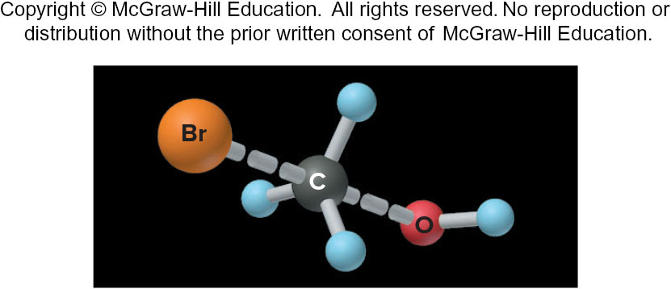
The Transition State of the Reaction Between BrCH₃ and OH⁻
The transition state contains partial bonds (dashed) between C and Br and between C and O. It has a trigonal bypyramidal shape.
Figure 16.19

Slide 79
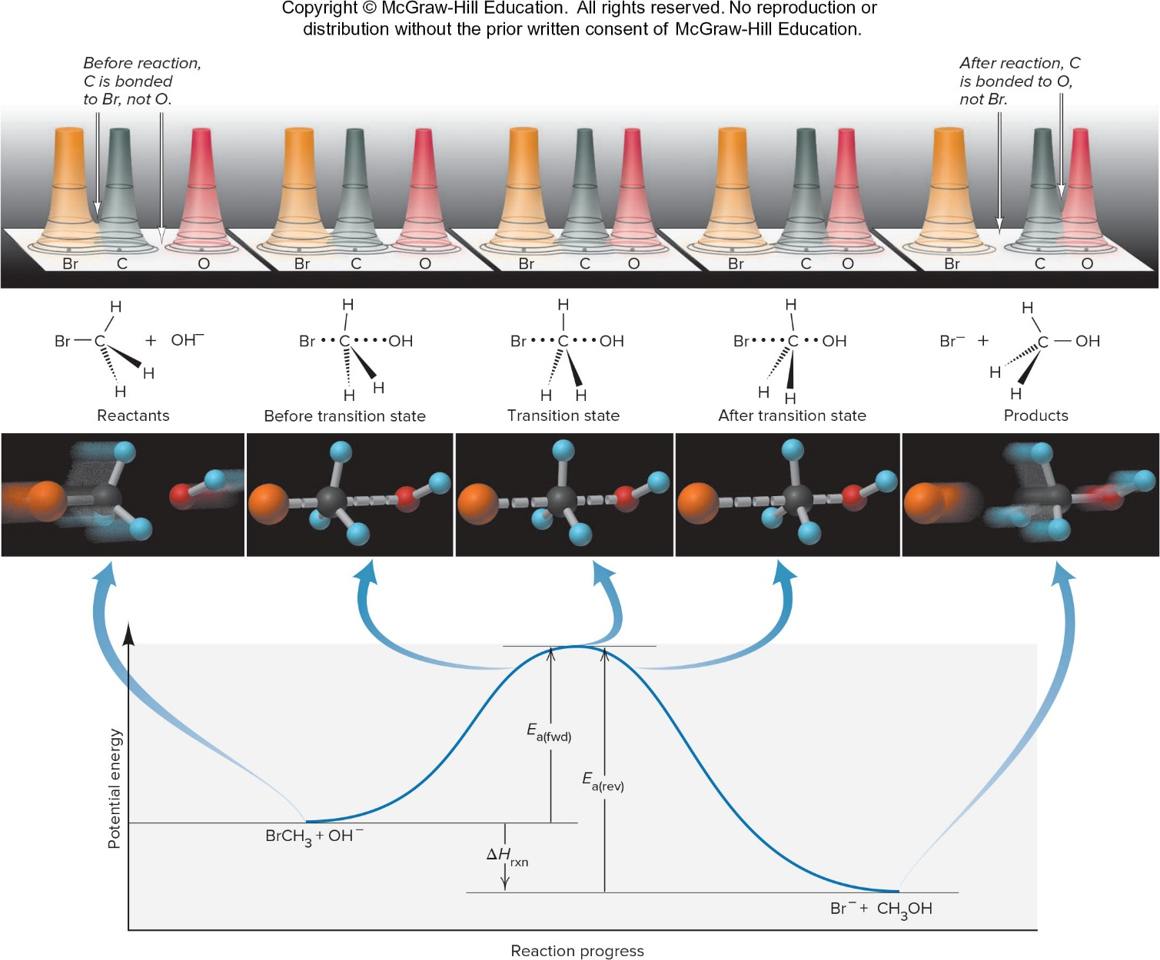
Depicting the Reaction Between BrCH₃ and OH–
Figure 16.20

Slide 80
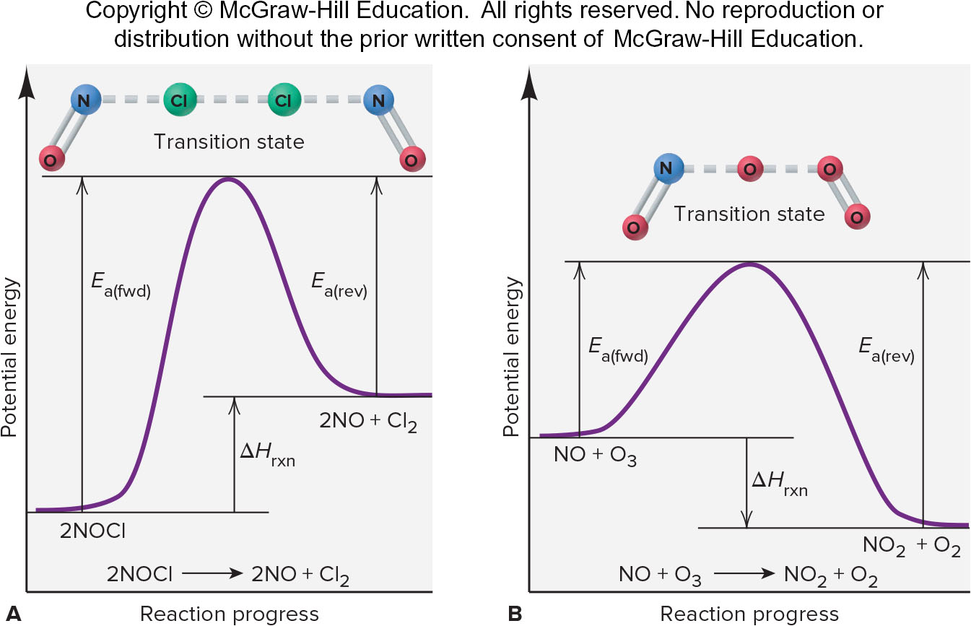
Reaction Energy Diagrams and Possible Transition States for Two Reactions
Figure 16.21

Slide 81
Sample Problem 16.9 – Problem and Plan
Drawing Reaction Energy Diagrams and Transition States
PROBLEM: A key reaction in the upper atmosphere is O₃(g) + O(g) → 2O₂(g). The E_{a(fwd)} is 19 kJ, and the ΔH_{rxn} for the reaction as written is −392 kJ. Draw a reaction energy diagram, predict a structure for the transition state, and calculate E_{a(rev)}.
PLAN: The reaction is highly exothermic (ΔH_{rxn} = −392 kJ), so the products are much lower in energy than the reactants. The small E_{a(fwd)} (19 kJ) means that the energy of the reactants lies slightly below that of the transition state. We calculate E_{a(rev)}. To predict the transition state, we sketch the species and note that one of the bonds in O₃ weakens, and this partially bonded O begins forming a bond to the separate O atom.

Slide 82
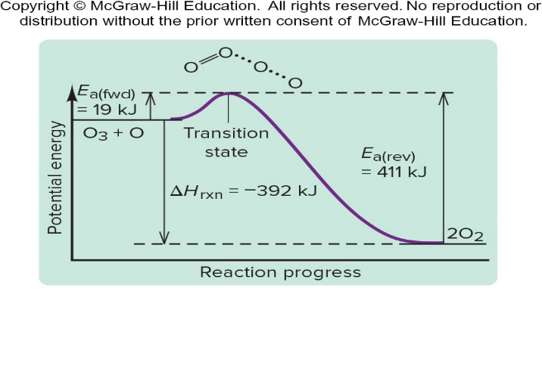
Sample Problem 16.9 - Solution
SOLUTION:
The reaction energy diagram (not drawn to scale), with transition state, is shown below.

Slide 83
Reaction Mechanisms
The mechanism of a reaction is the sequence of single reaction steps that make up the overall equation.
The individual steps of the reaction mechanism are called elementary steps because each one describes a single molecular event.
Each elementary step is characterized by its molecularity, the number of particles involved in the reaction.
The rate law for an elementary step can be deduced from the reaction stoichiometry – reaction order equals molecularity for an elementary step only.

Slide 84
Rate Laws for General Elementary Steps
Elementary Step | Molecularity | Rate Law
A ⟶ product | Unimolecular | Rate = k[A]
2A ⟶ product | Bimolecular | Rate = k[A]²
A + B ⟶ product | Bimolecular | Rate = k[A][B]
2A + B ⟶ product | Termolecular | Rate = k[A]²[B]

Slide 85
Sample Problem 16.10 – Problem
Determining Molecularities and Rate Laws for Elementary Steps
PROBLEM: The following elementary steps are proposed for a reaction mechanism:
(a) Write the balanced equation for the overall reaction.
(b) Determine the molecularity of each step.
(c) Write the rate law for each step

Slide 86
Sample Problem 16.10 – Plan
PLAN: We find the overall equation by adding the elementary steps. The molecularity of each step equals the total number of reactant particles. We write the rate law for each step using the equation coefficients as reaction orders.

Slide 87
Sample Problem 16.10 – Solution (a) and (b)
SOLUTION: (a) Writing the overall balanced equation:
(b) Determining the molecularity of each step: The first step has one reactant, Cl₂, so it is unimolecular. The second and third steps have two reactants (Cl and CHCl₃; Cl(g) + CCl₃), so they are bimolecular.

Slide 88
Sample Problem 16.10 – Solution (c)
SOLUTION: (c) Writing rate laws for the elementary steps:

Slide 89
The Rate-Determining Step of a Reaction
The slowest step in a reaction is the rate-determining or rate-limiting step.
has been proposed to occur by a two-step mechanism:
Observed rate law:
The rate law for the rate-determining step becomes the rate law for the overall reaction.

Slide 90
Correlating Mechanism with the Rate Law
A valid mechanism must meet three criteria:
  The elementary steps must add up to the overall balanced equation.
  The elementary steps must be reasonable.
  The mechanism must correlate with the observed rate law.
A mechanism is a hypothesis –we cannot prove it is correct, but if it is consistent with the data, and can be used to predict results accurately, it is a useful model for the reaction.

Slide 91
Mechanisms with a Slow Initial Step
The overall reaction 2NO₂(g) + F₂(g) →2NO₂F(g) has an experimental rate law Rate = k[NO₂][F₂].
The accepted mechanism is
The elementary steps sum to the overall balanced equation.
Both steps are bimolecular and are therefore reasonable.
Step 1 is the slow step, and rate₁ correlates with the observed rate law.
The mechanism is therefore reasonable.

Slide 92
Mechanisms with a Fast Initial Step
The overall reaction 2NO (g) + O₂(g) →2NO₂(g) has an experimental rate law Rate = k[NO]²[O₂]. A proposed mechanism is:
The elementary steps sum to the overall balanced equation. Both steps are bimolecular and are therefore reasonable.
When equilibrium (1) has been established

Slide 93
Mechanisms with a Fast Initial Step, Cont’d
The ratio of rate constants is itself a constant, equal to the overall rate constant for the reaction, so
rate₂ = k[NO]²[O₂] which is consistent with the observed rate law.
For any mechanism, only reactants involved up to and including the slow (rate-determining) step appear in the overall rate law.

Slide 94
Sample Problem 16.11 – Problem and Plan
PROBLEM: Consider the reaction mechanism in Sample Problem 16.10.
(a) Identify the intermediates in the mechanism.
(b) Assuming that step 2 is the slow (rate-determining) step, show that the mechanism is consistent with the observed rate law: Rate = k[Cl₂]^{1/2}[CHCl₃].
PLAN: (a) We write each elementary step and sum to get the overall reaction. Intermediates are substances that are produced in one elementary step and consumed as reactants in a subsequent elementary step. (b) We use the reactants in the slow step to write its rate law; if an intermediate is present in the rate law, we eliminate it by expressing it in terms of reactants.

Slide 95
Sample Problem 16.11 – Solution (a)
SOLUTION: (a) Determining the intermediates:
The species Cl is formed in step 1 and consumed in subsequent steps 2 and 3.
Likewise, CCl₃ is formed in step 2 and used up in step 3. Both Cl and CCl₃ are referred to as intermediates.

Slide 96
Sample Problem 16.11 – Solution (b)
SOLUTION: (b) Correlating the reaction mechanism and the rate law:
Step 2 is the rate-determining step:
The rate law can be written using the slow, elementary step in the proposed mechanism:
The species Cl is an intermediate; hence, [Cl] must be expressed in terms of reactant concentrations. For the equilibrium in step 1:
Substituting for [Cl] in the rate law for the slow step:

Slide 97
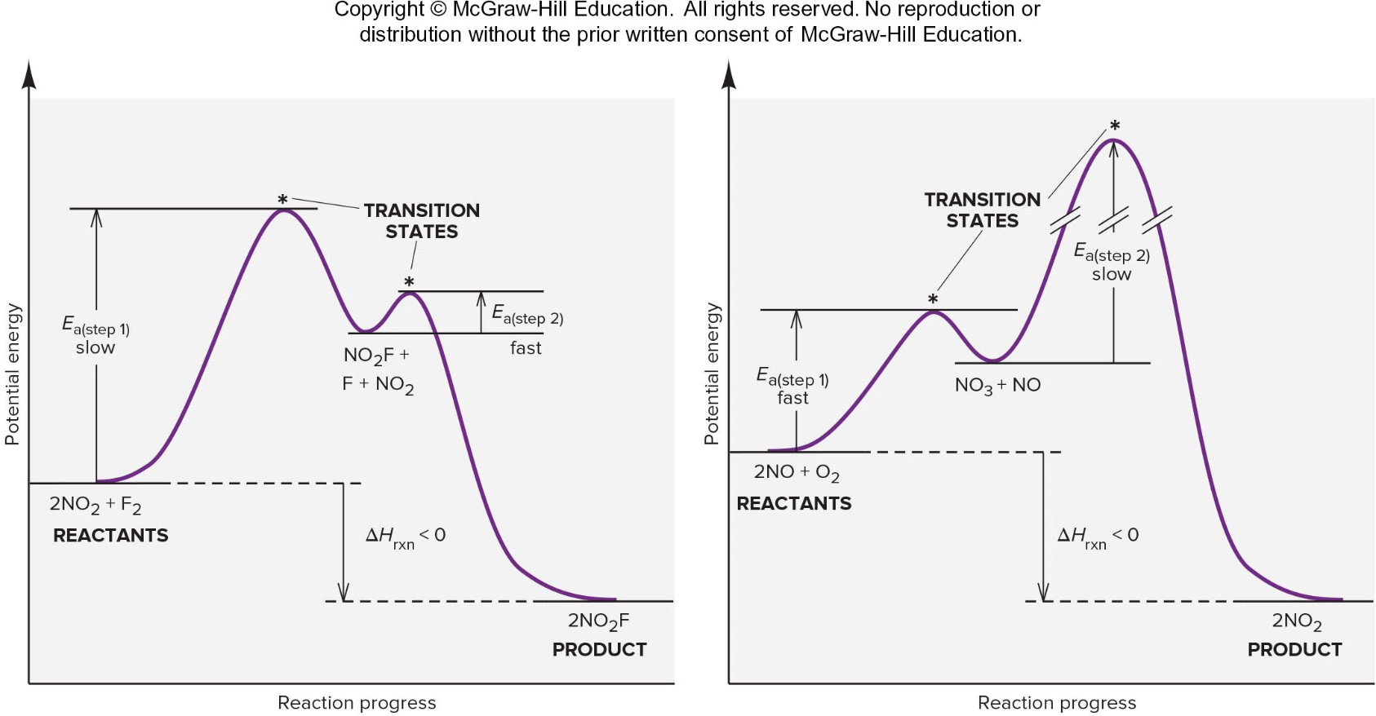
Reaction Energy Diagram for the Two-Step Reaction of (A) NO₂ and F₂ and of (B) NO and O₂
Each step in a multi-step reaction has its own transition state, which occurs at the energy maximum for that step.
Figure 16.22

Slide 98
Catalysis: Speeding up a Reaction
A catalyst is a substance that increases the reaction rate without itself being consumed in the reaction.
In general, a catalyst provides an alternative reaction pathway that has a lower total activation energy than the uncatalyzed reaction.
A catalyst will speed up both the forward and the reverse reactions.
A catalyst does not affect either ΔH or the overall yield for a reaction.

Slide 99
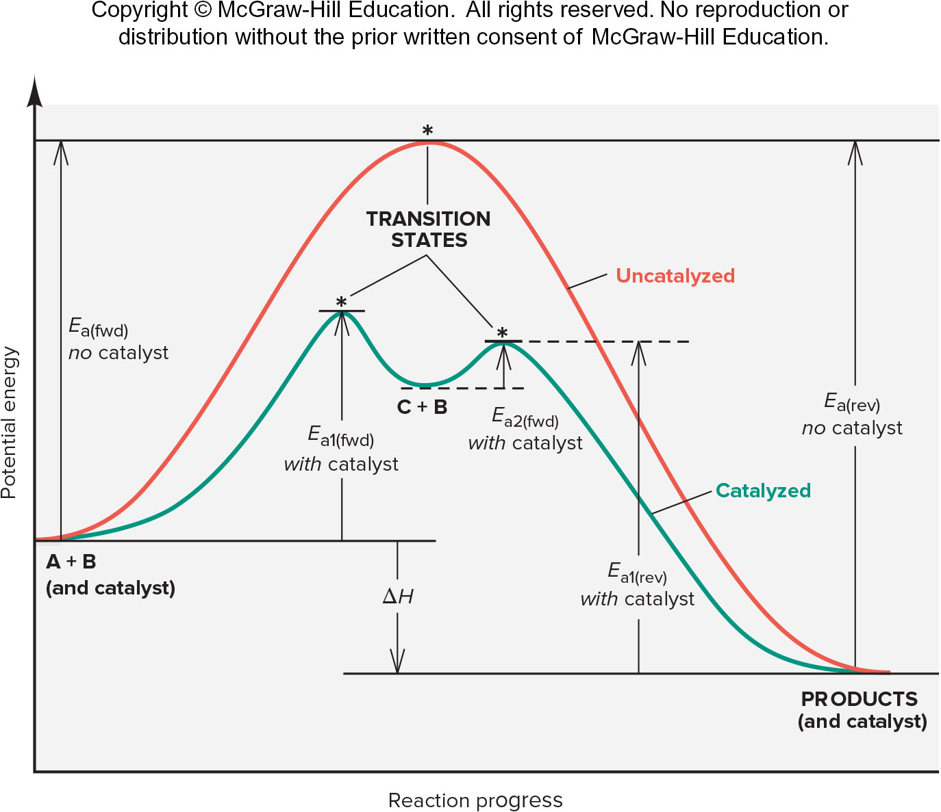
Reaction Energy Diagram for a Catalyzed (Green) and Uncatalyzed (Red) Process
Figure 16.23

Slide 100
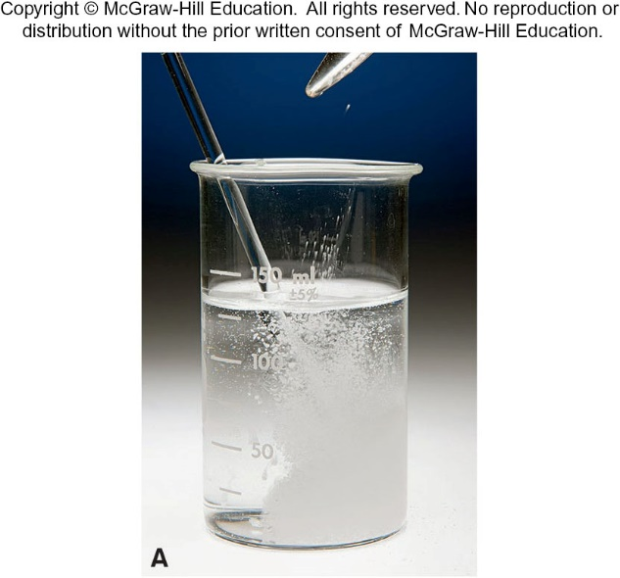
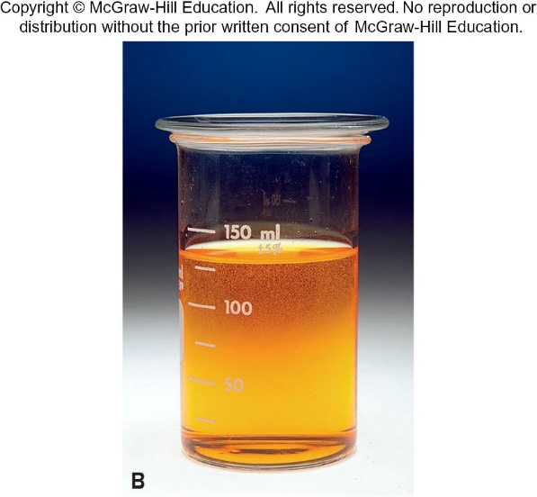
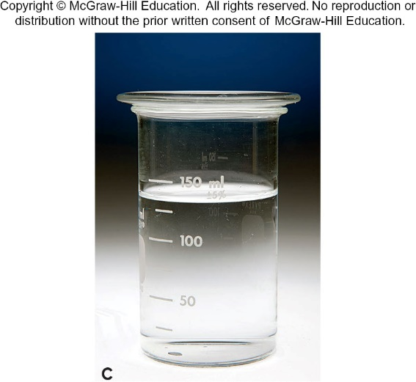
The Catalyzed Decomposition of H₂O₂
A small amount of NaBr is added to a solution of H₂O₂.
Oxygen gas forms quickly as Br⁻(aq) catalyzes the H₂O₂ decomposition; the intermediate Br₂ turns the solution orange.
The solution becomes colorless when the Br₂ is consumed in the final step of the mechanism.
Figure 16.26
Source: © McGraw-Hill Education/Charles Winters/Timeframe Photography, Inc.

Slide 101
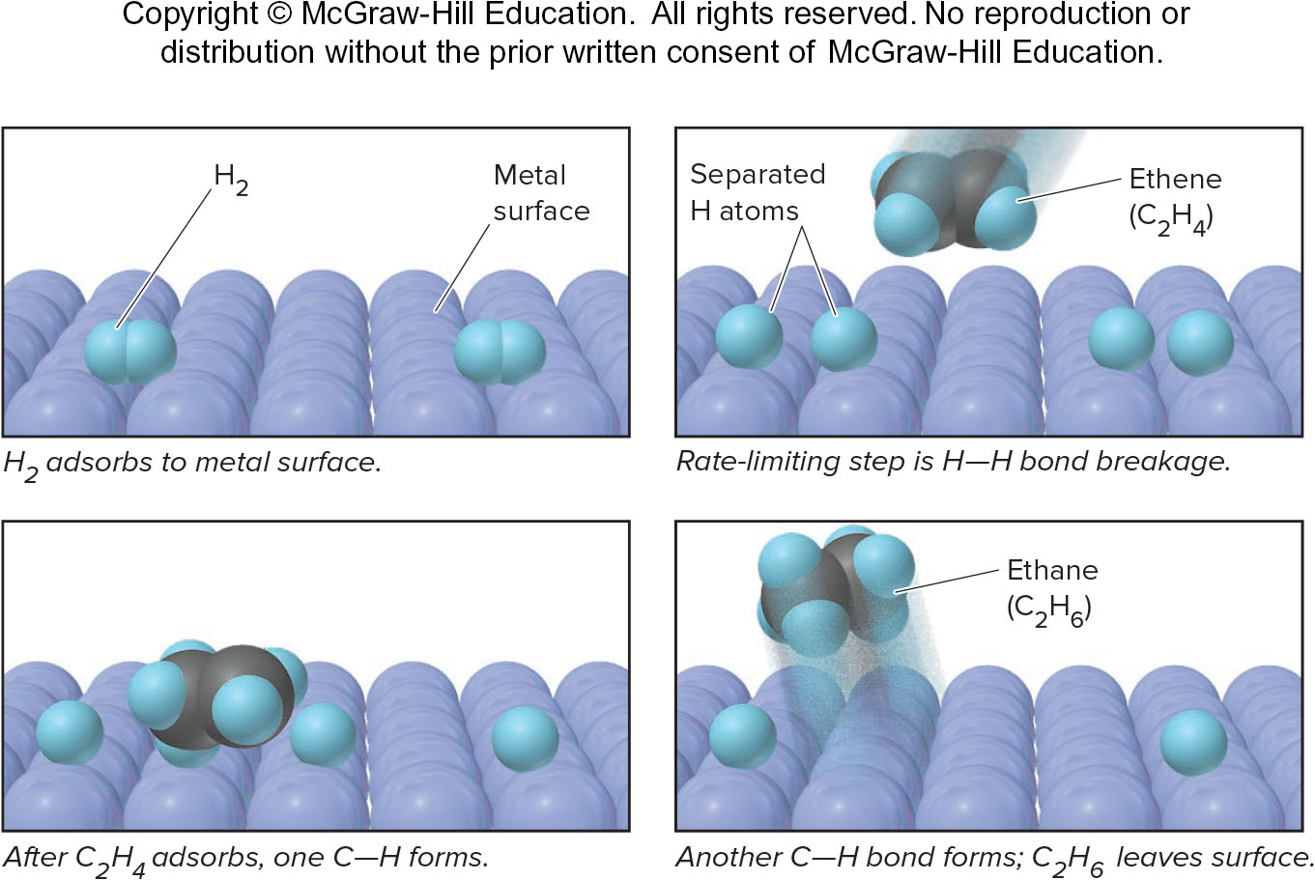
The Metal-catalyzed Hydrogenation of Ethene
A heterogeneous catalyst is in a different phase than the reaction mixture.
Figure 16.25

Slide 102
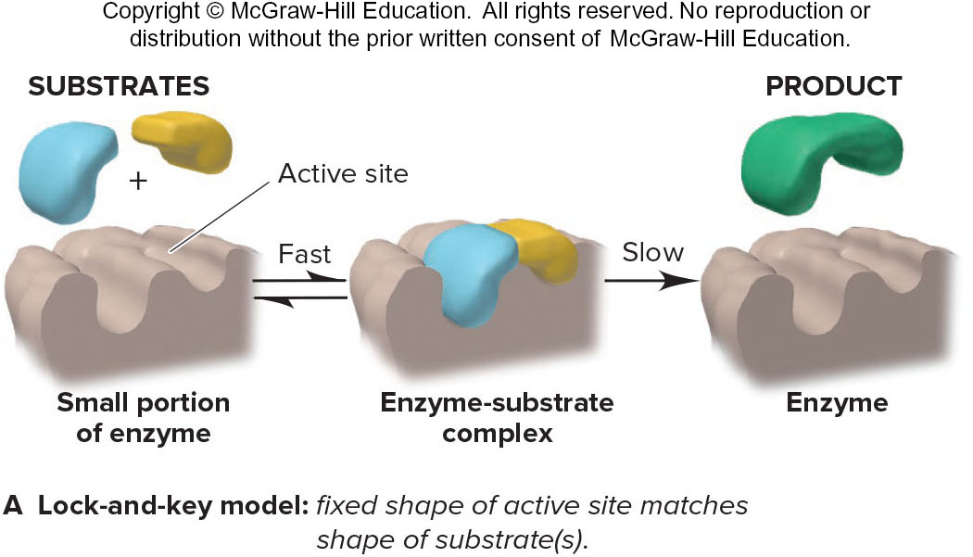
Lock-and-Key Model of Enzyme Action
The lock-and-key model visualizes the enzyme active site having a fixed shape. This shape matches the shape of its substrate(s). The active site is therefore specific to its substrate.
Figure 16.26A

Slide 103
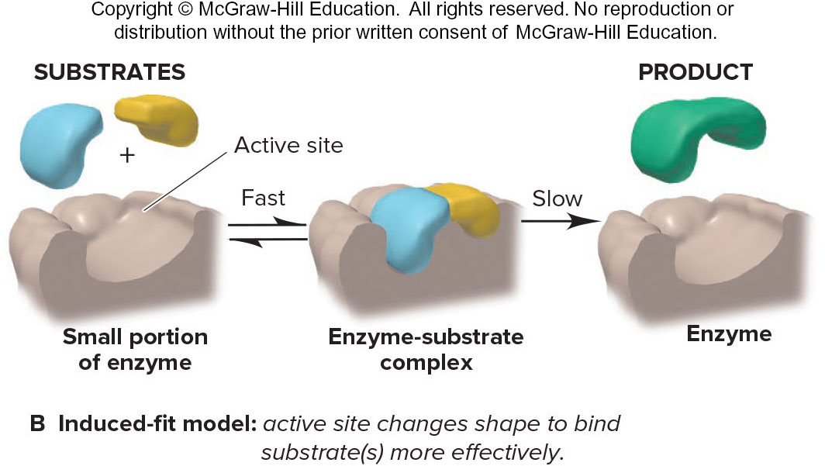
Induced-Fit Model of Enzyme Action
The induced-fit model visualizes the enzyme active site changing shape in order to bind its substrate(s) more effectively. The active site is still selective toward certain substrates.
Figure 16.26B

Slide 104
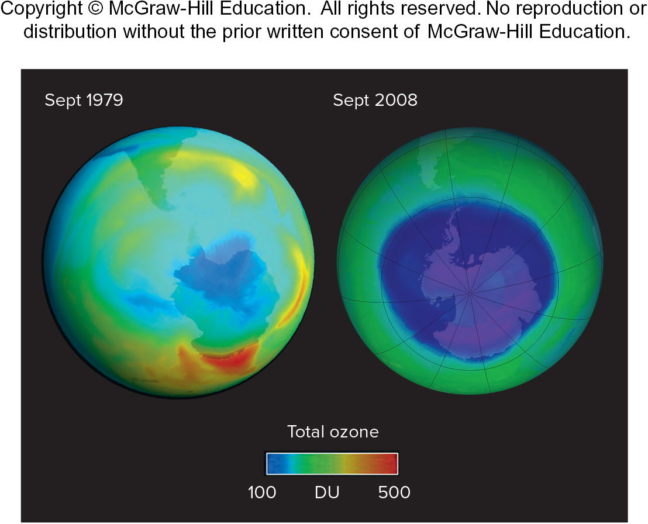
Satellite Images of the Increasing Size of the Antarctic Ozone Hole (Purple)
Figure B16.1
Source: NASA image courtesy Ozone Hole Watch

Slide 105
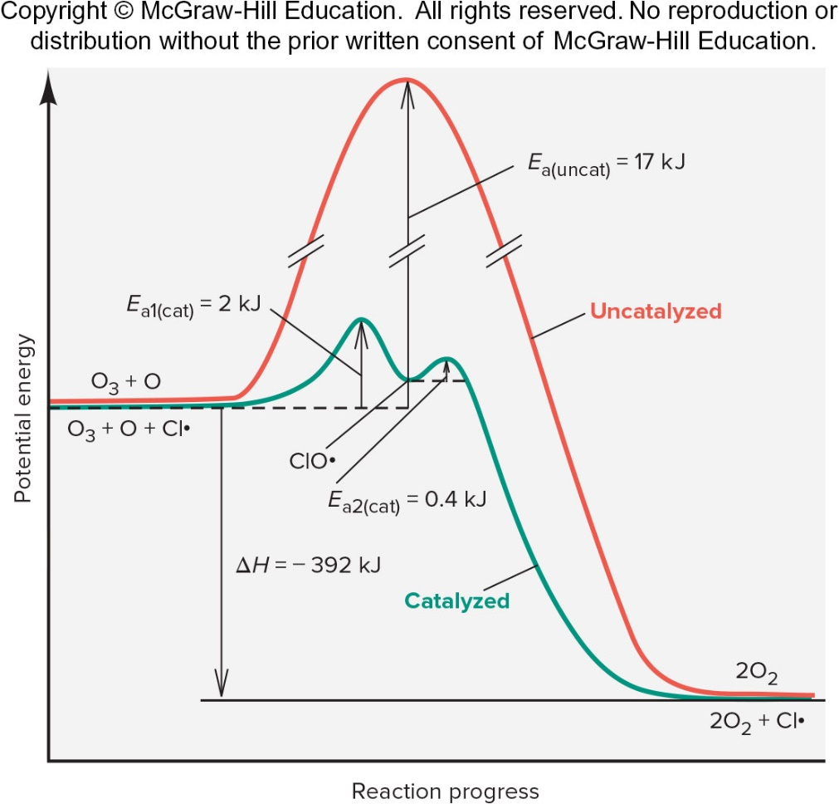
Reaction Energy Diagram for Breakdown of O₂ by Cl Atoms
Figure B16.2

