Slide 1
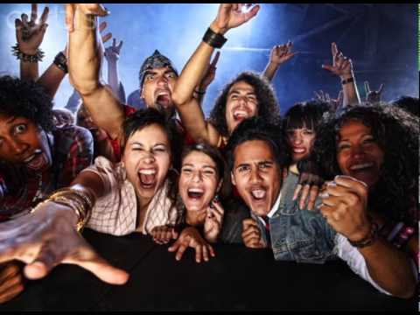
Welcome to EWRT 211 Winter 2019

Slide 2
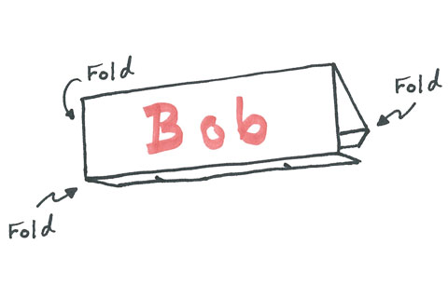
Make a Desk Name Tag
Use Markers, make very large, use first name you would like to be called.

Slide 3

Who’s Here?
Attendance Sheet

Slide 4
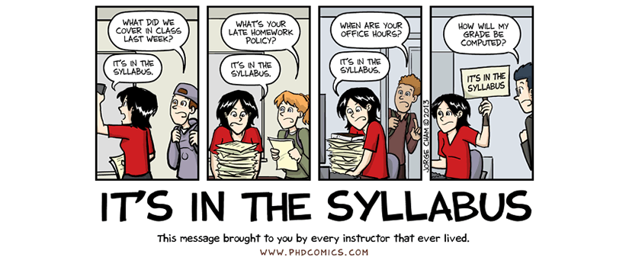
Syllabus
This is your lifeline to the class!
Everything you need to know about due dates, expectations, grading is on the syllabus.
Before you have a question, check the syllabus first, it’s probably answered there.

Slide 5
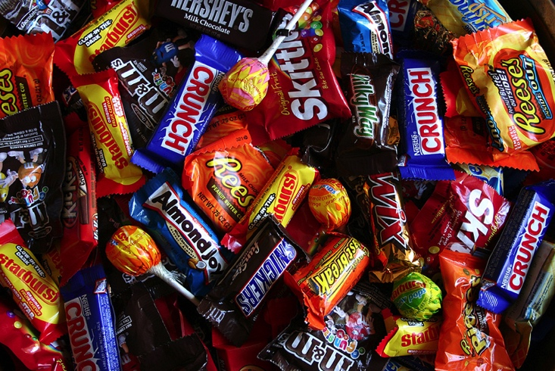
Candy Quiz
Let’s see how much you remembered!
Turn over syllabus
I’ll ask a question, raise your hand to answer. If you are correct, I’ll chuck you some chocolate.

Slide 6
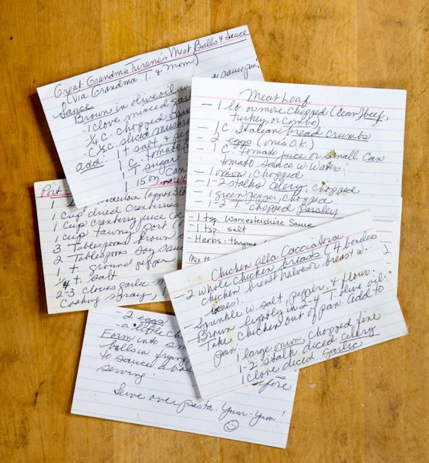
Index Cards
Let me know a bit about yourself
- Name (nicknames, special pronunciations, etc.)
- Contact Information – (e-mail, phone number)
- Previous English Class (If at De Anza, give instructor’s name)
- Strengths and Weaknesses in English
- Education and Career Goals
- Personal Interest/ Hobbies
- Work/Family/School Obligations
- Anything Else?

Slide 7
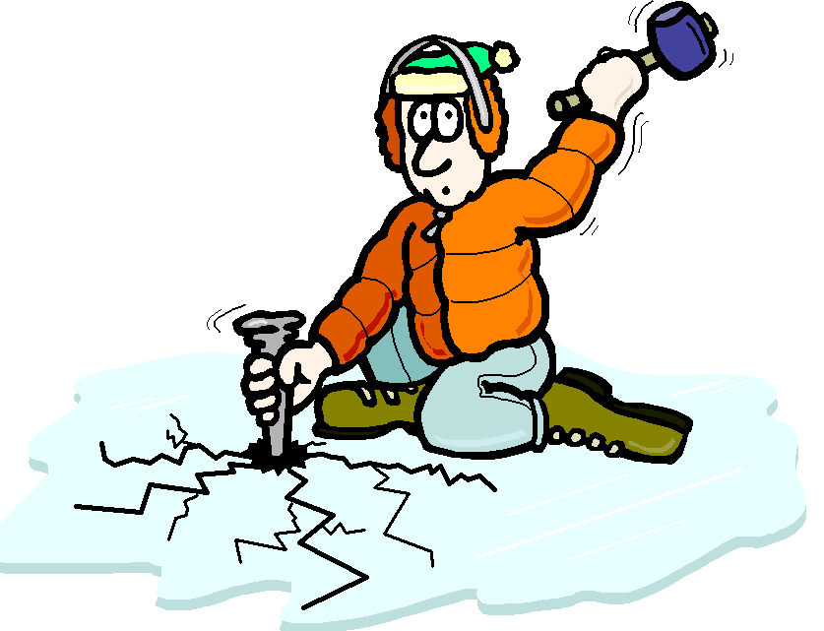
Ice Breaker

Slide 8
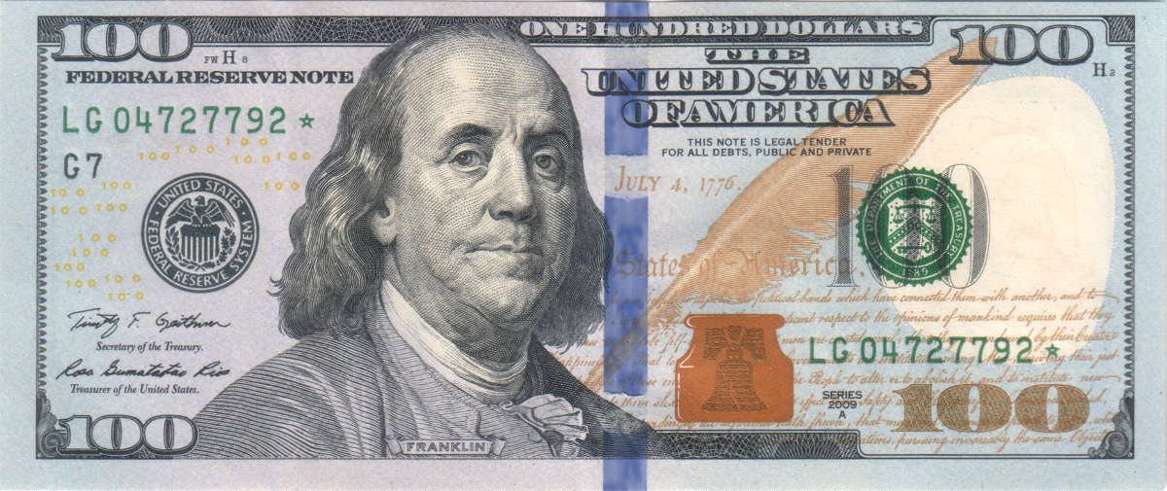
Theme for the Class
Who said, “Early to bed, early to rise, makes a man healthy, wealthy, and wise”?
- Is the famous saying correct? Should we be still following the advice of an old, dead, white guy from the 18th Century?

Slide 9
Writing Diagnostic
Health
Free Write!
Directions: State whether you agree or disagree with the following statements. Then write a paragraph giving reasons, examples, and evidence why.
1. I would only date a healthy person.
2. Americans love fast food.
3. The drinking age should be 18.
4. Using a smart phone too much is unhealthy.

