Slide 1
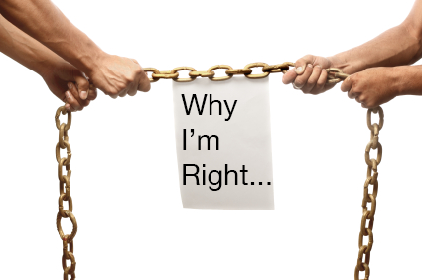
The Argument Essay
Attitude not Organization

Slide 2

The Power of Persuasion
We use every day
Examples:
- Persuade friend to see a movie
- A teacher to give you a grade
- Employer to give you a job
- A policemen not to give you a ticket
-A store to give you your money back
- Other Examples?

Slide 3

“In Praise of the ‘F’ Word” by Mary Sherry

Slide 4

Thesis, Crediblity, Evidence
1. What is Mary Sherry’s argument?
2. Why is she a credible source?
3. What evidence does she use?
Because this class is not research based, use your own experience and authority to argue.

Slide 5
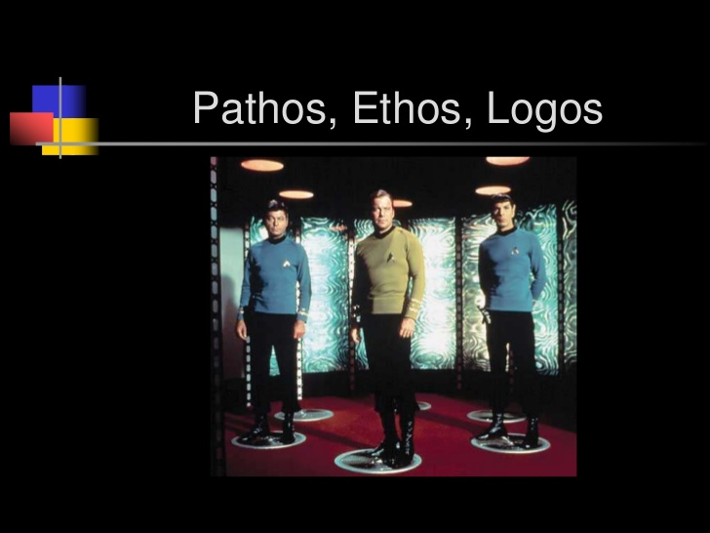
3 Kinds of Appeals

Slide 6
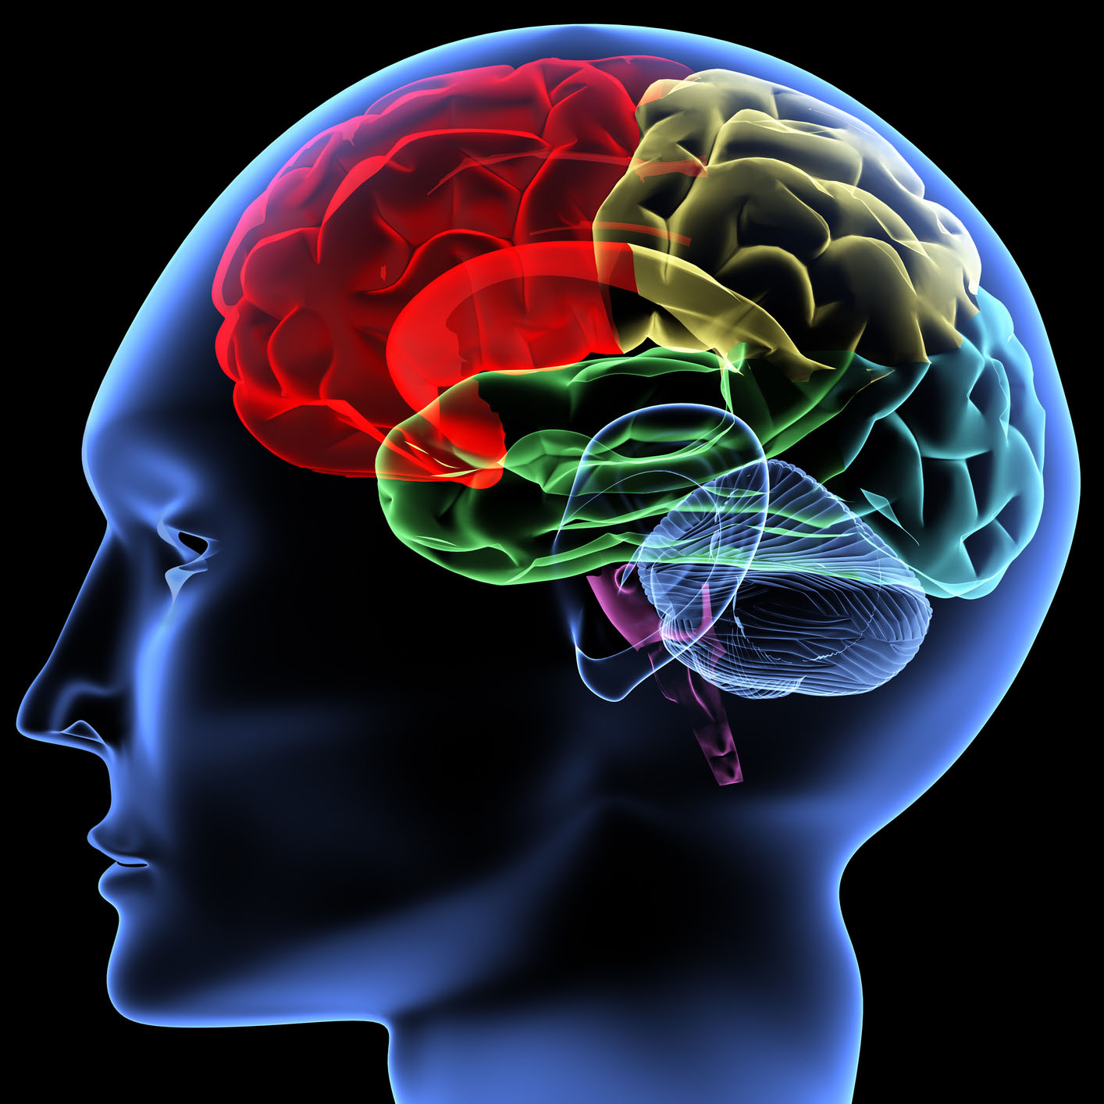
Logical Appeal (Logos)
- Test results
Statistics
Expert Testimony
Surveys
Practice : Persuade someone to Buy a Car?

Slide 7
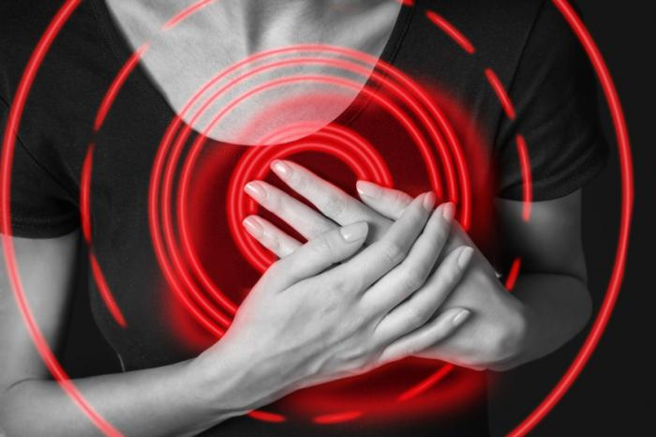
Emotional Appeal (Pathos)
- Need for conformity
- Need for Security
- Need for Independence
- Need for Achievement
- Creativity
Practice: Persuade someone to buy a Car
Honest Ads

Slide 8

Ethical Appeal (Ethos)
- Religion
- Patriotism
- Standards (good citizen, good professional, good parent)
-Humanitarianism (save environment, save the less fortunate)
Practice: Persuade someone to buy a car.

Slide 9

Your Turn
Examine an Advertisement and evaluate which appeal it is using to persuade.

Slide 10
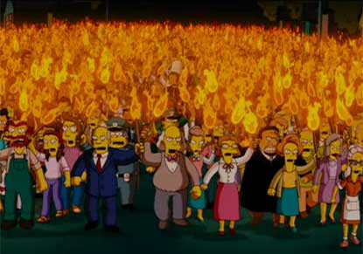
Appealing to Hostile Readers
Always remember your audience!

Slide 11
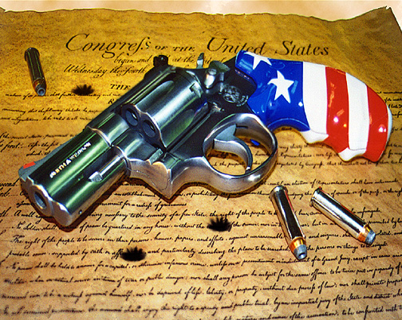
Practice (469)
Let’s pretend I want stronger gun laws and you are the National Rifle Association (NRA).
How will I appeal to you effectively?
I will say a statement and you tell me what strategy from the book I am trying to use.

Slide 12

“I’m not going to change you, but at least hear me out.”
Notes:
5. Ask readers to maintain open mind

Slide 13

“We both have families we care about and want to protect from dangerous criminals, and we only want what’s best for our country and the principles our country instills in us.”
Notes:
4. Stress shared values, experiences, and problems

Slide 14
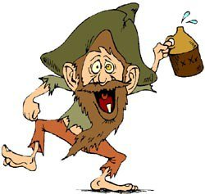
“You power loving, children killing group of back woods hillbillies!”
Notes:
3. Avoid making judgmental statements

Slide 15
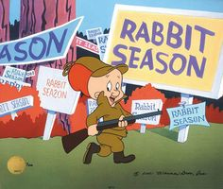
“I understand you think America should have its freedoms, and you want guns to be a legal sport, and you’re concerned the government is trying to take your lives.”
Notes:
2. Responsibly summarize opposing viewpoints

Slide 16

“You probably think I’m a government loving communist, wanting to see the world with Big Brother over our shoulder. After gun laws, then it’s surveillance, cameras and mandatory chip implants.”
Notes:
6. Overcome negative stereotypes

Slide 17
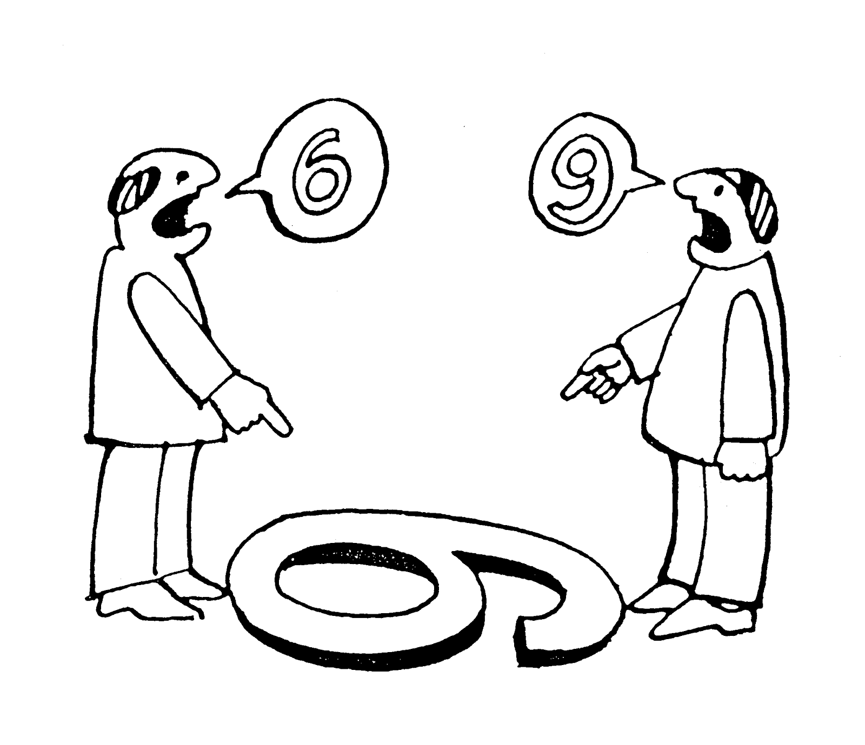
“I know you want freedom to use weapons and I don’t; let’s just state that openly.”
Notes:
1. Openly admit differences

Slide 18
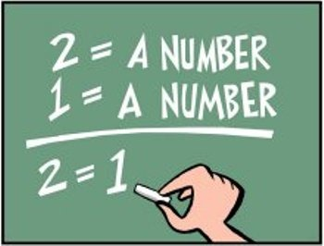
Logical Fallacies (page 39)
A logical fallacy is a flaw in reasoning. Logical fallacies are like tricks or illusions of thought, and they're often very sneakily used by politicians and the media to fool people. Don’t be fooled!
Ad Hominem, Red Herring, Hasty Generalization, and Absolute

Slide 19
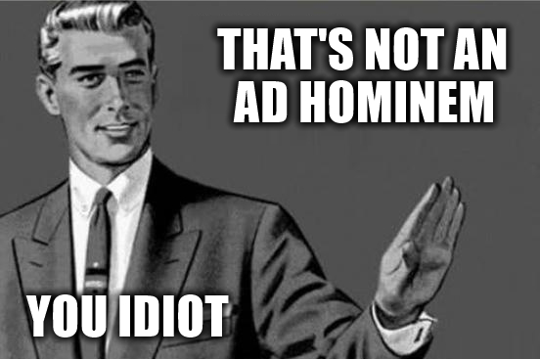
Ad Hominem
- Attacking the person not the issue

Slide 20
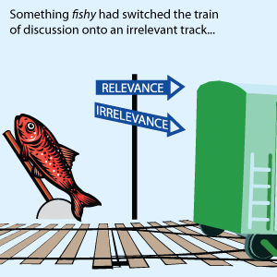
Red Herring

Slide 21
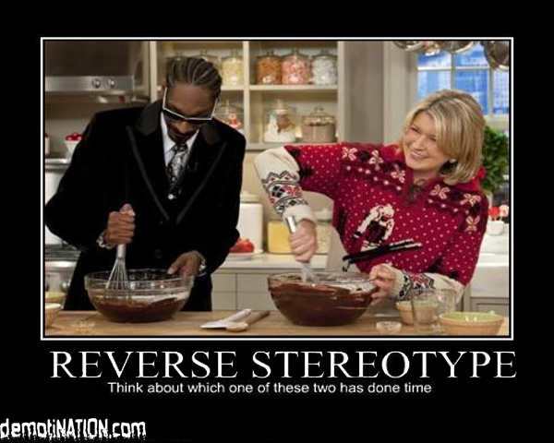
Hasty Generalization

Slide 22
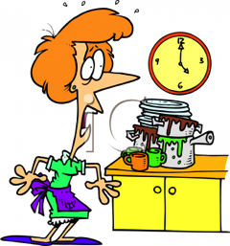
Absolute
A fallacy that concludes an argument as fact, 100% truth, all the time, all people no exceptions.
For example: “This essay proves that ….”
All the Kardashians are superficial
None of Trumps supporters are educated
You never clean the dishes.

Slide 23

Agree/Disagree
Let’s practice!
Go to the side of the room that shows if you Agree with the following thesis or Disagree. Give argument to get people to come to your side. If you catch someone using a logical fallacy, I’ll reward you with sugar!

Slide 24
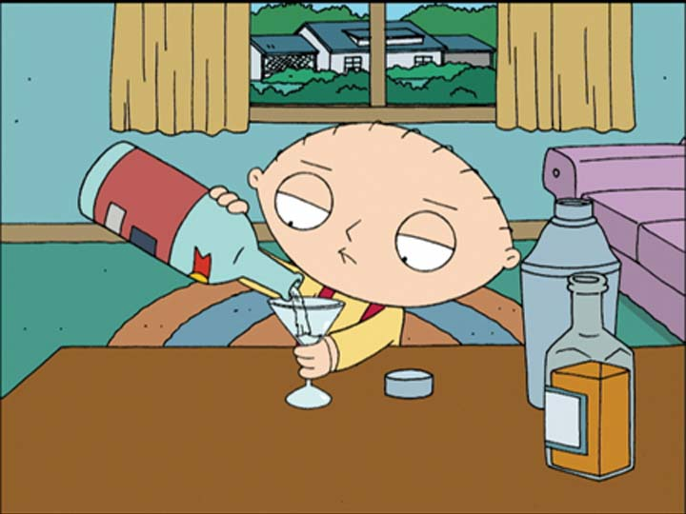
The drinking age should be 18.

Slide 25


John and Kelley are dating.
John promises Kelley he’ll meet her at 10am at the beach.
As he’s leaving, he gets a call from David who wants to play tennis. John goes to play tennis with David but the courts are full, so he meets Kelley at the Beach at 10am.
Thesis: John kept his promise to Kelley.

Slide 26

De Anza Courses should not have an attendance policy.

