Slide 1
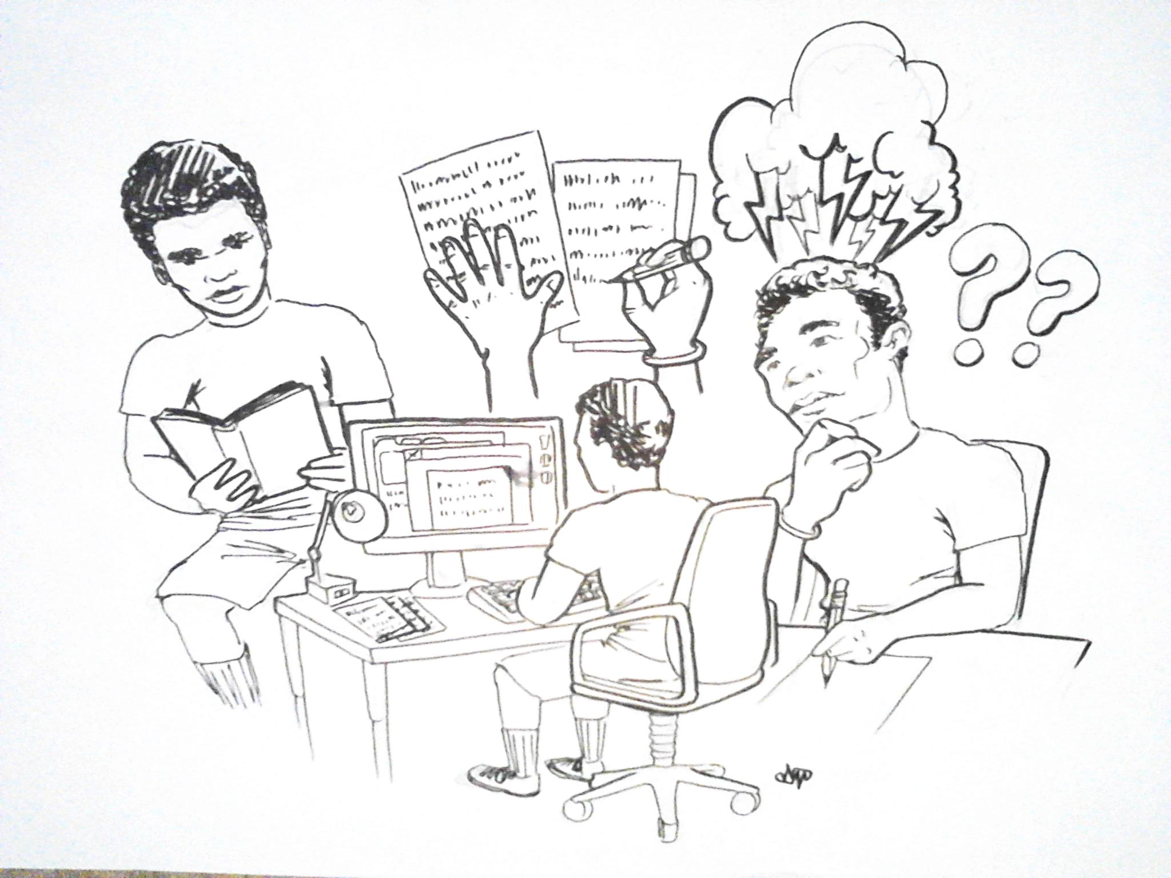
What is your writing process?
How to Get Started?

Slide 2
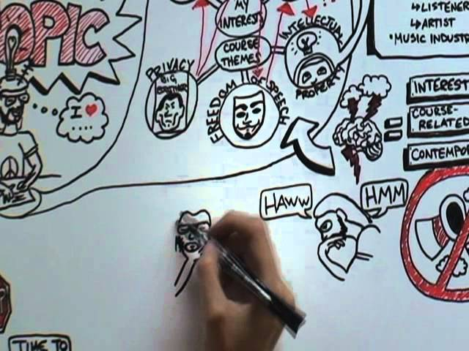
The Writing Process

Slide 3
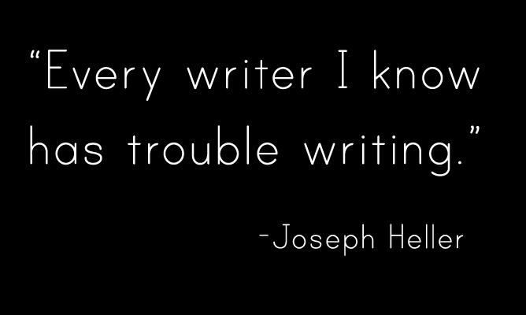
Pre-Writing
Your Instructor gives you an assignment and then you think, now what? How do you get started? How do you come up with ideas?
Make sure to spend time Pre-Writing to really understand the topic, assignment, and plan you will have before writing the essay.

Slide 4

Step 1: Annotate the Prompt

Slide 5
Annotate the Prompt
Every essay comes with a prompt you must follow to meet the objectives of the assignment.
In order to successfully meet the requirements of the prompt, you need to underline the main ideas and write in the margins to clarify each essay requirement before beginning the next step.

Slide 6

Step 2: START
Here’s a fun trick! Begin with START!
Self
Topic
Audience
Reason
Tone

Slide 7
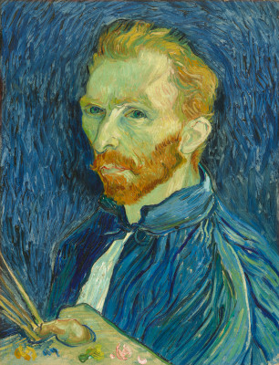
SELF
You too can write creatively and have original ideas because there is only one you and one of your perspectives. Don’t try to copy someone else’s ideas. You have a store of fresh ideas from all your experiences. Bring the “YOU” into your writing (son, daughter, childhood, religion, hobbies, interests, profession, culture). Use your experiences to feed your essays.

Slide 8

Practice
Who are you and how do your experiences give you a unique perspective?
Relate how the following have shaped your perspective on “Health”
Family
Culture
Places lived or worked
Hobbies, Interests

Slide 9
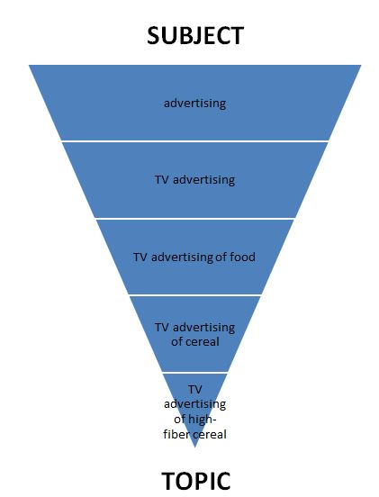
Topic
Limit the topic to something you can cover in 3 pages
Too Broad: Smoking
Narrowed: Movie’s influence on teenage smoking
Too Broad: Exercise
Narrowed: Benefits of walking 20 minutes in the morning
Too Broad: Dieting
Narrowed: Dangers of the Paleo Diet

Slide 10

Audience
Who am I writing this to?
Remember what knowledge, experience, and information they have and don’t have.

Slide 11

Practice
-Divide Class in Groups
-Convince group on your notecard to go to Disneyland
Each group will receive a separate audience and persuade.
The class will try to guess who the audience is.

Slide 12

Reason
Decide why you want your reader to read this argument.
Do you want to persuade him/her to do something?
Do you want to change the way he or she thinks about a topic?
Do you want to entertain the reader?

Slide 13
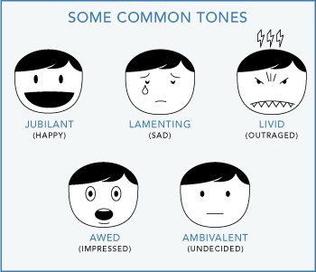
Tone

Slide 14

Practice
Compare the 2 articles on pages 61 and 62 of your Reader
Determine the Audience, Reason, and Tone for each.
Give details from the text that led you to those conclusions.

Slide 15

Step 3:
Choose a Pre-Writing Strategy
Explore what you think about the topic before deciding on a thesis
Brainstorming
Clustering
Journalist 6 Questions
Free Writing

Slide 16
Step 4: Outlining
Make a plan and translate pre-writing ideas into an essay map.
Write one sentence for your thesis
Then write one sentence for each topic sentence

Slide 17

Outline Example
Thesis: McDonald’s is now a healthy place for students to get a fast and nutritious meal because of its clear calorie charts, its new salad options, and its new children’s menu options. Paragraph 1: The clearly placed calorie count chart at McDonald’s makes customers know what they are eating to make better choices. Paragraph 2: The new salad options allows customers to eat healthy vegetables and protein as an alternative to high fat and sugar. Paragraph 3: Even the children’s Happy Meals now come with milk and apples instead of soda and French fries.

