Slide 1

Narrative Essay
We love stories!
We use it all the time when we tell what happened.
Accident report
Weekend event
Eyewitness
Retell a movie plot

Slide 2
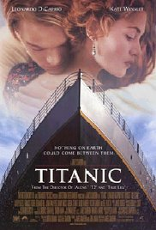
Significance (Thesis)
What is the purpose of sharing the story.
What moral or lesson was learned?
Example:
What is the significance of the story in….
- Titanic
- Forrest Gump
- Star Wars
- Wizard of Oz

Slide 3
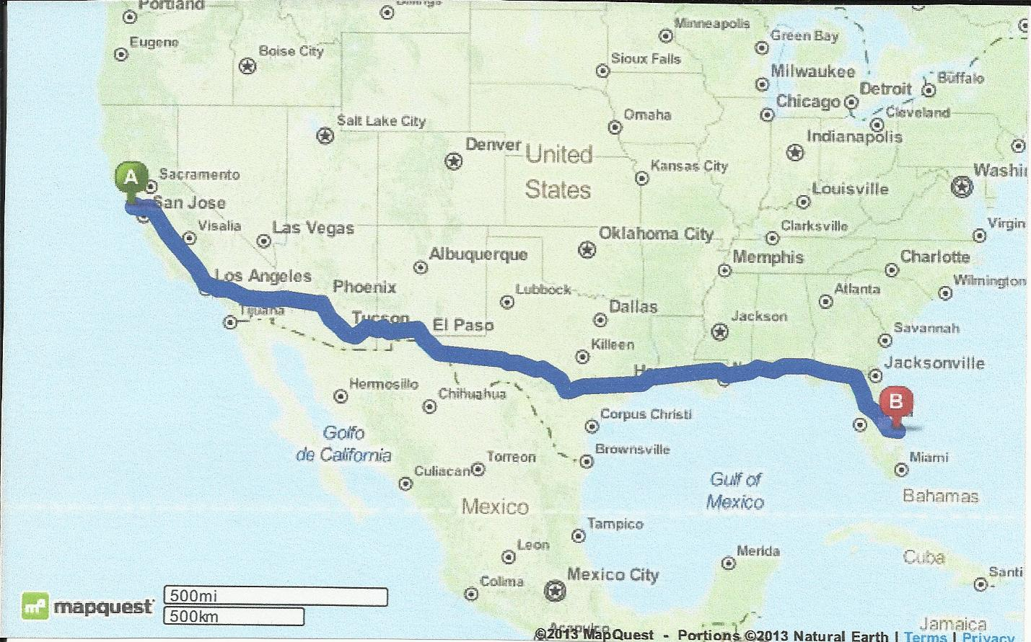
Exercise
Activity: Write down 3 events in your life and tell what you think the significance was?
Example:
I moved to California from Florida.
Significance: I learned that in life we often need to take a leap of faith and trust.

Slide 4
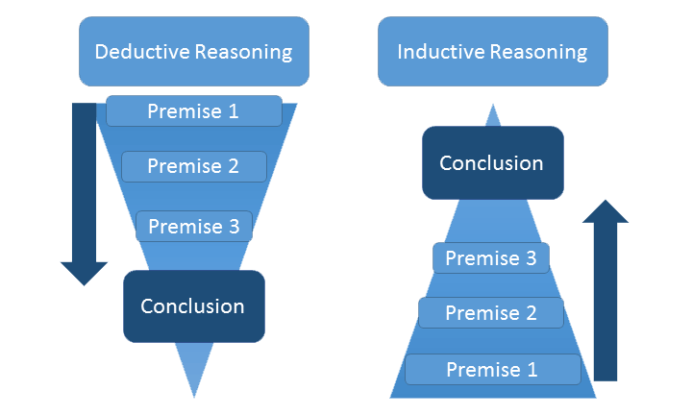
Deductive vs. Inductive Reasoning

Slide 5
Chronology
Organize your essay
Narrow story down to one day or less!
Introduction – Background /thesis (significance)
Body Paragraphs – Story that proves thesis (choose only relevant information – not everything)
Paragraph 1 – Beginning
Paragraph 2 – Middle
Paragraph 3 – End
Conclusion – reinforce how story proves thesis and connect to larger audience.

Slide 6
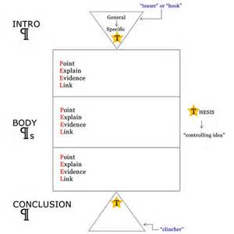

Slide 7
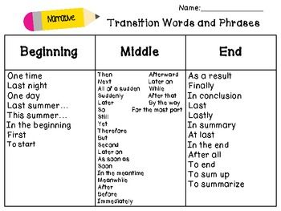
Transitions
Make clear when events are happening in story.
.

Slide 8
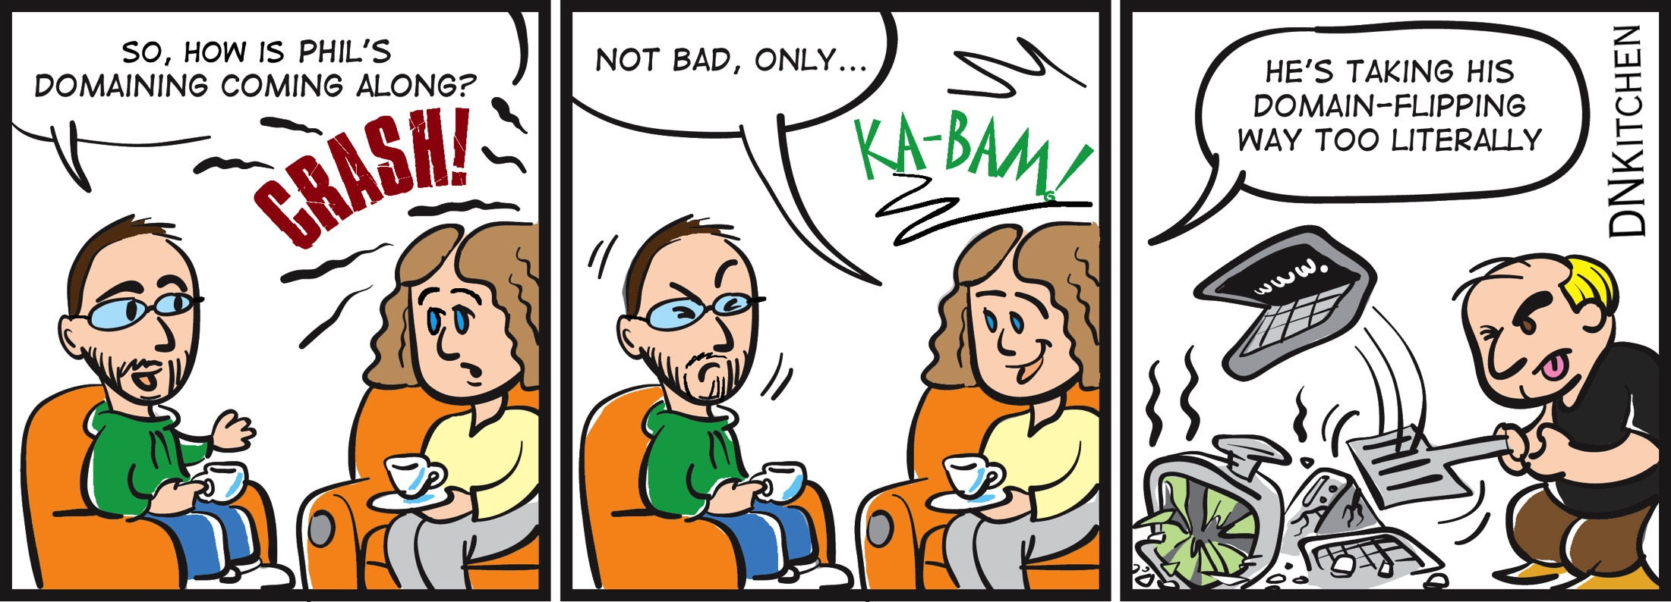
Exercise
Activity:
Each group will receive a comic strip that has been cut up into separate boxes.
Put together each story logically
Tell story with clear chronology and transitions

Slide 9
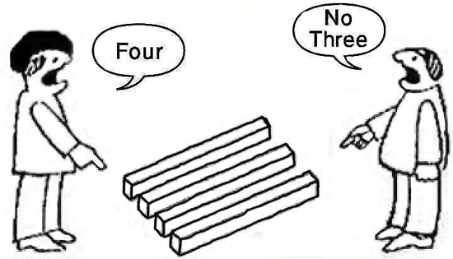
Perspective
Subjective – 1st person “I” “We”
All from one narrator’s view
Objective – 3rd person “He, She, They”
Eyewitness, researcher reconstructing chain of events

Slide 10
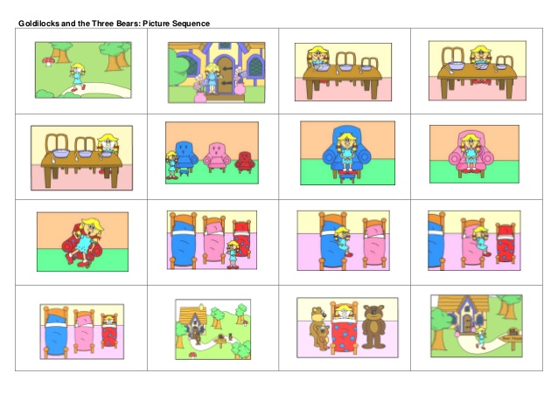

Slide 11
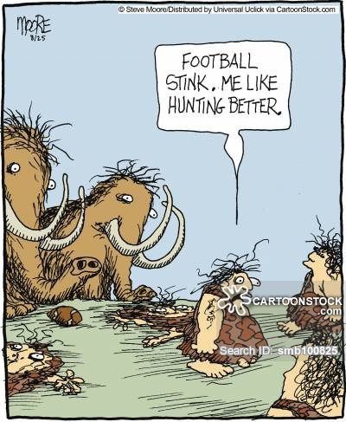
Description and Dialogue
Don’t just tell what happened.
Add descriptive detail so reader can see, smell, hear, feel the place and people.
Add dialogue to bring characters to life and make reader feel right there in scenario.

Slide 12

Exercise
Chain Story
Get in a circle
Each person will add another part of a story
1. Action
2. Description
3. Dialogue
Thesis: Blind Dates are terrible.

Slide 13
Sample Essay
Analyze Essay
1. What is the Thesis (Significance)
2. How long is the story?
3. How is the story divided into paragraphs?
4. Is every part of the story directly proving the thesis?
5. Is there effective use of description and dialogue?
6. How do the introduction and conclusion frame the story?
7. Are there effective use of transitions? Give examples.

