Slide 1

Organization

Slide 2
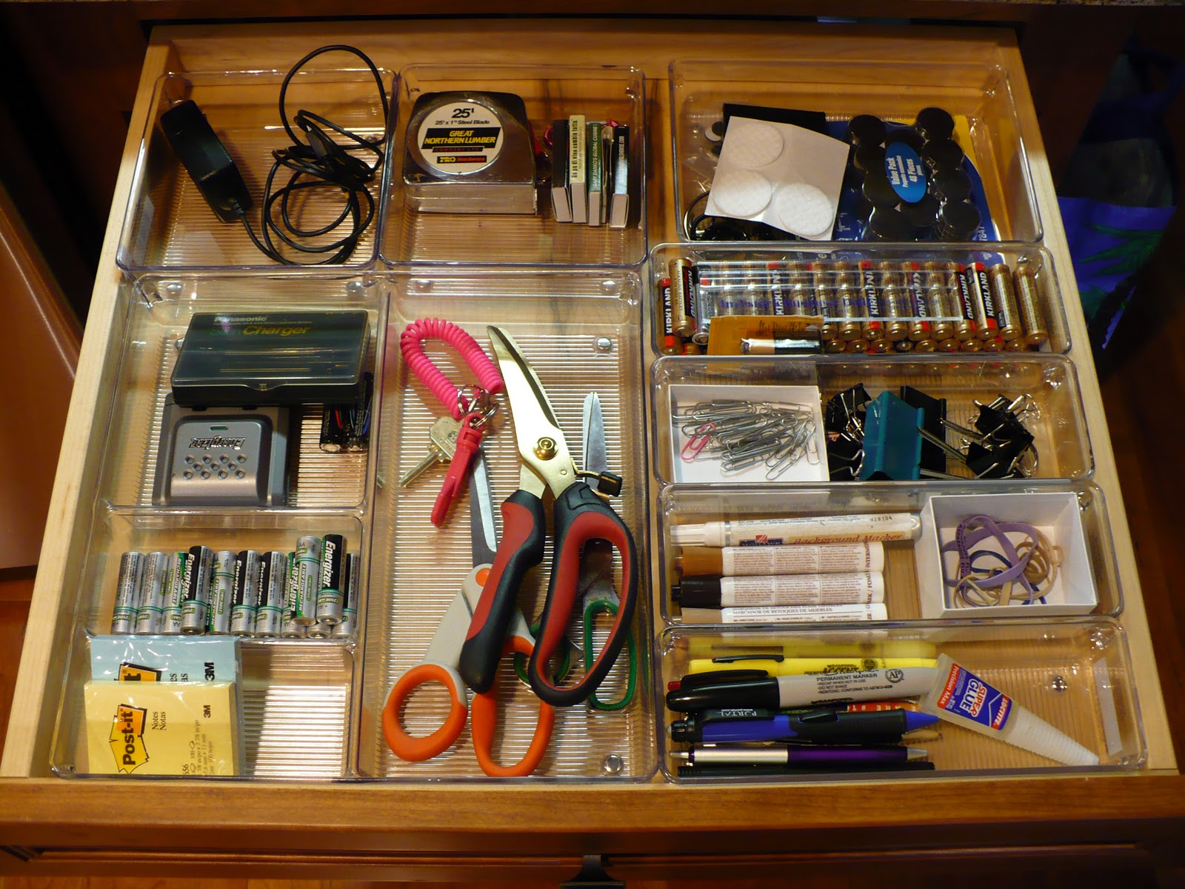
Topic Sentences, Unity, Coherence
A well organized essay is like a well organized room. The reader can find the thesis, support and details easily.
Three ways to achieve organization is to have:
1. Clear Topic Sentences
2. Unity
3. Coherence

Slide 3
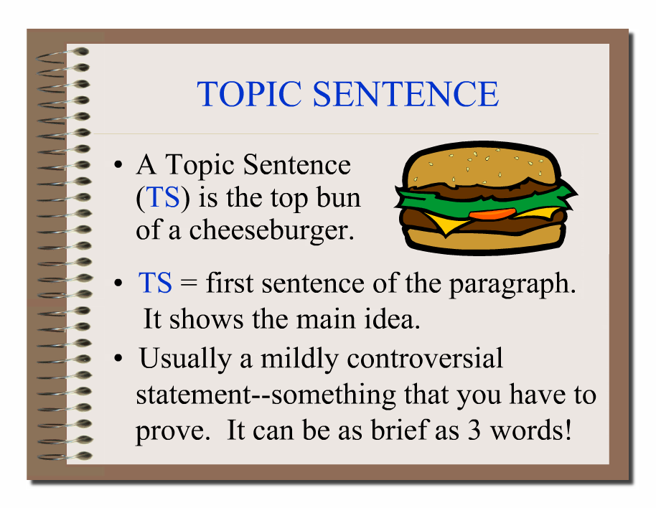
Topic Sentences
A topic sentence is the main idea for the whole paragraph.

Slide 4

Good Topic Sentence
A good topic sentence has:
1. Narrowed topic (What the paragraph is about)
2. Focus: Attitude/Opinion (What the writer thinks about the topic)

Slide 5

Bad Topic Sentence
A bad topic sentence is”
1. A fact
2. Is too broad or narrow for the main idea of the paragraph

Slide 6

Example
Thesis:
A man should pay for the first date
Topic Sentences
On my first date, I went to McDonalds.
Dating is confusing.
It is important to show a girl a good first impression.

Slide 7
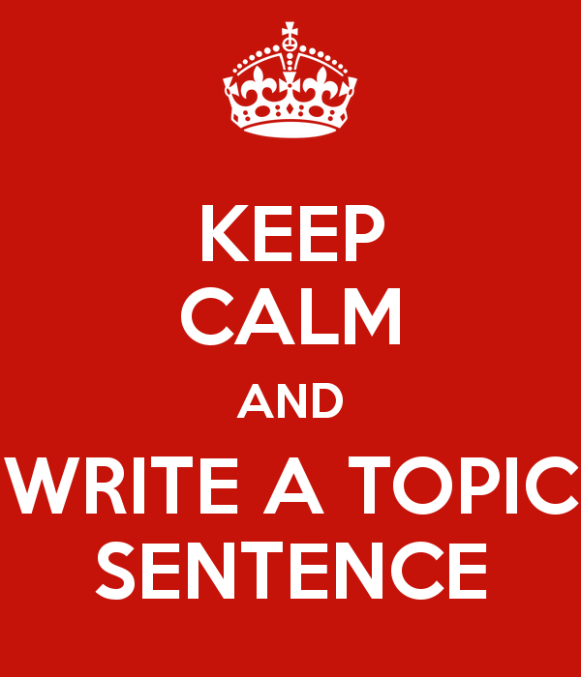
Practice
Page 48 of Reader

Slide 8
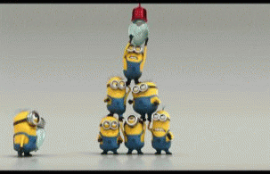
Unity
Unity means oneness or wholeness. Sentences are united when they all work together to form and support one point.
1. Make sure all topic sentences stay unified with the thesis
2. Make sure all sentences in paragraph unity with the topic sentence

Slide 9

Practice
Page 49 of Reader

Slide 10

Coherence
Coherence means stick together
Use Transitions and Connectors to help connect your paragraphs and sentences better to show relationships.

Slide 11


Practice
Read “Give Mine to the Birds” Essay
1. Circle Transitions
2 Underline Repeated Key Words that help connect ideas

