Slide 1

REVISION
Literally means to “re-see”

Slide 2

Revision as Surgery
Revision is not the same as proofreading. When you revise, you want to do more than spell check and change a few words. You want to move beyond surface issues and think about the main idea, your organization, and your development.

Slide 3
90% of the Writing Process is Revision

Slide 4
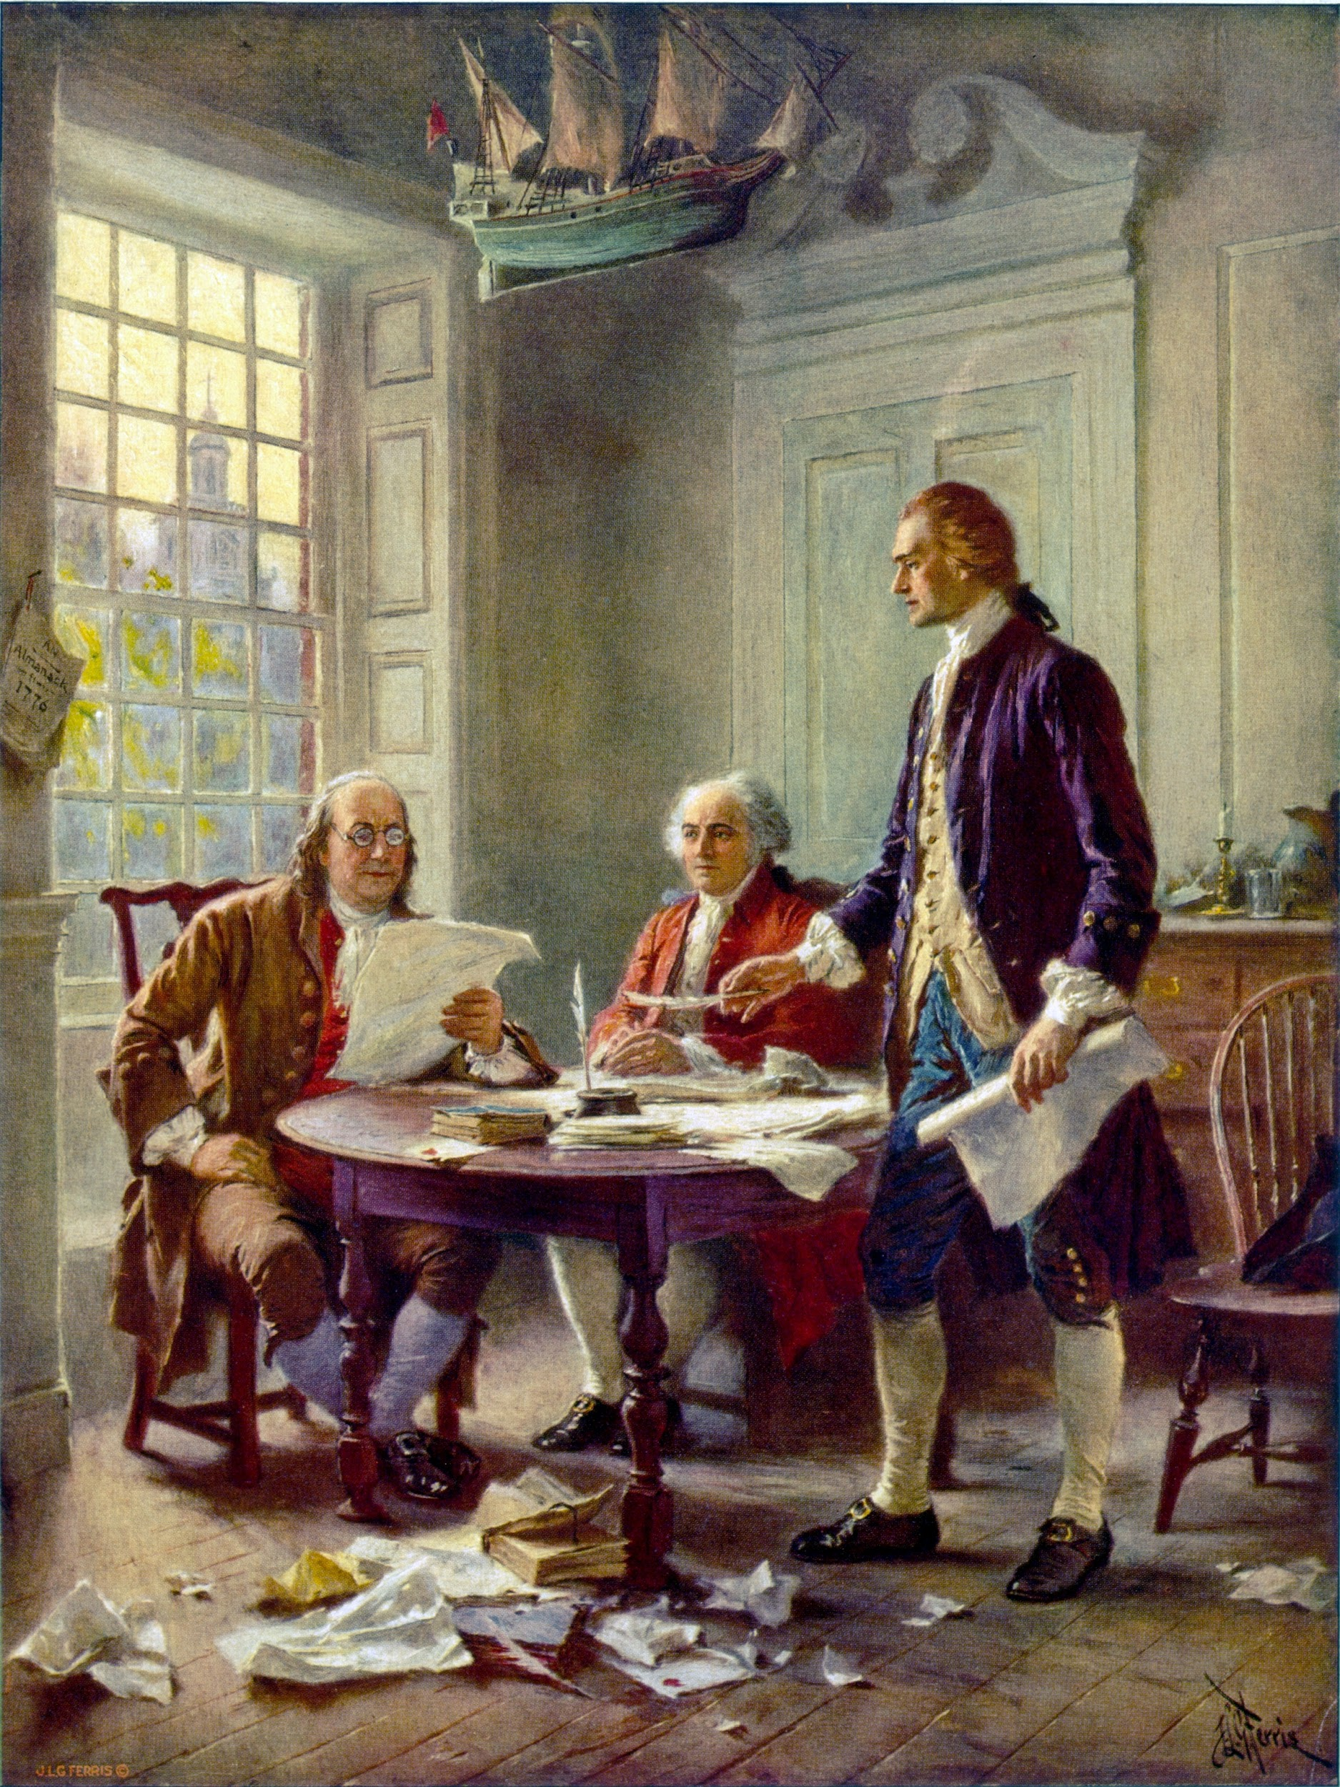
Fun Fact
Thomas Jefferson wrote the first draft of the Declaration of Independence in two weeks, but his work was far from being over. The document was revised by John Adams and Benjamin Franklin. How many times do you think they revised it together? Once the document was presented to Congress, how many additional revisions do you think were made?

Slide 5
47 & 39
“Wow!”

Slide 6
Evaluating your Own Essay
When we “re-see” we pretend we are seeing our writing for the first time. We are seeing it through the eyes of a potential reader. In other words, pretend you have amnesia.

Slide 7

The Final Portfolio
In-Class Essay
(essay 2 or 3)
2. Revised Out of Class Essay (essay 1)
3. Cover Letter- Reflection Essay

Slide 8

Revise for Content
Review all the comments and suggestions.
How and where can you add more examples, evidence and development?
How and where can you add more details?

Slide 9

Practice
Turn to page 51 in Reader. Choose one sentence to revise for content adding much more detail.

Slide 10
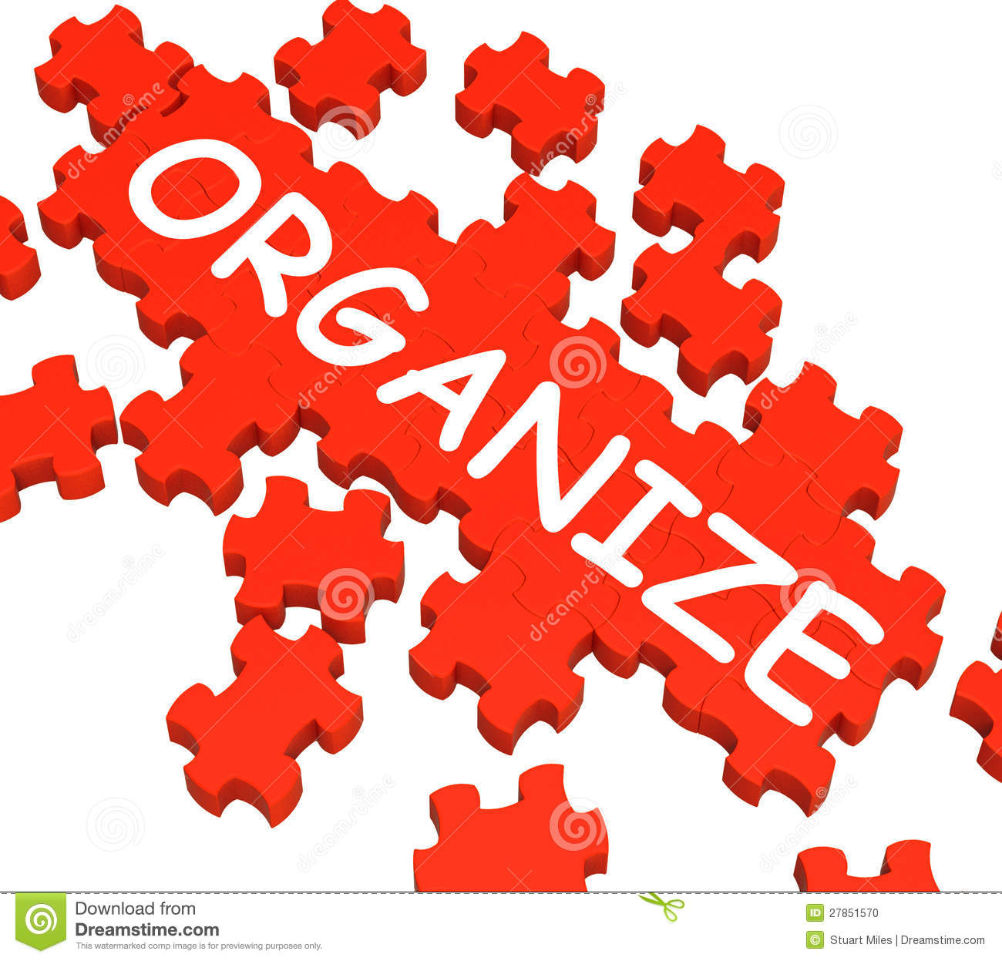
Revise for Organization
Review your essay for Organization
Is the thesis at the end of the introduction.
Does the thesis suggest the road map for the essay, list parts.
Does each paragraph have a clear topic sentence that directly supports the thesis?
Is each paragraph unified with the thesis and the topic sentences?
Are there logical transitions and coherence throughout?

Slide 11
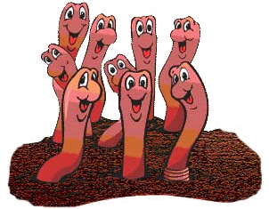
Practice
Examine the worms essay from last week for organization.

Slide 12
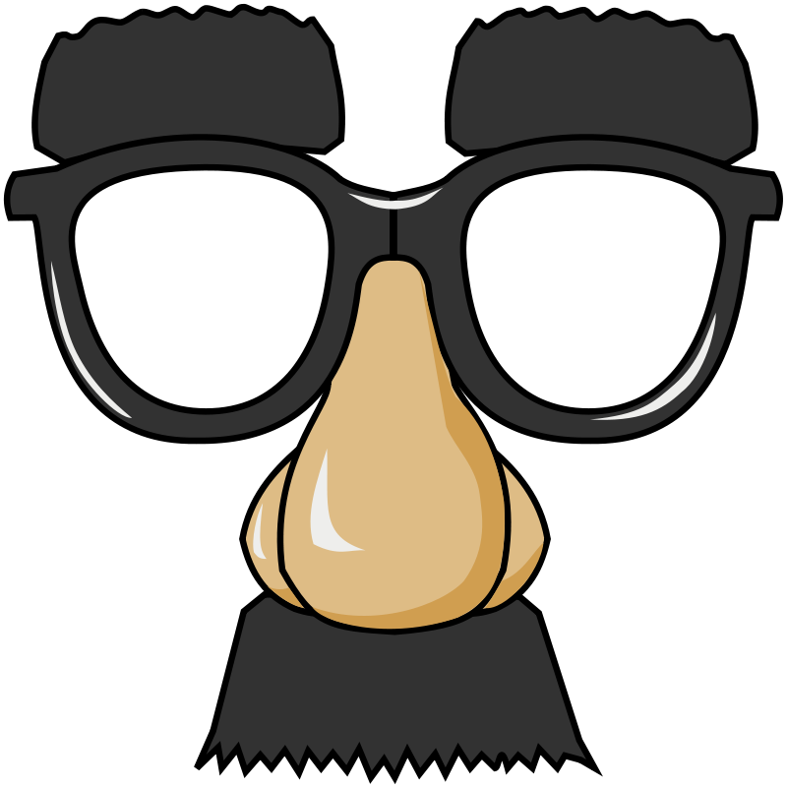
How do you now “see” your essay?
Reflection

Slide 13
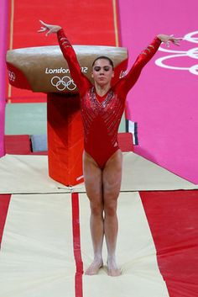
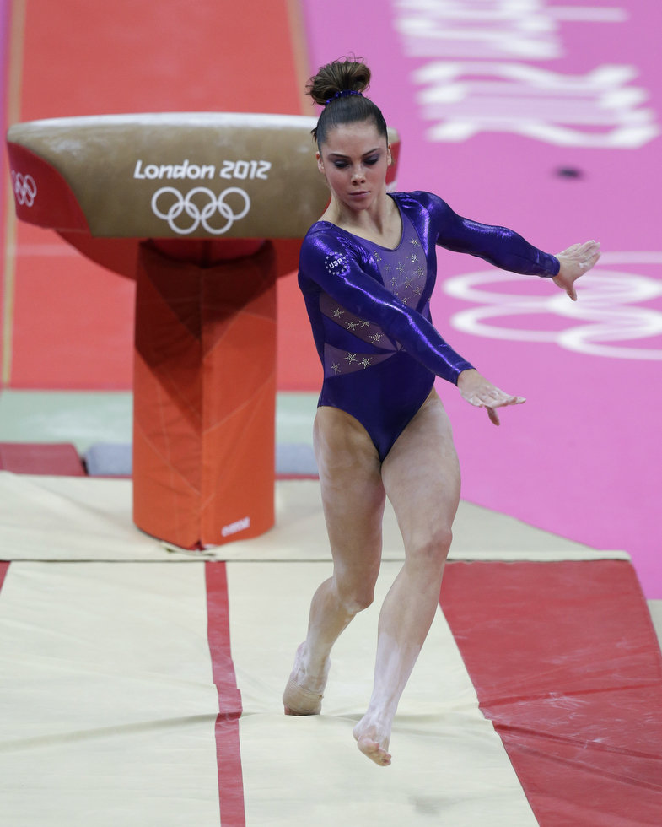
Conclusions

Slide 14
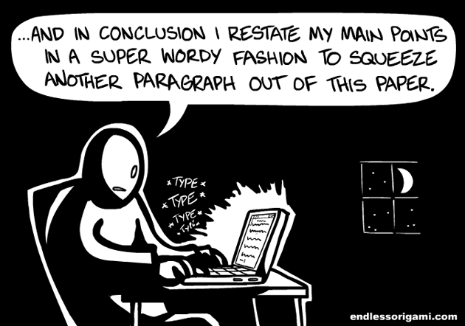
Practice:
1. Each group will receive one conclusion strategy
2. Make a 5-6 sentence Conclusion of the worms essay.
3. The class will guess what your concluding strategy is.

