Slide 1
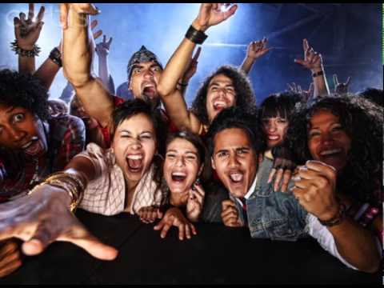
Welcome to
EWRT 1A

Slide 2
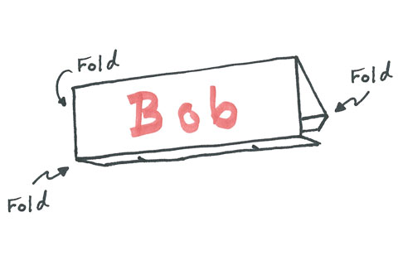
Make a Desk Name Tag
Use Markers, make very large, use first name you would like to be called.

Slide 3

Who’s Here?
Attendance Sheet

Slide 4
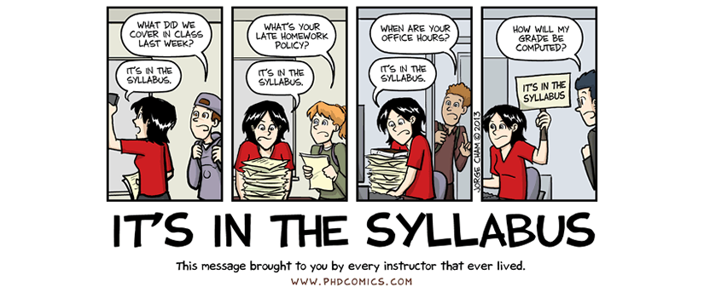
Syllabus
This is your lifeline to the class!
Everything you need to know about due dates, expectations, grading is on the syllabus.
Before you have a question, check the syllabus first, it’s probably answered there.

Slide 5
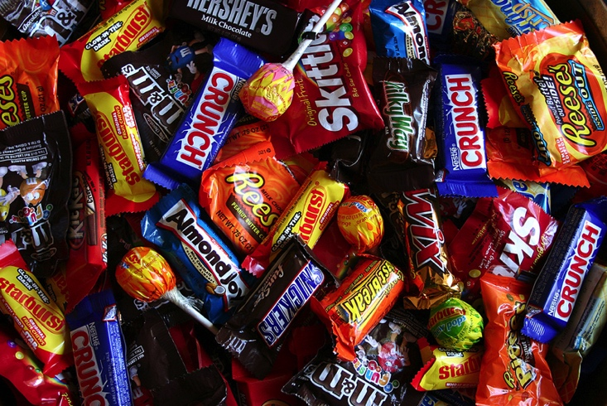
Candy Quiz
Let’s see how much you remembered!
Turn over syllabus
I’ll ask a question, raise your hand to answer. If you are correct, I’ll chuck you some chocolate.

Slide 6
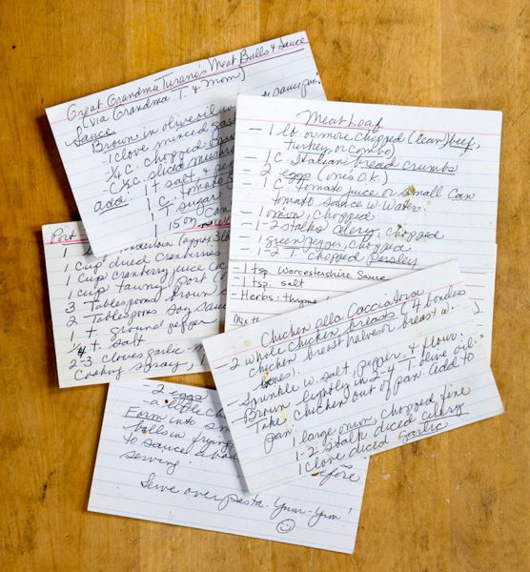
Index Cards
Let me know a bit about yourself
- Name (nicknames, special pronunciations, etc.)
- Contact Information – (e-mail, phone number)
- Previous English Class (If at De Anza, give instructor’s name)
- Strengths and Weaknesses in English
- Education and Career Goals
- Personal Interest/ Hobbies
- Work/Family/School Obligations
- Anything Else?

Slide 7
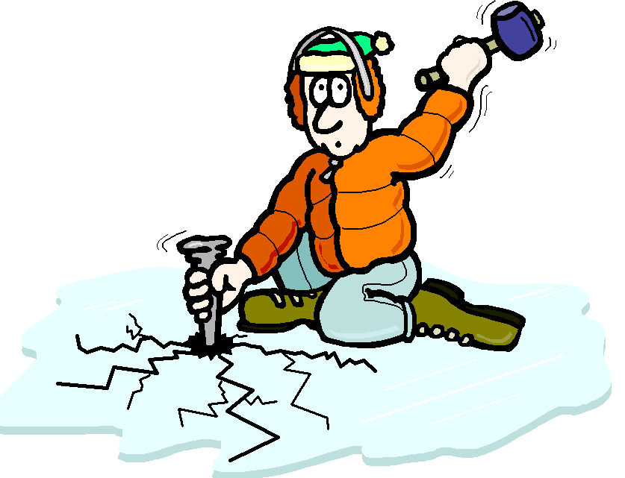
Ice Breaker

Slide 8
Writing Diagnostic
Free Write!
What is in a name?
Let’s check out “Your Name is Key”
https://www.youtube.com/watch?v=TuGL9_Isfyg
Write for about 15-20 minutes about your name. Who named you? Do you know what it means? Is it a reflection of your culture or your identity? Do you like your name? Do people have a hard time pronouncing your name? Do you have any nicknames?

