Slide 1
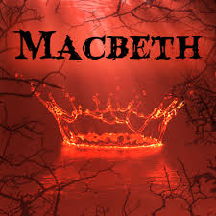

Slide 2
Audience Appeal
Shakespeare demonstrated the Elizabethan belief that the country is stable only if the King is good and virtuous.
The play was considered a thriller because it dramatizes a threat to an anointed King and the perceived evil behind the threat
Shakespeare included a lot of blood and murder, which the Elizabethans expected to see in a tragedy.
Elizabethans believed that evil occurs in darkness, which is a recurring theme in Macbeth.

Slide 3
Historical Background
Not very accurate about the real Macbeth, king of Scotland from 1040-1057.
  Ruled peacefully for a long time
Instead it’s directed toward the new King, James.
A problem of successon:
  There was no Tudor successor to the throne of England after Elizabeth died.
  Elizabeth chose James VI of Scotland to succeed her.
    Why?

Slide 4
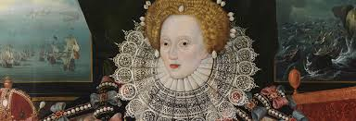
Elizabeth I had been instrumental in the death of her cousin, Mary Queen of Scots, who was beheaded
  The execution of rivals is the focus in the play.
    Nobody’s safe if that becomes a legitimate way to gain power.
  The pivotal role of Lady Macbeth in causing the violence links it to the Queen.
On her deathbed, Elizabeth wanted to ease her way into Heaven
  James was Mary’s son, so it’s a way of making amends.
  The appointment of James I unified England and Scotland under one King.
The play makes many references to this reunification under James’s ancestor, Banquo
  Images of Banquo’s heirs as rulers stretching on and on into the future

Slide 5
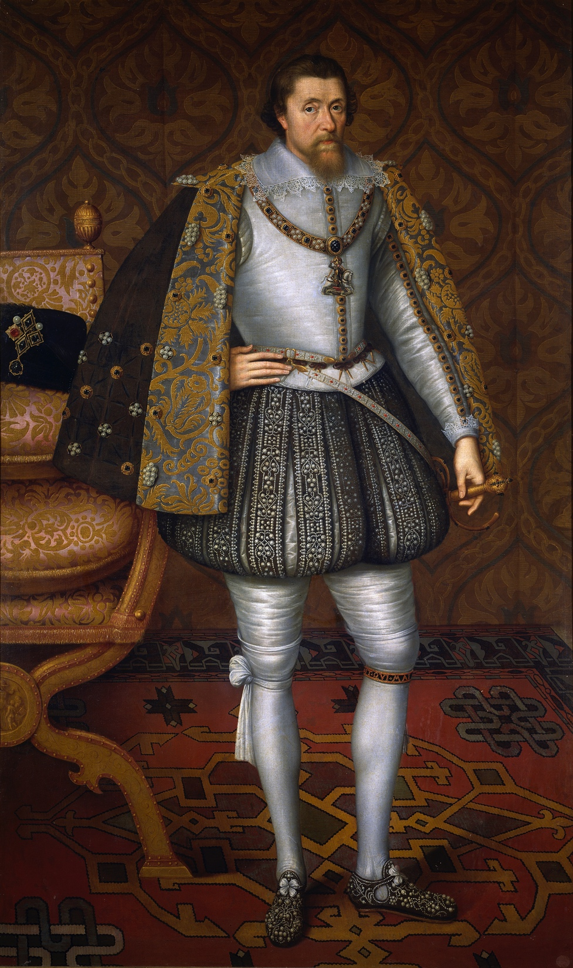
Shakespeare’s tribute to King James I
Shakespeare wrote Macbeth in 1606, during
King James’ reign.
The setting is Scotland, King James’ homeland
  Macbeth isn’t one of the king’s ancestors, so he can’t be the good guy, in spite of his fairly long peaceful rule (1040-1057).
Banquo was an ancestor of James and is shown in the play to be a virtuous person.
Also invoked in the play: witchcraft
  James believed himself to be an expert on witchcraft, so he would have been highly entertained by its role in Macbeth.

Slide 6
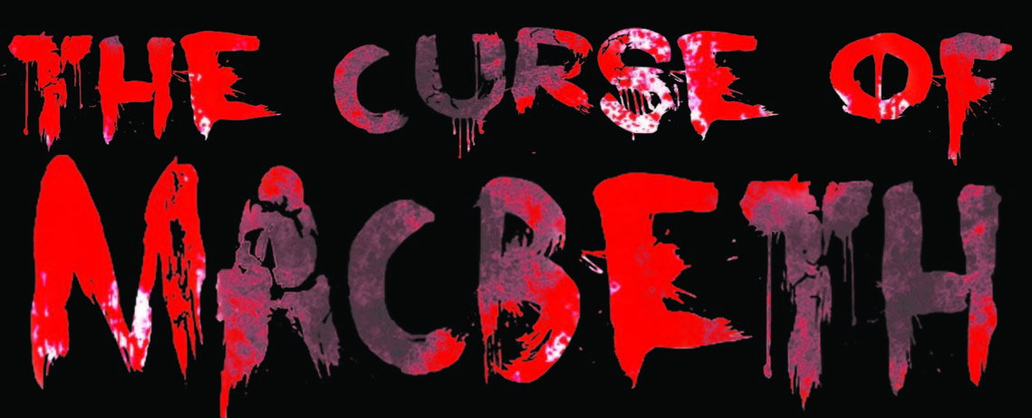
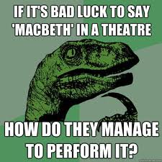
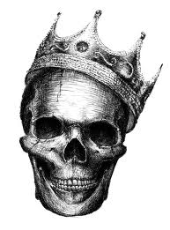

Slide 7
So What Really Happens?
Good guy goes bad
Guy wants power
Married to a woman who wants power
Kills people- LOTS of people
Gets power
Gets paranoid
  anyone could do the same to him, and some want to
Loses allies/friends
Wants more power! Kill! Kill!
Gets what’s coming to him in the end

Slide 8
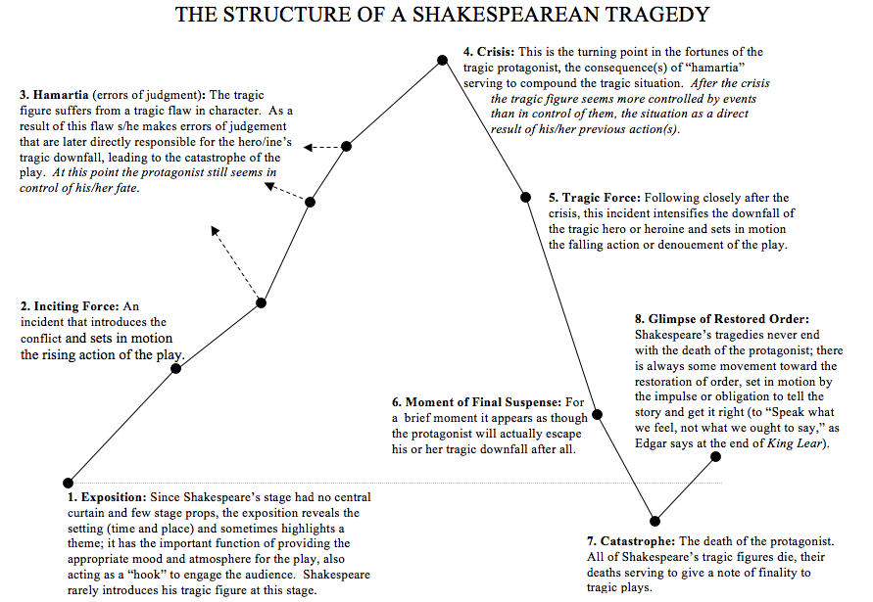

Slide 10
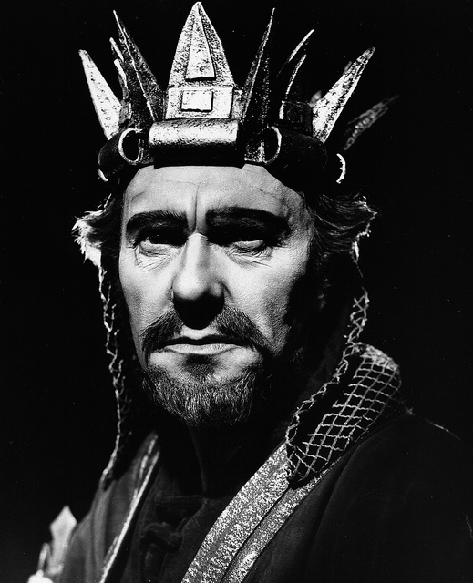
The Tragic Hero
Def. “Man of high standard who falls from that high because of a flaw that has affected many” - Aristotle
Macbeth is one of the most famous examples of the tragic hero.

Slide 11
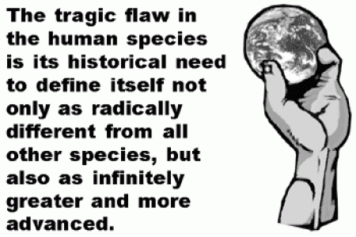
Don’t we all have a kind of hubris? (that will exact a price?)

Slide 12
Discussion: Chart the structure in Macbeth
Exposition (establishing the situation)
Inciting force (first moment of conflict)
Errors of Judgement (resulting from his flaw)
Crisis (turning point after which the character is controlled by events instead of the other way around)
Tragic Force (making it worse because of his tragic flaw)
Moment of Suspense (last possibility of escape)
Catastrophe
Glimpse of restored order

