Slide 1
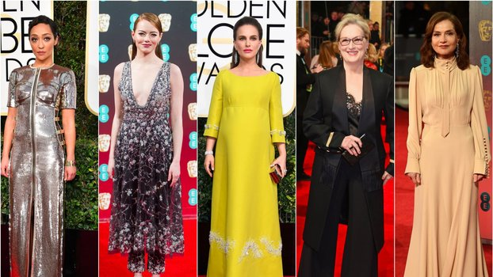
Style

Slide 2
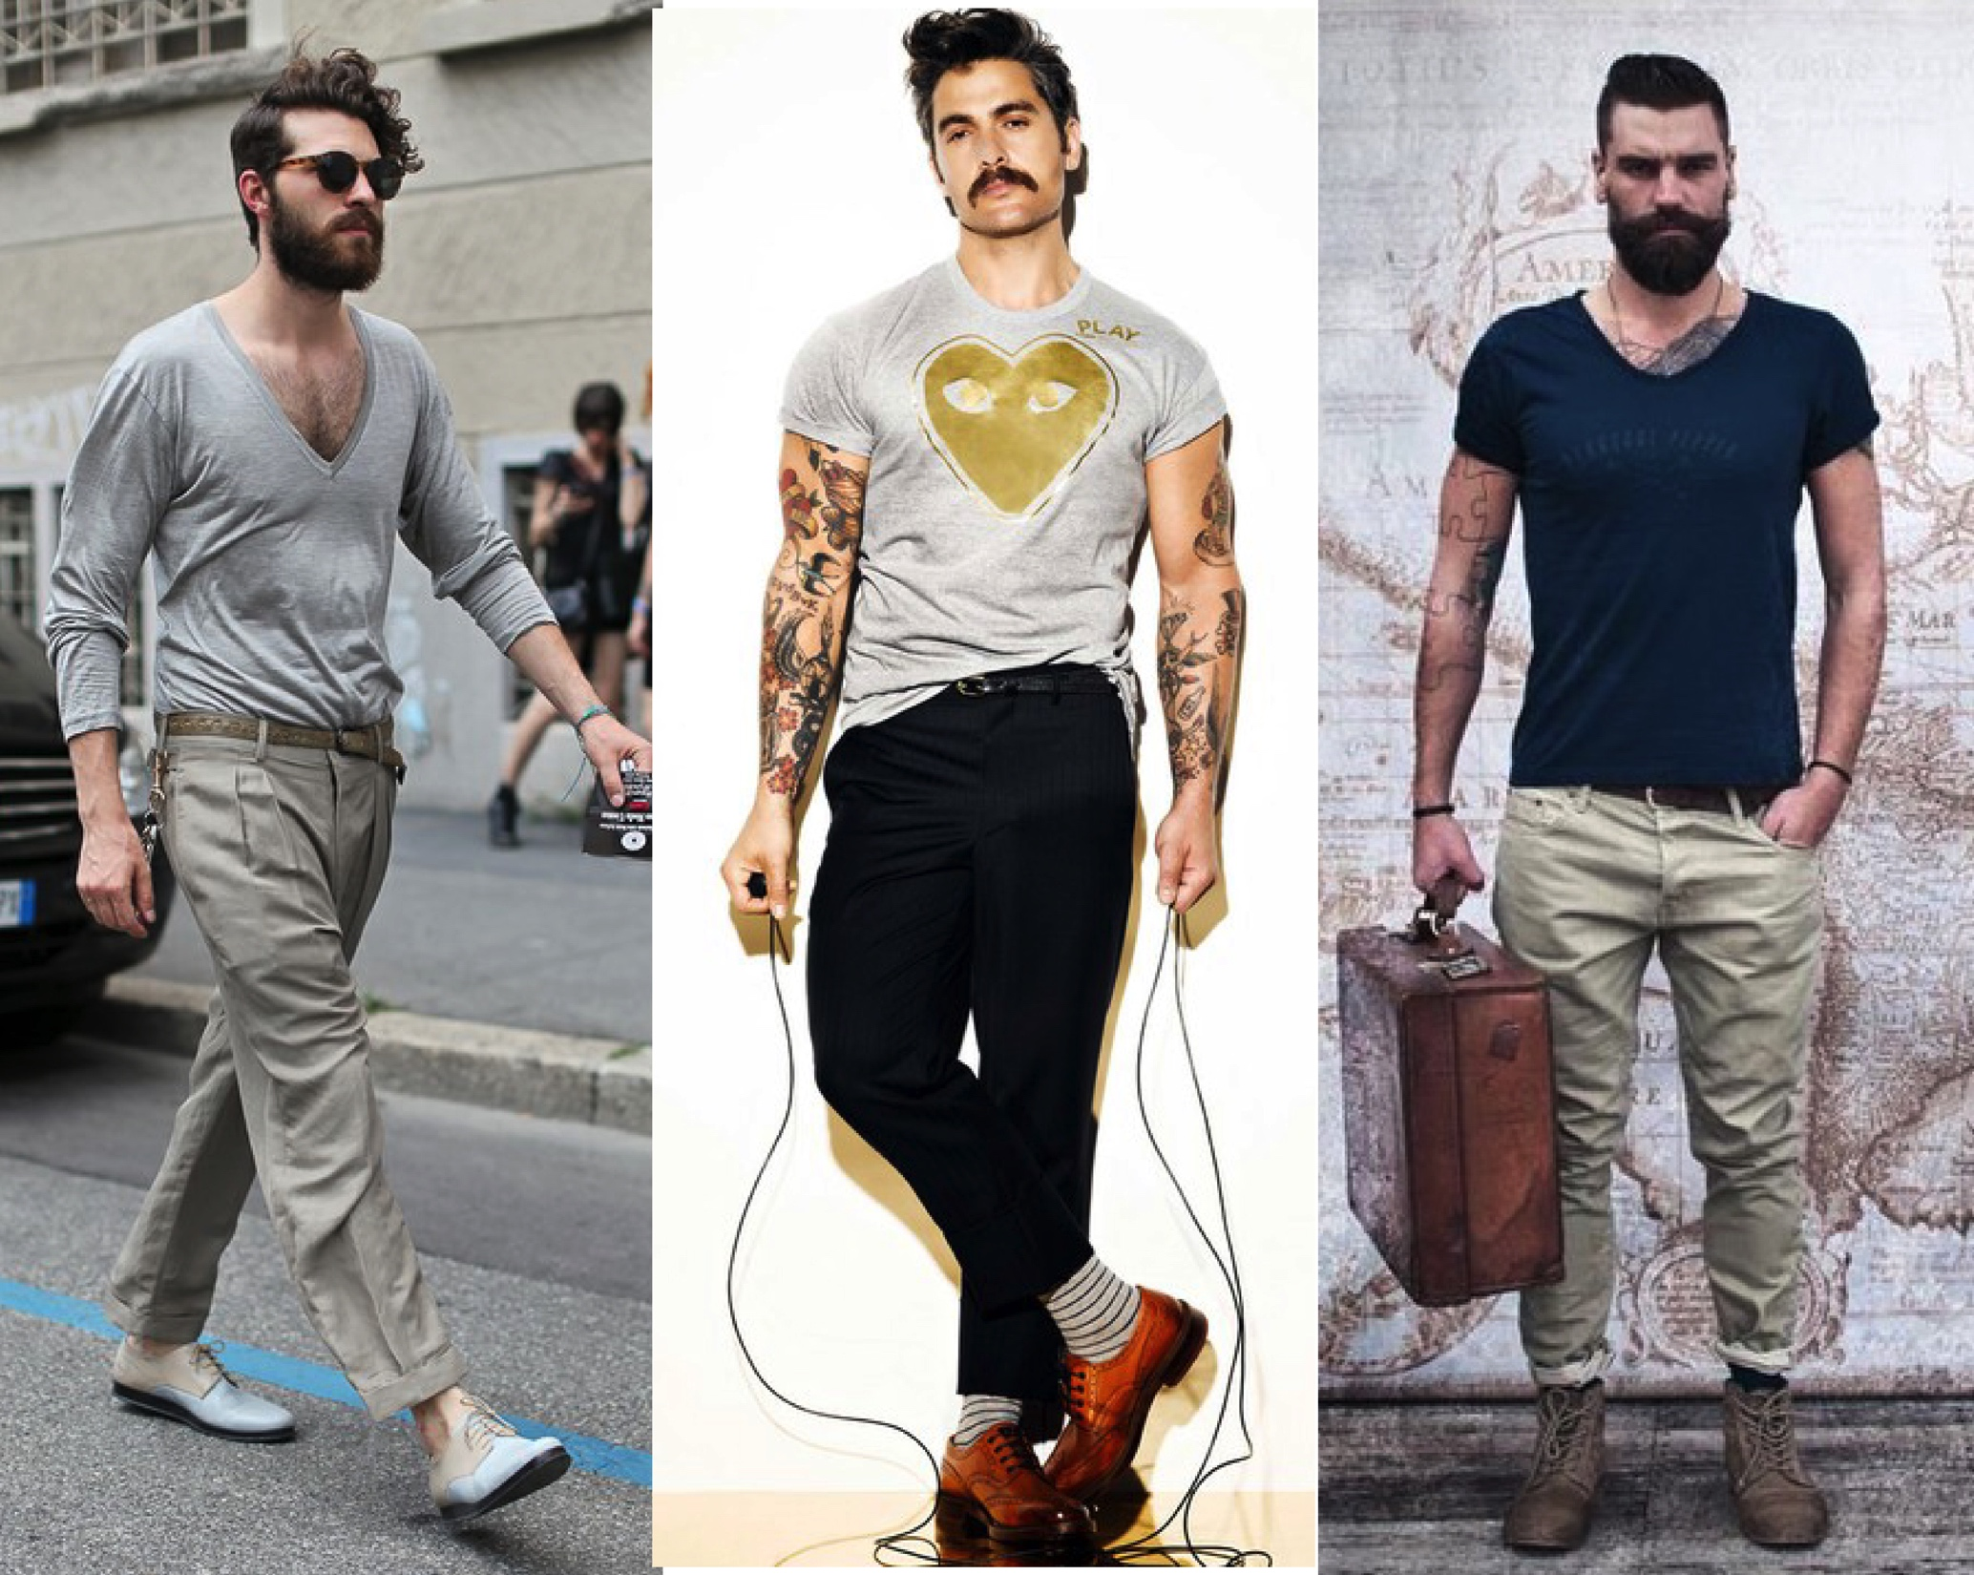
What is Style?
Style is like the way you walk, the way you talk, or the way you dress yourself.
As a writer develops, so does their style.
The sound of the language, the tone, and word choice all help convey a writer’s style.

Slide 3

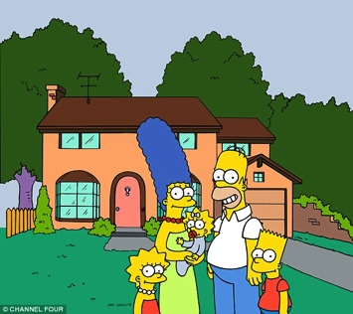
Diction (Word Choice)
Denotation is the dictionary definition of the word. It is an objective, neutral meaning.
example: House
Connotation is a subjective definition of the word. It has feelings, emotions and judgments attached
    example: Home

Slide 4
Let’s Play!
Turn to page 58 in your reader and practice expanding your diction with positive and negative connotation.
Neutral Positive Negative
Thin
Big
Smell
Old
Toilet
Died

Slide 5
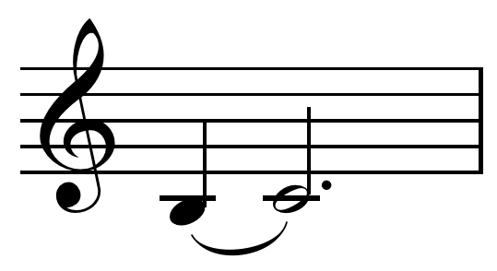
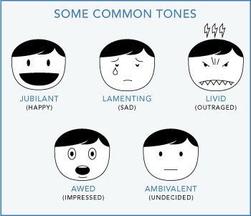
Tone

Slide 6
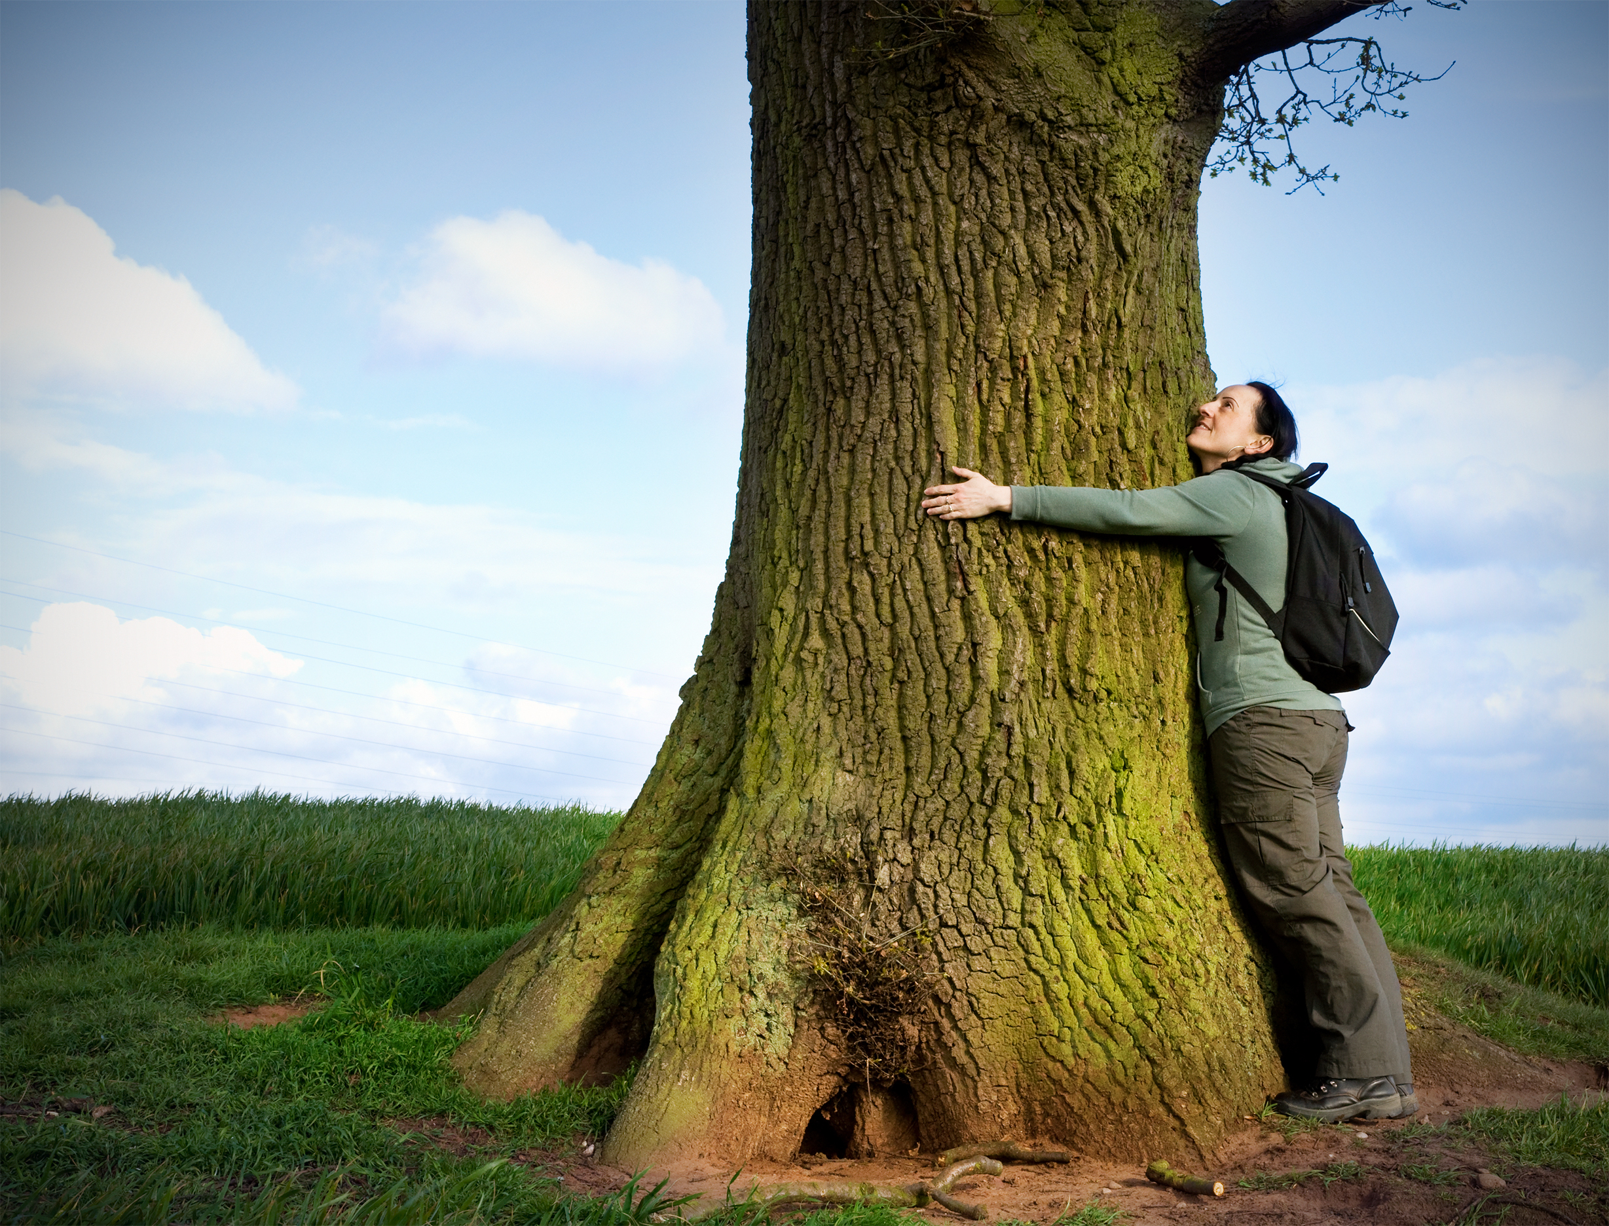
Practice
Compare the 2 articles on pages 61 and 62 of your Reader
Determine Tone for each.
Give details from the text that led you to those conclusions.

Slide 7

More Practice
Each group will receive one tone on an index card.
Write 4-5 sentences about a topic using your tone.
Don’t tell us the tone, but only use language to convey your tone and the class will try to guess your tone.
Topic: SPRING

Slide 8

Sentence Variety
Your tone can be too monotonous if you have the same sentence length and type.
Try to vary your sentences for musical interest.
https://www.youtube.com/watch?v=uhiCFdWeQfA

Slide 9
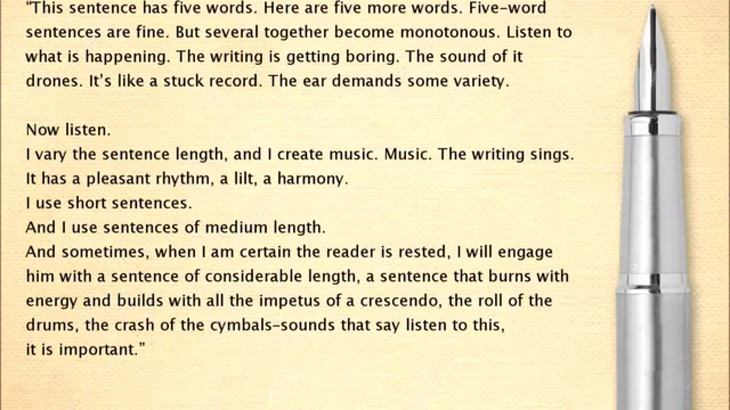

Slide 10
PRACTICE
Use your tone 4-5 sentences and add variety.
Add
1. One short sentence,
2. One long sentence
3. One medium sentence
4. One question
5. One command

