Slide 1
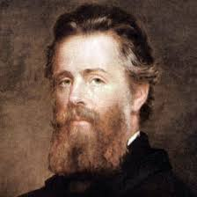
Herman Melville
Biography and “Bartleby the Scrivener”:
themes and narrative point of view

Slide 2
Biography highlights
1819-1891
Family became dependent on mother’s parents when dad went into debt then died.
Had a bunch of odd jobs, then shipped out as a cabin boy then on a whaler.
  After a year at sea, he & a friend jumped ship in Marquesas Islands near Tahiti
    Famous as “the man who lived among the cannibals”
Came back & wrote the hugely successful novel Typee, based on his island adventures followed by Omoo, also a sailing adventure.
Wanted to write more philosophical literature instead of adventure stories, so he struggled to make a living as a writer.
  Reviewers called him crazy after Pierre (about incest)
Only inheritance enabled him to keep writing.

Slide 3
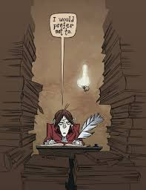
“Bartleby, the Scrivener”
Social problems: class structure
  Boss is in love with money (1158), sees others as tools
    Turkey & Nippers opposite functions
    Bartleby is machine-like (1163)
Historical problem: factory work
  Human Xerox machine, can do nothing else (1166)
    Dehumanizing work—male equivalent of spinning
      Without a personal identity (1171)
    Physical toll (1172 bottom)

Slide 4
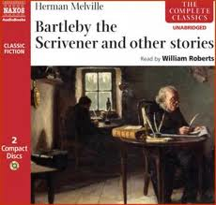
“Bartleby”
Narrative Point of View
Psychological theme: blindness & solitude
  Character can’t understand the human being in front of him (1175)
  Narrator hides as much as he is able to reveal
    Doesn’t understand himself either
      Readers get a chance to form their own opinions—we must

Slide 5
Discussion of POV
Groups consider attitude, motives, values and what might be left out of the picture (literal and figurative blindness) in these passages. In each case, continue to the end of the paragraph that the quote starts (9th ed. first; then 8th)
  “The good old office, now extinct in the state of New York . . .” (1158; 1484)
  “In that direction my windows commanded an unobstructed view of a lofty brick wall . . .” (1459)
  “His coats were execrable; his hat not to be handled. . . .” (1161; 1487)
  “Yes. Here I can cheaply purchase a delicious self-approval . . .” (1166; 1493-4)
  “I slunk away from my own door and did as he desired. . . .” (1169; 1494)
  “For the first time in my life a feeling of overpowering . . . “ (1169; 1495)
  “My first emotions had been those of pure melancholy . . . .” (1170; 1496)
  “I was now in such as state of nervous resentment . . . .” (1175; 1501)
  “Aside from higher considerations, charity often operates . . . .(1176; 1502)

