Slide 1
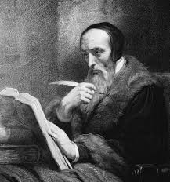
Lecture 2: Calvinism
Theology
&
Cultural Implications

Slide 2

The Five Points of Calvinism
Think of the TULIP
Total depravity
Unconditional election
Limited atonement
Irresistible grace
Perseverance of the saints (elect)

Slide 3
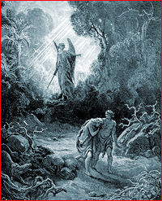
Total Depravity
Since the fall of Adam & Eve, every person is enslaved to sin.
People are not by nature inclined to love God but rather to serve their own interests and to reject the rule of God.
Thus, all people are morally unable to choose on their own to follow God because of their inherent natures.

Slide 4
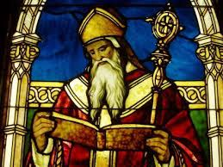
Unconditional Election
God has chosen from eternity those whom he will bring to himself not based on foreseen virtue, merit, or faith in those people; rather, his choice is unconditionally grounded in his mercy alone.
God has also chosen to withhold mercy from those not chosen.
Those chosen receive salvation through Christ alone.
Those not chosen receive the just wrath that is warranted for their sins against God.

Slide 5
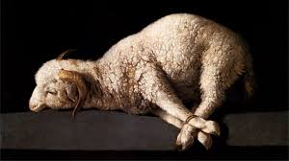
Limited Atonement
Only the sins of the elect were atoned for by Jesus's death.
While Christ’s atonement is sufficient for all sin, it is effective in offering grace only to the elect.
Since God has absolute and perfect power, he already chose those who would be saved, even before Christ was born.

Slide 6

Irresistible Grace
If you’re one of the people God has determined to save (that is, the elect), he will overcome the sin and resistance that is your nature and bring you to a saving faith.
If God wants to save you, you will certainly be saved.

Slide 7
Preservation of the Saints
The word "saints" is used to refer to all who are set apart by God: the Elect (the Puritans, they hope).
  It doesn’t refer to people who are holy, canonized, or in heaven.
Since God is sovereign and his will cannot be frustrated by humans or anything else, those whom God has called into communion with himself will continue in faith until the end.
Those who apparently fall away either never had true faith to begin with or will return to the faith.

Slide 8
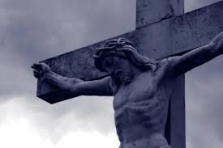
Nature of the atonement
Calvinists argue that if Christ takes the punishment in the place of a particular sinner, that person must be saved since it would be unjust for him then to be condemned for the same sins—like paying twice for the same car.

Slide 9
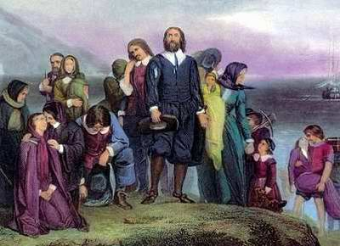
Cultural Implications
Discussion
Which part of Christianity does this theology emphasize more--God’s love or God’s power?
What might result psychologically or socially if you believe these things?
Total depravity
Unconditional election
Limited atonement
Irresistible grace
Preservation of the saints (the elect)

