Slide 1
Columbus
Some context and A reality check

Slide 2
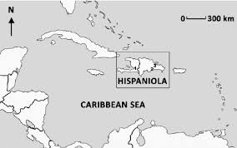
What was Hispanola like before he got there?
5 kingdoms of Taino people
Densely populated
  Estimated 500,000 to 1 million
fishing/farming villages
  No nightingales or honey bees or gold mines
  Did grow cotton, cassava, corn
Polytheists whose many gods controlled nature (like greek gods)

Slide 3
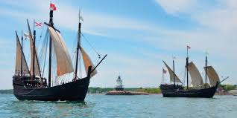
His purpose & challenges
He wanted to find a way to India and China via the Atlantic
  Inspired by the published voyages of Marco Polo
He realized fairly quickly that the Caribbean was a different place, but had no clue how far away he was from China
King Ferdinand and Queen Isabella’s promise: he would be given the rank of Admiral of the Ocean Sea and appointed Viceroy and Governor of all the new lands he could claim for Spain.
  He would be entitled to 10 percent of all the revenues from the new lands in perpetuity.
He was supposed to return with a great wealth for his patrons and backers
  His men were also mercenaries, soldiers used to making most of their ”salary” through spoils of war
  He couldn’t control them and others plotted against him back in Spain.

Slide 4
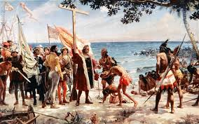
Problematic Assumptions
The obvious: his right to claim the land and inhabitants by proclamation
The superiority of his race and culture (religion, government, intellect)
That land so “claimed” could be said to “obey” the Spanish royalty (52).
That he bore no responsibility for the disaster in Hispanola
  He kidnapped a bunch of Taino people and brought them back to Spain (7 survived)
Other assumptions?

Slide 5
What brought him so low?
Accusations of cruelty reached spain, and the King & Queen sent a new governor to investigate (Bobadilla).
A 46 page report describes using torture and mutilation to govern
  According to the report, Columbus once punished a man found guilty of stealing corn by having his ears and nose cut off and then selling him into slavery.
  his brother ordered a woman paraded naked through the streets and then had her tongue cut out for suggesting that Columbus was of lowly birth. ⁽and he is)
  Columbus put down native unrest and revolt by slaughtering them and parading their dismembered bodies through the streets to scare others.
Columbus and his brothers were arrested and imprisoned upon their return to Spain from the third voyage.
  They sat in jail for six weeks before King Ferdinand ordered their release.
the royal couple heard the brothers' pleas, restored their freedom and wealth, and, after long persuasion, funded Columbus's fourth voyage.

Slide 6
How does that report compare to the tone in the letters?
glowing, emphasizing the beauty and ease of the life (46)
Says over and over how easy it’s going to be (45)
Exaggerates the wealth and size of the islands ((48)
claiming the purest unselfish motives (then reminds the crown of his original contract for 10% of everything). (51)
Blames others, “weeping” about how the islands were ruined. (51)

Slide 7
Discussion: Columbus
Take a page and analyze rhetoric. Find at least three of these:
  Words and phrases that imply possession/control
  Objectification, commodification
  awe
  superiority
  Blame
  Sucking up
  Begging
  humility
  lies

Slide 8
Compare to De las Casas
The report listing all Columbus’s offenses was produced by the person who took over his job.
  Not the most objective critic since he profited from discrediting Columbus
But De Las Casas did not profit personally, and in fact was ridiculed, criticized
  Like American abolitionists later, like the defenders of immigrants and prisoners now
  He avoids attacking particular people and instead attacks slavery

Slide 9
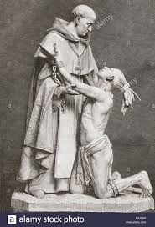
Discussion: De las Casas
Groups: Read selections from De las Casas “Devastation of the Indies”
What’s the most important detail in your section? What was his purpose?
Write: Why include this in American Lit?

