Slide 1
Shakespeare’s Comedies
tricks and targets

Slide 2
Definition: review
A play of Shakespeare’s time was called a comedy if it had a happy ending, and generally that meant a marriage.
Shakespearean comedy is not all about laughs, although it can be unbearably funny.
It may also involve some very dark or violent storylines.

Slide 3
Common Characteristics
A struggle of young lovers to overcome problems, often the result of the interference of their elders
There is some element of separation and reunification
Mistaken identities, often involving disguise
  usually a marker for farce
A clever servant (fool)
Family conflicts that are usually resolved in the end
Complex, interwoven plot-lines

Slide 4
Clowns and Fools
A Shakspearean fool usually is named “fool” and has the job of providing witty commentary that brings the powerful down a peg and also gets money out of them. They break boundaries of rank, have complete liberty of speech.
  Feste in Twelfth Night works for Olivia as a fool, and entertains all with his explanations about why things are really the opposite of what they appear. (3:1)
Clowns are everywhere (ain’t it the truth). Any character can play a clown part if he/she does idiotic things with little to no self-awareness.
  Sir Andrew Aguecheek, Sir Toby Belch
  Bottom is a clown in Midsummer Night’s Dream

Slide 5
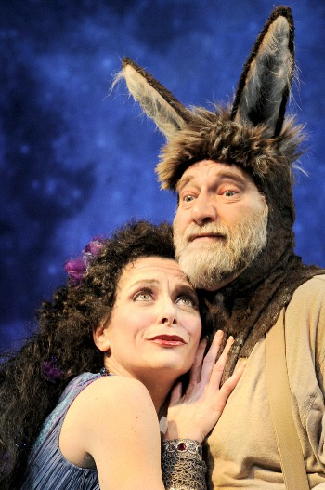
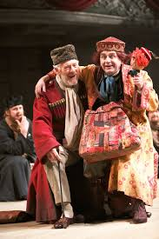
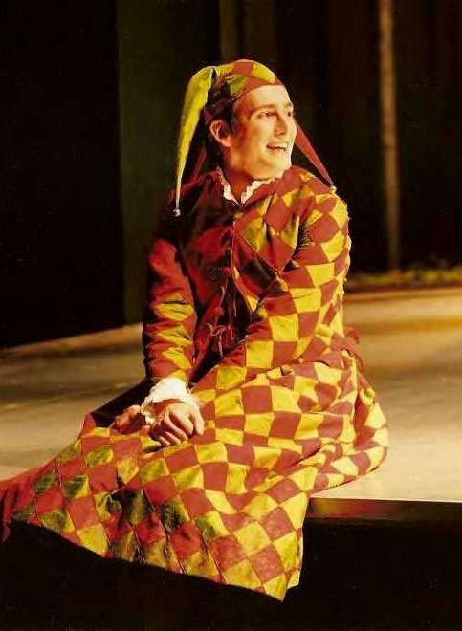
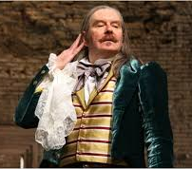
Fools VS Clowns

Slide 6
Comedy And Elizabethan Society
Comedy is serious business, and does important work in a culture
Laughter is a way of coping with something uncomfortable. People never laugh at anything that’s simply “nice”.
  Example: adultery is categorically, hysterically funny in Shakespeare’s time—why?
    In a culture where ”legitimate” offspring are essential and control of women’s bodies is like a religion, everyone’s screwing around.
Laughter recognizes “the difference between what things are, and what they ought to be”; “The . . . laughable then is the incongruous, the disconnecting one idea from another, or the jostling of one [contrasting] feeling against another.” (William Hazlitt)
We laugh at the disconcerting sight of a person losing the elasticity of humanity, becoming a mechanism, a thing, ‘something mechanical encrusted on the the living.’ (Henri Bergson)
  Think of Malvolio, who has no relationship to others except through his social ambition.

Slide 7
Marriage—why such a focus?
Marriage = a source of intense anxiety and desire; it’s both comforting and oppressive
  Characters want marriage, and fear it; they need to find their parents, and to escape from their parents.
The anxieties on which comic laughter plays are social anxieties:
    the need for money, security and social position, and the fear that the pursuit of such needs is dehumanizing.
  So the order affirmed in the traditional ending is social – marriage, the family, the rule of law
Comedy has a built-in contradiction between laughter and the happy ending
  Laughter = anxious, unsettled, contradictory; Happy ending = “nice.”.

Slide 8
Twelfth Night: mirrors and social Isolation: another layer of social Anxiety
Many images of solitude:
  Malvolio in his fantasy world and then in his dark prison
  Viola describing her “sister’s” unrequited love (II.iv.110–15)
    Each is a mirror image of self: Malvolio’s only relationship is with his own image, practicing behavior to his shadow, Viola in describing her sister’s loneliness is really describing her own.
    The “true” self and real relationship to others is lost.
Isolation ends for Viola when her twin brother Sebastian appears on stage with his sister
  Sebastian speaks Viola’s name, and the mirror becomes the other; relationships restored. The lovers are freed from the solipsistic world of mirrors.
Is there a possible resolution for Malvolio, a way he can be welcomed into the fold? If not, why is he excluded?

