Slide 1
Huckleberry Finn
The Raft on the Mississippi and the Ship of State

Slide 2
1840s and 1880s America
Two historical contexts for the novel
Slavery & Post-Reconstruction America mirror each other
    You can read the novel as an Allegory of the nation’s race problems
        an allegory is an extended metaphor where for a whole story or poem or novel, everything that happens comments on a parallel issue
      In the 1840s the nation let slavery swallow up more and more states and territories
      this is really a sort of metaphor for Twain’s time:
  In the 1880s the nation let the south go along, stripping African-Americans of their rights and setting up slavery substitutes.
    Remember some from week 1?
      Convict lease system, sharecropping, vagrancy laws, Jim Crow, KKK

Slide 3
Twain’s Allegory
Philosophical focus
  Not tied to specific political developments or laws like the Missouri compromise or the Fugitive Slave acts.
  Twain asks “what’s the over-arching cultural problem here?”
    Answer: the deadly hypocrisy in the nation’s refusal to be direct and honest about slavery then emancipation
      The book brings this to light, esp the second half

Slide 4
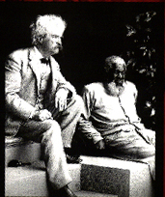
  Why see it as an allegory for the Nation?
Huck and Jim are the two most battered figures after the war—poor white and former slave
    There’s a lot at stake for the country in these 2 figures finding common cause
Loss of identity in the novel
    A national problem and a problem of slavery
      Who’s your father if you’re a slave child?
        Huck & Jim after the fog ask “who is I?”
          Because Huck denies him his memory (a condition of slavery)

Slide 5
Huck and Jim Similarities
Both abused and exploited figures
  Both stripped of family
  Both whipped, locked up, forced to work, looked down on with pity and contempt
    This is true in reality as well (of poor blacks and whites), but instead of making common cause, the poor whites of the south focused on their loss of phony status
  They fell into some of the same traps as former slaves
    Convict lease system and sharecropping
If they can recognize that they are in the same boat, the South can move forward and offer real freedom and reconciliation.
  What prevents that recognition?
    Somebody thinking their better because of their “birth right”, their divine right of superiority

Slide 6
King And Duke
What does Huck think of them?
    “Better just go along”--the mistake the country made
      White Southerners AREN’T really better than African-Americans, and have no right to any priviledges or denying same to Blacks, but the whites will make a fuss if we confront them, so let’s just smooth it over.
The contempt Twain felt for these guys is almost blinding, it’s so intense.
      Other characters are gently teased (the Widow, for example),
  King & Duke have no redeeming qualities
    no guilt, no sense that others are people.
  They are the embodiment of phony superiority of birth

Slide 7
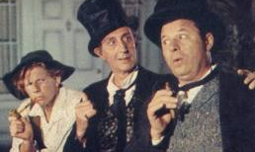
King and Duke hatch a scheme
Notes:
1957 film version

Slide 8
The Ending:
What Went Wrong?
Darkness gathers in the second ½ of the novel
    As they go down river, we go back in time—to the civil war, then to the heart of slavery.
  Parallel to nation’s slavery problem
    Jim thought he could get to a free state, but the “ship of state” drifts further and further into slavery—like the nation pre-civil war
  Civil War portrait in the Grangerford/Shepherdson battle
      201 Sounds like Twain’s own experience of the civil war
      Whipping up an unnecessary conflict
      Brother against brother for an idea that nobody understands

Slide 9
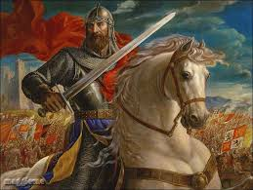
Twain thought Sir Walter Scott’s novels showing war as “chivalry” prolonged and added insanity to the Civil War

Slide 10
The Nation of Tom
Huck pretends to be Tom and betrays everything he has learned with Jim
    Gets enlisted into Tom’s crazy world and rules where we must all believe romantic ideas about nobility, chivalry, and the adventure of war
    Tom causes a battle over Jim’s escape and is badly wounded
      Like the lunacy of the civil war? Slavery was winning in the courts, winning most of the new territories, gaining protections even in “free” states. Why whip up a conflict?
Huck lets himself be used in the power system of a richer white person
    Poor white suckered by the romantic mythologies that serve only rich whites who exploit them
    Jim has been free all along—has been a person entitled to freedom from the beginning (Miss Watson’s will)
      Like the country said—oh you’re free on paper, but that doesn’t make any difference in how we treat you.

Slide 11
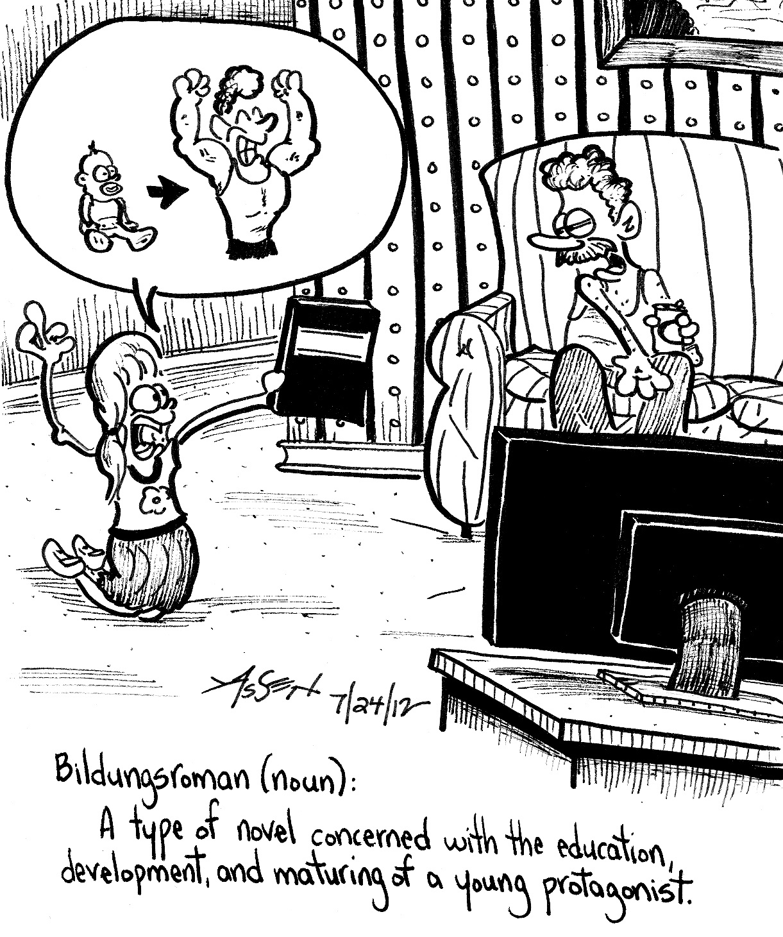
Other Interpretive Approaches
Also simply a bildungsroman—education novel.
What marks Huck as a child in the beginning?
How has he matured?
Is he an adult at the end?
How would the book define that?

Slide 12
Write 5 min
So far, which approach seems most appealing or interesting to you & why? Give 3 reasons
National allegory for post-war race problems
Theme of orphaning and loss of identity
Bildungsroman (coming of age story; the “education” of a young person)
Your own blend or new focus

