Slide 1
Edgar Allan Poe
Biography, Methods, The Gothic and Psychological Perspectives

Slide 2
A Difficult Life
Born 1809 to traveling actors
  Father abandons mother shortly after he’s born
  Mother dies of consumption (tuberculosis) when he’s 2
The Allans, a wealthy Virginia family take him in
  Never legally adopt him
  Sent him to good schools in England
  Went to U. of Virginia
    kicked out due to gambling debts Mr. Allan wouldn’t pay
  Joined the army; does well & got in to West Point
Mrs. Allan dies of consumption
    Hopes the rich Mr. Allan will support his studies at West Point
    Mr. Allan remarries and cuts Edgar off.
      Gets himself kicked out of West Point too (probably on purpose)
Edgar has a strong career as a writer, editor and critic
1836 he marries his 13 yr old cousin Virginia, who dies of consumption in 1847
    3 important women in his life die of consumption before he’s 40.
    Really goes downhill & more drinking binges
Found unconscious in a Baltimore ditch in 1849 & dies in the hospital

Slide 3
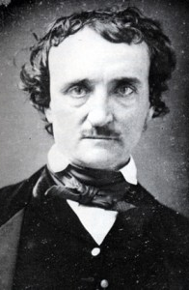
His Approach to Poetry*
Beauty is the province of poetry
Sadness is the most beautiful tone
The saddest thing is death
  Death of a beautiful woman = best theme
Poetry is created through crafting sound and ideas (rhyme, repetition, meter, etc), not divine inspiration
  A refrain is important for the music of a poem
  A repeated word should accrue meaning throughout the poem
    *From: The Philosophy of Composition, 1846

Slide 4
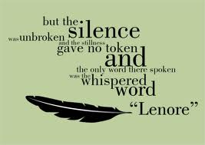
That looks a lot like “The Raven” and his life
He’s the student/writer at midnight thinking about a woman he has lost
  His dead young mother, stepmother, wife
Repetition of “Nevermore”
  Death is irrevocable, will never leave him

Slide 5
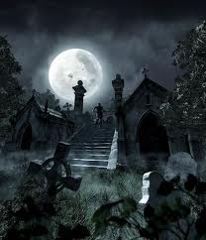
The Gothic
Earlier Romantics tended to ignore the “dark” side of human nature and human existence
  Transcendentalists presumed humans were by nature good
Gothic writers use many of the approaches of romantics
  Sublime in nature, aristocratic & sensitive characters, exotic locations
Gothic texts focus on topics neglected by Romantics
  Death, crime, violence, disease, the “macabre,” insanity, etc.
    Dracula, Frankenstien, Poe

Slide 6
Poe and Psychology
His own biography suggests a struggle with inner demons and a sense of divided self
  Crushing, repeated orphaning
    Self-loathing & abandonment
  Battles addictions: alcohol & gambling
    Tries to quit & relapses many times
    His own honor code punishes him for gambling debts and alcoholic scenes
      Very smart & very stupid, like many of us
Many stories create doubles where one must kill the other
    In William Wilson two guys have the same name, birthdate, voice & the bad version kills the good one
We could treat the horror as urban sociology, showing the reality of crime, but these stories feel more psychological than sociological
  The stories focus on the interior, not social circumstances or context
  Drive is toward terror, not analysis or explanation

Slide 7
“The Fall of the House of Usher”:
Collapse of the diseased mind
The house = the mind.
    All the locations within the house correspond to the locations of the qualities of the mind in phrenology as if the the house were a skull
      (R.’s study = Ideality; Madiline’s vault = sexuality, etc)
    It’s not just Roderick’s mind, but the Usher mind broadly, because Madeline is also part of that consciousness.
    She and her brother are twins, different components of the same psyche.
    Roderick is hiding something—incest or “inbred” origins
      When he buries her, he is burying his secret
    Incest also a metonymy for the House's isolation from the rest of the world
      Roderick is unable to establish relations with a true Other, with what is not Usher
The Usher Mind also represents the Artistic Mind
    Overly developed in some areas, possibly to morbidity.
    Too sensitive, too cautious to act in the world
      He fears for himself

Slide 8
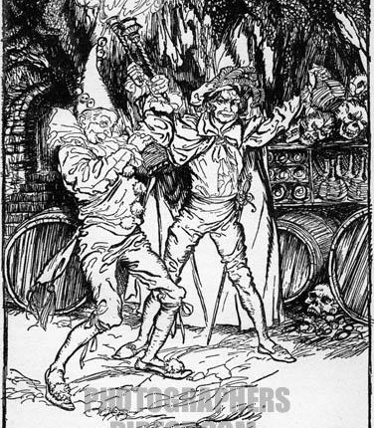
“The Cask of Amontillado”:
Killing off your double/weaker self
Names are equivalent: Fortunato = Montresor
One is drunk, sick, foolish, physical, compulsive (716)
The other is clever, urbane, manipulative (716)
  He can’t stand the other half of himself (like Poe?)
    The Montresor coat of arms (717)
Text is full of puns
  Another form of doubling
    Grave, masons (717)

Slide 9
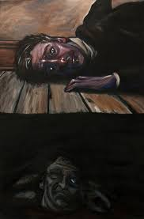
“The Tell-Tale Heart”:
The Father/King Must Die
No motive, supposedly (619)
Since Oedipus & Freud, cutting out the eye = castration
  Can’t stand being seen by the authority figure (Mr. Allan?)
He shines the ray of his lamp on the “Damned Spot,” his eye (693)
  Reference to Macbeth
Can’t really get rid of the King/father
  Heartbeat reveals all (964)
    It’s his own, of course
Trying to kill off his own internalized, loved and hated father?

Slide 10
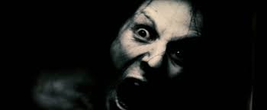
How does Horror Film/literature Function in Society?
Popular culture films like Aliens, Vampire, Zombies etc.
  A place to experience and re-contain social fears and losses:
    Contagion, alienation, insanity, out-of-control science, etc.
What fears/issues do we share with the 19th century?
What has changed?

