Slide 1
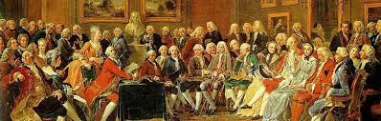
Franklin and Paine
Enlightenment and Revolution in the Colonies

Slide 2
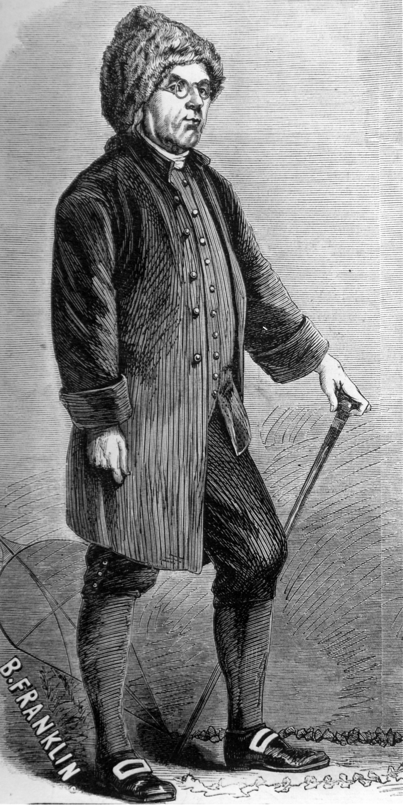
Benjamin Franklin
Born in Boston 1706
10th son of 15 children
Apprenticed at 12 to his brother, a printer
Set up his own printing business
just as demand for printed material
skyrocketed in the colonies.
At 24 he was sole owner of the
Pennsylvania Gazette
Prominent as a publisher, writer,
inventor, scientist, and statesman
Notes:
Illustration of Benjamin Franklin (1706–1790), American philosopher, author, and scientist, wearing a fur hat and holding a walking stick.
Benjamin Franklin was born in Boston, the tenth son in a family of fifteen children. “[W]hen Benjamin was twelve he was apprenticed to his brother, a printer. He must have been a natural student of the printing trade; he loved books and reading, he learned quickly, and he liked to write. . . . In 1723 Franklin broke with his brother and ran away to Philadelphia. . . . [Franklin’s career as a printer came] at the very time when the colonies’ print culture experienced a remarkable upsurgence that marked a period of increasing dependence on the printer as a disseminator of information. Franklin, ever an astute businessman, turned this to his advantage” (NAAL 455–56).

Slide 3
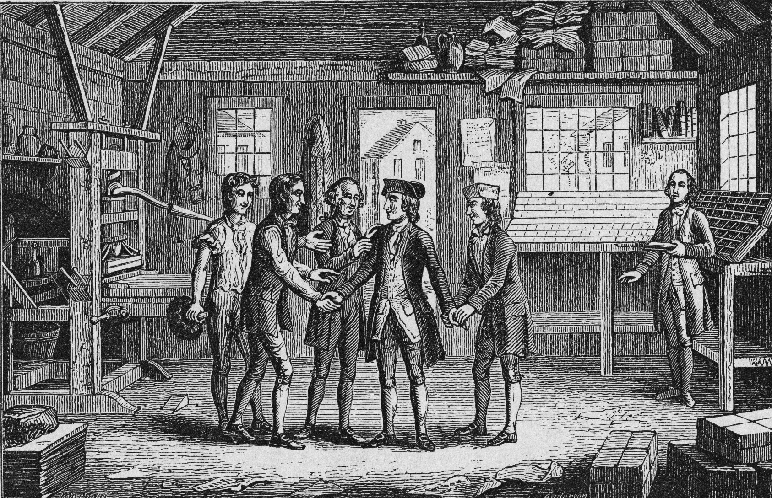
Franklin the Printer
Notes:
Benjamin Franklin in an engraving entitled, Benjamin's Visit to James's Printing Office, ca. 1800. In 1718, 12-year-old Benjamin Franklin was apprenticed to his brother James, a printer in Boston, Massachusetts who had started the New England Courant in 1709.
“By the time he was twenty-four he was the sole owner of a successful printing shop and was editor and publisher of the Pennsylvania Gazette” (NAAL 456).

Slide 4
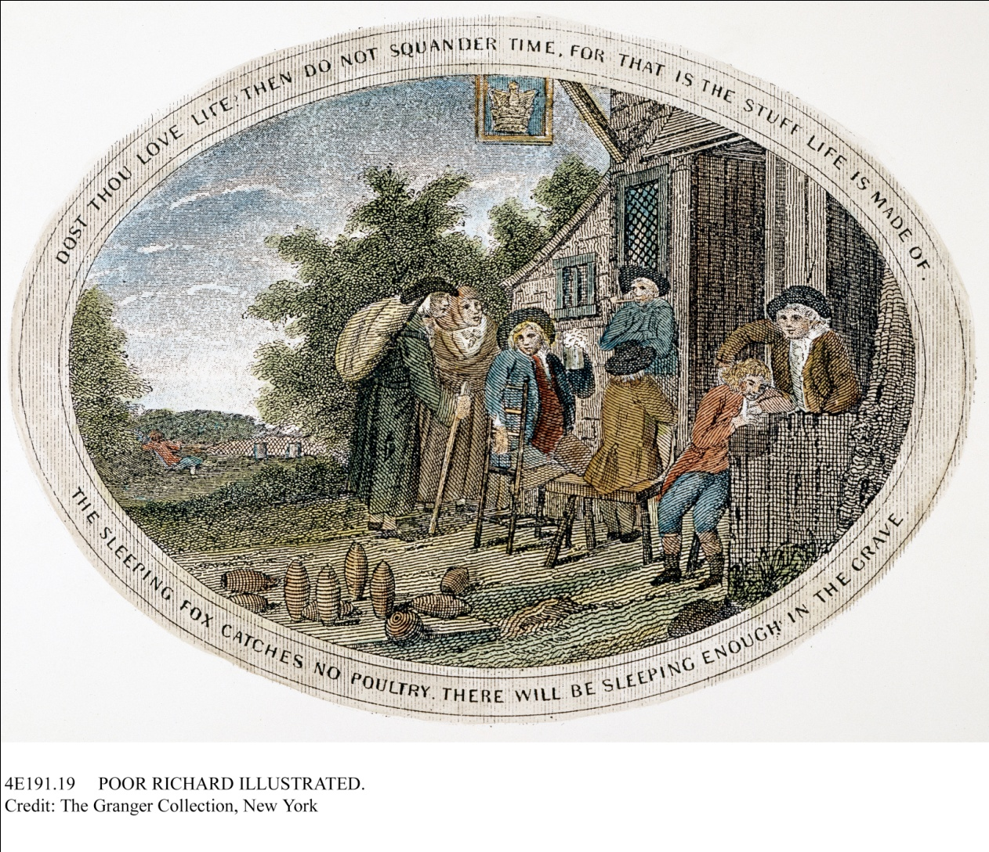
Poor Richard’s Almanac
Started 1733
Notes:
Panel from an engraving for Benjamin Franklin's Poor Richard’s Almanac, with the motto "Dost Thou Love Life? Then Do Not Squander Time, For That Is The Stuff Life Is Made Of." Ca. 1800.
“He offered his Poor Richard’s Almanac for sale in 1733 and made it an American institution, filling it with maxims, most of which he coined himself, for achieving wealth and preaching hard work and thrift” (NAAL 456).

Slide 5
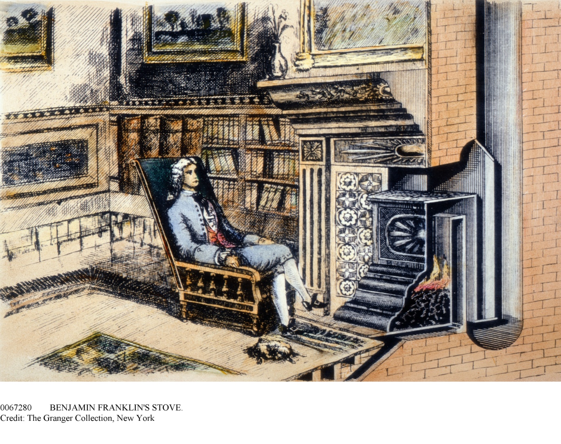
Franklin the Inventor
Notes:
Franklin's famous stove, designed just before he began his electrical experiments. The important feature was the flue, which doubled back and formed a sort of radiator. The stove was redesigned by David R. Rittenhouse and was in wide use by 1795.
“Before he retired from business at the age of forty-two, Franklin had founded a library, invented a stove, established a fire company, subscribed to an academy that would become the University of Pennsylvania, and served as secretary to the American Philosophical Society. It was his intention when he retired to devote himself to public affairs and his lifelong passion for the natural sciences, especially the phenomena of sound, vapors, earthquakes, and electricity” (NAAL 456).

Slide 6
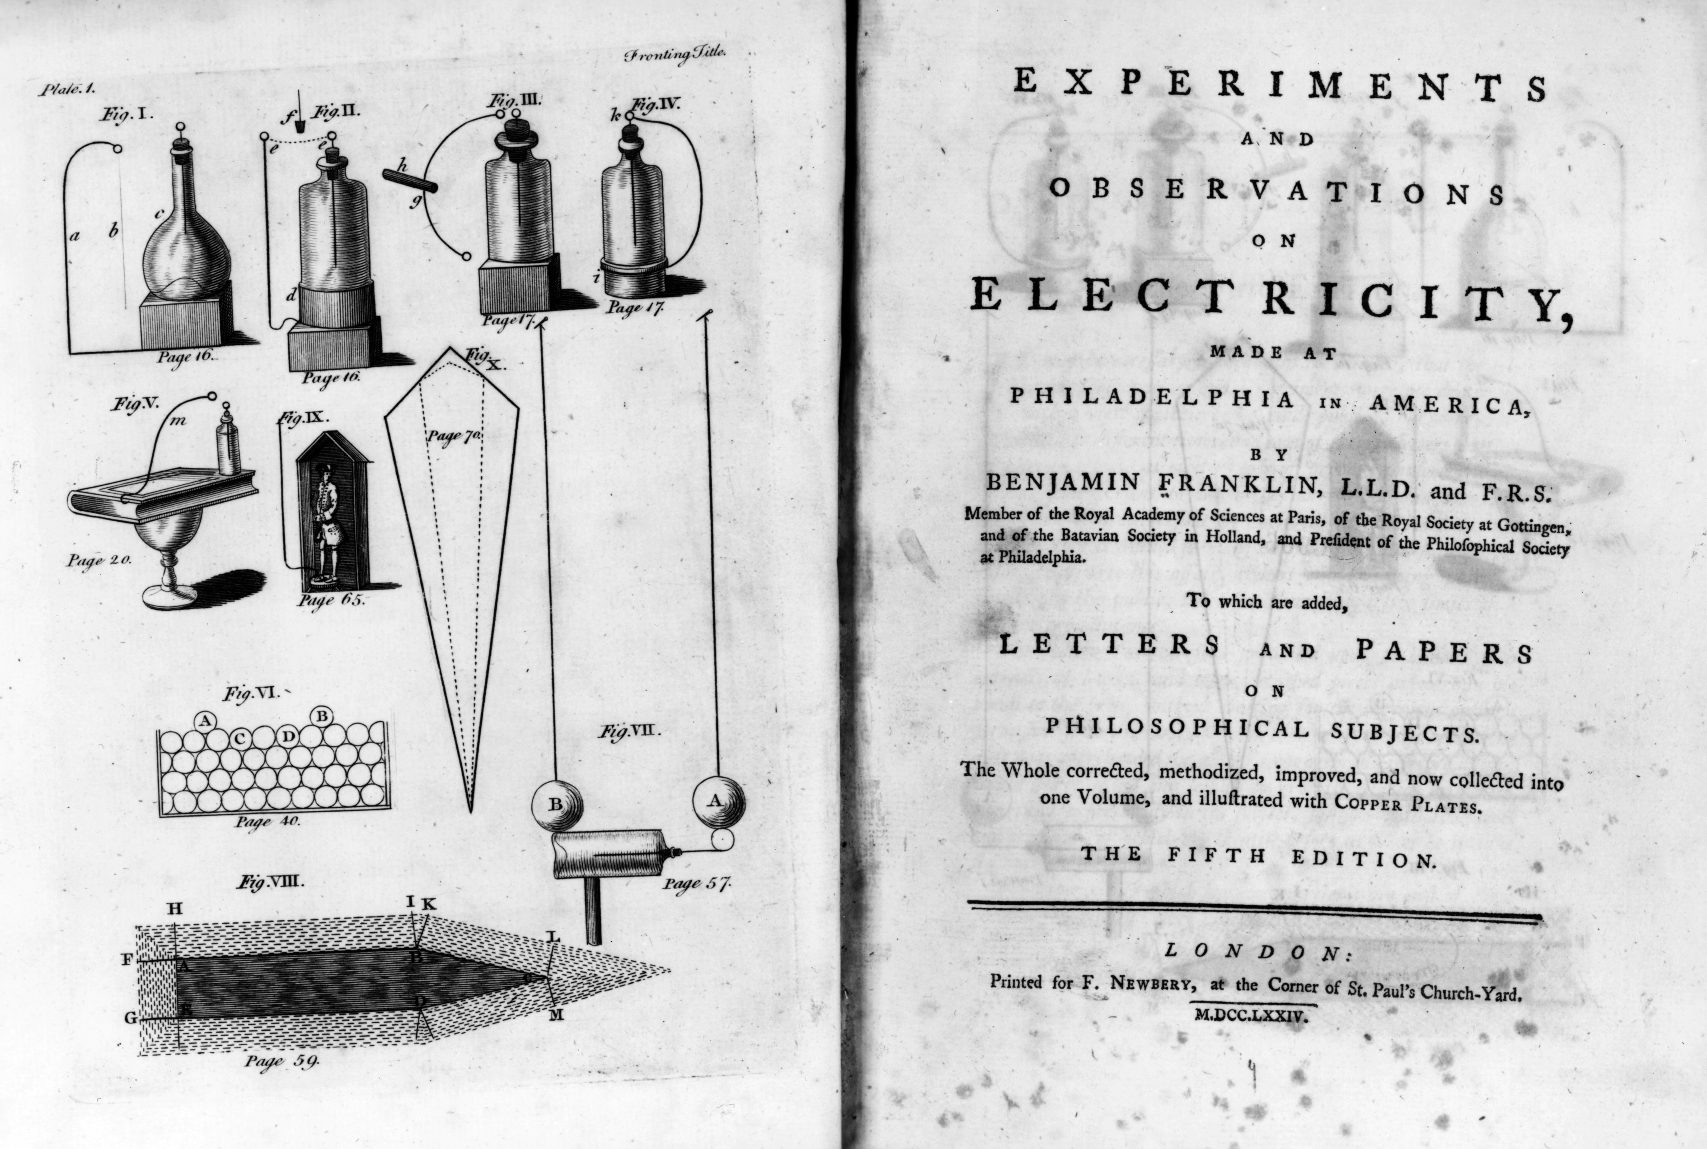
Franklin the Inventor
Notes:
The title page from the 5th edition of Benjamin Franklin's scientific book Experiments and Observations on Electricity, ca. 1750. The book was published in London in 1774, 23 years after it was first published in America.
“Franklin’s observations on electricity were published in London in 1751 and, despite his disclaimers in the Autobiography, won him the applause of British scientists. Science was Franklin’s great passion, the only thing, the American historian Charles Beard once said, about which Franklin was not ironic” (NAAL 456).

Slide 7
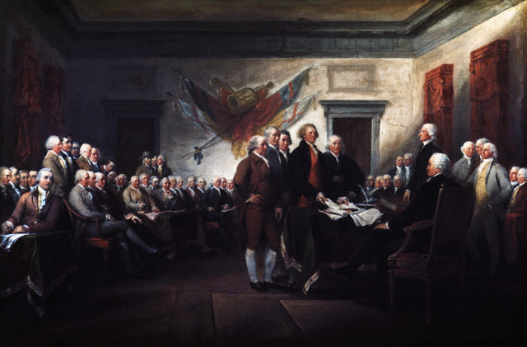
Franklin the Statesman
Notes:
John Trumbull, Declaration of Independence, 4 July, 1776. Ca. 1786–1819.
“Franklin’s remaining years, however, were spent not in a laboratory, but at diplomatic tables in London, Paris, and Philadelphia. . . . [H]e was chosen as a representative to the Second Continental Congress, and he served on the committee to draft the Declaration of Independence. In October 1776, he was appointed minister to France, where he successfully negotiated a treaty of allegiance and became something of a cult hero” (NAAL 456).

Slide 8
The Autobiography
1. TEMPERANCE.
Eat not to Dullness. Drink not to Elevation.
2. SILENCE.
Speak not but what may benefit others or yourself. Avoiding trifling Conversation.
. . . . .
5. FRUGALITY.
Make no Expense but to do good to others or yourself: i.e., Waste nothing.
6. INDUSTRY.
Lose no Time. Be always employ’d in something useful. Cut off all unnecessary Actions.
. . . . .
12. CHASTITY.
Rarely use Venery but for Health or Offspring; Never to Dullness, Weakness, or the Injury of your own or another’s Peace or Reputation.
13. HUMILITY.
Imitate Jesus and Socrates.
Notes:
Franklin’s most significant contribution to American literature was his autobiography, which he wrote between 1771 and his death in 1790. The Autobiography allows us to chart a transition from the Puritan tradition to the Enlightenment and beyond. What could be shocking about Franklin, from the point of view of a fervent New England Puritan, is his breezy acceptance of unreconciled conflicts and discontinuities in his own system of values. The Puritan quest for complete integrity among all of one’s words, public actions, private life, and cherished principles is replaced by a quest for maximum worldly effectiveness and exemplary citizenship—and the condition of the soul seems to have little to do with his plan. One can begin with a look at the famous rules that he lays out for himself in The Autobiography as a method for achieving a kind of perfection. With delight, students will notice the hedge about “venery”—to be used “rarely” for purposes other than “health or procreation,” meaning that it’s okay to go on a tear once in a while, provided you do it discreetly and don’t disturb others. And they may jump at the paradox inherent in trying to “imitate” both “Jesus and Socrates,” as if there were no differences between these moral models and as if such “imitation” weren’t in itself a problem in trying to achieve “humility.” When Franklin encounters such dilemmas (as he does here), he escapes with a wink and a joke.

Slide 9
The Autobiography
“I made a little Book in which I allotted a Page for each of the Virtues. . . . marking the Beginning of each Line with the first Letter of one of the Virtues, on which Line and in its proper Column I might mark by a little black Spot every Fault I found upon Examination, to have been committed respecting that Virtue upon that Day.”
Notes:
What similarities and essential differences can we see between Franklin’s “Project of arriving at moral Perfection” and the Puritan practice of rigorous introspection and meditation? Franklin writes that “daily Examination would be necessary,” and he uses a “little Book,” duly lined, “on which Line and in its proper Column I might mark by a little black Spot every Fault I found upon Examination to have been committed respecting that Virtue upon that Day.” What is familiar about this practice—and what makes it radically new?

Slide 10
The Autobiography
“I grew fond of her Company, and being at this time under no Religious Restraints, and presuming on my Importance to her, I attempted Familiarities, (another Erratum) which she repuls’d with a proper Resentment, and acquainted him with my Behavior.”
“Mr. Vernon about this time put me in mind of the Debt I ow’d him: but did not press me. . . . as soon as I was able I paid the Principal with Interest and many Thanks. So that Erratum was in some degree corrected.”
Notes:
Students will have much to say about that as an intellectual and moral strategy and about whether or not a Puritan thinker would ever allow himself or herself an evasion of that kind. Franklin’s life and his “instruction” through The Autobiography transform daily routine into something resembling a religious practice. Practical life itself seems to become his secular or deistic “religion,” governed by precepts, self-discipline, and a consistent desire for worldly self-improvement, so that Franklin’s work can be seen as both deriving from Puritan religious method and reacting against it. You might need to make clear that materialism and greed evidently aren’t the motives that propel Franklin but an assumption that civic, intellectual, scientific, and charitable action constitute the only self worth caring about and the only self that the Almighty (who Franklin imagines as somebody much like himself—busy, intellectual, reasonable, benign, undogmatic, and forgiving) cares about either. Students will have fun considering the implications of Franklin’s use of the word “erratum” in describing moral failings and his refusal to use the word “sin.”

Slide 11
Franklin in context
What do you see in Franklin that reminds you of Enlightenment ideals? In what ways does he adapt what he calls the “Age of Experiments” to political and personal life?
Is there something about his list of virtues and focus on service that harkens back to Puritans?

Slide 12
What sparked the revolution?
Philosophical
  Enlightenment thinkers debunk many traditional ideas, including divine right of kings
Legal
  British declaratory Act 1766
  Local governments/elections could be declared null
  No representation in Parliament in England
Practical
  Harassment by British soldiers who forced people to house & feed them
    Boston Massacre 1770
  Taxes & trade restrictions
    Tea party 1773

Slide 13
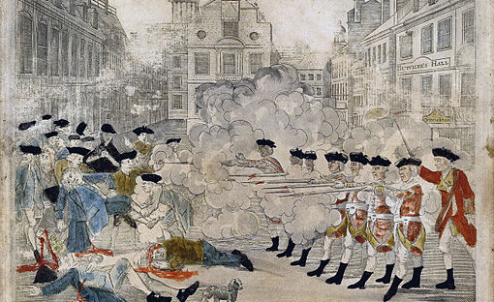
Boston Massacre 1770
Notes:
An engraving by Paul Revere depicting events.

Slide 14
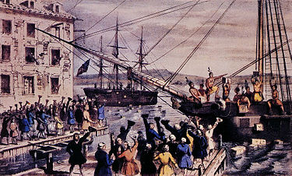
Boston Tea Party 1773

Slide 15
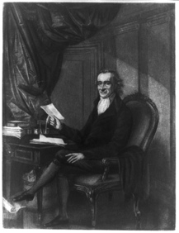
Thomas Paine
John Adams said, "Without the pen of the author of Common Sense, the sword of Washington would have been raised in vain.”

Slide 16
Key moments in Paine’s Bio
Born 1737, the poor son of a corsetmaker in England
  Runs away as a teenager, but comes back and goes to work on the corsets & later works for the gov’t as a tax collector.
  Gets married, she dies in childbirth
  Remarries, later divorced (maybe due to indiscretions)
Arrives in America 1774, age 37 with a letter recommending him to Ben Franklin
  Franklin puts him to work as a journalist
  Volunteered in the revolutionary army
  Got donations and loans from France to fund the revolution (French king hated England)
Floundered later in life
  Harshly criticized Christianity in a very devout time
    7 people came to his funeral & nobody knows where his bones are

Slide 17
Paine’s Ideas
Political:
  A utopian image of an egalitarian, republican society
    combined civic republicanism, belief in the inevitably of scientific and social progress and commitment to free markets and liberty
    Envisioned a society based on the common good and individualism
Religious:
  “All national institutions of churches . . . appear to me no other than human inventions, set up to terrify and enslave mankind, and monopolize power and profit” (Age of Reason).

Slide 18
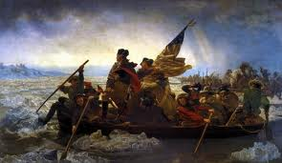
The Crisis was read aloud to troops to inspire them.

