Slide 1

Transcendentalism, Emerson & Thoreau
Transcendentalism:1830s-1840s
  Nonetheless had huge influence in lit, philosophy & social reform
Reaction against John Locke’s empiricist, materialist view of life
  Locke thought there was nothing in the mind/intellect which was not put there by the senses.
  Transcendentalism sees the mind differently
    Mind actively shapes experience
    Mind can understand spiritual truths without the “detour” of the senses
  Related to both Protestant reformation and American democratic individualism.

Slide 2
Transcendentalism Overview
There’s a direct connection or “correspondence” between the universe and the individual soul. As a result, Nature is the gospel of the new faith.
By contemplating nature, people can transcend the world and discover union with the Over-Soul (also known as the Supreme Mind) that unites us all. This idea is rooted in German Romanticism
Follow your own intuition and own beliefs, however divergent from the social norm they may be. Since all people are inherently good, the individual’s intuitive response to any given situation will be the right thing to do.

Slide 3
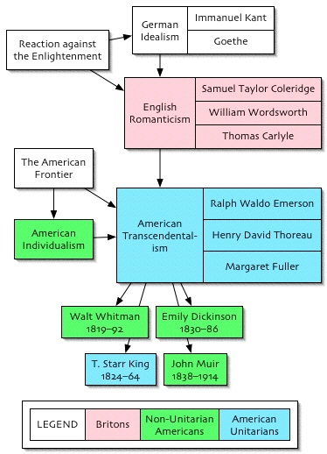
Relationship to other movements

Slide 4
Transcendentalism vs Unitarianism
Unitarians used Locke against Calvinism
  If the mind is a blank slate at birth, it can’t be innately depraved
  Also shows the special status of Jesus: the evidence of his miracles shows he is indeed “word made flesh.”
Transcendentalists like Emerson argued against the outward evidence of miracles as the basis for faith
  Wanted instead to focus on inward, personal and moral validations of Christianity
    Emerson made this point in “Divinity School Address”
      Quit the ministry (they were mad)

Slide 5
Transcendentalism’s Cultural influence
Education deeply influenced by their ideas
  Instead of memorization and recitation, children were encouraged to write what they understood from their reading
  Children able to understand spiritual truths
  Some thought the flow of knowledge would be reversed
    Children teach adults & congregation teach the ministers
  Their ideas are the backbone of progressive education in the U.S.
Communitarian Experiment: Brook Farm
  Goal: unite mind and hands and eliminate distinctions of social class
  Fell apart as tension mounted btn having rules for everything and having individual freedom
    Hawthorne lived there for a while

Slide 6
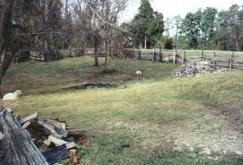
Literary Influence of Transcendentalism
Many of the transcendentalists were writers: Emerson & Thoreau
Emerson called for ditching European forms for something that looked within the American psyche & subjects
    Wanted not regular meters and forms, but “A metre-making argument . . . a thought so passionate and alive, that, like the spirit of a plant or an animal, it has an architecture of its own”
      Many later poets thought he was talking to them: Whitman, Hemingway and William Carlos Williams, to name a few.

Slide 7
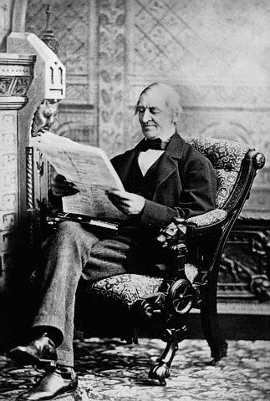
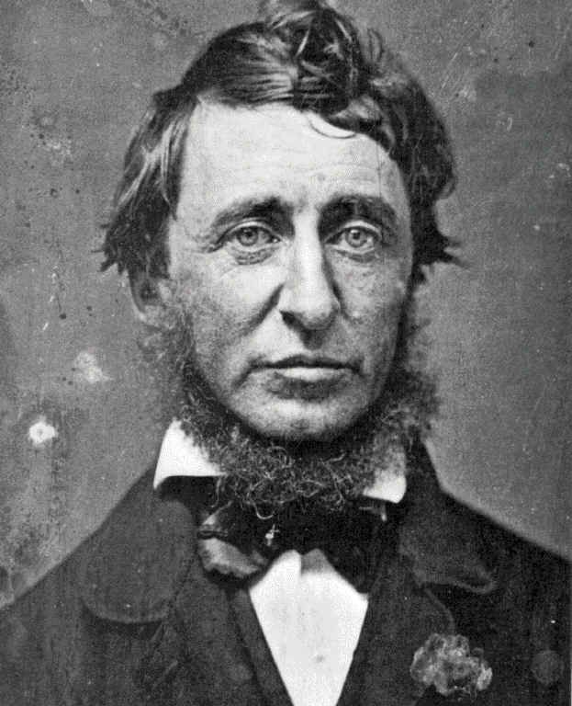
Emerson and Thoreau
Notes:
Ralph Waldo Emerson (left) and Henry David Thoreau (right) were two of the most influential thinkers in the antebellum United States. Both were based in the thriving intellectual community of Concord, Massachusetts, a small town just outside of Boston where a number of other notable American writers lived and worked: Louisa May Alcott, the author of Little Women; Bronson Alcott (Louisa May’s father), an abolitionist, women’s rights advocate, and teacher; Nathaniel Hawthorne, the author of The Scarlet Letter; and others, including regular visitors such as Margaret Fuller (an early feminist) and the poet Henry Wadsworth Longfellow. Henry James would later call Concord “the biggest little place in America.” Emerson and Thoreau would become central figures in the Transcendentalist movement, defining many of its intellectual contributions in works such as Nature (1836) and Walden (1854).

Slide 8
Emerson’s Early Life
Born in Boston in 1803
Studied theology at Harvard
Ordained a Unitarian pastor in 1829
Influenced by William Ellery Channing’s skeptical view of religion
His wife died of tuberculosis in 1831
Became disillusioned with religion and spent a year in Europe
Notes:
Emerson was the child of a Unitarian minister, who died when Emerson was only eight years old. His mother wanted to send him and his four brothers to Harvard so that they could follow in their father’s footsteps and become ministers themselves. Emerson showed no real promise at Harvard (he graduated thirtieth in a class of fifty- nine in 1821) and spent a few years as a schoolmaster in a number of Boston-area schools. He returned to Harvard’s Divinity School in 1825, and in 1829 he became a pastor in the Unitarian Church.
According to the NAAL introduction, Boston Unitarianism, led in the 1820s by William Ellery Channing (1780–1842), was a very secularized version of Christianity. Channing “accepted the Bible as the revelation of God’s intentions but no longer held that human beings were innately depraved; some Unitarians, like Channing, came close to suggesting that Jesus was not a god but rather the highest expression of humanity. Emerson was deeply influenced by Channing, and his skepticism toward historical Christianity was strengthened by his exposure to the German ‘higher criticism,’ which regarded the Judeo-Christian Bible as a document produced in a specific historical time, rather than as the direct word of God, and interpreted biblical miracles as stories comparable to the myths of other cultures. Emerson was gradually developing a greater faith in individual moral sentiment and intuition than in revealed religion.”
This intellectual skepticism toward religion, combined with the personal crisis of his wife’s death at the age of nineteen after only two years of marriage, led Emerson to resign his position as pastor in 1832. He left for Europe on Christmas day in 1832 and returned to America in October of 1833. While in Europe, he met with a number of well-known writers who influenced his intellectual development: In Italy he met Walter Savage Landor; in England he met Samuel Coleridge and William Wordsworth; and in Scotland he met Thomas Carlyle, with whom he would remain in contact for the rest of his life.

Slide 9
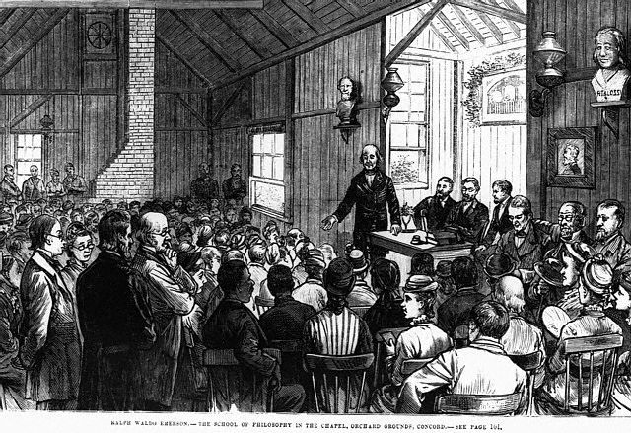
Emerson as Lecturer and Author
After returning from Europe, Emerson begins a new career as a lecturer and an author.
Notes:
Two factors contributed to Emerson’s career transition from Unitarian minister to lecturer and author: (a) his disillusionment with religion and his tour of Europe pointed him in a new intellectual direction; and (b) the inheritance from his first wife’s legacy assured him of an annual income of more than a thousand dollars, thus freeing him to pursue a career as an author.
Pictured here is Emerson addressing a large audience in a Concord, Massachusetts chapel during a meeting of the Summer School of Philosophy in 1882.

Slide 10
Emerson’s Nature
“Every particular in nature, a leaf, a drop, a crystal, a moment of time is related to the whole, and partakes of the perfection of the whole. Each particle is a microcosm, and faithfully renders the likeness of the world” (NAAL 230).
“Who looks upon a river in a meditative hour, and is not reminded of the flux of all things? Throw a stone into the stream, and the circles that propagate themselves are the beautiful type of all influence” (NAAL 223).
Notes:
In the first of these statements from Nature, we see Emerson attempting to articulate the unity of all things, which is one of the primary tenets of Transcendentalism. Specifically, Emerson is saying that the world—indeed, the universe—in all its vastness is no more complete or complex than the most basic elements of nature: “a leaf, a drop, a crystal, a moment of time.” Make sure that your students understand what he means by the term “microcosm,” and ask them to discuss what it would mean to think about the world as simultaneously existing on both a grand and a microscopic scale. How does it affect human experience to situate ourselves somewhere between the vast and the miniscule? How does it affect our perception to think of the vastness of the world as something that we can apprehend and appreciate on as small a scale as a single raindrop?
In the second of these statements, we see Emerson reaching, suddenly, for mutual common experience, for the everyday perceptions that everyone shares, in an effort to articulate a complex idea that we may fail to appreciate in the rush of our everyday lives. What are the metaphors that Emerson draws out of the river? (For example, “the flux of all things” suggests that our lives change as rapidly as the water in a stream; and the ripples in a river that reach the edge of a riverbank after tossing a stone into the center suggests the influence of forces that may lie outside our range of vision.) How is Emerson teaching us to learn from the natural world? Conversely, how is Emerson imposing human ideas on the natural world?
From here, you can begin to speculate about propositions that seem to provide the shape and continuity of Emersonian thought: (1) that our observation of the finite ripples on the water leads us to “see” the ripples that ease out into infinity; (2) that the concentric circles made by the ripples themselves form a series of analogies; and (3) that in the act of throwing one stone we can manage to touch an infinitely enlarging sphere. These perceptions can help us sort out some related ideas that “man is an analogist, and studies relations in all objects” (NAAL 223) and that “the world is emblematic. Parts of speech are metaphors because the whole of nature is a metaphor of the human mind” (NAAL 225) or that “Empirical science is apt to cloud the sight . . . a dream may let us deeper into the secret of nature than a hundred concerted experiments” (NAAL 239).

Slide 11
Thoreau’s Early Life
Born in Concord in 1817
Studied at Harvard
Worked as a schoolmaster, but quit when he was forced to inflict corporal punishment on his students
Worked as a handyman in Emerson’s home
Spent two years alone on Emerson’s property at Walden Pond in a cabin he built himself
Notes:
Attentive students may note how closely the early lives of Emerson and Thoreau parallel one another: Both were born in the Boston area; both studied at Harvard; both began their lives in professions that they soon renounced due to profound ethical dilemmas (Emerson refused to serve as the minister of a religion he did not wholly support and Thoreau refused to inflict corporal punishment on his students in his brief time as a schoolmaster); and both ultimately turned to the pen and the lecture circuit to support themselves. The two men’s lives intersected when Thoreau worked as a handyman at Emerson’s house in exchange for room and board in 1842. A few years later, in 1845, Thoreau would embark on the experiment “to live deliberately” in a cabin on Walden Pond that would come to define his career as a writer and activist. After living in his cabin for two years, Thoreau wrote about the experience and published it in 1854 as Walden, or Life in the Woods.

Slide 12
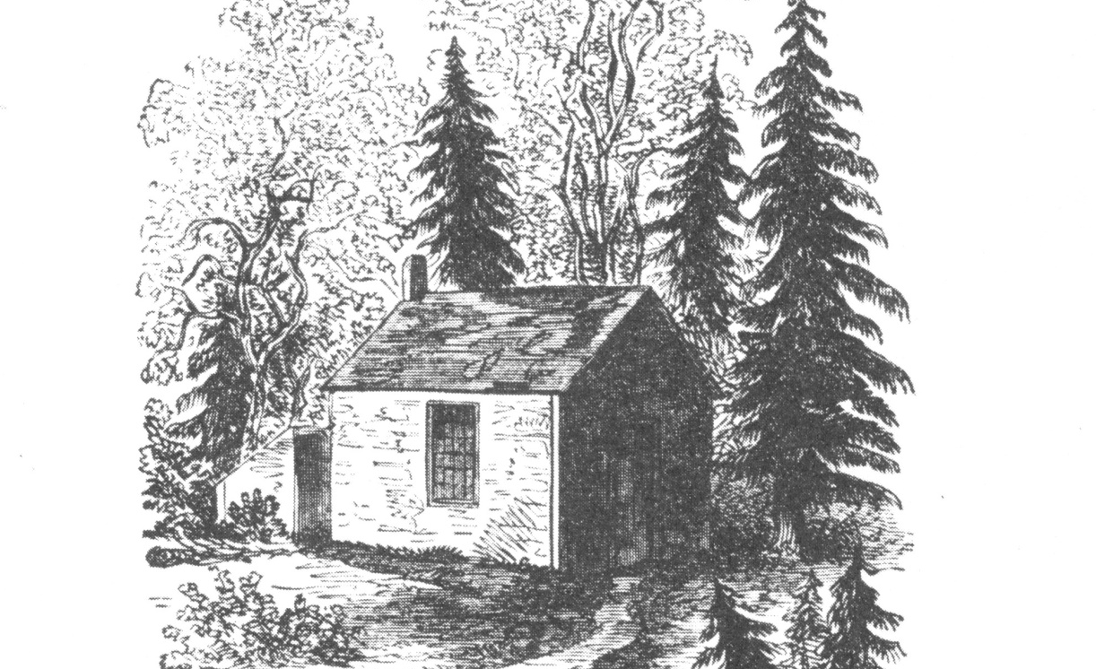
Thoreau’s Walden
Notes:
This sketch of Thoreau’s cabin on Walden Pond was done by his sister Sophia. It graced the cover of the 1854 edition of Walden. Thoreau’s stated reason for wanting to live alone in the woods was as follows: “I went to the woods because I wished to live deliberately, to front only the essential facts of life, and see if I could not learn what it had to teach, and not, when I came to die, discover that I had not lived” (NAAL 1028). Have any of your students shared a similar sentiment? What is the romantic pull of Thoreau’s decision to “live deliberately”? Are there any manifestations in popular culture today of men and women who seek to “live deliberately” as Thoreau did?

Slide 13

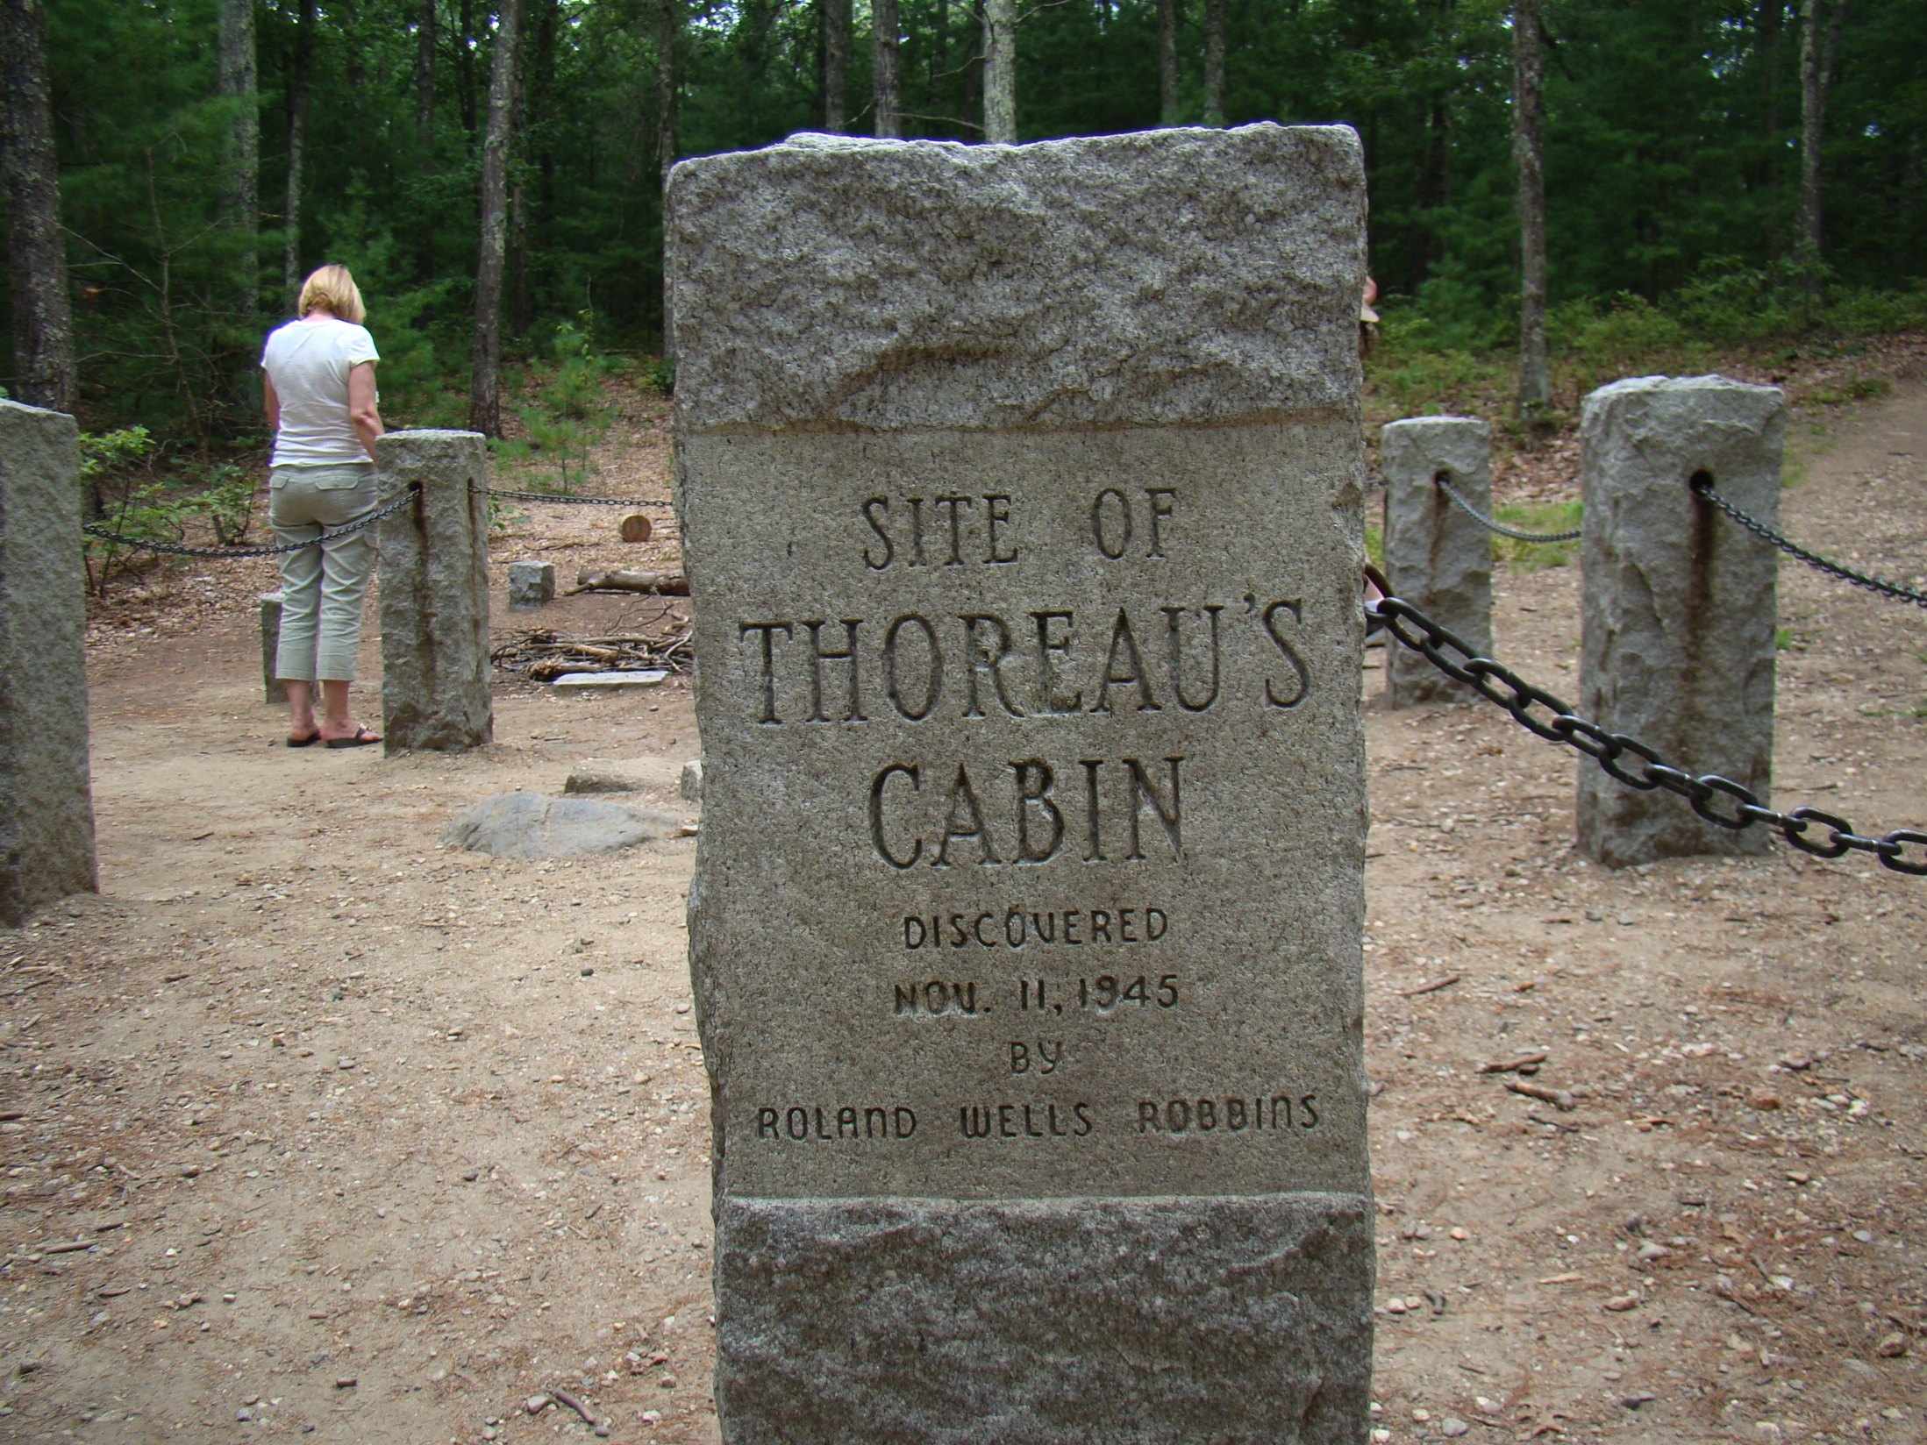
Walden Today
Notes:
This contemporary photograph shows Walden Pond as it appears today. Is it as wild and dramatic as it appears in Amy May Alcott’s nineteenth-century sketch? Did Alcott add a Romantic flourish to Walden to accentuate the profundity of Thoreau’s life of solitude?

Slide 14
Thoreau’s Walden
“I see young men, my townsmen, whose misfortune it is to have inherited farms, houses, barns, cattle, and farming tools . . . Better if they had been born in the open pasture and suckled by a wolf” (NAAL 982).
“Most men . . . are so occupied with the factitious cares and superfluously coarse labors of life that its finer fruits cannot be plucked by them” (NAAL 983).
Notes:
Focusing on “Economy,” ask students to address Thoreau’s practical concerns. What, for Thoreau, is wrong with the daily life of his contemporaries? What were his motives for going to Walden? What led him to write the book? Are Thoreau’s criticisms of his own society applicable to ours? How seriously are we to take his suggestion that students ought, quite literally, to build their own colleges?

Slide 15
  Literary Application
Most writers in the mid-nineteenth century were influenced by them, even if they weren’t part of the group who promoted these ideas. So . . .
What would be the writer’s attitude toward religious or political tradition and loyalty to authorit?
What kinds of literary characters would grow out of transcendentalist beliefs?
What kind of situations and settings will the transcendentalist-influenced writer be drawn to?

