Slide 1
Slavery
United States and International

Slide 2
Slavery in the Colonies
Started in Virginia in 1619.
  Initially more like indentured servants
    Some enslaved Africans were freed after fulfilling a work contract or converting to Christianity
Got much worse by mid 1600s
  Africans singled out for inherited, permanent slavery
    1662 Virginia passed a law saying any child born in the colony would follow the status of its mother, bond or free.
      Enabled slaveholders to hide the mixed-race children produced by raping of slave women
      Removed their responsibility to acknowledge, support, or emancipate the children.

Slide 3
Revolutionary Ideas
How can you write “All men are created equal” and still have slavery in the constitution?
  Huge debate, but emancipation was tabled in order to get the Southern States to agree to the Constitution
Revolution in Haiti is the second in the New World (1893)
  Slaves were freed by French Revolutionary govt.
    “Rights of Man” win for a change
  Re-enslaved by Napoleon
    Hell broke out & plantation owners slaughtered
    Southerners terrified
      Possibility of emancipation shrinks and laws in the U.S. tend to reinforce slavery instead of weakening it.

Slide 4
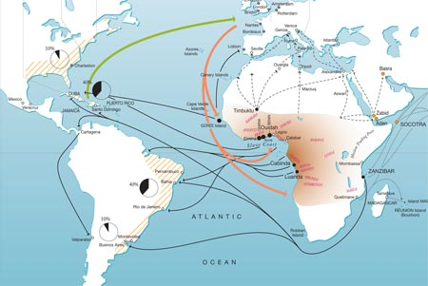
Triangle Trade: Europeans Get Rich
“Sins” traded, bartered for goods to trade for slaves:
glass beads, textiles, guns, whiskey
European goods traded for slaves in Africa
Slaves traded in Caribbean for products of slave labor:
rum, sugar, tobacco, molasses–so-called “Sin” products

Slide 5
New World slavery is harsh
Chattel slavery, not just slave role in life
  Slavery existed in many cultures (Africa, Ancient Greek, etc) but this is different.
  Destruction of family, culture, emotional life
    Attempt to make a person into a thing
Master as law unto himself
  On rural plantations, the master/overseer punished and worked slaves as he saw fit

Slide 6
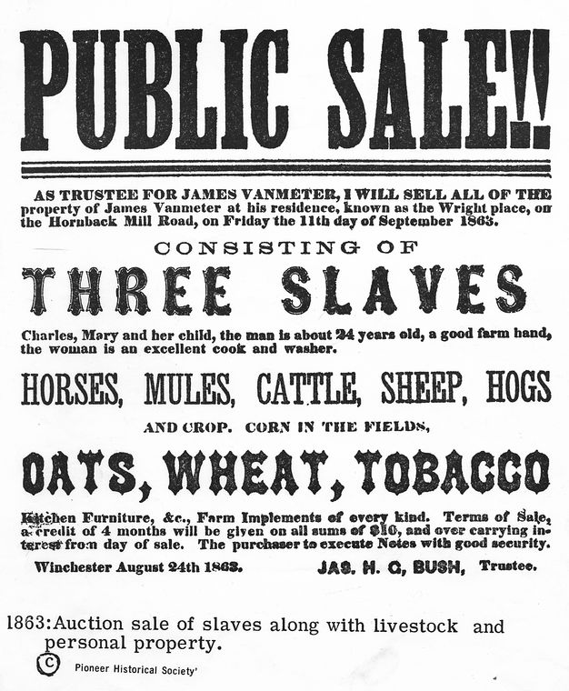

Slide 7
Midcentury Legal Intensification
Fugitive Slave Act (1850)
  Everyone must help capture escaped slaves, even in the North. If not, they could go to jail or pay $1,000 (think $30,000). Blacks could not ask for a trial to determine if they were escaped slaves; if someone claimed them, they were dragged off to the south.
Dred Scott decision (1857)
  Slaves, or their descendants—whether or not they were slaves—were not protected by the Constitution and could never be citizens of the United States. It also held that the United States Congress had no authority to prohibit slavery in federal territories. The Court also ruled that because slaves were not citizens, they could not sue in court.
New territories: Slave or Free?
  Slave states insisted on keeping a “balance” of slave and free states
    1846: 15 Slave; 14 Free
  Abolitionists saw this as allowing evil to grow

Slide 8
Slavery in the Americas is like war
Impossible without the threat of violence
Huge casualties
  middle passage, disease, worked to death
One civilization destroys another
  Even their music forbidden
  Language groups kept apart
  Illegal to teach slaves to read
Yet Southerners invent the myth of slavery as a paternalistic institution
  Slave narratives show the total falsehood of this justification (or any other)

