Slide 1
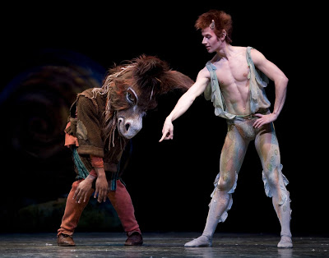
Midsummer Night’s Dream
Love, politics, transgression and Art

Slide 2
Political context and historical anxieties
The play asks whether fathers/husbands can really rule women.
  Egeus says he has the right to make his daughter compliant or dead.
This connects to the anxiety in England about their virgin Queen, Elizabeth.
  England faced a looming crisis of succession—no heir when she dies.
  Queen Elizabeth used courtship as diplomacy, but refused to marry.
    Elizabeth says to parliament in 1563 that while marriage is best for private women, I “think it is not meet for a Prince” meaning herself.
Part of Queen Elizabeth was like Theseus and part was like Hyppolyta and the play addresses the audience’s anxiety about how this can work. Does this leave them vulnerable?

Slide 3
Tragedy inside the Comedy
Midsummer written in the same years as Romeo and Juliet, and they are the mirror images of each other.
  Fathers want to choose their daughters’ husbands against their wishes
  Rebellious daughter threatened with life in a nunnery
  Disobedient daughters plan to run away with chosen lover
  Both contrast rigid day of rules and transformations and chaos of night
Pyramus and Thisbe also invokes the tragic potential of Midsummer’s premise:
  Reminds us that lovers who run away to the forest sometimes meet more dangerous beasts than Bottom/ass and more violent outcomes than our 4 Athenian lovers.
  The noble spectators can’t see any connection between their world and the play they are watching but we do: harsh laws could have driven these poor Athenian kids to the fate of Pyramus & Thisbe or Romeo and Juliet.

Slide 4
3 Part Structure: reality/dream/reality
Starts in civilized world of law and order
Moves to dream world of transformation and disorder
  Lysander is “Wood within this wood” because Wood = Old English word wod that means mad, lunatic. He is maddened and also “wooed” within the wood.
  Plus all the other transformations—Helena says she’ll be Demetrius’s “dog,” Women pursue men, swapping partners, Bottom has the head of an ass, Titania bewitched, Fairies rule the world
Back to reality with new knowledge.

Slide 5
Wedding/Festival in Midsummer
Midsummer Nights’ Dream uses weddings to frame and contain all—Theseus and Hyppolyta’s wedding plan starts the play, and we have a triple wedding at the end. Do they work to resolve the play’s questions?
  In a sense the play is a “war of the sexes” about who will be the master, the Fairy Queen or Fairy King, Theseus or Hyppolyta.
  The royal wedding comes of war not love—Theseus won her in battle.
  Personally, I’m pissed that Oberon gets his way at the end. I also don’t trust Theseus the international playboy/adventurer to be a decent husband. And I worry about these marriages based on magic juice.
  There’s a lot that the weddings don’t resolve in the play if we think of them in strictly practical terms.
Instead we might look at the weddings as a blend of the legal world and the rural festivals invoked in Fairy Land.
Conflicts in the story are resolved symbolically rather than literally by blending the worlds that once were in conflict.

Slide 6
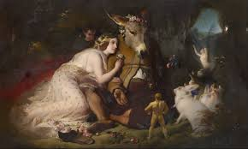
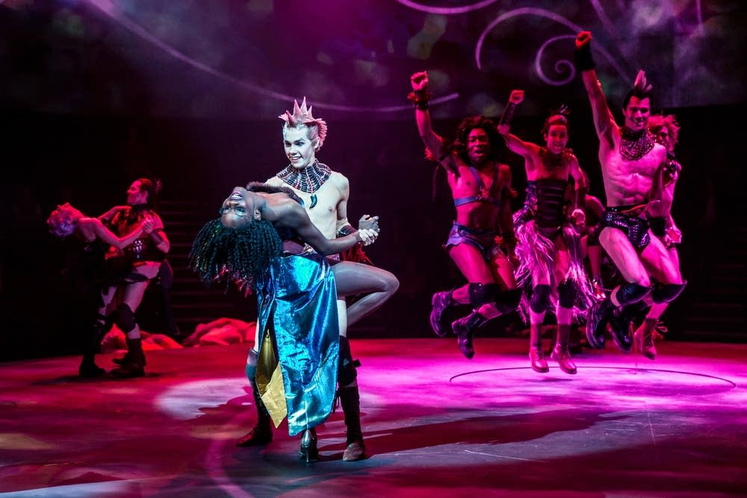

Slide 7
Civilization?
Some big questions that the audience must ponder (and that’s the point!)
  What is the new knowledge they found in the forest? How is the world of law changed? Are the lovers, rulers, and mechanicals changed?
    Maybe Theseus is nicer—marries all according to their wishes instead of Hermia’s Dad’s dictates (the original suitor Demetrius has changed anyway, so he couldn’t enforce the old rule).
  And which world is really more civilized?
    The world of law that would kill Hermia for refusing her father’s choice for her husband?
    Or the world of change and possibility in the forest?

Slide 8
Another Layer: Art and the Unconscious
3 part structure (civilization -> chaos -> civilization) lays over a deeper structure: Conscious, unconscious, art.
The “new knowledge” that we arrive at is not a new law, or a new social structure, but a new respect for the transformative, disruptive and creative power of the unconscious. We must integrate that into our understanding of ourselves.
  Bottom gets it: “Love and reason keep little company,” he says, and “Man is but an ass if he try to explain;” therefore he will write a song about it. Art is the only way to make sense of the chaos that is the human psyche.

