Slide 1
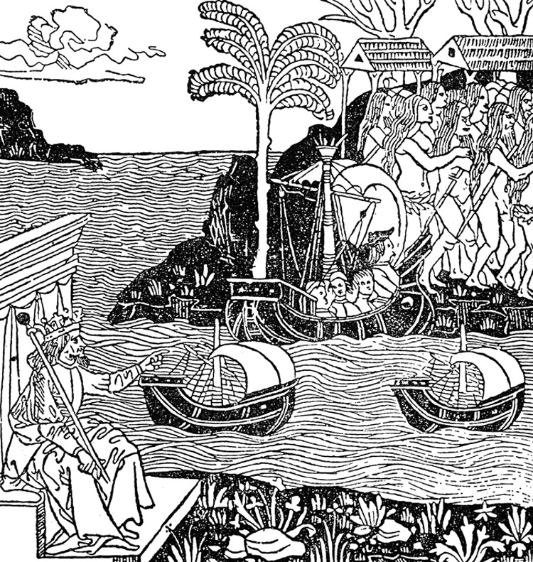
Lecture 1: First Contact
Natives, Europeans and cultural transformation

Slide 2
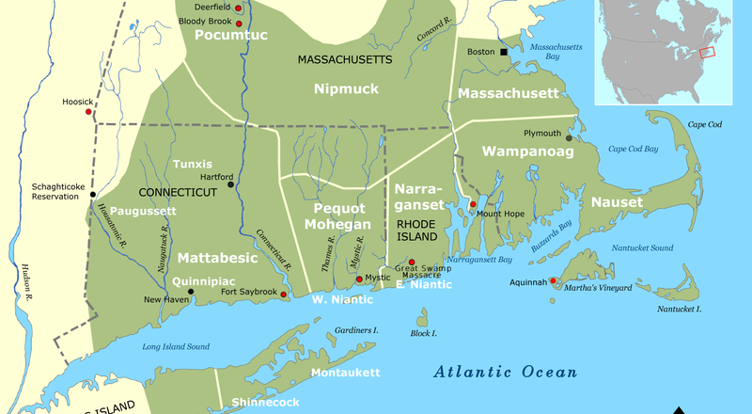
Native people were very diverse in terms of language, culture, economy, social structure.
In New England alone, many groups competed and collaborated, sometimes fighting each other and sometimes forming alliances to fight the Europeans.

Slide 3
Native Perspectives
Trade between equals was well established with Europeans in the northern coast before British colonists arrived
There are cases when Natives kicked Europeans out (refused trade and chased them back to their boats) as punishment for kidnapping or cheating
Natives thought they were kind of disgusting
    hairy, never bathed, scrawny, diseased, etc.
Used Europeans for their own political/military ends
    Disease emptied the coast & broke their resistance, so they had to find other means to defend themselves from whites and native rivals
      Squanto’s real story
Notes:
Complicates the usual model of conquest/imperialism: not one nation conquering another but a complex field of players all struggling for survival and power and resources.

Slide 4
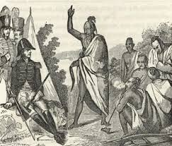
Hello, my name is THE WRATH OF GOD!

Slide 5
European Perspectives
Europeans also very diverse in N. America
  Dutch in New York; Spanish in FL; French in great lakes
    Most settlers not primarily seeking religious freedom
      VA is a commercial venture
        Descended into cannibalism
Big question for New England colonists: Who are the native people, and how do they fit into God’s plan?
  Pilgrims in Mass. thought villages emptied by disease meant God had cleared the way for them.
  Some of their theories about natives:
    Non-human
    Pagan
    “Lost Tribes of Israel”

Slide 6
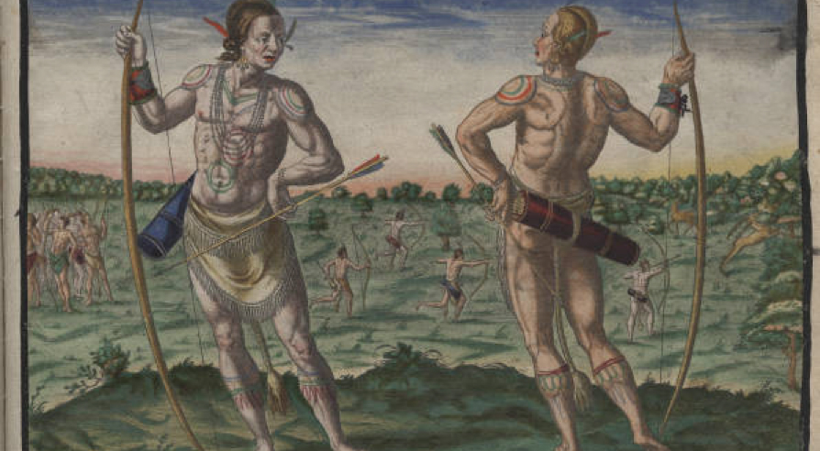
Europeans were impressed with the health, size and beauty of natives (to whom most of them compared poorly).

Slide 7
  Europeans tried to figure out and explain native rights and theirs.
Two main justifications for land grants in “new” world
  British said if there aren’t any Christians who already own the land, you can claim it.
    Thus little focus on Christianizing the natives.
      Contributed to a tradition of separation rather than mixing
  Spanish said if you bring them into the church, it’s for the glory of God and thus okay to take over the territory.
    Somehow this allowed the Spanish to enslave natives in Caribbean and Latin America.
      Two terms they used to describe the project: Encomienda & Repartimiento

Slide 8
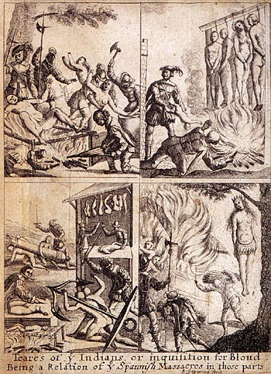
Some Europeans like Bartolome De las Casas documented abuses and eventually helped bring changes to the system.

Slide 9
How can we make sense of this complex negotiation between cultures?
Theory of the “Contact Zone” by Mary Louse Pratt
A dynamic exchange
  Even when one side tries to impose its culture and obliterate the other, they are never 100% successful. Contact means change for both sides
      Transculturation is often a better term for this exchange rather than assimilation or acculturation.
        Europeans adopted some practices of natives
        Natives borrowed from Europeans
  When the non-dominant group tries to represent itself to readers in the dominant group, it uses forms and ideas that are familiar to those readers.
      Heterogenous texts result from this mixing
        They might seem weird or unskilled if we look at them from a western values system. Some parts are native & some parts are borrowed from the dominant culture.
          Ex: the Iroquois creation story

Slide 10
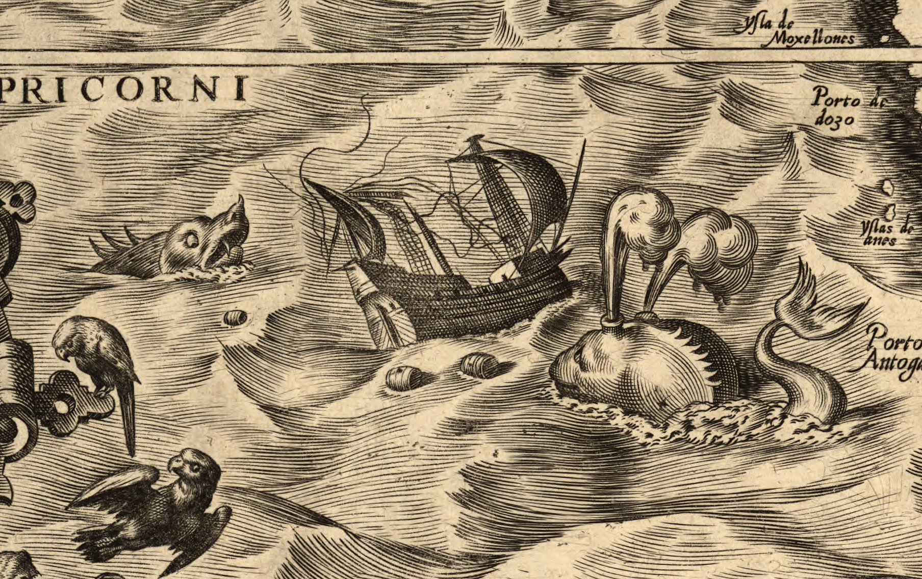
Hear something strange, revealing, important? Need a definition? Write a question or comment.

