Slide 1
Benito Cereno
“This slavery breeds ugly passions in man”
--Herman Melville (1559)

Slide 2
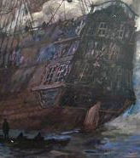
The Actual Mutiny
A real Amasa Delano re-took a mutinous slave ship, the Tryal, off Santa Maria Island, Chile in 1805.
Melville used the events of Delano’s account, but changed the character of Delano greatly
Delano’s real ship was Perseverance
The real Delano tried to claim salvage rights to the whole ship & contents
  Neither naïve nor selfless

Slide 3
Allegory for American Slavery?
Ship named for the Island of San Dominik—another name for Hispaniola, or Santo Domingo or Haiti (1528)
  Location of the first European colony in the new world
    The place Bartolome de las Casas described in Devastation of the Indies
  Second revolution in the new world 1791, after the 13 American colonies
    Haiti’s (Santo Domingo's) slave rebellion killed or drove out nearly all whites in Haiti
  Haiti’s example was the unspeakable, repressed nightmare of the American South
    Nat Turner’s rebellion (1831)
    More than 250 uprisings or attempted uprisings involving ten or more slaves in N. America between 1650-1865.
Notes:
Babo asks to be taken to

Slide 4
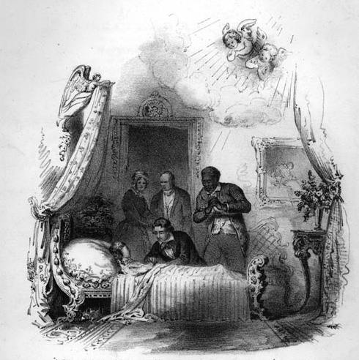
The Idea on Trial: Slavery’s Paternalism
Southerners invent the paternalistic myth of slavery
A way to put fears of rebellion to rest and justify the institution
Whites cast themselves benevolent care-takers (like fathers) of a race of people who were by nature very simple and preferred to take direction from their superiors.
  Enslaved Africans were supposedly grateful & devoted since they were so loved and taken care of.
  Whites pretended organized action and violence was impossible for such dumb, docile and dog-like servants.
    Even Jefferson was taken in

Slide 5
But Is Benito Cereno Allegorical?
Must be a sustained comparison
  action in the story = action on the idea
The American Captain Delano steps into a different, hidden world where the captain is a law unto himself (1529, 1532)
  Steps into slavery
  Goes on an on about the “happy innocent negroes” (1547, 1556 top 2, PP)
  Constant comparisons in Benito with “crumbling” images of Europe, a corrupt version of class privilege (1527, 1548 ruined summer house)
  South liked to imagine its “peculiar institution” as an improvement on a genteel aristocratic tradition, like Europe or ancient Greece
Delano refuses to see the signs of violence (hatchets 1529, gauntlet 1536, black stabs white 1536, questions about $ and defenses 1541, shaving 1557)
  like America refuses to see?
  Delano & America must presume whites are in control
    Truth: whites are dependent on blacks for survival

Slide 6
More Allegorical Connections
Delano must uphold the laws of the sea and assist Cereno (thereby thwarting a slave rebellion)
  Probably reflected Melville’s frustration with his father-in-law, Lemuel Shaw who was a supreme court justice in Massachusetts and upheld fugitive slave laws.
    Shaw presided in trials in 1842 & 1851. Declaring the Fugitive Slave Law constitutional, he forced escaped slaves to return to slavery
Delano’s men, hoping for a share in the cargo, suppress the slave revolt, killing many in spite of a financial motive to keep them alive.
  This is slavery’s ethical bottom line: only hope of profit limits violence against slaves

Slide 7
The End of the Narrative
How does the escape of Benito into the arms of the “genial” American fit the Allegory?
  What does Delano assume at first? (1567)
  Babo trying to kill Benito is what tears away the veil (1568)
  If we refuse see the real violence in slavery, what will be the result?
    It will erupt suddenly like a “sooty avalanche” (1567)
What must we realize about the Africans on board?
  Strategic, purposeful
    Consummate actors, especially the “little” Babo
  Intent on self-governance
    Assume that as their right
    Dispense their own harsh revolutionary justice on board
  Opposite of all paternalistic assumptions
Douglass said that any slave who kills his master should be considered a hero, like the heroes of our own revolution
  Can that slave hero speak from an authentic self in this text?

Slide 8
Maybe It’s Just Symbolic
Maybe about colonialism or racism more generally
  Haiti is also a powerful symbol of the cruelties of conquest/colonialism
  Babo wants to go to a place where blacks don’t have to be slaves to whites
    Rejection of rule by others, not just slavery
    Delano interprets everyone in terms of ethnic stereotypes, including Benito and that’s his failure
Maybe about the difficulty of seeing the difference between good and evil
  Is anyone unstained by violence on the San Dominick?
  Is Delano’s innocence really Good, since it nearly killed Benito?
  Symbols in landscape support this interpretation—all grey, no boundaries
Or American practical know-how versus European patronage and inherited status—Democracy vs. Aristocracy
  Benito Cereno didn’t earn his captaincy and that’s why he can’t command
  Delano knows the job so inspires confidence & succeeds
    Isn’t this shown to be Delano’s own misinterpretation?
      Delano’s belief in his own mastery nearly cost his ship

Slide 9
Why did abolitionists ignore Benito Cereno?
Melville challenged them too much in two ways:
Showing that one might “like” Africans and still be blinded by racism
  Racism isn’t just about overt hate (lynch mobs, beatings, etc.)
  The pretense of benevolence may be as bad as direct violence because it is both blinding and enabling
      A paternalistic racist like Cap. Delano can’t see how insulting and degrading his assumptions about blacks are.
      Because the violence of slavery is invisible to him, he approves & facilitates the status quo (works to return the slave ship to control of its master)
Showing a potential in Africans that most Abolitionists couldn’t handle or assimilate to the propaganda—refuses sentiment
  The sentimental image of the helpless, slightly docile victim was promoted except by a few former slaves like Douglass.
    Uncle Tom’s Cabin helped the cause greatly.
    Most readers don’t like any of the blacks in Benito

Slide 10
Or is Melville frightened of what lies ahead if (when) slaves are free?
If it’s a critique of slavery, it’s pretty oblique, considering the violence perpetrated by both whites and blacks
  Doesn’t paint either side as uniformly good or bad
    That frustrates some readers
Why can’t the story let Babo speak, claim his heroism?
  Wasn’t allowed to testify in a white court
  Why speak if none really hear?
Do you think the story is a critique of slavery?
Compare to Douglass

