Slide 1

Today Tues. April 18
  Topic: Food labeling
Thurs. April 20
  Finish labeling. Work on Label Assignment in class
  Label assignment due next class Tues. April 25
    Typed, one paper/team
    Include last name, first name and class time
  See syllabus for all exam and assignment due dates

Slide 2
Deciphering Labels-part l
The Basics
.

Slide 3
Labeling Overview
Intended Purpose →Inform consumer
Manufacturer’s purpose→ Make a sale!
‘Nutrition Facts’ panel info reliability is good!
Regulated by:
  Food and Drug Admin. (FDA)
  US Dept. of Agriculture (USDA)
% Daily Value (DV)
  Use to compare products
  Based on high quality data
Notes:
The label advertises and discloses some info about the product….integral part of nutrition education
%DV is based on the Recommended Dietary Allowances (RDA). RDA’s are considered the ‘gold standard’ for nutrient needs of healthy people, living in the US and consuming a typical US diet (assumes diet is adequate in calories and protein). RDA’s are revised regularly and include a huge safety factor (except the calorie recommendation)
It is recommended people get between ~67% and 250% of DV for all nutrients.

Slide 4

USDA-regulates most fresh foods!
Currently, labeling is mostly voluntary
Eggs, fresh fruit/vegetables, milk, meat
Notes:
USDA United States Department of Agriculture (Basically raw, fresh foods), not the same as FDA Food and Drug Administration (basically packaged food and supplements)

Slide 5
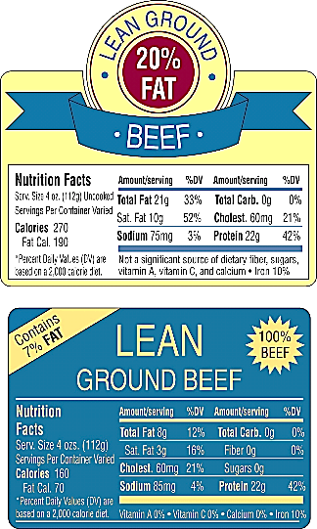
Most fresh meat is USDA monitored
USDA ‘Lean’
4 oz. serving
<10 g fat
< 95 mg
cholesterol
No!
Are the products
truly lean
and/or low-fat?
%fat ≠ %Cal
What are %Cal from fat in these items?
Yes, lean!
Illustration 4.4, p. 4-5
Notes:
Two examples of labels claiming “lean” ground beef. Only the 7% fat beef is actually lean. “20% fat” ground beef is far from lean, actually providing 21 grams of fat and 70% of total calories from fat per serving.
Prime→Choice—Selelct USDA grades of meat, the former the most tender, the latter the least. Standard/commercial is the lowest grade possible.

Slide 6
% fat ≠ % calories on meat products
“20% fat” means ~70 % of Calories from fat
“7% fat” means ~43% of Calories from fat
The 7% fat product is lean
Neither product is low fat (<3g fat/serving)
Both ~high fat/sat fat, high protein/iron foods ☹ ☺
Meat is tasty because of the fat in it!

Slide 7
Food & Drug Administration (FDA)
Regulates most foods, drugs and supplements
1990 Nutrition Labeling and Education Act
Goal: Provide consumer accurate food info
Reality: Caveat Emptor! Buyer Beware!
Laws improved to protect consumer → Labels
changed to work around the laws!
Notes:
1th amendment guarantees freedom of speech. It is legal to announce misleading and fraudulent info about a product on the internet or in an article, ‘Super foods have negative calories!’, however you cannot do this on a label or in a product advertisement.
FTC can pull illegal ads, but they are overwhelmed and often don’t catch problems until someone is sick or dies.
What about infomercials….and articles printed adjacent to a product ad? Those ARE OK!
Protected by Freedom of Speech.
http://www.consumerdirect.gov.uk/watch_out/Commonscams/weight-loss/fatfoe

Slide 8
A quick start for effective label use
Two parts are your friend!
    ‘Nutrition Facts’ panel
    Ingredient list
    Be skeptical of all other label info
      Consider it to be advertising
Notes:
Quoted from FDA link on this slide
Confusing Claims
The terms "natural," "healthy," and "organic" often cause confusion. "Consumers seem to think that 'natural' and 'organic' imply 'healthy,'" says Schneeman. "But these terms have different meanings from a regulatory point of view."
According to FDA policy, "natural" means the product does not contain synthetic or artificial ingredients. "Healthy," which is defined by regulation, means the product must meet certain criteria that limit the amounts of fat, saturated fat, cholesterol, and sodium, and require specific minimum amounts of vitamins, minerals, or other beneficial nutrients.
Food labeled "organic" must meet the standards set by the Department of Agriculture (USDA). Organic food differs from conventionally produced food in the way it is grown or produced. But USDA makes no claims that organically produced food is safer or more nutritious than conventionally produced food.
For example, says Dr. Barbara Schneeman, "A premium ice cream could be 'natural' or 'organic' and still be high in fat or saturated fat, so would not meet the criteria for 'healthy.'"

Slide 9
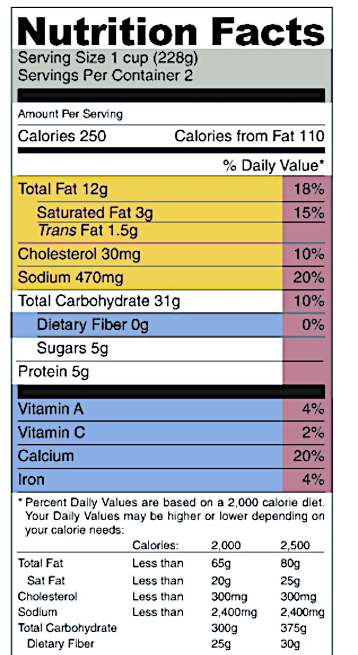
Overview: current ‘Facts Panel’
Macaroni and Cheese
Start here→
5/20 Rule
5% DV or less is low
20% DV or more is high
Limit these
(gold)
Get enough
of these
(blue)
Footnote
Notes:
Label is a guide; a good start. Does not give all info required to make a wise food choice.
5% DV considered low
20% high
Only certain vit/min listed unless claim made
Missing carb/fat?
Portion size matters; standardized and considered’ reasonable’ by FDA
Sugars all lumped together

Slide 10
What can you learn from this list?
INGREDIENTS: Milled corn, sugar, enriched flour {wheat flour, reduced iron, niacinamide (vit B₃), riboflavin (vit B₂), thiamine hydrochloride (vit B₁) and folate}, corn syrup, molasses, salt, honey, partially hydrogenated vegetable oil (one or more of the following oils; coconut, cottonseed or soybean oil), sodium ascorbate and ascorbic acid (vit C), niacinamide, zinc oxide , BHT (preservative), annato, folic acid, vitamin D and B-12.
Notes:
Ingredients are in descending order by weight. This product is mostly corn, by weight.

Slide 11
Ingredients-listed high to low by wt.
INGREDIENTS: Milled corn, sugar, enriched flour {wheat flour, reduced iron, niacinamide (vit B₃), riboflavin (vit B₂), thiamine hydrochloride (vit B₁) and folate}, corn syrup, molasses, salt, honey, partially hydrogenated vegetable oil (one or more of the following oils; coconut, cottonseed or soybean oil), sodium ascorbate and ascorbic acid (vit C), niacinamide, zinc oxide , BHT (preservative), annato, folic acid, vitamin D and B-12.
Notes:
Ingredients are in descending order by weight. This product is mostly corn, by weight.

Slide 12
What is ‘Sugar Splitting’?
INGREDIENTS: Milled corn, sugar, enriched flour {wheat flour, reduced iron, niacinamide (vit B₃), riboflavin (vit B₂), thiamine hydrochloride (vit B₁) and folate}, corn syrup, molasses, salt, honey, partially hydrogenated vegetable oil (one or more of the following oils; coconut, cottonseed or soybean oil), sodium ascorbate and ascorbic acid (vit C), zinc oxide, BHT (preservative), annato, folic acid, vitamin D and B-12.

Slide 13
Sugar Splitting is deceptive!
INGREDIENTS: Milled corn, sugar, enriched flour {wheat flour, reduced iron, niacinamide (vit B₃), riboflavin (vit B₂), thiamine hydrochloride (vit B₁) and folate}, corn syrup, molasses, salt, honey, partially hydrogenated vegetable oil (one or more of the following oils; coconut, cottonseed or soybean oil), sodium ascorbate and ascorbic acid (vit C), zinc oxide, BHT (preservative), annato, folic acid, vitamin D and B-12.
Are
sugars
natural
or
added?

Slide 14
Added Sugars
Goal:≤ ~25g/d women
≤ ~35 g/d men
INGREDIENTS: Milled corn, sugar, enriched flour {wheat flour, reduced iron, niacinamide (vit B₃), riboflavin (vit B₂), thiamine hydrochloride (vit B₁) and folate}, corn syrup, molasses, salt, honey, partially hydrogenated vegetable oil (one or more of the following oils; coconut, cottonseed or soybean oil), sodium ascorbate and ascorbic acid (vit C), zinc oxide, BHT (preservative), annato, folic acid, vitamin D and B-12.
All are
added!
Stand alone
ingreds
to
sweeten
Notes:
Other names for added sugar: dextrose, fructose, honey, raw sugar, malt syrup, rice syrup, sucrose, xylose, corn sweetener, fruit juice concentrate, high-fructose corn syrup (HFCS), brown sugar, beet syrup, cane sugar, cane sugar syrup, glucose, lactose, maltose, evaporated cane juice, agave nectar, cane crystals, crystalline fructose, barley malt, beet sugar…and there are probably more!
Natural Sugar primarily comes from milk (lactose) and fruit (fructose) Pretty much all else is added sugar with little if any other nutrients associated with it.

Slide 15
Most Common Additives??
INGREDIENTS: Milled corn, sugar, enriched flour {wheat flour, reduced iron, niacinamide (vit B₃), riboflavin (vit B₂), thiamine hydrochloride (vit B₁) and folate}, corn syrup, molasses, salt, honey, partially hydrogenated vegetable oil (one or more of the following oils; coconut, cottonseed or soybean oil), sodium ascorbate and ascorbic acid (vit C), zinc oxide, BHT (preservative), annato, folic acid, vitamin D and B-12.
Notes:
Two most common additives used (at home and in retail foods) are sugar and salt

Slide 16
Most Common Additives!!
INGREDIENTS: Milled corn, sugar, enriched flour {wheat flour, reduced iron, niacinamide (vit B₃), riboflavin (vit B₂), thiamine hydrochloride (vit B₁) and folate}, corn syrup, molasses, salt, honey, partially hydrogenated vegetable oil (one or more of the following oils; coconut, cottonseed or soybean oil), sodium ascorbate and ascorbic acid (vit C), zinc oxide, BHT (preservative), annato, folic acid, vitamin D and B-12.
Notes:
Two most common additives used (at home and in retail foods) are sugar and salt

Slide 17
Partial Hydrogenated Oil…good or bad?
PHO=>
trans fat
INGREDIENTS: Milled corn, sugar, enriched flour {wheat flour, reduced iron, niacinamide (vit B₃), riboflavin (vit B₂), thiamine hydrochloride (vit B₁) and folate}, corn syrup, molasses, salt, honey, partially hydrogenated vegetable oil (one or more of the following oils; coconut, cottonseed or soybean oil), sodium ascorbate and ascorbic acid (vit C), zinc oxide, BHT (preservative), annato, folic acid, vitamin D and B-12.
Notes:
Goal < 2 gm Trans fat (TF)/day or no more than ~1% of total calories from fat should come from trans fat.
If 2000 Cal diet→ 1% (2000ca) = 20 calories max from TF.
Knowing there are 9 cal/ g fat, then a 20 calorie value is ~2gm TF (20/9)

Slide 18
Bad!! Trans Fat is NOT Heart Healthy
INGREDIENTS: Milled corn, sugar, enriched flour {wheat flour, reduced iron, niacinamide (vit B₃), riboflavin (vit B₂), thiamine hydrochloride (vit B₁) and folate}, corn syrup, molasses, salt, honey, partially hydrogenated vegetable oil (one or more of the following oils; coconut, cottonseed or soybean oil), sodium ascorbate and ascorbic acid (vit C), zinc oxide, BHT (preservative), annato, folic acid, vitamin D and B-12.
Note: Found in processed foods with partially hydrogenated oil (PHO) and naturally in beef/beef byproducts. Less is best.
Notes:
Artificial partially hydrogenated oils (PHO) will be banned from most foods. Natural PHO are not banned. Not sure if they are OK or not Found in beef and its by-products so meat/dairy lobby not happy about any labeling re: trans fat. Unclear yet if natural trans fats are bad for us. Lobbies say NO….but of course, they are biased. Patience and moderation in use of red meat and animal byproducts (cheese, wholefat milk, etc.)

Slide 19
What does enriched mean?
INGREDIENTS: Milled corn, sugar, enriched flour {wheat flour, reduced iron, niacinamide (vit B₃), riboflavin (vit B₂), thiamine hydrochloride (vit B₁) and folate}, corn syrup, molasses, salt, honey, partially hydrogenated vegetable oil (one or more of the following oils; coconut, cottonseed or soybean oil), sodium ascorbate and ascorbic acid (vit C), zinc oxide, BHT (preservative), annato, folic acid, vitamin D and B-12.

Slide 20
‘Enriched’?
Think depleted!
whole grain
 nutrient loss (i.e. vit, min, fiber, etc.)

heavily processed grain
 add back some of lost nutrients

‘enriched’ grain

Slide 21
‘Enriched’: Red flag-‘heavily processed’
Generally enriched foods are not top tier, nutrient dense (ND) foods
ND= lots of nutrients/calorie
Examples: white rice, white bread and many (most?) cereals use enriched grain (wheat, corn, rice)
Notes:
All refined grains must be enriched (e.g. egg noodles, spaghetti, white rice, corn meal) B1, B2, B3, iron and folic acid.
Are these nutrient dense? Not really, not compared to there whole grain relatives. Generally enriched foods are highly processed, not top nutrient dense foods.

Slide 22
Bring in the fortifications!
Fortification is a red flag for ‘highly processed’
One+ nutrients added in amount greater than present before processed
Common in cereals
Sets stage for deceptive nutrient claims
Increase risk of exceeding upper limit toxicity (UL). Can be dangerous!
Notes:
FORTIFICATION and ENRICHMENT are not the same but both are RED FLAGS for processed and used to boost sales. Popular also now to ‘add fiber…from all sorts of foods and to all sorts of foods, even things like yogurt!’
Energy Bars, drinks fortified cereals….are sort-of like supplements they have so many vits/mins added to them
More is NOT necessarily better
Upper Limit (UL) exists for some vits/mins ….too much of a nutrient (e.g.folate, calcium, vitamin A, D,etc.)

Slide 23
Name Game Deceptions
Beware of processed ’berry’ products.
Berry waffles/yogurt/drinks may have no berries!
Read ingredient list for if/what fruit actually
added
Notes:
Real Blueberries or blueberry bits (sugar, oil artificial color and flavor) or bites or clusters or????

Slide 24
More tricky names
Juice ≠ Drink
Orange Drink
Mostly sugar-water, flavored w/some real juice
100% Orange Juice
The Real Deal : )
Notes:
Real Blueberries or blueberry bits (sugar, oil artificial color and flavor) or bites or clusters or????

Slide 25
Legal (but confusing) Terms
Change is coming!
Healthy-Limits cholesterol/fat/sodium/sat.fat No limit on sugar.
  nuts, salmon, avocado fail---pudding in a cup passes?!?
Natural- No synthetic/artificial ingredients
  allows GMO’s/antibiotic use in animals?!?
Free Range- No legal definition….yet!
Fresh-No preservatives, raw, never frozen, canned or heated. This is the only well defined term of the list!
Notes:
Sat fat = saturated fat. Associated with increased risk of heart attack/stroke.
Free Range, All Natural, healthy mean nothing
Healthy per serving means < or equal 60g chol, 3g fat,1g sat fat, 10%+ DV vit A, C Fe, Ca, Prot, or fiber and 360mg Na…. but can be high sugar, with artificial food colorings.
Table 4.2 pg 4-5 txt for examples of claims not approved by FDA
Cut and paste link to see original article http://www.foxnews.com/health/2014/04/07/6-food-labels-that-dont-mean-what-think-do/

Slide 26
Legal, but deceptive!
Beware of label claims
Some true, some bogus. Tough to differentiate.
ADVICE! Ignore all claims and descriptors !
Remember!
Product claims ≠ govt. guarantee a product
is healthy.
Notes:
Ignore the packaging health and structure function claims on packaged food. Some claims have validity, but most are used to primarily to sell the product. This is particularly true of supplements. More on this later on in the course.

Slide 27
Next Class
With a partner, work on labelling assignment in class
Due next class, Tues. April 25
We will finish-up label topic following in-class work time

