Slide 1

Today Thurs. May 4
  Carbohydrates
  Return Exam 1
Next Week Tues. May 9
  Managing Blood Sugar
  Market Assignment due-20 points
No Nutrition 10 class Thurs. May 18

Slide 2

The Working Fuel
Carbohydrates
Provides us with fuel
for the long haul; the
work of daily living!
Notes:
Fuel= energy = calories
Essential, energy nutrients are carbs, protein and lipids.
Alcohol is an energy nutrient but is NOT essential
Vitamins, minerals and water are not a significant source of calories.

Slide 3
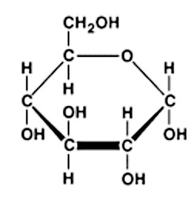
Carbs: vital fuel and more
Natural source of fiber
Spare protein from use as fuel
Help fat burn efficiently
Our #1 source of glucose
Why is glucose so special?
Notes:
The body highest priorities are meeting its energy (ATP) and glucose needs. Protein is an energy nutrient and can be converted to glucose when necessary. However, the best use of protein is for jobs that only protein can do which is to build/repair body proteins (e.g. enzymes, antibodies, muscle fibers, transporter molecules like lipoproteins, etc.) and NOT for use as a fuel!

Slide 4
Glucose….
A product of photosynthesis
Versatile, clean burning fuel
Some cells only use glucose to make ATP
……we have a 24/7 need for blood glucose
It is ‘blood sugar’
Basic building block of most dietary carbs
We store glucose…but, as what?
……Glycogen…. til depot fills, then as fat!!!
Notes:
Sunlight + CO2= H20→ ATP + Heat energy+ O2+ glucose (review lecture 2 for info on photosynthesis)
FYI: We do not have the technology for artificial photosynthesis but interesting advances are being made. See The Huffington Post link in slide for more details on a breakthrough harvesting solar energy and using it to capture C02 (like photosynthesis does) and make it into products of value to us…..some fuels (not edible fuels as plant photosynthesis can), polymers and pharmaceuticals

Slide 5
We make glucose from….
Glycogen (stored carb in muscle and liver)
Dietary and body proteins
Dietary carbs, our #1 source of glucose
: )
Notes:
Why is it a poor idea to make glucose (simple sugar) out of protein?
Wasteful
Extra work for the body to excrete the N that makes protein unique (there is no N in glucose so if you make it from protein you have to dump it out and that is work)
Expensive way to meet your energy needs.
Increases water needs (to make more urine to excrete the extra nitrogen)

Slide 6
Ideally, most glucose
comes from healthy dietary carbs.
Examples”
fruit
vegetables
grains, beans
grain by-products
milk, yogurt
honey, sugars

Slide 7
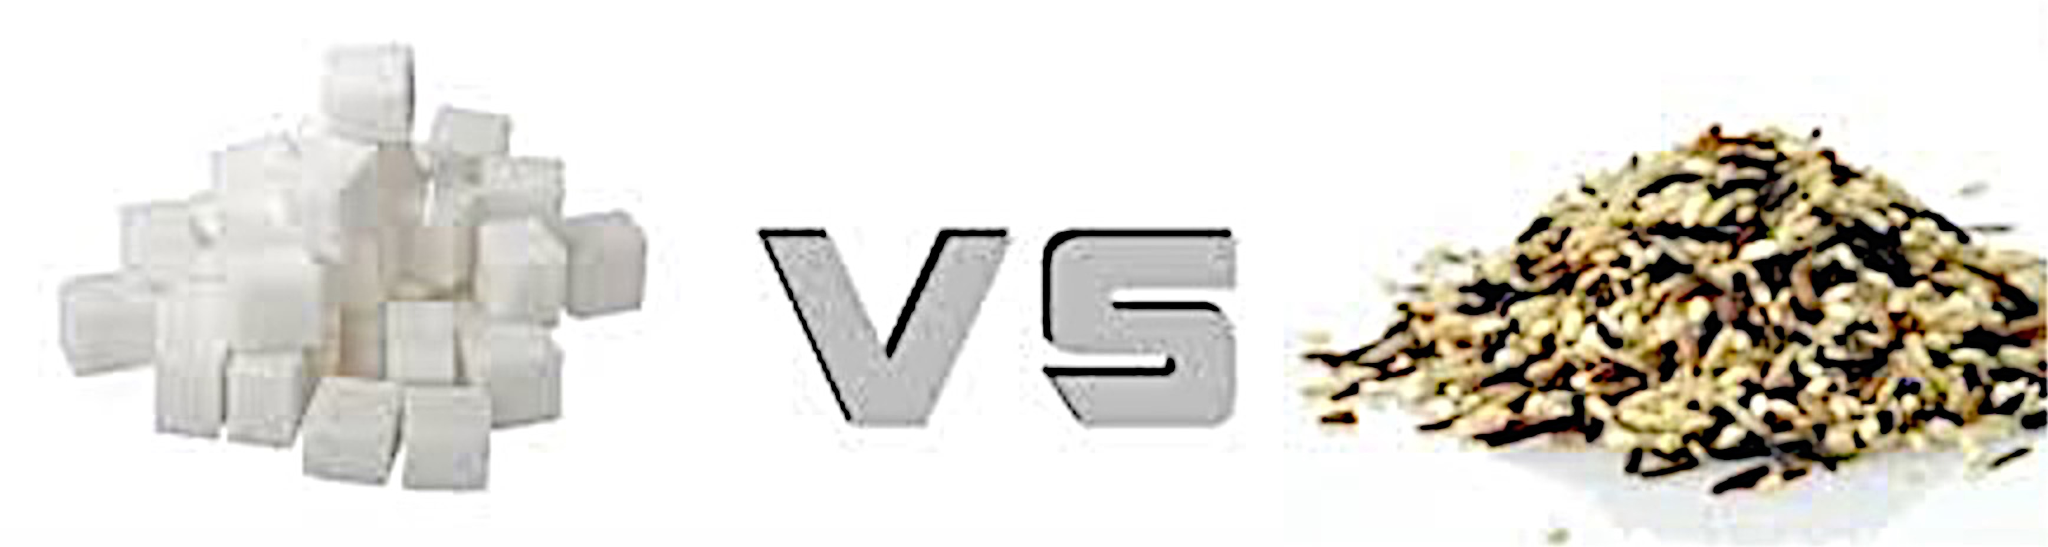
Carbohydrates
Simple - Complex
Simple structure
Label as syrups
‘ose’ suffix common
Glucose: blood sugar
Fructose, sucrose, lactose
Complex structure
Bulk of calorie intake
Starch, fiber, glycogen
Chains of glucose
King Carb !!
Cane, Beet etc. Sugar
Fruit Sugar
Milk Sugar
Notes:
Note: We can digest starch into its glucose components to be absorbed giving us 4 calories/gram. We cannot digest fiber into its glucose components so it travels on to the Large Intestine where there are bacteria that can breakdown some of the fiber into a form we can absorb giving us only about 1-2 calories/gram or maybe less. Without the bacteria in the LI, there would be no digestion of fiber in the human GI tract as we do not make the chemicals needed for its breakdown. Glycogen is not consumed in foods. We make it in the body and it is dumped into the blood (from the liver or muscle where it is stored) when we need a quick ‘fix’ of glucose.’

Slide 8
Carb Rich Foods: simple or complex
milk, sugars, honey
flavored yogurt, fruit juice
simple only
fruit
simple + complex
grains, beans
most veg
mostly complex
Notes:
The two main categories of dietary carbs are simple and complex

Slide 9
A Closer Look at Simple Sugar
Added vs. Natural
fruit and its juice
vegetables
grains, beans
milk, plain yogurt
honey, sugars, syrups
Notes:
Some products have both added and natural sugars e.g. ice cream, flavored yogurt

Slide 10
A Closer Look at Simple Sugar
Added vs. Natural
Fruit and its juice
vegetables
grains, beans
milk, plain yogurt
honey, sugars, syrups
Notes:
Some products have both added and natural sugars e.g. ice cream, flavored yogurt

Slide 11
Added sugar vs. Natural sugar
You add
Nature adds
Advice->limit intake
of added sugar
No limit on natural sugar
from whole fruit and
low-fat dairy
Max added/day
Men ~35 g (9t.)
Women ~25 g (6t.)
Notes:
Added: what we add to a product, usually to sweeten it. Typically a ‘syrup’ or word ending in ‘ose’
Natural: Milk (lactose) and fruit sugar (fructose). Natural sugars are a part of a food, not the food itself (sugar cane can be eaten raw ‘natural’…but it is considered an ‘added’ sugar)
The difference has more to do with the source of the sugar (e.g. fruit or cookies), than the structure of the sugar (e.g. sucrose or fructose).

Slide 12
Time Out ….Think
Lactose: a natural sugar found
in milk and most by-products.
Is it a simple or complex carbohydrate?
Is it an ‘added’ or ‘natural’ sugar?
Is it bad for you?
Does lactose intolerance =milk allergy
Describe the carbohydrate in flavored yogurt?
Notes:
Lactose is milk sugar (not sweet)
Lactose Intol : Lactose is not digested due to a missing or inadequate nz (lactase). If not digested, it can’t be absorbed. Therefore, it reaches the bacteria in the LI. Bacteria use it as a fuel. Causes unpleasant GI symptoms
Milk Allergy; allergy results when a foreign (e.g. cow) protein gets into the blood. Causes an unpleasant immune response.
Most of global adult population is lactose intolerant; milk allergy is uncommon.
Northern European were herders; if milk available, then survival advantage to those who tolerate milk (good source of protein, calcium, calories…plus it is portable. Any factor that help us to survive to reproductive age, has survival value.)

Slide 13
Eating carbs results in gain weight.
Not necessarily!
Only store fat (gain weight) if consume more calories than needed
regardless of what foods the extra calories came from!
Notes:
Remember you need a source of glucose 24/7. If you do not get it in your diet, you will make it. First your body turns to glycogen to help keep your blood sugar normal. When you use your stored glycogen, you liberate the water stored with it (3g water/1g glycogen) and excrete the water. It SEEMS you are losing weight quickly when you cut carbs…you are losing water weight released when glycogen is used as a fuel. The water weight will return as soon as you add back carbs into your diet and rebuild your glycogen stores.
The goal of weight reduction is to lose body fat not to dehydrate yourself!
NOTE: It is normal and beneficial to have a glycogen store.
Once glycogen is gone (few hours), if there still is no dietary source of carbs you turn to dietary protein and if that is missing, then body proteins are sacrificed to make energy (ATP) and glucose!!!!
Many people believe that carbs make you fat. This is not necessarily true. We only make fat when we consume more calories than we need from any of the energy nutrients (carb, protein or fat…all three can and will be stored as fat if they are excess calories)

Slide 14
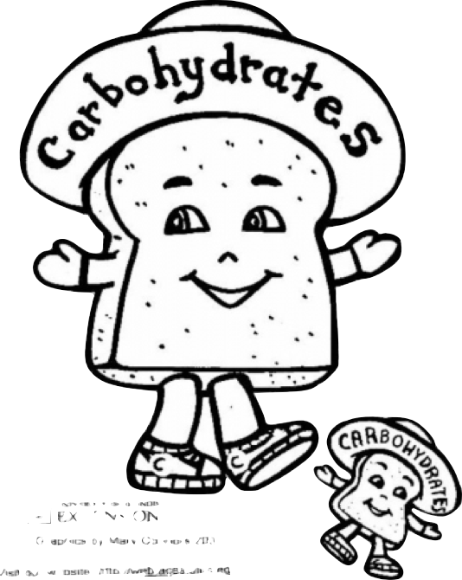
Complex carbs
Many glucose units linked together
starch (food)
fiber (food)
glycogen (storage carb in body)
Notes:
FIBER: We haven’t the enzymes needed to break down fiber into its constituent glucose units
GLYCOGEN: Store ~ 2000 Cal as carb in body, as glycogen. Note: 1 gram of glycogen is stored with 3 grams of water

Slide 15
Complex CHO (Plant Forms)
Starch
Storage glucose in plants
Fiber
  Difficult to digest
  Not destroyed by cooking
  Soluble vs. insoluble
  Important for;
  GI tract health
  heart health
  satiety
  elimination
Notes:
Good source of phytochemicals (health promoting plant based chemicals)…heart and cancer.
FIBER:
Adds bulk to the diet/GI tract…GI tract health-Decrease risk of hemorrhoids, diverticulosis, appendicitis
Filling, so eat less…. IF listening to hunger signals…which is an entirely different story!
Lowers Calorie density of a food
Slows absorption of glucose into the blood (particularly good fro someone with diabetes or high risk of the disease)

Slide 16
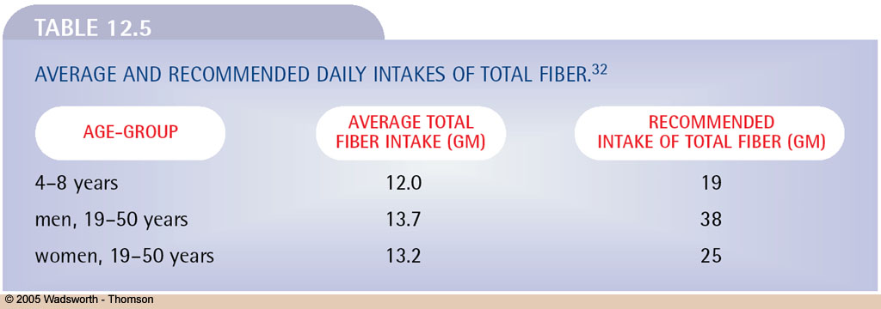
Fill up with real, whole food fiber!
Plants rule the fiber domain!
See Table 12.5 for a list of high fiber foods

Slide 17
Complex CHO (in animals)
Glycogen
  Storage carb
  ~ 2000 Cal/150 lb (70Kg) adult
  Diet and exercise alter glycogen reserves where stored in liver/muscle
  Stored with water!
Notes:
~400 Cal of CHO (as glycogen) in the liver
~1600 Cal CHO (as glycogen) Amount in muscle depends on size of muscle mass, training schedule and diet

Slide 18

Eat more healthy, complex carbs
veggies/whole fruit & grains/greens/beans
Eat fewer ‘added sugar’ foods
flavored yogurt/candy/pastries/soda
Max=~25 g/d (6t.) women ~35 g/d (9t.) men
Read full carb breakdown on Facts Panel
total carb, sugars, fiber
Check out ingredient list for carb origin
natural or added (latter covered by new label)

