Slide 1

  Today Tues. June 20
    Nutrition and Exercise
    Due Something! Assignment due
  Last Lecture Thurs. June 22
    Finish Exercise
    Domestic Hunger???
    Final (exam 3) Review
  Final Exam Dates
    9:30 class Tues. June 27 9:15-10:45
    11:30 class Tues. June 27 11:30-1:00

Slide 2
Please work alone. On the card provided, print your last name, first name and class time and answer questions.
1. Name the 4 fuels we consume (only 3 are essential).
  Which 2 are the main fuels for muscle work?
  Why are the other 2 fuels NOT preferred for muscle work?
2. Excess of any fuel is stored as what?

Slide 3
Eat Wise to Exercise
Nutrition & Exercise
Recreational
~1 hour/day
Objective: To teach the nutrition basics required for optimal performance.
Notes:
Goals:
Appreciate value of regular exercise in reaching and maintaining optimal health.
Understanding the principles of nutrition so that you can make the best food/beverage choices to achieve peak performance.

Slide 4
What’s so great about Exercise?
Reduce risk for many diseases
Improve mood
Lower risk of dementia
Reduce stress
Improve strength/flexibility
Minimizes lean mass loss when losing weight
Fun!
Notes:
youTube 23.5 hours

Slide 5
Nutrition Concerns for the physically active
WATER
LYTES
FUEL
Notes:
Hydration #1
Electrolytes consume with food and beverage
Fuel from the diet (ideally mostly healthy carbs, some healthy fats will be used as fuel. The vast majority of protein will be used to build/replace body proteins and not be used as a fuel)
Fuel from the body (stored carbs are limited, body proteins have other jobs to do besides be used as a fuel, fat is abundant in most all of us, even at normal weight and normal % body fat.)

Slide 6
#1 priority… fluids !

Slide 7
Why is Water so important?
Maintain:
Blood volume
Muscle structure → function
Cooling system
How much fluid needed?
Goal: urine frequent and clear
Need varies with size, temp, load, fitness, etc.
~ half your weight in ounces
Notes:
Blood volume 2/3 water…blood takes nutrients to/wastes away from the muscle
If blood volume is down, then performance is down
Muscle structure 2/3 water. Change structure, change function
Cooling…tea kettle on stove.
How much?
Increase need with increase size
Hot, untrained, heavy work → 40 C/day!!!! 2 ½ gallons!!! More typical ~8 C some
Keep urine clear and frequent! Weight self before and after exercise.
1% loss in body water→ decrease performance
Fit and trained to work in heat…lose more water, less salt. Avoid salt tabs unless extreme fluid loss, salt in/on food adequate for most

Slide 8
How-why Calculate sweat rate??
HOW? (Pre workout weight – post weight) + fluids taken during workout (e.g. 16 oz. water) = wt. change during workout. Divide by minutes exercised = fluid loss/min.
WHY? Tells amount of fluid needed to stay hydrated.
Notes:
Determine sweat rate wt (assumes no urination) Divide by minutes exercised to determine sweat rate per minute.
Example: During 1 hour workout
Pre wt (ideal if sans clothes)130 lbs., minus post wt (again best if no clothes) 129 lbs., PLUS fluid consumed 16 oz.=1 lbs.
Total change 2 lbs. (or 32 oz. weight loss/60min. So, need ~8 oz./15 min to stay ~hydrated).

Slide 9
When to Hydrate?
Sip over entire day
Hydrate on schedule→ thirst poor indicator of need
Avoid over hydration!
Notes:
Once thirsty, you are already dehydrated
Glycerol hyper-hydration is not recommended as it can lower blood serum sodium (sodium is required for normal muscle and nerve function)

Slide 10
What to Drink?
Plain ‘ol water !
If >1 hour; add dilute carb
If >3-4 hours; add carb and Na+
Avoid alcohol
  It’s a diuretic, poor muscle fuel, dangerous
Why?
Notes:
Make your own CarbLyte replacer (Gatorade1/3 cup sugar to a qt of water + Na+ add 1/8 tsp. /quart+ food coloring or little bit of fruit juice to color
DANGEROUS
Over-hydration: over-dilute lytes, then muscles and nerves do not function correctly. One way to spot hyper-hydration is if gain weight occurs during workout Bad sign!

Slide 11
Battle OF the Beverages?
Remember 1 tsp. ~ 4 grams
12 oz. serving | g. sugar | carb type | g. protein*
Powerade | 20 | HFCS | 0
LFChocMilk | 29 | Lactose, HFCS | 13
100% OJ | 36 | Natural (fructose+sucrose) | 0
Prot. Monster | 37 | Evap Cane Juice | 25
Coke | 39 | HFCS | 0
Notes:
Remember recommended maximum added sugar for women 6 tsp. /day (~100 cal) for men 9 /day (150 cal)
1 tsp is about 4 grams
1 gram sugar (carb) provides about 4 calories
NOTE: HFCS is high fructose corn syrup. Regular corn syrup (glucose + fructose) is modified and some of its glucose is converted to fructose. Fructose is sweeter than glucose so less is needed to get the same sweetness. This cuts cost of production. In addition, the US corn crop is highly subsidized (This is when our tax dollars are used to keep its price lower than it would be otherwise). These two facts resulted in huge amounts of added sugar coming into our diet as HFCS in the last couple of decades. HFCS is not poison, but it is cheap and overused in our food supply (e.g. bottomless soft drinks….)
Good to have a bit of protein after a work out so LF chocolate milk is great

Slide 12
ELECTROLYTES (lytes)
Required: normal muscle function & fluid balance
Major lytes: Na⁺ and K⁺ (2:1 respectively)
Sweat rate/composition influences need
Best for most→salt (NaCl) post-exercise meal
Lyte replacer drinks OK, usually not needed
Try:1C Greek yogurt + frozen banana + 1C. greens
Notes:
Na(Sodium) and K (Potassium) W ant about 2x sodium to potassium.
NOTE: Vitamin K is NOT the same as the mineral Potassium (chemical symbol is K+)

Slide 13
POTASSIUM (K⁺) RICH FOODS
POTAT
ES
AL
L
AVOCADO
COCONUT
WATER
MUSHROOMS
YOGURT
CANTALOUPE
ORANGE
JUICE
WHEY
POWDER

Slide 14
Primary Muscle Fuels-Make ATP
NOTE: Protein is a poor fuel !!!!
Low-moderate intensity, long duration activity
Adequate O₂ to muscle-aerobic
Fatty acids (fat) + glucose = fuel
High intensity-short duration activity
Inadequate O₂ to muscle-anaerobic
Glucose = only fuel
Notes:
We consume four fuels: Carb, protein, lipid (fat/oil) and alcohol. All are essential, except alcohol.
Best muscle fuels are carb and fat
Protein poor because when it is used for any job other than to build protein the amino group (NH2) must be removed and excreted by the kidneys in the urine. It is also not a preferred fuel because it has unique jobs that only protein can do in our body. If we use it for fuel, then some of those functions may be jeopardized.
Alcohol is not a good fuel, because muscles do not have the metabolic machinery to burn alcohol for fuel, plus is it s dangerous to perform most sports if you are drunk. Also, alcohol causes you to make urine faster, thus increasing your risk of dehydration.

Slide 15
BREATHING Easy
Aerobic environment
  O₂ available to the cell
  low intensity, long duration workout (sit, stand, jog)
  fuel mostly fat + some glucose (minimal, little protein)
  Goal: stay aerobic at as high intensity as you can
  Ideal way to decrease excess fat stores
  Improve heart/lung fitness → stay aerobic easier
Notes:
Staying aerobic means your cardiovascular system has gotten strong enough to deliver plenty of oxygen to the muscle cell even though you are working out super-hard. This allows you to keep burning fat (most abundant fuel) PLUS carb (glucose-limited) mix. This fuel mix….allows fat to be burned efficiently and for your limited carb supply to last longer. Good to save carb supply for when you need/want to kick up intensity for a short burst of activity

Slide 16
Breathing hard
Anaerobic
O₂ limited
Glucose ONLY
High intensity short duration workout (sprint)
Notes:
Creatine phosphate may help with high intensity anaerobic performance for a few seconds (long enough for’ lift’). Likely no harm from this, but all benefit disappears once stop the supp. Remember also that supps are poorly controlled so be sure you are really getting what the label says is included in the pill/tab.

Slide 17
Carbohydrate
Clean, versatile fuel. Body has limited supply
Before (1+ hr.) ~complex carbs-low fat
During ~usually only need if exercise > ~1hour
After~carb (simple or complex) + protein (~3:1)
Notes:
General CHO advice suitable for most.
If AM workout, advise Dinner hi CHO + bedtime snack.
Otherwise Bfast light, complex carbs, some protein, low fat; focus on fluids finish 1-2 hr pre-event if possible
150 lb. woman +~75 g Prot/day (estimated protein need at .5g/lb.)
Post 45 g carb + ~15 g protein/bfast
translated into food this = 2 slices of bread + 2 oz. meat (produce, mayo, mustard as desired) + small piece of any fruit.
16 oz milk and an apple
CHO during may be needed, but mostly only if CHO depleted at start of workout! Remember carb spares protein from being used as a fuel….a good thing!
GI Glycemic Index not taught in my classes. It won’t hurt you, but it is not a miracle approach to eating healthy
Also, popular now: two names for what seems very similar to me. Basically, it sets you up to workout carb depleted.
1. TRAIN LOW- COMPETE HIGH
2. Carb backloading
If this works for you, fine. It shouldn’t hurt you either, but it may make a morning workout more difficult and it is not a panacea (cure all) for building muscle as sometimes promoted.
Bottom-line on muscle building is the consistent demand on the muscle to provide more power. This stimulates growth. You provide the calories to do the work from carbs and fat in your diet and/or body. The building blocks for the muscle are from Protein and water. Not much protein is needed ~7-10 gm/ day extra should do it to support a pound gain of lean/week.

Slide 18
Protein
~.5 g/lb or ~ half your weight in grams
>1g/lb exceeds protein body can assimilate
~30 g protein/meal is upper usable limit for protein synthesis
Menu Idea: post workout MiniMeal PBJ + LF Milk
Notes:
ASSUMES ADEQUATE CAL/CHO INTAKE!!!!
If you are trying to lose weight while gaining mass, you will need more protein/pound ~0.7 g/pound

Slide 19
Is The Paleo Diet the answer?
Impossible to truly eat paleo!
You can live on it!
Encourages exercise
Discourages processed foods
Often excess prot. & low calcium
Restricts some healthy carbs; e.g. dairy, beans, grain, potatoes

Slide 20
Eat real food. Mostly plants. Not too much. Stay hydrated.
Eat right
Sit Less
Move More
Have fun
being
active!
Notes:
DO WHAT KIDS DO BEST!!!! Have fun moving!

Slide 21
Join a team
Add a thrill
Buddy up
Dancing counts
Do it!
Notes:
Ineffective Approach Effective Approach
No pain, no gain attitude No blame, no shame
Should Do Will Do
Ex for weight loss Ex to ↑ life quality
More is better Less, 4ever is better
Exercise Physical Movement
T. Anastasia 2007
You don’t have to be a high-performance athlete to benefit from exercise. Do the things you enjoy—walk, ride a bike, garden, swim, play.

Slide 22
Please work alone. Answer these questions again on the same card you used prior to the lectures on sports-nutrition
1. Name the 4 fuels we consume (only 3 are essential).
  Which 2 are the main fuels for muscle work?
  Why are the other 2 fuels NOT preferred for muscle work?
2. Excess of any fuel is stored as what?

Slide 24
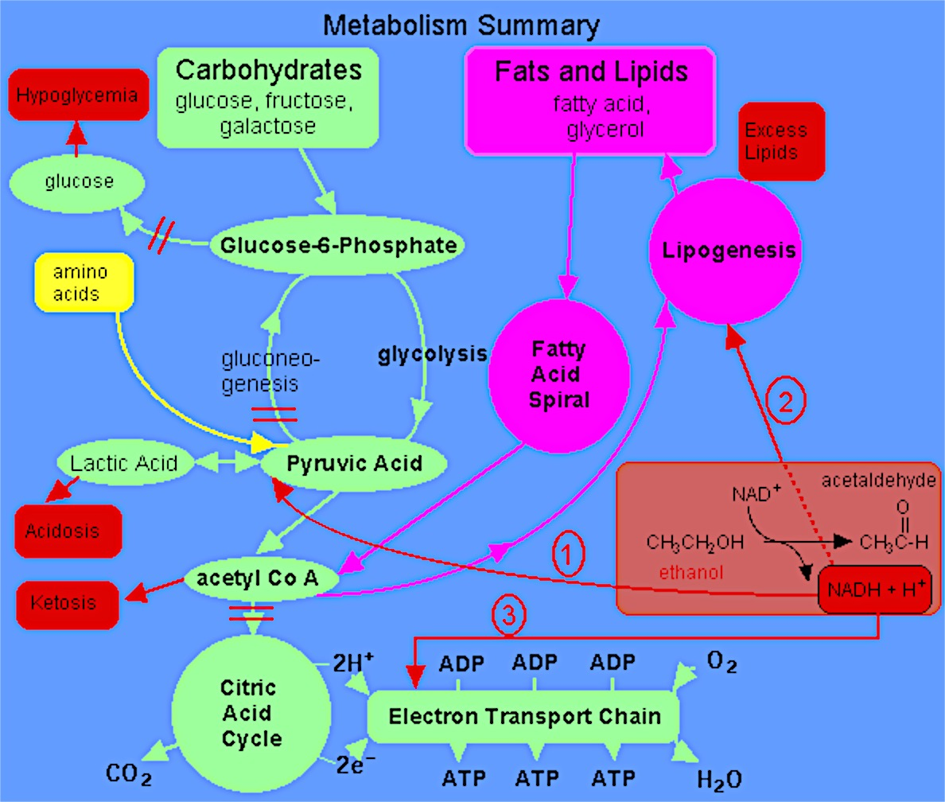
Notes:
glycolysis
TCA cycle
b-oxidation
Glycogenolysis
Gluconeogenesis
Ketogenesis
ETS

