Slide 1
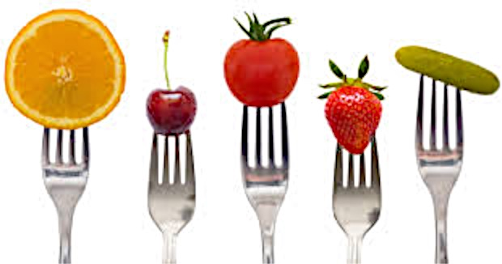
Nutrition 10
Spring 2016
Diana Wright PhD, RD

Slide 2
My Goal
To teach you the basics of nutrition science ;
To provide you tools to….
know when/if your diet is healthy.
be able to correct a poor diet, if desired.
distinguish nutrition fact from fiction.
Get an A+ in the class!

Slide 3
Want an A in Nutrition 10?
Read and use the syllabus.
Check my website weekly for postings.
Textbook strongly advised for lecture support.
Follow directions. Turn in quality work, on time.
Last Name, First Name, class time on all work.
And, in case you missed it the first time round…
Read and use the syllabus!
Notes:
Best way to reach me...wrightdiana@fhda.edu

Slide 4
What is nutrition?
What subjects relate to nutrition?
Pair to discuss.
Share with class.
Anthropology, anatomy, chem, health, agriculture,
marketing, psych, behavior, enviro sci, cooking, etc!
Notes:
Define it? How do you know if what you are eating is healthy?

Slide 5
Nuttrition is…….
An interdisciplinary, science that studies foods, their nutrient and other chemical constituents, and how they impact health. Brown 7th Ed.
Sustenance; provides raw materials for life.
Nutrients come in many shapes and flavors
Choose wisely. Truly, you ARE what you eat!!!
Notes:
Nutrition is a science, both academic and applied. It is related to many fields of science; physiology, biology, chemistry biochemistry, math, physics, environmental science, agriculture science, psychology, food science, medicine, etc. etc. etc.
Nutrition is what we consume to maintain life. In a hospital when they give 'life support' it means you are feeding and giving oxygen to a person. Remove these and what is living, will die.
Practically speaking most people just want to know 'what to eat'. In this class you will learn about the what, and some of the why….. of eating (what you need to eat and why you need it)

Slide 6
Which of these provide nutrition?
Most all foods provide nutrition (calories and
nutrients) Best to eat more of the foods that have a lot of nutrients/calorie (higher nutrient density) and fewer of the empty calorie foods (high in calorie and few, if any, nutrients).
Notes:
Slide showed photo of: beer, kebab, grasshopper, hot dog, sodas. These all provide nutrition, some higher in nutrients (higher nutrient density) than others but all offer calories (energy) and at least some nutrients.
Goal is good balance of calories and nutrients for health and growth. Want to avoid deficiencies/excesses→ can cause illness. Avoid classifying foods as good or bad. Even plain old sugar with few, if any, nutrients does have calories. And…meeting our calorie (energy) need is a top priority for our body. Meeting your energy need is more important minute by minute.... than meeting our protein, vitamin or mineral, etc. needs.

Slide 7

Best bet for expert advice
Registered Dietitian -Nutritionist (RD or RDN)
Requirements:
Bachelor’s degree/meet academic requirements
Internship
National registration exam
Continuing Education throughout career
Visit www.eatright.org to learn more

Slide 8
Today's homework
Read the course outline!
Notes:
Yep! This would be a great idea. You will see what I mean, if you do it : )

