Slide 1
Nutrition 10
Today Tues. May. 23
  Diet Assignment Due
  Return Protein Calorie Estimate
  Vitamins, Minerals and Supplements
Next class Thurs. May 25
  Finish Vit/Min
Reminder: Exam 2 is Thurs. June 1

Slide 2
Minerals and Vitamins

Slide 3
What do you know? T/F
High doses of vitamins can be toxic.
High doses of minerals can be toxic.
When in life is Peak Bone Mass achieved?____
Vitamin D is not essential because we make it from sunshine.
5. A typical US diet has ~10 mg iron/1000 cals.
6. Supplement overdose is unlikely in kids as
they have very high nutrient needs.

Slide 4
Minerals/Elements/Ash….A review
Inorganic, provide no energy, essential
Water soluble; stable in air, heat
Common functions
  Assist enzymes
  Body structure (bone)
Most better absorbed
from animal products
Notes:
Examples of less known essential mineral needs; Tin, Nickel, Vanadium, Silicon, Sulfur (in S-amino acids) and Cobalt and electrolytes (Na, Ca, K)
About 40 mins in the body but only 15 are essential, others from air or as a part of other nutrients we eat (like N in protein and cobalt in Vitamin B12

Slide 5
Iron (Fe)
#1 mineral deficiency globally
Common deficiency in young women
Excess is damaging
~6mg/1000 calories US diet
Recall it is added to ‘enriched’ grains : )
Which is best source of Fe....enriched flour, spinach or meat?
Notes:
Primary nutrient deficiency globally, particularly in young women.
Fewer binders in animal foods so absorption better than from plants. Examples of plant binders: phytates (whole grains, bran) and oxalates (dark leafy greens).

Slide 6
Best Fe source-red meat
Factors that increase Fe uptake
  Presence of heme iron (blood)
  Acidity (vitamin C rich foods)
    Potatoes, tomatoes, crucifers, citrus
  Deficiency
  Binders in plants decrease Fe uptake
Notes:
6mg/1000 Calories in typical US food supply. Iron need for men ~8mg/day (easy to achieve) women18 mg/day (tough to achieve) during child-bearing years
Red meat is red because it contains so much blood!

Slide 7

Fluoride excess→Fluorosis
Healthy
amount of
Fluoride reduces
decay!
What mineral
excess causes this?
Note: Fluoride : ) $≠$ Fluorine : (
Fig. 8-12, p. 301
Notes:
Figure 8.12: Fluorosis.
The brown mottled stains on these teeth indicate exposure to high concentrations of fluoride during development. Fluoride is not the same as fluorine gas…which is a poison
Fluoridation of water has been one of the most successful public health measures instituted in the US. F prevents tooth decay.
Check with your water company to find out if your water is fluoridated.

Slide 8
Iodine deficiency is rare in US
table salt is fortified with Iodine
What mineral deficiency causes this?
Iodine
prevents
Goiter &
Cretinism
p. 292
Notes:
In iodine deficiency, the thyroid gland enlarges—a condition known as simple goiter. Thyroid gland is in your neck and makes the protein based hormone Thyroxine (that helps to regulate BMR). Historically common in mid west of US ‘til salt was required to be fortified with Iodine. Deficiency common in parts of China….salt fortification with Iodine is being implemented

Slide 9

Osteoporosis
  chronic calcium deficeincy
  ~1 of 4(8) women (men) in US
  disease of aging (exceptions???)
  ⬆ risk in thin, white, older, female, sedentary, smoker, drinker and poor diet

Slide 10
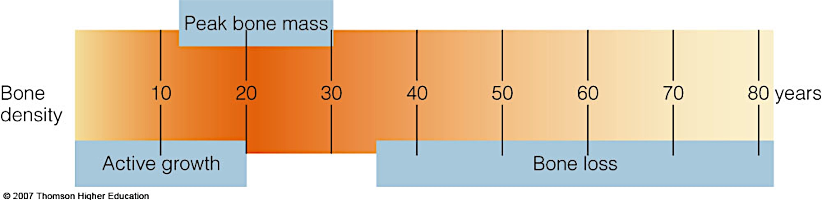
Goal: Achieve Peak Bone Mass by mid-20’s
to decrease risk of osteoporosis in old age!
Fig. 12-16, p. 421

Slide 11
Daily Goal ~1000 mg/day
Calcium Food Sources ~200-300mg
1 C milk (cow or soy)
1 C Greek yogurt, plain
1 ½ C ice cream
1 ½ C cooked starchy beans
1 C dark leafy greens
1 C fortified OJ (read label)
40 oranges!
Notes:
About 30% of dairy calcium is absorbed. Best when Vit D is present. Most US milk is fortified with vitamin D (added to milk as it is not naturally present in it)
About 5-60% of plant calcium absorbed with kale, broccoli and bok choy at higher end with regard to content and absorb-ability.

Slide 12
Other Calcium Considerations
Absorbed from SI into blood
  Vitamin D → greatly improves uptake
  High protein or sodium intake→ reduces uptake
Supplements
  Best absorbed=>Calcium Citrate + Vitamin D₃
  Caution: Upper Limit (UL) of safety
Notes:
Vitamin D3 goal= 600 IU
Calcium (Ca) goal- 1000 mg
Both vary over lifespan
Upper Limit of safety (UL)-2500mg
Upper Limit (UL) of safety. Ca> 2500 mg/day can lead to calcification of soft tissue (heart, lung, etc.
UL Vitamin D >4000 IU/day
Highly unlikely to occur unless you are taking supplements

Slide 13
Sodium (Na⁺⁾
More later on Na+ and potassium (K⁺)
Our primary source of sodium is salt!
Notes:
Only a small % of dietary sodium comes from our use of the salt shaker at the table or in home cooking.
More later on the MINERALS…. Sodium in Heart Health lecture and more on Potassium and Sodium in the upcoming Sports nutrition lecture.

Slide 14
Food 1st
VITAMINS
Supplements 2nd

Slide 15
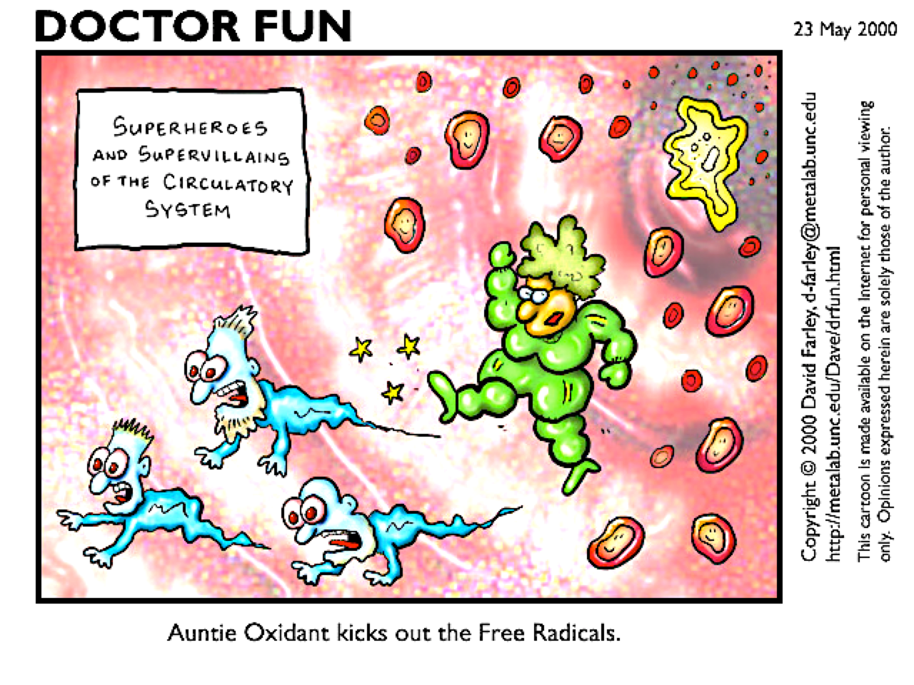
Vitamin Trivia
Fat or water soluble
Essential, organic, assist nz’s
Do not provide us energy
Easily destroyed by time, heat, air
Some have antioxidant function
  -destroy damaging particles in cells
-Vit C, E, A (as beta-carotene*) and Selenium (a mineral)
Some have Upper Limit (UL) for safe intake
Notes:
**‘Auntie Oxidant (antioxidants) ‘kicks out’ invading free radicals (damaging charged atoms) to protect the cell from damage.
Many vitamins contain Nitrogen…but not in a form (amino group) that we can use to build proteins.
Vitamin A (as beta carotene), E, C and Selenium, a mineral also act as antioxidants.
*beta-carotene is found only in plants, is non-toxic except it will turn your skin yellow-orange if taken in excess and is used by the body to make vitamin A. Vitamin A is found only in animal products, is highly toxic.

Slide 16
Supplement OD is #1 poisoning cause in young kids
Too much or too little = health risk
Best Source: fresh whole foods
Notes:
Whole foods….a cheap, easy way to have a healthy diet. Fresh veg, fruit, whole grain, low fat and/or lean sources fo protein

Slide 17
Fat Soluble Vitamins A, D, E, K
Excess stored in body; can be toxic!
Beta-carotene + E have antioxidant function : )
We make some, but not enough, so still essential!
Gut bacteria → vit K blood clotting
Beta carotene → vit A skin/eye health
  Plant form colorful but non-toxic
  Animal form- toxic in excess
Notes:
Vit A and D can be toxic. There are concerns about overdosing on vitamin E as well. Not much concern on vitamin K, there is not a lot in foods and our body self regulates its own vitamin K production by gut bacteria..
** We are not exposed to enough sunlight year round to make all the vitamin D we need in our skin. At our latitude we need a diet source of vitamin D from about Halloween (Oct/Nov) to St. Patrick’s Day(mid-March)
Here is a group of facts that need further explanation!!!
Vit D is required for calcium absorption.
Vit D induced calcium deficiency→ Rickets (spongy bones) whereas straight calcium deficiency → Osteoporosis (porous bones)
There are limited amounts of Vit D in foods, but we can make some Vit D when sunlight hits the cholesterol in our skin, it initiates this process
Vitamin D deficiency is more prevalent in dark skinned people because their greater skin pigment limits the initiation of vit D synthesis in our skin.
However, darker skinned people have a higher peak bone mass (PBM) potential and therefore we see less osteoporosis in this group.
Statistics show that darker skinned people who do not get enough vitamin D develop Rickets. However, darker skinned people who get enough vitamin D, but not enough calcium are less likely to get osteoporosis…perhaps because they absorb calcium more efficiently than lighter skinned people during growth due to their higher genetic potential for higher PBM. I am not sure of the complete explantation!

Slide 18
‘Vitamin’ D
Sunshine →cholesterol skin→ liver→ kidney’s → active D₃
What it does
  Bone health, mood, immunity, prostate health…
  Intestinal calcium absorption
Influences on requirement
  Skin color, age, home latitude
  Food sources
    Fortified dairy & subs, oily fish, cod liver oil
    D₃ supplement
Notes:
600 IU D3 if 1- 70 years
800 IU D3 if > 70 years
Can tolerate 1000IU…maybe 2000IU D₃ daily.
Measure 25 OH D3 in blood. Considered deficient if < 10-20 ng/ml. Some are more conservative and set deficient level at 30 ng/ml.. Consider though that 25OH D₃ levels can be 80 ng/ml in equatorial populations
Sunscreen limits D₃3 production
All of us need oral source D₃ living in Bay Area in winter~ Oct-Mar. Longer window of need if darker skin and older.
NOTE: At our latitude, Vitamin D is not made by our body year round. The sun not intense enough to initiate the synthesis in our body. Late fall → early spring we need a diet source vitamin D. The timing of need depends on the latitude where we reside, skin color and age. Highest self production in young Caucasian, living on the equator. Lowest for the older, dark skinned person living at a far north latitude (Canada, Scandinavia, Northern China, Russia)

Slide 19
Water Soluble B-vits, Vit C
Excess excreted, except B₁₂ (low toxicity)
Most easily destroyed/inactivated
Niacin (B₃) made in body
Tryptophan → niacin
  (EAA) (vit B-3)
‘Enrichment’ adds B vits + iron to processed grains
Vit C does not prevent colds : (
Folic Acid supp advised for
women trying to get pregnant!
Notes:
What else do you know about B-12? Very low toxicity. Has cobalt in its structure, required for CNS function, needed for RBC formation and is found in animal foods so vegans have high risk for deficiency (pernicious anemia)
Folic acid deficiency associated with neural tube birth defects, many of which will be handicapped and/or die
Recent B3 report that it can reduce risk of skin cancer. More data needed to confirm claim
Bogus vits Table 20.3 in text B-complex 9 vits: the usual + Pantothenic Acid (Homocys→Met), Biotin (vision, hearing, nrg nutr metab), Choline, Lecithin is phosphatidyl choline (mostly in animal foods and beans)
NOT VITs Gerovital, Hesperidin, Inositol, Lipoic Acid, PABA, Rutin

Slide 20
How do I get my vit/mins?
1. Canned → OK
2. Frozen → BETTER
3. Fresh foods if eaten fresh…
4. Best nutrient retention
-cook with least time/temp/H₂O
5. Supplement only if, and when, needed
-remember Food 1st-Supplements 2nd
Notes:
Phytochemicals, antioxidants, vit/min retention best when you least time to cook, least amount of heat and least amount of water in prep.
Regarding the above nutrients, Fresh is best, but only if eaten when truly fresh ( soon after purchase….not a week later!)
Michael Pollan clip on McD french fries
Check out Blue Apron for assistance preparing healthy homecooked meals.

Slide 21
Change Gears

Slide 22
Concept Map: Blood Sugar Level Control
Terms: blood sugar (glucose), hyperglycemia, hypoglycemia, glucagon, insulin, Type 1 diabetes, Type 2 diabetes, ineffective insulin, inadequate insulin
Draw a diagram logically linking all terms. Add explanations, arrows, descriptors as needed.

Slide 23
Supplements=Big Business
US market ~150 million users $32 billion/year in sales

Slide 24
How Supplement Smart are you?
All are True
True or False? Supplements:
1. Must be labeled as supplements
2. Can list ingredients as a ‘proprietary blend’
3. Don’t have to list side effects/interactions
4. Can’t claim to prevent, cure, treat disease
‘FDA doesn’t approve, test or regulate mnf/sale; nor does it test safety, purity, quality or effectiveness of supplements prior to sale’.
Notes:
Food Drug Administration (FDA)
FDA doesn’t approve, test or regulate mnf/sale
doesn’t test safety, purity, quality or effectiveness
prior to sale’.

Slide 25
Supplements Rule….... Without Enough Rules!
1994 Dietary Supplement
and Health Education Act-DSHEA
Established loose, loop-hole
filled rules for supplement labels
Notes:
DSHEA pronounced da-shay

Slide 26
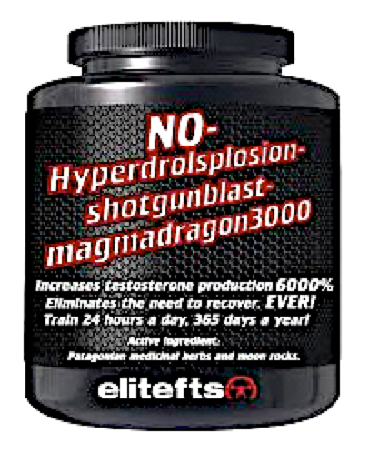
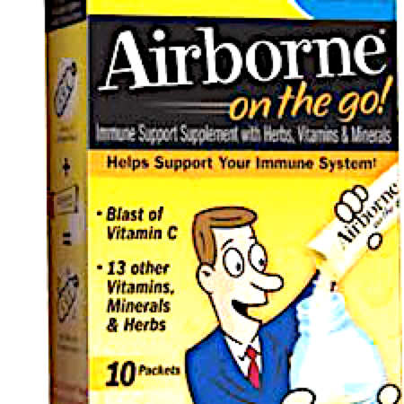
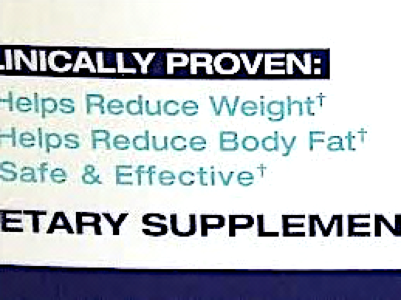
‘Claims’ with disclaimers!
This statement has not been evaluated by the FDA. This product is not intended to diagnose, treat, cure or prevent any disease.
Fat burner
Metabolism booster
Memory enhancer
Notes:
This disclaimer is required on any supplement that makes a structure function claim (such as immune support, fat burner, etc.)

Slide 27

What’s in the Bottle?
Large % of supplements are mislabeled for content (ingredient type/amount)
‘USP is 3rd party audit of product content. If product passes, logo allowed
Logo does not guarantee safety
or effectiveness of supplement
Notes:
USP has been around since 1820 and assures a supplement has been safely and sanitarily produced and that it dissolves in the body.
It does NOT test for effectiveness or safe action of the supplement in the body.
Consumer Lab (CL) is also good logo to see and/or use to learn more about a particular supplement on-line

Slide 28
Vitamin and Mineral Summary
You don’t need much
Deficiency or excess → illness and/or death
Foods 1st – Supplements 2nd
USP for label content accuracy
Best and most safe source is real food!
Notes:
1. Food are regulated; watch out for fortified foods; you can get too much of some vits/mins; supplements poorly regulated DSHEA 1990
2. Foods have other nutrients in them that supps do not
3. The body was designed to get nutrients from foods
4. Unlikely to overdose if vit min from food
Food First-Supplement Second M. Dunford (good reference) Remember USP is a guarantee for label content accuracy.

