Slide 1

TODAY Thurs. April 20
  Work on label assignment in class
    Assignment is not due today
Next Week Tues. April 25
  Turn in Label Activity-10 points-Due today!
  Gastro-Intestinal (GI) Tract
Reminders
  Exam 1 Tues. May 2
  See syllabus for all exam/assignment due dates
Notes:
A total of three (3) Scantron forms (2052 brown or 882E green) are required for my entire Nutrition 10 course.

Slide 2
Deciphering Labels-part II
The Language of Labels

Slide 3
Labeling Activity-Product Comparison
Compare two products using labels provided
Complete the handout
Explain your choice to another group. Do they agree with you?
Due next class. One paper/team, typed, last name/first name

Slide 4
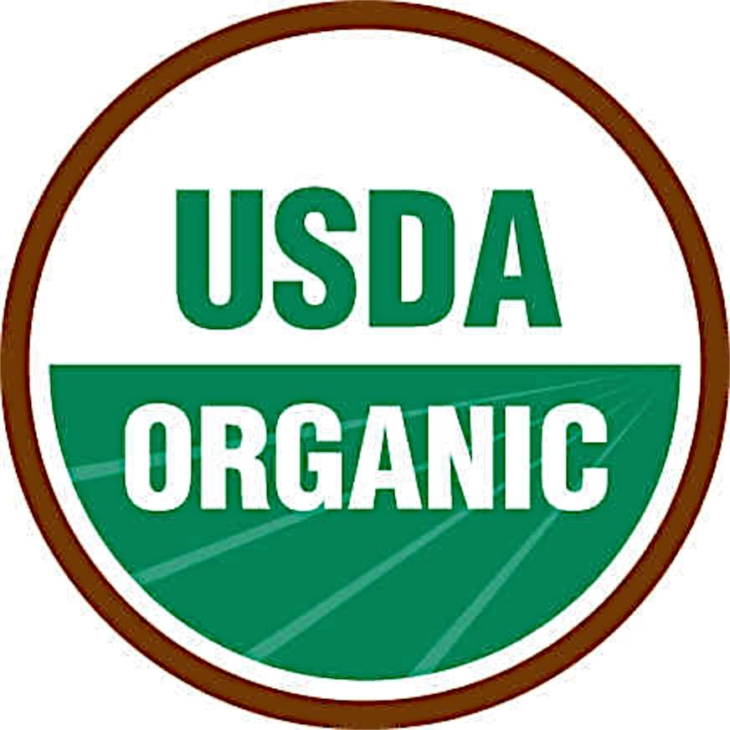



Reliable Logos to Recognize
Notes:
USP logo important since many of people take supplements and trust that what is in the bottle is what is on the label. This is not the case. Supps DO NOT have to be proven to be safe or effective prior to being sold. If they make enough people sick the FDA is allowed to order a recall…but this is a slow inefficient process. USP is a 3rd party audit that guarantees the supp ingredient list is accurate, therefore you can be sure you are getting what you are buying. REMEMBER...USP doesn’t guarantee that the supp is safe or effective!

Slide 5
Quality Assurance Labels-Supplements
USP and Consumer Lab (CL)
Look for on supplements
Assures accurate ingredient list
Does NOT insure safety or effectiveness
Notes:
This slide is a bit out of context as it refers to supplements, NOT packaged foods. However, since supps are notorious for being mislabeled, and many of us take them, it is a good idea to buy ONLY USP products. USP (or CL) guarantee purity and accuracy of ingredient list on a supplement. It does guarantee anything about efficacy or safety of the supplement. More later on Supplements

Slide 6
Certified Fair Trade (FT)
Typical products: coffee, tea, chocolate, cotton
Pro: Safer working conditions, more fair wages paid;
No child labor, community support provided, no GMO
Environmental safeguards required
Con: Often pricey, high Carbon-footprint, ‘luxury’ items
FT items may be, but are NOT necessarily, organic or healthy, and usually not locally grown/produced.

Slide 7
Labeling of Organic Foods
‘100% organic’ = all ingredients are
organically produced
‘Organic’= 95% ingredients organic
‘Made w/ organic ingredients’
>70% USDA seal NOT allowed

Slide 8
Organic Pros/Cons-you decide!
Better for environment →better for us!
Usually more expensive.
  Not subsidized, smaller scale production, demand> supply
  Costs for worker, animal, soil/air/water protections
  Land fallow (resting) on rotation to rebuild, so no crop!
Organic is NOT necessarily CFT, fresh or local!
Notes:
Organic is often more expensive than conventional product
See link
Time is money! Takes more time, labor to produce smaller crops--> increase price
Demand often exceeds supply
Fields fallow more often to allow time to rebuild soil
Smaller output means cant take advantage of economies of scale, machinery to harvest, processing and transportation to market
Must segregate organic from conventional produce in market place
Not subsidized like conventional agriculture is.
Conventionally produced foods do not take into account worker, animal and soil health as does organic so costs less. Plus conventional benefits from government subsidies.

Slide 9
Organic: (A few) USDA Qualifying rules
  Plants
    no synthetic fertilizers, pest or herbicides x 3yrs.
    no sewer sludge used; cannot be irradiated
    no use of genetically modified (GMO) seeds
  Animals
    no factory farming conditions
    no antibiotics/hormones (prevent disease/ promote growth)
    no irradiation
    fed 100% organically grown feed
Notes:
No CAFOs (confine animal feeding operation) used in animal husbandry.

Slide 10
Genetically Modified Organism (GMO)
DNA of live organisms/cells, modified in a lab
~60%+ of US processed food has GMO content
GMO label NOT required on US foods : (
Pros v. cons GMO unfolding over time
Want to avoid it?
Buy 100% organic or look for NON-GMO certification
Check out Trader Joe’s products
Whole Foods to be 100% Non-GMO
Notes:
NOTE: 1992 legislation allergy clause: If gene from a food containing a common allergen (peanuts, shellfish) is added to a new food, then the new food must be labeled for allergy sensitivity (but no GMO label required) Example: making a new tomato and add a gene from soy (allergen), then must label tomato for allergy sensitivity.
Only about 20% of Americans think they have eaten GMO food, yet 60-80% of soy and 25-30% of corn is GMO in US! The vast majority of us have eaten GMO food
Foods likely to have GMO Corn, Rice, Sugar Beets, Wheat, Canola, Soy, Flax…and others

Slide 11
CFT, Organic, Non-GMO
Too pricey?
Think before you buy!
Better-Increase intake of conventionally produced veggies/fruits if organic, CFT, non-GMO are unavailable/un-affordable.
Do what you CAN!
  New label rules will help you make better choices.
Notes:
Frozen vegetables and fruits are a cheap satisfactory substitute for fresh, CFT, organic, non-GMO…etc. produce
Most of us have many ways we can improve out diet. Pick one and work on it!.

Slide 12
Labels are Changing- July 26, 2018
‘Added sugar’
is separate
entry
Calorie listing and serving size
more obvious
%DV revised and Footnote
eliminated
Vitamin Mineral
listing changed
Add Vit D, K+
Remove Vit A & C
Notes:
K+ is the mineral potassium

Slide 13
Standard portion for
foods/beverages enlarged.
½ cup→ 2/3 cup
8 oz.→12 or 20 oz.
A good or bad change?
  More realistic
  Normalizes excess

Slide 14
Til then......
Good→ Better→ Best!!!!!
Consume more food products that make few/any claims!
Use ingredient list and Nutrition Facts panel! Ignore the rest!
Better yet, consume more foods requiring NO label such as vegetables and fruit!

