Slide 1
Applying to De Anza as a student

Slide 2
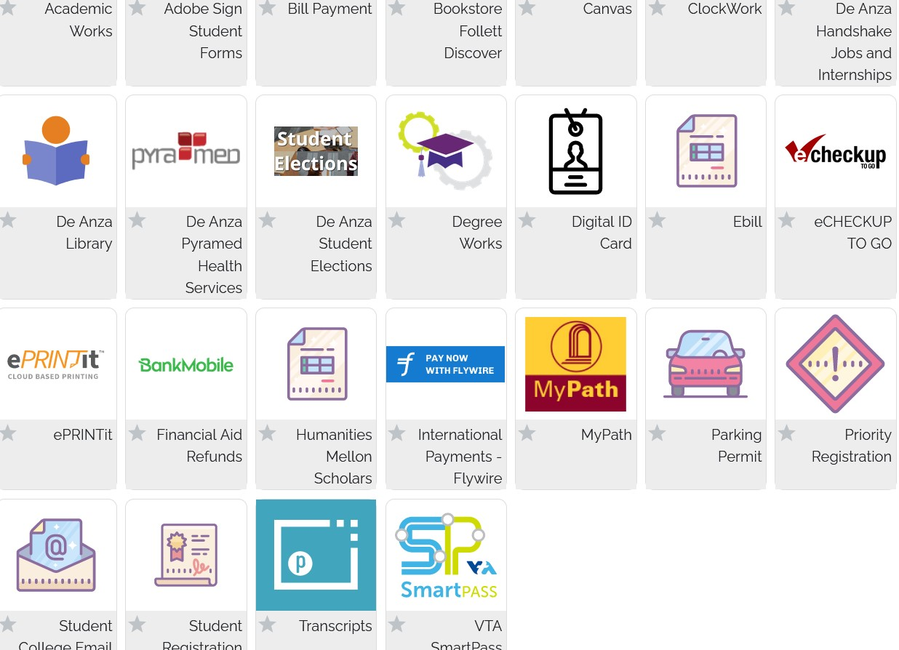
Problem # 1:Tab for student registration right at bottom.

Slide 3
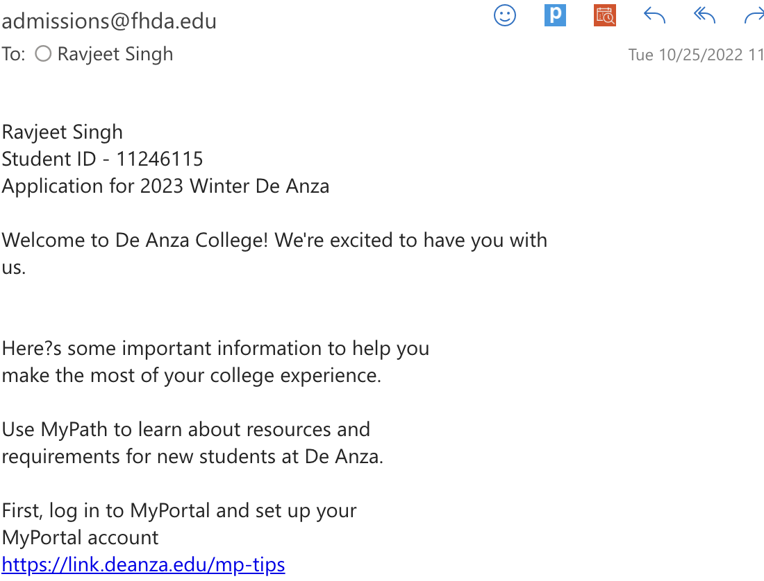
Problem # 2: Registration Dates- you may not get registration dates right away if you are a former student

Slide 4
In the welcome letter…
It would be good to have:
If the student does not get a date to register within 24 hours, then, the possible reasons could be:
Changes made to application from previous one (SSN, Release of information)
Vaccination cards not uploaded

Slide 5
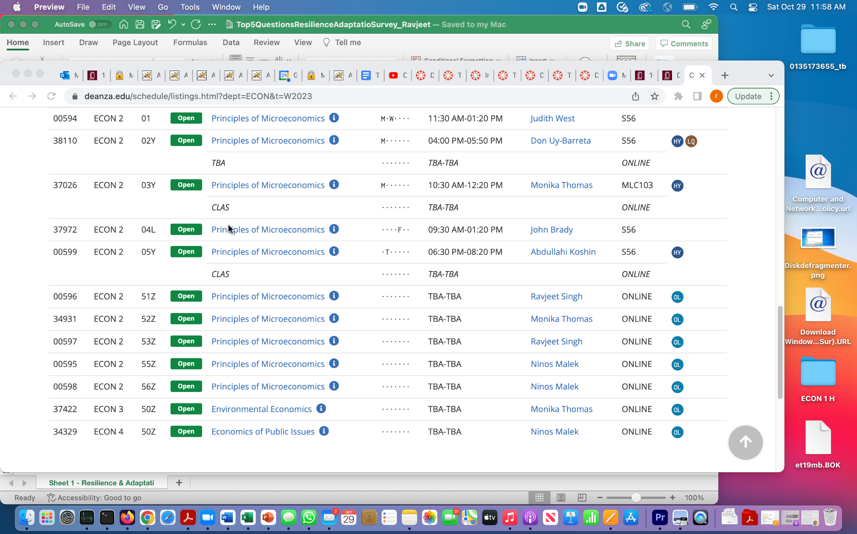
Problem # 3: Legend for Late Start missing on schedule (LQ)

Slide 6
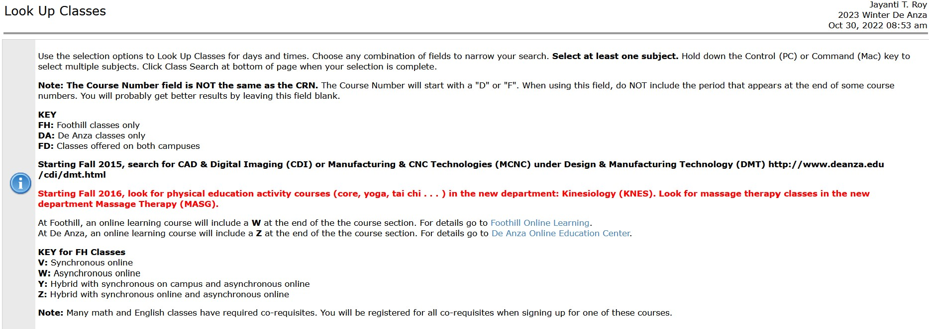
Legend for Late Start missing on schedule

Slide 7
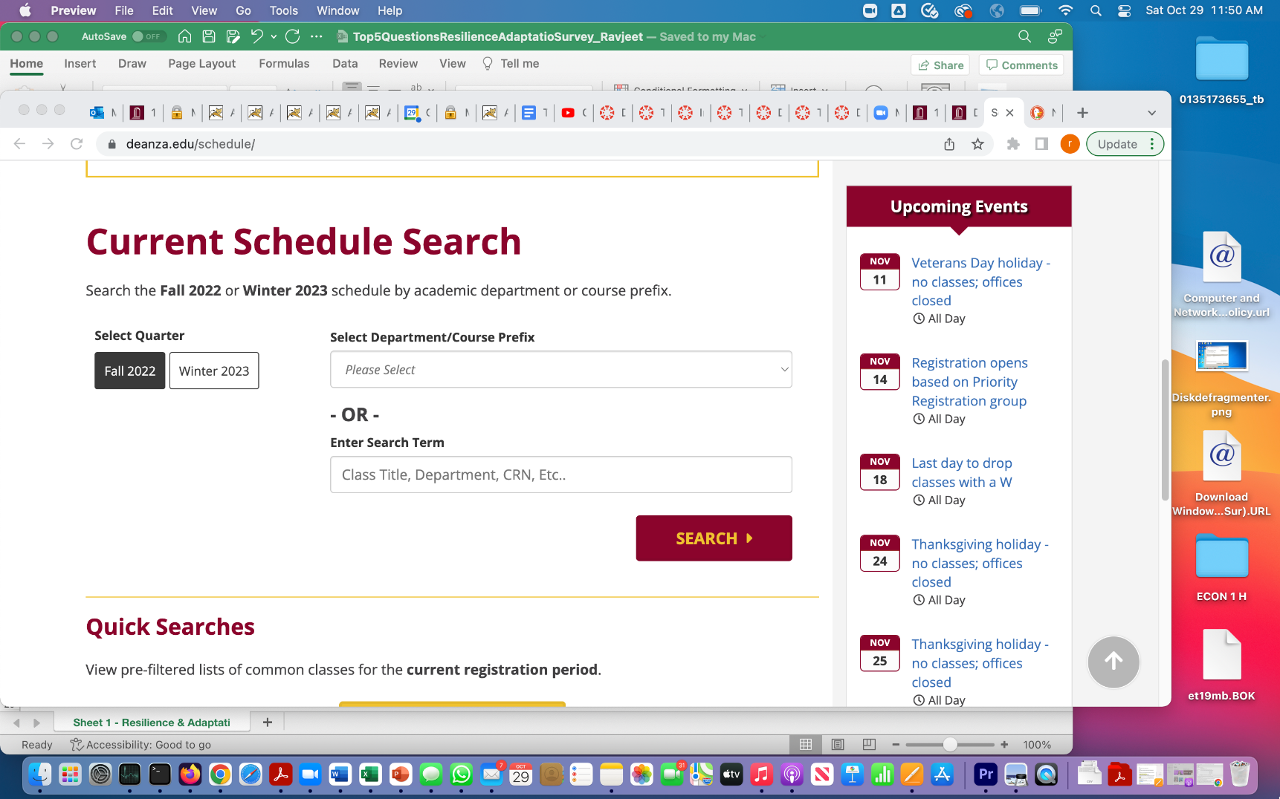
Suggestion: Fall should be Late Fall after late date to regsiter

Slide 8
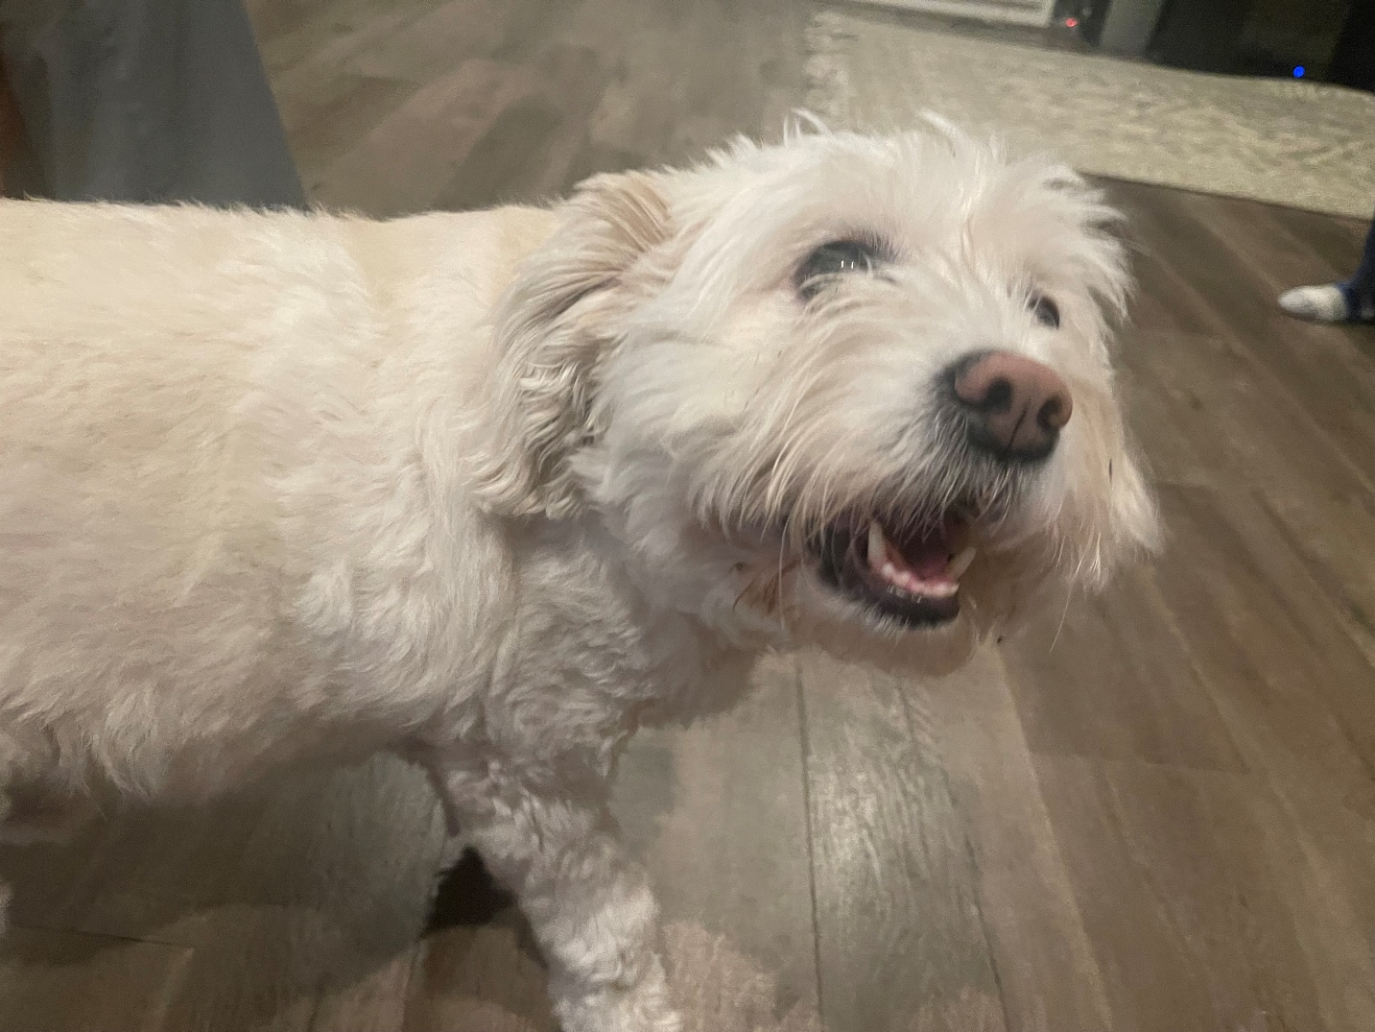
Questions…?

