Slide 1
OER/ZTC: Senate Update
Shagun Kaur: 5/13/24
This work is licensed under a Creative Commons Attribution 4.0 International License.

Slide 2
Agenda
History [SB1359]
ZTC Grants
Implementation
Acceleration
Acceleration 2.0
Impact Grants
OER Expansion Grants
OER Liaison

Slide 3
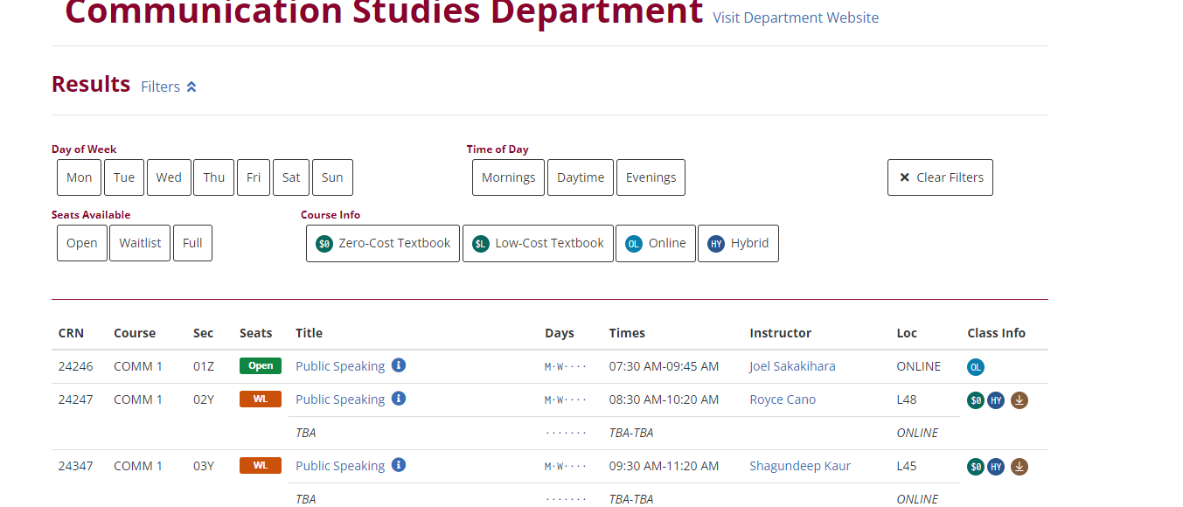
SB1359
Clearly highlight, by means that may include a symbol or logo in a conspicuous place on the online campus course schedule, the courses that exclusively use digital course materials that are free of charge to students and may have a low-cost option for print versions.

Slide 4
Zero Cost Degree Grant Program [ZTC]: An opportunity
In the Budget Act of 2021-22, the Legislature appropriated $115 million, one-time funding to the ZTC program to reduce the overall cost of education and decrease the time to completion for California community college students. (Education Code Section 78050-78052)

Slide 5
Implementation Grant: $180,000 Zero Textbook Cost Math Transfer Degree Pathway
Training on accessibility, OER , Creative Commons License, and creation platforms like LibreTexts, ADAPT, H5P etc. [Spring 24]
Project Management [F24-F25]
Curation, remixing, and creation of OER for the following courses:
Math 1A: Calculus
Math 1B: Calculus
Math 1C: Calculus
Math 1D: Calculus
Math 2A: Differential Equations
Math 2B: Linear Algebra
By F25, Math will be a Zero Cost degree for students at De Anza College

Slide 6
PSME: Student Equity and Success Champions
Doli Bambhania
Rani Fischer
Vinh Nguyen
Neelam Shukla
Danny Tran
Jyothsna Viswanadha
Bill Wilson
Fatemeh Yarahmadi

Slide 7
Acceleration Grant: $150,000 Zero Textbook Cost Kinesiology Transfer Degree Pathway
Training [Spring 24]
Project Management [F24-F26]
Curation, remixing, and creation of OER for the following courses:
KNES 45: Intro to Kinesiology
PE Area 1-6
BIO 40A, 40B, 40C: Human Anatomy and Physiology
CHEM 30A: Intro to General, Organic and Biochemistry
A total of 6 classes across three departments
By F26, Kinesiology will be a Zero Cost degree for students at De Anza College

Slide 8
KNES/BIO/CHEM Hall of Fame
Cheryl Owiensky
Rusty Johnson
Danielle Altman
Lakshmikanta Sengupta
Sushmita Sengupta
Brendan Mar
Gorkem Ermut
Semere Bairu
Burcak Artun

Slide 9
Acceleration Grants: In the works
We received $125,000 seed money for the following:
A.A.-T in Political Science [ Jim Nguyen and Bob Stockwell]
A.A.-T in Communication Studies [ The whole department☺]
A.A.-T in Psychology [Susan Thomas]
Certificate in Data Science [Mary Pape and Clare Nguyen]
Advanced Cert in Early Childhood Education [Jayanti Roy]

Slide 10
Let’s Keep it Going: Money, Money, Money
Student Achievement Gaps?
Equity Goals?
Low Enrollment?
Tired on the publisher cost increase for every “version” change?
Textbook does not speak to our student population?
Examples and text missing a DEI lens?
Need better ancillaries?
Need homework system/software etc. that won’t go away when money runs out?
There is currently $66.5 million remaining to be allocated to colleges for the ZTC Degree Grant program.

Slide 11
Acceleration II Grants
($200,000 capped per eligible program, not per college)
For pathways that have not been awarded (specifically in a region) in prior phases.
Unique and non-duplicative academic program pathways to make the program more accessible to a larger number of students.
Deadline: Dec 16, 2024

Slide 12
Impact Grants
($200,000 capped per eligible program, not per college)
Support high impact programs that benefit larger numbers of students at the institution.
Colleges that did not submit initial ZTC Acceleration Grants in subject matter areas that were likely duplicative and/or missed the associated Collaboration Cohort efforts are strongly encouraged to apply.
Admin of Justice, Anthropology, Art History, Biology, Business, Economics, English, History, Humanities, Journalism

Slide 13
OER Expansion Grants - Individual
($20,000 capped per eligible course, not per program or college)
For an existing ZTC program pathway or a ZTC program pathway under development using this resource to convert course textbooks to OER.
Courses submitted for OER Expansion grants must not have been identified in a prior ZTC Degree Grant Program pathway plan.
This grant may be a useful option for developing additional GE courses for students to complete their program of study in an expedited manner, per the authorizing legislation

Slide 14
Communication
Who is using low cost and zero cost.
Talk to your colleagues and encourage them to reach out.
Are you interested in your course being OER?
Would you liked to be informed/engaged in this work on campus?

Slide 15
Campus Engagement: OERI Liaison
The OERI supports OERLs so that they may serve as advocates by taking an active role in increasing local OER awareness, adoption, and support.
Each college’s OERL will be eligible for a yearly stipend of $1,000.
Attend two additional OERI or OERL Events (Webinars or Conversations) during the term, or host one.
Communicate with your local senate and faculty regarding the work of the OERI by forwarding the OERI Newsletter broadly and reaching out to specific faculty and departments as warranted.
Check-in at least twice with an OERI representative to share local needs and issues.

