Slide 1

De Anza Event Center
Campus discussion-Evaluation of needs, February 28, 2020

Slide 2
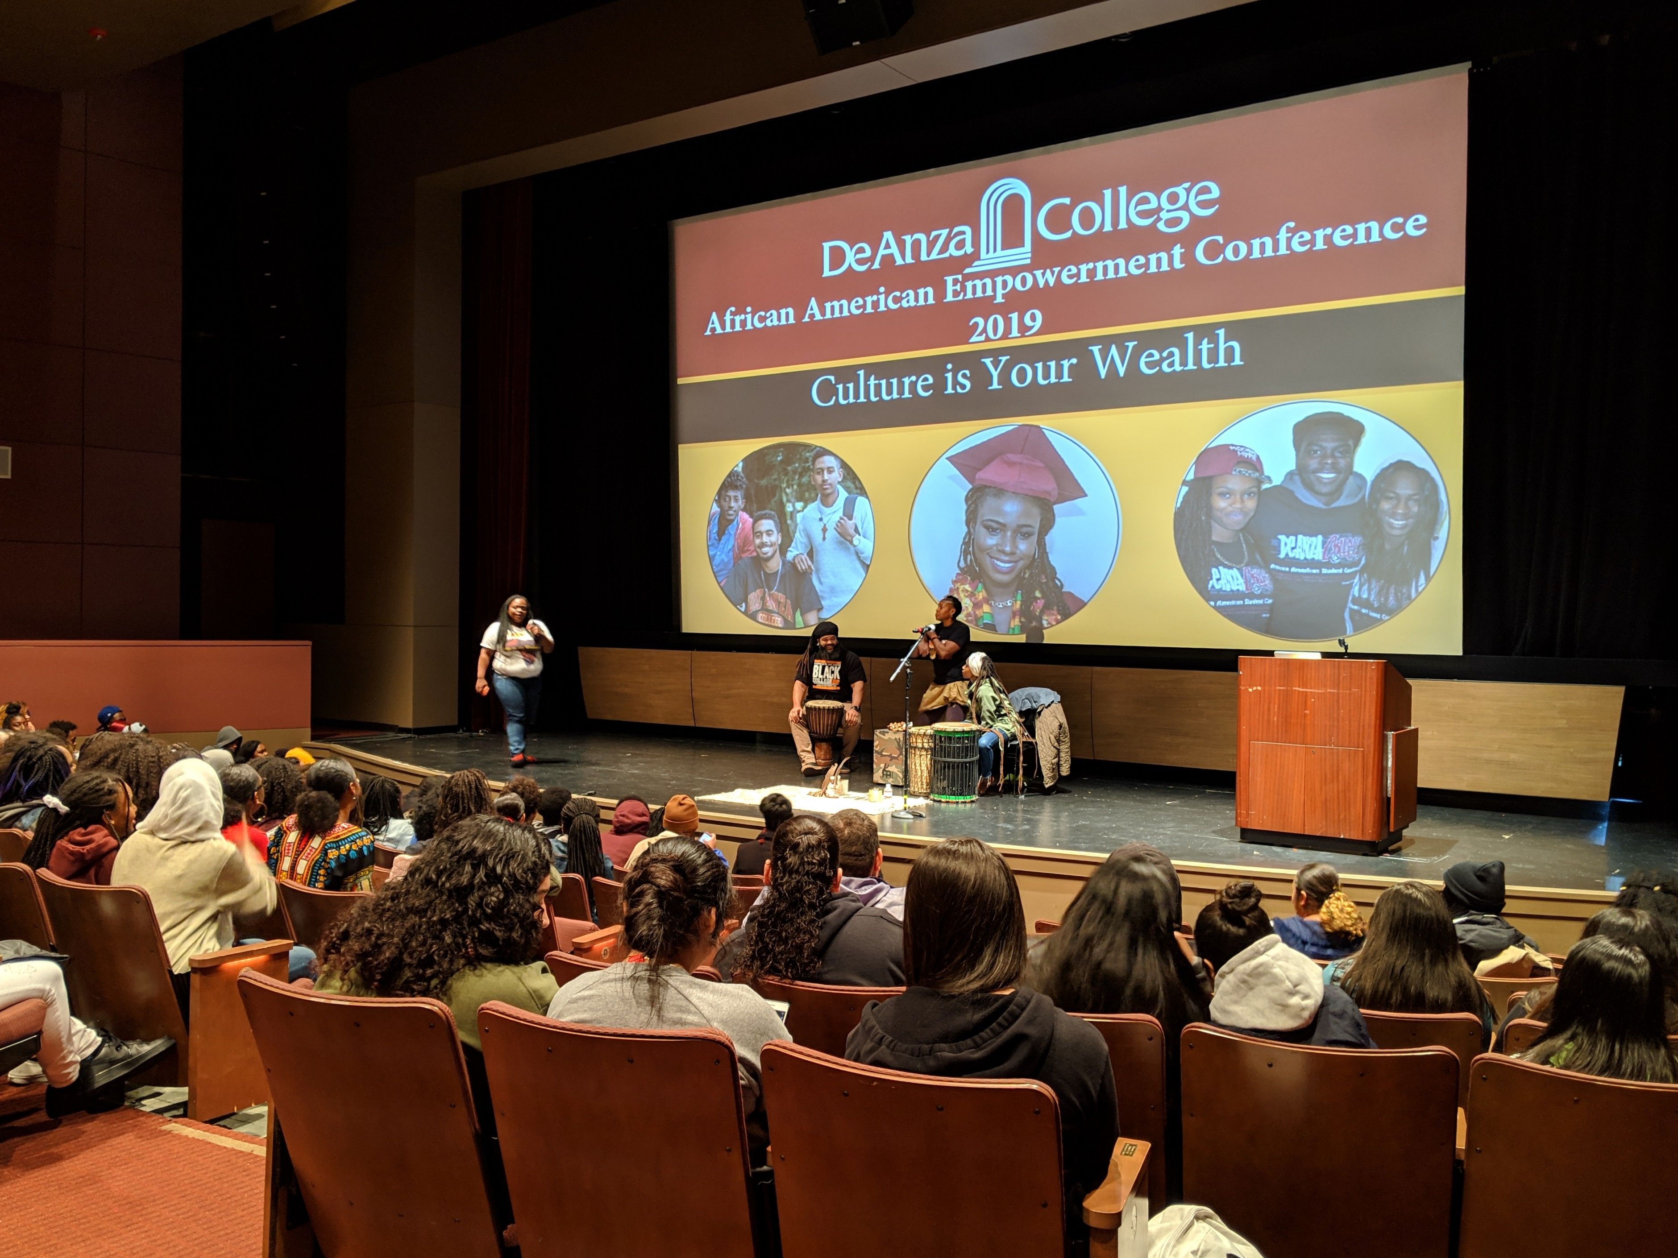

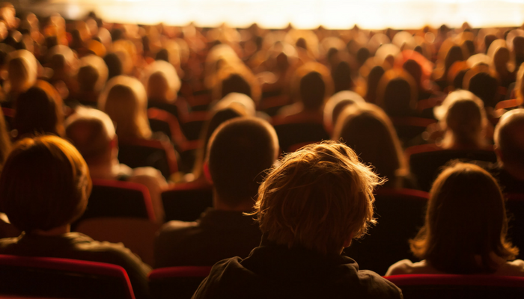
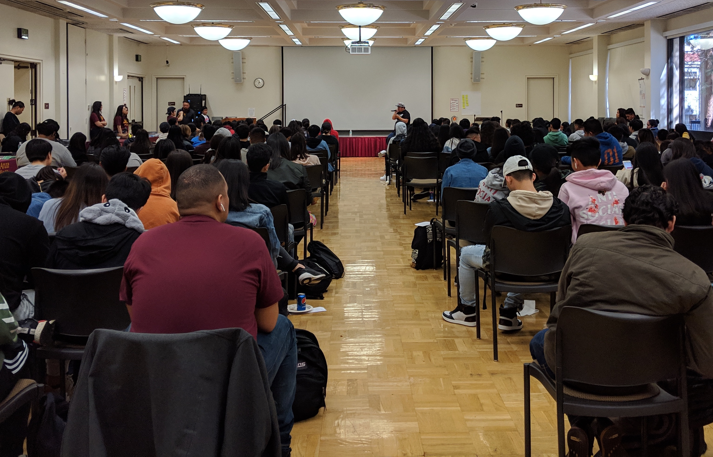
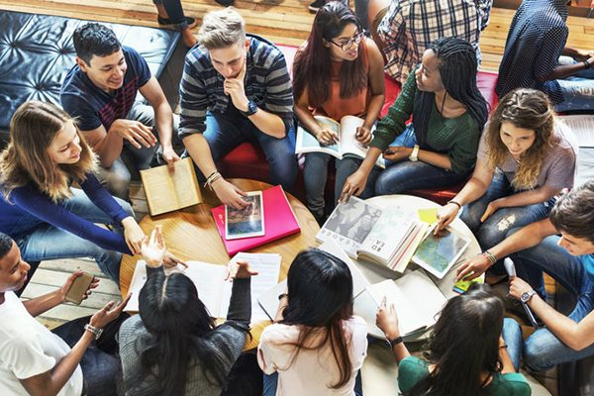
User Groups
Campus
Community
Rentals
District

Slide 3
Possible Building Elements
Conference /Meeting Spaces
  Student/Education spaces
  Lounges
  Meetings
  Flexibility
Performance Spaces/Theater
  Types of Performances
  Stage
  Seating Style
  Performance Preparation (Green Rooms, Dressing Rooms, Restrooms)
  Rehearsal Spaces
  Instrument Storage
  Back-of-house (set/production) storage and staging
Food Serving
  Kitchen
  Serving Style
  Dining/Eating locations
Gift Shop
Key Building Facilities
  Restrooms
  Elevators
  Utility Rooms
  Storage
  Lobby

Slide 4
Existing Theater Buildings
Visual Performing Arts Center (De Anza) Flint Center (De Anza)
Overall Building Size = 26,258 square feet Overall Building Size = 84,218 square feet
Stage Size = 2,942 square feet Stage Size = 4,656 square feet
Number of Fixed Seats = 400 Number of Fixed Seats = 2,570
(Euphrat Museum = 2,000 square feet)
Smithwick Theater (Foothill)
Overall Building Size = 24,460 square feet
Stage Size = 1,635 square feet
Number of Fixed Seats = 941

Slide 5
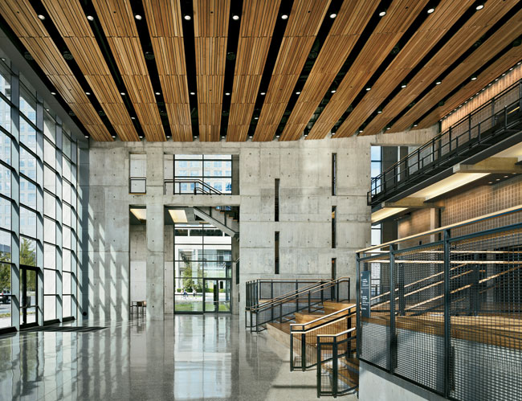
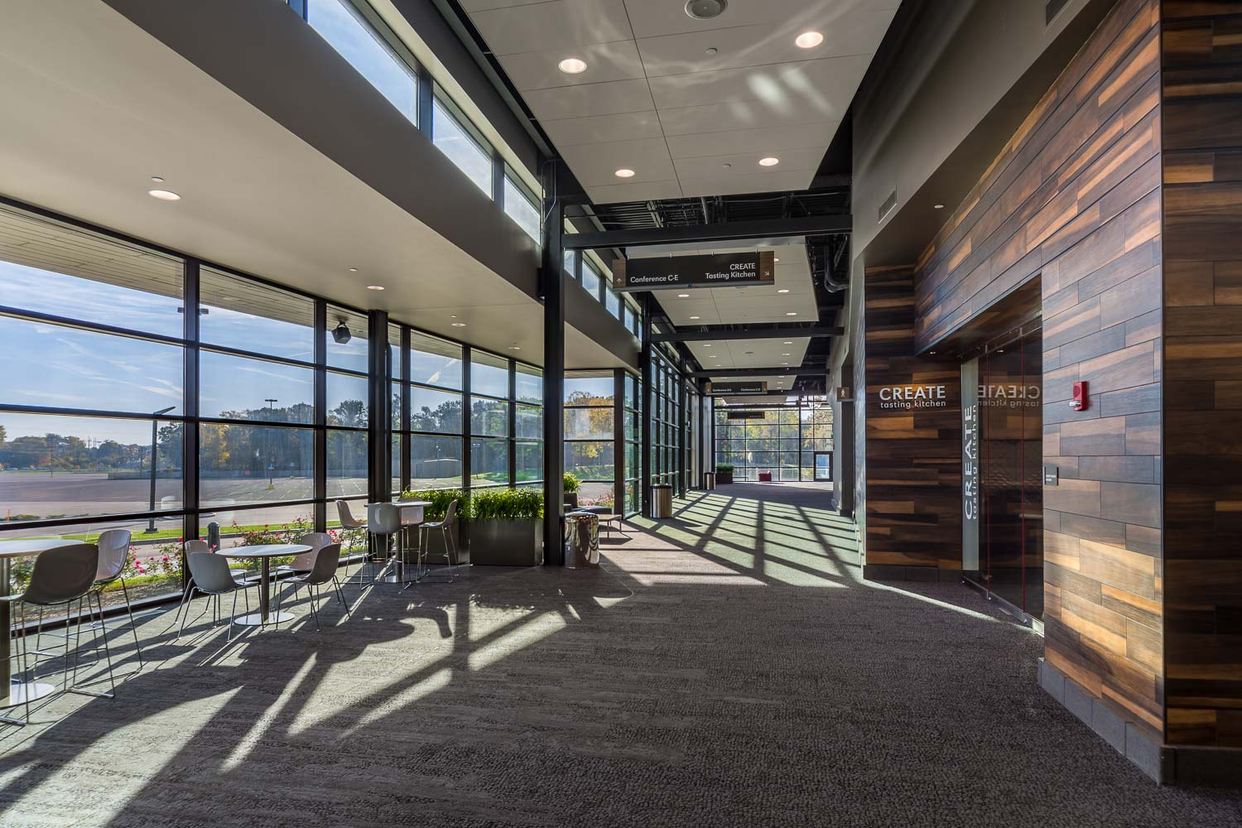
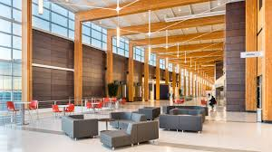
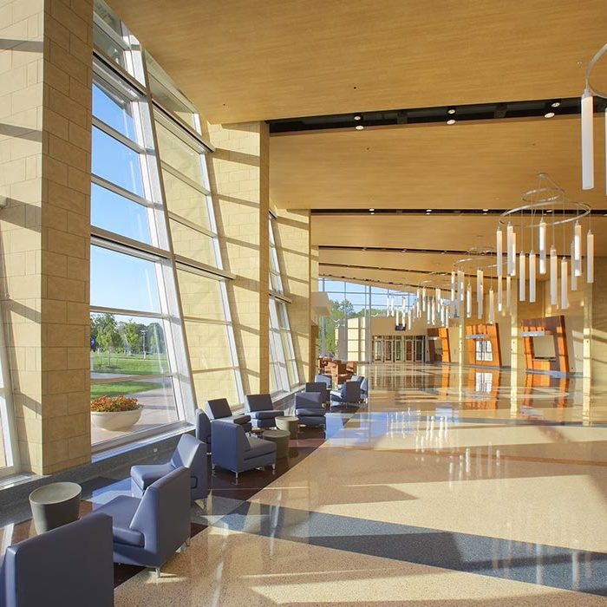
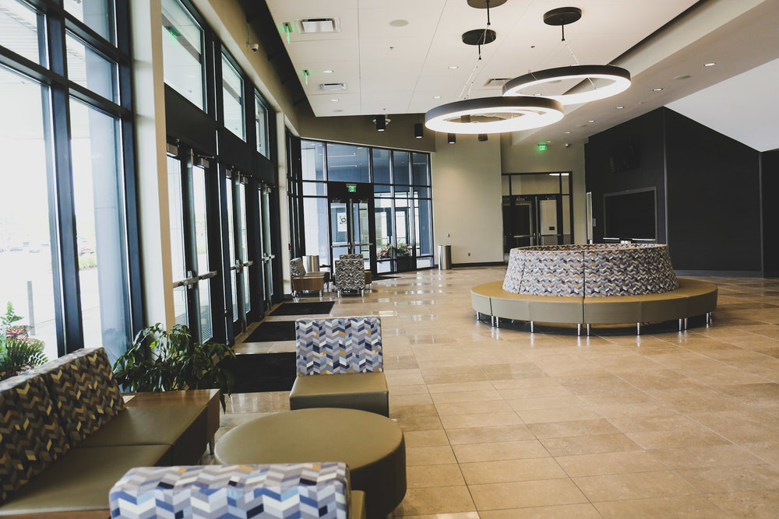
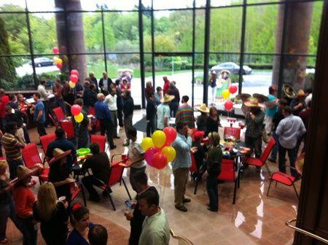
Lobby
Entrance
Gathering
Event location – concession, ticketing, check-in

Slide 6
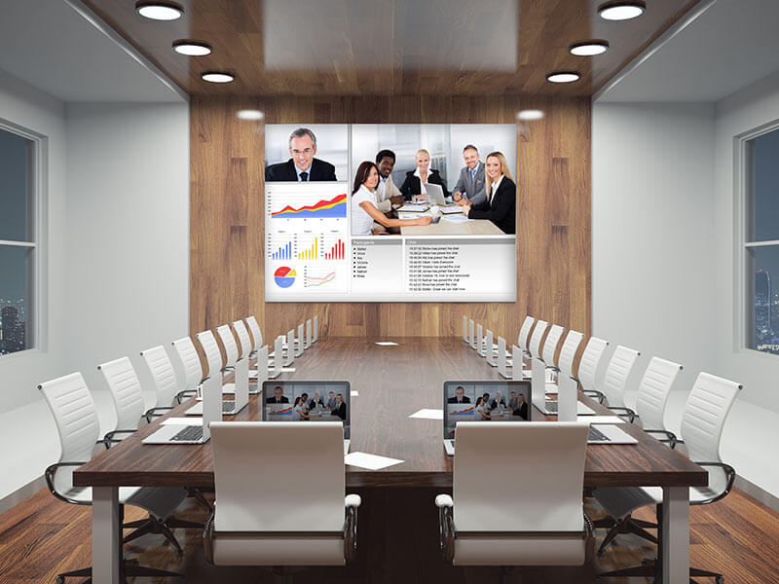
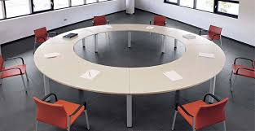
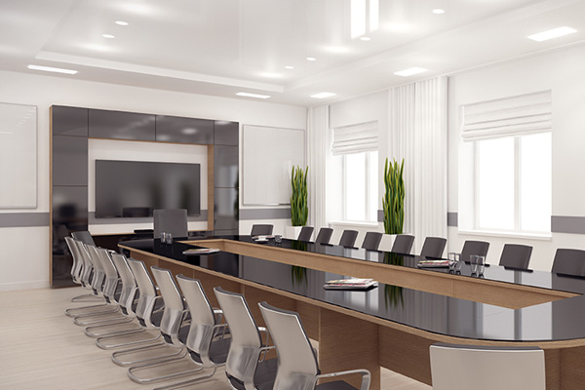
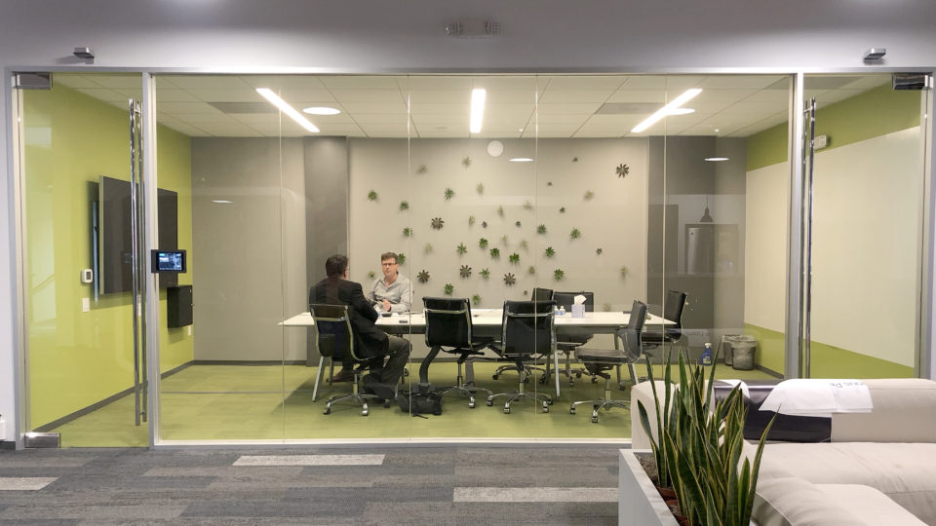
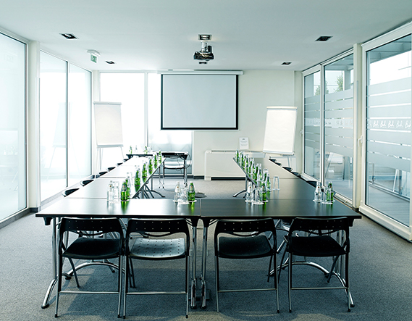
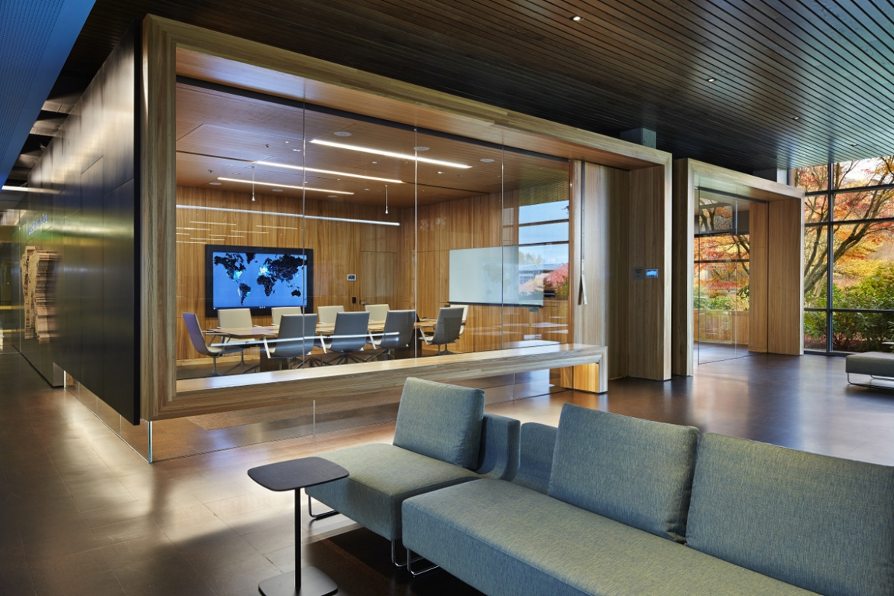
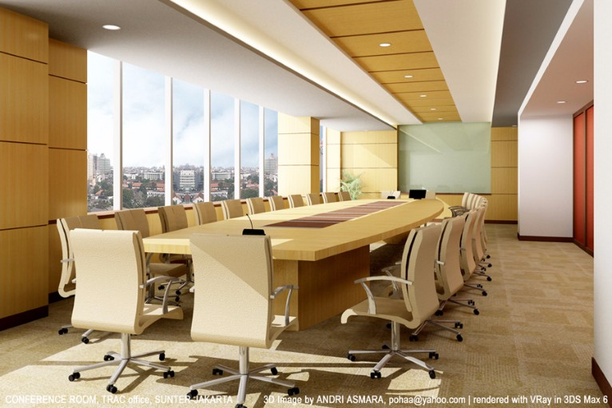
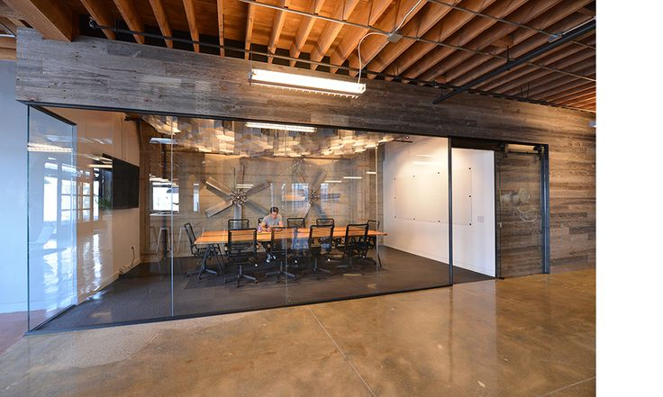
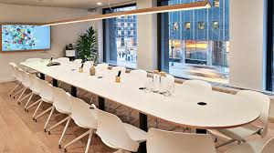
Meeting Spaces
Smaller Conference Room Functions
Flexible
Visibility/Privacy
User Groups
Campus
Students
Public

Slide 7
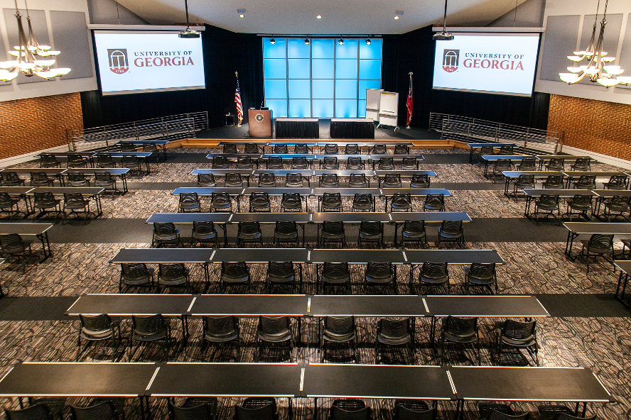
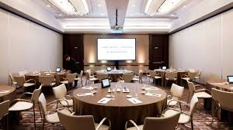
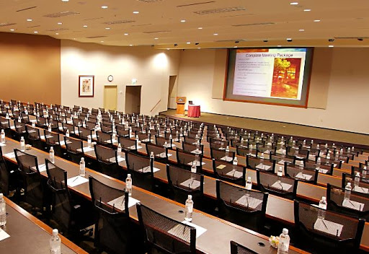
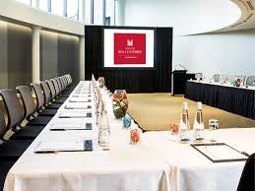
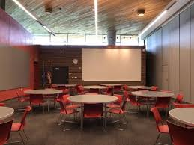
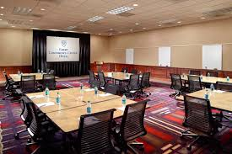
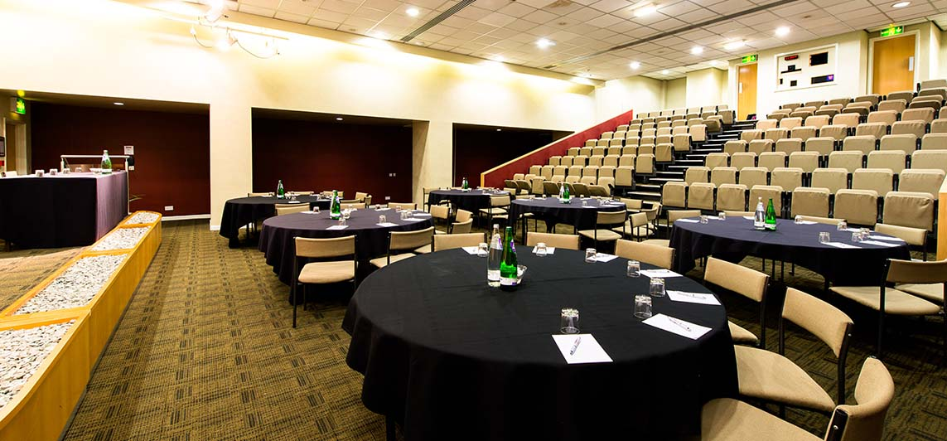
Conference Rooms
Larger scale than meeting rooms/ spaces
Flexible setups
Dining
User Groups
Campus
Students
Public

Slide 8
Existing Campus Conference Rooms
Campus Center
Conference Room A
  Size of Room = 43’ x 54’ = 2322 square feet
  130 Person Seating Theater style
  72 Person Table Seating
Conference Room B
  Size of Room = 54’ x 54’ = 2,916 square feet
  200 Person Theater style seating
  125 Person Table style seating
Forum 1 Classroom
Size of Room = 3,922 square feet
Number of People = 323
Conference Room Admin 109
Size of Room = 970 square feet
Number of People = 40
Conference Room Admin 106
Size of Room = 548 square feet
Number of People = 20

Slide 9
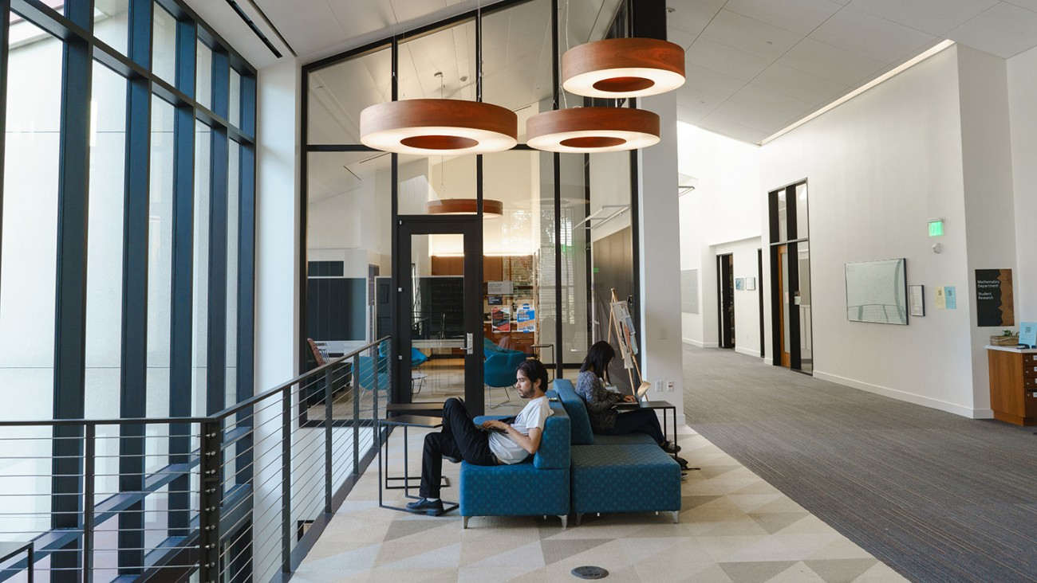
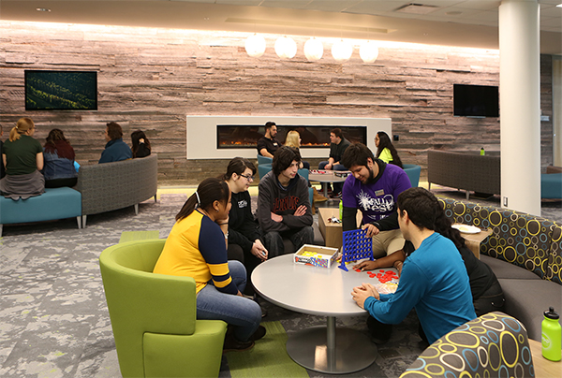
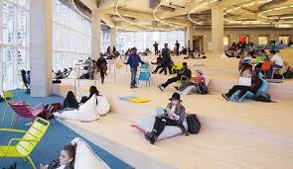
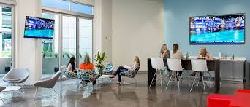
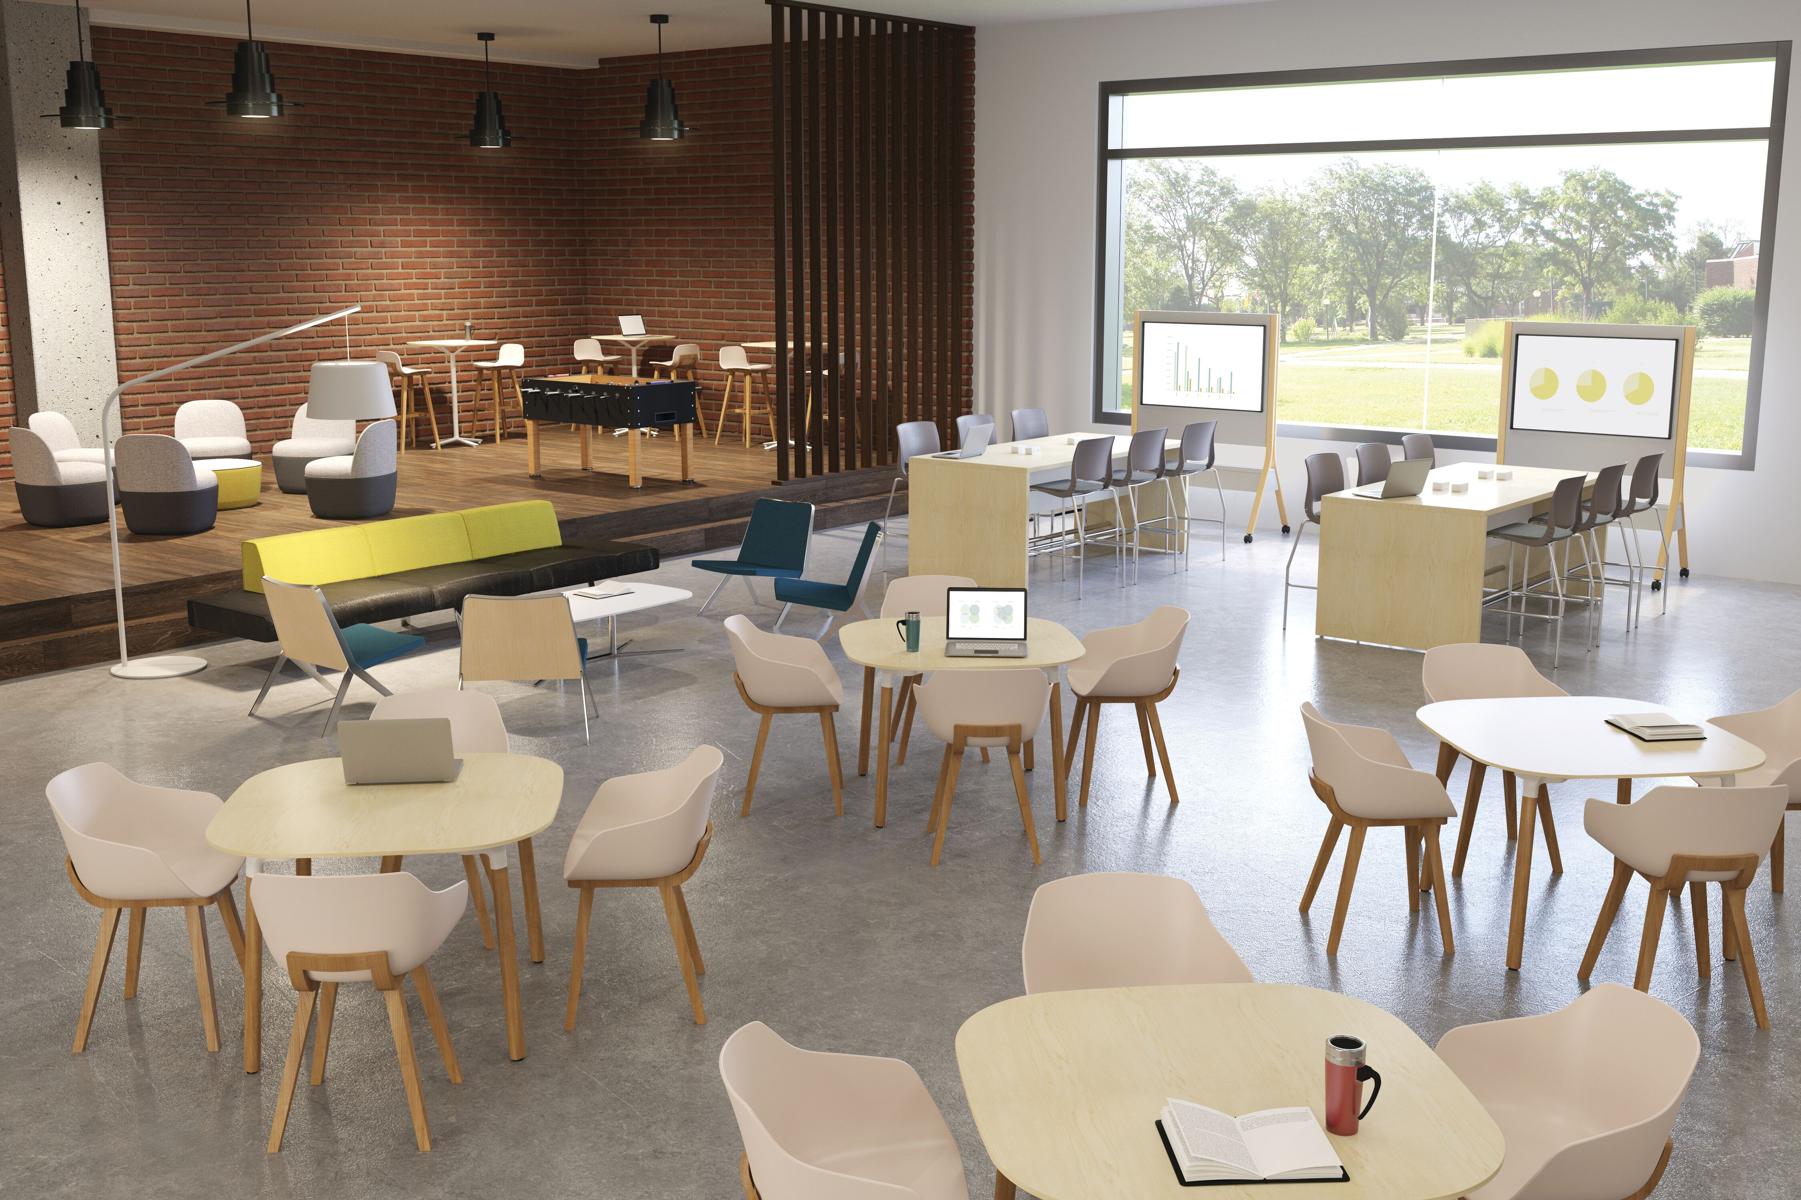
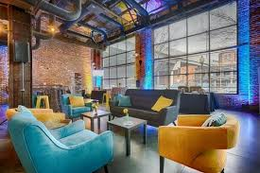
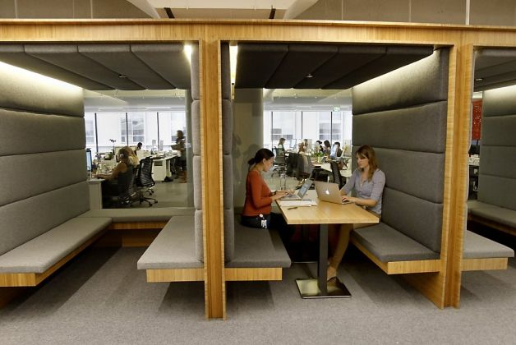
Gathering Spaces
Collaboration
Lounge
Visitor Use
Student Use
Destination/Accidental

Slide 10
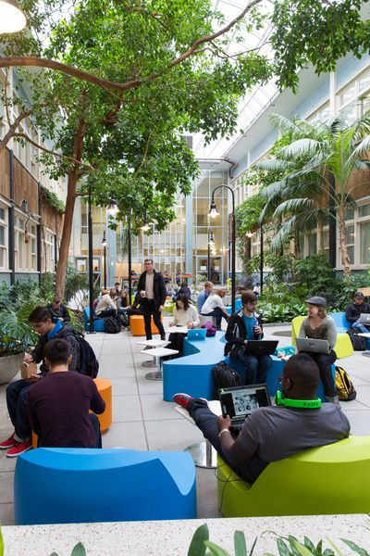
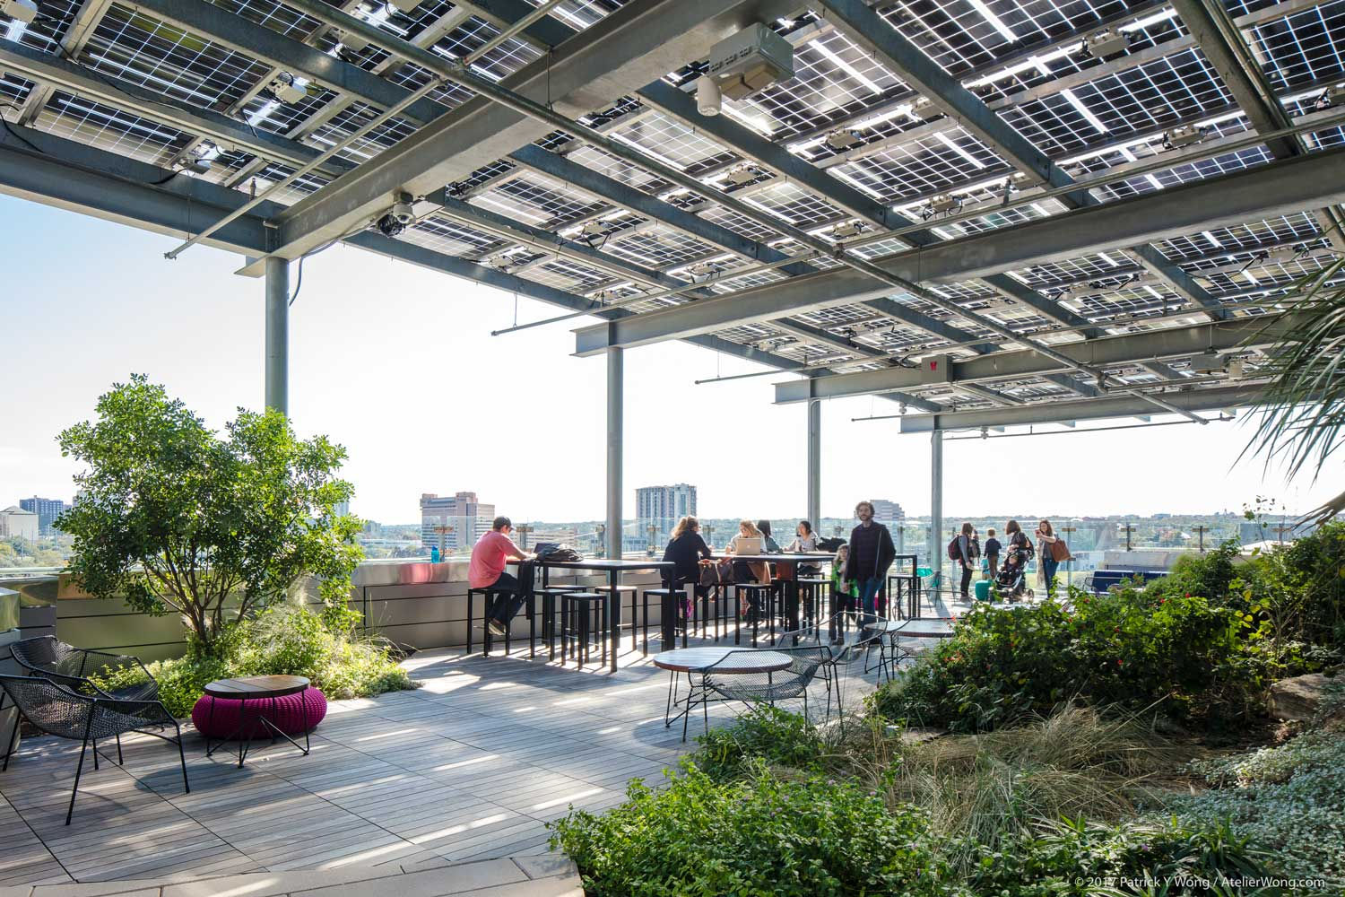
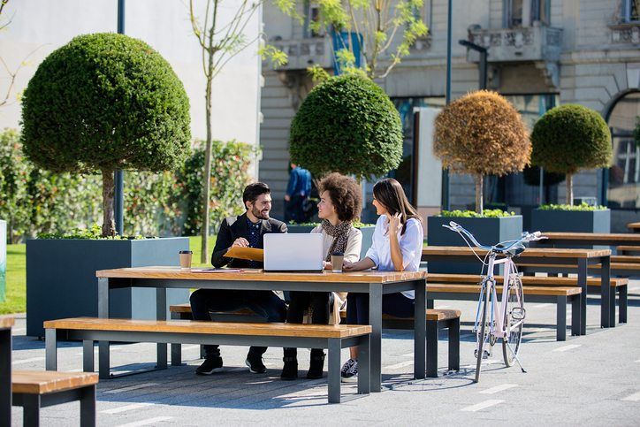
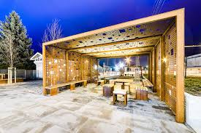
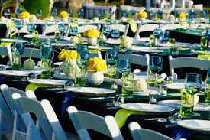
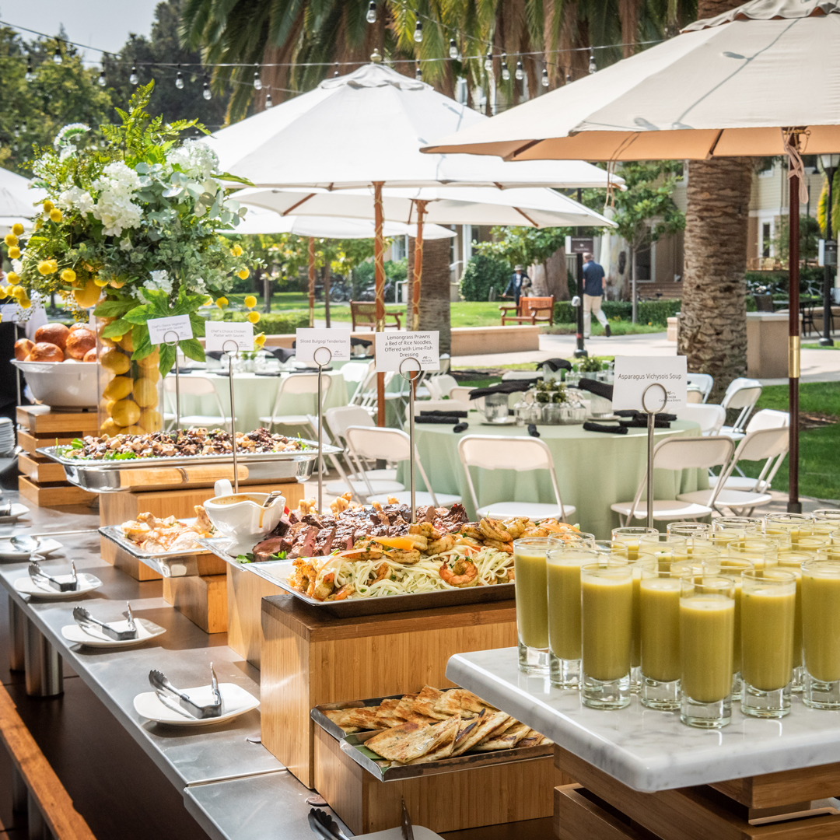
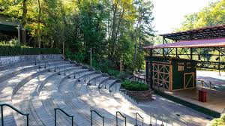
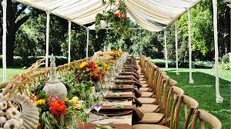
Exterior Public Spaces
Gathering
Events
Location
Rooftop
First Floor
Security
User Groups
Campus
Students
Public

Slide 11
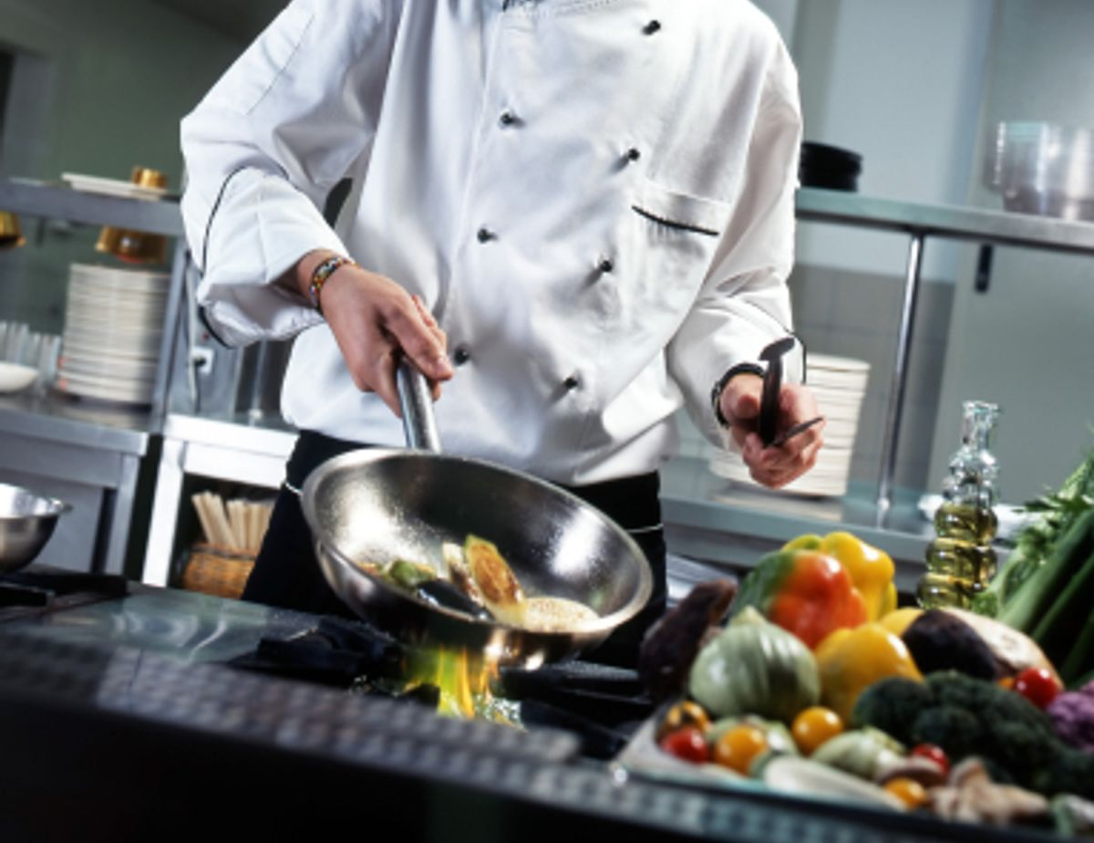
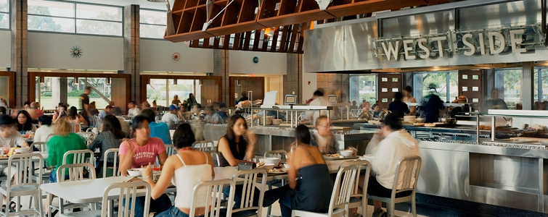
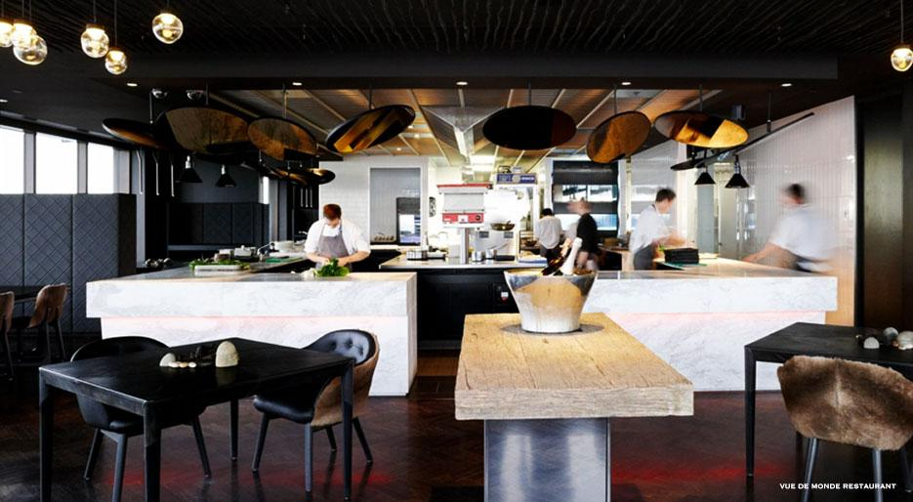
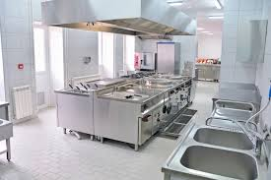
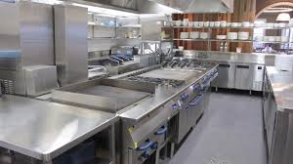
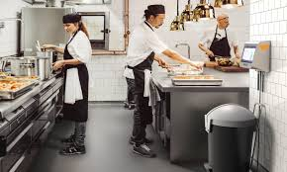
Kitchen
Food Preparation
Food/Beverage Services
Planned
On Demand (Open Kitchen)
User Groups

Slide 12
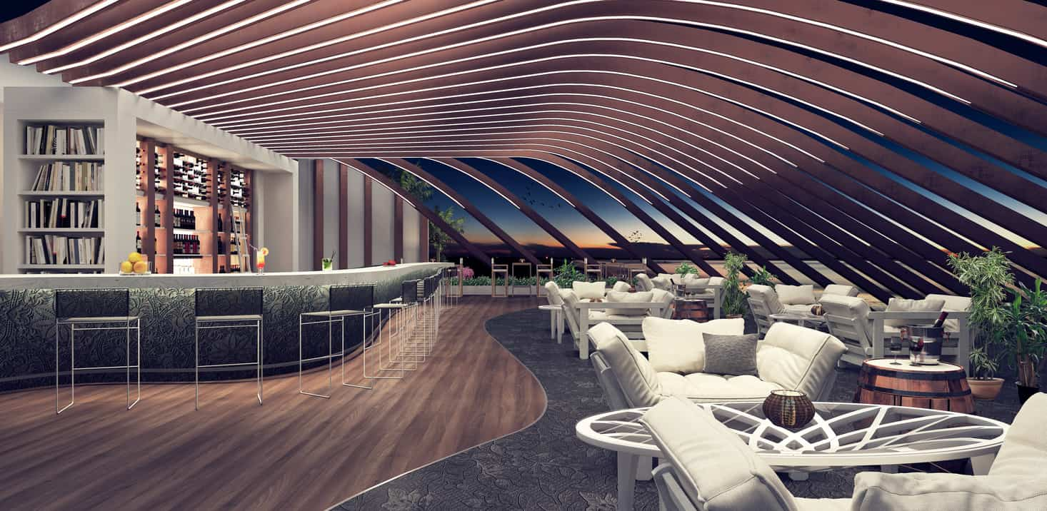
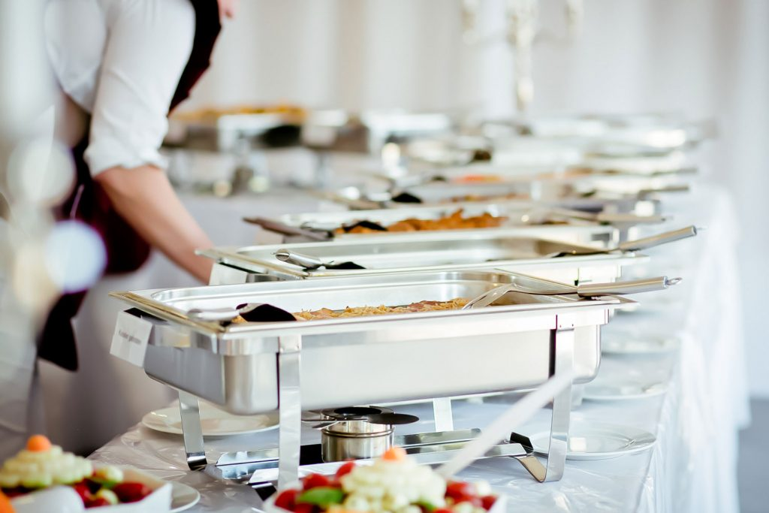
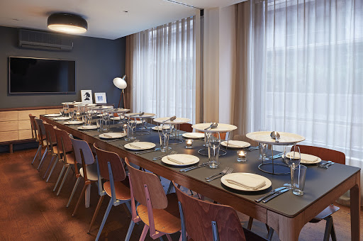



Dining
Types of Services
Seated Served
Buffet
Group Sizes
On Demand (open kitchen)
User Groups

Slide 13







Performance Spaces
Theater Productions
Music Venue
Dancing Venue
Speaking Functions
Seating Style/Layout
Stage Size/Function

Slide 14







Performance Spaces cont.

Slide 15







Performance Spaces - Additional
Practice Areas
Storage
Preparation
User Groups

Slide 16








Exterior
Main Entrance
Campus Gateway
Statement

