Slide 1

Student Services
SSPBT Presentation
College Council
- Administrative Reorganization -
October 25, 2018

Slide 2
Need for Administrative Reorganization
  Student Services is required to make $3.2 million in budget cuts
  Budget cuts can come from general funds only (not categorical)
  Initial SSPBT recommendations included elimination of 24.5 positions; 12 faculty, 12.5 classified, but no managers
  We need to make proportional cuts in management positions
  At the June 21, 2018 College Council meeting, the President expressed concern about the deep cuts to front-line counselors
  and staff in the SSPBT budget reduction recommendation while there were no recommendations regarding reduction in the administration of Student Services
  The President accepted only 8 of the 10 counselor positions recommended for elimination in General Counseling
  The President directed the VPSS to address the remaining deficit ($274,026) through administrative reorganization

Slide 3
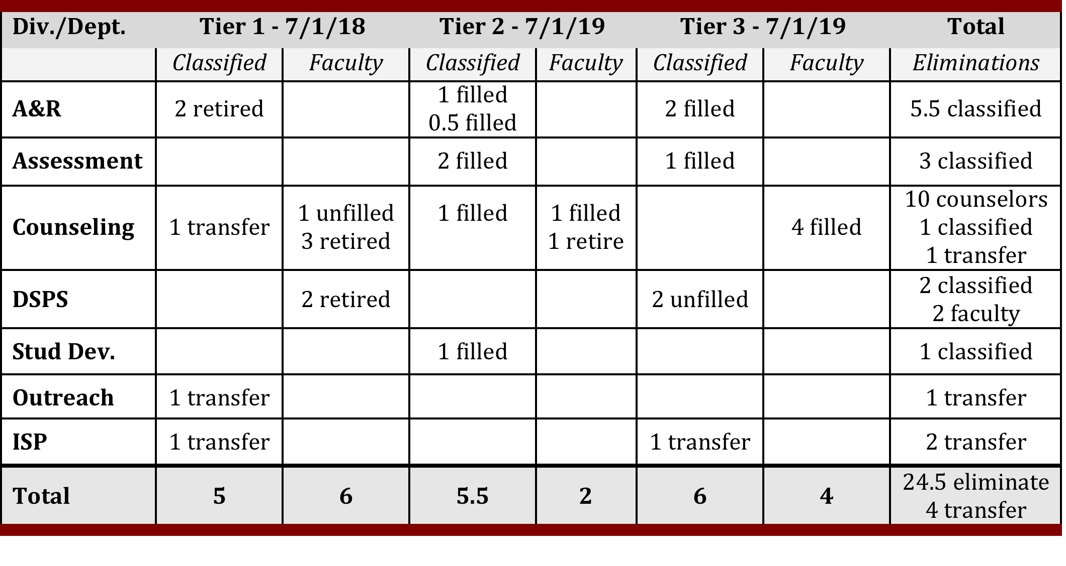
SSPBT Recommendations in 2017-18
Original cuts include 24.5 positions: 12 faculty, 12.5 classified, no administrators
(5 filled faculty positions, 8.5 classified positions)

Slide 4
President’s Directive
  There was concern about level of cuts to front-line
  counselors and staff positions, but no reduction
  in Student Services Administration.
  Save two counselor positions in General Counseling
  Review administrative reorganization options to:
      Address remaining budget deficit
      Mitigate impact of budget cut on students

Slide 5
Rationale for Proposed Reorganization
    Initial SSPBT budget cuts significantly impact Counseling
    and Admissions and Records
    Budget cuts can come from general funds only; this disproportionately impacts Counseling and A&R
    Student Services has several categorical/grant-funded programs that could not be part of the budget reduction: EOPS, DSPS, Financial Aid, CalWorks, SEAP (former SSSP)
    Better alignment of services to mitigate impact of budget
    cuts on students and delivery of services
    Administrative reorganization will result in saving:
    2 counselor and 1 classified position in A&R
    Reorganization will reduce SS management positions
    from 7 to 5

Slide 6
Review of SS Administrative Positions
  Dean of DSPS:
    Categorically funded, mandated services, match requirement,
    Title 5 position, state audit, duties cannot be assigned to another manager.
  Dean of Student Development/EOPS
    Categorically funded, match requirement, Title 5 position,
    state audit, duties cannot be assigned to another manager.
  Director of Financial Aid:
    Categorically funded, mandated services, match requirement,
    Title 5 services, state audit, duties cannot be assigned to another manager.

Slide 7
Review of SS Administrative Positions
  Dean of Enrollment Services:
    General fund, no match requirement, CCFS-320
    apportionment reporting, Title 5 mandated services:
    student admissions; student records, grades, transcripts, attendance accounting, state audit, duties cannot be
    assigned to another manager.
  Dean of Counseling and Student Success:
    General fund, no match requirement, duties can be assigned
    to another manager.
  AVPSS:
    Vacant position, duties can be assigned to another manager.

Slide 8
Rationale for Elimination of Proposed Positions
AVPSS
    Position is currently vacant
    Areas reporting to this position can be assigned to other managers
    The Vice President of Student Services can assume oversight for some areas
  Dean of Counseling
    General Counseling has steadily declined in size, and will be even smaller with proposed budget cuts and anticipated retirements.
    Counseling services have been decentralized and distributed across the campus.
    Over the years, several programs have been moved from Counseling to other areas:
      Articulation – moved to Instruction
      ISP – moved to AVPSS
      SSRS – moved to Instruction
      Career Center – eliminated
      Assessment – moved to Enrollment Services
      Health Services – moved to Student Development

Slide 9
Proposed Administrative Reorganization
  Option I:
  Consolidation of Counseling & Student Development/EOPS

Slide 10
Rationale for Consolidation:
Counseling & Student Development
    Both areas have counselors and provide services that support student retention and success.
    The Dean of Student Development is qualified to supervise Counseling, as would any future dean given minimum qualification.
    The combined Student Development/Counseling Division is manageable in size to be supervised by one dean.
    The Counseling Department Chair assists with scheduling,
    Re-employment Preference (REP), counseling in-service, and related counseling and instructional functions.
    Several counselors already work in other divisions, cohort programs, and Learning Communities outside of General Counseling.

Slide 11
Proposed Administrative Reorganization
  Option 2:
  Consolidation of Counseling & Disability Support Programs
  and Services

Slide 12
Rationale for Consolidation:
Counseling and DSPS
    Both areas have counseling and instructional components.
    The Dean of DSPS is qualified to supervise Counseling, as would any future dean given minimum qualifications.
    The combined DSPS/General Counseling Division is manageable in size to be supervised by one dean.
    The Counseling Department Chair assists with scheduling,
    Re-employment Preference (REP), counseling in-service, and related counseling and instructional functions.
    HTCTU is no longer part of DSPS, which lessens workload for the dean, facilitating consolidation.
    Several counselors already work in other divisions, cohort programs, and Learning Communities outside of
    General Counseling.

Slide 13
Amended SSPBT Recommendation
  Positions recommended for elimination:
    AVPSS = $179,767
    Dean of Counseling = $203,050
    Total: $382,817
  Positions to be removed from previous recommendations:
    Faculty/Counselor in General Counseling = $137,978
    Faculty/Counselor in General Counseling = $136,048
    Classified/A & R position = $93,526
    Total eliminated positions: 10 faculty, 11.5 classified, & 2 managers
        Total: $367,522 (+ $15,265 towards B budget)
* All figures presented include salary + benefits and are provided by the District.

Slide 14
SSPBT Vote
  Option I:
  Consolidation of Counseling & Student Development/EOPS
      1 Yes
      4 No
      6 Abstained
  Option II:
  Consolidation of Counseling & Disability Support Programs & Services
      2 Yes
      3 No
      6 Abstained
  Summary:
      The determination was that there was no consensus from
      the SSPBT committee on the two reorganization proposals
      that were presented.

Slide 15
VPSS Recommendation
  The VPSS was charged with developing administrative reorganization options for Student Services to address the budget cuts.
  Absent a consensus from SSPBT, the VPSS recommends Option I: Consolidation of Counseling & Student Development/
  EOPS as the most viable option.

Slide 16
Why Option I?
  In addition to rationale discussed earlier, the combined Counseling & Student Development division will be manageable in size (49) and will have several key leadership positions that oversee critical operations:
      Supervisor and Assistant Director for EOPS
      Clinic Director in Health Services
      Director of Health Education & Wellness
      Director for College Life
      Director for Psych Services
      Department Chair for Counseling

Slide 17
Student Services: Current Organization Chart 2018-19
Rob Mieso
Vice President, Student Services
Title IX Coordinator
Lisa Mandy
Director, Financial Aid
& Scholarships – (13)
Stacey Shears
Dean, DSPS – (45)
Michele LeBleu-Burns
Dean, Student Dev. & Counseling – (26)
Sheila White-Daniels
Dean, Counseling – (26)
Open
Dean, Enrollment
Services – (22)
DSPS
Marilyn Booye,
Supervisor
DSS
APE
DHHS
Rosemary Jenson,
Supervisor
HOPE
Counseling
Patty Burgos, Chair
Transfer Center
Foster Youth
Financial Aid
Gary Valentine, Supervisor
CCPG
Grants
Loans
Scholarships
CCP
Student
Employment
Student Development
Office of College Life
Hyon Chu Yi Baker, Coord.
EOPS/CARE
George Robles, Supervisor
Truly Hunter, Asst. Director
Health Services
Clinic Director (open)
Mary Sullivan, HS Educ.
Psych Services
Siew Kuek, Director
A & R
Open, Sr. Supervisor
Barry Johnson,
Supervisor
Evaluations
Veronica Aparicio, Coordinator
Assessment
Cassie Wheat,
Supervisor
Veterans Services
Outreach & Relations w/Schools – (7)
Outreach
Men of Color
Food Pantry
Middle College/College Now
DA College Promise
Erick Aragon, Director
Erika Flores, Program Coordinator
International Student Programs – (11)
Joseph Ng, Supervisor
Occupational Training Institute – (7)
Sabrina Stewart, Supervisor

Slide 18
Student Services: Proposed Organization Chart 2019-20
Rob Mieso
Vice President, Student Services
Title IX Coordinator
Lisa Mandy
Director, Financial Aid
& Scholarships – (13)
Stacey Shears
Dean, DSPS – (45)
Michele LeBleu-Burns
Dean, Student Dev. & Counseling – (49)
Open
Dean, Enrollment
Services – (27)
DSPS
Marilyn Booye,
Supervisor
DSS
APE
DHHS
Rosemary Jenson,
Supervisor
HOPE
Financial Aid
Gary Valentine, Supervisor
CCPG
Grants
Loans
Scholarships
CCP
Student Employment
Student Development
Office of College Life
Hyon Chu Yi Baker, Coord.
EOPS/CARE
George Robles, Supervisor
Truly Hunter, Asst. Director
Health Services
Clinic Director (open)
Mary Sullivan, HS Educ.
Psych Services
Siew Kuek, Director
General Counseling
Patty Burgos, Chair
Transfer & Career Services
Foster Youth
A & R
Open, Sr. Supervisor
Barry Johnson,
Supervisor
Evaluations
Veronica Aparicio, Coordinator
Assessment
Cassie Wheat,
Supervisor
ISP
Joseph Ng, Supervisor
Veterans Services
Outreach & Relations w/Schools – (7)
Outreach
Men of Color
Food Pantry
Middle College/College Now
DA College Promise
Erick Aragon, Director
Erika Flores, Program Coordinator
Occupational Training Institute – (7)
Sabrina Stewart, Supervisor

Slide 19
Questions/Comments

