Slide 1
De Anza College
A brief history of the smoking policy and process

Slide 2

No Smoking policy 2005 began…
FHDA district passed a non smoking policy in June 2005.
The Plan:
  Phase 1: enforcement through education was implemented
    Maps, buttons, mini quit kits, enforce-mints and compli-mints were used. Surveys of students & employees smoke exposure & use done.
  Phase 2: smoking moved to designated parking lots, later adjusted to designated smoking areas.

Slide 3

Gov Jerry Brown signed AB795
Oct 8, 2011, all community colleges, CSUs and UCs impose fines for violating policy. Through extensive work by Naomi Kitajima and the smoking policy committee, current FHDA Board Policy 3217 came to be.
Smoking defined – “engaging in an act that generates smoke:”
  A lighted pipe
  a lighted hookah pipe
  an electronic cigarette of any kind
  a lighted cigar
  a lighted cigarette of any kind

Slide 4

2007 Tobacco Cessation for students started & the program continues…
Initially Breathe California grant funded advertising, signage and free Nicotine Replacement supplies
Student Health Services continues Tobacco Cessation program

Slide 5

Policies in place
Fines defined/enforced
Resources for support available

Slide 6
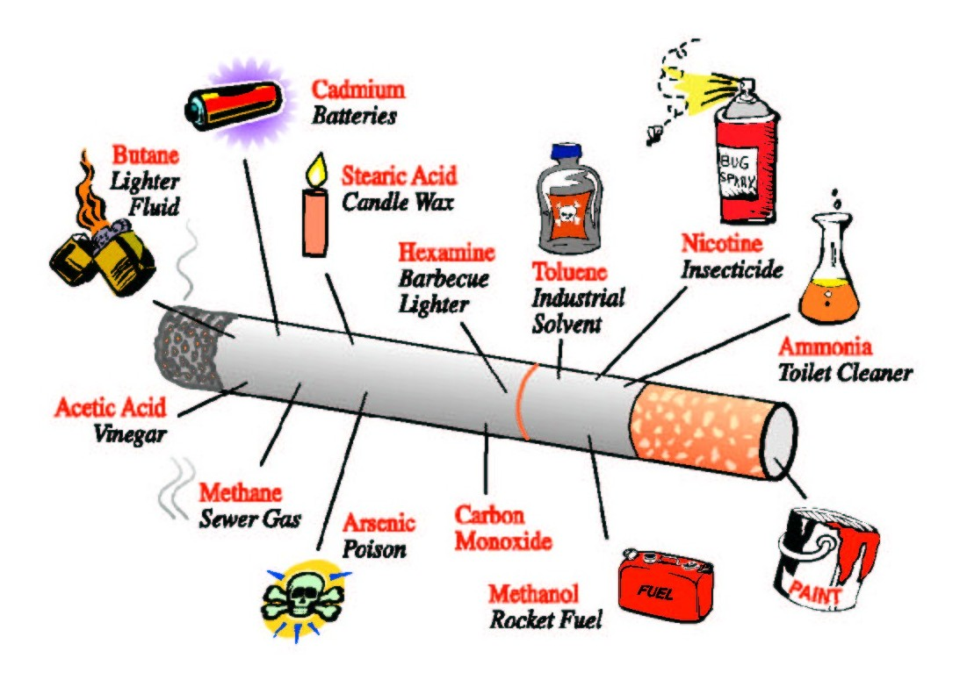
Stronger recommendations
Dec 2012 White paper from ACHA supports Surgeon General.
Tobacco use in any form, active and/or passive, is a significant health hazard.
Classified a Class-A carcinogen
  most dangerous class of carcinogens
  there is no safe level of exposure to environmental tobacco smoke
  a toxic air contaminate
  Colleges are encouraged to adopt a NO TOBACCO USE policy

Slide 7
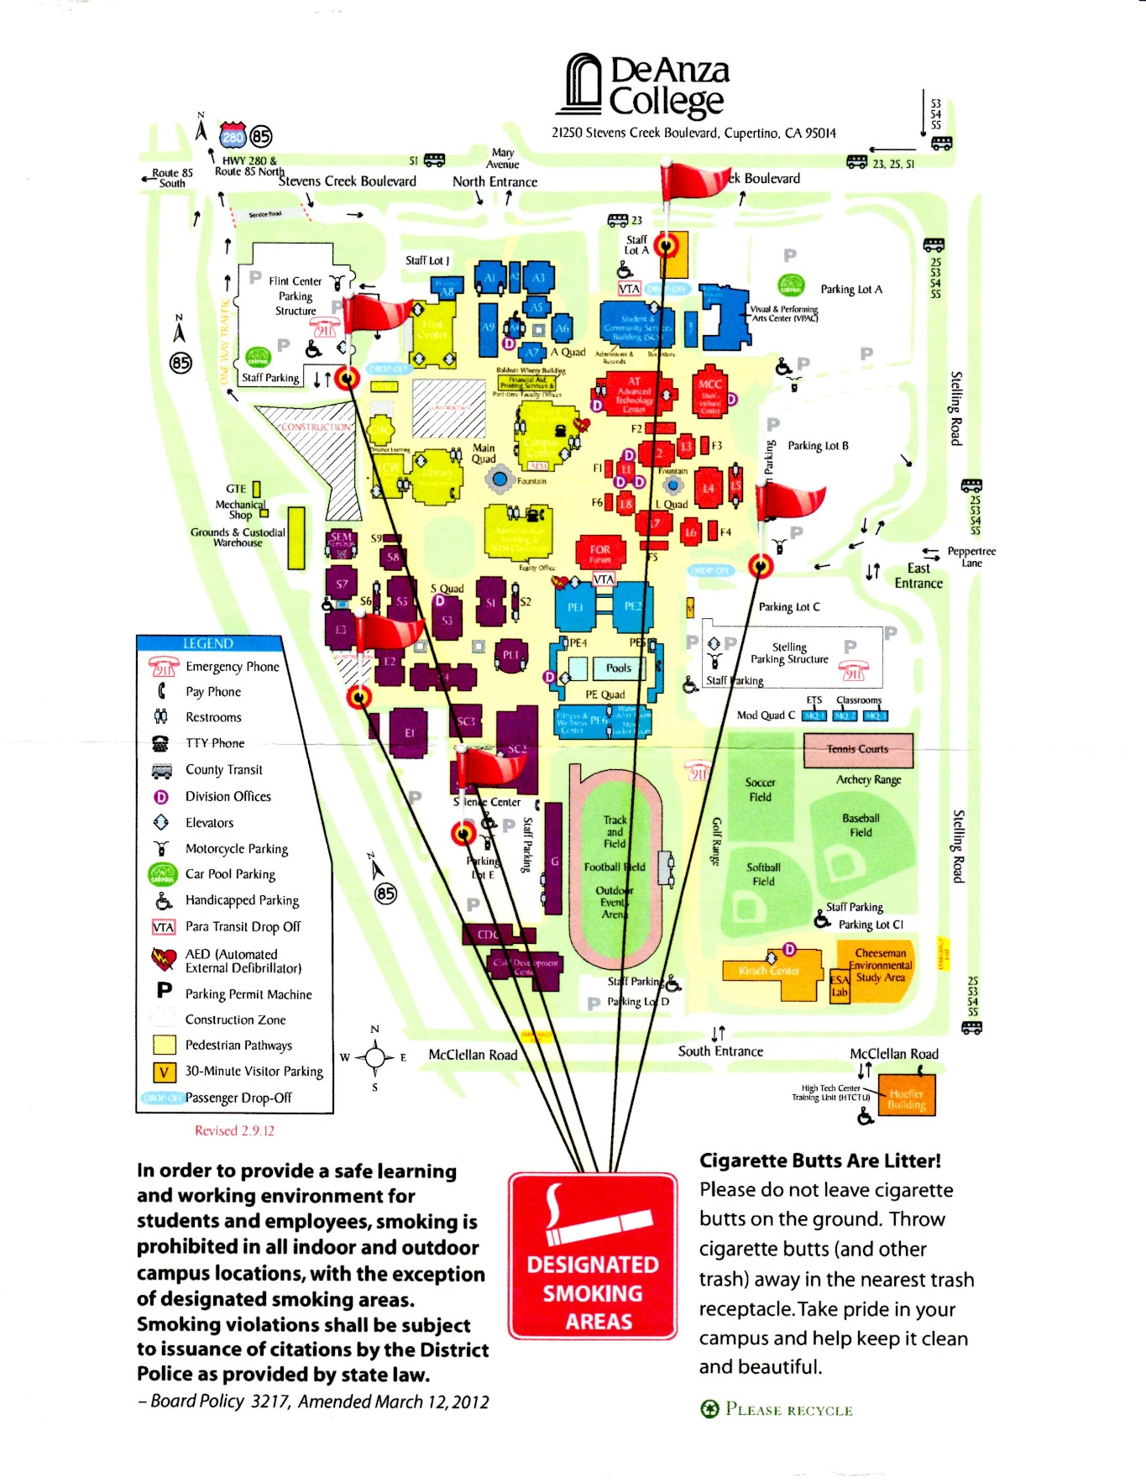
The smoking areas changed from…
parking lots
to
-designated areas
Avoiding the gauntlet of smoke

Slide 8
2016
USC & CSU totally smoke free
Governor did not mandate community colleges smoke free…

Slide 9
FHDA got a “C” on their report card (2018)
Tobacco-Free Policy Report card from California Youth Advocacy Network (CYAN)
Official district policy is a "designated areas" policy (ordinarily gets a "D" grade), but we restrict designated areas to parking lots which boosted grade to C.
To receive an "A+" district would need to adopt a 100% smoke and tobacco-free policy, including e-cigarettes.

Slide 10
40 California Community Colleges have implemented smoke-free campus policies.
FHDA needs to proactively protect our students and employees from the dangers of all smoke (tobacco & vaping)

Slide 11
CCC Board of Governors adopts 100% Smoke and Tobacco-Free Resolution for California Community Colleges (May 2018)
CCC Chancellor Oakley urges all 72 California Community College districts to adopt and implement 100% smoke and tobacco-free policies’ to provide tobacco cessation services and referrals on campus and to access CYAN resources and support (July 26, 2018)

Slide 12
Getting compliant -
We already have:
  smoking policy,
  smoking cessation services
  use CYAN resources
  Next step - updating the current FHDA Board approved smoking policy, removing the designated smoking areas, and publicizing the policy change.

Slide 13
New FHDA Policy – needs group approval
Provisions
1.0 Each college will identify designated smoking areas be 100% tobacco and smoke free. It will ensure that clear and consistent signage are displayed at all entrances to the campus, as well as other conspicuous locations, to notify the public that smoking is permitted only in the officially designated areas and is otherwise prohibited on the campus grounds or in campus buildings.

Slide 14

Progress – for our health!

