Slide 1










Equity & Engagement
First Year
Experience
FYE

Slide 2
Key Services
Trainings: Safe Space, Equity Certification, Equity Literacy Teams
Multicultural events, Lit Lunch Best Practices
Conferences (Queer & Now; HEFAS Summit, Student Voices for Social Change, Global Issues)
Technical support for Equity Partners (Best Practices)
Instructional, mentors, and tutors support (Student Equity Training)
Community Partners: Community Colleges Count Campaign, Student Interns
Learning communities: cohort model, stand alone LCs, service learning
Intrusive counseling and support for DIS populations (Summer Bridge, UndocuWelcome, Program Orientations, Personal Dev. courses

Slide 3
COVID-19 IMPACT
Physical Spaces: Loss of access to computers, printers, calculators, study space, tutoring, peer to peer mentoring, food security (lunch vouchers, satellite food pantry), sense of belonging & community
Face to Face direct service: tutoring, counseling and support staff, instructional support from faculty and peers
Re-envisioning & Re-imagining: Services, programming, community engagement and instructional support
Enrollment: Loss of students not prepared for remote learning (undocumented students, African American, Latinx, AAPI)

Slide 4
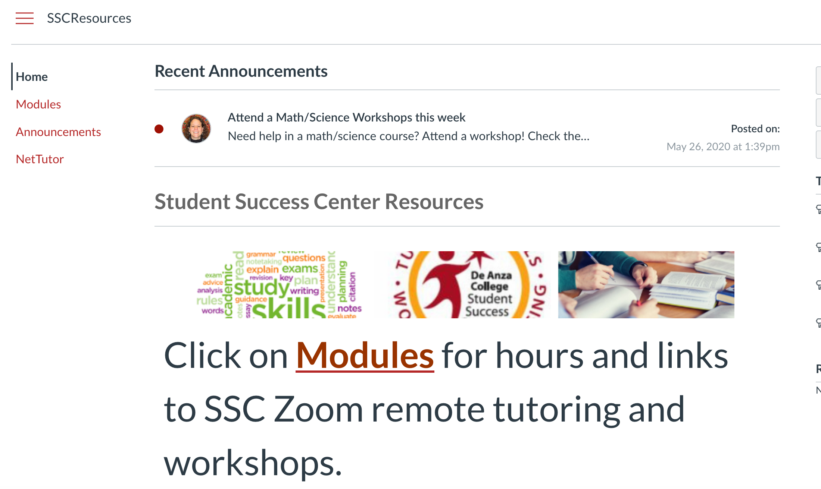



Navigating Covid-19 Landscape

