Slide 1

Career Technical Education (CTE) Division

Slide 2
CTE Overview
23 CTE Programs
Division Dean
Division Assistant
Grant Administrator
  Strong Workforce Program
  Adult Education
  Perkins
  LAEP
Counselor
Program Coordinator

Slide 3
Leadership Involvements
Bay Area Community College Consorsium
Adult Education -North Santa Clara County Consortium
Silicon Valley Leadership Group
Bridge to Recovery
California Community College Assosication Ocupational Education
NOVA Workforce Board
Work to Future
CTE Committee

Slide 4
CTE Committee
Made up of the Deans and Chairs
CTE Curriculum
Noncredit course vetting
Program review resource request vetting and consolidation
Works with CTE Program Chairs to develop plans for Perkins and Strong Workforce Program
Looking into doing our own marketing

Slide 5
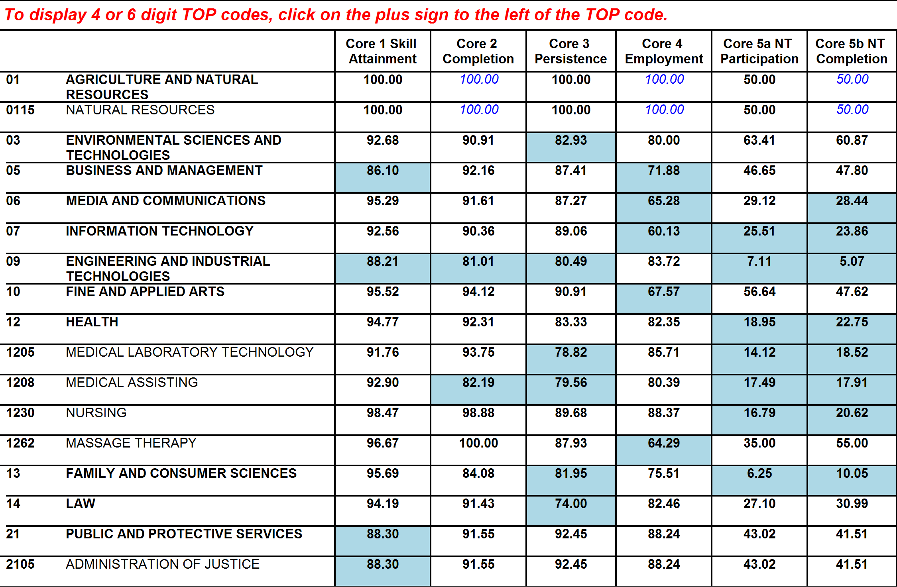
Core Indicators of Performance by Vocational TOP Code (Indicators for 2020-2021 Fiscal Year Planning)
Performance Rate Less Than Goal is Shaded
Core 1 - Skill Attainment, GPA 2.0 & Above: 91.75% Performance Goal - ( 2017- 2018)
Core 2 - Completions, Certificates, Degrees and Transfer Ready: 82.88% Performance Goal - ( 2017- 2018)
Core 3 - Persistance in Higher Education: 83.08% Performance Goal - ( 2017- 2018)
Core 4 - Employment: 73.23% Performance Goal - ( 2017- 2018)
Core 5 - Training Leading to Non-traditional Employment: Greater than 26.00% Participation & 30.00% Completion - ( 2017- 2018)
Notes:
Only Health is expanded

Slide 6
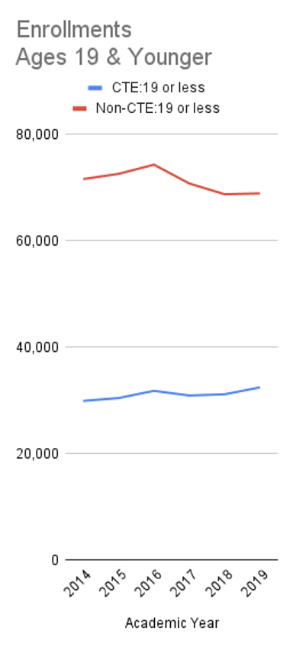
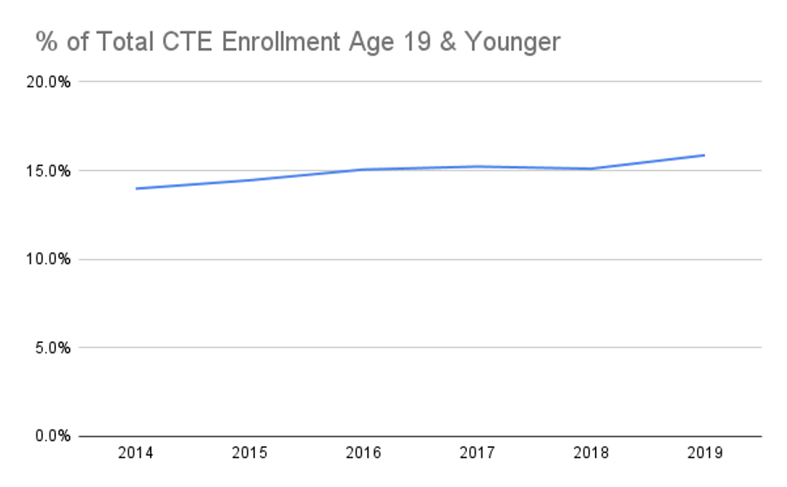
CTE Enrollment Snapshot
Current De Anza enrollment 15,862
Current CTE enrollment 8,870
Notes:
Year starts with Summer
2021 Spring is not included in the report
Based on Inquiry tool
Awards Issued from Program review tool

Slide 7
Program Support
Advisory Board Meetings
Perkins
SWP
LAEP
Adult Education
Curriculum Process
Ordering Items
Dual Enrollment
Concurrent Enrollment
Noncredit
Employer engagement

Slide 8
Grant Administration
SWP (1.9M Yearly)
LAEP (2.4M over Nine years)
Adult Education (275K Yearly)
Perkins (440K Yearly)
  Application
  Resource Allocations
  NOVA reporting
  Special Projects

Slide 9
Career Counseling
Workshops/Presentations:
Internship and Resume workshop for Mentors at De Anza student organization and De Anza College Leap student organization
Resume Workshops for Women in Computer Science students, First Year Experience learning community students, and HEFAS/VIDA students.
General Career Workshop Series - Topics included: Internship and Job Search Strategy, Resume Development, Choosing a College Major or Career, Labor Market Information Research, Resume Writing and Interview Skills (Job Fair Prep), and Post-Job Fair Follow-Up
Presented in evening Auto Tech classes to help students with applying for degrees/certificates and choosing general education classes, and promoted counseling services
Child Development General Academic Advising Session in a child development evening class - Q&A on certificates/degrees/transfer/child development state permit/foreign transcripts, etc.
CIS Pathways Workshop - Q&A for CIS students on how to reach their academic goals and earn certificates and/or degrees while fulfilling transfer requirements.
Collaborations:
Collaborated with the Office of Equity to organize the Social Justice, Nursing, and Health Care Providers Career Panels
Collaborated with Anita Vazifdar, DSPS Counselor to organize an employer panel/career workshop for students with disabilities
Collaborated with Office of Outreach to organize an AAPI Career Panel/CTE programs workshop for high school students at the AAPI High School Empowerment Conference
Invited adult school students to participate in the career workshops and presented a specialized major/career workshop specifically for adult school students during spring quarter

Slide 10
Job Search
Launched Handshake to replace the College Central Network job posting system in Fall 2020
May 12 Virtual Job Fair on Handshake
  Employer registrations: 63
  Student registrations: 435, session sign-ups: 195
  268 unique student/employer connections were facilitated

Slide 11
Dual and Concurrent Enrollment Academic Year 2020-2021
First Year Offering Dual Enrollment and Concurrent Enrollment in Career Technical Education at De Anza
Dual Enrollment
  Students received high school and college credit
  Courses were offered in Automotive Technology and Child Development and Education Pathway
Concurrent Enrollment
  Students received college credit only
  One course was offered in the Business Pathway

Slide 12
Enrollment Data 2020-2021
Quarter | Class | Student Count
Summer | Counseling 5 | 35
Fall | Child Development 10G* | 39
Fall | International Marketing* | 37
Fall | Automotive Technology 50A | 15
Winter | Child Development 50* | 20
Winter | Automotive Technology 51A | 12
*Classes had a mix of high school and college students.

Slide 13
Dual and Concurrent Enrollment For The Upcoming Academic Year 2021-2022
Increase in the number of courses offered
Dual Enrollment
  Courses will be offered in Child Development and Education, Accounting, and Health Pathway
Concurrent Enrollment
  Courses will be offered in Computer Information Systems, Business, and Administration of Justice Pathway

Slide 14
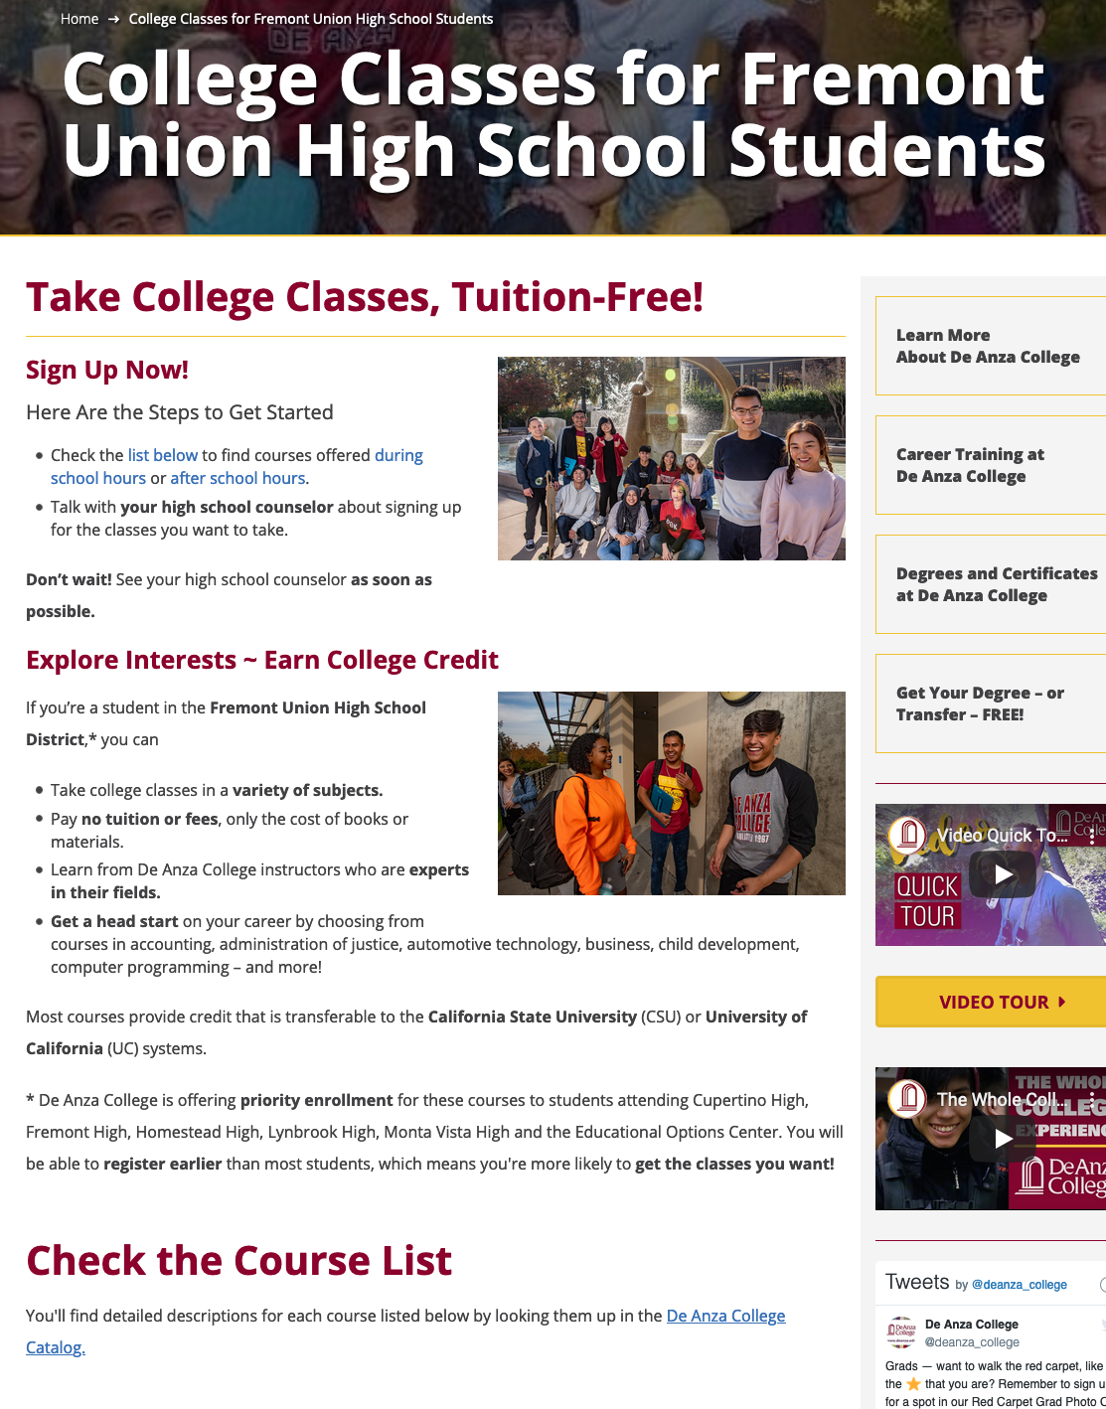
College Classes for Fremont Union High School District
Website Created for Fremont Union High School District Students to Advertise Courses for the 2021-2022 Academic Year
Website is updated as needed
https://www.deanza.edu/fuhsd/

Slide 15
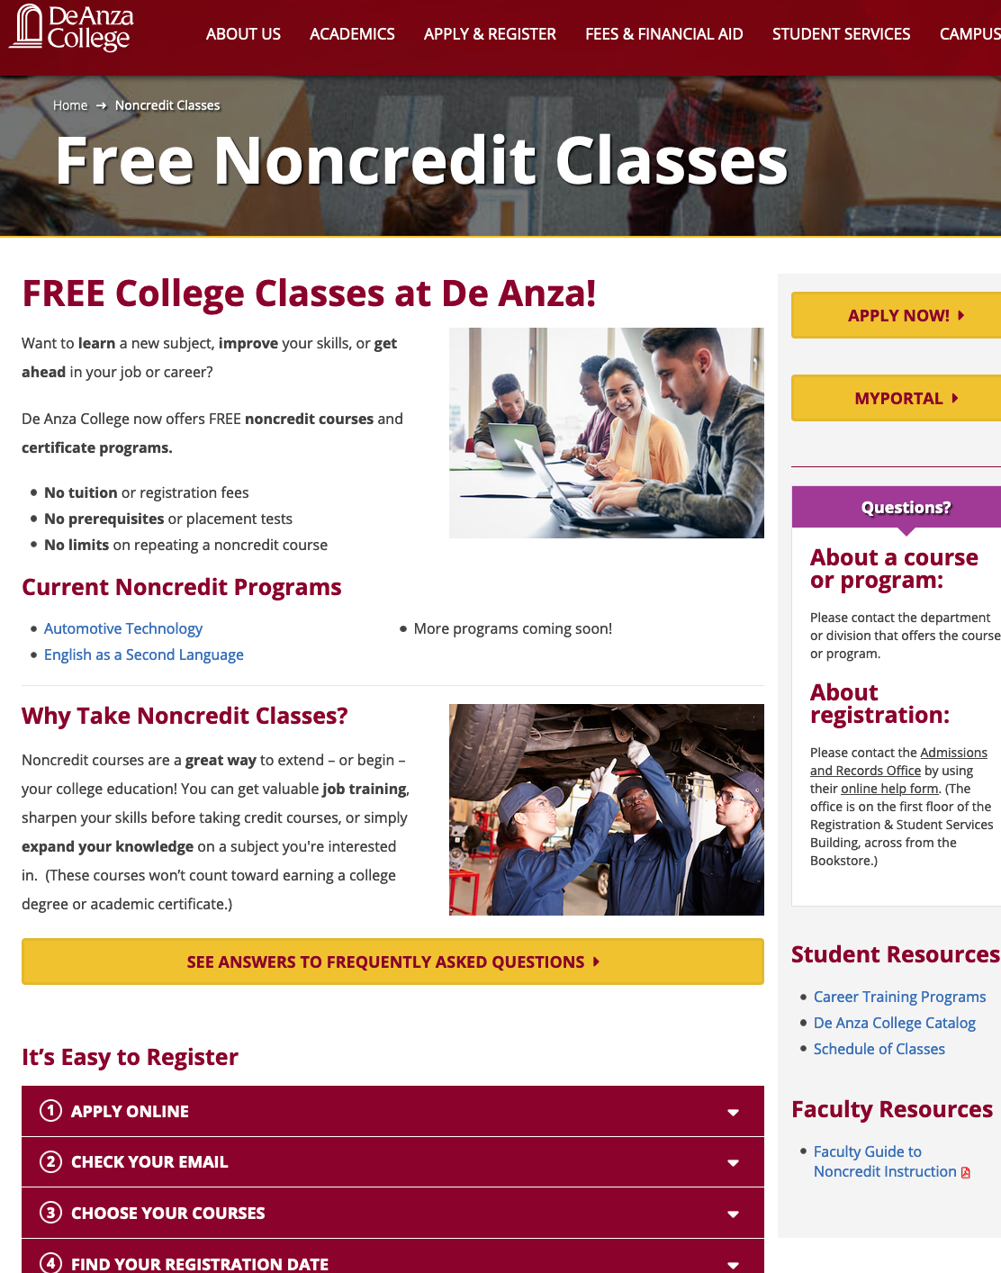
Noncredit Support
Created Noncredit Website
  Includes Faculty Guide To Noncredit Instruction
  Frequently Asked Questions For Students
  Links To Departments Offering Noncredit
Generated Noncredit Email
  Assist faculty with the noncredit process
  Email: Noncredit@fhda.edu

Slide 16
CTE Outreach
Presentations/Collaboration
Dual/Concurrent Enrollment Recruiting Presentations
Dual/Concurrent Enrollment Registration Workshops
SVCTE and De Anza College Automotive Technology Virtual Fieldtrip
Building Post-Secondary Bridges to CTE and Support Services Presentation
De Anza College/DCAC Community College Gathering
Noncredit Task Force & Curriculum/Academic Senate
CCAE 2021 Conf.: North Santa Clara County Consortium Presentation
Community College Outreach & Disabilities Outreach - CTE Presentation
Bay Region Dual Enrollment Exchange Monthly Meeting
CCEMC 7th Annual Dual Enrollment Summit
FHDA Collaboration: Dual Enrollment & Adult Ed
De Anza DSPS Liaison Collaboration For Dual Enrollment Students
De Anza Adult Education Students Dual Enrollment Training

Slide 17
Adult Education & Consortia
FHDA board approved policy for adult education students to be admitted as special-admit
Collaboration has been established between adult education transition advisers and CTE counselors to facilitate the enrollment of adult education students at De Anza
CTE Faculty and staff are active members of the North Santa Clara County Consortium: Student Support Work Group and Curriculum Alignment Work Group

Slide 18
Thank you
Questions?

