Slide 1

Draft Technology Plan Goals
Marisa Spatafore
Associate Vice President Communications and External Relations
May 6, 2021

Slide 2


Goal 1
Increase Overall Student Access to Technology for Learning and Services
Includes but not limited to the provision of laptops for students, and other devices as necessary; software and/or SAAS as appropriate, both required and that would enhance the student experience; continuous technical improvement of communications resources including the website, app and portal; and classroom equipment to support student learning and engagement in evolving modalities

Slide 3
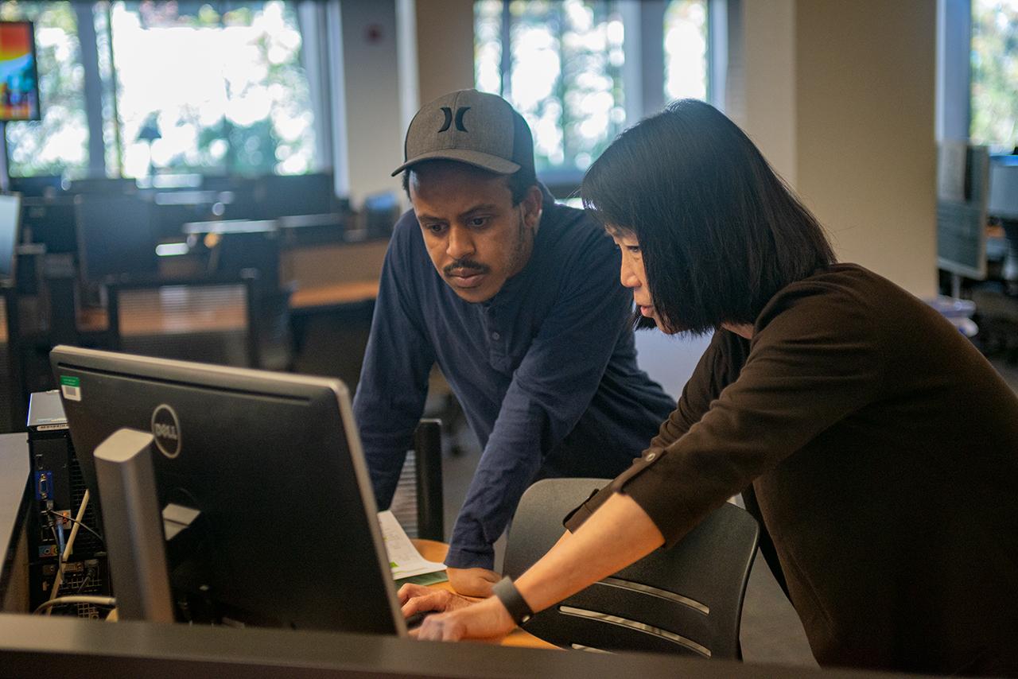
Goal 2
Increase and Enhance Faculty and Staff Professional Development and Training
Includes but not limited to robust training and related communication about the trainings, especially to improve online, hybrid and classroom teaching, including in evolving modalities such as HyFlex; and accessibility training

Slide 4
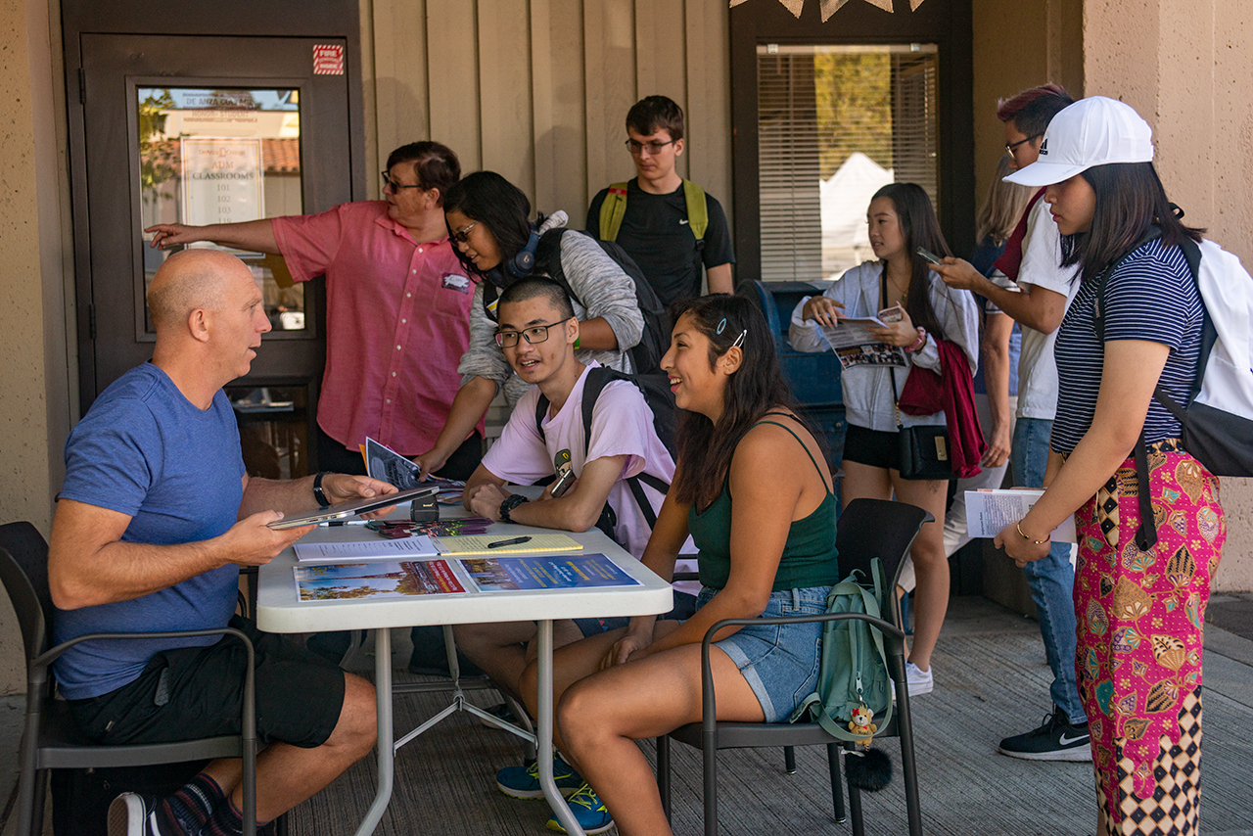
Goal 3
Work to Ensure Accessibility
Includes but not limited to implementation of SAAS to support an equitable teaching and learning environment; researching strategies and emerging technologies and implementing as appropriate; ongoing ensuring of accessibility in communications tools

Slide 5
Goal 4
Enhance Communication and Collaboration with ETS to Achieve Evolving Priority College Objectives
Strategy to include monthly small-group meetings of Tech Committee and ETS leadership, with updates as requested, on college-identified priorities including but not limited to
Ubiquitous, functioning WiFi, including on Athletics fields and in parking lots
Upgraded technology for employees, including shorter personal technology refresh cycle of three years
Development and support of peripheral loan program to address additional needs, such as doc cams, iPads for whiteboards, etc.
College-identified projects that
Directly affect student success and/or the student experience, particularly timely requests via expert administrators
Address regulatory issues

Slide 6
Draft Technology Plan Goals
Marisa Spatafore
Associate Vice President Communications and External Relations
May 6, 2021

