Slide 1

Draft 2 Technology Plan Goals
Alex Harrell, Mary Pape and Marisa Spatafore
Chairs, Technology Committee
June 3, 2021

Slide 2

Draft 2 edits noted in
strikeouts and italics

Slide 3
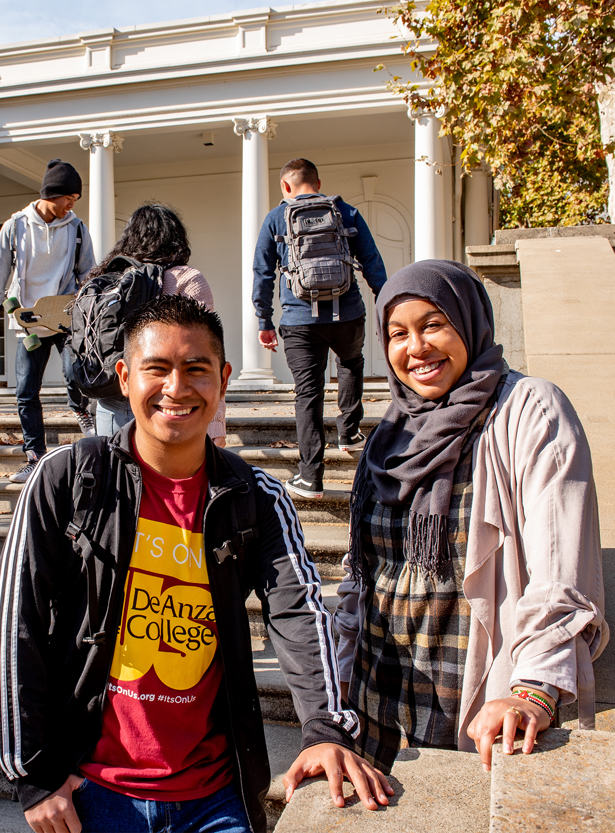
Goal 1
Increase Overall Student Access to Technology for Learning and Services
Includes but not limited to the provision of laptops for students, and other devices as necessary; software and/or SAAS as appropriate, both required and that would enhance the student experience; continuous technical improvement of communications resources including the website, app and portal; and classroom equipment to support student learning and engagement in evolving modalities, with classroom needs documented through updated classroom standards, program review and the Facilities Condition Assessment

Slide 4
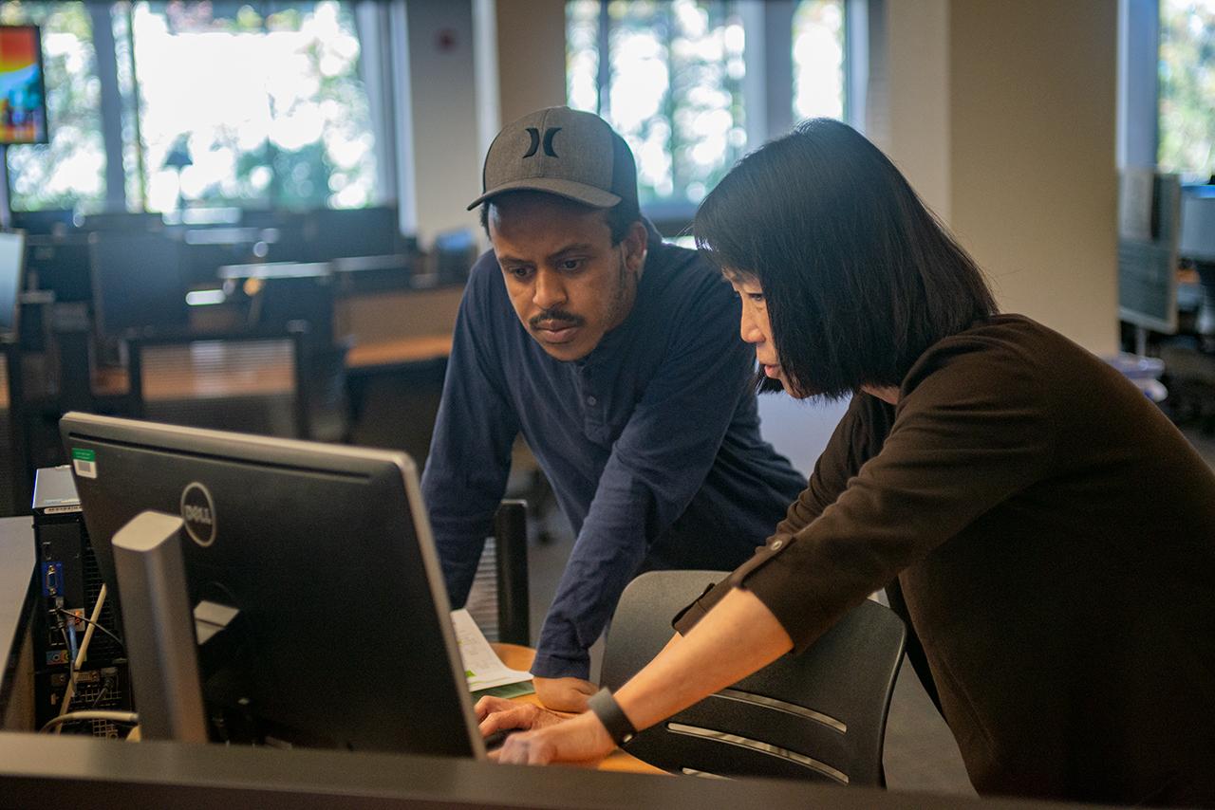
Goal 2
Increase and Enhance Faculty and Staff Professional Development and Training
Includes but not limited to robust training and related communication about the trainings based on faculty and classified professional feedback, especially to holistically improve online, hybrid and classroom teaching, online pedagogy and pedagogy in the use of technology tools, including in evolving modalities such as HyFlex; and accessibility training

Slide 5
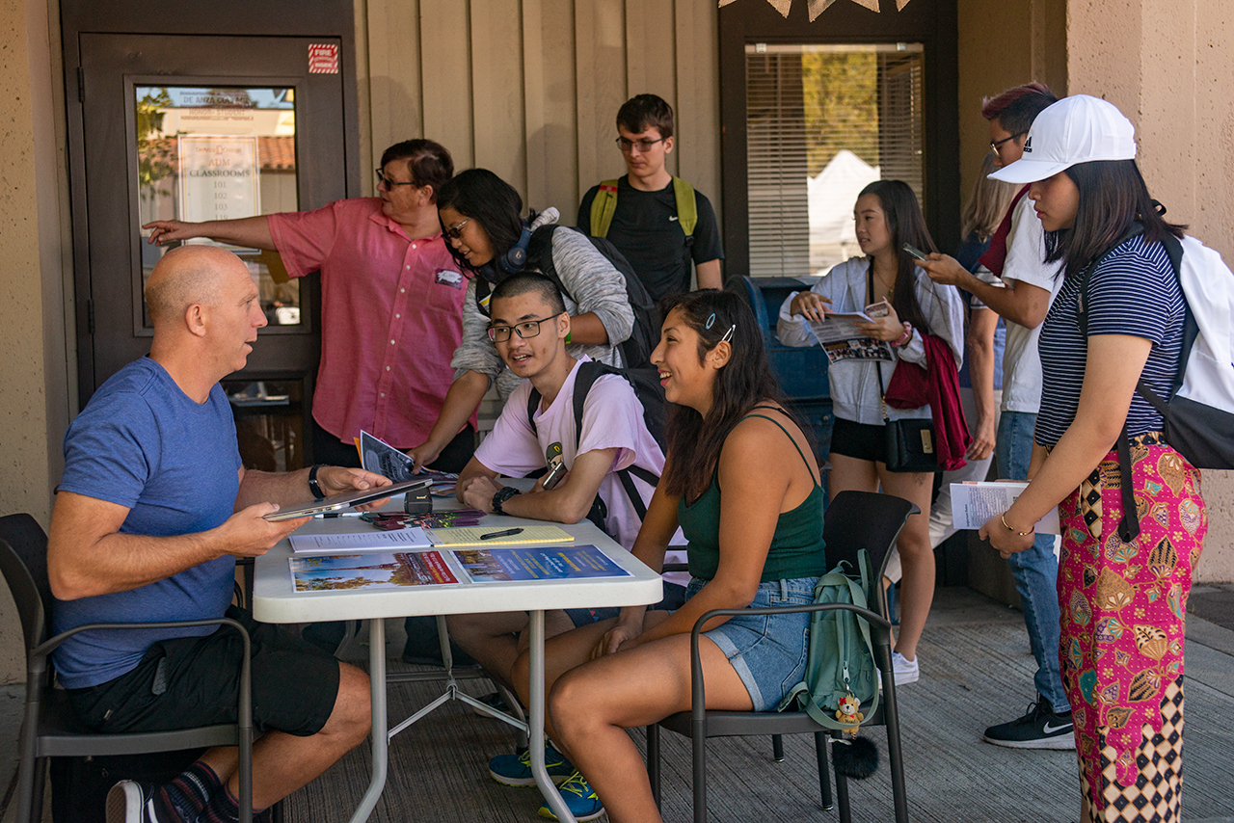
Goal 3
Work to Ensure Accessibility
Includes but not limited to implementation of SAAS to support an equitable teaching and learning environment; researching strategies and emerging technologies and implementing as appropriate; ongoing ensuring of accessibility in instructional and communications tools

Slide 6
Goal 4
Enhance Communication and Collaboration with ETS to Achieve
Evolving Priority College Objectives
Strategy to include monthly small-group meetings of Tech Committee and ETS leadership, with updates as requested, on college-identified priorities including but not limited to
Ubiquitous, functioning WiFi, including on Athletics fields and in parking lots
Upgraded technology for employees, including shorter personal technology refresh cycle of three years
Improving communication, including of system and software availability and changes
Development and support of peripheral loan program to address additional needs, such as doc cams, iPads for whiteboards, etc.
College-identified projects that
Directly affect student success and/or the student experience, particularly timely requests via expert administrators
Address regulatory issues

Slide 7
Draft Technology Plan Goals
Marisa Spatafore
Associate Vice President Communications and External Relations
May 6, 2021

