Slide 1
Naviance and Pathways Pilot Projects
De Anza College
Tech Committee Presentation
Rob Mieso
February 2, 2017

Slide 2
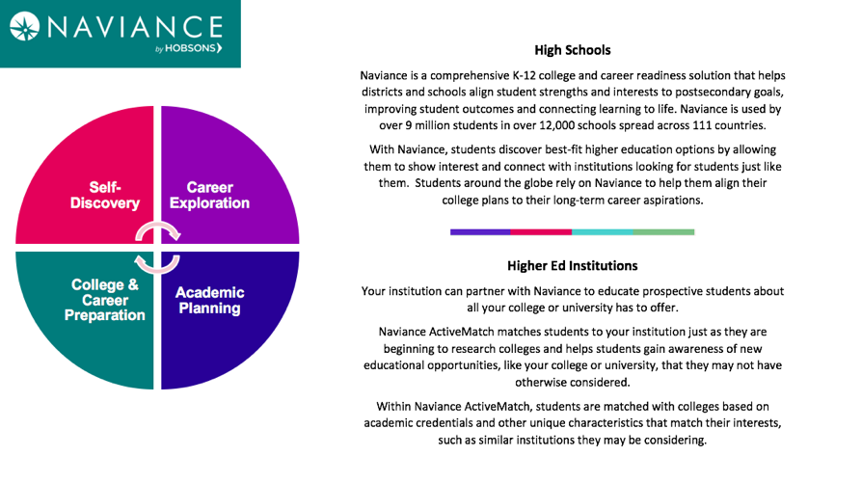
Naviance Highlights

Slide 3
Naviance Overview
College & career readiness platform used by HS students in college search
Helps outreach and recruitment efforts to reach more prospective students
Used in all major high school districts in the area, including:
  FUHSD
  San Jose Unified (SJUSD)
  East Side (ESUHSD)
  35 high schools in Santa Clara County
  134,000 students on Naviance within 25 mile radius of De Anza
Used by major universities, including San Jose State

Slide 4
Naviance Pilot Project Scope
Pilot period: 6 month pilot – March-August, 2017
Cost = $3000 for the pilot phase
Target high school students within 50 miles of campus
Gives prospective students more visibility to our college
Hub Page – profile page with up to 31 photos/videos
  [Hub Page example]
5 URLs – (Ex. Apply, Enrollment Steps, Financial Aid, etc.)
Active Match – display message for students
  [Active Match example]
Targeted messaging to all Naviance students within 50 miles of campus
Electronic transcript submission

Slide 5
Naviance Process and Current Status
Presentation to SSPBT
Presentation to Technology Committee
Contract for the pilot phase reviewed and approved by Risk Management
Collaboration between Hobsons, ETS, A&R, Outreach, and Communications
Hub Page and messaging goes live 2/28/17 for 6 months
Review outcomes after the pilot period
Decide whether to continue using the product moving forward

Slide 6
Pathways Highlights
Platform that helps counselors and staff track and support students from enrollment thru graduation and/or transfer
Supports student engagement in high schools
Helps in tracking and supporting students through the matriculation process
Supports student equity
Improves student’s chances of persisting, completing and transferring
Allows customized, personal communication with students
Gives counselors real-time data on student progress

Slide 7
Pathways Overview
Tracks and engage with students during the enrollment process
Tracks student status for SSSP core services:
  Assessment
  Orientation
  Ed Plans (Abbreviated and Comprehensive
Targets support to underperforming students to increase student success
Improves student services, outreach efforts, and communications
Provides measurable metrics and reports for student support programs
Identifies disengaged students through analytics, leading to successful interventions

Slide 8
Pathways Pilot Project Scope
Pilot period: Winter 2017
No cost for the pilot phase
Piloted by SSSP and Equity counselors
All student cohorts and Learning Communities included
Daily data upload, provides current student profile
Track students through SSSP core services and other key success factors
  [Example]

Slide 9
Pathways Process and Current Status
Pilot phase contract reviewed and approved by Risk Management
Coordination with ETS ongoing
Demo and training held for counselors January 12
SSSP and Equity counselors testing the platform, providing feedback
Continued customization and improvement based on feedback
We will review outcomes after the pilot period
Decide whether to continue using the product after the pilot period

Slide 10
Questions?
Thank you
Contact: Rob Mieso
miesorob@deanza.edu

