Slide 1
Online Course-Taking and Success at Foothill and De Anza
Rachel Baker
Daniel Klasik
Stanford Graduate School of Education
Notes:
This is a first shot using only one term of data
Limited variables—if there’s something you’re interested in, it’s probably not in our data.
We are planning to follow up with multiple terms
We’re looking for feedback on other things that we should look at and other ideas of things we want to do moving forward
We’re looking at it from enrollment and success perspective trying to help answer the question: What should we do about these low success rates?
Other things we have on tap: focus groups, larger research agenda (right at beginning)
(what kind of information students use when choosing major or program of study)

Slide 2
Course Success
Foothill-De Anza, Fall 2012
Notes:
Differences in outcomes could be due to:
-different classes are offered online and in-person
-different students opt to take classes online
-online classes cause students to do worse

Slide 3
Main Questions
What courses are offered online?
Who takes them?
Who completes them successfully?

Slide 4
Main Questions
What courses are offered online?
Who takes them?
Who completes them successfully?

Slide 5
Departments Ranked by Enrollment

Slide 6
Math (9816)
Physical Ed. (7663)
English (6954)
Accounting (3088)
Biology (2982)
Psychology (2981)
History (2931)
ESL (2823)
Music (2684)
Anthropology (2374)
Business (2326)
Art (2317)
Economics (2184)
Intercult. Stud. (1757)
Chemistry (1730)
Political Science (1679)
Counseling (1592)
Speech (1586)
Philosophy (1581)
Sociology (1421)
Humanities (1385)
Comp. Info. Sys. (1272)
Astronomy (1188)
Child Dev. (1149)
Non-Cred: Bas. Sk.(977)
Reading (934)
Physics (930)
Dance (877)
Health Tech.(850)
Geography (835)
Enviro. Studies (827)
Photography (827)
Enviro. Sci. (826)
Film & TV Prod. (740)
Communications (740)
Auto. Tech. (701)
Human Dev. (693)
Phy. Ed. Adapted (687)
Spanish (676)
Computer Sci. (655)
Child Dev. (637)
CAD & Dig. Im. (613)
Computer App. (591)
Nursing (580)
Japanese (513)
Theater Arts (488)
Admin. Of Justice (480)
Health (469)
Vet. Tech. (458)
Spec. Ed. (429)
Nutrition (428)
Career & Life Planning (414)
Paralegal (403)
Dental Hygiene (369)
Int. Studies (361)
Skills (360)
Language Arts (357)
Allied Health Ser. (348)
Graph. & Inter. Des. (330)
Radiologic Tech. (323)
Prim. Care Assoc. (309)
Learn in New Media (299)
Mandarin (299)
Manuf. & CNC Tech. (298)
Respiratory Ther. (295)
Environ. Hort. & Des (292)
Peace Officer (288)
Performing Arts (240)
Video Arts (229)
Guidance (224)
Social Science (204)
Geology (201)
Diag. Med. Sono. (197)
French (193)
Adapted Learn: Comm. (187)
Pharmacy Tech. (187)
Journalism (183)
Meteorology (174)
Adapted Learn.: Trans (163)
Real Estate (163)
Dental Assisting (160)
Emerg. Med. Tech (153)
Women’s Studies (131)
Sign Language (125)
Media Studies (118)
Library (113)
Korean (113)
Engineering (106)
EMT: Para. (90)
Vietnamese (86)
Fine Arts (70)
Learn. Assis. (69)
Adapt. Learn: LD (41)
Persian (41)
Linguistics (40)
Tech. Writing (39)
Gerontology (38)
Hindi (38)
Russian (34)
Phsy. Sci. Math & Eng (31)
Journeyman (15)
Apprent.: Sheet Met.(11)
NC: Parenting (5)
Military: ROTC (3)
Apprent.: Sound (1)
Notes:
Across both campuses, number of students enrolled in all sections in each department

Slide 7
Math (9816)
Physical Ed. (7663)
English (6954)
Accounting (3088)
Biology (2982)
Psychology (2981)
History (2931)
ESL (2823)
Music (2684)
Anthropology (2374)
Business (2326)
Art (2317)
Economics (2184)
Intercult. Stud. (1757)
Chemistry (1730)
Political Science (1679)
Counseling (1592)
Speech (1586)
Philosophy (1581)
Sociology (1421)
Humanities (1385)
Comp. Info. Sys. (1272)
Astronomy (1188)
Child Dev. (1149)
Non-Cred: Bas. Sk.(977)
Reading (934)
Physics (930)
Dance (877)
Health Tech.(850)
Geography (835)
Enviro. Studies (827)
Photography (827)
Enviro. Sci. (826)
Film & TV Prod. (740)
Communications (740)
Auto. Tech. (701)
Human Dev. (693)
Phy. Ed. Adapted (687)
Spanish (676)
Computer Sci. (655)
Child Dev. (637)
CAD & Dig. Im. (613)
Computer App. (591)
Nursing (580)
Japanese (513)
Theater Arts (488)
Admin. Of Justice (480)
Health (469)
Vet. Tech. (458)
Spec. Ed. (429)
Nutrition (428)
Career & Life Planning (414)
Paralegal (403)
Dental Hygiene (369)
Int. Studies (361)
Skills (360)
Language Arts (357)
Allied Health Ser. (348)
Graph. & Inter. Des. (330)
Radiologic Tech. (323)
Prim. Care Assoc. (309)
Learn in New Media (299)
Mandarin (299)
Manuf. & CNC Tech. (298)
Respiratory Ther. (295)
Environ. Hort. & Des (292)
Peace Officer (288)
Performing Arts (240)
Video Arts (229)
Guidance (224)
Social Science (204)
Geology (201)
Diag. Med. Sono. (197)
French (193)
Adapted Learn: Comm. (187)
Pharmacy Tech. (187)
Journalism (183)
Meteorology (174)
Adapted Learn.: Trans (163)
Real Estate (163)
Dental Assisting (160)
Emerg. Med. Tech (153)
Women’s Studies (131)
Sign Language (125)
Media Studies (118)
Library (113)
Korean (113)
Engineering (106)
EMT: Para. (90)
Vietnamese (86)
Fine Arts (70)
Learn. Assis. (69)
Adapt. Learn: LD (41)
Persian (41)
Linguistics (40)
Tech. Writing (39)
Gerontology (38)
Hindi (38)
Russian (34)
Phsy. Sci. Math & Eng (31)
Journeyman (15)
Apprent.: Sheet Met.(11)
NC: Parenting (5)
Military: ROTC (3)
Apprent.: Sound (1)
Math (9816)
Physical Ed. (7663)
English (6954)
Accounting (3088)
Biology (2982)

Slide 8
Departments Ranked by Enrollment in Online Courses

Slide 9
Music (1438)
Comp. Info. Sys. (1272)
Accounting (1244)
English (1137)
Business (1003)
Psychology (930)
Computer Sci. (655)
Art (609)
History (604)
Comp. Applic. (557)
Sociology (550)
Economics (540)
Communications (478)
Phys. Ed. (430)
Anthropology (406)
Poli. Sci. (380)
Intercul. Stud. (369)
Geography (351)
Math (349)
Philosophy (338)
Photography (292)
Graph & Inter. Des. (277)
CAD & Dig. Imag. (276)
Allied Health Sci. (271)
Health Tech. (244)
Environ. Stud. (233)
Humanities (220)
Video Arts (205)
Career & Life Plan. (192)
Biology (158)
Child Dev. (120)
Media Studies (118)
Library (113)
Child Dev. (104)
Health (96)
Dental Hygiene (95)
Diag. Med. Sono. (72)
Dance (72)
Fine Arts (70)
Journalism (65)
Counseling (63)
Theater Arts (57)
Social Science (55)
Dental Assist. (55)
Spec. Ed. (54)
Nutrition (49)
Manuf. & CNC Tech. (45)
Human Devel. (40)
Tech. Writing (39)
Environ. Sci. (38)
Women’s Studies (37)
ESL (34)
Learn in New Media (9)
Phys. S., Math & Eng (8)
Learn. Assist. (6)
Nursing (5)
Admin. of Justice (3)
Paralegal (2)
French (1)

Slide 10
Music (1438)
Comp. Info. Sys. (1272)
Accounting (1244)
English (1137)
Business (1003)
Psychology (930)
Computer Sci. (655)
Art (609)
History (604)
Comp. Applic. (557)
Sociology (550)
Economics (540)
Communications (478)
Phys. Ed. (430)
Anthropology (406)
Poli. Sci. (380)
Intercul. Stud. (369)
Geography (351)
Math (349)
Philosophy (338)
Photography (292)
Graph & Inter. Des. (277)
CAD & Dig. Imag. (276)
Allied Health Sci. (271)
Health Tech. (244)
Environ. Stud. (233)
Humanities (220)
Video Arts (205)
Career & Life Plan. (192)
Biology (158)
Child Dev. (120)
Media Studies (118)
Library (113)
Child Dev. (104)
Health (96)
Dental Hygiene (95)
Diag. Med. Sono. (72)
Dance (72)
Fine Arts (70)
Journalism (65)
Counseling (63)
Theater Arts (57)
Social Science (55)
Dental Assist. (55)
Spec. Ed. (54)
Nutrition (49)
Manuf. & CNC Tech. (45)
Human Devel. (40)
Tech. Writing (39)
Environ. Sci. (38)
Women’s Studies (37)
ESL (34)
Learn in New Media (9)
Phys. S., Math & Eng (8)
Learn. Assist. (6)
Nursing (5)
Admin. of Justice (3)
Paralegal (2)
French (1)
Music (1438)
Comp. Info. Sys. (1272)
Accounting (1244)
English (1137)
Business (1003)
Notes:
Given the differences we’ve seen in how many online classes different departments offer, it’s important to note that different kinds of students enroll in different departments. So we might see differences in outcomes between in-person and online course takings because the courses offered online are different or because the students who sort into these departments are different.

Slide 11
What types of courses are offered online?
Overall 26.4% of courses are offered online
  About two-thirds of these are offered only online
17.3% of sections are online
Average online section size is 28.0 students
  26.7 students in in-person courses
3.3% of online sections are pre-collegiate
  17.8% of in-person sections are pre-collegiate
33% of online sections are STEM
  27% of in-person sections are STEM
Notes:
-classes that are offered online have fewer sections that classes that are offered in person and/or
-classes that are offered both online and in person have more in person

Slide 12
Main Questions
What courses are offered online?
Who takes them?
Who completes them successfully?

Slide 13
Who takes online courses?
 | All students | Any student who takes at least one class online
Male | 48.6% | 46.2%
From zip code with above median income | 49.7% | 48.8%
Foreign | 9.6% | 10.7%
Notes:
Online course takers are slightly more female and foreign.

Slide 14
Who takes online courses?
 | All students | Any student who takes at least one class online | All students who attempt 12+ credits | All students who attempt 12+ credits and take at least one class online
Male | 48.6% | 46.2% | 52.1% | 49.1%
From zip code with above median income | 49.7% | 48.8% | 49.4% | 51.2%
Foreign | 9.6% | 10.7% | 17.8% | 19.0%
Notes:
Same trends hold when we look only at full time students.

Slide 15
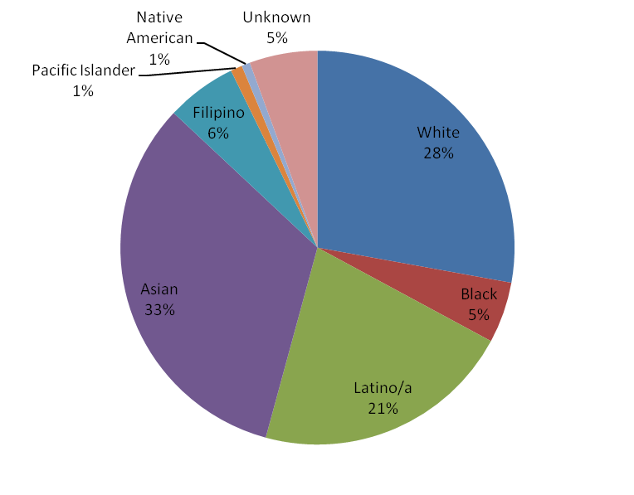
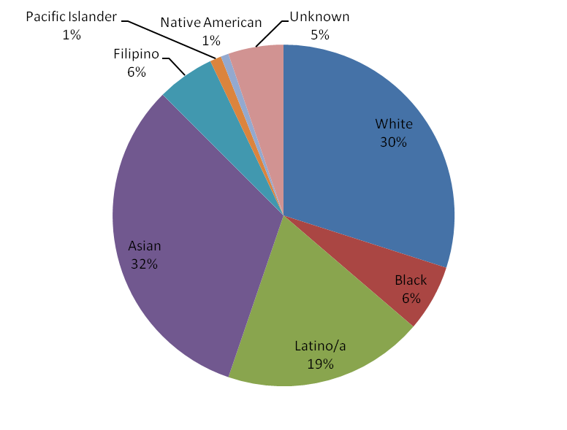
Who takes online courses?
All students took at least one class online
All students
Notes:
Online course takers tend to be more white and black and less latino and asian.

Slide 16
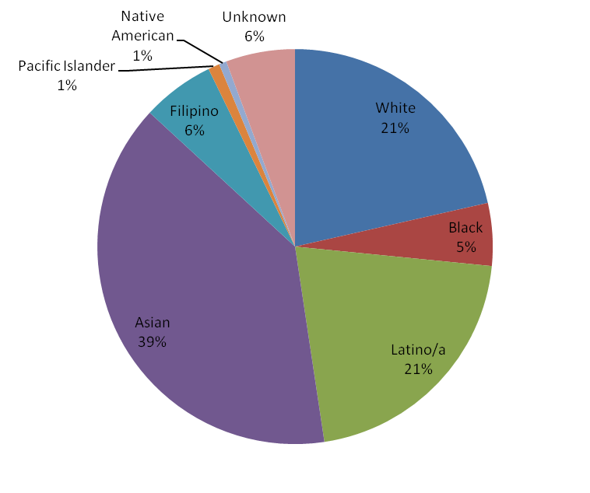
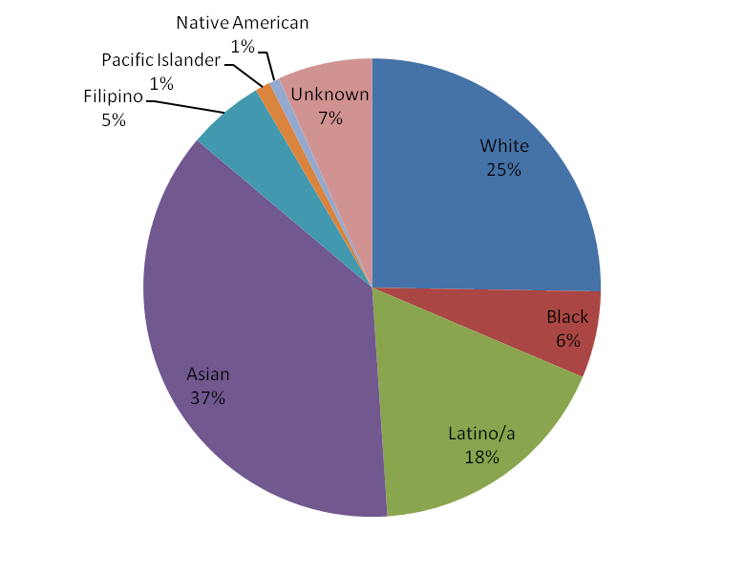
Who takes online courses?
All students who attempted at least 12 credits
All students who attempted at least 12 credits and took at least one class online

Slide 17
Are students* who take online classes different in their registration patterns?
 | Online class | In-person class
Registered at least a week before classes started | 75.5% | 74.3%
Registered within one week of course start date | 20.5% | 20.7%
Registered a week or more after first day of classes | 3.9% | 5.0%
* Only students who complete the class and do not withdraw
Notes:
Definitions:
Registered late- registered a week or more after the first day of classes
Registered first week- registered between the first day of classes and 6 days later
Registered last week- registered in the last week before classes started
Regiestered on time- registered more than a week before classes started17
later (last class students add is online?)

Slide 18
Some students take online courses because they have to—others have a choice.
Do these two groups of students differ?

Slide 19
Enrollments in online only and “choice” classes
 | All students | Students in online- only courses | Students who choose online courses
Male | 49.4% | 49.5% | 40.9%
Wealthy zip | 49.8% | 49.6% | 44.4%
Register on time | 74.3% | 75.3% | 75.7%
Register late | 5.0% | 4.6% | 3.2%
Asian | 34.8% | 31.6% | 29.4%
Black | 5.1% | 7.3% | 7.9%
Filipino | 5.9% | 4.3% | 6.4%
Latino | 21.7% | 17.6% | 20.8%
Native American | 0.6% | 0.7% | 0.7%
Pacific Islander | 1.0% | 1.1% | 1.1%
White | 25.3% | 32.0% | 28.6%
Notes:
We see the trends exacerbated:
-even more female
-Register later
-more black
-less Asian
(Latino and white trends aren’t quite as clear)

Slide 20
Main Questions
What courses are offered online?
Who takes them?
Who completes them successfully?

Slide 21
Who is successful in online courses?
Notes:
Groups of three bars by demographic characteristic
Male
Zip codes above median
races
Within those groups: success rates for in-person, courses offered online only and online by choice.
Clear trend that everyone does worse in online classes
Choose-online always worse than have-to-online

Slide 22
Who is successful in online courses?
Notes:
Biggest differential:
-black (seems to be due to both more failures and more withdrawals)
-Latino (seems to be more withdrawals)
-Native American (big change in withdrawals)
-Pacific Islander (big change in withdrawals)

Slide 23
Who is successful in online courses?
Notes:
Don’t have rates of withdrawal because we don’t have registration times for students who eventually withdraw
Again-online has lower success rate
Especially true for students who register late- blue slope down is steeper (and choose to take a class online)

Slide 24
Taking multiple factors into account
Notes:
We know each of these factors on their own may be associated with success in online courses. Can we learn more by accounting for lots of things at once? (for example, maybe Asian students do better than white students, but maybe it is because they take courses that are harder to pass.).
Regression- like holding all characteristics (number of classes taking, % online, gender, time of registration…) the same and then varying one at a time (varying race, for example). Then we can see for similar students if this one characteristic matters. And our model allows us to see if this characteristic matters particularly in online classes.
For those of you who are statistically inclined, we ran a multivariate regression. Dependent variable- success (or withdrawal) on a number of characterstics, and then all of these characteristics interacted with the class being online. It is these interaction coefficients that tell us if particular demographic traits matter especially in online classes. I’m not going to be using any of this statistical language here on out.

Slide 25
Major limitations of this analysis:
  Don’t have out of school factors
    We don’t have any information about prior academic achievement
    We’re using zip code as a crude proxy for SES
  Some of the data are self-reported
  We’re only using one term of data
  We don’t have time of registration data for all students (particularly those who eventually withdrew)
Notes:
Other things we control for

Slide 26
Can we predict persistence in online courses?
Relative to white students:
  Latino students are
    1.8% more likely to withdraw from an in-person class
    4.4% more likely to withdraw from an online class.
  Black students are
    3.7% more likely to withdraw from an in-person class
    6.5% more likely to withdraw from an online class
Withdrawal from pre-collegiate (vs. college-level) class is
  Less likely if it is in person
  More likely if it is online
Foreign students are less likely to withdraw from all classes; particularly true for online classes
Notes:
Remember- this is holding all else equal. These are students who are taking the same number of classes in the same subject…

Slide 27
Can we predict persistence in online courses?
  The higher percentage of online courses a student takes, the more likely they are to drop a class, particularly if it is online
Male students more likely than female students to withdraw from a class, same in both formats.
Asian students less likely than white students to withdraw from a class, same in both formats.
Notes:
Two characteristics where gap doesn’t change: male and Asian

Slide 28
Examples- estimated probability of completing a class for:
A white female taking a college level English class online (attempting 12+ credits, taking 50% of classes online, registered for the class on time)
Same as #1 except a white male
Same as #1 except a black female
Same as #1 except a Latina
Same as #1 except a math class
88%
86%
82%
84%
81%
Notes:
Probability of a black male completing a math course: 73%

Slide 29
Can we predict success* in online courses?
Compared to white students:
  Black students are:
    12.5% less likely to succeed in-person
    18.0% less likely to succeed online
  Latino students are:
    8.6% less likely to succeed in-person
    10.7% less likely to succeed online
Compared to those registering on time:
  Late-registrants are:
    7.6% less likely to succeed in-person
    13.6% less likely to succeed online
The higher percentage of courses a student takes online, the less likely they are to succeed in an online course:
  14% less likely to succeed if 75% of their classes are online
*success is defined as earning a grade above a C, conditional on finishing
Notes:
Controlling for everything else
…of students who finish the term

Slide 30
Can we predict success* in online courses?
No differential success rate in online vs. in-person classes based on:
  Gender
  Citizenship
  Being Asian
  Zip code wealth

Slide 31
Examples- estimated probability of getting a passing grade (conditional on finishing the class) for:
A white female taking a college level English class online (attempting 12+ credits, taking 50% of classes online, registered for the class on time)
Same as #1 except a white male
Same as #1 except a black female
Same as #1 except a Latina
Same as #1 except a math class
Same as #1 except registered late
89%
86%
71%
78%
74%
75%
Notes:
Black male taking a math class, registered late: 29%

Slide 32
Summary
Online courses not evenly distributed among all departments
  Fewer pre-collegiate
  More STEM
Compared with in-person classes, students who take online classes are more likely to:
  Be Black
  Be White
Disproportionately less likely to succeed in online classes:
  Latino Students
  Black students
  Late registrants

