Slide 1

Multiple Measures Spring Follow-up
Math Department

Slide 2

Considerations Moving Forward:
1. Low match rate with Cal-PASS Plus – consider collecting and using self-reported transcript data
2. Expanding the pilot to levels above/equivalent to Math 10
3. Change the way we notify students of their placement level
i.e. psychological implications of receiving two placement levels and two week lag between the Accuplacer score and the multiple measures score
4. Consider using the EAP score of Standard Exceeded as an additional Multiple Measure

Slide 3
Recap on Historical Placement and Completion Rates

Slide 4
Placement and Enrollment Rates
 | First Time Students | Percent Placing in Basic Skills Math | Percent Enrolling in Basic Skills Math in First Year | Percent Placing in College Level Math | Percent Enrolling in College Level Math in First Year
Fall 2015 | 3,684 | 75% | 83% | 15% | 84%
Fall 2014 | 3,657 | 76% | 84% | 14% | 87%
Fall 2013 | 3,677 | 76% | 82% | 13% | 84%
Students who took placement test on March 1-September 30 prior to each fall term
Includes the highest test score received in the subject area
Math placement includes Math 210, 212, 217 for basic skills; Math 10, 11, 41, 44, 45, 57 for college level
Source: IRP
Notes:
75% of students place into basic skills math while only 14% place into college level math. About the same percent of students enroll when placed in either basic skills or college level courses.

Slide 5
Placement By Ethnicity
Students who took placement test on March 1-September 30 prior to each fall term
Includes the highest test score received in the subject area
Math placement includes Math 210, 212, 217 for basic skills; Math 10, 11, 41, 44, 45, 57 for college level
Source: IRP
Notes:
There is a disproportionate impact on basic skills placements for African American and Latino students where 4% of the student population is African American but 5% of African American students place into basic skills while only 1% place into college level. For Latino/a students, they comprise 26% of the population but 42% place into basic skills while only 10% place into college level. It is the inverse for Asian students where they account for 38% of the population and 27% place into basic skills and 64% place into college level.

Slide 6
Tracking Students Through Transfer Level
Fall 2009 to Spring 2012 - 6 Years
 | MATH10
 | Starting Cohort | % Complete
MATH114 | 447 | 51%
MATH212 | 551 | 38%
MATH210 | 490 | 16%
Students who started in the basic skills course listed and completed Math 10 within 6 years.
Source: CCCCO Basic Skills Tracker
Notes:
Completion of the math sequence from basic skills to college level greatly increases as the number of levels needed to complete decreases.

Slide 7
Transfer Rates by Placement Level
Students who placed into Math 10 or Math 114 and passed the course in 2013-14 and transferred by Spring 2016 (~3 years).
Rate of transfers by grade received in starting level course.
Source: IRP and National Student Clearing House
Notes:
Of students who enroll in either Math 10 or Math 114 as their first course, those that transfer to a 4-year institution is higher for students who start at Math 10 than those that start at Math 114. If a student receives an A grade in Math 114, they are just as likely to transfer as a student who receives a C grade in Math 10. However, if a student receives a B or C grade in MATH 114, they are much less likely to transfer.

Slide 8
Background of our High School Students

Slide 9
Last High School Math Class
Course | Students | Average Grade
Algebra 2 (5) | 1,982 | C
Geometry (4) | 1,638 | C
Math Analysis (7) | 1,067 | C+
P-Algebra 2 (5) | 856 | D+
Algebra 1 (3) | 592 | C
P-Math Analysis (7) | 657 | D+
AP Statistics (6) | 479 | C+
P-Geometry (4) | 356 | D+
AP Calculus AB (8) | 346 | C+
Pre Calculus H (8) | 336 | C+
N= 15,770; Last math high school course completed and average grade for students who enrolled at De Anza. (0-9; 0 = least rigorous; 9 = most rigorous) Includes only the top 10 courses by enrollment. Students enrolled in HS between 1997 and 2014.
Source: CalPASS Plus
Notes:
This table displays the highest math course our students took in high school and their average grade. The parenthesis signify the level of rigor. The largest population completed Algebra 2 with a C followed by Geometry with a C. However, another large group completed a high level Math Analysis course with a D+ grade. This table shows that grades in math high school courses hover around a normal distribution, even slightly lower. Thus, it appears from this sample, that there is not grade inflation, or that our students are not higher performers than other students in high school.

Slide 10
Rule Set Compared to Average GPA
Transfer Level Course | Direct Matriculant | Average High School Unweighted GPA of De Anza Students
Statistics (Non STEM) | HS 11 GPA >= B OR HS 11 GPA >= C+ AND Pre-Calculus C (or better) | B-
Unweighted GPA for students who took a course within the subject area in high school.
Last high school GPA, 11th grade for direct matriculants, 12th for non direct, N = 15,770
Source: The RP Group and CalPASS Plus
Notes:
The average unweighted high school GPA of our students in high school is a B-, to place into Statistics with the rule set, you will need to have a B or better or a C+ or better and completed Pre-Calculus or higher with a C or better.

Slide 11
Spring 2016 Pilot – Early Results

Slide 12
CalPASS Matches
Students uploaded to CalPASS | 308
Student matches | 171
No match | 137 | 33 were out of state, the rest were high school graduates with no transcript data
Usable matches | 79
Notes:
Between February 16 and April 1, 308 students were uploaded to CalPass Plus, 171 were matched but only 79 had enough high school information to receive a multiple measures placement. This is the cohort we had to work with.

Slide 13
Math Placements
Multiple Measures | Accuplacer | Students
MATH42 | MATH42 | 1
MATH10 | MATH10 | 4
 | MATH114 | 4
 | MATH210 | 1
 | MATH212 | 11
MATH114 | MATH114 | 1
 | MATH212 | 1
MATH210 | MATH212 | 1
MATH212 | MATH114 | 1
 | MATH210 | 1
 | MATH212 | 2
 | Total | 28
First time students who took a math placement test for the first time between 2/8/16 and 4/19/16.
Source: IRP
Notes:
Of the 79 students that were matched via CalPass, 28 were given a multiple measures placement. This table shows their MM placement compared to their Accuplacer placement. Comparing MM to Accuplacer, 8 students were placed at the same level (28.5%), 18 were placed higher with MM (64.3%), and 2 were placed lower with MM (7.2%).

Slide 14
Math Enrollments
Multiple Measures | Accuplacer | Course Enrolled | Students
MATH10 | MATH114 | MATH114 | 1
 | MATH212 | MATH212 | 4
MATH210 | MATH212 | MATH212 | 1
 | Total |  | 6
First time students who took a math placement test for the first time between 2/8/16 and 4/19/16.
Source: IRP
Notes:
Of the 28 students who received a MM placement, 6 enrolled in a math course. All 6 students enrolled in the course were they were placed via Accuplacer and not via multiple measures.

Slide 15
Data Matching and Self-Reported Data

Slide 16
High Schools Reporting to CalPass Plus
CalPass Data Available | Reporting High School | Enrolled in Fall 2014 | % Enrolled in Fall
2014-15 | East Side Union | 984 | 28%
N/A | Out of State/Other California | 700 | 20%
2014-15 | Fremont Union | 486 | 14%
2012-13 | San Jose Unified | 405 | 12%
2009-10 | Cambell | 279 | 8%
2014-15 | Santa Clara Unified | 194 | 6%
N/A | Milpitas | 129 | 4%
N/A | Santa Clara Private HS | 66 | 2%
N/A | Morgan Hill | 59 | 2%
2012-13 | Mountain View-Los Altos | 52 | 1%
N/A | Los Gatos | 52 | 1%
2014-15 | San Mateo Union | 51 | 1%
N/A | Sequoia | 20 | 0%
N/A | Gilroy | 18 | 0%
N/A | Palo Alto | 14 | 0%
N/A | San Mateo Private HS | 13 | 0%
 | Total | 3,522
Source: IRP
Notes:
This table lists the breakdown of our first time students in Fall 2014 and the high school they attended. To receive the high school transcript data for MM placement, we need to have their high school submit data to CalPass Plus. Currently, we only have up-to-date transcripts for East Side, Fremont, Santa Clara, and San Mateo; leaving a large gap in the number of students we can place with MM.

Slide 17
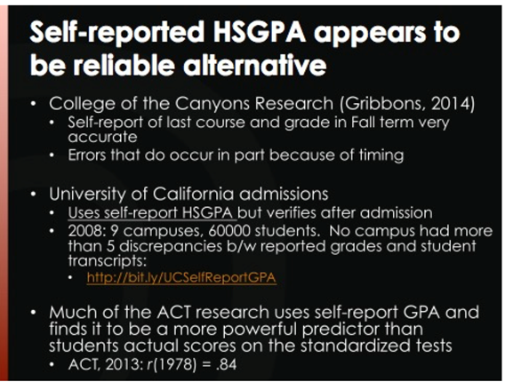
Self-Reported Data
Notes:
Many colleges have already been using self-reported transcript data within the assessment process with great success. Self-reported transcript data can enable us to increase our sample size to determine if MM is working or not. It can also increase access to a larger population of students.

Slide 18
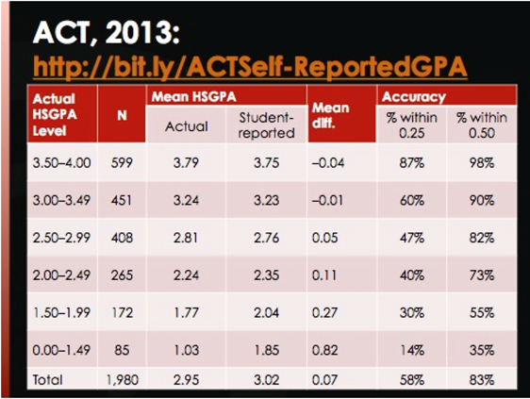
Self-Reported Data
Notes:
ACT reported that students in the upper GPA range tend to under-report their GPA to a small degree (0.04-0.01) while students in the lowest GPA range tend to over-report their GPA 0.82-0.27) to a rather significant level. Students between 2.0 and 4.0 tend to most accurately report their GPA. Students in the lowest range should not be a concern for math MM placement as the lowest GPA used in the models as the only variable to place into a math course is 2.0.

Slide 19
EAP Score
CSU’s Early Assessment Program (now part of Smarter Balanced K-12 testing system)
- Assessment of high school juniors to measure their readiness for college-level English and Math
- Includes a computer adaptive test and an essay (English)
CSU accepts students who receive ‘Standard Exceeded’ into college-level English and Math coursework – do not need to take a placement test
  More information: https://www.calstate.edu/EAP/

Slide 20
Next Steps
Continue to place students using Accuplacer and Multiple Measures
  Open up to all levels of math?
  Use EAP scores to place students as a multiple measure as well?
Discuss different ways to notify students in the pilot
  Provide only one placement level rather than Accuplacer and MM?
  Automate the process so students receive their MM placement at the same time as Accuplacer (now a 2 week delay)
Track the spring cohort to course completion
Survey students who were in the pilot to get their feedback
  Discuss the possible use of self-reported transcript data
    Collect course, grade, and GPA on application
    Validate 10% of self-reported data against CalPass transcripts
    Allows greater access for students without transcript data in CalPass
    Increase our sample size to determine if MM is working or not
Notes:
What are your department’s thoughts on the steps mentioned above?
Provide feedback/questions/concerns to newellmallory@fhda.edu

