Slide 1

Student Success Scorecard
Spring 2016
Office of Institutional Research and Planning

Slide 2
Overview
Statewide Student Success Scorecard
      Degree/Transfer Rate
          Ethnicity
          Placement Level
          Pathway Programs
De Anza College Placement Rates
          Ethnicity
          Placement Level
          Sequence Completion Rates by Placement Level
Summary and Implications

Slide 3
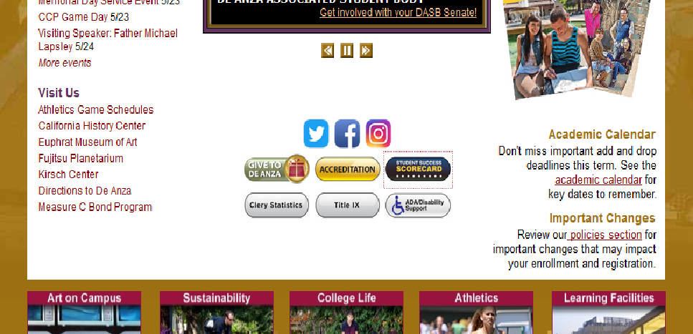


Slide 4
Student Success Scorecard – Degree/Transfer Rate
De Anza Peer Group:
Santa Barbara 62%
Orange Coast 61%
Diablo Valley 59%
Ohlone 59%
Moorpark 58%
Pasadena 56%
Las Positas 55%
Glendale 54%
Palomar 53%
Mira Costa 53%
San Diego Mesa 53%
Golden West 52%
Cuesta 52%
Fullerton 51%
Cypress 51%
LA Pierce 51%
Sierra 49%
Skyline 49%
Folsom Lake 47%
Definition: Percentage of first-time students with minimum of 6 units earned who attempted any Math or English course in the first three years and achieved any of the following outcomes within six years: degree, certificate, transfer, or “transfer prepared” (90 UC/CSU transferable units with a GPA >= 2.0)
Institutional Metric:
The college will achieve 71% or the highest score within the peer group.
There will be no more than a 5% gap between targeted groups and all other groups.
Prepared
Non Targeted Ethnicity
Overall
Unprepared
Statewide - Overall
Targeted Ethnicity
Peer
Group
High
65.6%
Overall Completion Rate by Ethnicity
50% African American (54/108)
60% Filipino (115/191)
46% Latino (274/595)
Compared to
79% Asian (932/1,175)
60% White (326/539)
Prepared based on first course enrolled. 2014-15 cohort = 3,238; African American: 108; Asian: 1,175 ; Filipino: 191; Latino/a: 595; Native American: 143; Pacific Islander: 19;
Multi Ethnic: 145; White: 539; Unreported: 323. Targeted ethnicity = African American, Latino/a, Filipino, Pacific Islander. Non Targeted = Native American, Asian, White, Unreported.
Notes:
Prepared/Unprepared based on lowest attempted Math or English course.
If lowest attempted Math course was one below or college level, then student is “prepared for college.”
If lowest attempted English course was college level, then student is “prepared for college.”
If lowest attempted Math or English was below college level (two levels below or more in Math), then student is “unprepared for college.”
If student attempts both Math and English, if lowest of either is below college level, then student is “unprepared for college.”
Transfer-Prepared” (60 UC/CSU transferrable units with GPA=>2.0)
International Students DA = 251
JCS = 72
District metric is 75% or peer high
Set Peer Group – Peer group the same for each metric

Slide 5
Scorecard – Degree/Transfer Rate – Ethnic Distribution by Placement Level
-5 percentage
point difference
5 percentage
point difference
Basic skills/college level based on first course enrolled. 2014-15 cohort = 3,238; African American: 108; Asian: 1,175; Filipino: 191; Latino/a: 595; White: 539.

Slide 6
Scorecard – Degree/Transfer Rate – Ethnicity and Placement Level
11 percentage
point difference
17 percentage
point difference
Basic skills/college level based on first course enrolled. 2014-15 cohort = 3,238; African American: 108; Asian: 1,175; Filipino: 191; Latino/a: 595; White: 539.

Slide 7
Degree/Transfer Rate – Basic Skills Students Compared to Pathway Program
Basic skills based on first course enrolled. 2014-15 cohort = 3,238; African American: 108; Asian: 1,175 ; Filipino: 191; Latino/a: 595; Pacific Islander: 19; White: 539.
Pathways defined as a student who took at least one course in any pathway program. LinC = 412, MPS = 69, LEAD = 14, FYE = 129, Umoja = 64.

Slide 8
Scorecard - Basic Skills English Sequence Completion Rate
Non Targeted Ethnicity
Definition: Percentage of students who started 1-2 levels below transfer level English tracked for six years, who complete college level English.
Institutional Metric: The basic skills English course completion rate will achieve 77%.
Overall
Targeted Ethnicity
Statewide - Overall
Overall Rate by Ethnicity
59% African American (58/98)
78% Filipino (126/160)
65% Latino (272/421)
Compared to
82% Asian (572/695)
70% White (232/330)
2014-15 cohort total N: 2,105; African American: 98; Asian: 695; Filipino: 160; Latino: 421; White: 330; Native American: 78, Multi Ethnic: 63; Unreported: 244; Pacific Islander: 16
Targeted ethnicity = African American, Latino/a, Filipino, Pacific Islander. Non Targeted = Native American, Asian, White, Multi Ethnic, Unreported.
Notes:
District Metric: 85% of the peer high.

Slide 9
Scorecard - Basic Skills Math Sequence Completion Rate
Definition: Percentage of students who started 1-2 levels below transfer level math tracked for six years, who complete 1 level below college level math.
Institutional Metric: The basic skills Math completion rate will achieve 57%.
Non Targeted Ethnicity
Overall
Targeted Ethnicity
Overall Rate by Ethnicity
36% African American (49/135)
57% Filipino (97/169)
43% Latino/a (296/689)
Statewide - Overall
Compared to
64% Asian (256/402)
58% White (304/526)
Total N: 2,375; African American: 135; Asian: 402; Filipino: 169; Latino: 689; White: 526; Native American: 84; Multi Ethnic: 94; Unreported: 255; Pacific Islander: 21.
Targeted ethnicity = African American, Latino/a, Filipino, Pacific Islander. Non Targeted = Native American, Asian, Multi Ethnic, White, Unreported.

Slide 10
Scorecard - Basic Skills ESL Sequence Completion Rate
Definition: Percentage of students who started any levels 1-6 below transfer level ESL tracked for six years, who complete transfer level ESL or EWRT.
Institutional Metric: The basic skills ESL completion rate will achieve 50%.
Non Targeted Ethnicity
Overall
Statewide - Overall
Targeted Ethnicity
Overall Rate by Ethnicity
38% African American (6/16)
62% Filipino (5/8)
22% Latino (17/78)
Compared to
44% Asian (216/486)
28% White (25/90)
Total N: 799; African American: 16; Asian: 486; Filipino: 8; Latino/a: 78; White: 90; Native American: 14; Unreported: 106; Pacific Islander: 1.
Targeted ethnicity = African American, Latino/a, Filipino, Pacific Islander. Non Targeted = Native American, Asian, Multi Ethnic, White, Unreported.

Slide 11
De Anza College - First Time College Student English Placement by Ethnicity
-8 percentage
point difference
17 percentage
point difference
First-time college students who took a placement test on March 1 through September 30, prior to the fall term in which they first enrolled. Average of Fall 2015, 2014, 2013.
English placement: EWRT 200 and 211 (basic skills) and EWRT 1A (college level). Source: FHDAIRP

Slide 12
De Anza College - First Time College Student Math Placement by Ethnicity
-11 percentage
point
difference
16 percentage
point
difference
First-time college students who took a placement test on March 1 through September 30, prior to the fall term in which they first enrolled.
Math placement: MATH 210, 212, and 114 (basic skills) and MATH 10, 11, 41, 44, and 46 (college level). Average of fall 2015, 2014, and 2013. Source: FHDAIRP

Slide 13
De Anza College - Course Sequence Completion by Level Placed
Successful Completion of Course Sequence in Three Years
 | Starting Three Levels Below | Starting Two Levels Below | Starting One Level Below
MATH | 21% | 48% | 88%
EWRT | N/A | 53% | 67%
Reading | N/A | 54% | 74%
ESL - Writing | 31% | 45% | N/A
ESL - Reading | 30% | 36% | 41%
Math progression to 10, 11, 41, 44, 46; EWRT and READ progression to EWRT1A; ESL progression to ESL 5 or EWRT1A. Students tracked from Fall 2012 through Spring 2015
Source: CCCCO Basic Skills Progress Tracker and FHDAIRP

Slide 14
Summary & Implications
Our degree/transfer completion rate is higher than the State and is the highest among our peer group.
Rate is largely driven by prepared students, but this is not representative of our student demographics.
Prepared students are more likely to achieve a degree, certificate, or transfer.
  But these students are not representative of our student demographics.
What strategies should we implement to close the achievement gap?
Is there a disproportionate rate of targeted groups placing into basic skills courses?
Targeted student groups are more likely to place into basic skills than non-targeted student groups.
Their English, Math, and ESL basic skills completion rates trail non-targeted student groups.
The gap is greater than 5%.
How do we continue to grow Pathway Programs while maintaining completion rates?
Unprepared students in Pathway Programs have higher degree/transfer completion rates than non-Pathway Program students.
Students placed into 2-3 levels below transfer level complete the sequence at a lower rate than those placed into 1-level below.
How do we increase throughput rates? What supplemental supports are needed?

