Slide 1

Fall 2018 & Winter 2019
AB 705 Results

Slide 2
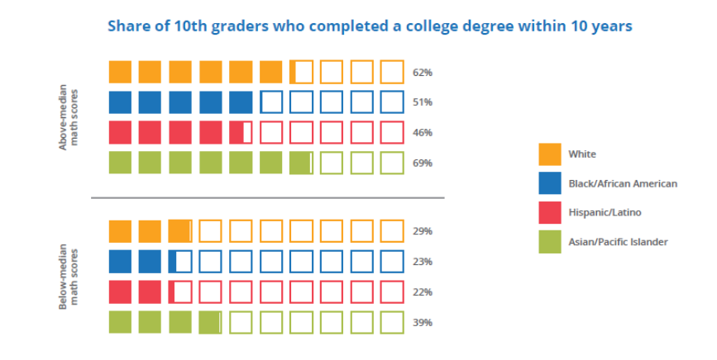
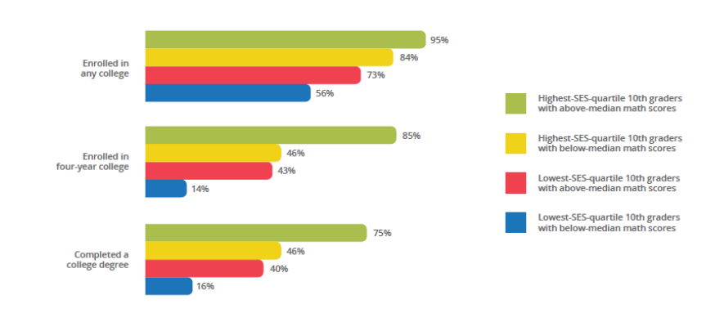
‘Born to Win, Schooled to Lose’
A recent study shows that low SES
students from
minority backgrounds who have
high test scores, complete college at
a LOWER rate then high SES students
from white/Asian backgrounds with
low test scores.
Notes:
The graphs are pulled from this article: https://www.insidehighered.com/news/2019/05/15/report-notes-trends-related-race-class-and-educational-attainment?utm_source=Inside%20Higher%20Ed&utm_campaign=a767da0dc3-DNU_2019_COPY_01&utm_medium=email&utm_term=0_1fcbc04421-a767da0dc3-199154925&mc_cid=a767da0dc3&mc_eid=1db4a98e32 The main takeaway here is that minority/low income students with higher test scores have lower outcomes on multiple measures than White/Asian students with lower test scores. We can no longer argue that it is the student but rather the systemic barriers throughout the educational system. How does De Anza ensure we are removing these barriers?

Slide 3
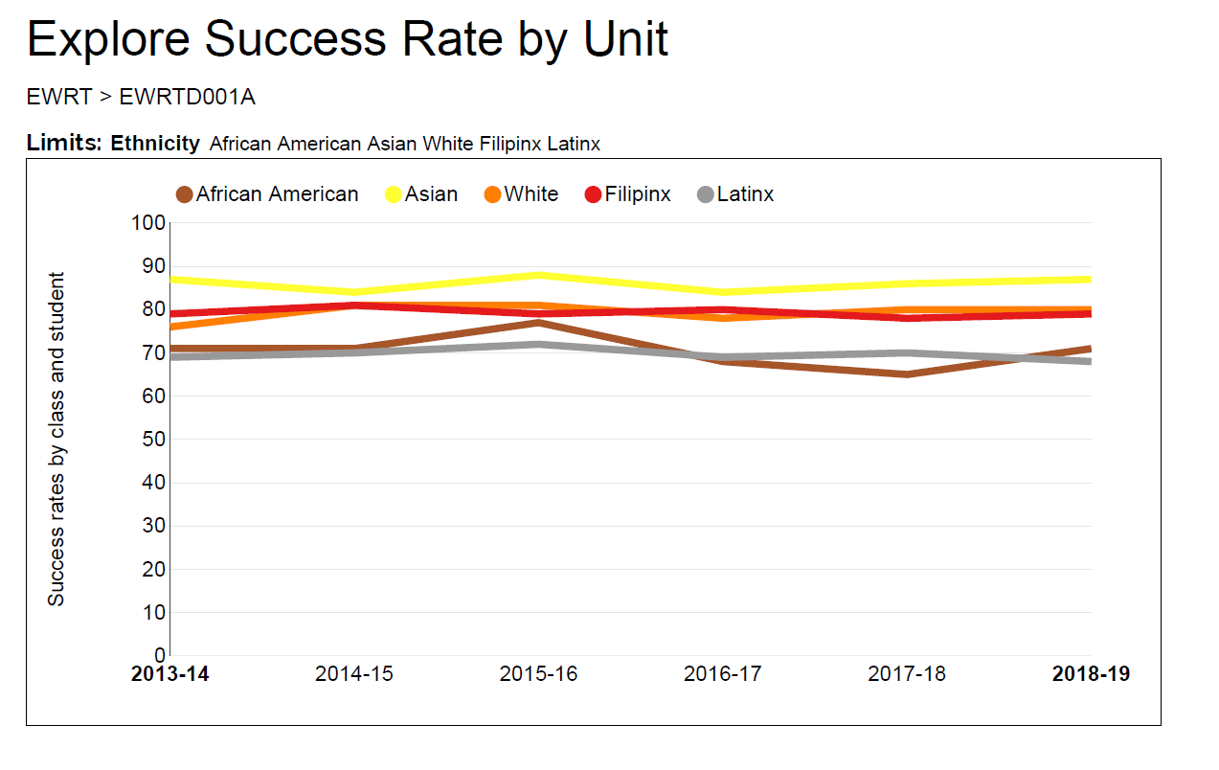
EWRT1A: Success Rates by Year and Ethnicity
Notes:
What are the main points you see in the graph? Relatively no change in success rates over the past 6 years. African American and Latinx students have the lowest success rates, consistently.

Slide 4
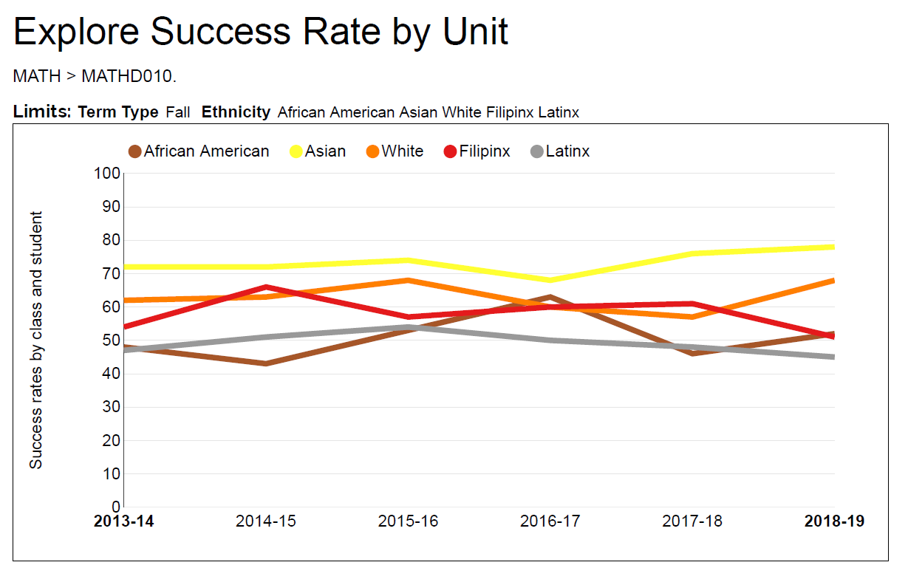
MATH10: Success Rates by Year and Ethnicity
Notes:
Same trends here with relatively no change in success rates over the past 6 years. African American and Latinx students have the lowest success rates, consistently.

Slide 5
Summary of Changes Starting in Fall 2018
EWRT
EWRT 1A: Eligible if high school GPA is at least 2.6
  A few sections of EWRT 1A + LART 250 offered to students with high school GPA between 1.9 and 2.59
One section in winter 2019 of EWRT1A split over 2 quarters offered to students with high school GPA below 1.9
Math
Statistics (MATH 10): Open to all students
Precalculus: Eligible if high school GPA is at least 3.4, or at least 2.6 if enrolled in calculus in high school
Calculus and above: Eligible by placement test
All students automatically given a placement if they have a high school transcript available and meet these criteria.

Slide 6
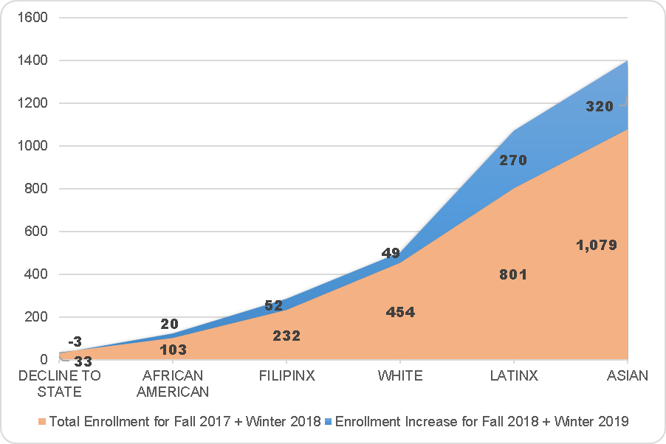
EWRT 1A: Increase in Enrollment Post AB 705 Changes
Native American,
Decline to State and
Pacific Islander
not plotted. 1,514 enrollments in fall 2017 and 1,930 enrollments in fall 2018. 1,230 enrollments in winter 2018 and 1,520 enrollments in winter 2019.
Notes:
Represents the change in enrollment from last fall and winter to this fall and winter. Orange is last year and blue are the ADDITIONAL enrollments added this year on top of last year. With a decrease in enrollment overall and collegewide, but we are seeing an increase in enrollment into transfer level courses.

Slide 7
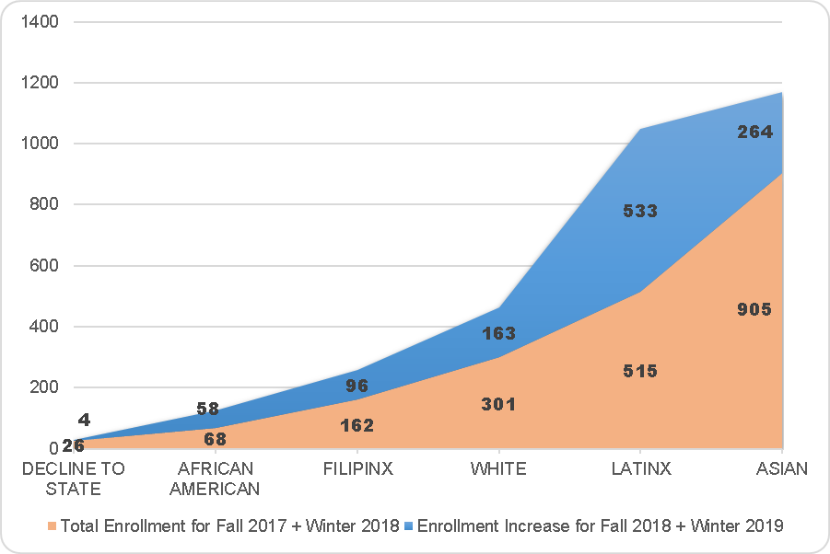
MATH10: Increase in Enrollment Post AB 705 Changes
Native American,
Decline to State and
Pacific Islander
not plotted. 1,038 enrollments in fall 2017, 1,780 enrollments in fall 2018. 955 enrollments in winter 2018, 1,360 enrollments in winter 2019.
Notes:
Represents the change in enrollment from last fall and winter to this fall and winter. Orange is last year and blue are the ADDITIONAL enrollments added this year on top of last year. With a decrease in enrollment overall and collegewide, but we are seeing an increase in enrollment into transfer level courses. What is particularly important here is that there are almost as many Latinx students in Statistics this year as Asian students, were historically there has been a huge gap in enrollment between these groups.

Slide 8
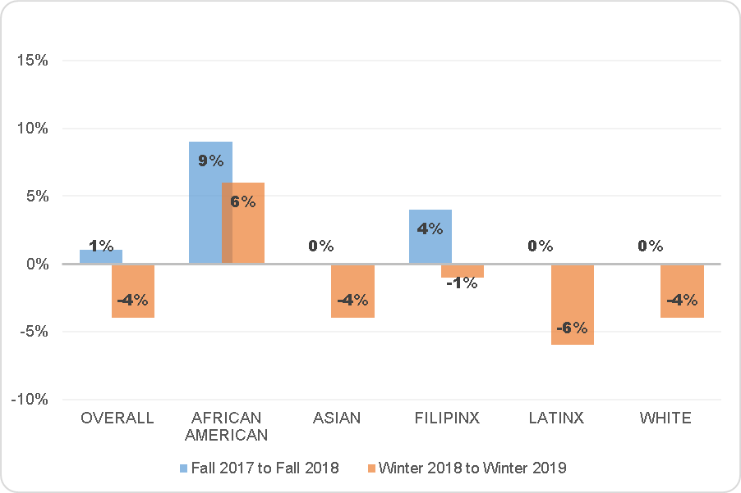
EWRT 1A: Changes in Success Rates by Ethnicity
Native American,
Decline to State and
Pacific Islander
not plotted. Success is A. B, C P. 1,514 enrollments in fall 2017 and 1,930 enrollments in fall 2018. 1,230 enrollments in winter 2018 and 1,520 enrollments in winter 2019.
Notes:
Success overall has not changed that much for EWRT1A, +1% in fall and -4% in winter. Note that while some ethnic groups have seen a drop in success, all ethnic groups have seen the total number of successful completions increase which is displayed on the next slide. In both English and math, there is a positive increase in success for African American students.

Slide 9
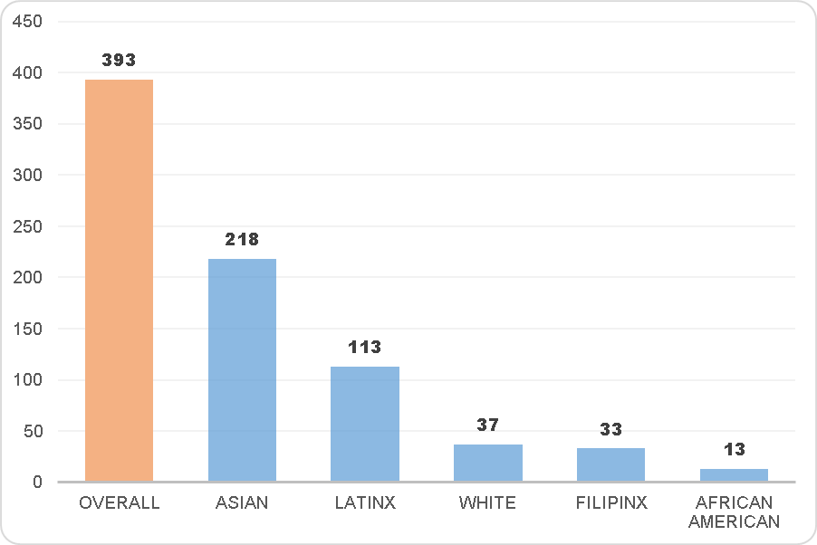
EWRT 1A: Number of Successful Completions by Ethnicity -
Fall 2017 vs Fall 2018 + Winter 2018 vs Winter 2019
Native American,
Decline to State and
Pacific Islander
not plotted. Success is A. B, C P. 1,514 enrollments in fall 2017 and 1,930 enrollments in fall 2018. 1,230 enrollments in winter 2018 and 1,520 enrollments in winter 2019.
Notes:
This graph represents the additional SUCCESSFUL (A, B, C, P grades) completions for this fall and winter compared to last fall and winter. Almost 400 additional successful completions of EWRT1A this year than last year, coupled with an overall enrollment decline. 113 of those are Latinx students.

Slide 10
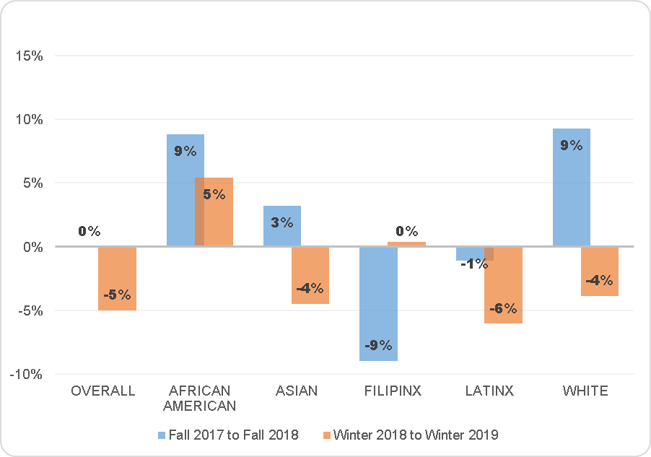
MATH10: Changes in Success Rates by Ethnicity
Native American,
Decline to State and
Pacific Islander
not plotted. Success is A. B, C, P. 1,038 enrollments in fall 2017, 1,780 enrollments in fall 2018. 955 enrollments in winter 2018, 1,360 enrollments in winter 2019.
Notes:
Success overall has not changed that much for MATH10, flat in fall and -5% in winter. Again, note that while some ethnic groups have seen a drop in success, all ethnic groups have seen the total number of successful completions increase which is displayed on the next slide. Again, there is a positive increase in success for African American students.

Slide 11
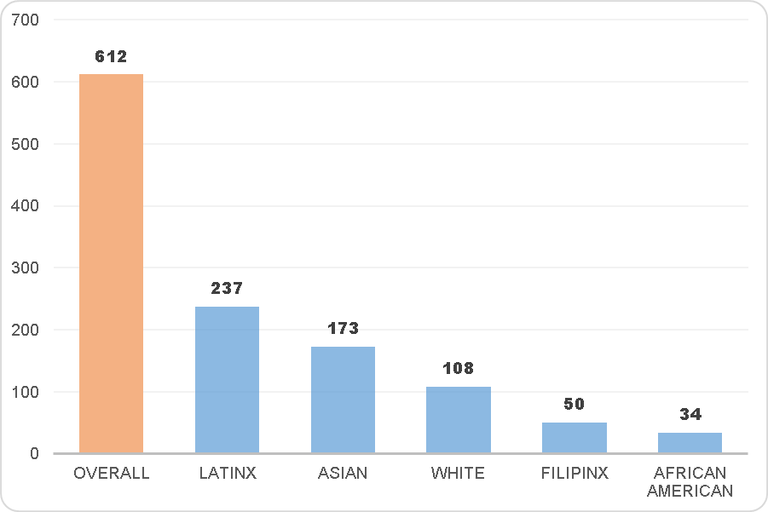
MATH10: Number of Successful Completions by Ethnicity -
Fall 2017 vs Fall 2018 + Winter 2018 vs Winter 2019
Native American,
Decline to State and
Pacific Islander
not plotted. Success is A. B, C, P. 1,038 enrollments in fall 2017, 1,780 enrollments in fall 2018. 955 enrollments in winter 2018, 1,360 enrollments in winter 2019.
Notes:
Compares SUCCESSFUL (A, B, C, P grades) from last fall and winter to this fall and winter. 612 additional students successfully completed MATH10 this year than last year. 237 of them were Latinx.

Slide 12
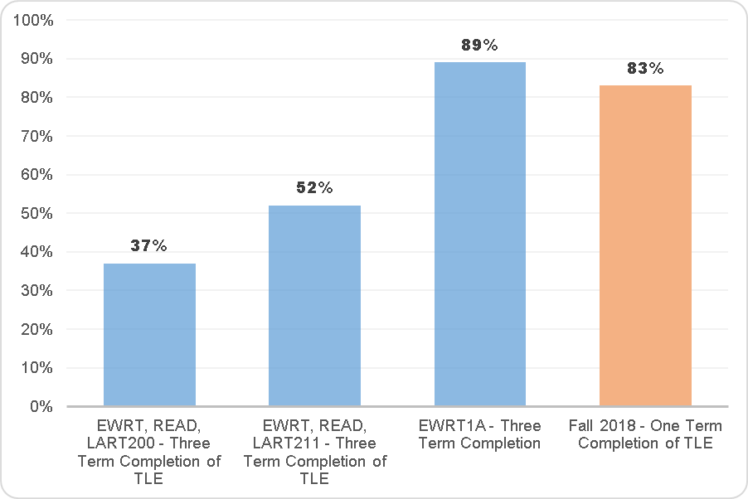
First-Time Students:
Completion of Transfer Level English (TLE) in 1 Year
TLE is average of first time students starting in fall 2016 or fall 2017. Students starting in any 200 or 211 level course to completion of any transfer-level English course in three terms. EWRT, READ or LART200 cohort includes 517 students, EWRT, READ, or LART211 cohort includes 1,677 students, EWRT1A cohort includes 860 students.
Notes:
This slide compares the throughput rates of students whose first course was at the level displayed who successfully complete transfer level English in 3 quarters. The highest course they started in resulted in the level in which they started. The fall 2016 and fall 2017 cohorts of first time students were combined and averaged to create a larger cohort to track. Fall 2018 is the one-term success rate of first time students who started in EWRT1A and passed.

Slide 13
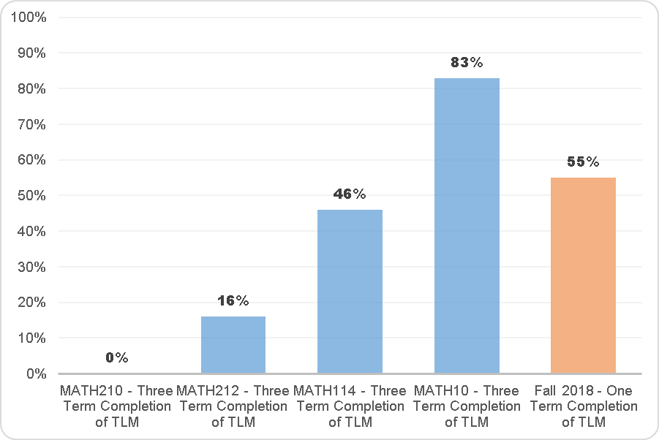
First-Time Students:
Completion of Transfer Level Math (TLM) in 1 Year
TLE is average of first time students starting in fall 2016 or fall 2017. Students starting in the level displayed course to completion of any transfer-level English course in three terms. MATH210 cohort includes 614 students, MATH212 cohort includes 1,184 students, MATH114 cohort includes 693 students, MATH10 cohort includes 195 students.
Notes:
This slide compares the throughput rates of students whose first course was at the level displayed who successfully complete any transfer level Math in 3 quarters. The fall 2016 and fall 2017 cohorts of first time students were combined and averaged to create a larger cohort to track. Fall 2018 is the one-term success rate of first time students who started in MATH10 and passed MATH10. Note that students who started in MATH10 in fall 2018 still had a higher throughput rate than students who started at any level below transfer, including MATH114, and this was only one term, not three terms.

Slide 14
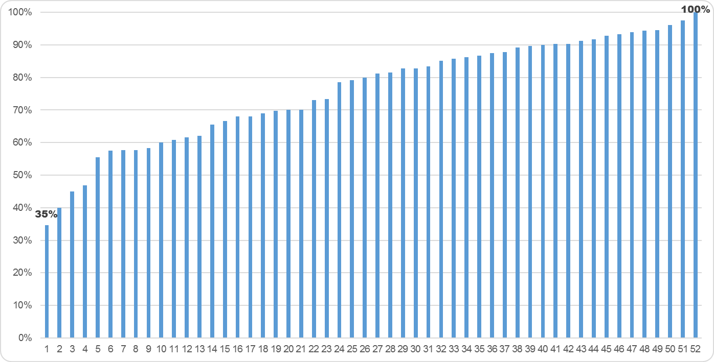
EWRT1A: Winter 2019 – Success Rates by Section
Success is A. B, C, P grades. Includes 52 sections and 1,520 enrollments.
Notes:
This slide displays the variability in success rates (A, B, C, P grades) by section. There were 52 sections of EWRT1A in winter 2019 and the success rates ranged from 35% to 100%. We don’t know why this is, and there is a lot of variability across sections, but it is something that should be discussed when talking about student success rates and AB 705 changes.

Slide 15
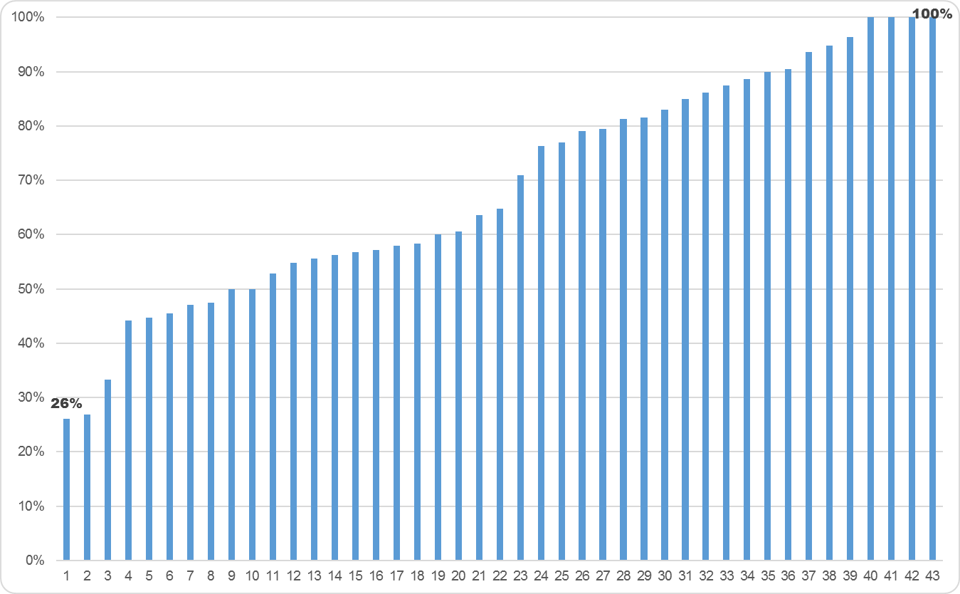
MATH10: Winter 2019 – Success Rates by Section
Success is A. B, C, P grades. Includes 43 sections and 1,360 enrollments
Notes:
This slide displays the variability in success rates (A, B, C, P grades) by section. There were 43 sections of MATH10 in winter 2019 and the success rates ranged from 26% to 100%. We don’t know why this is, and there is a lot of variability across sections, but it is something that should be discussed when talking about student success rates and AB 705 changes.

Slide 16
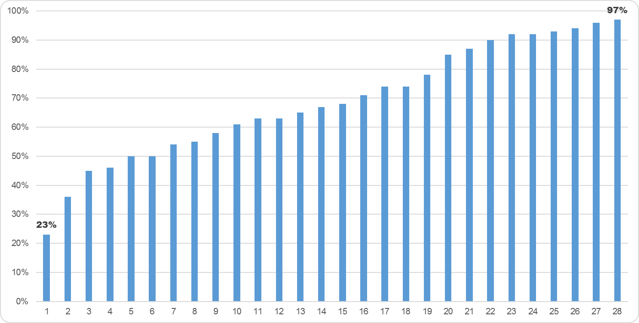
Fall 2018 + Winter 2019:
Success Rates by Section – Anonymous Social Science Course
Success is A. B, C, P grades.
Notes:
This slide is here to show that variability by section is not isolated to English and Math, this is a random department in the Social Science division. It combines fall 2018 and winter 2019 sections together to create enough sections to compare and provide unanimity to the sections. Though the same trends exists with success rates ranging from 23% to 97%.

Slide 17
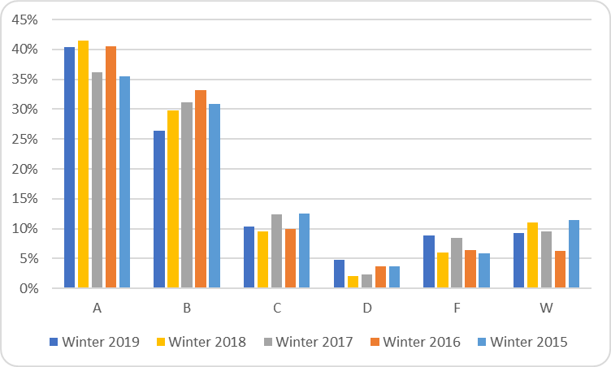
EWRT1A: Winter 2019 – Success Rates by Grade
Notes:
Another factor around the changes is the distribution of letter grades. The IR office often gets questions around whether students are just going to get a C and “not be able to transfer” or if the curriculum will be watered down so more students pass and then they are not successful in the next course. This slide displays the letter grades over the past 5 winter terms, and shows that for EWRT1A the highest awarded grades are A, then B and there has not been a huge shift this winter.

Slide 18
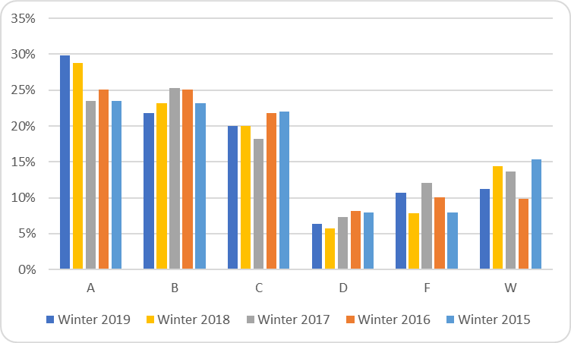
MATH10: Winter 2019 – Success Rates by Grade
Notes:
Similar trends for MATH10, however, there is more of an even distribution between A, B, and C grades, in that order.

Slide 19
Fall 2019: EWRT1A open to all GPA bands
  High School GPA:
    2.6 and Above – EWRT1A without Support (5 units)
    1.9 – 2.59 – EWRT1A (5 units) + LART250 (3 units) support course
    Below 1.89 – EWRT1AS + EWRT1AT (two quarters – 10 units)
MATH10 (Statistics)
  High School GPA:
    3.0 and Above – MATH10 without Support (5 units)
    2.3 – 2.99 – MATH10 (5 units) + MPS or MATH210x (5 units) support course recommended
    Below 2.89 – MATH10 (5 units) + MPS or MATH210x (5 units) support course required
MATH41 (PreCalculus)
  High School GPA:
    0.00 – 2.59 & Calculus OR 2.6 – 3.9 – MATH41 with Support Recommended (5 units)
    Below 2.59 – MATH41 (5 units) + MPS or MATH231 (5 units)

Slide 20
Questions?
- What other questions does this raise for you?
Are you surprised by the results? Skeptical?
How do we continue to support students in transfer-level courses
to help them be successful?
How do we ensure we are not institutionalizing disadvantage for
minority/low-SES students at De Anza?
Full reports available:
AB 705 Success Rates for Winter 2019
AB 705 Success Rates for Fall 2018

