Slide 1
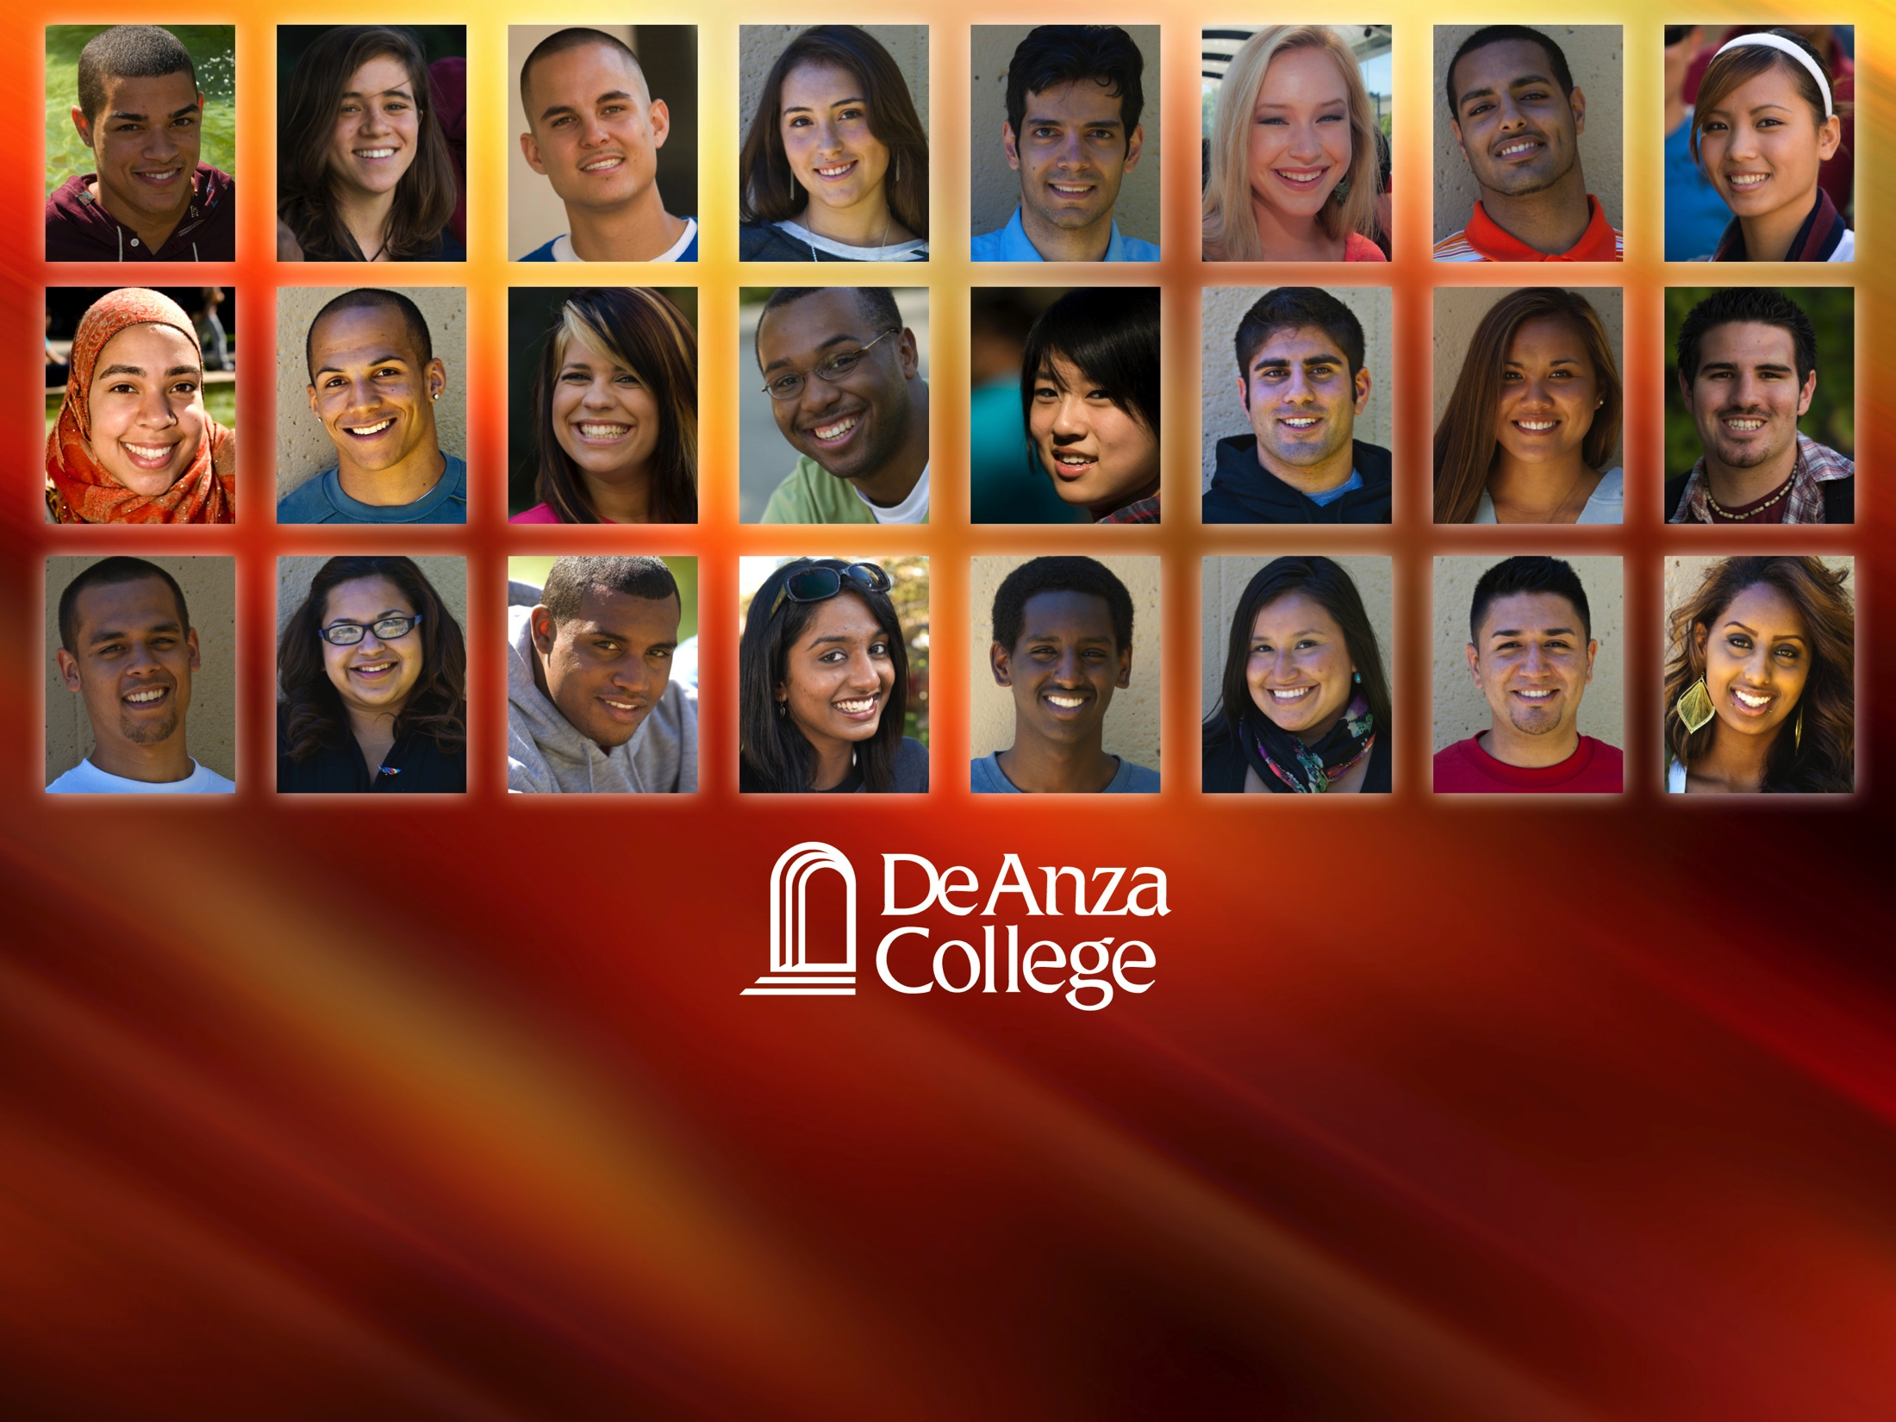
Scorecard Future File Data
Institutional Research and Planning, 5/23/2018

Slide 2



Scorecard Data
Scorecard Metric: Cohorts of degree, certificate, transfer-seeking first-time students. The 2012-2013 cohort will be our “Degree/Transfer Completion” cohort next year (Scorecard will be replaced after this year)
Students achieve Degree/Transfer Completion if they: Earn an AA/AS or certificate, transfer to a four-year university, or achieve transfer-prepared (90 UC/CSU transferable units) within six years.
Current Scorecard Data
2010-2011
2011-2012
2015-2016
2012-2013
2013-2014
2017-2018
2016-2017
2014-2015
Future Scorecard Data

Slide 3
Future Cohorts
The four most recent cohorts ranged between 3,479 and 3,157 students
This analysis of the future file from the Scorecard includes rates of degree/transfer completion matched to our own data to determine: percent of students who are still enrolled, highest level of English and Math completed, and rates of completion by ethnicity.
2010-2011
2011-2012
2015-2016
2012-2013
2013-2014
2017-2018
2016-2017
2014-2015
3,416
3,401
3,479
3,157

Slide 4
2018 Scorecard Data 5-Year Trends

Slide 5
Basic Skills Completion Rates

Slide 6
Transfer-Level Course Completion

Slide 7
Scorecard Future File Analysis

Slide 8
Completion of Degree/Transfer Vs. Non Completion

Slide 9

Currently Enrolled Student who DID NOT Achieve Completion
2012-2013
5%
Original Cohort
2013-2014
10%
19% of last four cohorts are still enrolled
2014-2015
19%
2015-2016
45%

Slide 10
English Course Completion
2015-2016 Cohort

Slide 11
2015-2016 Scorecard Cohort: Highest English Course Completed
3,157
2015-16 Cohort
745
24%
Completed
2,412
76%
Not Completed
977
41%
Not enrolled
1,435
59%
Currently enrolled
40%

Slide 12
2015-2016 Scorecard Cohort: Highest English Course Completed
3,157
2015-16 Cohort
745
24%
Completed
2,412
76%
Not Completed
977
41%
Not enrolled
1,435
59%
Currently enrolled
133 Non-pass grades in EWRT1A
100 Non-pass grades in EWRT211
38 grades from ENGL courses at Foothill

Slide 13
Math Course Completion
2015-2016 Cohort

Slide 14
2015-2016 Scorecard Cohort: Highest Math Course Completed
3,157
2015-16 Cohort
745
24%
Completed
2,412
76%
Not Completed
977
41%
Not enrolled
1,435
59%
Currently enrolled
40%

Slide 15
2015-2016 Scorecard Cohort: Highest Math Course Completed
3,157
2015-16 Cohort
745
24%
Completed
2,412
76%
Not Completed
977
41%
Not enrolled
1,435
59%
Currently enrolled
225 Non-pass grades in Math10
178 Non-pass grades in Math114

Slide 16
Achievement of Degree/Transfer Completion by Cohort and Ethnicity

Slide 17
2015-2016 Cohort: Completion and Non Completion by Ethnicity

Slide 18
2014-2015 Cohort: Completion and Non Completion by Ethnicity

Slide 19
2013-2014 Cohort: Completion and Non Completion by Ethnicity

Slide 20
2012-2013 Cohort: Completion and Non Completion by Ethnicity

Slide 21
Summary

Slide 22
Future Cohorts: 2015-2016 Cohort
The majority of students who did not achieve degree/transfer completion are still enrolled (59%)
The majority of students have either completed transfer level Math (60%) or transfer level English courses (60%). Why one and not the other?
Currently enrolled students who did not pass transfer-level courses struggled with EWRT1A and EWRT211 in English, and struggled with Math10, Math114, and Math41 in math

Slide 23
Targeted Ethnicities

Slide 24
Questions/Comments

