Slide 1
Student Success Scorecard
Spring 2017
Office of Institutional Research and Planning

Slide 2
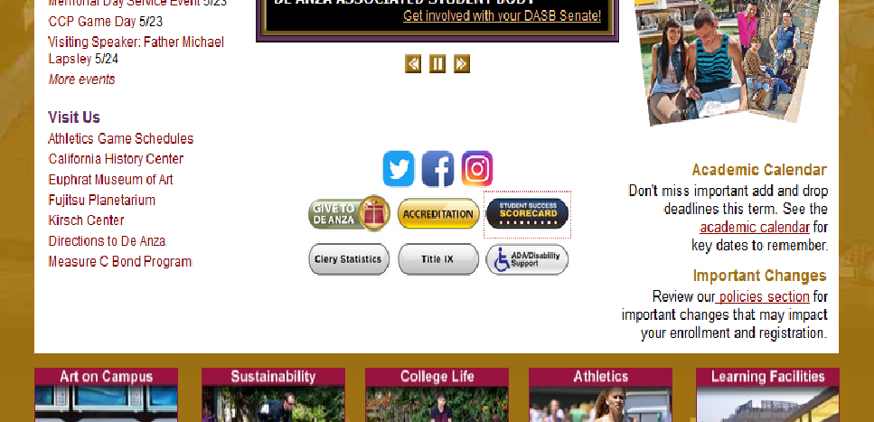

Slide 3
Student Success Scorecard – Degree/Transfer Rate
De Anza Peer Group:
Moorpark 63%
Santa Barbara 62%
Diablo Valley 62%
Orange Coast 61%
Ohlone 61%
Las Positas 61% San Diego Mesa 56%
Golden West 56%
Mira Costa 55%
Pasadena 54%
LA Pierce 54%
Cypress 53%
Cuesta 52%
Sierra 52%
Fullerton 51%
Santa Monica 51%
Skyline 49%
Folsom Lake 49%
Alameda 45%
Definition: Percentage of first-time students with a minimum of 6 units earned who attempted any Math or English course in the first three years and achieved any of the following outcomes within six years: degree, certificate, transfer, or “transfer prepared” (90 UC/CSU transferable units with a GPA >= 2.0)
Institutional Metric:
The college will achieve 71% or the highest score within the peer group.
There will be no more than a 5% gap between targeted groups and all other groups.
Prepared
Non Targeted Ethnicity
Overall
Unprepared
Statewide - Overall
Targeted Ethnicity
Overall Completion Rate by Ethnicity
48% African American (46/96)
59% Filipino (107/182)
49% Latino/a (305/620)
Peer
Group
High
64%
Compared to
77% Asian (875/1,130)
62% White (356/575)
30% of the cohort are ‘Prepared’ vs 70% ‘Unprepared’
Prepared based on first course enrolled. 2015-16 cohort = 2,779; African American: 96; Asian: 1,130 ; Filipino: 182; Latino/a: 620; Native American: 5; Pacific Islander: 10;
Multi Ethnic/Unreported: 161; White: 575. Targeted ethnicity = African American, Latino/a, Filipino, Pacific Islander. Non Targeted = Native American, Asian, White, Unreported.
Notes:
Prepared/Unprepared based on lowest attempted Math or English course.
If lowest attempted Math course was one below or college level, then student is “prepared for college.”
If lowest attempted English course was college level, then student is “prepared for college.”
If lowest attempted Math or English was below college level (two levels below or more in Math), then student is “unprepared for college.”
If student attempts both Math and English, if lowest of either is below college level, then student is “unprepared for college.”
Transfer-Prepared” (60 UC/CSU transferrable units with GPA=>2.0)

Slide 4
Student Success Scorecard – Degree/Transfer Completion Rate - Comparisons
-4%
change
De Anza Completion
13%
difference
Statewide Completion
De Anza Completion - Targeted
-2%
change
9%
change
De Anza Enrollment of Targeted Students
33%
change

Slide 5
Scorecard - Basic Skills English Sequence Completion Rate
1%
change
Non Targeted Completion
12%
difference
Definition: Percentage of students who started 1-2 levels below transfer level English tracked for six years, who complete college level English.
Institutional Metric: The basic skills English course completion rate will achieve 77%.
9%
change
De Anza - Overall
Targeted Completion
Statewide - Overall
8%
change
1%
change
Targeted Enrollment
31%
change
2015-16 cohort total N: 2,082; African American: 100; Asian: 699; Filipino: 145; Latino/a: 605; White: 376; Native American: 12, Multi Ethnic/Unreported: 131; Pacific Islander: 14
Targeted ethnicity = African American, Latino/a, Filipino, Pacific Islander. Non Targeted = Native American, Asian, White, Multi Ethnic, Unreported.

Slide 6
Scorecard – Transfer Level English Completion Rate – 1 Year
Definition: Percentage of first-time students who complete 6 units and attempt any EWRT course in their first year who go on to complete EWRT1A within one year.
Non Targeted Ethnicity
Overall
Targeted Ethnicity
Statewide - Overall
Overall Rate by Ethnicity
54% African American (42/78)
68% Filipino (168/247)
52% Latino/a (451/870)
Compared to
55% Asian (546/999)
62% White (268/431)
Total 2014-15 N: 2,812; African American: 78; Asian: 999; Filipino: 247; Latino/a: 870; White: 431; Native American: 1; Multi-Ethnic/Unreported: 174; Pacific Islander: 12.
Targeted ethnicity = African American, Latino/a, Filipino, Pacific Islander. Non Targeted = Native American, Asian, Multi Ethnic, White, Unreported.

Slide 7
Scorecard - Basic Skills Math Sequence Completion Rate
-9%
change
13%
change
Non Targeted Completion
Definition: Percentage of students who started 1-2 levels below transfer level math tracked for six years, who complete 1 level below college level math.
Institutional Metric: The basic skills Math completion rate will achieve 57%.
De Anza - Overall
15%
difference
Targeted Completion
-7%
change
Targeted Enrollment
-5%
change
Statewide - Overall
18%
change
Total N: 2,154; African American: 120; Asian: 457; Filipino: 130; Latino/a: 733; White: 523; Native American: 10; Multi Ethnic/Unreported: 166; Pacific Islander: 15.
Targeted ethnicity = African American, Latino/a, Filipino, Pacific Islander. Non Targeted = Native American, Asian, Multi Ethnic, White, Unreported.

Slide 8
Scorecard – Transfer Level Math Completion Rate – 1 Year
Definition: Percentage of first-time students who complete 6 units and attempt any MATH course in their first year who go on to complete transfer level math within one year.
Non Targeted Ethnicity
30%
difference
Overall
Targeted Ethnicity
Statewide - Overall
Overall Rate by Ethnicity
21% African American (16/78)
43% Filipino (107/247)
25% Latino/a (216/870)
Compared to
66% Asian (655/999)
42% White (183/431)
Total 2014-15 N: 2,812; African American: 78; Asian: 999; Filipino: 247; Latino/a: 870; White: 431; Native American: 1; Multi-Ethnic/Unreported: 174; Pacific Islander: 12.
Targeted ethnicity = African American, Latino/a, Filipino, Pacific Islander. Non Targeted = Native American, Asian, Multi Ethnic, White, Unreported.

Slide 9
Scorecard - Basic Skills ESL Sequence Completion Rate
Definition: Percentage of students who started any levels 1-6 below transfer level ESL tracked for six years, who complete transfer level ESL or EWRT.
Institutional Metric: The basic skills ESL completion rate will achieve 50%.
Non Targeted Ethnicity
Overall
Statewide - Overall
Targeted Ethnicity
Overall Rate by Ethnicity
31% African American (9/29)
17% Filipino (1/6)
24% Latino/a (12/77)
Compared to
52% Asian (257/498)
38% White (39/104)
Total N: 715; African American: 29; Asian: 498; Filipino: 6; Latino/a: 51; White: 104; Native American: 0; Unreported: 26; Pacific Islander: 1.
Targeted ethnicity = African American, Latino/a, Filipino, Pacific Islander. Non Targeted = Native American, Asian, Multi Ethnic, White, Unreported.

Slide 10
Summary & Implications
Our degree/transfer completion rate is higher than the State and is the highest among our peer group.
Our rate is largely driven by Asian and Prepared students, but this is not completely representative of our student demographics.
Prepared students are more likely to achieve a degree, certificate, or transfer.
But these students are not representative of our student demographics.
Is there a disproportionate rate of targeted groups placing into basic skills courses?
Our completion rate and the State rate are declining but the achievement gap is lessening for targeted populations
While the enrollment of targeted students increased 33% over the past 5 cohorts, their completion rate increased by 9%.
As enrollment of targeted groups increase, how do we ensure their success?
The Statewide English and math completion rates are increasing at a higher rate than our college rate.
Enrollment of targeted students in the English cohort increased 31% over the past 5 cohorts while their completion rate increased by only 1%.
The math cohort increased 18% while their completion rate decreased by 5%.
How do we ensure we retain our standing at the top of the state in these rates?
A little over half of all students who started in basic skills English completed transfer level English in one year.
44% of students who started in basic skills math completed transfer level math in one year.
How do enable students to complete basic skills work in a timely manner to progress to transfer level?

