Slide 1

Student Feedback Survey: Online Learning
November 2020

Slide 2
Methodology
Distributed in September 2020 to all students who enrolled in the spring and summer quarters of 2020
Sent via an online link
Open for two weeks with one reminder
Includes students who had experienced at least one term of fully-online instruction.
The survey collected 1,219 responses for a response rate of approximately 6%.
Content:
  Online course format preference
  Office hours preference
  Student services used
  What made students feel most supported and connected in the online learning environment
  Greatest challenges with the online learning environment
  Interaction with instructors
  Online support
Full Report: bit.ly/OnlinePreference

Slide 3
Highest Ranked Preference for Online Learning Format
 | First Choice |  | Second Choice |  | Third Choice |  | Total
No scheduled meetings: There are no required meeting times. You complete the coursework at your own pace within the scheduled due dates. | 505 | 42% | 277 | 23% | 410 | 34% | 1,192 | 100%
Mixed format: Some class meetings are held in real time (via Zoom) but other coursework can be completed independently, or participation in real time sessions is voluntary. Instructors may record meetings for you to view whenever you prefer. | 427 | 35% | 660 | 55% | 113 | 9% | 1,200 | 100%
Regularly scheduled meetings: All class meetings are in real time (via Zoom) and you are required to attend at the scheduled time. | 278 | 23% | 253 | 21% | 667 | 56% | 1,198 | 100%
Total | 1,210 | 100% | 1,190 | 100% | 1,190 | 100% | 3,590
Of those that selected a Mixed format, they preferred to meet half of all class meetings (40%).
Ranked Order:
First choice: No scheduled meetings (42%)
Second choice: Mixed format (55%)
Third choice: Regularly scheduled meetings (56%)
First + Second Choice Combined:
First choice: Mixed format (90%)
Second choice: No scheduled meetings (65%)
Third choice: Regularly scheduled meetings (44%)

Slide 4
Highest Ranked Preference for Office Hours
 | First Choice |  | Second Choice |  | Third Choice |  | Total
Mixed office hours: Faculty are available to answer emails AND are available online during a set time to speak with you. | 561 | 46% | 464 | 39% | 174 | 15% | 1,199 | 100%
Face-to-Face online: Faculty are available online during a set time to speak with you via Zoom or other online video. | 253 | 21% | 418 | 35% | 521 | 44% | 1,192 | 100%
Email or online messaging: Instructors answer your questions via email, through Canvas or by online chat during a designated time – but are not available to meet face-to-face via Zoom or other online video. | 398 | 33% | 308 | 26% | 486 | 41% | 1,192 | 100%
Total | 1,212 | 100% | 1,190 | 100% | 1,181 | 100% | 3,583 | 100%
Ranked Order:
First and second choice: Mixed office hours (42% & 39%)
Third choice: Face-to-Face online (44%)
Note: Email or online messaging only was not a top choice.

Slide 5
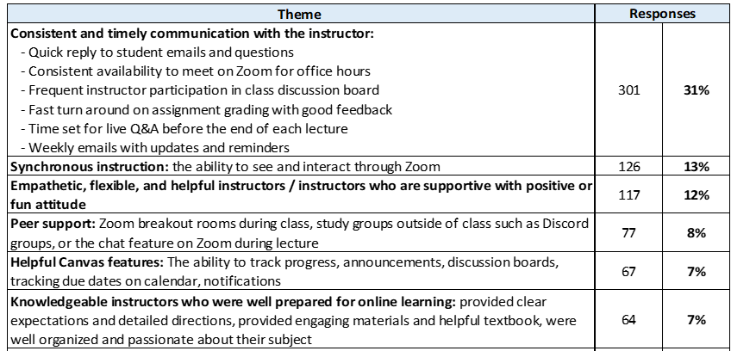
What made you feel most supported and connected?

Slide 6
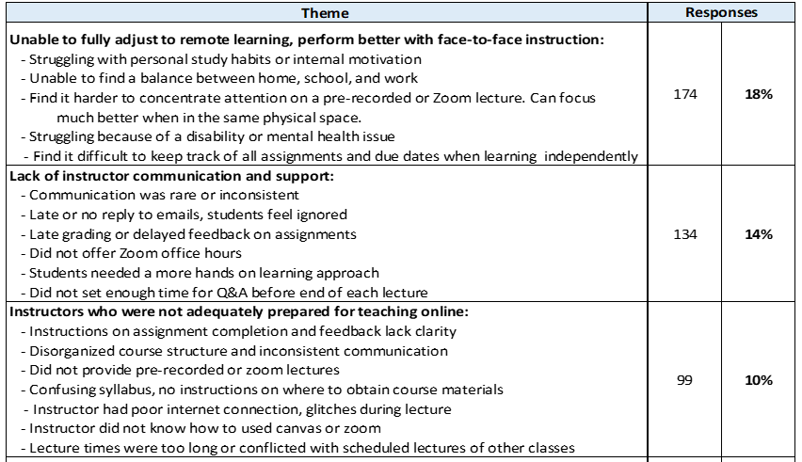
What was most challenging about online learning?

Slide 7
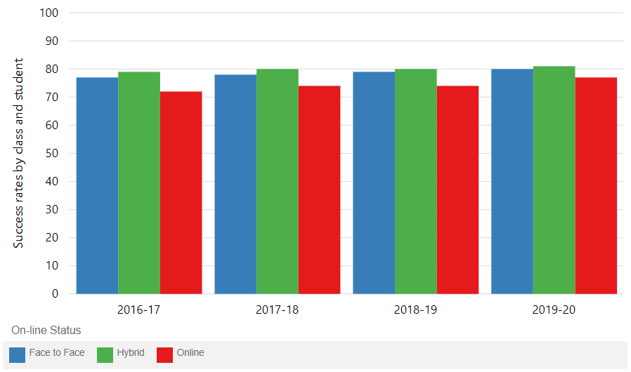
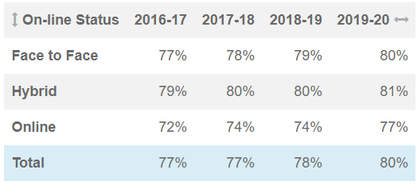
Annual Success Rates by Modality
Online success rates are 3-4 % pts lower for online than face to face modalities.
Hybrid success rates are 1-2 % pts higher than face to face instruction.

Slide 8
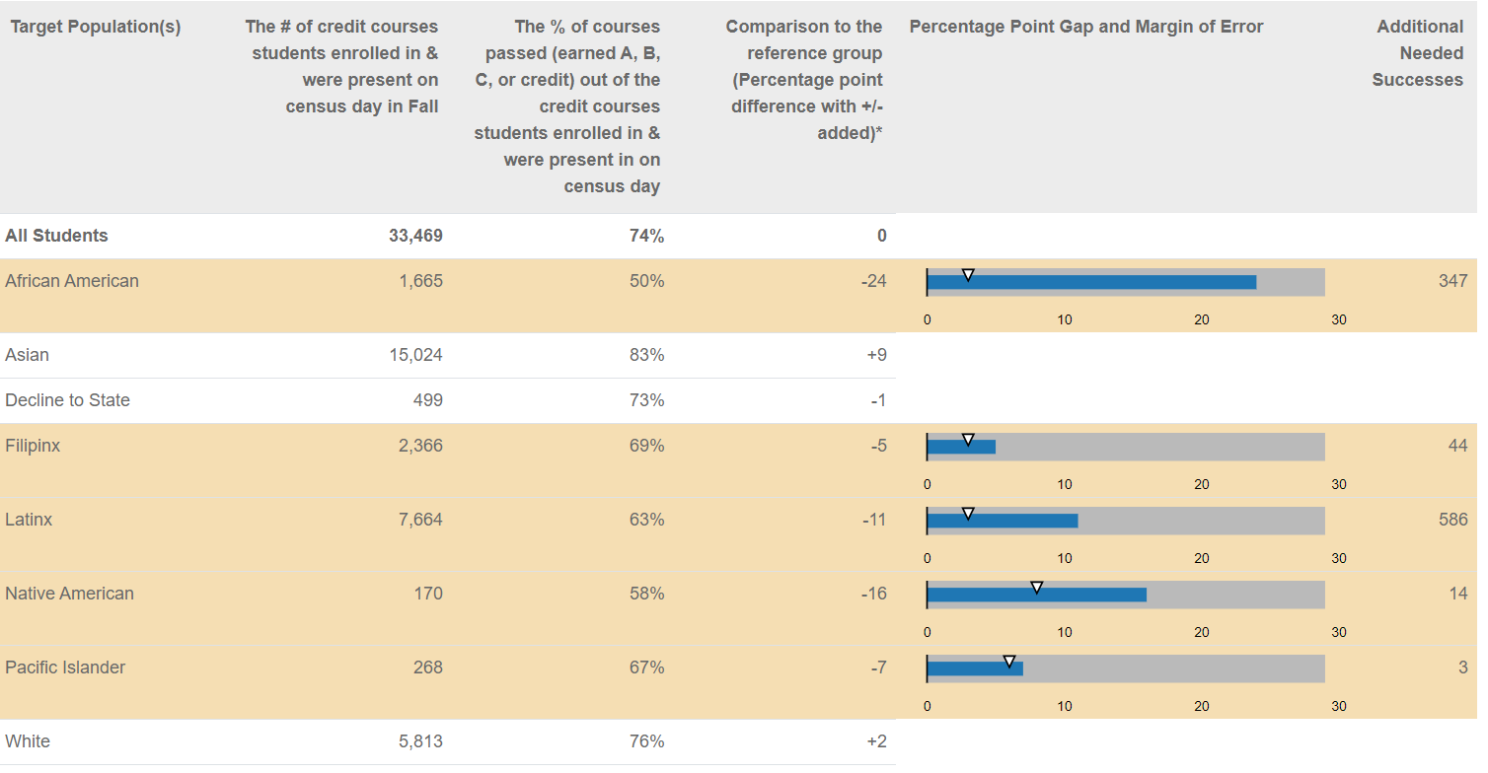
2018-19 Online Success Rates and Disproportionate Impacts
We see disproportionate impacts for African American, Filipinx, Latinx, Native American, and Pacific Islander students in online classes.
Face to face courses shows DI for African American (-7%), Latinx (-8%) and Pacific Islander students (-7%).

Slide 9
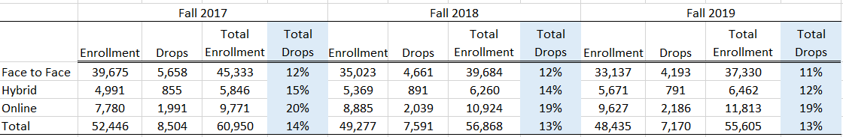
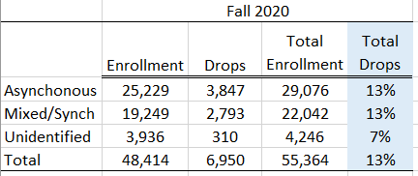
Drops by Modality
Course drops, between registration start and census, have slowly decreased over the past three fall terms.
Drops were highest for online sections at 19-20% and lowest for face to face sections between 11-12%.
Course drops for fall 2020 overall were similar to prior terms at 13%.
Drops for Asynchronous and Mixed/Synch courses were similar, though not all courses could be identified for fall.

Slide 10
Level of Interaction with Instructors
 | Responses
All my classes | 659 | 54%
More than half of my classes | 257 | 21%
About half of my classes | 201 | 16%
Less than half my classes | 92 | 8%
No Response | 10 | 1%
Total | 1,219 | 100%
  75% of respondents agree or strongly agree that the level of interaction with their instructors was sufficient in “all” or “more than half” of their courses.

Slide 11
Online Support
 | Responses
Strongly agree | 267 | 22%
Agree | 443 | 36%
Not sure | 335 | 27%
Disagree | 109 | 9%
Strongly disagree | 49 | 4%
No response | 16 | 1%
Total | 1,219 | 100%
  58% of respondents agree or strongly agree that the support they received outside of class - via online tutoring, online library services, online financial aid assistance, online counseling, etc. - was enough to help them be successful in their courses.
  The services students indicated they did not know existed online were: Counseling –psychological (10%), Health services (10%), Assessment center (8%), Financial emergency resources (9%), Food assistance (8%), Library 7%), Tutoring (7%).

Slide 12
Peer interactions improve online learning outcomes…
Examples of peer interaction are think-pair-share activities with partners, small group activities, encouraging students to work together outside class time in preassigned groups and allowing students to work together on exams.
it’s “possible to incorporate peer interaction such as think-pair-share or small group activities into synchronous online courses,” and these teaching strategies are “significantly associated with improved learning during the remotely taught portion of the semester.”
“Having students work together to answer challenging questions and engage in ‘peer instruction’ has also been associated with positive student outcomes.”
“This can be done synchronously, in real time through social media, polling, online breakout rooms and other tools -- but also asynchronously online through collaboration tools that allow students to work at their own pace, on their own time but collectively produce work.”
http://bit.ly/PeerInteraction

Slide 13
Questions?

